Slide 1
Pid 122277 uni-37-12.24 over bokes creek
Notes:
Welcome and intro

Slide 2

Uni-37-12.24 bridge over bokes creek

Slide 3
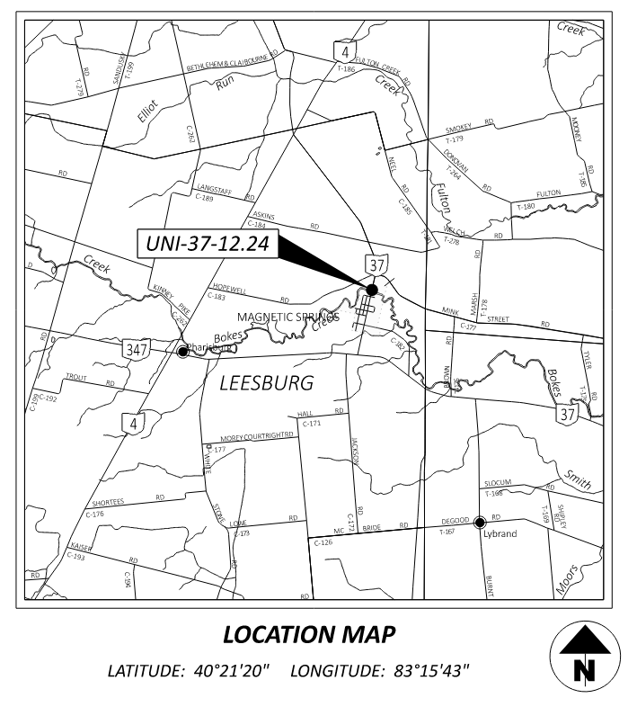
Uni-37-12.24 bridge over bokes creek

Slide 4
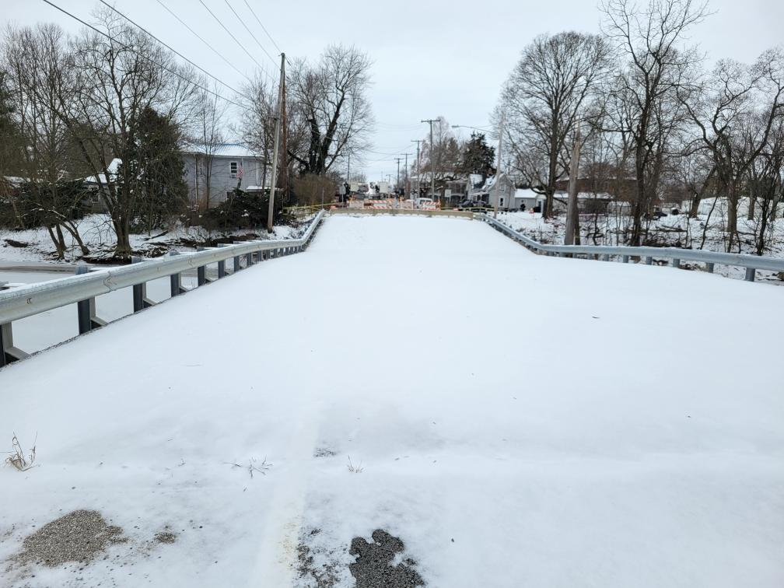
Uni-37-12.24 bridge over bokes creek

Slide 5
Recent History
District had previously recommended this bridge for the original proposed work, originally scheduled for this summer.
For undetermined reasons, on 12/24/24, the existing bridge suffered a partial collapse.
Existing HP12x53 capped piles at Pier 2 failed which resulted in the settlement of the bridge deck.
ODOT closed the bridge to all vehicular traffic shortly thereafter.

Slide 6
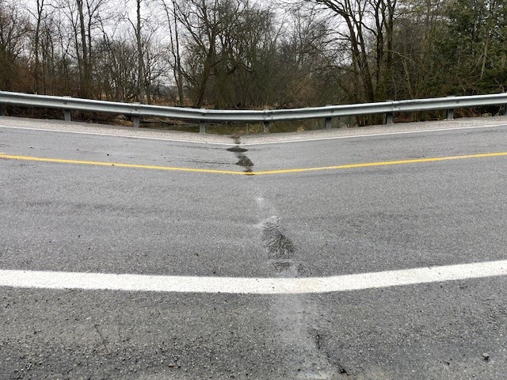
Uni-37-12.24 bridge over bokes creek

Slide 7
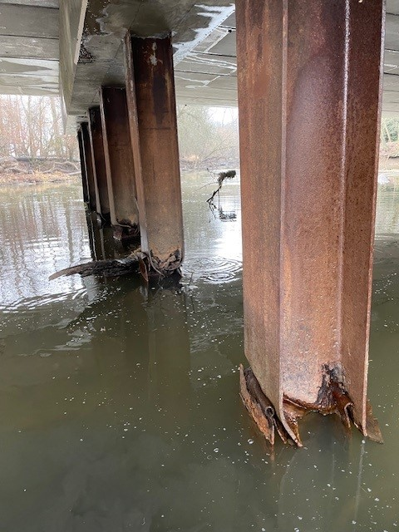
Uni-37-12.24 bridge over bokes creek

Slide 8
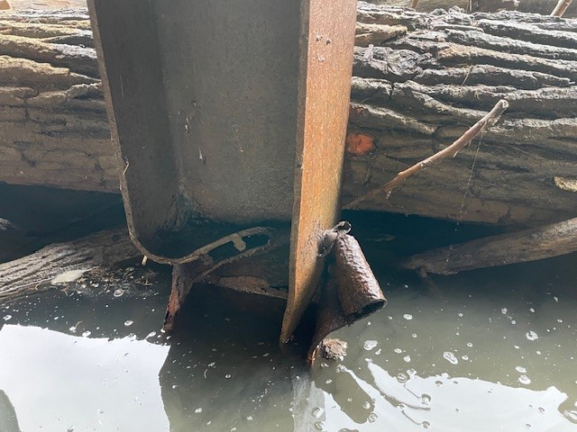
Uni-37-12.24 bridge over bokes creek

Slide 9
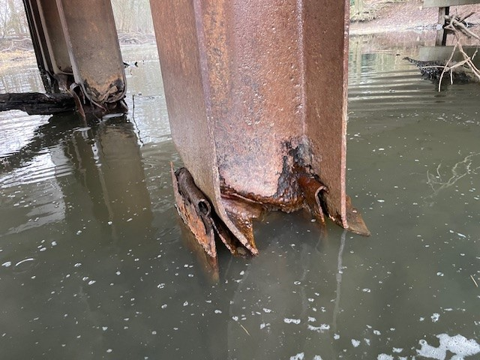
Uni-37-12.24 bridge over bokes creek

Slide 10
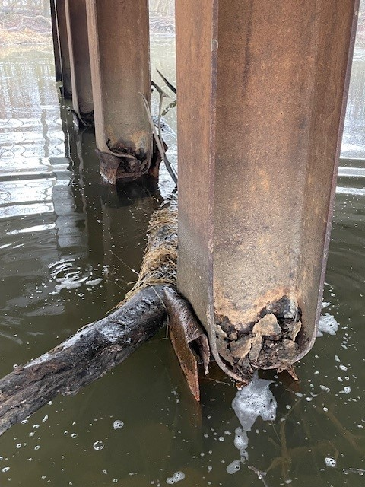
Uni-37-12.24 bridge over bokes creek

Slide 11
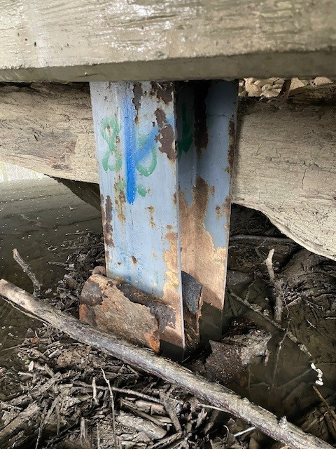
Uni-37-12.24 bridge over bokes creek

Slide 12
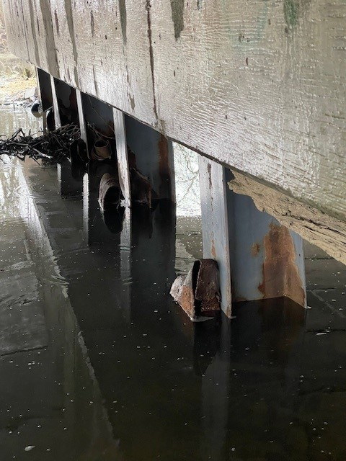
Uni-37-12.24 bridge over bokes creek

Slide 13
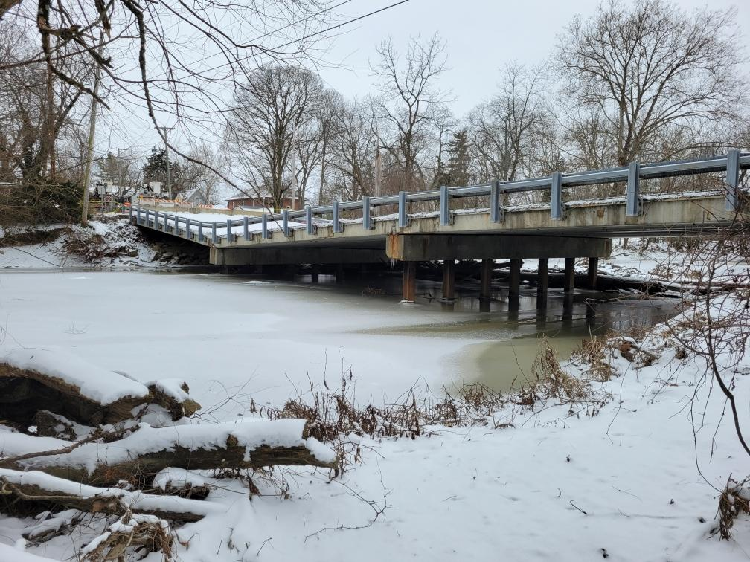
Uni-37-12.24 bridge over bokes creek

Slide 14
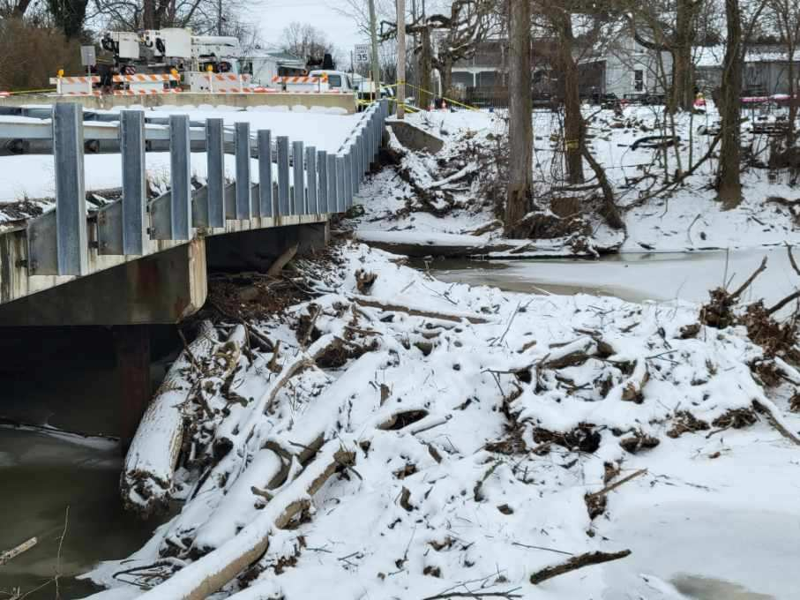
Uni-37-12.24 bridge over bokes creek

Slide 15
Project description
Sale: 3/27/25
Complete Date: 09/05/25 (future addendum change from 1/31/26)
Est. Cost: $1.5 million
Project Description
  Rehabilitation of Structure over Bokes Creek in Magnetic Springs. Work to consist of superstructure replacement from non-composite to composite box beams and pier reconfiguration from a 3 span to 2 span bridge. Additional work to include full depth pavement correction and replacement of existing curb and curb inlets.

Slide 16
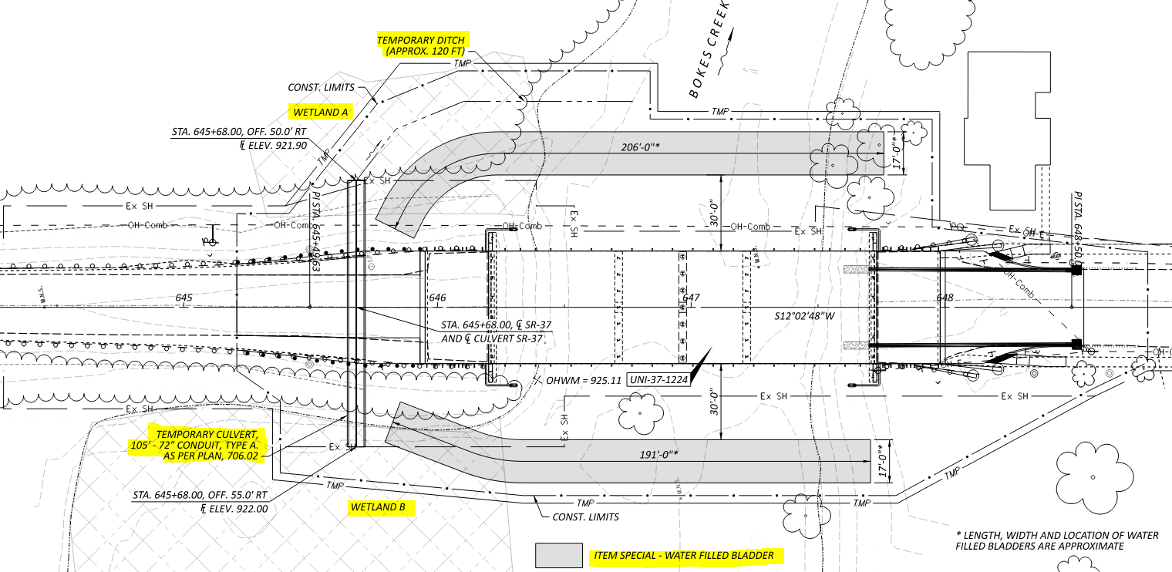

Special demolition considerations

Slide 17
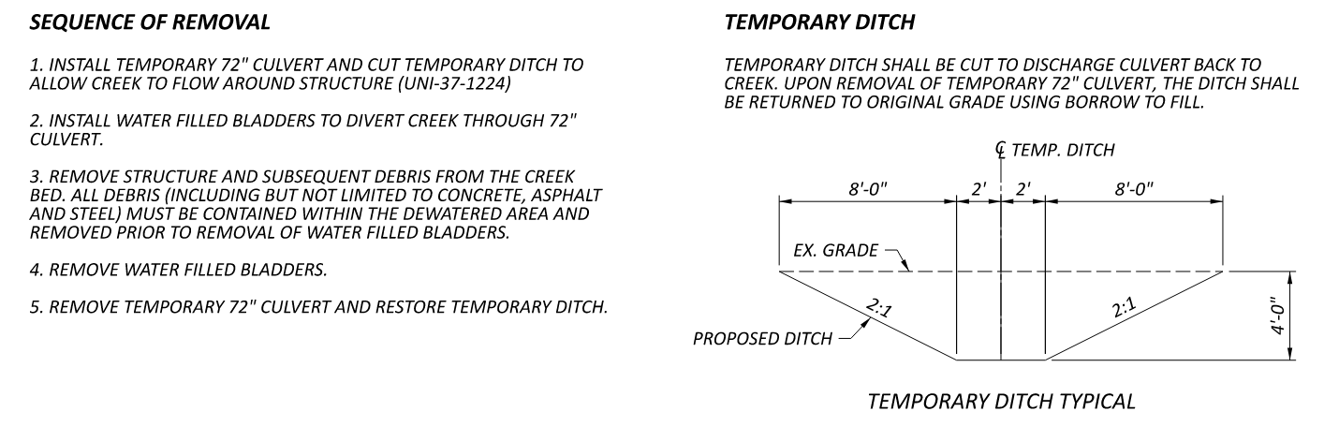
Special demolition considerations

Slide 18
Right of way issues
ODOT has secured Right of Entry from Property Owners on all 4 corners of the bridge. Temporary Easements noted.
Existing Right of Way did not extend out far enough for proposed construction and demolition.
Due to compromised bridge condition, ODOT did not have the time to go through normal right of way acquisition.
There is existing signage for a USDA easement, however the easement is not recorded and not official. The area is located within the identified wetland areas.

Slide 19
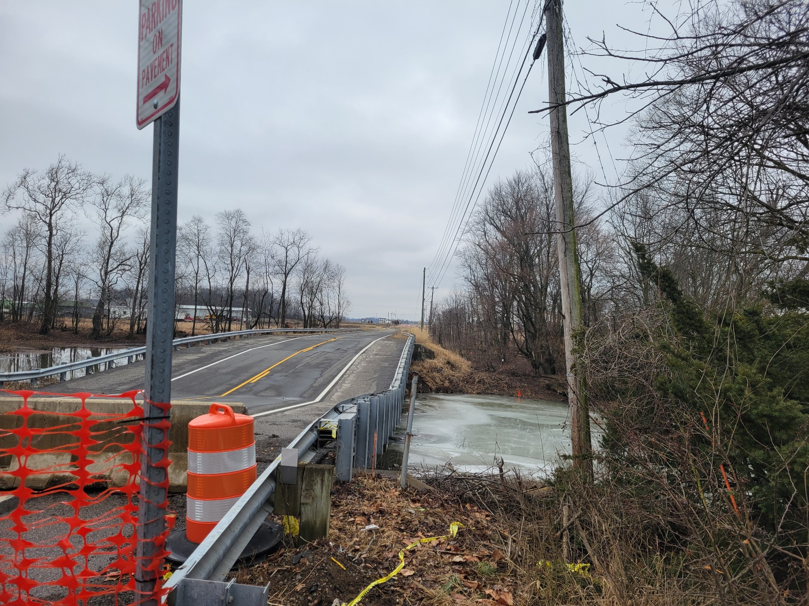
Utility issues
East side of bridge has an Ohio Edison 7.2KV existing line.
This is the only electrical feed for the Village of Magnetic Springs
The line can not be de-energized due to no backfeeding options.
Arm will be placed on North pole to give vertical clearance.

Slide 20
Environmental issues
There are known impacts to 2 wetlands on the North side of the bridge.
  The temporary 72” pipe will be installed in this area.
  Construction limits should be monitored closely and all reasonable attempts to minimize disturbance should be pursued when performing this work.
Still some trees that need to be removed prior to the work commencing.
There is an existing log jam against the existing piers on the west side of the structure that will need removed.

Slide 21
Questions
?

