Slide 1
CUY-90-6.69 pre-bid meeting – PID 76779
March 11, 2025

Slide 2
AGENDA
Overview
Schedule
Maintenance of Traffic
Drainage
Tree Clearing

Slide 3
OVERVIEW

Slide 4
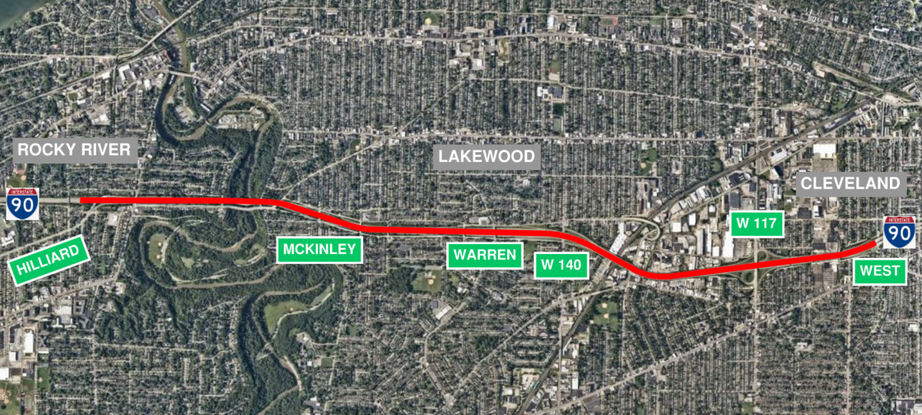
overview
IR 90 from Hilliard Blvd. to West Blvd (4.6 mi)

Slide 5
overview
Full-depth pavement replacement
New Drainage
Bridge vertical clearance improvements
Bridge overlays and substructure patching
Rocky River bridge work is more in-depth
New Lighting
New Signing

Slide 6
SCHEDULE

Slide 7
schedule
4/17/25 – Sale
4/28/25 – Award
5/19/25 – Begin Construction
8/1/28 – End Construction

Slide 8
MAINTENANCE OF TRAFFIC

Slide 9
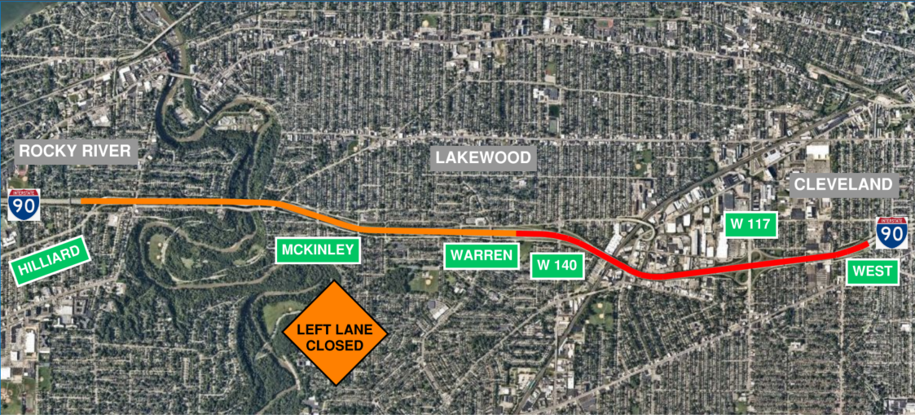
Maintenance of traffic
EB lane closure allowed during Phase 1 & Winter Phase 1 into Phase 2

Slide 10
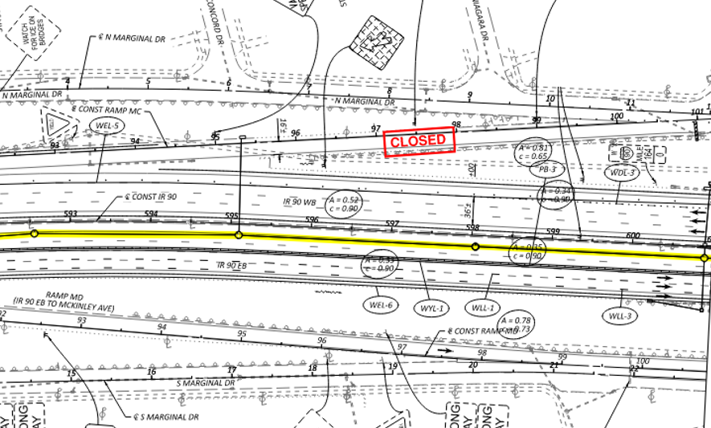
Maintenance of traffic
EB lane closure
Allows trunk line installation from Rocky River east to W. 140th St.

Slide 11
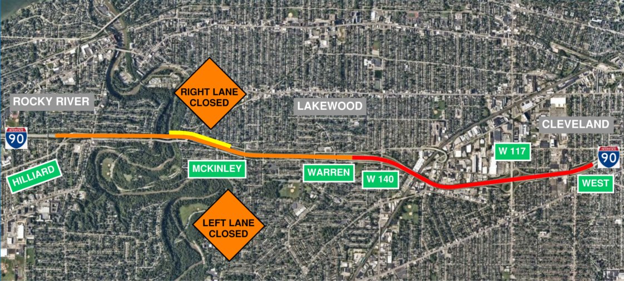
Maintenance of traffic
Short term WB lane closure at McKinley Ave.

Slide 12
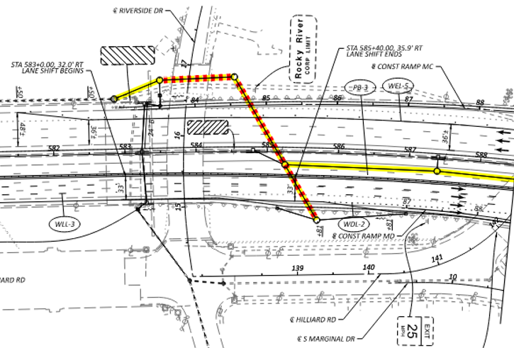
Maintenance of traffic
Short term WB lane closure at McKinley Ave.
Bore/Jack near Riverside Drive

Slide 13
Maintenance of traffic
Ramp Phasing
Work window contract revised on sheet 56A
Ramps to be built in Phase 1:
Hilliard Blvd. Ramp HA
West Blvd. Ramp W13

Slide 14
Maintenance of traffic
Ramp Phasing
Work window contract revised on sheet 56A
Ramps that may be built either in Phase 1 or in phase with outside lane & shoulder reconstruction:
McKinley Ave. – Ramps MC & ME
Warren Road – Ramps W1 & W1A
W. 140th St. – Ramp 140-4
W. 117th St. – Ramps 117-5 & 117-9

Slide 15
DRAINAGE

Slide 16
drainage
Drainage
Reconfigured bore/jack near Riverside Drive

Slide 17
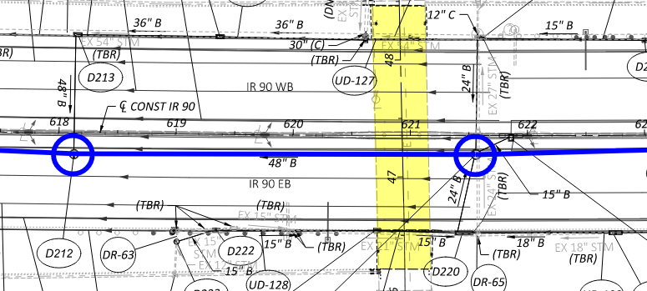
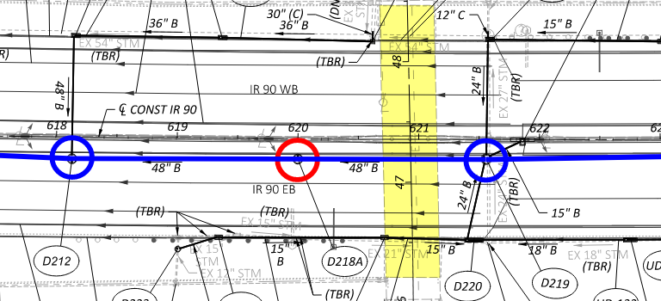
drainage
Drainage
Reconfigured manholes at overhead bridges due to limited clearances

Slide 18
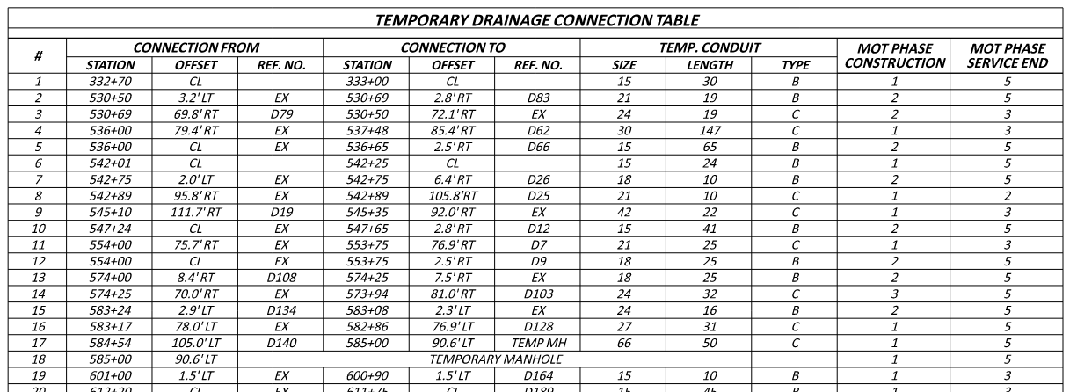
drainage
New Maintenance of Drainage Phasing Table

Slide 19
TREE CLEARING

Slide 20
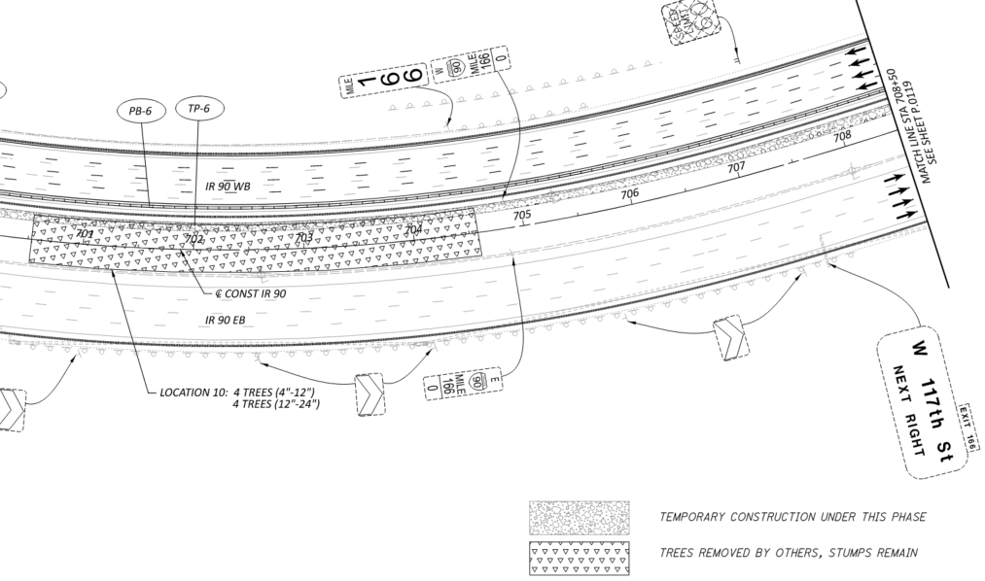
Tree clearing
Trees have been cleared; Stumps remain
See MOT Phase 1 plans

Slide 21
Thank you

