Slide 1
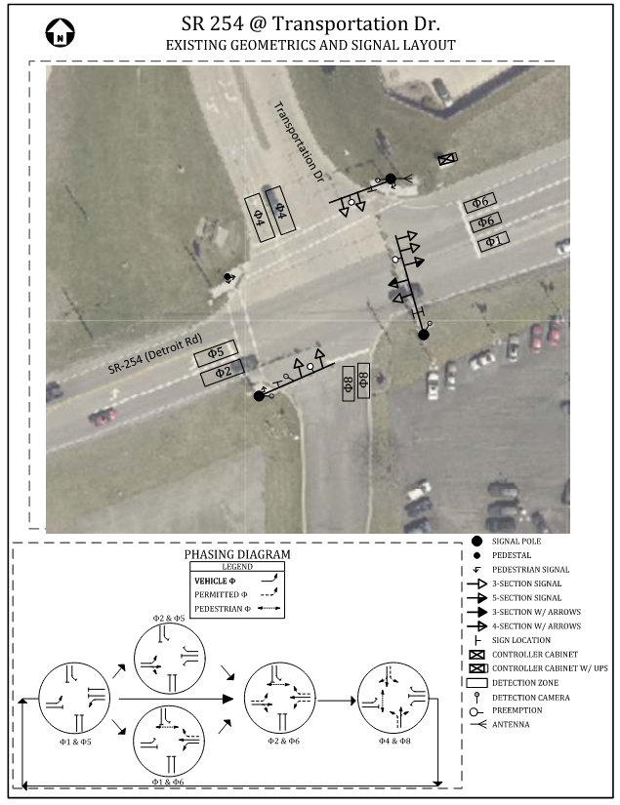
Signal Timing Summary
LOR-254 & Transportation Dr
Sheffield Village
Lorain County – ODOT D3

Slide 2
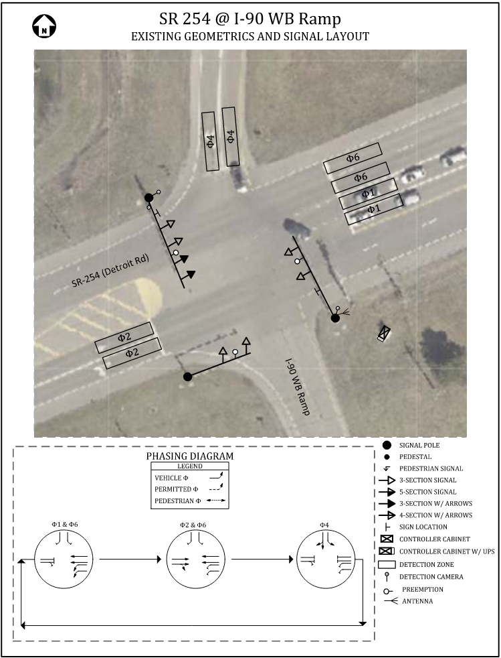
Signal Timing Summary
LOR-254 & I-90 WB Ramps
Sheffield Village
Lorain County – ODOT D3

Slide 3
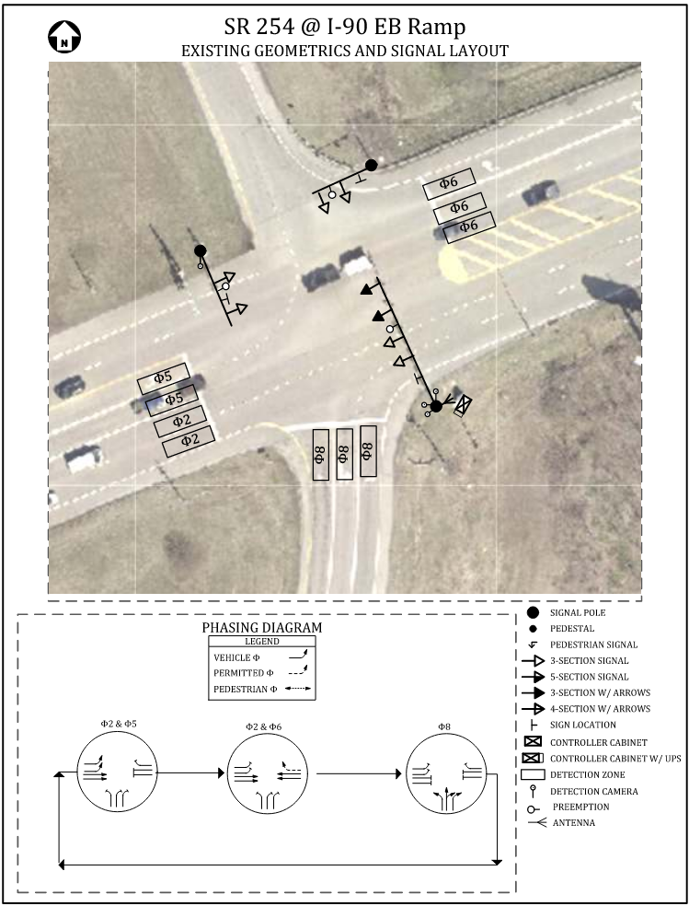
Signal Timing Summary
LOR-254 & I-90 EB Ramps
Sheffield Village
Lorain County – ODOT D3

Slide 4
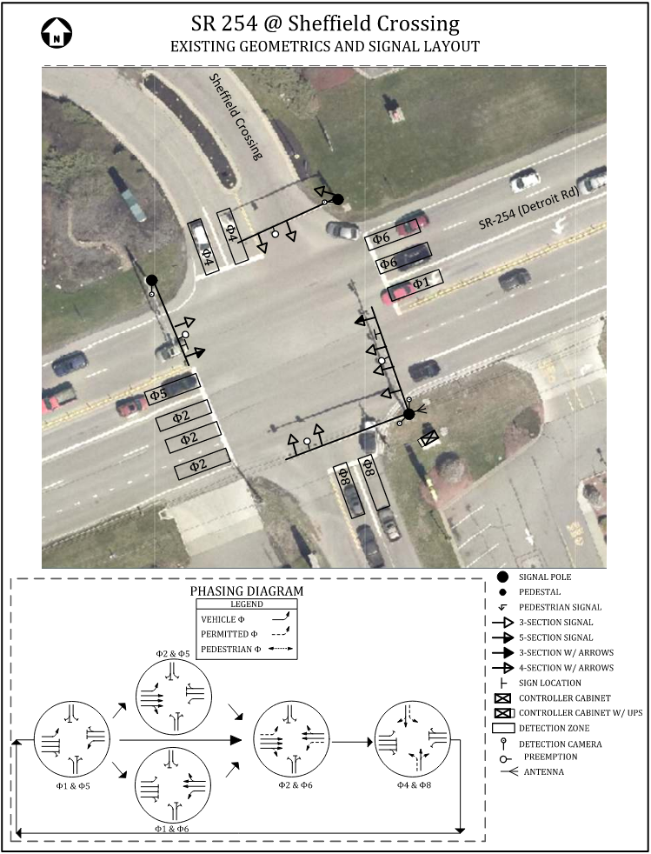
Signal Timing Summary
LOR-254 & Sheffield Crossing
Sheffield Village
Lorain County – ODOT D3

Slide 5
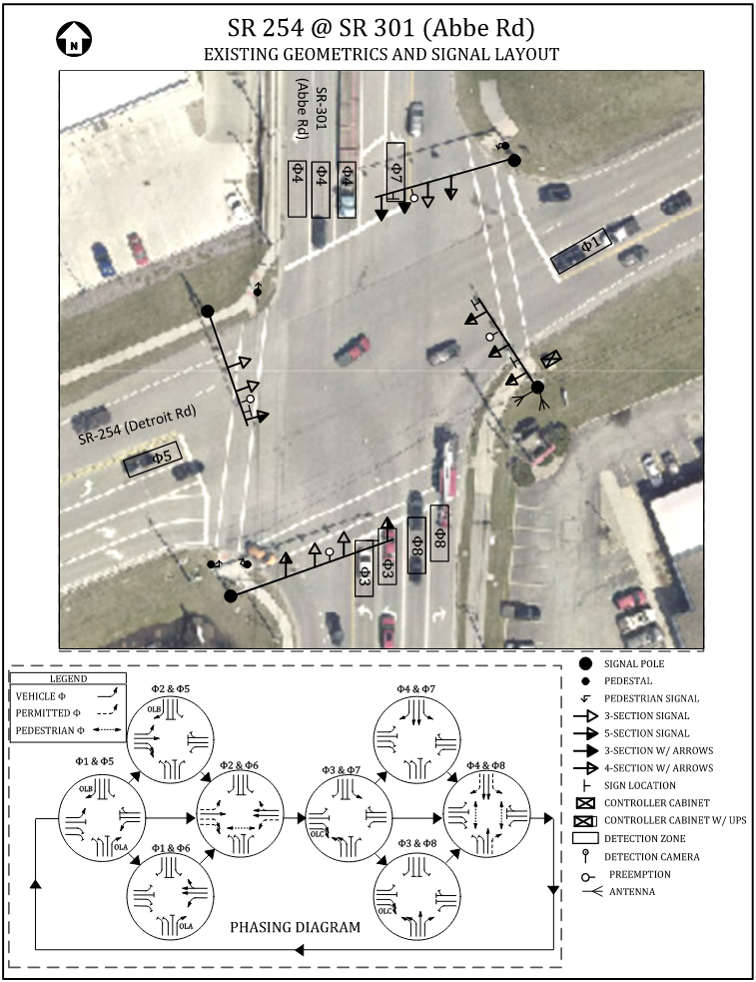
Signal Timing Summary
LOR-254 & SR 301
Sheffield Village
Lorain County – ODOT D3

Slide 6
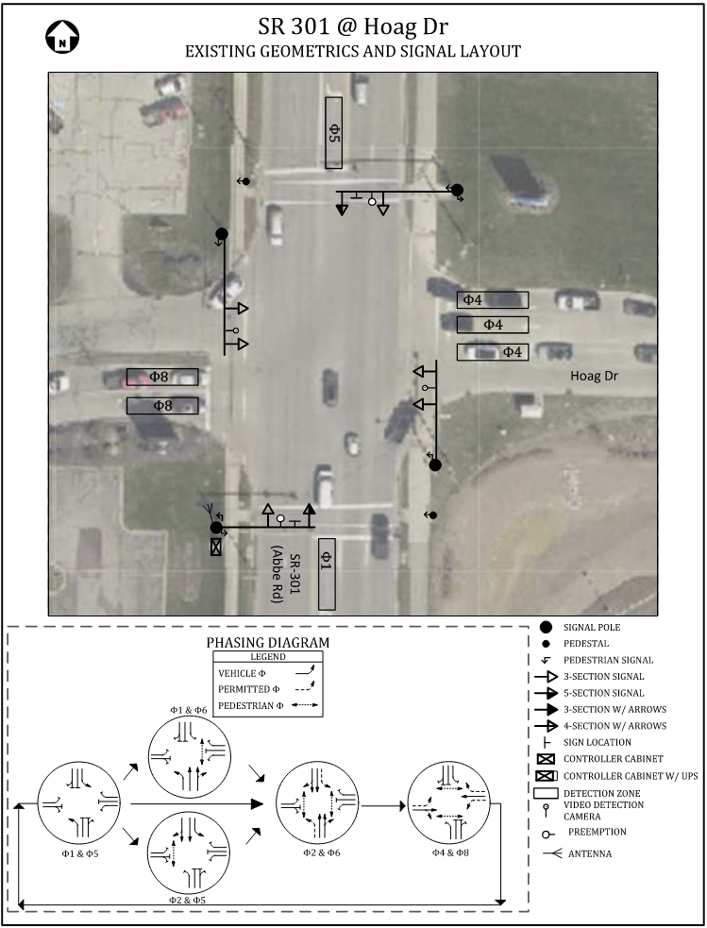
Signal Timing Summary
LOR-301 & Hoag Dr
Sheffield Village
Lorain County – ODOT D3

