Slide 1

Design-Build
Part 2: Project Development
Notes:
Note that you will now begin Part 2 of the course, which provides an overview of the DB project development and scoping process. This part is expected to take 70 minutes, after which we will break for lunch.

Slide 2
Learning Outcomes
Understand how to integrate the DB project development process into ODOT’s standard processes
Understand the importance of developing complete and thorough scoping documents
Notes:
Briefly review the learning outcomes for this section and indicate that you will revisit the outcomes once again at the end of this portion of the training.

Slide 3
Contents
1
DB Decision Process
2
DB Project Development
3
Scope Development
4
Case Studies – Project Scoping
5
Questions/Discussion
Notes:
Use this slide to present the main topic areas covered in this section.
Note that the information presented in this section supplements existing Department manuals, such as the PDP, with information specific to the DB method of project delivery. The information provided has been developed based on lessons learned on ODOT projects as well as best practices from the DB industry, with consideration given to how these practices can be best integrated into the Department’s existing project development and project management processes.

Slide 4
DB Decision Process
Notes:
Use this slide to provoke thought and reinforce the information conveyed during Part 1:
• Based on what we learned in Part 1, what are some considerations for using DB? Possible answers may include:
- Reduce delivery time
- Promote innovation
- Allocate risk to the party best able to manage it
- Enhance constructability
- Obtain earlier cost certainty
Consider the following scenarios. What delivery method would be most appropriate for the given situation?
- We want quick project delivery? DB
- Design is complete and not complex (e.g., rehab job)? DBB
- Projects having a high sense of urgency? DB
- Projects having manageable public controversy and minimal third party or environmental issues? DB

Slide 5
Project Delivery Decision Process
Define Project Goals and Objectives
Assess Project Characteristics
Align Goals and Characteristics to Delivery Approach
  Reduce delivery time
  Promote innovation
  Allocate risk to the party best able to manage it
  Enhance constructability
  Obtain earlier cost certainty
  Potential for reduced owner staffing
  Emergency project
  Large program with multiple phases or contracts
  Limited owner resources
  Non-standard design; specialty expertise required
Delivery Method
DBB
DB
Procurement Approach
Low Bid
Value Based
Two-Step
Technically Responsive
Contracting Strategies
Incentives
Notes:
Explain that before deciding to use DB, the project team should make a concerted effort at defining project goals, assessing project characteristics, and then aligning these to the delivery method. For example, on an emergency project where the goal is to reduce overall project delivery time, DB may provide the best option.
Note that an additional consideration, which will be discussed in greater detail in Part 3, relates to also tailoring the procurement approach (low bid vs. value-based) to the project goals and characteristics. For example,
• A low bid DB approach would apply to projects where a compressed construction schedule is beneficial or possible but the Department must provide a high level of design definition and retain control of quality and third party coordination.
• A value-based DB approach is better suited for projects where a low level of design definition is possible, there is greater opportunity for innovation, and the DBT can assume greater responsibility for quality and third party coordination.
A final consideration relates to the use of incentive/disincentive strategies (e.g., for timely completion, quality, etc.) to motivate the contractor to achieve key project goals.

Slide 6
DB Project Development
Notes:
Ask the class how familiar they are with ODOT’s PDP. Note that this discussion will address the necessary adjustments to the PDP to accommodate DB.

Slide 7
DBB vs. DB Project Delivery
DBB
DB
Preliminary Design
Final Design
Bid
Construction
Scope Development
Procurement Process
Final Design
(by DBT)
Construction
Notes:
Refer to the graphics shown on the slides to identify the high-level differences between the DBB and DB project development processes.
• Under DBB, the Department conducts preliminary and final design (represented by the green and orange shapes) to procure construction contractors to build the project in strict accordance with the Department’s design.
• Under DB, 100% complete plans and specifications do not form the technical basis of the construction contract. Instead, the Department’s Scope of Work Document forms the technical basis of the DB contract, and the 100% complete plans and specifications are a required deliverable under this contract. As such, the Scoping Phase (akin to Preliminary Design under DBB) takes on heightened importance (again shown in orange) under DB.
• Given the increased complexity of procuring DB teams, the bidding phase (particularly for value-based procurements) is generally longer under DB (as represented in brown in both diagrams).
• The duration of the overall construction phase (shown in blue) may not differ between the two methods, but the ability to fast-track construction means that overall project duration may be reduced.

Slide 8
DBB Project Development Process (PDP)
Planning
Preliminary Engineering
Environmental Engineering
Final Engineering
Project Start-Up
Project Initiation Package
E&FC Analysis
P&N Development
Concept
Scope & Budget
Stakeholder Involvement
Feasibility Study
NEPA Studies
Cost Estimates
Alt. Eval. Report
Value Engineering
Begin Stage 1 Design
Stakeholder Involvement
Preferred Alternative
Stage 1 Design & Approval
Value Engineering
Cost Estimates
NEPA & Permit Approval
Stage 2 Design & Approval
ROW Plans
Stakeholder Involvement
ROW/Utility Acquisition and Relocation
Stage 3 Design & Approval
Cost Estimates
Final Plan Package
Mitigation
Stakeholder Involvement
Notes:
Briefly display this slide, which represents ODOT’s standard project development process, as taken from the PDP manual.
Explain that you will use a similar set of graphics in the next few slides to display how DB fits into ODOT’s PDP.

Slide 9
How Does DB Modify the PDP?
Expand Planning Phase to include a concerted effort to:
  Identify and rank the project’s goals and objectives;
  Identify, evaluate, and allocate project risks; and
  Select the appropriate delivery method given the goals and risks identified for the project.
Making the DB Decision
  For most Path 1 and 2 candidate DB projects, the project may be chosen for DB delivery after completion of the PIP
  For some Path 2 and 3 candidate projects, the DB decision won’t occur until after the completion of the Feasibility Study in the PE Phase
Planning
Project Start-Up
Project Initiation Package
Consider project goals and risks
Is the project a candidate for DB?
E&FC Analysis
P&N Development
Concept
Scope & Budget
Stakeholder Involvement
Notes:
Note that the use of DB will not substantially change the existing Planning phase. As indicated by the red text shown in the figure, the Planning phase should be expanded to include
• Identification of project goals and risks
• Selection of the delivery method that aligns with these goals and risks
Explain that the DB decision itself can generally be made after the completion of the PIP; for more complex projects this may not occur until after the completion of the Feasibility Study in the next Phase.

Slide 10
How Does DB Modify the PDP?
Preliminary Engineering
  Red Flag Summary
  Feasibility Study
  Utility Coordination
    Utility assessment
    Contact utilities
    Begin relocation (if applicable and possible)
Initial Scoping
  Preparation of DB Scope of Services and Bid Documents
  Identify design exceptions
Preliminary Engineering
Feasibility Study
Confirm project is a viable candidate for DB delivery
NEPA Studies
Begin DB Scope of Services Document
Prepare Bid Package
Cost Estimates
Alt. Eval. Report
Value Engineering
Begin Stage 1 Design
Stakeholder Involvement
Notes:
Point out the following key changes:
• Preparation of the DB Scope of Services document replaces the traditional staged design process. In developing the Scope, the project team should take the time upfront to determine:
- What design exceptions it will approve
- What items it can’t live without
• A VE assessment does not need to be performed

Slide 11
How Does DB Modify the PDP?
Environmental Engineering
Final Engineering
Preferred Alternative
Stage 1 Design & Approval
Value Engineering
Cost Estimates
NEPA & Permit Approval
Stage 2 Design & Approval
ROW Plans
Stakeholder Involvement
Complete DB Scope
ROW/Utility Acquisition and Relocation
Stage 3 Design & Approval
Cost Estimates
Final Plan Package
Mitigation
Stakeholder Involvement
Bid phase
Aware
Final Engineering by DBT
Notes:
Use this slide to point out the following:
• Under DB, there is no clear distinction between the Environmental and Final Engineering phases.
• Value Engineering does not have to be performed.
• Even though the lump sum nature of a DB project makes the development of quantities for bidding purposes unnecessary, Estimating still needs a detailed scope and quantities from which to develop a reasonable estimate (i.e., not just plug numbers) for Project Filing purposes. The estimate should be based on the worst case or preferred alternate.
• While developing the Scope, develop a listing of appropriate DB-specific pay items. (Note you will discuss this topic in more detail in Part 3 when discussing the bid package preparation)
• Minor projects can typically be bid after environmental clearance is obtained.
• Most of ODOT’s DB projects are:
- Environmentally exempt or qualify for a Level 1 Categorical Exclusion
- Require no ROW acquisition
• Final Engineering is the responsibility of the DBT.

Slide 12
DB Project Development
 | Preliminary Project Development | Identify and Allocate Project Risk | Finalize Project Scope | Procurement Process | Award
Key Activities | Field review Red Flag Summary Preliminary engineering Preliminary scope definition | Risk Workshop Identify risks Analyze risks Allocate to party best able to manage Determine procurement approach Low bid vs. value-based One vs. two-step | Obtain input from multiple departments as necessary Planning Production Construction Maintenance Central Office Determine design criteria Prepare Scope of Services Prepare cost estimate | Develop bid package Scope of Services Proposal Notes Develop evaluation plan (for value-based) Pre-Bid Meeting (at District’s discretion; recommended for complex projects) | Confirm responsiveness Make contract award recommendation Pay stipends (if applicable) Debrief unsuccessful proposers
Considerations | Level of design and development required Permitting requirements ROW acquisition Environmental clearance Utility relocation Schedule requirements Traffic maintenance | ROW acquisition Third-party issues (railroads, utilities, permitting) Construction phase risks (DSC, traffic management, schedule) | Level of design to maximize benefit of DB | Low bid vs. value-based vs. Technically Responsive One-step vs. Two-step ATCs Evaluation and selection method (for value-based) Stipends | Have requirements been met? Bid escrow Bonds and insurance Quality management plans Preliminary schedule and NTP date
Notes:
Note that in the interest of time you will not cover this slide in depth. However, it can serve as a useful reference/checklist for ensuring that key activities and considerations are not forgotten.
Explain that the key takeaways from this slide should be the following:
The scoping and bid package development process can be intensive effort, requiring
input from multiple functional areas and specialized expertise
a dedicated effort to identify goals, risks, and Department preferences, and
a significant effort to evaluate proposals (if a value-based procurement process is used).
Note that the decision to use a two-step low bid or value-based procurement process is a Central Office decision.

Slide 13
Project Scoping
Notes:
Poll the class to see if anyone present has been involved with developing a Scope of Services document.

Slide 14
Function of Scope of Services Document
Replaces the 100% complete plans and specifications used to fully define project requirements on a DBB project
Communicates ODOT’s minimum requirements and expectations regarding the project’s:
  physical components
  basic configuration
  operational requirements
  performance
Represents ODOT’s last chance to fully influence the design (w/o additional post-award costs)
Notes:
Review the bullets shown on the slide, emphasizing that the Scope of Services document essentially replaces the plans and specifications used on a traditional job and acts to establish the Department’s minimum requirements.

Slide 15
Scoping Objectives
Develop a clear and complete project description for inclusion in the bid and contract documents
  Requirements should ideally have only one interpretation
  Scope should reflect ODOT’s essential needs and preferences
  Scope sets the minimum
  Changes from minimum = Change Orders
Do NOT rely on design review process to further refine requirements
  Use scope to identify what you want and what you don’t want (i.e, what you can live with vs. what you can’t live without)
Notes:
Review the bullets shown on the slide, emphasizing that the Scope sets the minimum. It should be used to identify what the Department wants, as well as what it does not want.

Slide 16
Scope Development
Conduct field review before writing scope
  Evaluate items such as fatigue analysis and corrosion protection system upfront so that the required repairs can be defined in the scope
  Perform subsurface exploration to allow inclusion of such information in the scope
Use ODOT’s Scope of Services Form
  Instructions for completing the form provided in ODOT’s DB Scope Manual
Specify the desired alternate if ODOT design and specification requirements allow more than one option
Specify all preferences, plan notes, and special provisions
Notes:
Review the bullets shown on the slide.
• In disputes, the contract is construed against the person writing the contract.
• ODOT has the knowledge of the projects and know the intent of the project.
• Ensure what is being described can be built
Use this slide to provoke thought by asking the following question:
• Can anyone think of a Department preference that should be stipulated in the Scope? Think in terms of what we can live with versus what we can’t live without.

Slide 17
Scope Development
Things to avoid
  Phrases such as “as directed by the engineer,” “if recommended by the Department,” “It is the intention of…”
  “Rehabilitation of…”, “Repair…”, “Improve…” (if needed, set forth parameters)
  Procedural directions regarding construction means and methods, unless absolutely necessary
  Broad statements of performance (e.g., minimize impact of traffic)
Notes:
Explain that to avoid misinterpretation, scope requirements should be clear and quantifiable if possible. By including any vague or unclear requirements, the Department will risk receiving:
• a design that it doesn’t want, and/or
• higher bids than anticipated if bidders price in risk.

Slide 18
Key Scope Areas to Address
Hazardous Materials
Environmental
ROW
Maintenance of Traffic
Technical Criteria
Design Exceptions
  Shoulders
  Super-elevation
  Geometrics
Notes:
Refer to ODOT’s Scope of Services manual and form and explain that these documents should be used as a checklist to help ensure the development of a complete Scope.

Slide 19
Hazardous Materials
Provide bidders with all information related to the presence of hazardous materials and substances at the site
For asbestos:
  Identify if and when asbestos inspection was conducted (or if investigation is a DBT responsibility)
    HIGHLY recommend performance of asbestos investigation
    Risk item
  Identify whether or not asbestos was encountered
  Attach investigation results
Notes:
Note that the Scope should include all information related to the presence of material and substances at the site that could create hazardous conditions. Include the following information:
• Type of contaminated material present
• Quantity of materials
• Locations
• Parties responsible for testing and handling
• Payment method

Slide 20
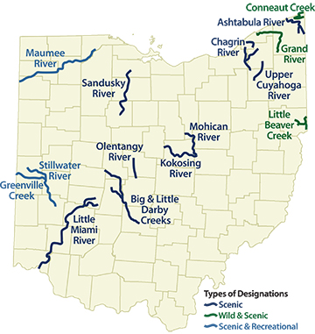
Environmental
Determine and size project impact area to accommodate “worst case scenario” environmentally
Address Scenic Rivers
Address environmental commitments made as part of NEPA process
Determine permit requirements
Notes:
Note that:
• Because design will likely be incomplete at the procurement stage, the Scope preparer may have to assume a “worst case scenario” from an environmental perspective when preparing permit applications. This “worst case” areas should include all anticipated work areas, including temporary work areas.
• Because the DBT has control over the final project design, some permit applications may have to be completed or modified by the DBT. The Scope must be clear in identifying which party is responsible for acquiring which permits.
• Permit conditions may also result in unexpected design and/or construction requirements that may be more costly or time consuming than originally anticipated by the DBT. The Scope must therefore provide enough detail about environmental conditions and commitments and the general status of the permitting process to clearly convey the level of risk to be absorbed by the DBT for environmental compliance issues.
• Special attention needs to be paid with projects on Scenic Rivers (i.e. the Big and Little Darby, Olentangy, Kokosing Little Miami, Maumee). These can have special commitments which need specifically called out.
• The Scope should also stipulate, regardless of the operator named on the permit (i.e., the Department or the DBT), that all environmental violation costs are the responsibility of the DBT.

Slide 21
Additional Right of Way
ODOT generally acquires all ROW prior to award
If the DBT requires additional ROW to accommodate its design, typical responsibilities are as follows:
DBT Responsibilities | ODOT Responsibilities
Prepare and submit ROW plans and legal descriptions Contract with ODOT pre-approved Title Agent to perform Search and Title Reports | Acquire ROW Perform Relocation Assistance study (if required) Provide ROW Cost Estimate Prepare and submit Certificates of ROW to FHWA
Notes:
Explain that although ODOT typically only applies DB to projects having minimal need for ROW acquisition, in some cases, the conceptual design prepared by the Department may not support the identification of all ROW needs prior to the completion of the DBT’s final design. In this case, the scope needs to address exactly what is required of the DBT to support the Department’s ROW acquisition process. In general:
• All necessary ROW will be acquired by ODOT
• The DBT will prepare ROW plans and legal descriptions

Slide 22
Utilities
Utility Coordinator Responsibilities | DBT Responsibilities
Pre-Award Identify potential utilities Contact utility companies to locate underground facilities and identify known conflicts Estimate utility reimbursement costs Begin relocation (if necessary) Attach all known utility information to the Scope and list all underground & overhead utilities Answer pre-bid questions related to utilities Post-Award Direct relocation needs to utilities Attend all utility meetings Authorize funds for relocation Assist and keep records of DBT’s coordination process | Coordinate with all affected utility owners Identify utility relocation needs Coordinate utility relocation with construction activities Minimize potential delays in coordination and relocation of affected utilities Attend meetings with utility owners and District Utility Coordinator Coordinate proposed betterments with Utility Coordinator
Notes:
Interactivity/Talking Points
Use this slide to emphasize that even though the DBT will ultimately be responsible for coordinating with the affected utilities, ODOT’s Utility Coordinator will continue to perform many of the same pre-award and post-award tasks that are necessary under DBB.
Ohio Design-Build Utility Responsibilities Pre sale -Reference Locations & Good Practices
ODOT Responsibilities:
PDP: Requirements of utility coordination same on DB as for all projects through the Feasibility Study and the Alternative Evaluation Report. (PDP Manual-Introduction 11.1. lithe project may be chosen for Design-Build during the Planning Phase of the PDP after the Project Initiation Package (PIP) is completed. For some Path 2 projects and the non-complex Path 3 candidate projects, this decision will occur after the Feasibility Study (FS) is completed in the Preliminary Engineering Phase.")
• Utility Assessment (PDP Manual-Preliminary Engineering: 1. Feasibility Study Development)
• Utility companies are contacted and asked to locate their underground facilities within the project area. (PDP Manual-Preliminary Engineering: 3: Alternative Evaluation Report)
• Utilities which conflict with the proposed project work are identified for relocation. (PDP Manual -Preliminary Engineering: 3: Alternative Evaluation Report)
• Determine estimated utility reimbursement cost. (PDP Manual-Preliminary Engineering: 3: Alternative Evaluation Report)
Determine which utilities are located in the location of the project. Gather and provide all known utility information (PDP Manual-Planning: 8.4) and provide this information to the DBT during the Bidding process and list all underground and overhead utilities, similar to a Utility note (DB Manual-Section 12.1).
Direct the utility owners to relocate or adjust water lines, gas lines, wire lines, service connections, water and gas meter boxes, water and gas valve boxes, light standards, cableways, signals, and all other utility appurtenances within the limits of the proposed construction (unless otherwise noted in the contract). (PN126: 105.07 Cooperation with Utilities)
Coordinate early with the utilities to establish realistic relocation schedules upon final design (Good practice¬ and inferred in 105.07 Cooperation with Utilities -B. "If performance of the Contractor's work is delayed because the utility owners fail to relocate or adjust their facilities as previously agreed, the contract time will be adjusted in accordance with the provisions of108.06.")

Slide 23
Maintenance of Traffic
Identify all:
  Preferences
  Special provisions
  Work restrictions
  Work area limits
  Applicable TEM Designer Notes
Consider Incentive/Disincentive or Lane Rental Strategies
Notes:
Instruct the class to refer to the ODOT Scoping Manual for a checklist of items that should be considered when preparing the MOT section of the Scope form.
• Specify minimum number of lanes to maintain.
• Review all TEM notes and specifically include if needed.
• Known restriction on time to be clearly noted. Do not specify ambiguous restrictions without noting.
• Innovative Contracting methods allowed.
o A+B allowed
o Incentive/Disincentive allowed
o Window Contract / Flexible Start allowed
If a project goal is to minimize disruption during construction, suggest that preparers may also wish to consider the use of I/Ds related to road closures.

Slide 24
Scoping Areas of Concern
Roadway
  Lane Configuration
  Signage Layout (if warranted)
Geotech
  Provide soil and subsurface information
  No interpretation
  Subgrade Stabilization requirements
Utilities
  Identify conflicts
  Identify relocation timeframes (if possible)
Drainage
  Reuse vs replacement
Notes:
Coordinate with the Office of Pavements for buildup and types.
o Rehabilitation types and options to be specified.
Lane Configuration and Turn lane required lengths – specify graphically or narrative. Ensure clarity. Specify minimum underdrain depths as design guides specify a max depth.
Signage – Overhead or ground mounted (freeway). Potentially provide preliminary layout.
Provide soil or structure borings, but do not provide recommendations. DBT to determine capabilities from information provide – interpretation risk on the DBT.
o Subsurface high risk item.
o Reuse of existing borings acceptable to provide IF quality of borings appears good and Office of Geotech agrees.
Perform subgrade analysis and specify subgrade treatment per Geotechnical Bulletin-1 (GB1).
Major drainage installations need evaluated prior to award.
o Consideration of reuse only if determined usable prior.
o Do not leave the determination of quality of drainage structures (pipe and installations) up for DBT to determine if available for reuse.

Slide 25
Scoping Areas of Concern
Structures
  Repairs / Patching
  Steel / Concrete
  Bearings
Lighting
  City Standards
  2 vs 3 wire
  Underpass and Tunnel Lighting
Design Exceptions
  Identify any allowed
  Clear Prior
    Interstate & Bridge Piers / Light Towers
    Preliminary Engineering Design Exceptions
    Shoulder Widths
Notes:
Specify minimums allowed for structure types. Considerations given for replacements for railroads.
Identify bearing work needed for rehabilitated structures. New vs refurbished. Shear requirements of existing pier caps need addressed, or potentially ignored. Loading of existing substructures and unknown piling may disallow concrete beams (if substructure not new). Consideration needing to be given for drilled shafts vs
Repair areas (patching) needed to be clearly scoped, or consideration for establishing unit price pay item. Subjective area of evaluation by DBT will almost always be made towards the minimal option.
Lighting – consider underpass lighting requirements. Specify tunnel lighting, if required. Consideration given for upgrading of system.
Identify allowed design exceptions. If shown in preliminary engineering, then difficult to disallow after award. Median towers and median bridge piers often require shoulder exceptions.
Traffic Signals – Consult with Traffic Engineering for requirements. Coordinate with municipalities to establish and use their criteria (if applicable)

Slide 26
Technical Criteria
Specify basic configuration
Specify preferences
Identify restrictions
Supply existing plans and studies
Prescriptive (method) vs. performance specifications
Notes:
Instruct the class to refer to the ODOT Scoping Manual for a checklist of items that should be considered when preparing the design and construction requirements of the Scope form. Stress the need to include all preferences, plan notes, and special provisions.
A key aspect of scope development entails establishing the basic configuration. The DBT’s proposal and design must be consistent with the basic configuration (though it could be subject to changes approved in accordance with ACT procedures). Typical constraints addressed in the basic project configuration include:
• Project Boundaries:
- ROW plans that depict the limits of ROW or easements obtained or to be obtained by the Department
- Environmental constraints (e.g., wetland protection)
- Project limits
• Horizontal and vertical alignment;
• Vertical clearance requirements;
• Critical project components:
- Number of lanes
- Interchanges
- Ramps
- Location of major structures
• Other factors that may define the limits and constraints of the project.
Note that Scope preparers may also want to consider using more performance-oriented or end result specifications if innovation is a project goal.
Explain the differences between method and performance specifications:
• Method specifications (also called prescriptive or recipe specifications) require contractors to use specific materials, equipment, and methods to complete the work. The prescribed requirements are typically based on materials and methods that have historically produced satisfactory results for the Department, thereby eliminating risk associated with newer, less proven methods and risk associated with varying contractor performance. Contractors are provided few, if any, opportunities to deviate from the specified requirements, and, provided that the specifications are met, is not responsible for performance deficiencies of the end product (i.e., the Department retains performance risk).
• Performance specifications contain statements of required results that focus on the desired quality level or performance of the finished work. (For example, “the interchange should perform at LOS B”).

Slide 27
How Far to Take Preliminary Design?
ODOT generally prepares Red Flag Summary, performs preliminary engineering, and prepares Scope of Services
Appropriate level of preliminary design driven by:
  Project goals
  Risk-sharing decisions
  Procurement approach (least cost vs. technically responsive vs. value-based)
Level of design can affect:
  DBT’s ability to innovate
  Extent to which DBT can influence cost and time savings through ATCs or alternate designs
  Risk transfer between ODOT and DBT
Notes:
Use this slide to spark a discussion on how much preliminary design the Department should be performing for a DB project. Ask the class,
• Identify some advantages of performing a high level of preliminary design.
- A possible answer would be to retain more control over the end product. If the class provides this answer, respond by asking:
- If we know exactly what we want, does it make sense to use DB? (yes, if we need to expedite project delivery)
• Identify some disadvantages of performing a high level of preliminary design. Possible answers would include:
- Reduces DBT’s ability to innovate
- Department retains more design responsibility

Slide 28
Level of Design vs. Risk
MAX
80
DBT
OWNER
60
RISK
40
20
MIN
0%
LEVEL OF DESIGN
100%
Notes:
Use this slide to quickly reinforce the idea that as the Department performs a higher level of preliminary design, less design risk can be shifted to the DBT.

Slide 29
Design Risk and Spearin Doctrine
DB contract can transfer some of the design risk to the DBT
  To the extent that DBT provides the plans and specifications, it impliedly warrants their adequacy and sufficiency
  Owners can assert a shield from any Spearin liability when the DBT’s design results in cost overruns or does not work
However…
Spearin Doctrine is still alive under DB
  Risk of design deficiencies may continue to reside with owners if design details included in the DB contract set forth specific requirements, sizes, quantities, etc. and remain under the owner’s control
  General disclaimers and exculpatory contract clauses cannot be relied upon to relieve owners from liability
  What ODOT provides must be correct based on actual conditions encountered
Notes:
Note that although DB shifts some risk of faulty design to the DBT, the Department will continue to retain some design risk (hence the criticality of preparing clear and complete scoping documents).
• The information provided by ODOT must be correct based on the actual conditions encountered.
• If evidence suggests that a design defect stems from owner-issued specifications, the courts may apply the Spearin Doctrine to protect the DBT.
If time allows, ask the class to read the summary of the Drennon Construction case provided in their Participant Workbooks. Note that this is a recent case in which the Spearin Doctrine was applied to protect a DBT.

Slide 30
Case Studies
Notes:
N/A

Slide 31
Case Study #1
Widening of existing bridge, and with that, an existing pier
Project Scope:
“Cap and column piers shall have a minimum of three columns when completed”
Notes:
Set up case study by defining the key scope requirements
Describe the key project scope statement for the case study project: “Cap and Column piers shall have a minimum of three Columns when completed…”
The existing bridge was to be widened, therefore existing piers needed to be widened.
Transition
The three column configuration to accommodate the bridge widening is illustrated.

Slide 32
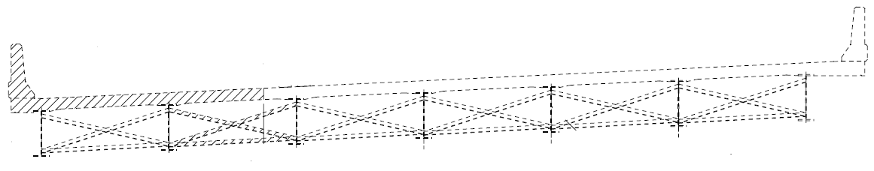
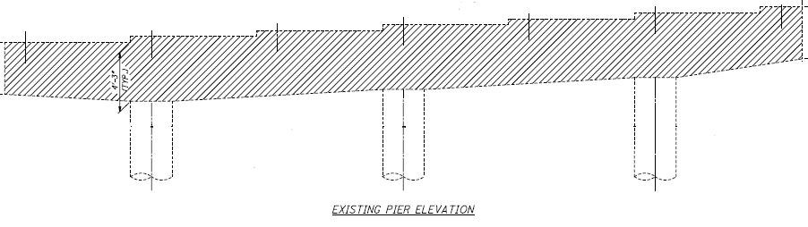
Case Study #1
Notes:
Illustrate the configuration of widened bridge section with 3 piers
The conceptual design for widening shows a configuration with three piers to accommodate the widened roadway.

Slide 33
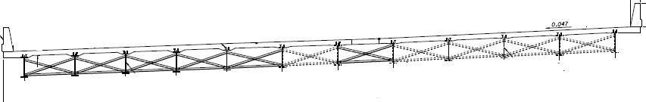
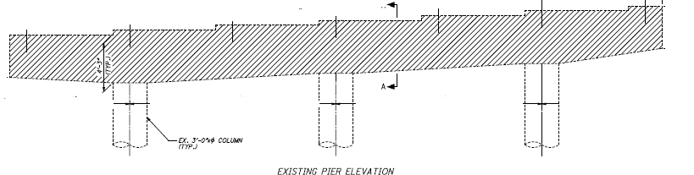

Case Study #1
New Steel – Widened
1
2
Notes:
A proposed design for the widened bridge section shows the additional of two piers.

Slide 34
Case Study #1 – Issue
Question asked:
How does this comply with the scope requirement of 3 columns per pier?
Answer:
“It complies as there are 5 columns when complete. This is a bridge widening and it includes the existing portion with the existing pier element all in that pier, and then we’re extending it making 5 columns all together. It complies with the scope.”
Notes:
Ask participants whether the proposed configuration complies with the scope requirement as drafted? Show the configuration again on previous slide if needed. Ask for one or two responses before giving the answer provided by the DBT.

Slide 35
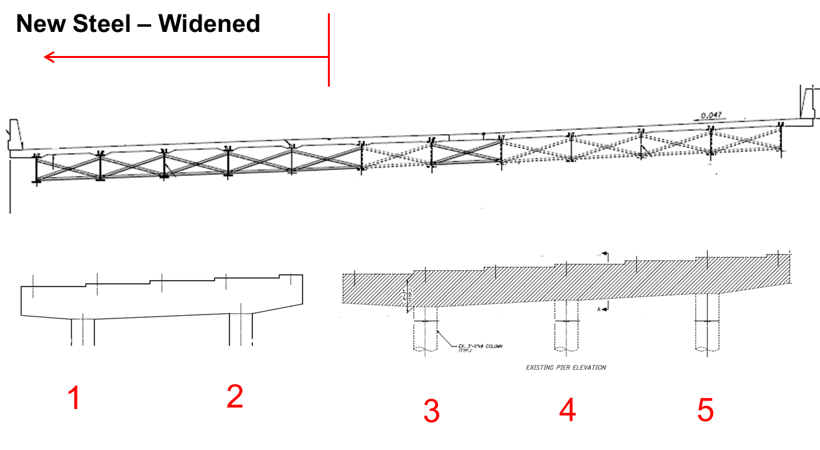
Case Study #1 – Lesson Learned
Winner’s answer:
“The scope requires 3 columns per cap and column pier. We will be compliant by either connecting the new pier cap to the existing pier cap or by adding a third column to the new pier site.”
Lesson Learned:
Ensure there is only one way to interpret requirements
Notes:
Emphasize that when drafting scope, say what you want (and don’t want) because that’s what you’ll get. Draft the scope requirement such that requirements are interpreted the one way intended (unless multiple solutions are sought)
More attention (review) is required for the scoping stages. Inputs are needed from multiple departments: Planning, Production, Construction, Maintenance, C.O.
Attention is especially needed from those who are going to be involved with the project. They have the most to gain/lose. The Project Manager should be sending out for review. Central Office review will be for consistency through the state – not to direct the project.

Slide 36
Case Study #2
Scope:
“The location of the proposed conduit banks shall all be located within 1 bay of the Bridge. The proposed conduits shall be … per the Department’s bridge design standards.”
Notes:
Point out to participants that the scope language required that the conduit banks on the bridge be designed in accordance with ODOT’s bridge design standards

Slide 37
Case Study #2
From Bridge Design Manual (BDM), Standards for Installation of Utilities on Bridges
  Should not be located in the floor panel behind the fascia stringer
  Critical utility lines (gas, etc.) located well above the bottom of the superstructure
  No utilities shall be placed inside of box beams
  Allowed to provide a space between box beams
Standard Drawings = Nothing
Notes:
Note that the requirements for installation of utilities on bridges addressed the requirements as summarized, but did not provide a standard drawing or detail for installation of conduit banks within one bay of a bridge. There are no standard drawings!!

Slide 38
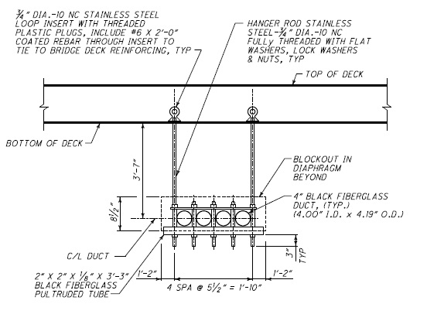
Case Study #2
DECK
HANGERS
Notes:
Ask participants:
• Does this proposed design solution (utility hangers fastened to the bridge deck) comply with the design standards referenced in the scope?

Slide 39
Case Study #2
No ODOT Standards for Utility Hangers
Contractor not constructing this way – convinced them that this does not meet another scope requirement.
Not reducing future maintenance costs…
They finally gave up
Make sure if you say design and build per “standard,” a minimum standard actually exists
Notes:
As pointed out, there were no ODOT design standards for utility hangers
The DBT proposed a solution using utility hangers, but ODOT advised them that it did not meet separate scope requirements to reduce future maintenance costs
The DBT ultimately gave up on the design detail
Lesson-learned:
• If the scope references a “standard” for design and construction of an item, make sure a standard actually exists!

Slide 40
Questions
Notes:
N/A

Slide 41
Learning Outcomes
Understand how to integrate the DB project development process into ODOT’s standard processes
Understand the importance of developing complete and thorough scoping documents
Notes:
Ask participants:
• Identify the basic steps in the DB decision process:
- Define goals
- Assess Project characteristics
- Decide on DB and procurement method based on alignment of goals and characteristics
• Identify some modifications to PDP process to accommodate DB:
- Planning: Added project selection process
- Preliminary Engineering: Begin DB scope and bid documents based on feasibility, NEPA, ROW, alternatives analysis, stakeholders, etc.
- Final Engineering: Performed by DBT
• Identify some recommended practices for developing a sufficient Scope of Services:
- Conduct field review before writing scope
- Avoid broad statements of performance or directions regarding means and methods unless necessary
- Draft scope to allow for one interpretation unless otherwise specified
- If scope allows for more than one option, specify the desired alternative
- Specify all preferences, plan notes, and required special provisions
• Recap the lessons learned from the case study:
- Draft scope carefully to provide one interpretation (if that is the intent)
- Ensure that design standards exist or are consistent with scope language

