Slide 1

Design-Build
Part 4: DB Contract Administration
Notes:
Present the basic structure for this portion of the training, which consists of:
• Execution overview. What are the key considerations for DB, a DB execution process overview, and quality management overview?
• Design contract administration: This section focuses on the design administration of the project including the design phase process and deliverables, and what’s different regarding DBT and ODOT responsibilities. A case study is also presented.
• Construction contract administration: This section addresses the administration of the, construction, and closeout phases of the project.
• Review Questions

Slide 2
Learning Outcomes
Understand considerations for DB contract execution
How do roles and responsibilities change for DB contracts?
For the design phase, what is required of the Department and DBT for design and what is different for DB contracts?
What is required of the Department and DBT for construction, and what is different for DB contracts?
Key issues to consider
Notes:
Present the learning outcomes for this portion of the course. These learning outcomes will be reviewed at the conclusion of this section to assess the degree to which the content was retained and understood by participants

Slide 3
Contents
1
Execution Overview
2
Design Contract Administration
3
Construction Contract Administration
4
Case Study
5
Questions/Discussion
Notes:
N/A

Slide 4

Some Key Considerations for DB Contract Execution (DBIA 2013)
Structured process to facilitate timely and effective communication, decision-making, and issue resolution
Staff trained and experienced with collaborative DB work flow
Dedication of sufficient resources from Department and DBT staff to meet project schedule
Process to enable 3rd party stakeholders (local agencies, utilities) to effectively interface with DBT
“Successful projects do not just “happen”—they require real teamwork, not just voluntarily restrained self-interest. Successful teamwork requires the whole team to share the same goals.”
Notes:
DB is not business as usual. Owner staff must collaborate and integrate with DBT to meet the Project schedule, budget, and quality goals.
Note the following:
• Traditional contract administration under DBB design and construction are administered under separate contracts. Administrative decision-making and approvals are often less efficient and difficult to coordinate
• DB integrates design and construction to meet shared goals – “all on the same team” mentality
• The pace of DB demands that ODOT staff dedicate sufficient resources and experienced staff to meet DBT schedule while ensuring that design and construction are in compliance with ODOT requirements.

Slide 5
Collaboration
Collaboration means using ALL team members to …
Identify and define ALL the problems to be solved in a project
Develop solutions that meet the needs of the project, owner’s business processes, market conditions, stakeholders, financing, operation, and maintenance (as well as design and construction)
Notes:
DBIA promotes establishing collaborative working relationships:
• “All members of the Design Build Team must understand that the project’s success is dependent on the ability of the team members to work collaboratively and trust that each member is committed to working in the best interests of the project.” (Design-Build Done Right - Project Execution)
• Integrated Project Delivery (or “little IPD”) means adopting a collaborative working relationship in while maintaining the traditional contracting protections/constraints in DB contract.
• ODOT personnel need to be willing to participate. While they are responsible for more of the project, ODOT needs to be involved. DB projects require Partnering, and the project management needs to be willing to “jump-in”.

Slide 6
Design-Build Execution Process Overview
ODOT Design Review/Administration
Design Phase
Pre-design
Meeting
Prelim.
Plans
Final Plans
Release for Construction
Packages
As-Builts
Pre-con
Meeting
Construct Buildable
Unit 1
Construct Buildable
Unit 2….n
Construction Phase
ODOT Construction Administration
Notes:
Integration of design and construction work flow increases the pace of project delivery (fast-tracking allows construction to begin before design is complete)
All parties (owner and DBT) must adopt a project first approach to maintain the work flow
Ask participants:
• How do design responsibilities (submittal reviews) change for a DB contract both for the DBT and for ODOT staff?
• What would be the advantage(s) of proceeding with early construction?
• What would be the challenges?

Slide 7

Quality Assurance for Design-Build
Design QA Program
Construction QA Program
DBT
Design QC
ODOT Design
QA/
Acceptance
DBT
Construction QC
ODOT Constr.
QA/
Acceptance
No CFR Requirements
23 CFR 637.207 B
Notes:
Note the following:
• Federal requirements (CFR 637) are the same for DB as for DBB – the Owner is responsible for QA verification, IA, and acceptance. However, the owner may reduce the frequency of testing or inspection on DB projects based on the criticality of the materials or the work.
• Federal CFR requirements are not applicable for design. Best practice standards for DB require design check and independent review (AISC, ISO, ODOT Design Manual, etc.)
• For design QA, the same QA requirements apply as for DBB in the ODOT Design Manual
• For large projects (value-based DB), DBT prepares a QMP and an independent QA entity not reporting to DBT management, the IQF, performs QA review, verification inspection, and testing.

Slide 8
Design Administration
Notes:
N/A

Slide 9
What’s Different?
Element | DBB | DB
Design Ownership | ODOT owns details of design and A&E directs ODOT responsible for plan review & revision, and E&O | Designer of Record: DBT owns details of design and E&O after award ODOT responsible for plan review for compliance
Design Submittal Review | Comments are directive in nature A/E must incorporate | Comments are advisory DBT’s consultant must respond to comments stating logic for not incorporating
Design Completion | Design complete before bidding or construction Construction contractor calculates price based on quantities Subs are known and have submitted hard quotes during bid process | Design not complete until As-Builts submitted Price is fixed before design complete May not know who subs are Must design to budget and schedule Design details the variable element in the process
Notes:
Interactivity/Talking Points
Use this slide to emphasize the following:
• For DBB: “Project is a product of the design,” DB: “Design is a product of DB contract.
• Design Ownership
- ODOT no longer serves as the “go between” the design professional and contractor
- Traditionally, ODOT owns the details of design. For DB, the DBT responsible for the design details and E&O.
• Design Submittal Review
- ODOT’s role in design review shifts to oversight and plan review for compliance with the scope
• Design Completion
- Design is not complete until final as-builts submitted after construction
• Design and construction are not sequential – they overlap and integrate.
• The focus is on design efficiency/constructability to support and enhance the construction process
• ODOT will establish minimum standards “quality of design” and performance goals in scope, but should not dictate details of design to meet those standards

Slide 10
Pre-Design Meeting
Lines of communication
Scope and budget
Process for electronic submissions (e.g. Sharepoint)
Schedule of LS items (reasonable/verifiable values)
Interim design schedule w/ milestones
ODOT PM
PM for Design
DBT PM
DBT Design PM
Notes:
Use this slide to explain the following:
• Key difference is mandatory pre-design meeting for DB
• Pre-design meeting establishes how the project team (ODOT & DBT) will work together collaboratively. It will:
- Establish Lines of communication, roles and responsibilities,
- Inventory major features of design work & correlate to major features of construction,
- Develop initial progress schedule with design submittal breakdown of deliverables and milestones for payment,
- Identify sub-consultants & other firms involved in design,
- ODOT and 3rd party design review requirements and schedule, and
- If applicable, project management office and facilities.

Slide 11
DBT Design Responsibilities
Design
Submittals
St.1 Preliminary
Plans
St. 2
Final
Plans
Prepare design packages in buildable units (i.e. earthwork, pavement, structures) w/assumptions at each stage of design development
Design Quality Control (QC)
  Adhere to ODOT standards/manuals
  De-conflict and coordinate sub-consultant design.
  Review & approve shop drawings & submittals from subcontractors
  Coordinate Owner and 3rd party design reviews and approvals
  Correct errors and omissions
Release for Construction
As-Builts
Notes:
Note the following:
• DBT defines Buildable Units (BU) and how far they take design in logical packages that can be reasonably reviewed
• DBT is responsible for development of design and construction plans to meet the contract requirements
• Inputting electronic submittals (sharepoint)
• DBT Design Deliverables include:
- A schedule of defined submittals and payment milestones
- Surveys, analysis, investigations, and other submittals as needed to support plans
- Preliminary, final and release-for-construction plans (with materials quantities for certain items requiring sampling frequencies?)
- As-built construction plans (after completion & prior to final acceptance)

Slide 12
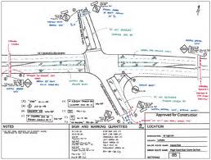
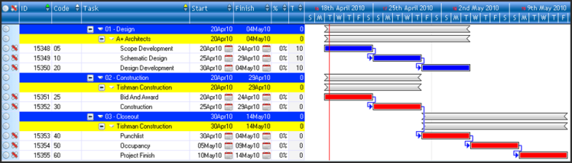
Submittals of Buildable Units (BU)
Table of Buildable Units
BU Code | Type of Work | Area within Plans
BU 1 | Earthwork | Area 1
BU 2 | Pavement | Area 2
BU n | Bridge | Area n
Construction Plans w/ BU Codes
Progress Schedule w/ BUs
Notes:
Note the following:
• Buildable units (BU) are defined in terms of logical units of work, or areas within the work zone organized in a table of BUs coded to project plans and schedules
• BU submittals should define logical discrete items of work with assumptions and information for adjoining components (i.e. pavement, bridge, retaining wall). Individual elements (i.e. Pier 1, Abutment 1, Span 4 for a bridge) are not acceptable
• BUs require sufficient information for adjoining components or areas of work to allow for evaluation of BU submittals.
- Any assumptions need to be clearly defined (e.g. loading for superstructure during substructure review), and all supplemental information is required for a complete review
- MOT submittals should include description of all work to be done in a specific MOT phase

Slide 13

Design Administration - Key Responsibilities
Review of DBT design QC processes and records
Review submittals to verify compliance with criteria, standards and quality requirements
Responses to design RFIs or clarifications of scope during construction
Value-based DB responsibilities
Notes:
Ask participants:
• Comment on the issues that might arise related to ODOT design reviews for DB projects.
• Given the ODOT review responsibility, should the reviewer point out obvious errors or omissions in the plans?
Note the following:
• ODOT reviews should not ask for or provide additional design details. Review only for compliance with scope and design standards. Excessive direction or requests for more detail may lead to ODOT assuming “ownership” for design if issues arise during construction related to the design.
• ODOT should point out obvious errors or omissions or lack of compliance but not direct the DBT how to fix
• Submittal reviews of buildable units (i.e. earthwork, pavement, structures) must be carefully coordinated so as not to delay the construction sequence & project schedule
• Review comments should clearly define whether a response (or revision) is needed
• Additional design review responsibilities:
- Joint reviews of release-for-construction plans
- Review and concurrence of field changes (minor design revisions) arising during construction
- Review and acceptance of final as-built plans
• For value-based DB, ODOT’s role becomes of an oversight function, auditing the DBT ‘s design QMP processes and procedures, ensure that IQF is performing QA of design, and confirming DBT adherence to design QMP

Slide 14
Submittal Reviews
3rd Party Reviews (Municipalities, Permitting agencies, Utilities, Railroads)
  3rd parties must understand that DB means partial submittals
  Early coordination, commitment to a POC, and contractual comment/review periods
ODOT Reviews – centralized disposition review spreadsheet
  Lists every comment and disposition
  POC should filter & de-conflict all comments
  DBT will have opportunity to:
    Incorporate or justify why not
    Ask for clarification
    Request for a scope change
Notes:
• 3rd Parties
- Clarify that submittal reviews are based on partial designs
- POC required for coordination
- Commitments to contractual comment/review timeframes
• ODOT Process
- Centralized disposition review spreadsheet
- POC to filter and de-conflict comments
- DBT will incorporate, justify, ask for clarification, or request change

Slide 15
Case Study
Issue: Ambiguities or conflicts between project scope and ODOT design standards
Scope: Reconstruction of interstate (w/options)
Design per existing design standards
Pavement reconstruction specified optional bid between
  Crack and Seat with a new asphalt overlay
  Or
  An Unbounded Concrete Overlay
Notes:
Briefly summarize DB scope where DBT is requested to select an option.

Slide 16
Case Study
Crack and Seat w/ Asphalt Overlay | Unbounded Concrete Overlay
Item 254: Remove the existing ±6” asphalt overlay. Item 321: Cracking and Seating Existing Non-Reinforced Concrete 1.5” Item 442 – Asphalt Concrete Surface Course, 12.5 mm, Type A (446) 1.75” Item 442 – Asphalt Concrete Intermediate Course, 19 mm, Type A (446) 8” Item 302 – Asphalt Concrete Base | Remove the existing ±6” asphalt overlay. Item 442 - 1” asphalt bondbreaker. Item 452 – 10.5” Non-Reinforced Concrete Pavement
Total New Buildup = 11.25” | Total New Buildup = 11.5”
Notes:
Note that both options in the scope specified the exact type/dimension of pavement buildup, not minimum values.

Slide 17
Case Study
Both options – Specified exact type of pavement buildup, not a minimum
Project requirements – All project items must follow current design standards
Existing did not meet current superelevation requirements as section changed from Rural designation (more superelevation) to Urban designation (less superelevation)
Notes:
Use this slide to describe what happened:
• The conflict with super-elevation requirements was not picked up during the scope development
• ODOT Central Office preliminary review commented on the elevation issue but it did not get addressed and incorporated into the scope
• This is a construction contract – ambiguities or conflicts between scope and design standards are construed against the drafter
Ask the class:
• How could this issue have been avoided? (More careful review and disposition of comments)

Slide 18
Case Study – What Happened?
Meeting the new Super elevation criteria required a change to the pavement buildup from that which was specified
The requirement to meet the existing standards and the requirement of the specified buildup conflicted … could not do what was specified in the Scope if you also had to meet the design standards
Know what you are specifying is buildable!
Ambiguity (in scope) is construed against the drafter.
Notes:
Note that because the scope did not address super-elevation requirements, a design change to the specified pavement build-up was required to meet these design requirements. ODOT issued a contract change order to modify the scope resulting in additional design (and construction) cost.
Explain the key takeaway:
• Project was unbuildable as specified. The risk of ambiguities or conflicts between scope and design standards is retained by the owner
Ask participants:
• How could this issue have been avoided?
- Identify known design exceptions and obtain conceptual approval of design exceptions
- Scoping (use minimum buildup dimension and modify the buildup to adapt to super-elevation requirements)
- Emphasize that design reviews must carefully consider current design standards in context of project scope

Slide 19
Case Study – Design Requirements
Issue: Interpretations of Contract Requirements
The Project required the construction of a new Urban Arterial roadway within an existing brownfield area. Involved new structures, roadway, interchanges, and drainage.
Scope Language:
  “Interpret all references to guidelines, recommendations and considerations within applicable design manuals as minimum requirements except when specifically excluded within the Scope of Services. Perform recommended evaluations if not provided by the Department.“
Notes:
Describe the language inserted to assign responsibility of the design guide to allow flexibility. Recommendations must be adhered as minimum requirements.

Slide 20
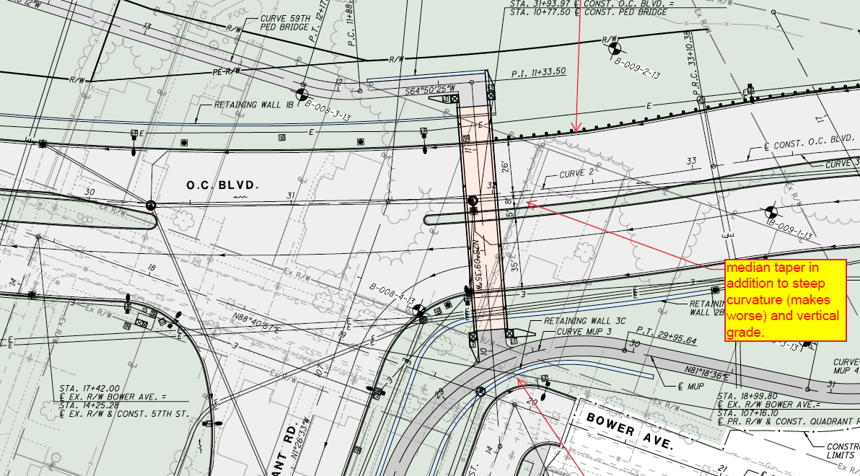
Case Study – Design Requirements
Notes:
Note that this is a new intersection on a new alignment which has no limiting external factors forcing the horizontal grades

Slide 21
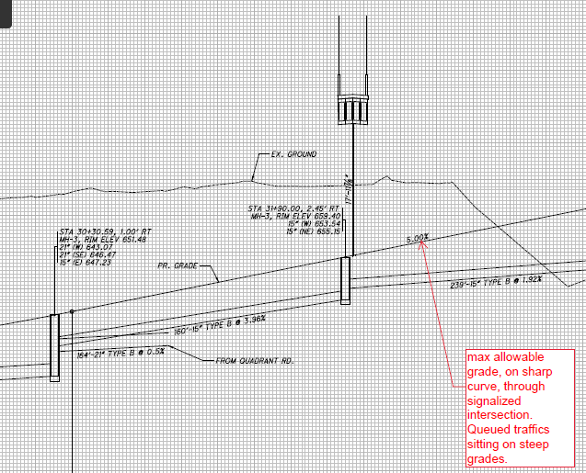
Case Study – Design Requirements
Notes:
Use this slide to describe what happened:
• Value Based DB project with a Proposal
• These two slides show the grades for the intersection provided.

Slide 22
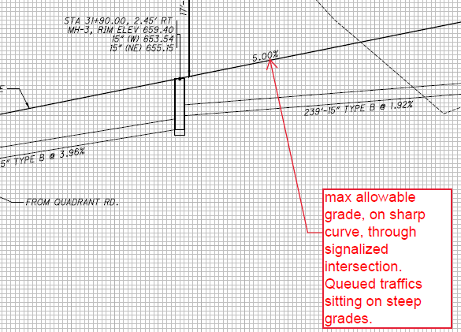
Case Study – Design Requirements
ODOT L&D: 401.1: “It is also recommended that intersections be located where the grade on the mainline roadway is 6 percent or less, with 3 percent being the desirable maximum.”
Notes:
-

Slide 23
Case Study – Design Requirements
ODOT Comment:
  “OC mainline is placed at 5% grade through intersection at Quadrant Roadway. While grade is allowable per scope, it is not appropriate at an intersection, especially at the first intersection off the freeway where truck % is the greatest. Also, not appropriate if placed in conjunction with sharp horizontal curvature.”
  “Interpret all references to guidelines, recommendations and considerations within applicable design manuals as minimum requirements except when specifically excluded within the Scope of Services”
  “recommended that intersections be located where the grade on the mainline roadway is 6 percent or less, with 3 percent being the desirable maximum”
Contractor Response:
  “The proposed grade is acceptable per the Scope Requirements of Article 1.5 F, “Basic Configuration” which allows a maximum vertical alignment grade of 5%.”
Notes:
- The proposal was evaluated very low in this section.
- The minimums, unless specifically addressed, are to be followed.
- Grades were specifically addressed, and not qualified by location, so reasonable interpretation

Slide 24
Case Study – What Happened?
The Department agreed to initiate a change order to get the slope to the desired max grade of 3% as the Basic Configuration stated a maximum grade of 5% could be used and did not qualify a location.
The required language for grades through intersections can not by separated from the dictated maximum grade for the project – reasonable interpretation.
Ensure specific language does not conflict with specific desirable design outcomes
Ambiguity (in scope) is construed against the drafter (did not go to claim).

Slide 25
Project Design Administration Summary
Carefully review plans to ensure that details don’t conflict with project requirements or relevant design standards
Don’t rely on design review process to further refine requirements
  Ownership and details of design rest with DBT
  Ownership of scope rests with ODOT
Work with DBT to:
  Collaboratively manage ODOT review and comments to maintain schedule
  Assist with coordination of 3rd party reviews
Notes:
Summarize key take-aways:
• Careful coordination of scope with design standards
• Design details are DBT responsibility
• Collaboratively manage reviews and comments (both internal and 3rd party external)

Slide 26
Questions
Notes:
Ask if there are any questions regarding the material just discussed.

Slide 27
Construction Administration
Notes:
Note that in this portion of the course, you will introduce key DB construction administration topics including quality management, roles and responsibilities, payment, changes, utility coordination, and final acceptance.

Slide 28
What’s Different?
Element | DBB | DB
Communication/ Decision-making | Design and construction are separated. Communication and decisions flow through ODOT | Design and construction are integrated (and in some cases co-located). Communication and decisions flow directly between design and construction with ODOT concurrence
Quality Management | ODOT primarily responsible for quality management Inspection QA verification and acceptance testing IA | DBT has heightened responsibility for quality management including design ODOT performs inspection, QA and IA testing for Low Bid DB IQF used for Value-Based, with ODOT providing QA oversight and IA
Payment | Periodic payments made for unit-priced items based on calculation of detailed quantities of work | Partial payments made based primarily on percent complete of lump sum items
Changes | ODOT retains the risk of variations in actual quantities, accuracy and completeness of the plans, and unforeseen conditions or utility coordination | DBT assumes the risk of quantity variations for lump sum items, accuracy and completeness of the plans, or other responsibilities as defined in the DB contract.
Notes:
Ask participants:
• Who has experience on administration of a DB project during construction?
• Can you offer one key difference between construction administration for a traditional DBB project and a DB project?
Explain the differences (and similarities) for topics noted on the slide (i.e. communication and decision-making, quality management, payment, and changes).
• Communication/Decision-making: Because design and construction are on same team for DB, ODOT no longer serves as the go between for communication and decision-making. Decisions must be made collaboratively to support the DB project schedule
• Quality management: For DBB, ODOT has primary responsibility for quality. For DB, quality management is heightened (Low Bid) or shifts to the DBT (Value-based)
• Payment: For DBB, payments are made based on detailed quantity calculations for standard unit priced bid items. For DB, payments are based on percent complete of standard DB lump sum items
• Changes: For DBB, ODOT retains the risk of quantity variations, completeness and accuracy of the design, and unforeseen conditions. For DBB, the DBT assumes the risk of quantities for lump sum items, and accuracy and completeness of plans.
Add to these topics as participants share experiences. Additional differences may include:
• Start of construction before completion of design
• Expedited pace of construction
• Inspection without a complete set of plans and specifications
• Tracking and management of field changes during construction
• Verifying materials quantities for lump sum items
• ODOT oversight of IQF (for value-based DB)

Slide 29
Pre-Construction
Pre-construction Meeting
  Communication and coordination
  Roadmap and rules for conduct of construction
  Identification of potential risks or changes
Agreement on breakdown of pay items and estimating progress
  Progress schedule
  Payment of materials
Concurrence on Release-for Construction Plans
ODOT PE
PM for Construct
IQF
(Value-based)
DBT Construct PM
DBT PM
Notes:
• Explain purpose of pre-construction meeting per ODOT CA MOP - it establishes lines of communication and coordination, lays out roadmap and rules for construction, and discuss issues or concerns.
- Pre-construction meeting addresses traditional requirements.
- It also reviews highlights of scope and potential high risk issues
• For DB, point out that there are differences in requirements for review and release for construction plans, quality management, payment, and changes. These are addressed in more detail in follow-on discussion
• Note that one of the important pre-construction items is concurrence on DB pay items and process for submitting monthly partial payment estimates. This includes:
- Review the itemized cost breakdown of items the DBT submitted as part of its bid (based on ODOT item master for lump sum DB) and assuring that breakdown reflects realistic costs of major elements of work that make- up the lump sum price.
- Establishing and tracking materials quantity estimates as a component of pay items.

Slide 30

Release for Construction
St.1 Preliminary
Plans
St. 2
Final
Plans
Release for Construction
  Final plan comments resolved
  QC check performed by DBT Design PM
  Plans signed and sealed by DoR
  Joint review meeting as necessary
  ODOT review for compliance with scope
  DBT release for construction
Construction plans = design commitment
  (Basis for purchasing decisions and construction planning)
DBT cannot proceed with construction at own risk
Construct Buildable
Unit 1
Notes:
Note the following:
• Design is integrated with construction. Several design steps are typically needed to achieve release–for–construction BUs. If needed, a collaborative review meeting is held where the DBT summarizes design submission and provides supporting documents to ODOT, and ODOT reviews for compliance with the scope.
• The Release-For-Construction plans represent the commitment by DBT and ODOT that project will be constructed in accordance with the final design.
• Question: Can the DBT proceed with construction without final approved plans? Ans. The DBT cannot proceed (at own risk) with construction without approved & QAed plans

Slide 31
Some Potential Issues to Consider
Basis of payment
Change management
Utility relocations impacting construction
Notes:
Note the following:
• Business as usual approach to ODOT plan reviews and construction inspection may not support construction schedule
• Payment – How does ODOT verify and document materials for payment?
• Changes – What constitutes a change and when is a change order required?
• Pricing
• 3rd party reviews and Utility coordination - Who has most influence and control?

Slide 32
Payment
Agreement on progress pay items for design and construction
  Easily discernable values for items of work (i.e. pavement, bridge, retaining walls)
  ODOT item master for DB items
  Building bill of materials for items of work w/ item codes
Large projects
  Fewer pay items
  Cost-loaded CPM (aligned & coded w/ items in schedule of values)
Small projects
  More pay items
Notes:
Ask the class the following:
• Why is it important to develop a schedule of progress pay items? (Ans. Schedule of pay items protects ODOT from paying too much, creates predictable cash flow, & more accurate estimates of percent complete.)
• Predominantly – Payments made on a percent complete of lump sum items. The Schedule of Values breaksdown the Lump Sum Items so we have a bases to determine percentage of the LS item.
• What are DBT responsibilities?
- Preparation of partial payment estimates based on % complete for each pay item (or activities in schedule)
- Certification of payment requests with supporting documentation
- Estimates of certain materials quantities for sampling frequencies
• What are ODOT responsibilities?
- Review for concurrence with earned value for each item, completeness of supporting documentation
- Verification of materials quantities for payment, and tracking quantities to build a bill of materials
Note the following:
• Large Projects: If too many items, schedule becomes unmanageable
• Small Projects: More pay items are easier to manage

Slide 33
Payment (cont’d)
Other considerations
  Payment of contingent items (difficult to quantify)
    Unit prices
    Price adjustments for fuel, asphalt, etc. (indexing)
  Acceptance and final payment
Notes:
Note the following:
• Pay items that are impractical to administer as a lump sum are unit priced. The DBT estimates unit prices and quantities for bidding
• ODOT retains the risk of fluctuations in fuel and asphalt prices with price adjustment indexing
Ask the class:
• What does DBT need to submit as a prerequisite for final payment for a DB project that is different from DBB project? (Ans. As-built drawings)

Slide 34
Changes
What circumstances or conditions would require a Change to DB contract?
Issue/Event | Answer
DBT change in the final design plans or specifications
Unexpected or changed field or subsurface conditions
Material Substitutions proposed by DBT
Design alternatives proposed by DBT field personnel
Changes to Environmental Documentation/Permits
Significant increases in quantities
Fuel price increases
Change in design standards
Non-standard concrete beam & shapes
Notes:
Instruct the participants to review the slide and ask them to identify (Y/N) what issues or events on a DB project would or would not justify a contract change order?
ISSUE/EVENT ANSWER
DBT change in the final design plans or specifications……………………. No
Unexpected or changed field or subsurface conditions Yes
Material Substitutions proposed by DBT……………………………………… No (if on approved list), Yes (if not on approved list
Design alternatives proposed by DBT field personnel No
Changes to Environmental Documentation/Permits………………………. Yes
Significant increases in quantities No
Fuel price increases…………………………………………………………………... Yes
Change in design standards Yes
Non-standard concrete beam & shapes………………………………………...Technically Yes, realistically No
An issue would be eligible for a change if it couldn’t be reasonably known during the design of the project
Review ODOT Section 104.02, Revisions to Scope of Work. Ask participants:
• Would these specifications apply to a DB project? (Ans. Yes, with qualification that the variation in quantities provision would not apply to the predominantly lump sum items. Also, for contingent unit-priced items, a significant change in quantities may not be eligible for a revision to the scope of work.)
• Per ODOT 104.02, the Standard DSC applies for DB projects. Pre-bid representations of site conditions are not nullified in DB (or any other contract type) by the DBT’s duty to conduct a site investigation. Some owners have the view that a DB contract transfers the risk for subsurface conditions to the DBT. This would only hold if the owner transfers the responsibility for pre-proposal site investigations to the prospective proposers and compensates proposers for these investigations. The recent Metcalf decision (Metcalf Construction v United States, 2012) re-affirmed the government’s responsibility for a differing site condition on a U.S. Navy DB project.

Slide 35
Managing Design Changes during Construction
DBT
  Identification of design preferences (v requirements) in design development
  Manage design changes and conflicts or errors
  Communicate issues to ODOT design PM
  Make plan revisions
  Assess impact to schedule
What is required from ODOT
  Not responsible for design changes, conflicts, or errors
  Work with DBT to assess and resolve to expedite approval
  Work should not proceed on major plan revisions without approval
Notes:
Emphasize the following:
• ODOT not the go between design and construction
• Don’t manage communications between the designer and builder
• Collaborate with DBT to expedite review and approval
• Work should not proceed on major plan revisions without approved plans
• Field changes must comply with the Scope

Slide 36
Change Order Pricing for DB
What is required from DBT
  Breakdown of labor, equipment, materials, and mark-ups for changed or extra work
  Same process specified in 109.05, Changes and Extra Work
What is required from ODOT
  Comparative pricing analysis based on similar work, statewide averages, and force account provisions (109.05.C)
  Standard process for negotiated prices followed by force account if no agreement
  Expedited COs
Notes:
Review ODOT Section 109.05, Payment for Changes and Extra Work with participants.
Ask participants the following:
• Would these specifications apply to a DB project? (Ans. Yes, with qualification that quantity estimates for negotiated pricing would be more difficult to assess for lump sum items. Force account provisions would apply for documenting and tracking quantities.)
Note that:
• If lump sum contract, pricing must still be justified
• Should give some consideration to risk in pricing
• Need timely processing

Slide 37
Utility Coordination
What is required from DBT
  Utility coordinator (larger projects)
  Utility plans identifying potential conflicts and utility relocation requirements and constructing relocations in accordance with approved final plans
  Coordination with utility owners in connection with project and required utility work
    In some cases, contractual responsibility or work for municipal utility relocations part of DBT scope
What is required from ODOT
  Providing all known utility information to DBT pre-sale
  Authorizing funds for utility relocations
  Proactively assisting DBT with utility coordination
  Post-sale utility meetings
Notes:
Use this slide to note the following:
• Utility coordination – Who has the most influence and control? Best to have utility relocation in project scope if DBT has most influence.
• DBT responsible for designing around utility conflicts or justify why relocation is needed.
Review ODOT Section 105.07, Cooperation with Utilities, and 109.05, Payment for Changes and Extra Work with participants.
Ask participants:
• What happens if utility owners fail to relocate or adjust utilities in accordance with the DB contract?
• Who is responsible & what recourse by ODOT or DBT?
- DBT must justify that they have tried to design around and mitigate impact.
- Only ODOT has responsibility to notify utilities to perform extra work
Emphasize the importance of early notification and coordination with utilities by ODOT and DBT team.
ODOT Utility Involvement Post sale - -Reference Locations & Good Practices
Attend all utility meetings post sale. (PN 126: 104.011 Design of the Project and Scope 12.2)
Authorize project funds for utility relocations eligible for reimbursement and issue permits to the utilities relocating facilities that require relocation within the Right of Way. (PN 126: 104.011 Design of the Project)
Determine eligibility of betterments or eligible costs if utility relocations are included in the project (Standard Scope of Service template -Section 12.2)
Keep record of all coordination correspondence between DBT and utilities (PN 126: 104.011 Design of the Project)
Assist in the coordination if utilities are non-responsive to DBT (Good practice as Per PN 126 -105.07 -A. The Engineer shall be satisfied that the Contractor has made every effort to prosecute the design and construction work despite any delays encountered or revisions in the Contractor's scheduling of work. B. If performance of the Contractor's work is delayed because the utility owners fail to relocate or adjust their facilities as previously agreed, the contract time will be adjusted in accordance with the provisions of 108.06.)
DB Team Responsibilities
• Stake the existing ROW in the field and perform clearing and grubbing within that ROW, in order to allow utility relocation and reduce potential delays. (Scope 12.2)
• Be cognizant of the project's impact on utility facilities. In the event utility relocations are required, do not preclude legal occupancy of the highway ROW by the relocated utility facilities. (Scope 12.2)
• Coordinate all existing utilities with construction activities. Ensure that potential delays in coordination and relocation of the affected utilities are minimized. (Scope 12.2)
• Hold a meeting at or near preliminary review between the DBT, the District Utility Coordinator and the utility owners to determine if any significant utility relocations can be eliminated or mitigated. (Scope 12.2)
• Perform SUE required for utility relocations at Department's option. (Scope 12.3)
• Coordinate all design for relocation or accommodation of any utilities within the project (PN126 -104.011 Design of the Project)
• Determine and show on the plans the names of all existing utilities within project limits. (PN126 -104.011 Design of the Project)
• Identify and resolve utility conflicts and reflect the resolutions and decisions accepted on the plans and details. (PN126 -104.011 Design of the Project)
• Call any utility meetings needed to ensure that the concerns are addressed on the plans involving utilities. (PN126 -104.011 Design of the Project)
• Notify the Project Engineer at least two working days in advance of any utility meeting. (PN126 -104.011 Design of the Project)
• Take responsibility for working with the individual utilities to ensure that all utility concerns are addressed and that any required utility relocation plans, estimates and support material are developed and copies are provided to the district utility office. (PN126 -104.011 Design of the Project)
• Keep the district utility office aware of all utility coordination information. (PN126 -104.011 Design of the Project)
• Design for and perform any relocation of utilities as required in the Scope of Services.

Slide 38
Final Acceptance
What is required from DBT
  Substantial completion requirements similar to DBB
    Materials certifications, certified payrolls, force account records
  Resolution of punchlist
  As-built plans
What is required from ODOT
  Punchlist items
  Final inspection
  Final bill of materials
Notes:
Note the following:
• Final acceptance requirements are the same for DBB
• Main difference is DBT requirement to provide final as-built plans
• Final bill of materials

Slide 39
Questions
Notes:
N/A

Slide 40
Questions
Q. During ODOT design reviews, a reviewer notices that a concrete quantity calculation is incorrect. Is this an issue and how do you handle?
A. ODOT is not responsible for errors and omissions in the design. Obvious errors or conflicts should be noted in review comments. The DBT has the responsibility to address and resolve.

Slide 41
Questions
Q. If the DBT requests to proceed with construction work prior to the Release-for-Construction plans, can the contractor proceed at its own risk?
A. No. Some DB contracts allow the DBT to proceed with early construction before completion of final construction plans at its own risk with the understanding that DBT is responsible for any changes necessary to comply with final plans. ODOT does not allow construction to proceed without release-for-Construction plans.

Slide 42
Questions
Q. If a bid item for payment has a lump sum amount of $40,000, and if the DBT later requests $100,000 as complete payment for that item as the work was revised by the Designer after award, is the DBT entitled to additional compensation?
A. No. The DBT retains the market risk for the lump sum price and any changes. The only adjustments allowed for actual costs are for justified scope changes, contingent unit-priced items, or indexed adjustments for fuel or specified materials.

Slide 43
Questions
Q. If the soils report identifies rock at 10 feet below grade (by interpolation) at a specified location on the approved plans for a pile foundation, and the DBT encounters boulders or materials classified as rock at 6 feet below grade at the specified location, is the DBT entitled to a change order and additional compensation?
A. Qualified Yes. The DBT would be required to immediately notify ODOT, and assess whether design revisions can mitigate the cost and time impacts before proceeding further with construction. The DBT would submit a request for a change in accordance with Section 104.02 for Differing Site Conditions.

Slide 44
Questions
Q. If during the placement of a concrete deck, the ODOT inspector finds that the DBT’s subcontractor is excessively vibrating the concrete and causing segregation, and not providing adequate protection after screeding. Given the DBT responsibility for design and construction quality, what steps should the inspector take if any?
A. The ODOT inspector should do the following:
  Stop the work
  Immediately contact the ODOT engineer, brief them, and document the issue
  Notify the DBT PM to correct the issues with concrete placement
  Maintain communication with the DBT until the issue is corrected before continuing with the work

Slide 45
Questions
Q. If RFC drawings have been issued and DBT is forming up an abutment, to make it easier to build, the DBT changes dimensions of the footer and the reinforcing layout. What is the inspectors responsibility?
A. The ODOT inspector should do the following::
  Stop work (the work is not in conformance with the RFC plans)
  Contact the ODOT engineer, brief them on the issue, and document
  ODOT engineer will advise DBT design manager to assess the impact, document the changes, and revise the plans
  Maintain communication with the DBT until revised plans are released before continuing with the work

Slide 46
Course Recap – What Did We Cover?
Part 1 – Introduction to DB
  Background
  Advantages and Limitations
  Project Selection
Part 2 – Project Development/Scoping
  DB Decision Process
  DB Project Development
  Scope Development
Part 3 - Procurement
  Procurement Process
  Procurement Considerations
  Contract Considerations
Part 4 – Contract Administration
  Execution Overview
  Design Contract Administration
  Construction Contract Administration
Notes:
Quickly review what was discussed in each of the sections.

Slide 47
Thank You for Participating!!
Any Final Questions or Comments
Post-Test
Notes:
Administer the post-test, noting that participants may consult their notes but not each other.

