Slide 1
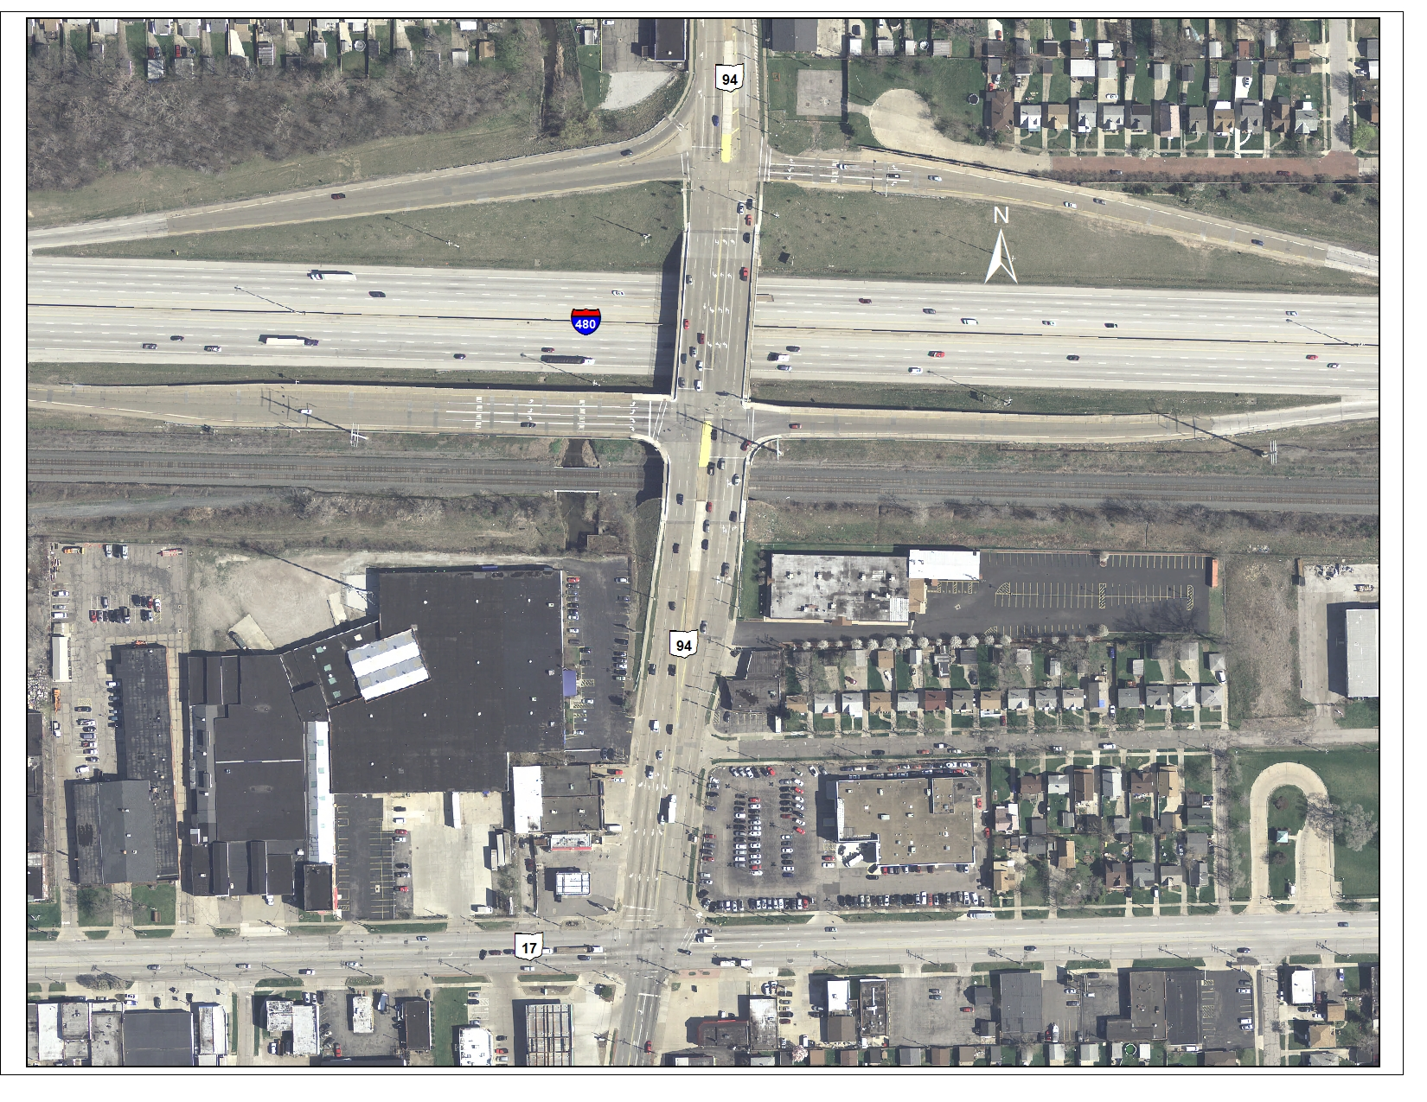
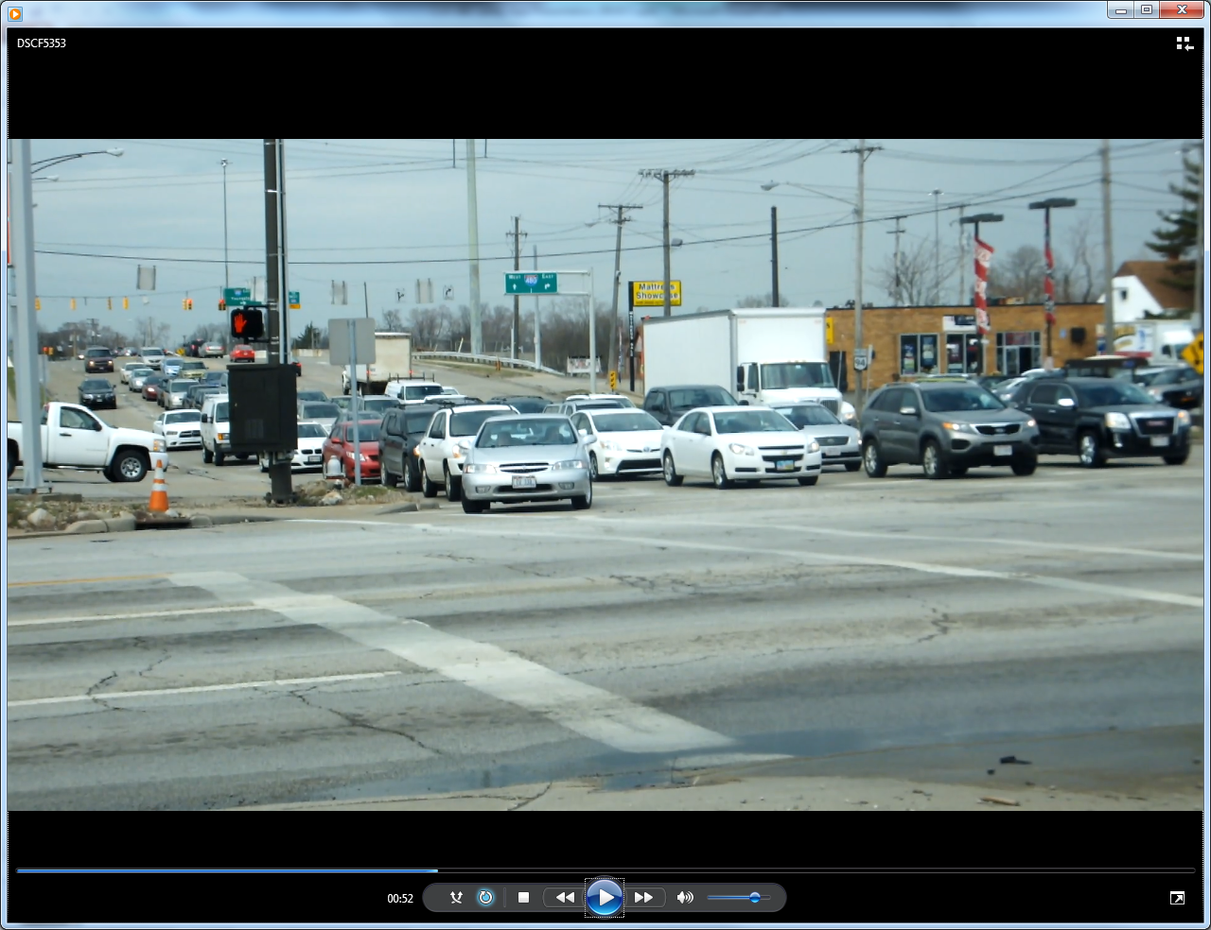
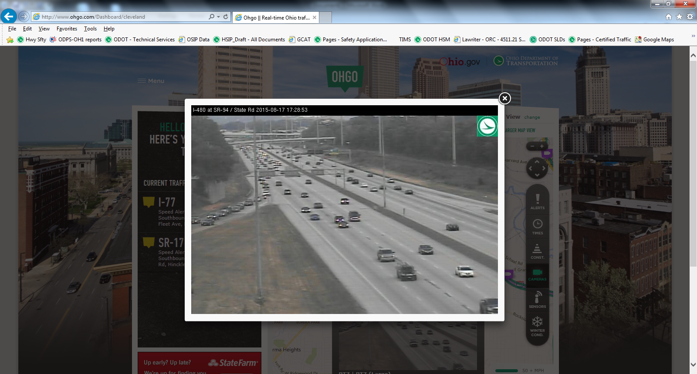
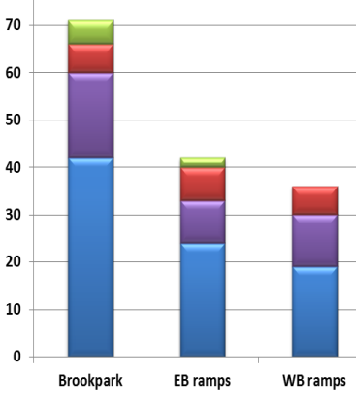
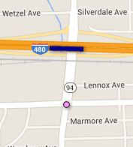
Brookpark
CUY-17/94/480-10.78/10.05/13.04
Safety Funding Application
ODOT District 12

Slide 2
Introductions
Brian Blayney, ODOT District 12
Kevin Miller, LJB
Scott Knebel, CMT

Slide 3
Purpose and Need
Increase capacity of the critical intersection (Brookpark Road)
Reduce queues on the WB exit ramp that extend onto mainline I-480 and through adjacent intersections on State Road
Improve lane continuity to reduce unnecessary lane changes

Slide 4
Area Map
← WB Exit
350’
I-480
EB Exit →
Urban Fwy Rank:
-2010 – 83
-2012 – 64
-2013 – 67
SR 176
Recurring congestion
during PM peak hour
750’
SR 94 (State Rd)
1.6 miles
I-480
Urban Int Rank:
-2010 – 35
-2012 – 99
-2013 – 87
SR 94
SR 17 (Brookpark Rd)
Notes:
Closely spaced intersections on State Road from I-480 ramps to Brookpark Road intersection
Safety Analyst Ranking:
I-480 – Year 2012 (64), Year 2013 (67)
SR 94 and Brookpark intersection – Year 2010 (35), Year 2013 (87)

Slide 5
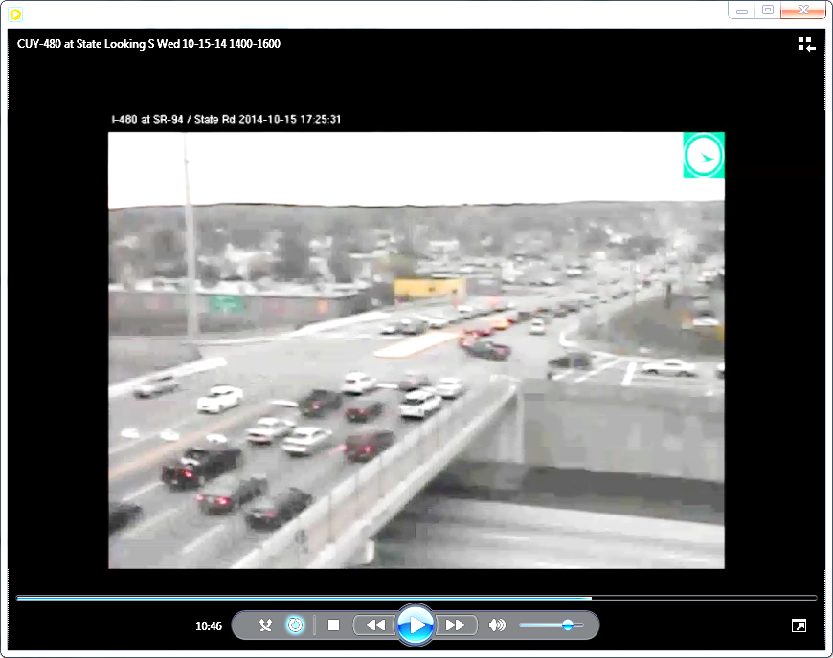
Existing Conditions, PM Peak
1
I-480 WB Exit Ramp Queue Spillback
2
EB Exit Ramp Blocked by SR 94 SB Queues from Brookpark
SR 94 SB Queues at Brookpark Extending to EB Ramp Intersection
3
(1) At I-480 WB Exit Looking East (2) At EB Exit Looking South (3) At Brookpark Looking North
Notes:
Queues extend from the Brookpark intersection during AM and PM peak periods
Closely spaced ramp intersections cannot provide sufficient storage for turning movements to/from I-480
Queues on I-480 WB exit ramp to State Road extend to mainline I-480 during PM peak

Slide 6
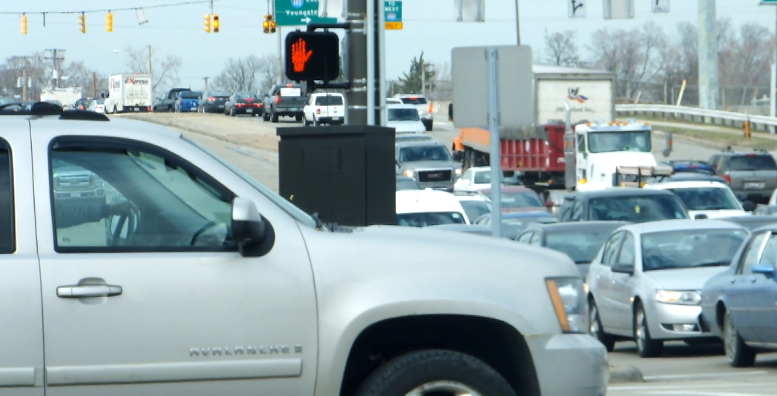
Existing Conditions
2
1
Unmet demand, NB inner through lane at the end of green
Residual queue at the end of green

Slide 7
Crash Summary
201 total crashes (2011-2013)
  61 injury accidents (30% vs 25% average)
  99 rear end crashes (49% vs 31% average)
  48% of crashes occur during AM and PM peaks
location | TOTAL | REAR END (30.9%) | ANGLE / LT (20.8%) | FIXED OBJECT (14.6%) | SIDESWIPE PASSING (8.7%) | TOD (6-9AM) | TOD (3-6PM) | ODOT RSI
SR 94/ Brookpark | 76 | 42 (55.3%) | 18 (23.7%) | 5 (6.6%) | 6 (7.9%) | 19.7% | 32.9% | 22,820
SR94/I-480 EB Ramps | 43 | 24 (55.8%) | 9 (20.9%) | 2 (4.7%) | 7 (16.3%) | 18.6% | 18.6% | 20,795
SR94/IR-480 WB Ramps | 36 | 19 (52.8%) | 11 (30.6%) |  | 6 (16.6%) | 8.3% | 27.8% | 22,356
Notes:
189 crashes on State Road and its intersections from Brookpark to Ralph/Burger
An additional 12 crashes on I-480 WB mainline near the State Road exit ramp/gore area during weekday PM peak hour conditions

Slide 8
Countermeasures
Add WB right turn lane on Brookpark Road at State Road (350’)
Extend storage lengths on the I-480 WB Exit ramp (600’) (L-L-R)
Revise interchange phasing to operate Buckeye diamond sequence
Revise lane configuration on NB approach at the I-480 EB ramp from T(L)-T-TR-R configuration to a T(L)-T(L)-T-R configuration
Notes:
Adding WB right turn lane increases intersection capacity
WB exit turn lane extension mitigates ramp queues/crashes
NB lane mitigates lane imbalance
70% of approach volumes destine to WB ramp
Only single right turn onto EB entrance ramp is possible
Lane-use sign upgrades

Slide 9
Countermeasures
Revise lane configuration on SB approach at the I-480 WB ramp from T-T-TR configuration to a T(L)-T-T-R configuration
Restripe auxiliary turn lanes on State Road at Wetzel/ Springdale
**No pavement widening needed on State Road!
Notes:
5) Channelize SB inside lane mitigates left turn crashes at WB ramp intersection
Improvements on State Road assume overlay on existing pavement without widening.

Slide 10
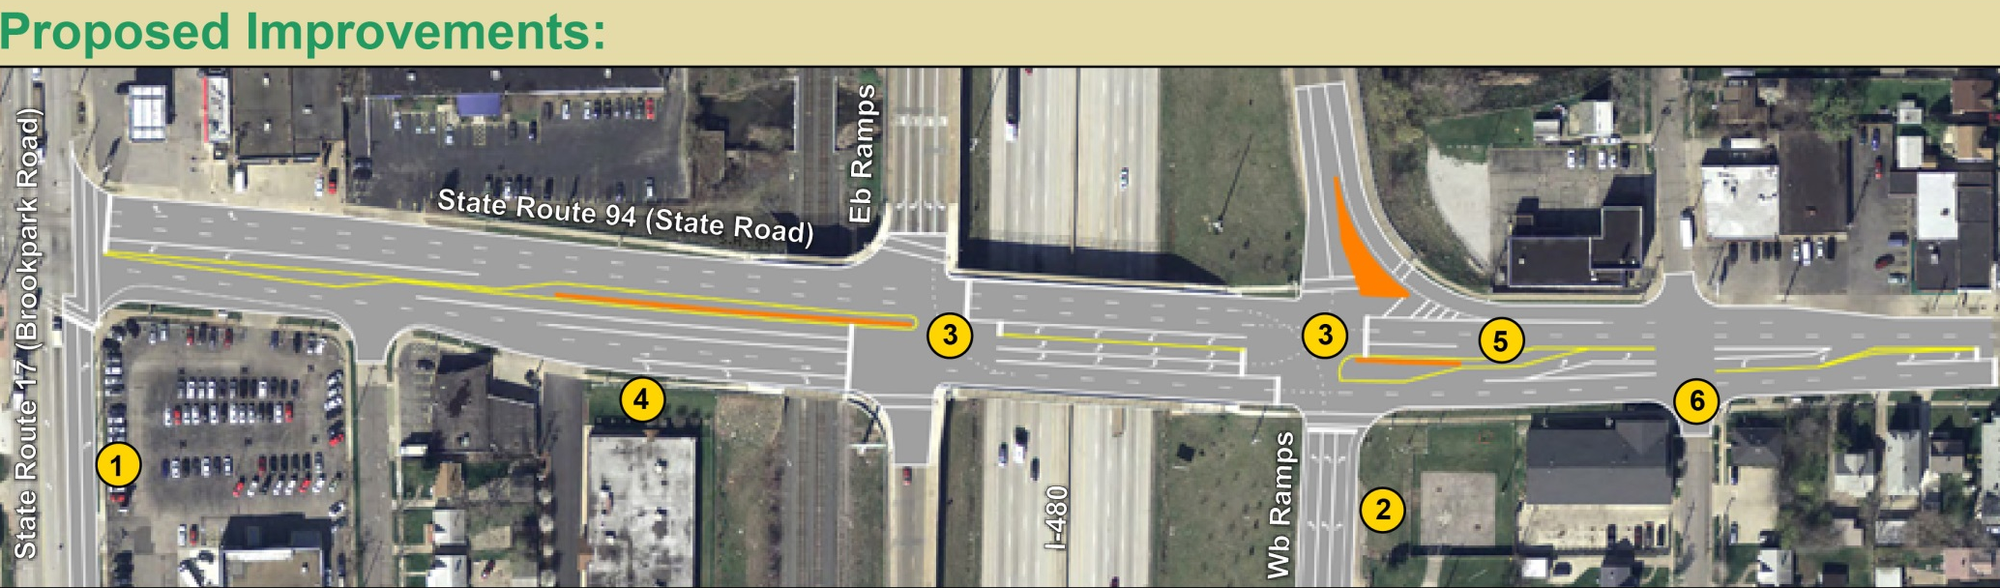
Proposed Improvements
SR 94 (State Road)
N
Notes:
Add a WB right turn lane at Brookpark/State Rd intersection (Additional ROW required)
(-) Restripe NB receiving lanes on State Road from the Brookpark intersection from 3 lanes to a 2-lane section for better channelization.
(3) Revise NB approach at EB ramps intersection from the existing T(L)-T-TR-R configuration to a T(L)-T(L)-T-R configuration. The T(L) lane designation represents the back of the NB-to-WB left turn slots, south of the EB exit ramp intersection. Expand throat width on inside of NB double left to I-480 WB.
(5) Revise the SB approach at the WB ramps intersection from the existing T-T-TR to a T(L)-T-T-R configuration. The T(L) lane designation represents the back of the SB-to-EB left turn slot, north of the WB exit ramp intersection.
(6) Form left turn lanes on State Road between WB ramps and Ralph/Burger Avenue within existing pavement width.
NOTE: Improvements on State Road can be accommodated within existing pavement.

Slide 11
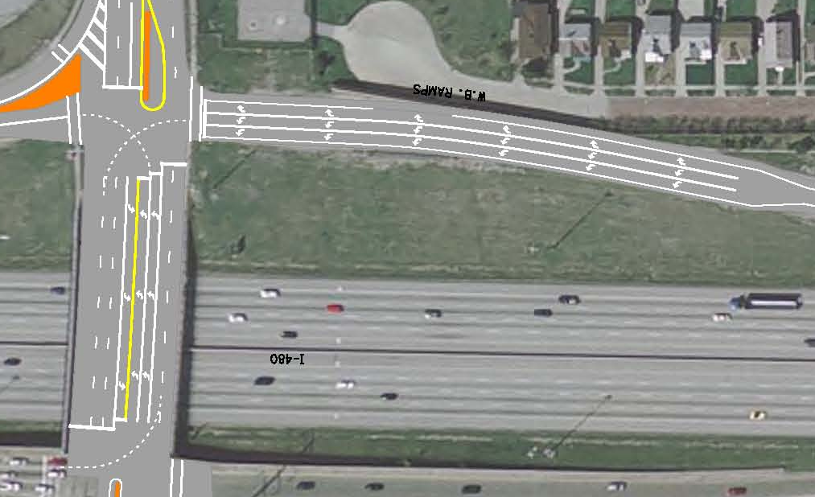
Proposed Improvement Plan
I-480 WB ramp
N
WB Ramp
600’
SR 94
I-480
Notes:
Widen WB exit ramp turn lanes from 200’ to 600’

Slide 12
Program Management
Minor signal upgrades to improve turn lane detection and signal head visibility installed 2014
Targeted improvements to reduce queuing on WB exit
Long-term need for dual SB left turn lanes deferred; too costly, produces diminishing returns

Slide 13
Funding Summary
$97,400 safety study completed
$350,000 for Environmental/PE and Detailed design
$133,000 Right of Way
$2.26M Construction Cost
  30% design risk
  8.5% inflation cost
$2.83M Total Safety Funding Request
Notes:
Interchange Operations Study (IOS) Required

Slide 14
Scoring
Benefit cost ratio = 1.23
Existing volume to capacity ratio >1.0 with demand volumes factored into analyses
Percent PSI to Total Expected Crashes = 8%
Annual Crash reduction = 5.7 crashes

Slide 15
Summary
Safety Project
  Mitigates safety hot spot (#35 in 2010)
  Reduces queues on WB exit and through adjacent intersections on State Rd
  Reduces weaving in congested corridor
RW impacts minimized at Brookpark Road

