Slide 1
GEA 422-11.56 (Rapids) Safety application
Safety Funding Application
September 21, 2022

Slide 2
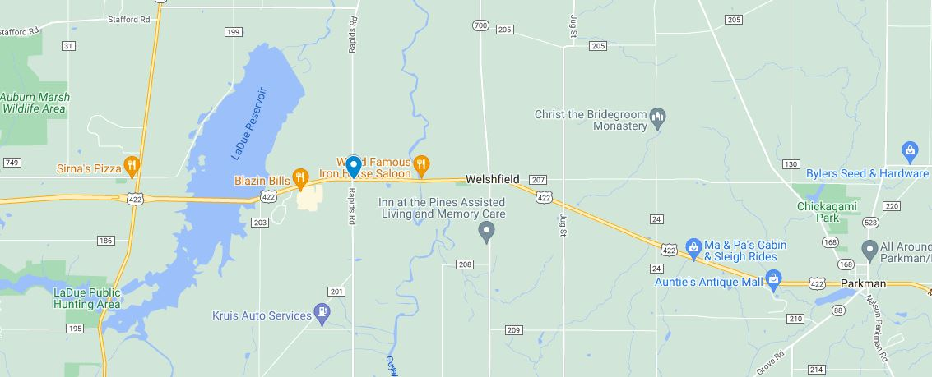
Project Location & Purpose
GEA 422-11.56
Signalized Intersection of U.S. 422 and Rapids Road
Purpose: Mitigate rear-end crashes on U.S. 422

Slide 3
History
2014
2017
2022
GEA-422-10.8/13.3 Study
GEA-422-11.1/11.5 Abb. Safety
GEA-422 Toast Study
#60 among rural intersections
Rear-end & Angle Crashes
Failing LOS on Rapids Road
#82 in 2017
Rear-end Crashes
Opportunity for improvement in:
Safety
Incident Clearance
Volume per Lane
Travel Times
Convert to Signal
Add Left Turn Lanes on U.S. 422
Add Left Turn Lanes on U.S. 422

Slide 4
History
2014 GEA-422-10.93/13.31 Corridor Study
Ranked #60 on ODOT’s safety priority list for rural intersections
Issues: Rear-end and angle crashes, failing LOS on Rapids Road
Recommendation: Convert the intersection to a traffic signal
2017 GEA-422 (11.1-11.5) Abb. Safety Study
Ranked #67 in 2014, #17 in 2015, and #82 in 2016 for rural int.
Recommendation: add backplates and left turn lanes on U.S. 422
2022 GEA-422 TOAST Study
TOAST scores documented opportunities for improvement
Safety, Incident clearance, Volume per lane, Travel times
Recommendation: Add left turn lanes on U.S. 422

Slide 5
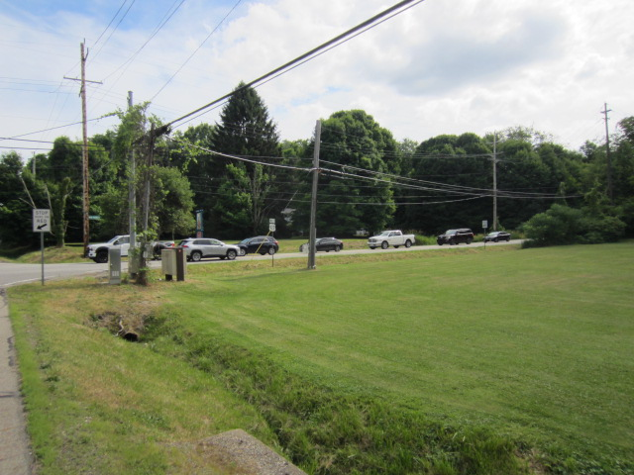
Existing Conditions
Four leg signalized intersection
Single lane approaches
P.M. Peak Hour – EB 900 vehicles
8% turning left
300-foot-long queues
Significant Truck %
10% Eastbound
12% Westbound
Eastbound Queue

Slide 6
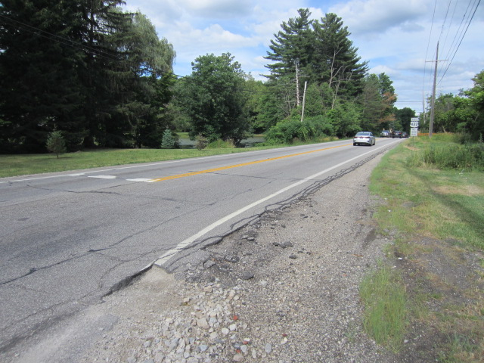
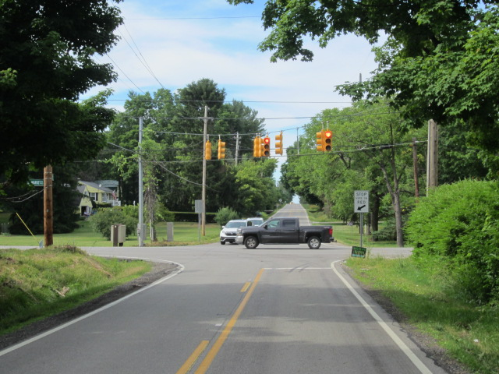
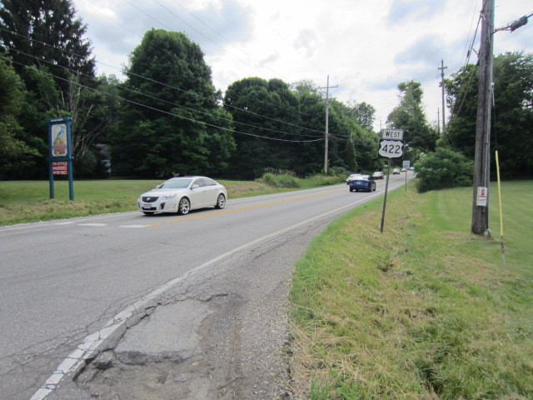
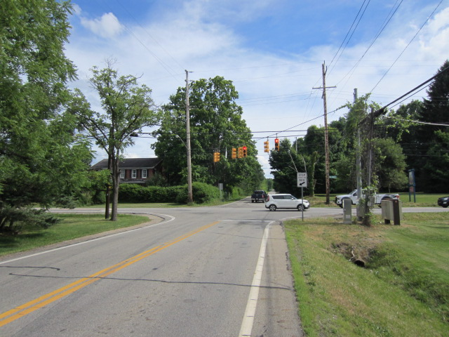
Existing Conditions
Looking East
Looking North
Looking West
Looking South

Slide 7
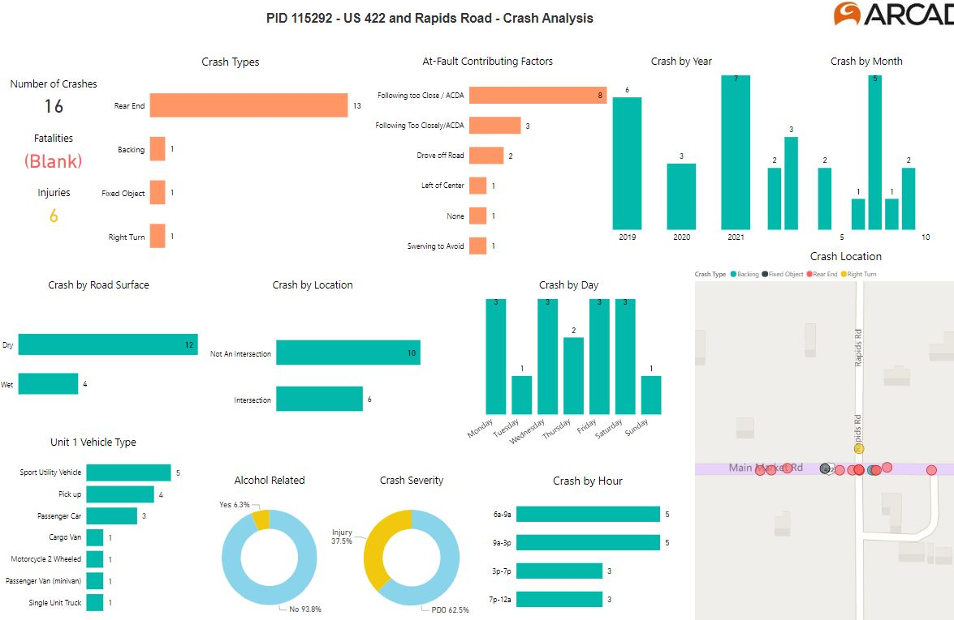
Crash Summary
16 Crashes & 6 Injuries (2019 to 2021)
13 Rear-End Crashes & All 6 Injuries
All Rear-End Crashes were on US 422

Slide 8
Recommended Countermeasures
Add Left Turn Lanes on US 422
Provides storage for left turn vehicles waiting to turn left during a red signal phase potentially reducing queue lengths
Provides storage for left turn vehicles to avoid blocking the through lane during a green signal phase
Rebuild Traffic Signals on Mast Arms with Far-Side Head Placement and Backplates

Slide 9
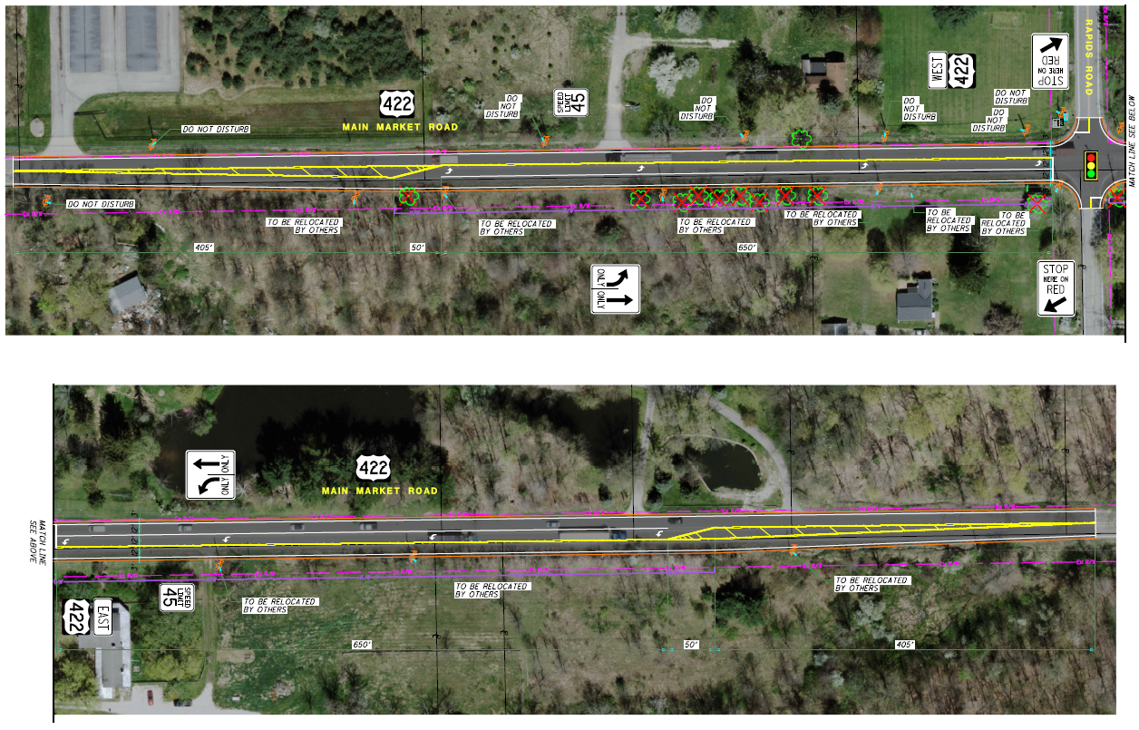
Concept plan

Slide 10
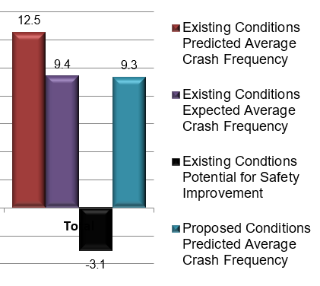
FUNDING AND SCHEDULE
Safety Benefits
Net Value of Safety Benefits: $767,000
BC Ratio on Total Cost: 0.98
Expected Annual Crash Reduction: 3.2 Crashes
Project Phase: | Safety Study | PE - Enviro | PE - Design | RW/ Utilities | Construction | Total
Fiscal Year | 2023 | 2024 | 2025 | 2026 | 2027
Previous Safety |  |  |  |  |  | $0
New Safety |  | $80,000 | $90,000 | $100,000 | $902,016 | $1,172,016
Sponsor Funding | $30,000 |  |  |  |  | $30,000
Totals: | $30,000 | $80,000 | $90,000 | $100,000 | $902,016 | $1,202,016

Slide 11
Questions
?

