Slide 1
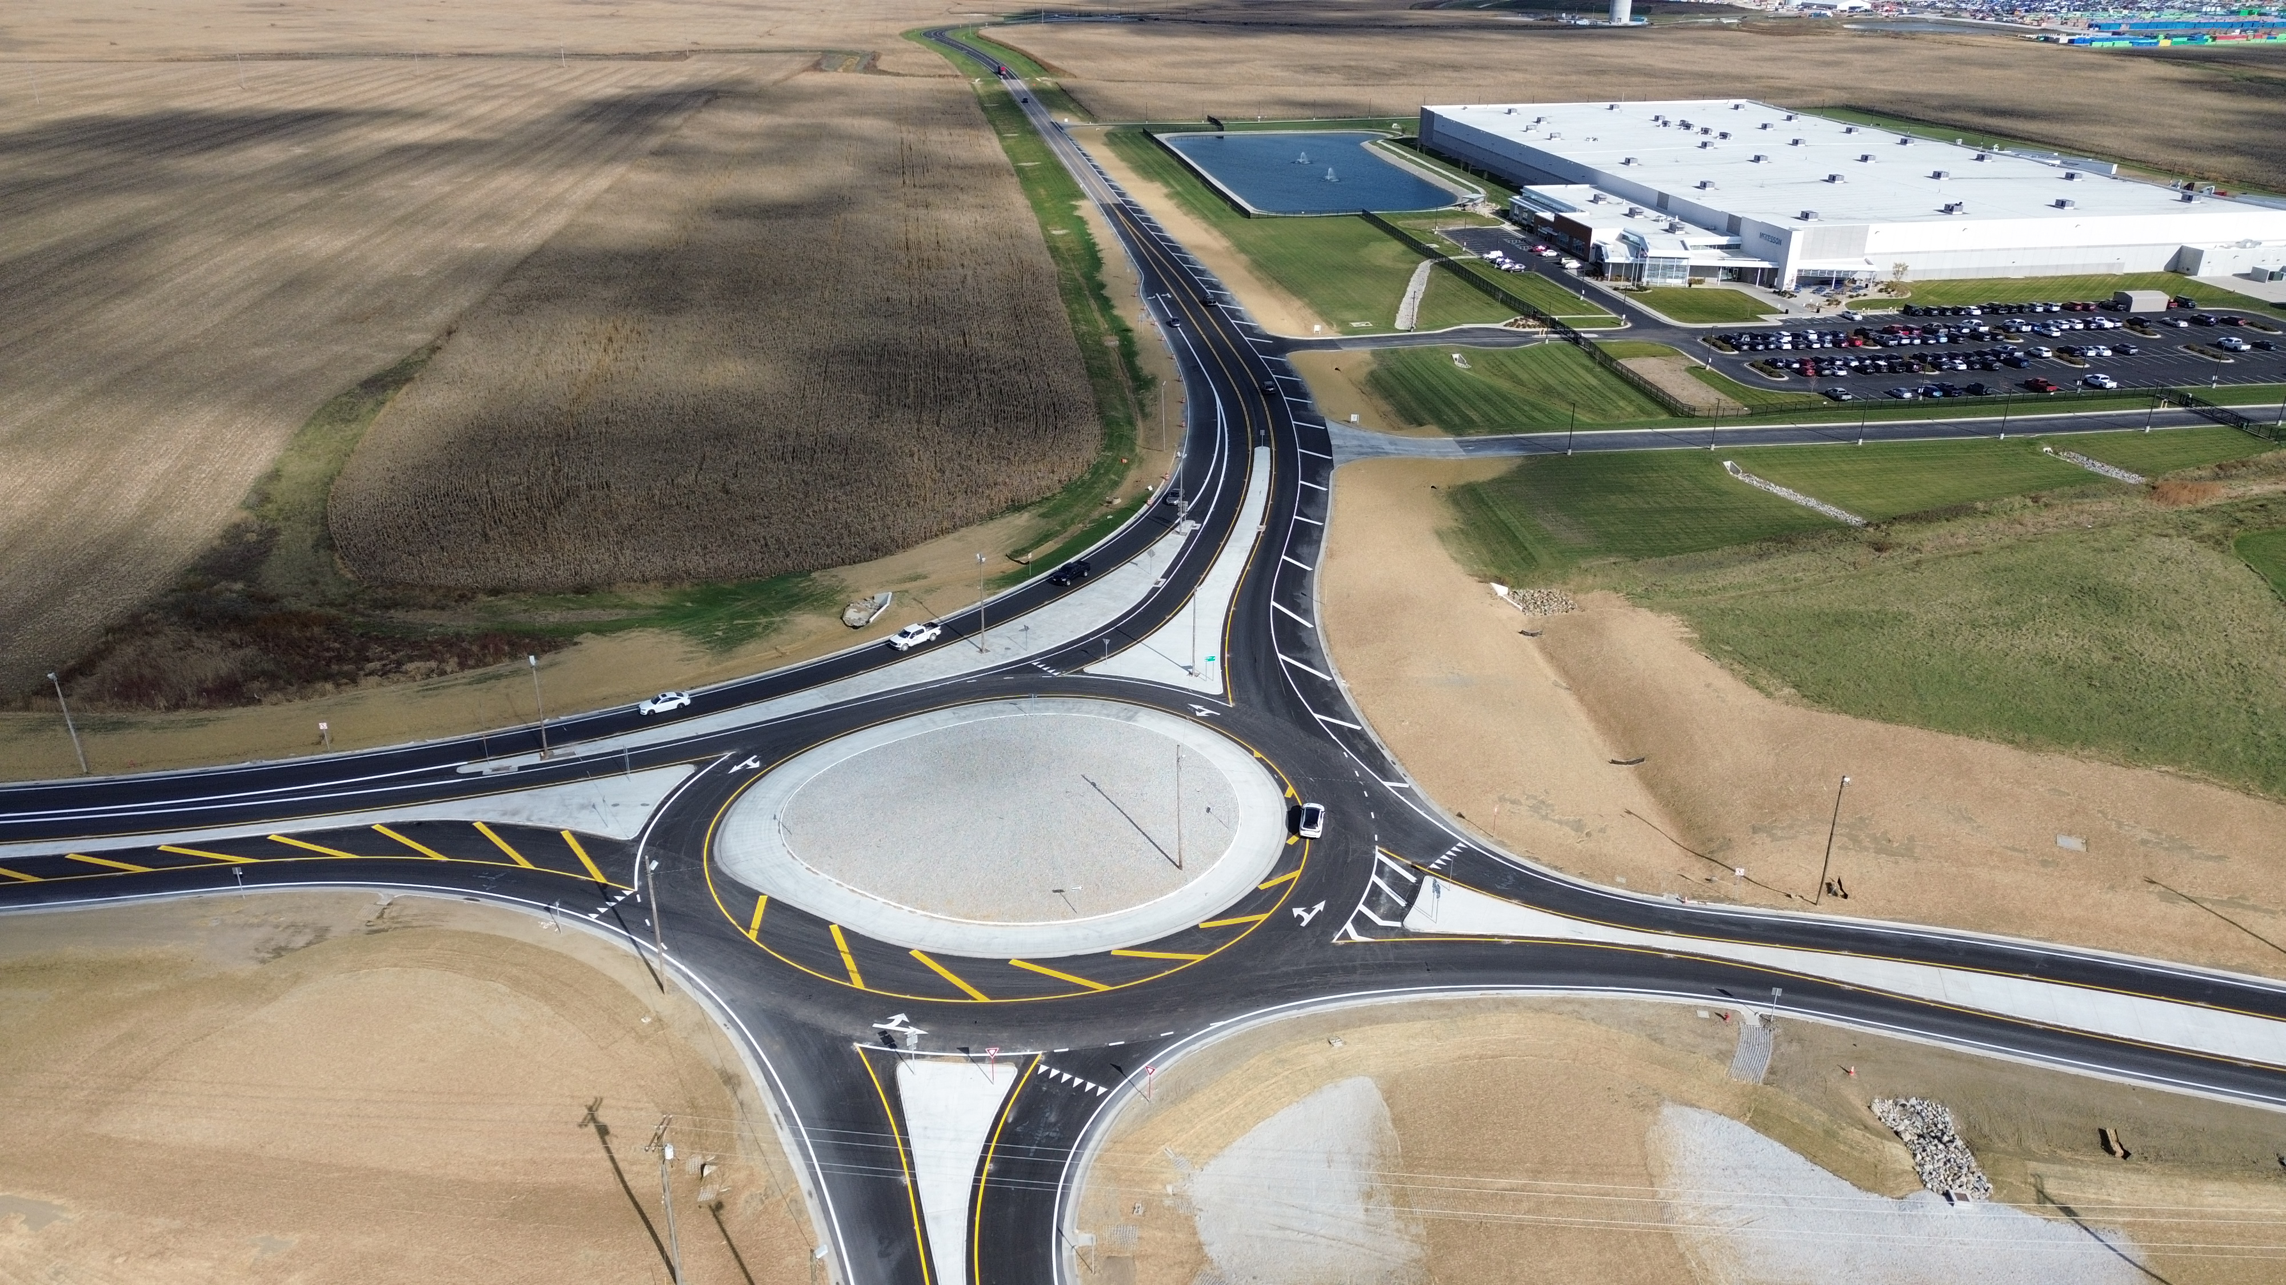
23-3008, PID 117955, FAY-435-1.52
Dispute No. 06-233008-02
Step 2
Ramp D Pavement Performance Review
Notes:
Introduce purpose and panel acknowledgement.

Slide 2
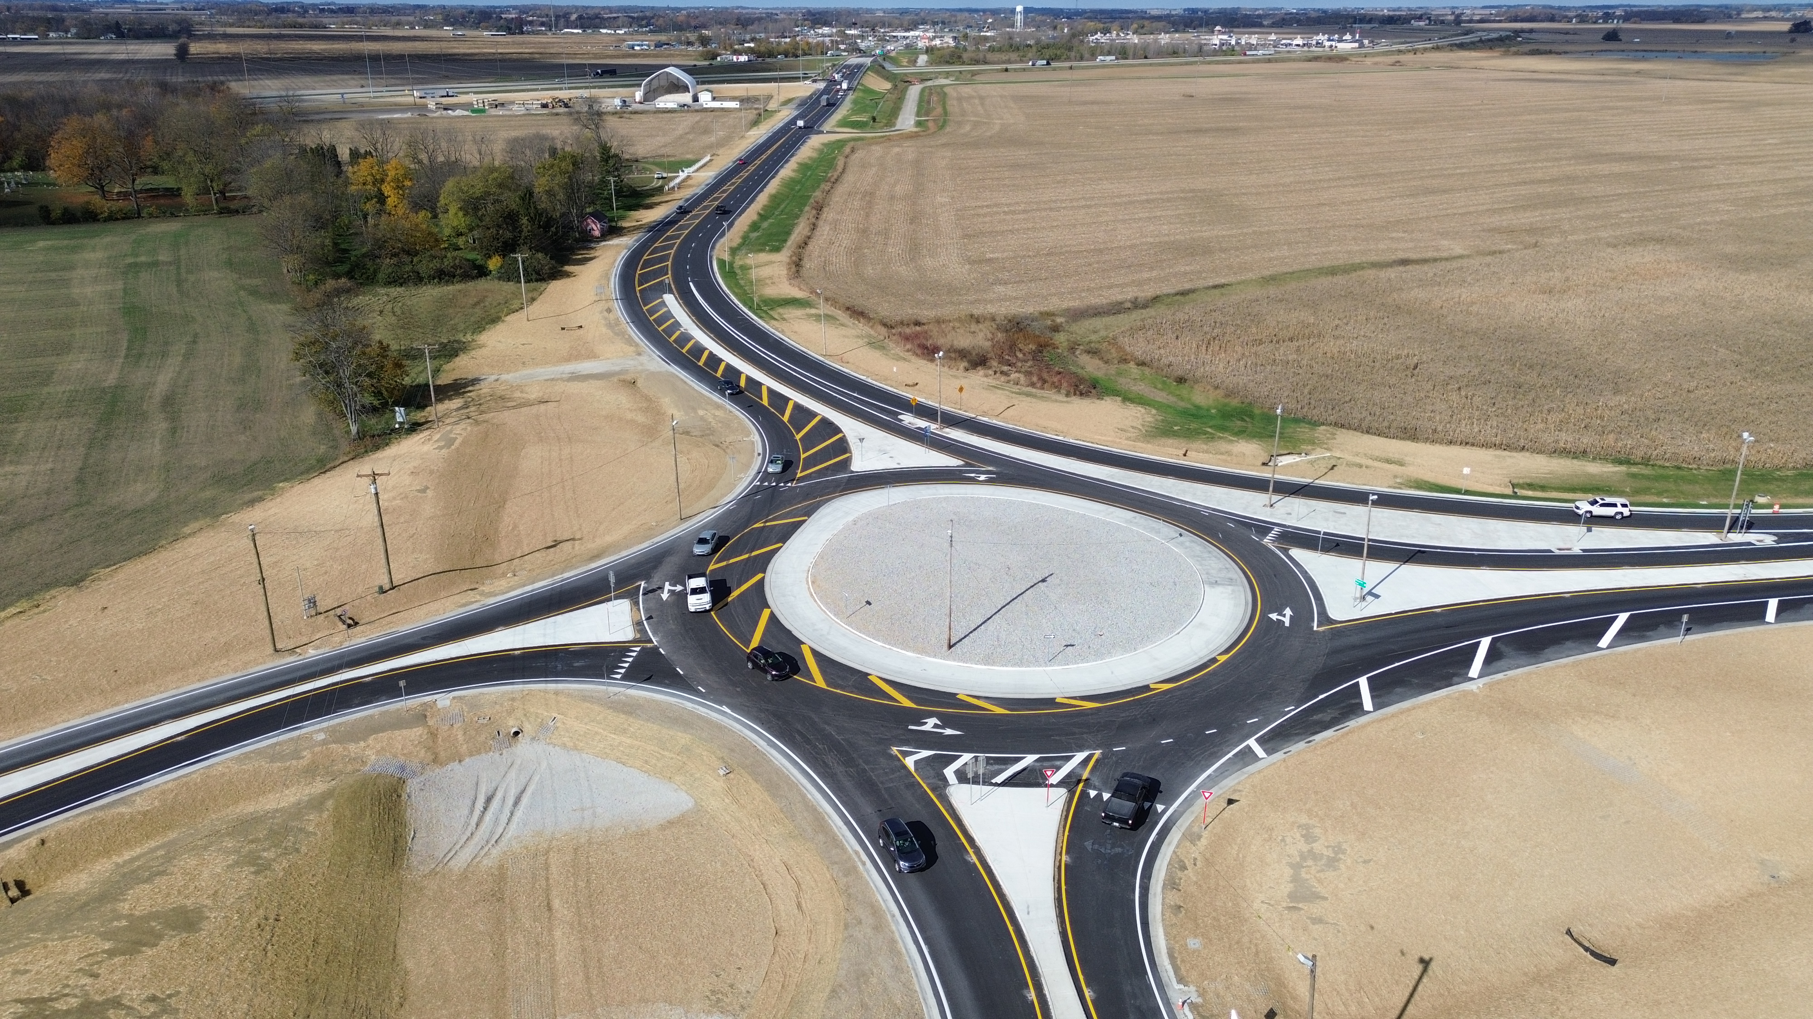
23-3008, PID 117955, FAY-435-1.52
Dispute No. 06-233008-02
Step 2
Ramp D Pavement Performance Review
Notes:
Introduce purpose and panel acknowledgement.

Slide 3
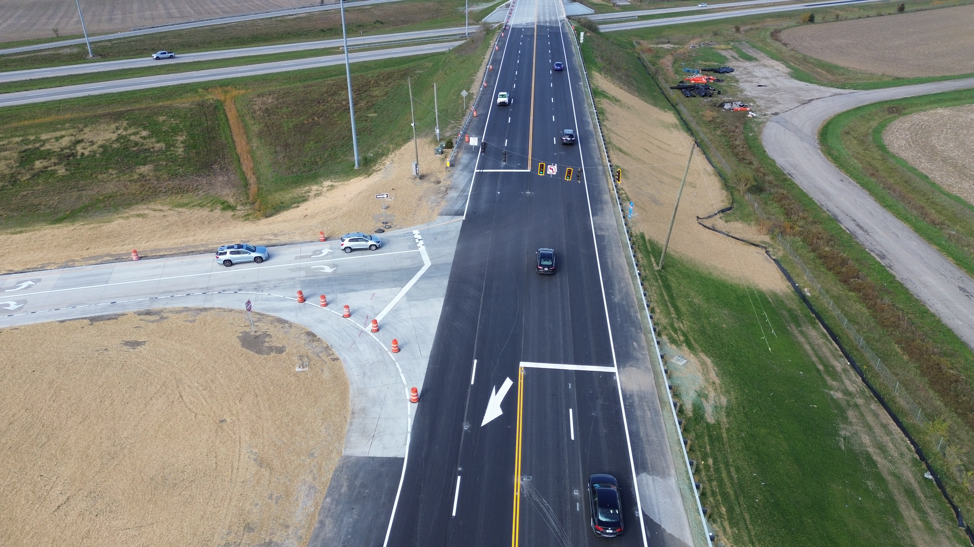
Purpose
Evaluate Ramp D cracking
Confirm construction compliance
Review acceptance and opening process
Present engineering explanation
Notes:
Set objective: explanation not accusation.

Slide 4
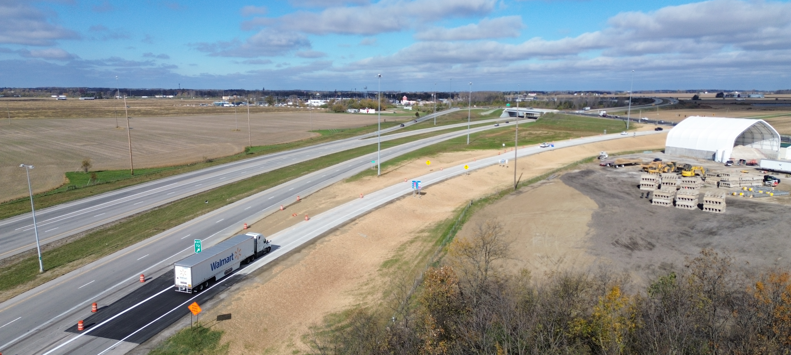
Project Context
Single-lane ramp
Heavy truck channelization
High braking/turning stress
Notes:
Use site photos to explain loading environment.

Slide 5
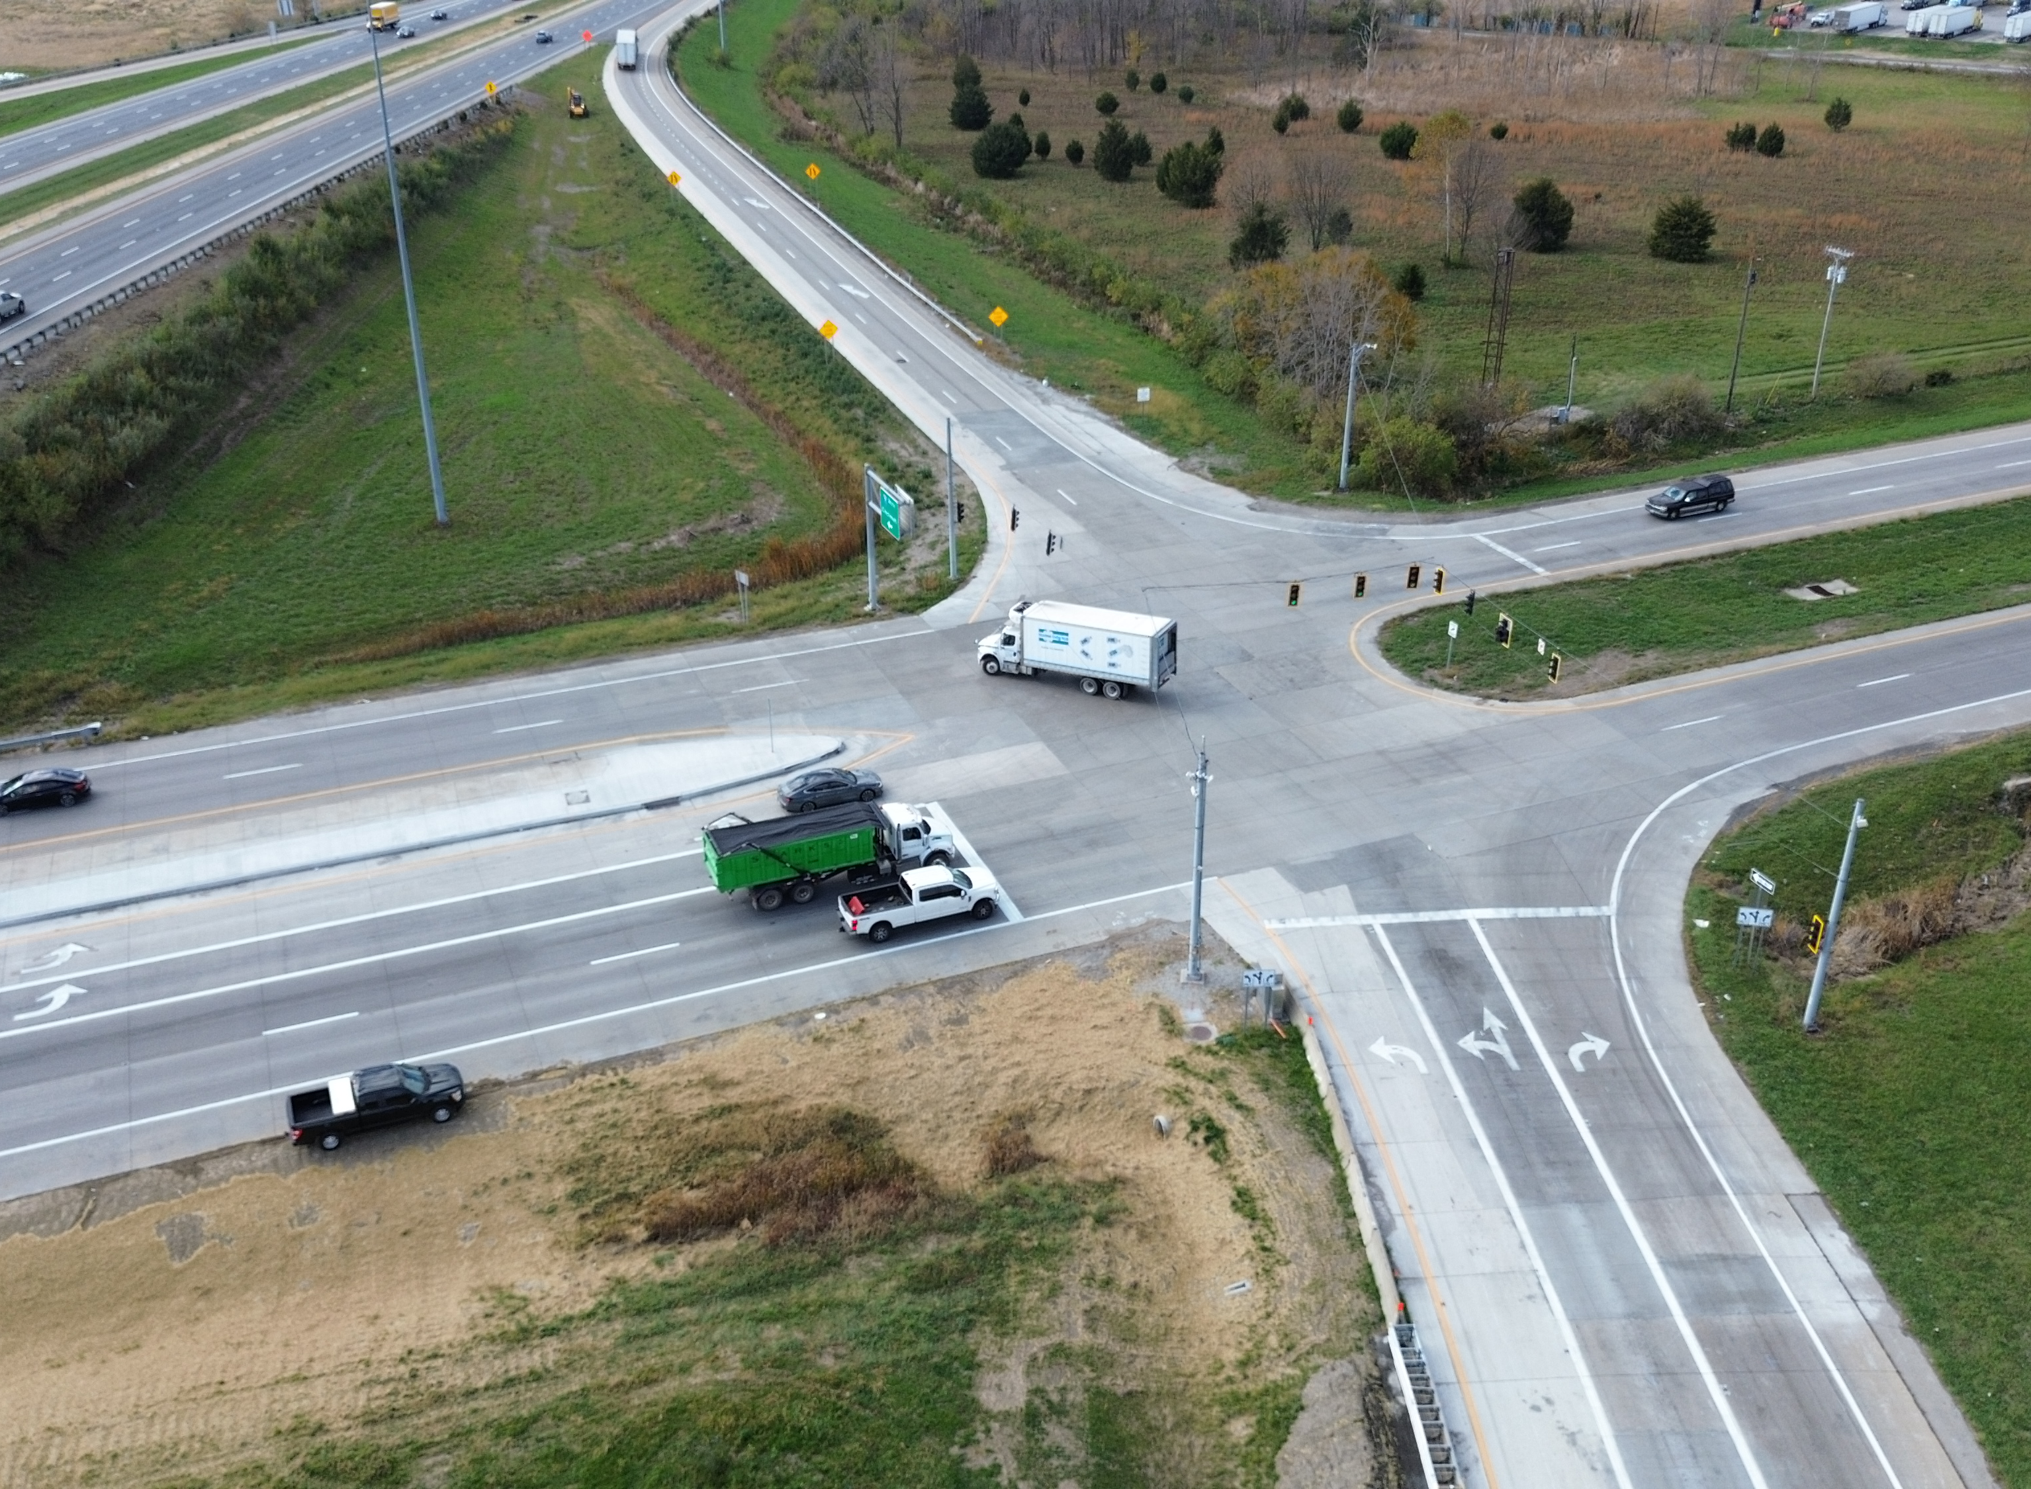
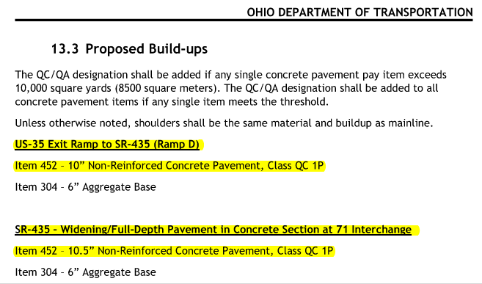
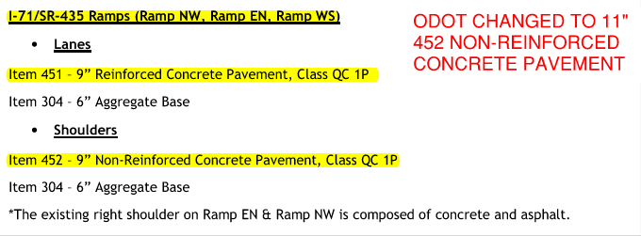
Prescribed Pavement Section
Section prescribed and Buildable Units approved by ODOT
Notes:
Emphasize contractor followed design.

Slide 6
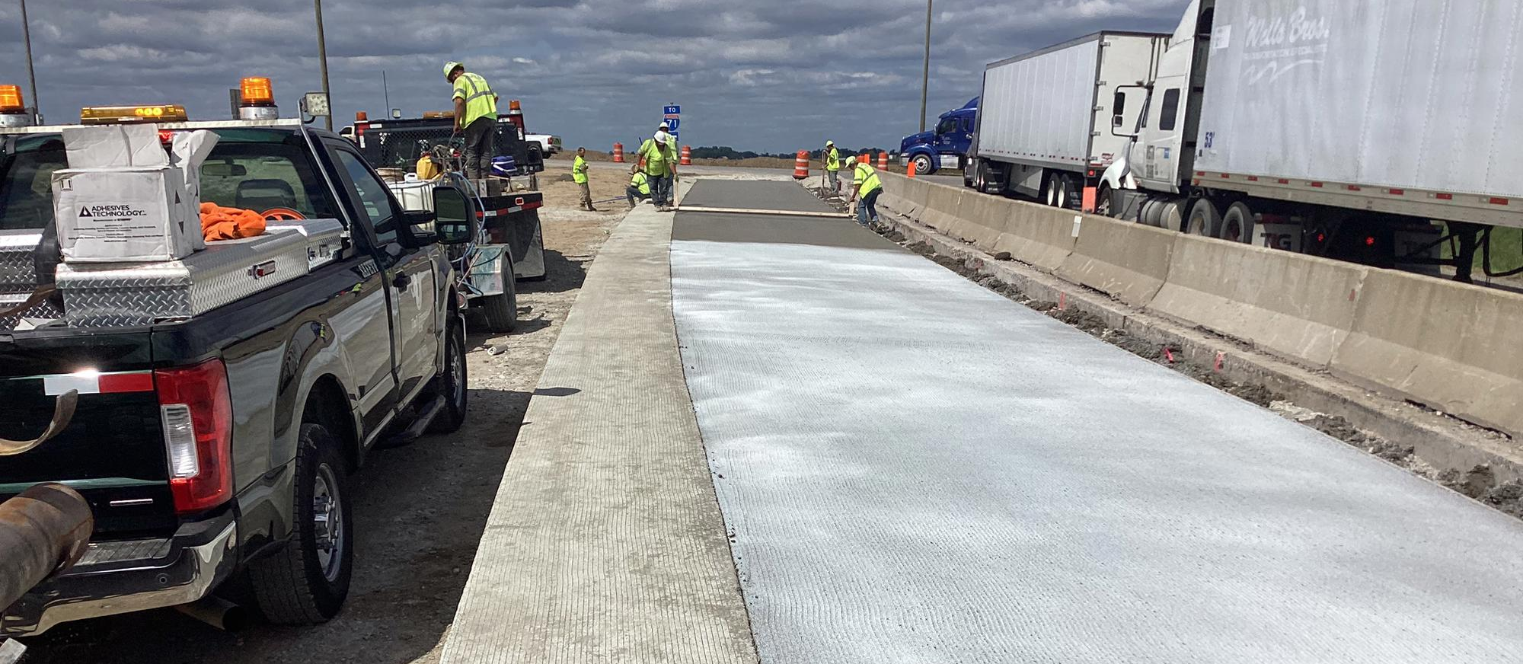

Construction Compliance
Approved mix
Approved placement
Approved curing
Passed acceptance testing
Opened under ODOT direction
Notes:
Establish Spearin without naming it.

Slide 7
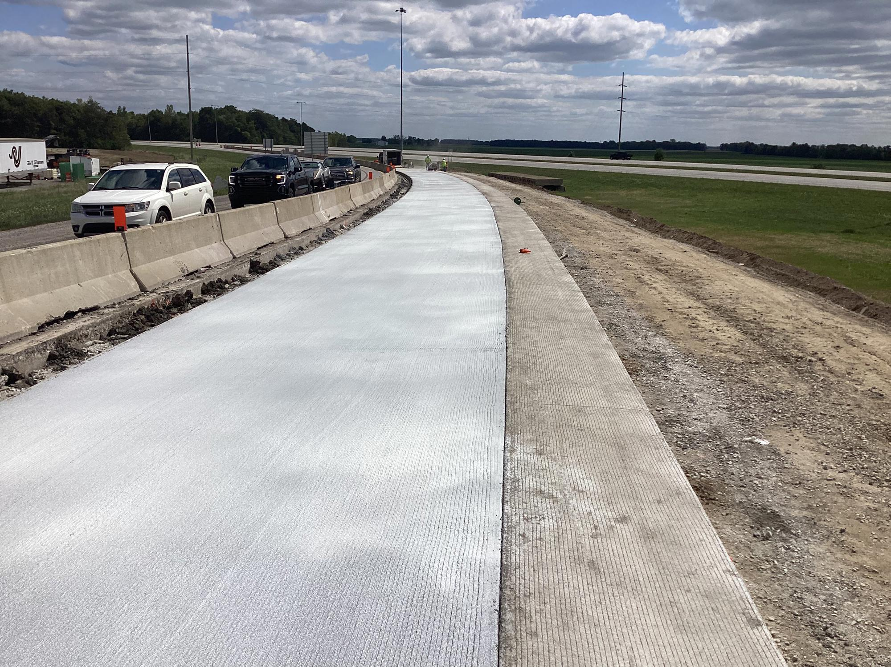
Construction Compliance
Approved mix
Approved placement
Approved curing
Passed acceptance testing
Opened under ODOT direction
Notes:
Establish Spearin without naming it.

Slide 8
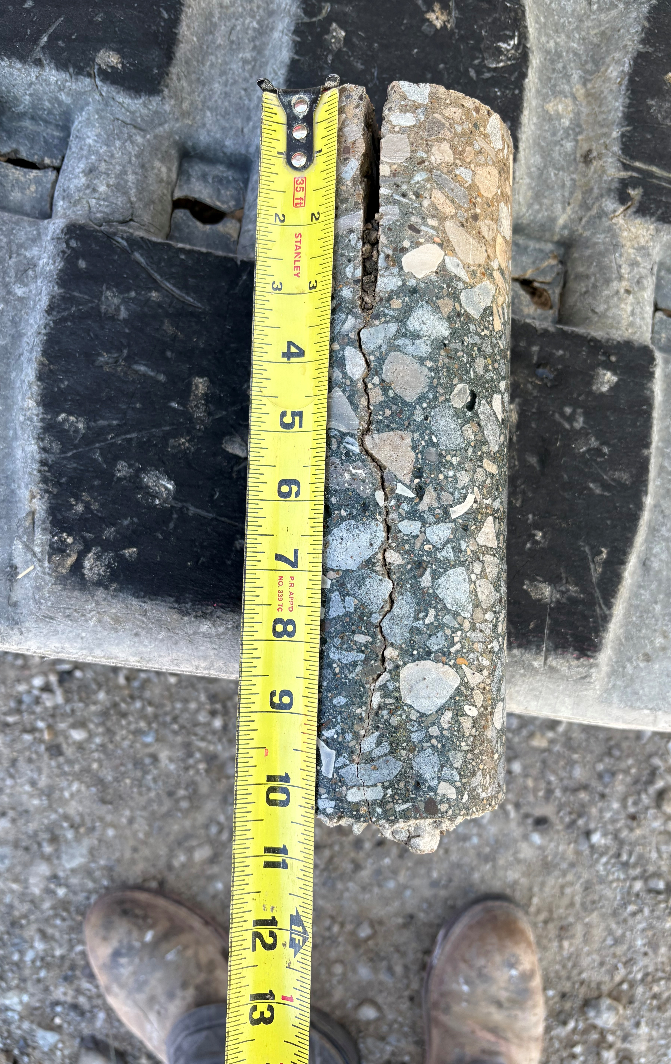
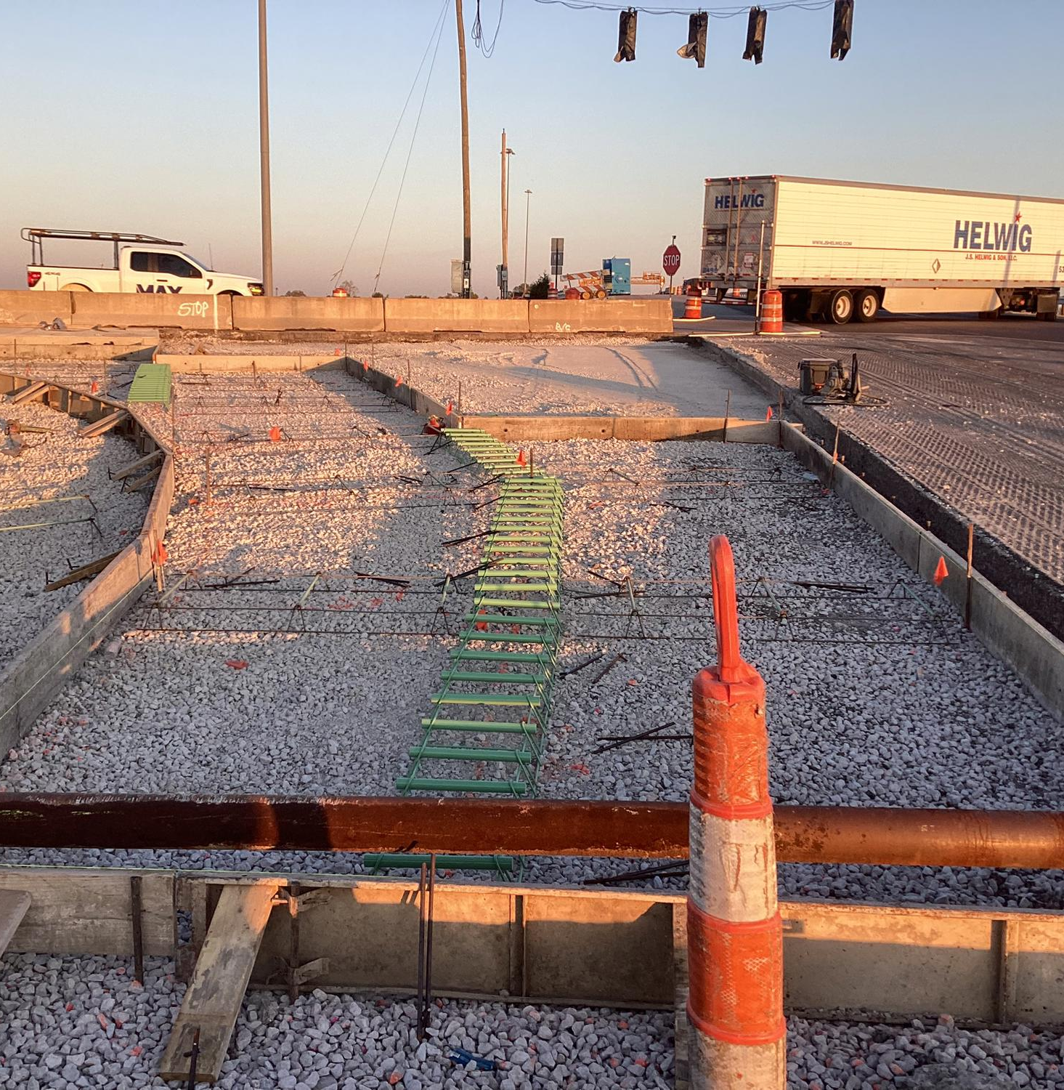
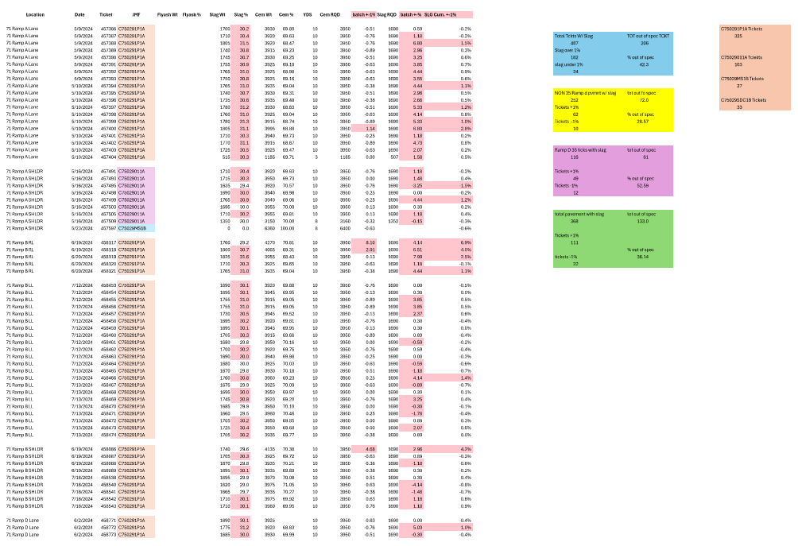
Department Causation Theory
Batch tolerances
Placement method
Workmanship
Notes:
Neutral framing.

Slide 9
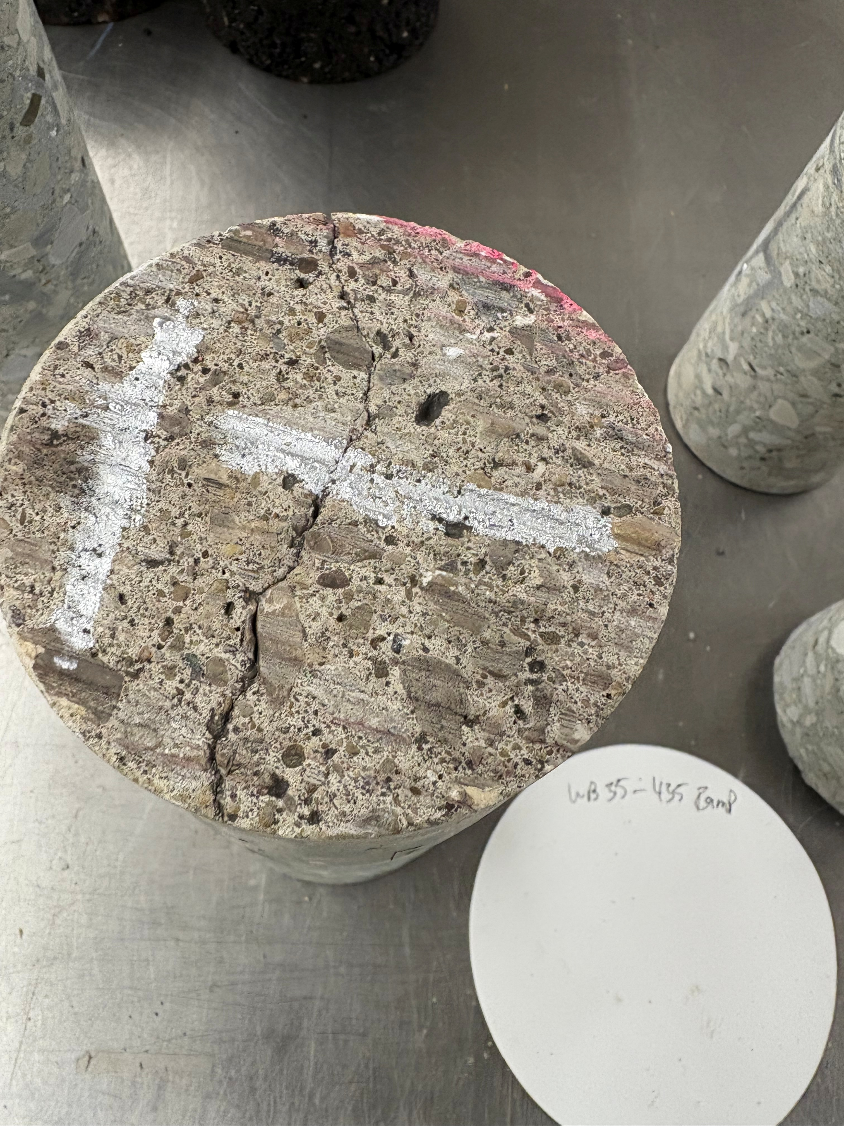
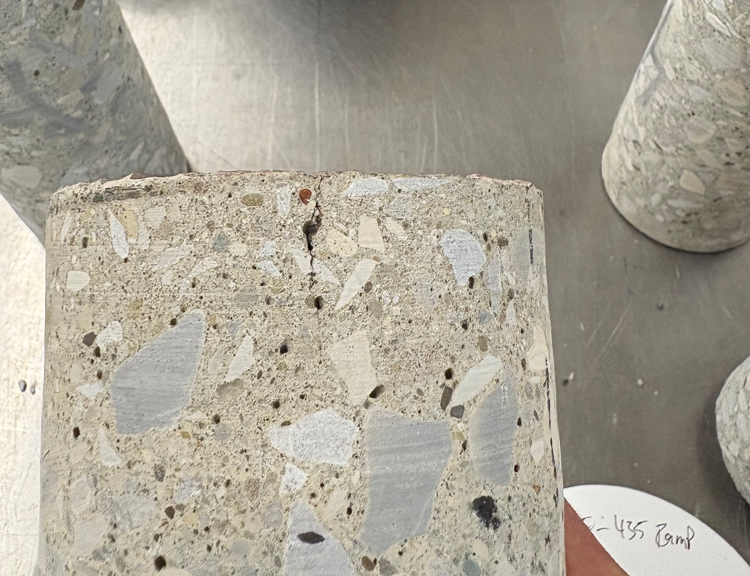
Observed Distress
Mid‑panel cracking
Patterned
Post‑acceptance
Notes:
Show photos only — minimal text.

Slide 10
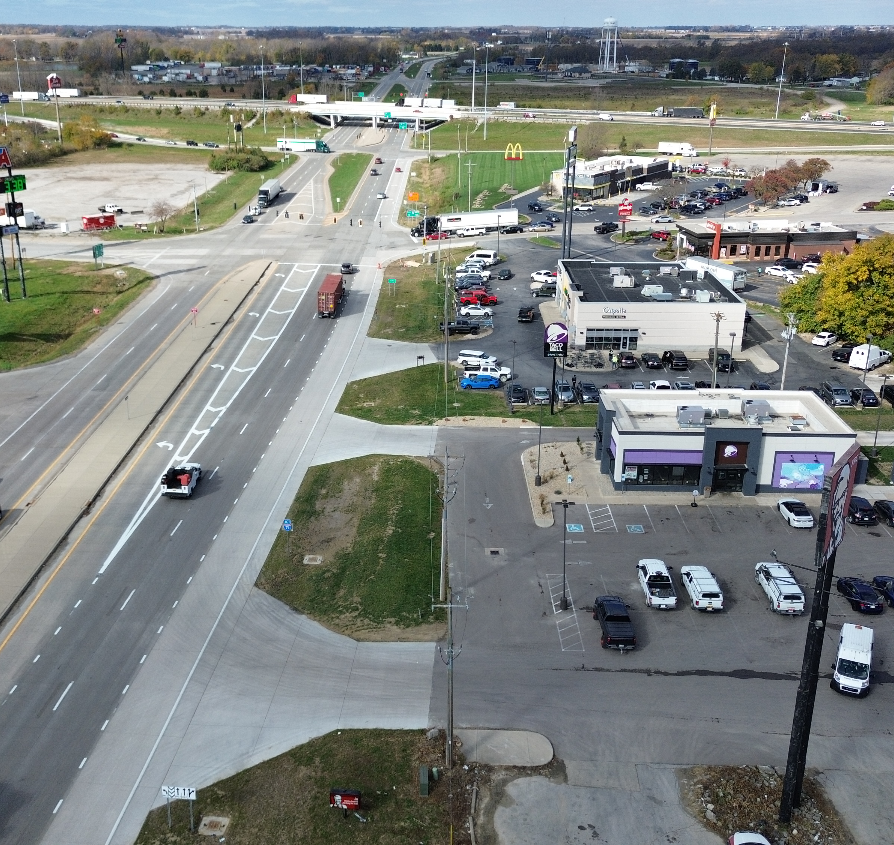
Concrete Variability
Variability occurred project‑wide
No spatial correlation with distress
Notes:
Reference CA‑C‑1 data.

Slide 11
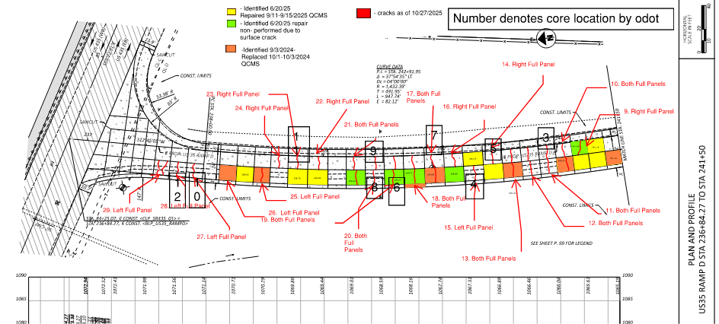
Replacement Panels
Similar cracking observed
Notes:
Weakens batching theory.

Slide 12
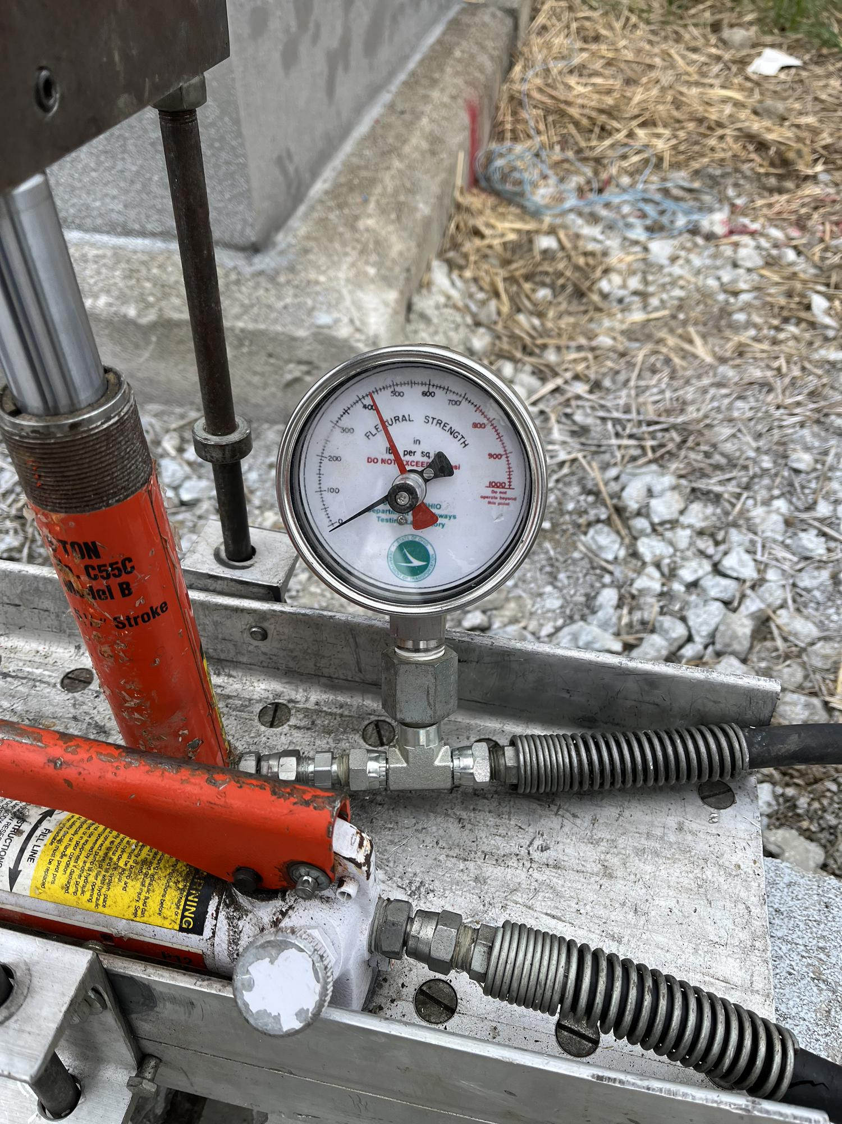
Acceptance & Opening
Flexural strength governed opening
Opening controlled by Department
Documentation inconsistencies
Notes:
Introduce early loading concept.

Slide 13
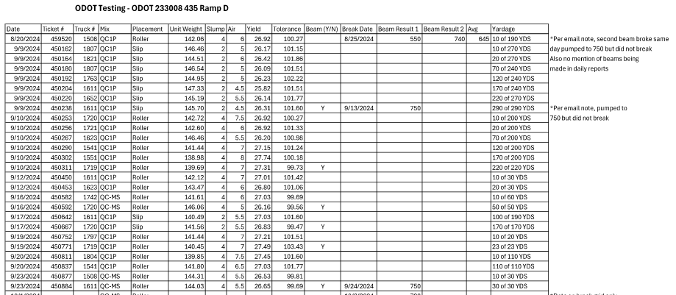
Beam Documentation Questions
Beams cast vs break results
Break ages vs opening timing
Maturity expectations
Requested ODOT testing records
Notes:
Raise uncertainty calmly.

Slide 14
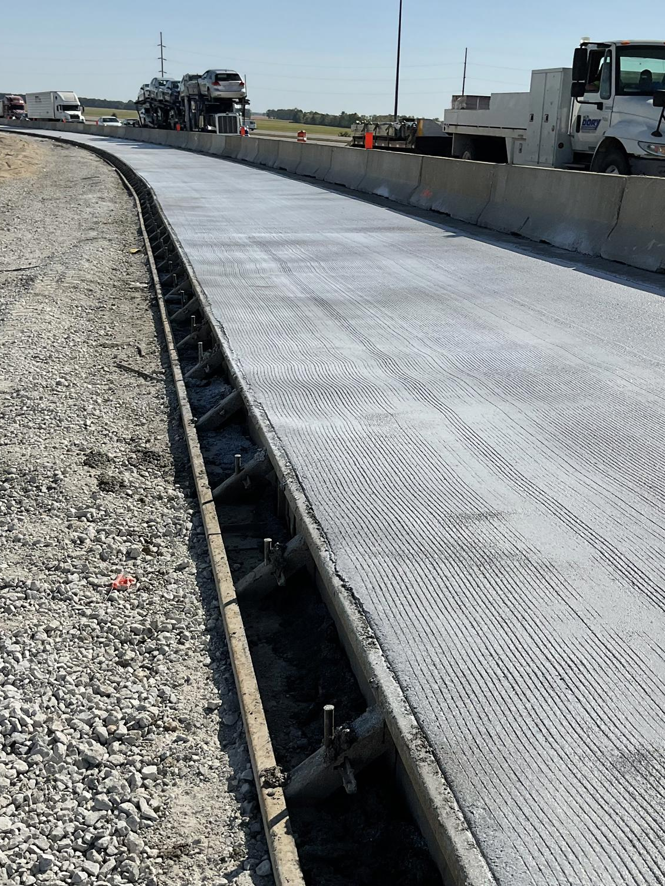
Structural Sensitivity
Thicker sections performing
10" ramp showing distress
State-wide 1L cement seminar
Notes:
Use 71 ramp comparison.

Slide 15
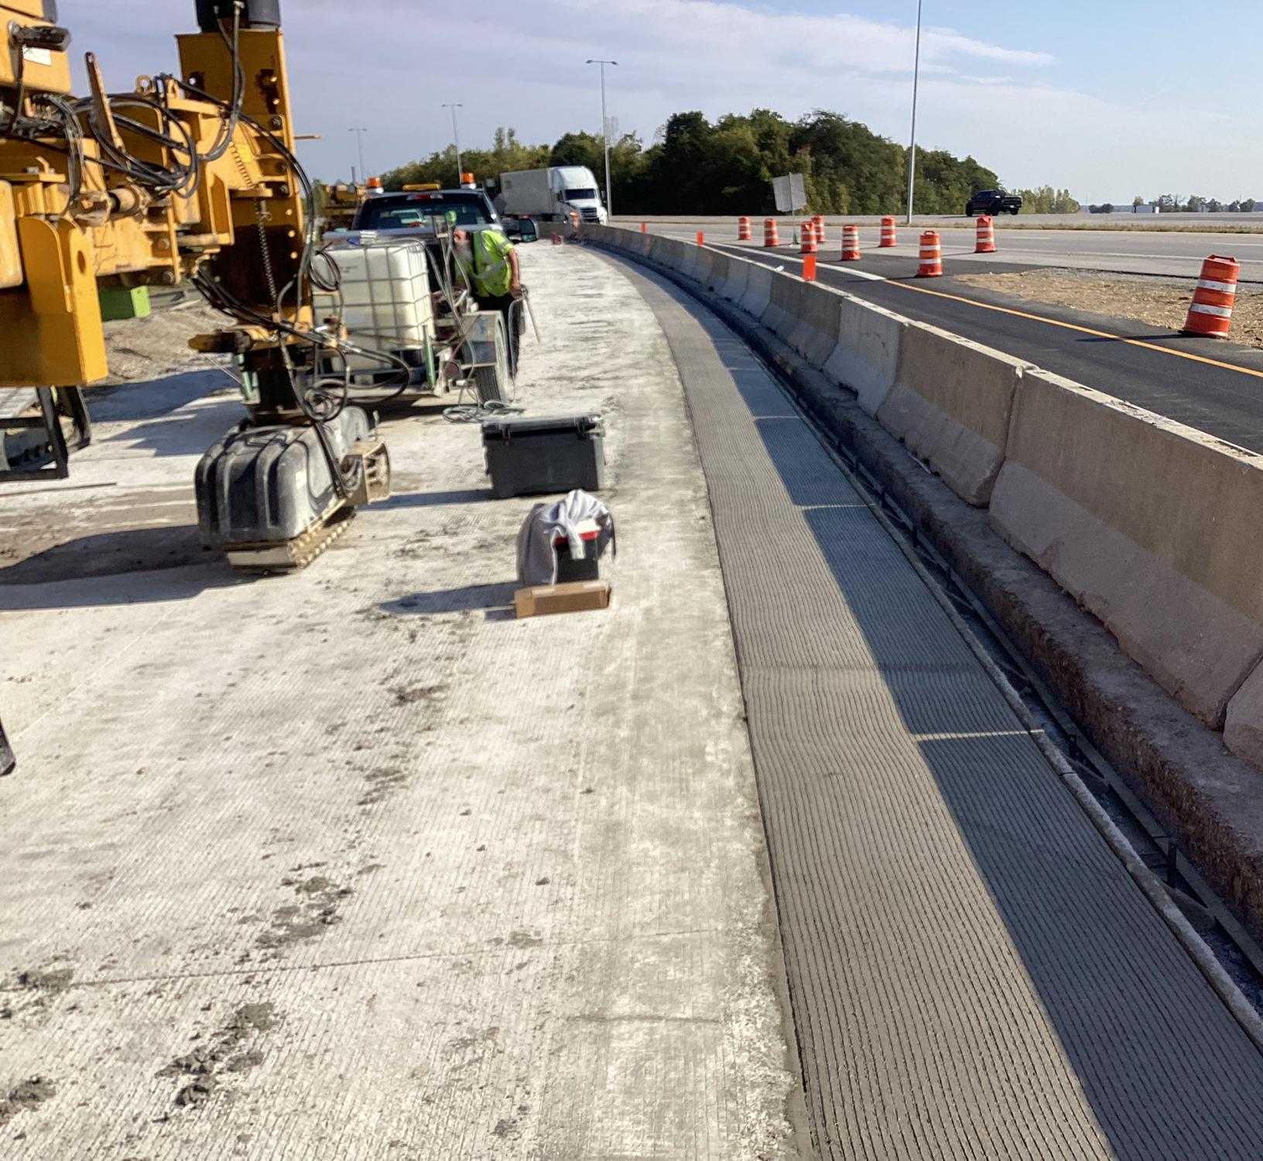
Engineering Mechanism
Early loading
Channelized truck stress
Mid‑panel cracking
Notes:
Explain physics.

Slide 16
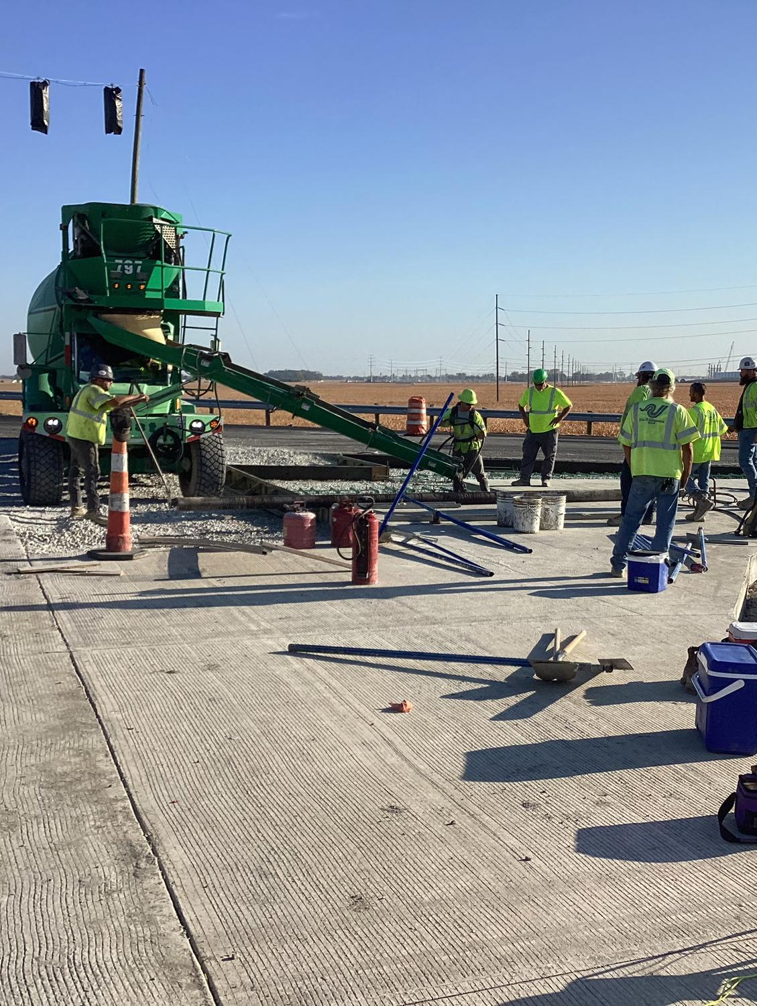
System Interaction Summary
Design margin
Traffic concentration
Acceptance timing
Material behavior
Notes:
Tie narrative together.

Slide 17
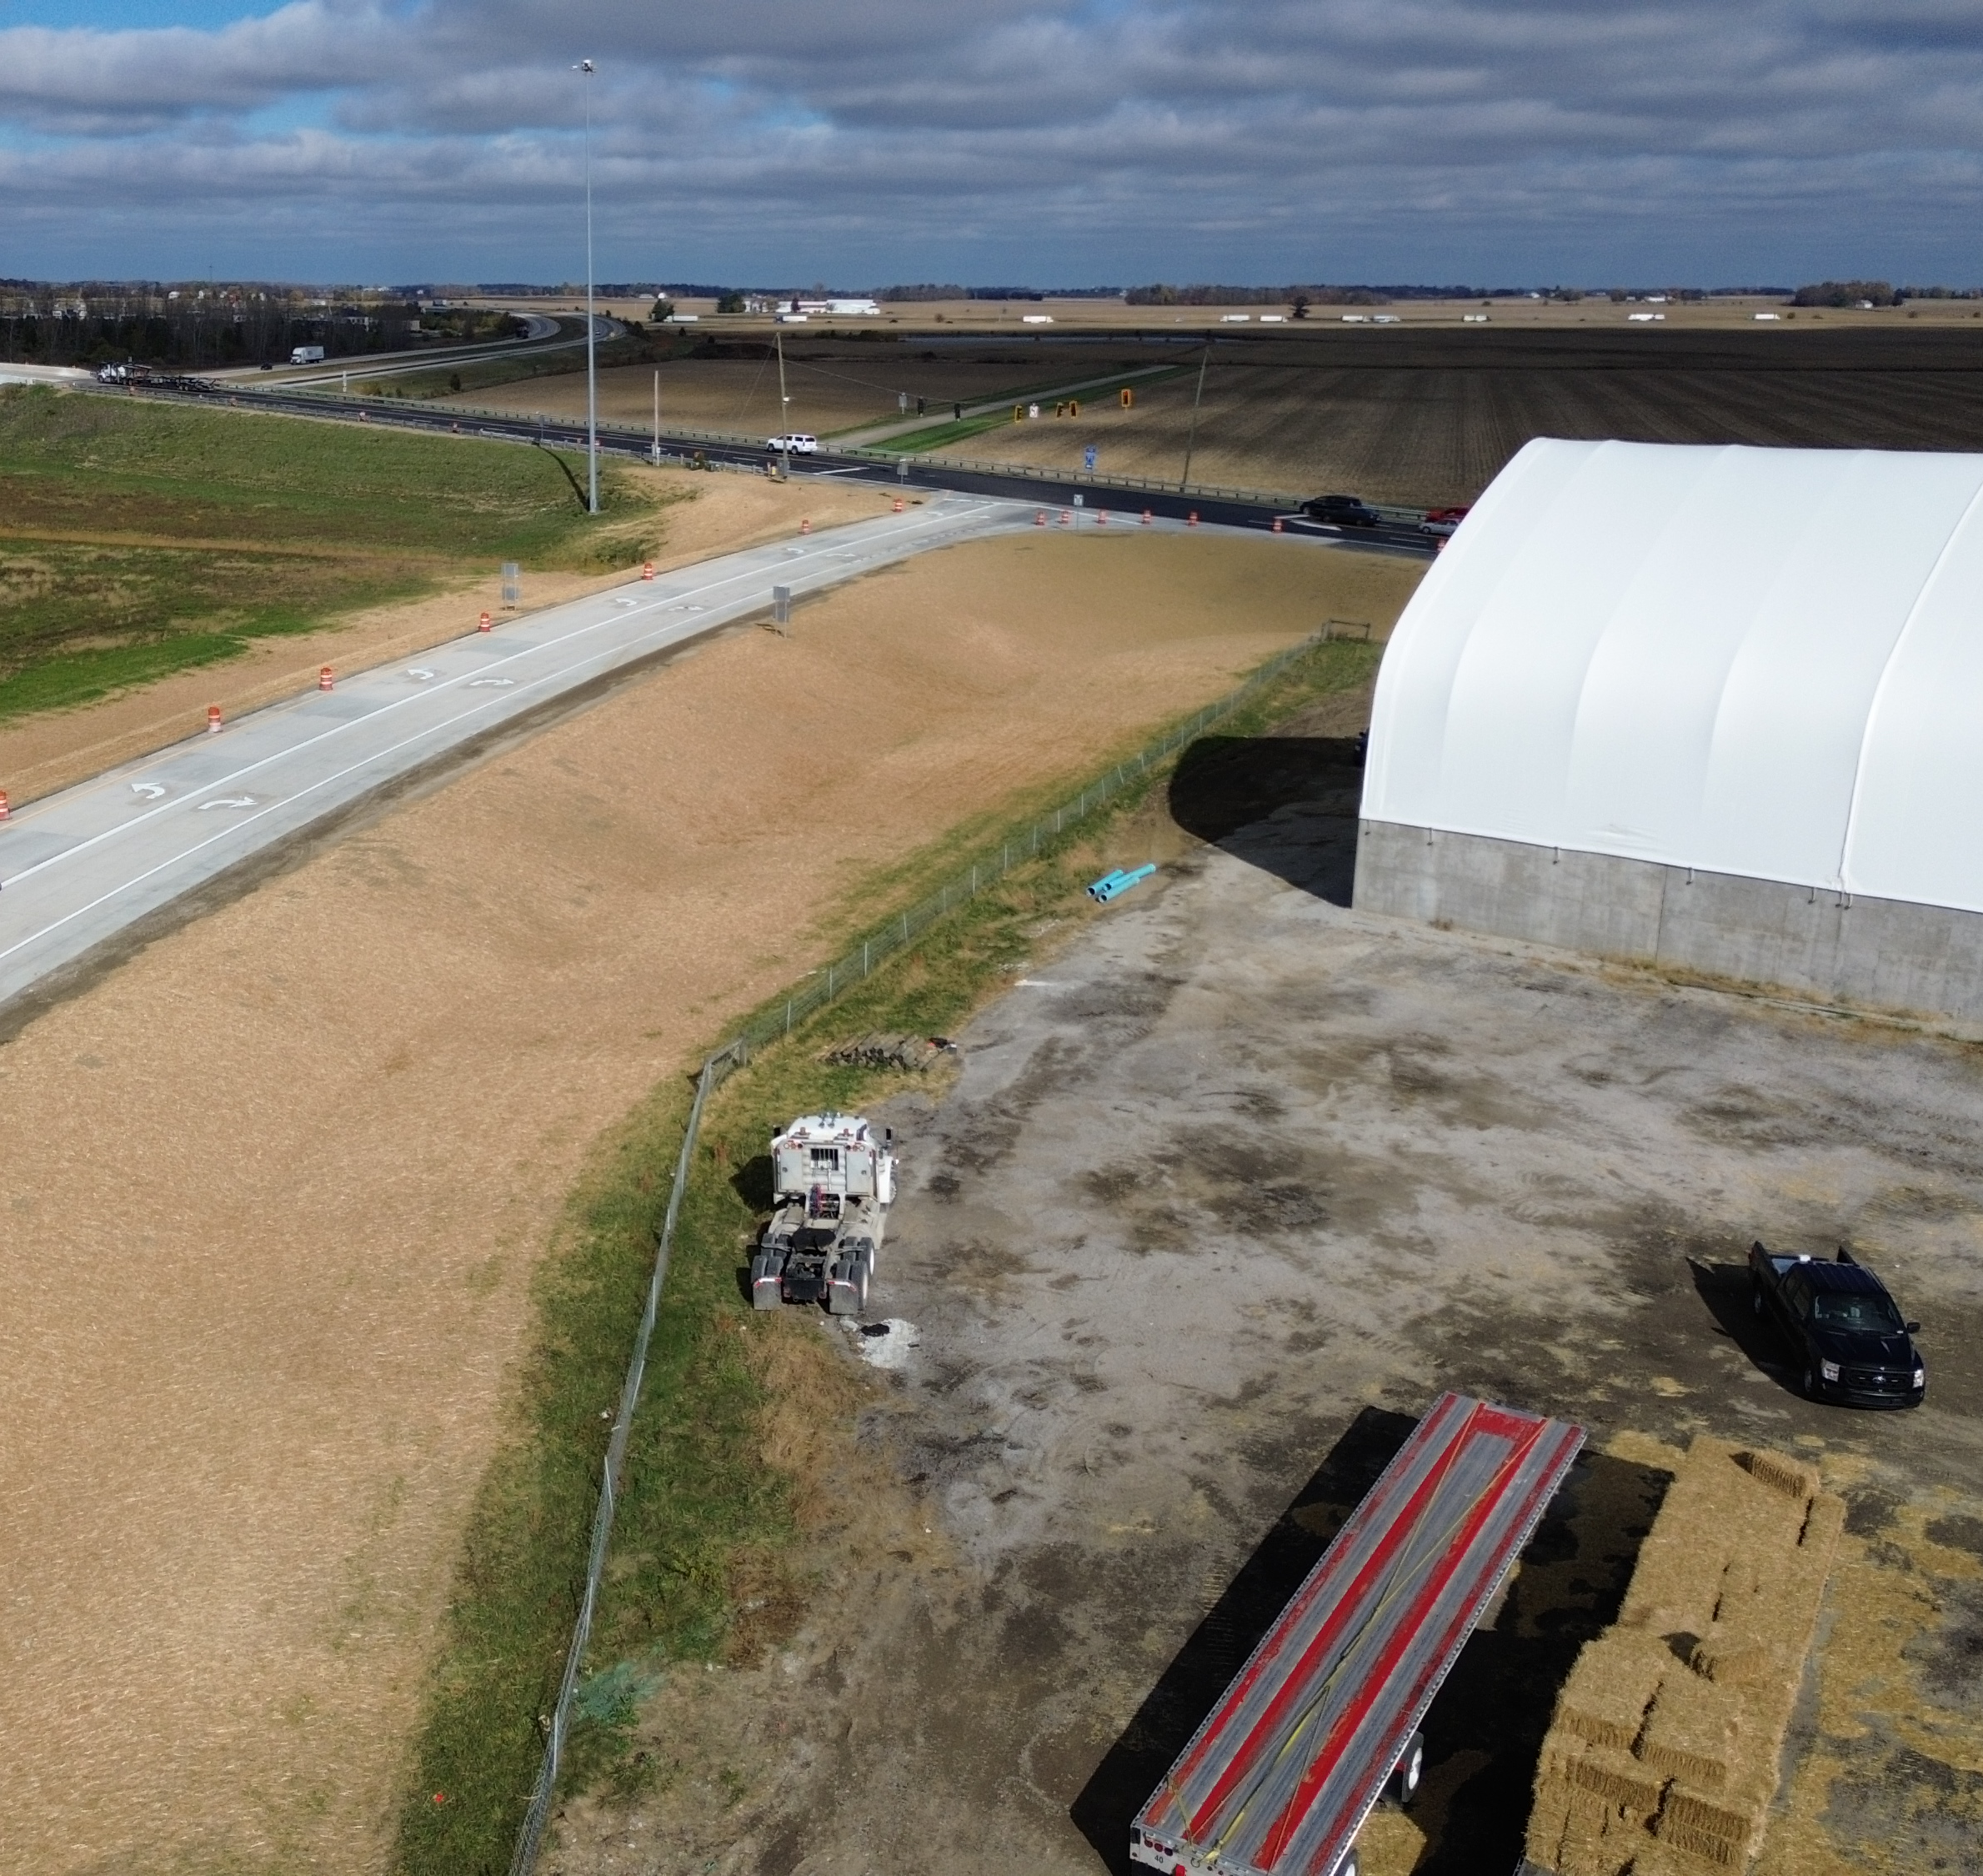
Requested Path Forward
Collaborative evaluation
Targeted repair
Avoid unnecessary removal
Shared technical review
Please consider causes for next steps
What is the purpose:
  Determine Cause?
  Assign $$$ fault?
Notes:
Signal reasonableness.

