Slide 1
Design-Build
Part 3: Procurement and Contracting
Notes:
Note that you will now begin Part 3 of the training, which addresses DB procurement and contracting issues. The part is expected to take approximately 60 minutes, after which there will be a brief 10 minute break.

Slide 2
Learning Outcomes
Understand DB procurement options and processes
Identify contracting issues unique to DB
Notes:
Briefly review the learning outcomes and indicate that you will revisit the outcomes once again at the conclusion of this portion of the training.

Slide 3
Contents
1
Procurement Process
2
Procurement Considerations
3
Contract Considerations
4
Case Study
5
Questions
Notes:
Use this slide to present the main topic areas covered in this portion of the training.

Slide 4
DB Procurement
Notes:
Ask the class, under traditional DBB:
• How does the Department procure design services? (Answer: based on qualifications)
• How does the Department procure construction services? (Answer: based on low bid)
Note that under DB these traditional procedures no longer apply. When design and construction elements are combined into a single contract, Federal and State statutes allow the Department to use other procurement strategies.

Slide 5
Procurement Process Overview
Develop Procurement Strategy
Prepare Bid Documents
Advertise and Award
Identify project needs and goals
Assess project risks
Determine procurement approach
Low bid vs. value-based
One vs. two-step
ATCs?
Stipends?
Develop scoring criteria and evaluation plan (for value-based)
Prepare preliminary design to the appropriate level of completeness
Develop bid package
Proposal Notes
Scope of Services
Selection Criteria
Document Inventory
Pre-Bid Meeting
Q&A
Issue Final Addenda
Receive Bids
Confirm responsiveness
Make contract award recommendation
Pay stipends (if applicable)
Debrief unsuccessful proposers
Notes:
Use this slide to briefly explain that at a high level, the DB procurement process can essentially be boiled down to 3 key steps – planning the procurement strategy, developing the bid package, and advertising and awarding the DB contract.
• The first step in the procurement process should begin by planning a procurement strategy that aligns with the needs and goals of the project and the reasons why DB was selected as the project delivery system. These three elements (i.e, project goals, delivery system, and procurement approach) should all be in harmony.
• In conjunction with the development of the Scope of Services document, the complete bid package must be prepared.
• Finally, the project can be advertised and awarded. Note that the bidding phase is generally much longer and more involved under DB than DBB, particularly when a value-based approach is used.
(There is no need to address the numerous bullets shown on the slide at this time – these items will be adequately addressed in following slides.)

Slide 6
Developing a Procurement Strategy
What is allowed under the DB Final Rule (23 CFR Part 636)?
Two-phase procurement process (RFQ w/short-listing + RFP)
Best-value (any combination of price and other factors)
Minimal preliminary engineering w/ performance specs
RFP issuance and DBT selection before final NEPA decision
Discussions with proposers
Alternate technical concepts
Negotiations after selection and prior to contract execution
Stipends to unsuccessful proposers
QA by DBT (both design and construction) w/ oversight and verification testing by owner
Warranties
Flexibility in DBE procedures
Notes:
Note that the DB Final Rule explicitly addresses many procurement options, not all of which will necessarily be implemented by ODOT with any regularity, if at all. For example, although the Final Rule allows agencies to issue an RFP and award a DB contract before the final NEPA decision, ODOT will generally only issue a bid package once NEPA is complete and the necessary environmental clearances have been obtained.
Stipends, while recommended, are not paid regularly by ODOT.

Slide 7
Developing a Procurement Strategy
What is possible in Ohio?
One-Step, Low Bid
Majority of ODOT DB projects
Two-Step, Low Bid
Only on select projects with Central Office approval
Short-list Offerors by evaluating their Statements of Qualification
Award to lowest price Bid from short-listed Offerors
ATCs may be used
Notes:
Use this slide to briefly review ODOT’s procurement options, noting the following:
• Although the majority of projects are procured using a one-step low-bid process, the Central Office can decide to apply a two-step low bid or value-based process if warranted by project conditions. The Two Step requires the submission of a proposal for evaluation of the quality of the proposed DBTs.
• Under both the two-step low bid and value-based options, the Department may allow Offerors to propose Alternate Technical Concepts (ATCs), which will be discussed more a bit later in this presentation. However, in brief, an ATC is a request by a proposer to modify a contract requirement (for its competitive advantage) that provides a solution that is equal to or better than the base design requirements.

Slide 8
Developing a Procurement Strategy
What is possible in Ohio?
Two-Step, Low Bid Technically Responsive
Only on select projects with Central Office approval
Short-list Offerors by evaluating their Statements of Qualification
Preliminary Technical Information Meetings
Award to lowest price Bid from short-listed Offerors
ATCs may be used
Value-Based
Only on select projects with Central Office approval
Short-list Offerors by evaluating their Statements of Qualification
Award to short-listed DBT having the highest combined price/technical score
ATCs may be used
Stipends may be offered to unsuccessful, responsive proposers
Notes:
Use this slide to briefly review ODOT’s procurement options, noting the following:
• Central Office can decide to apply a two-step low bid , Two-step Low Bid Technically responsive, or value-based process if warranted by project conditions.
• Under both the two-step low bid, Two-step Low Bid Technically responsive, and value-based options, the Department may allow Offerors to propose Alternate Technical Concepts (ATCs), which will be discussed
more a bit later in this presentation. However, in brief, an ATC is a request by a proposer to modify a contract requirement (for its competitive advantage) that provides a solution that is equal to or better than the base design requirements.
• Two-step Low Bid Technically responsive requires a pass/fail evaluation prior to opening bids.

Slide 9
Spectrum of Procurement Methods
Fixed-Price
Sealed
Bidding
Value-Based (Best-Value)
QBS/Sole Source
Price
Considerations
Price with Other Key
Considerations
Qualification
Considerations
Historically Public Sector
Typically Fixed-Price
Open Bidding
Historically Private Sector
Typically Negotiated
Prequalification Processes
Notes:
Starting with the left-hand side of the graphic, explain that in public sector construction, the traditional procurement decision for construction services is based primarily on price (or qualified low bid). Add that this method is generally the most objective process, requiring only a comparison of bid prices, a responsiveness check, and a price reasonableness analysis.
Moving on to the right side of the graphic, explain that the procurement of so-called “professional” or design services is traditionally based on qualifications, a much more subjective approach.
Logically then, a value-based process falls in the middle, as it marries together price and other factors. Note that value-based procurement approaches are often used in connection with DB and other non-traditional delivery methods that combine design and construction services.
2. Ask the class where they think ODOT’s DB program falls on this spectrum. (The slide is animated. Once you receive a consensus response, click on the slide to reveal the bouncing ODOT symbol)
Explain that ODOT is shown as being closer to the left because most of its DB projects are low bid. Even for those projects that are value-based, the predominant evaluation criterion is often price.
We do not do Sole Source selection. This would be were only one proposer could give a price. If you get into DB regulations, this would be a “Progressive DB”.

Slide 10
Procurement Strategy – Project Considerations
Align Project Characteristics with Procurement Approach
Low Bid, 1-Step
Low Bid, 2-Step
Tech Responsive
Value-Based
Low risk, non-complex projects
Time-sensitive projects
Minimal third-party issues (ROW, utility, environmental)
High level of conceptual design provided by Dept.
Moderately complex projects that still demand highly qualified teams
Project characteristics suggest that technical proposals with possible risky solutions
Medium to large, complex, multi-phase projects
Solution desired to be known
Project characteristics suggest that technical proposals could reveal significant differences among bidders
Medium to large, complex, multi-phase projects
Lower level of conceptual design by the Dept.
Notes:
Short-listing phase used to limit the playing field to the most qualified firms on the basis of pass/fail criteria and a limited number of scored criteria
Explain that certain project characteristics lend themselves better to one procurement option than another.
• A one-step low-bid DB approach would apply to low-risk, non-complex projects where a compressed construction schedule is beneficial or possible, but the Department must still provide a high level of design definition. Other circumstances conducive to a one-step low bid approach would include the following:
- Proposers do not have to perform substantial design work to develop price proposals
- Time constraints do not allow for a separate short-listing step
- Department lacks the resources to develop the required documents and manage a two-phase selection process
- Department wants to open up the bidding process to more firms, including those with minimal or no DB experience
• A two-step low bid approach would apply to moderately complex projects that still require highly qualified teams. For example, a short-listing step would be appropriate if the Department wants to the limit the playing field to firms that qualify for a specialized type of work (e.g. bridge rehabilitation, environmentally sensitive work, etc.) or to firms that have prior DB experience on similar projects.
• A two-step low bid technically responsive approach would apply to moderately complex projects that still require highly qualified teams, but ODOT is not looking for betterments. For example, a short-listing step would be appropriate if the Department wants to the limit the playing field to firms that qualify for a specialized type of work (e.g. bridge rehabilitation, environmentally sensitive work, etc.) or to firms that have prior DB experience on similar projects. We would have the opportunity to reject the bid if the approach is not within the Scope of Services.
• A value-based DB approach is better suited to projects where the Department can convey project requirements based on a low level of design definition, there is opportunity for innovation, and the DBT can assume greater responsibility for quality and third party coordination.
Stress that use of a two-step low bid, A two-step low bid technically responsive approach, or value-based process requires Central Office approval.

Slide 11
Low-Bid Procurement
Advantages | Disadvantages
Most similar to the traditional approach to procuring construction contractors By providing detailed, descriptive documents, ODOT can control outcome By awarding only on the basis of price, little subjectivity is introduced into the evaluation and selection process | Places greater design risk on ODOT Restricts innovation
Notes:
Point out a low-bid procurement process has the advantage of being the most similar to the Department’s traditional low-bid approach to procuring construction contractors. ODOT can provide a high level of design definition and thus control the design solution. Also, awarding only the basis of price and responsiveness introduces relatively little subjectivity into the evaluation and selection process. However, by precluding the consideration of factors other than cost alone (e.g., quality, innovation, schedule, etc.), it may be difficult to ensure that the Department ultimately receives the best-value, particularly for large, complex projects.

Slide 12
One-Step Low Bid Process
Notes:
Low bidder still need to be pre-qualified
Use this slide to describe the low-bid DB process.
Note that even under the one-step low-bid process, interested DBTs must still be pre-qualified to submit a bid.
Highlight the key steps shown on the figure:
10. Identify project goals and risks.
11. Based on the goals and risks identified for the project, take the preliminary design to the desired level of completion.
12. Prepare and issue the DB solicitation package, which will include items such as:
• Scope of Services document
• Proposal notes (including PN126)
• Schedule of contract items (should be specific to DB)
• Specifications, Special Provisions, Supplemental Specifications
13. Hold a pre-bid meeting.
14. Issue addenda to address questions submitted during the Q&A period.
15. Receive and open bids.
16. Determine the Apparent Low Bidder.
17. Verify bid responsiveness.
18. Award contract.

Slide 13
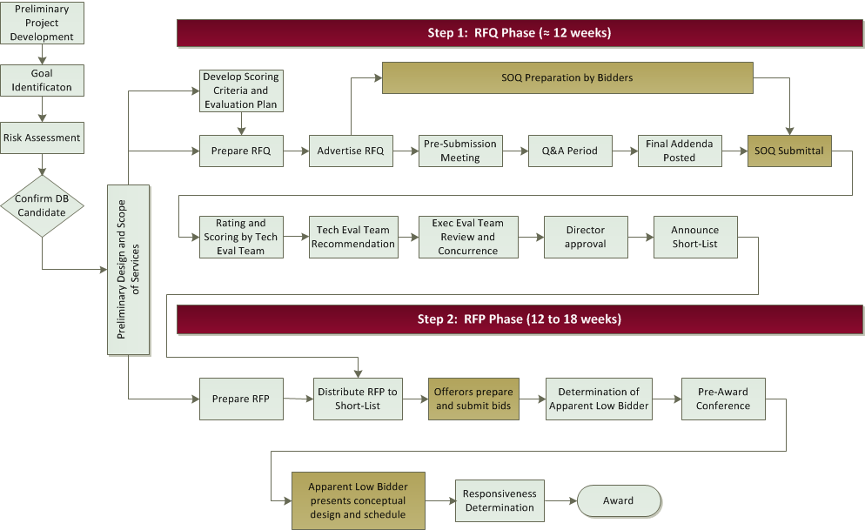
Two-Step Low Bid Process
Notes:
Note that compared to the previously discussed one-step low-bid process, the two-step process can be more time-consuming and resource-intensive.
RFQ Phase
Using the figure shown on the slide, note that the RFQ phase can take up to 12 weeks. Highlight the key activities taking place during this phase, which include the following:
1. Identify project goals and risks.
2. Based on the goals and risks identified for the project, take the preliminary design to the desired level of completion.
3. Develop RFQ evaluation criteria. Note that the evaluation factors included in a RFQ should focus on the general qualifications of the proposers to perform the work, using indicators such as key staff qualifications, firm experience on similar projects, firm capabilities, and past performance. Note that requesting past performance information (e.g., adherence to contract schedule, good workmanship, cost control, value of change orders and claims) can be controversial, as some indicators may be out of the contractor’s control (e.g., owner-caused delays). Bidders should therefore be able to explain or qualify issues related to cost growth, delay, violations, or other issues related to change orders or claims with the information submitted.
4. Prepare and issue the RFQ.
5. Hold a pre-submission meeting.
6. Issue addenda to address questions submitted during the Q&A period.
7. Offerors submit their Statements of Qualifications (SOQ). Note that the Lead Designer and Contractor must be prequalified.
8. Rate and score the SOQs to limit the playing field to typically the 3 most qualified firms on the basis of pass/fail criteria and a limited number of scored criteria.
9. Announce the short list of fully responsive RFQs.
RFP Phase
Note that the RFP phase, even when using a low-bid process, can take another 12 to 18 weeks. This phase is relatively similar to that of the one-step low bid process, except for the following:
• Competition is limited to the DB teams short-listed in the first step.
• As part of its responsiveness determinations, the Department will generally hold a pre-award conference in which the Apparent Low Bidder will be asked to present its conceptual design and schedule for
Department review.

Slide 14
Two-Step Technically Responsive Low-Bid
A procurement process in which proposals contain both price and qualitative technical components. Responsiveness to key critical elements are evaluated on a Pass/Fail evaluation, and ultimate award is based on price.
+
Notes:
Review the definition for Two-Step Technically Responsive Low-Bid procurement, emphasizing that this method allows the Department to consider a Pass/fail evaluation before opening the price to determine the apparent low bidder.
Explain that the Department has implemented Two-Step Technically Responsive Low-Bid procurement as a two-step selection process:
• Step 1 entails short-listing Offerors (based on qualifications submitted in response to an RFQ), in a manner similar to the RFQ step just described for the two-step low-bid process.
• Step 2 entails evaluating technical proposals submitted by short-listed Offerors in response to an RFP for responsiveness
Personalize the idea – when you buy something, do you want to make sure it is in the bag before you hand over the money.

Slide 15
Two-Step Technically Responsive Low-Bid Process
Notes:
Note that compared to the previously discussed one-step low-bid process, the two-step process can be more time-consuming and resource-intensive.
Discuss the benefits of ODOT being assured that the approach is one we can live with. The primary things we review depend on the high risk items on the project. We must specify what they are to submit for review.
Ask in this situation, who is at greater risk? DBT if it does not meet our expectations.
As there is a risk to the bidders that we may reject the bids, we hold the PTI meetings to allow them the opportunity to present their plans, especially the items we want to evaluate in the pass/fail. This occurs typically within 3-4 weeks of bid date. Why? So it can be adjusted to ensure a passing submittal.

Slide 16
Two-Step Technically Responsive Low-Bid
Advantages | Disadvantages
Reduces ODOT risk for design inadequacies Provides ODOT with the opportunity to evaluate the DBTs’ proposed solutions before award By awarding ultimately on the basis of price, little subjectivity is introduced into the award process | Procurement process is moderately time-consuming and moderately resource-intensive for both ODOT and the DBTs Difficulty in comparing technical proposals on a true “apples-to-apples” basis
Notes:
Use this slide to review some of the advantages and disadvantages of value-based procurement.

Slide 17
Value-Based Procurement
A procurement process in which proposals contain both price and qualitative technical components and award is based upon a combination of price and qualitative considerations
Notes:
Review the definition for value-based procurement, emphasizing that this method allows the Department to consider price and other key factors (e.g., cost, time, qualifications, quality, and design alternates) in the evaluation and selection process.
Explain that the Department has implemented value-based procurement as a two-step selection process:
• Step 1 entails short-listing Offerors (based on qualifications submitted in response to an RFQ), in a manner similar to the RFQ step just described for the two-step low-bid process.
• Step 2 entails evaluating price and technical proposals submitted by short-listed Offerors in response to an RFP.
Note that some entities refer to this method as “best-value” procurement.
To personalize the idea of value-based procurement, ask the class to think about the last large purchase they made. Did they base their decision solely on price, or did other factors play a role as well? For example, when buying a car, is price the only consideration? What about other factors, such as reliability, safety, brand reputation, key features or options, etc.

Slide 18
Value-Based Procurement
Advantages | Disadvantages
Encourages innovation Allows DBT to optimize cost and other project goals Reduces ODOT risk for design inadequacies Encourages DBTs to commit to providing solutions that exceed the minimum (value-added) DBTs generally propose their best people Provides ODOT with the opportunity to evaluate the DBTs’ proposed solutions before award | ODOT relinquishes more control and thus may not be completely satisfied with the technical solutions Procurement process is time-consuming and resource-intensive for both ODOT and the DBTs Difficulty in comparing technical proposals on a true “apples-to-apples” basis
Notes:
Use this slide to review some of the advantages and disadvantages of value-based procurement.

Slide 19
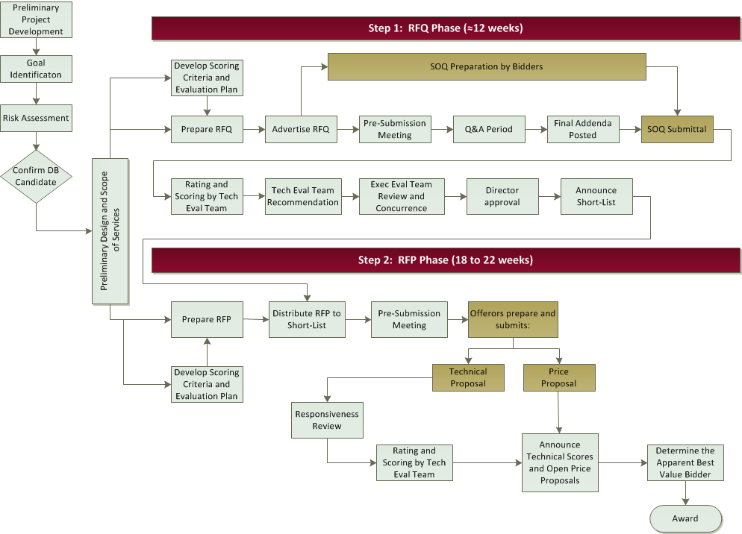
Value-Based Procurement
Notes:
Explain that the Department has implemented value-based procurement as a two-step process, which first incorporates an RFQ step similar to that just described for a two-step low-bid process.
Implementing Step 2 of the value-based process then typically entails the following:
15. Issue the DB RFP to the short-listed Offerors.
16. Offerors submit price and technical proposals.
17. Open technical proposals and determine responsiveness.
18. Score the responsive proposals in each technical area.
19. Open the price proposals to determine responsiveness to required pricing requirements.
20. Eliminate any non-responsive proposals.
21. Roll-up evaluation results, and determine the total point score for each responsive proposal.
22. Compute the final scores and determine the Apparent Best Value Bidder.
Point out that the RFP phase generally takes another 18 to 22 weeks on top of the 12-week RFQ phase.

Slide 20
Value-Based Procurement
Evaluation Plan
Value-Based Selection Criteria
Project Goals and Objectives
Selection Criteria Scoring System
Value-Based Award Formula
Notes:
Explain that this figure represents the key elements of evaluation system planning.
First, one should consider the project’s goals and objectives. These goals and objectives will then drive the selection of evaluation criteria that:
• Align with the project goals
• Are critical to project success
• Will enable meaningful comparison and discrimination among competing proposals
Note that because the RFQ/SOQ step focuses on the Offerors’ qualifications and experience, the RFP/proposal step may focus on how Offerors intend to complete the project, particularly for those project elements for which the Department will allow some flexibility in design and/or construction solutions.
To help streamline the proposal evaluation process, emphasize that scored criteria should be limited to those items that will reveal true differences among bidders and that will most influence the successful execution of the project. Don’t ask for too much!
Possible evaluation criteria may include:
• Price
• Schedule
• Maintenance of traffic
• Technical concepts
• Project management approach
• Aesthetics
• Public outreach
• Impacts (environmental, traffic, etc.)
Once the selection criteria have been identified, the maximum point values should be pre-established for each of these factors and stipulated in the RFP. These point values should reflect the relative importance of the various criteria to the Department.
Finally, the evaluation and selection plan should identify the method or formula by which an overall score is determined for the price and technical proposals. The DB Final Rule allows for many different options (e.g. adjusted bid, weighted criteria, tradeoff analysis, etc.). On past value-based projects, the Department has used a weighted criteria approach, in which technical factors and price are scored and summed to arrive at a total score. The formula used is shown on the next slide.

Slide 21
Previously Used Scoring System
Bidder’s Score =
$35 × \frac{Bidder^{′}s Technical Proposal Score}{Highest Technical Proposal Score}$ +
$60 × \frac{Lowest Price Proposal}{Bidder^{′}s Proposal Score}$ +
$5 × \frac{Shortest Project Duration}{Bidder^{′}s Project Duration}$
(normalized weighted criteria)
Notes:
Explain that this slide shows the formula ODOT used on the I-670/71 Interchange Improvement DB Project to determine the Apparent Best Value Bidder.
Point out that price remained a key determinant in the final score.

Slide 22
Value-Based Selection Best Practices
Minimize subjectivity
Strive for efficient RFQ/RFP processes (don’t ask for too much!)
Provide transparent evaluation process, criteria, and rating systems to attract and retain industry confidence
Provide evaluation training
Offer post-award debriefings to promote transparency
Notes:
Use this slide to quickly emphasize the importance of minimizing subjectivity and providing for a transparent evaluation process when using a value-based procurement approach.

Slide 23
Procurement Considerations
Notes:
Point out that when developing a procurement approach, it is important to consider some of the challenges unique to DB projects. For example,
• Given the time and expense Offerors will incur in developing responsive proposals, how can the Department attract healthy competition?
• How can the Department ensure opportunities for subcontractors if the conceptual design included in the RFP provides insufficient detail for such firms to submit binding quotes to Offerors?
• How can the Department promote innovation, enhance quality, or reduce cost?
Explain that in the next set of slides you will identify such concerns and discuss how they can be minimized through the use of stipends; providing the appropriate level of preliminary design; limiting the size and scope of technical proposal requirements; and by allowing for Offerors to propose alternative technical concepts.

Slide 24
Obstacles/Risks
Procurement Time
One-Step Low Bid
8 to 12 weeks (similar to traditional DBB letting schedule)
Minimal owner involvement
Two-Step Low Bid
SOQ = 12 weeks; RFP = 12 to 18 weeks
Two-Step Technically Responsive Low-Bid
SOQ = 8 weeks; RFP = 18 to 22 weeks
More resource intensive to prepare and review proposals
Value-Based
SOQ = 8 weeks; RFP = 18 to 22 weeks
More resource intensive to prepare and review proposals
Subjectivity of evaluation (qualitative factors can be difficult to define and evaluate)
Potential for reduced competition
Potential for bid protests
Notes:
Use this slide to identify some possible risk areas and associated mitigation strategies.
Note that as discussed earlier, the procurement process can be very time consuming, acting to tie up valuable resources from both the Department and DBTs. A best practice suggested earlier, that of limiting scored criteria to key differentiators, can help streamline the process and help mitigate this issue.
Given the amount of engineering and design work typically needed to prepare a responsive DB proposal, particularly for two-step procurements, another mitigation strategy is to consider paying a stipend to proposers who submit responsive, but unsuccessful, proposals. The intent of such stipends is to:
• Compensate unsuccessful proposers for a portion of the cost of preparing a proposal, thereby encouraging firms to participate in a lengthy and involved procurement process;
• Ensure that smaller firms are not put at a competitive disadvantage;
• Increase the quality of proposals;
• Increase the level of innovation in proposals; and
• Secure owners right to use ideas and concepts within all proposals
Note that stipends are typically 0.25 to 1% of total project construction costs

Slide 25
Potential Protest Areas
Short-Listing
Scoring issues: minor differences in scores unsupported or unjustified
Inaccurate or unfair past performance ratings
Evaluation/Selection
Unjustified selection of higher priced proposal
Ambiguous selection decision
Scope misinterpretation
Failure to follow evaluation criteria
Unsupported or inadequately documented decision
Misleading discussions
Notes:
Use this slide to briefly review some potential bid protest issues.
Note that some of the best practices that have already been discussed in this course can help prevent protests. These include:
• Clear and complete project scopes
• Fair and transparent evaluation processes

Slide 26
Level of Design
 | 30% Design or More | Less than 30% Design
Design Risk | More design risk stays with owner | DBT assumes more design risk
Procurement Strategy | Typically low-bid | Candidate for value-based procurement
DBT Selection | More price-oriented selection | Greater emphasis placed on technical qualifications: DBT’s proposed solution Project approach Personnel Experience
Notes:
Remind the class of the discussion held during Part 2 related to the relationship between the level of preliminary design provided by the Department and the design risk that can be shifted to the DBT.
Use this slide to briefly point out that the level of design will also vary with the procurement approach. If the Department provides a high level of design definition (affording industry little flexibility or opportunities for innovation) a low-bid process is suitable. As less design is provided, a value-based approach may become necessary to evaluate technical qualifications and approach.

Slide 27
Alternative Technical Concepts (ATC)
Per FHWA:
A request by a proposer to modify a contract requirement, specifically for that proposer’s use in gaining a competitive benefit during the bidding or proposal process … [that] provides a solution that is equal to or better than the owner’s base design requirements.
Notes:
Use this slide to introduce ATCs.
Note that the following proposed changes could constitute an ATC:
• Concept does not comply with existing criteria or specifications
• Concept generates a cost, time, or life-cycle benefit
• Concept requires a design variation from standard agency documented practices
In contrast, a simple waiver request from standard Department practices is generally not considered an ATC.
Ask the class,
• What are some possible benefits that ATCs could provide? (Possible answers: innovation, reduced cost, reduced schedule, minimized disruption)
• What are some potential challenges related to implementing ATCs? (Possible answers: Additional procurement time/cost to review, comparing an “equal or better” design to base design, maintaining confidentiality, etc.)

Slide 28
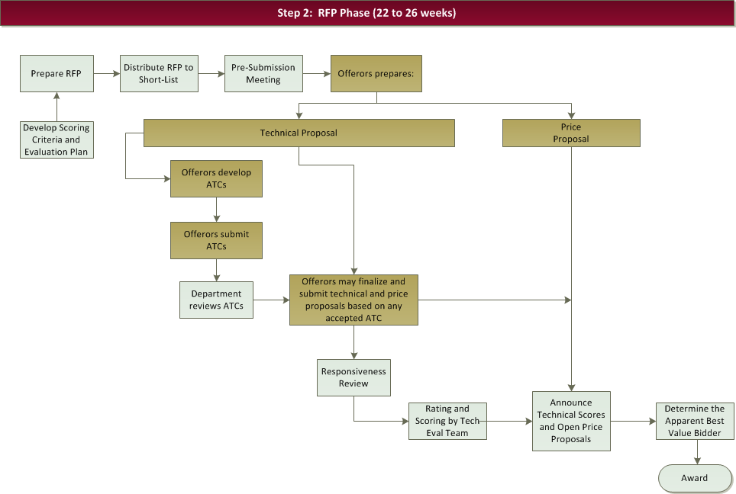
ATC Submittal and Evaluation Process
Notes:
Use this slide to illustrate how ATCs are incorporated into the RFP process, noting that it can add 4 weeks to the procurement schedule.
Indicate that although the figure reflects a value-based procurement process, ATCs could also be used in a two-step low-bid process, where no separate technical proposal is submitted.
Also add that the Department may incorporate one-on-one meetings with the Offerors to discuss the ATCs before the final submittal.

Slide 29
Procurement Summary
Use the procurement approach that best fits project needs and goals
Evaluate proposals based on criteria that:
Add value to the process
Don’t overly burden the DBT or the Department
Less preliminary design by ODOT = greater the contractor’s ability to innovate/influence costs
Consider awarding stipends to attract competition
Consider allowing ATCs to promote innovation
Notes:
Use this slide to quickly run through the highlights of the procurement discussion.

Slide 30
DB Contracts
Notes:
Note that because DB alters the traditional roles and responsibilities of the Department and industry, the contractual basis between these parties changes as well.
Although specific contract provisions will vary from project to project, the nature of the DB delivery approach requires careful revision of existing general provisions or the addition of unique special provisions for DB.

Slide 31
New or Modified Definitions
Term | Definition
Basic configuration | The project scope in its entirety, and elements of the Conceptual Plans as indicated in the project scope
Buildable Unit | Parts of the project that can be designed, reviewed, and constructed with only limited controls and assumptions coming for the design of other portions of the Project
Engineer of Record | An individual, or individuals, properly registered as a Professional Engineer with the Ohio State Board of Registration for Professional Engineers and Surveyors, who seals the construction plans and associated documents/calculations
Design-Build Team (DBT) | Legal entity contracting with Department to perform the Work
Plans | Drawings, standard construction drawings, and supplemental drawings provided by the Department or produced by the DBT
Project Manager (PM) | The Department’s design representative to the DBT
Project Engineer (PE) | The Department’s construction representative to the DBT
Work | The entire completed design and construction of the project including performing professional design services and construction as required by the Contract documents
Notes:
Use this slide to quickly point out that use of DB requires some new definitions, which have been incorporated into ODOT’s proposal notes. For example, Engineer of Record refers to the DBT’s Lead Designer who seals the construction plans.
Other existing definitions require some modification. For example, under DB, “the Work” refers to both the design and construction of the project.

Slide 32
Bid Documents
DBB
Location and description of the project
Estimate of quantities and description of the Work
Time to complete the Work
Amount of Proposal Guaranty
Dept’s deadline for receiving a completed Bid
Schedule of Contract items
Standard Specs, Special Provisions, Supplemental Specifications
Proposal
DB
Location and description of the project
Estimate of quantities and description of the Work
Time to complete the Work
Amount of Proposal Guaranty
Dept’s deadline for receiving a completed Bid
Schedule of Contract items
Standard Specs, Special Provisions, Supplemental Specifications
Proposal
Project Scope (Scope of Services)
Selection Criteria (for value-based)
Document Inventory
Notes:
Use this slide to explain that due to the lump sum nature of DB, the Department no longer provides Offerors with an estimate of quantities.
The basis of the DB contract becomes the Scope of Services document.

Slide 33
DB Contract Provisions
Intent of Contract Documents
Design and construction
Design of Project
DBT’s design responsibilities (Engineer of Record)
ODOT review and oversight responsibilities
Insurance
Professional Liability Insurance
Value Engineering
VE Change Proposals are typically NOT permitted
Measurement of Quantities and Payment Provisions
Lump sum pricing and payment
Payment for design and construction
Notes:
Use this slide to briefly review some of the required changes to standard provisions. For example:
• The intent of the contract documents needs to address both design and construction.
• On a DB project, in addition to general liability and builder’s risk insurance, it is also common to require professional liability, or Errors and Omissions (E&O) insurance, as the DBT, and not the Department or a design consultant, is the Engineer-of-Record. The professional liability insurance policy should be held in the name of the DBT that enters into a contract with the Department. This means that the DBT cannot rely on the insurance policy or policies of its designers to cover professional liability. This protects the Department from dealing with multiple insurance agencies and policies that may or may not cover the risks associated with a particular project.
• VE Change Proposals are typically not accepted.
• Measurement and payment provisions need to be revised to reflect the lump sum nature of the project and address payment for both design and construction services.
Note that additional contract administration issues will be addressed in the next Part of the course.

Slide 34
Specifications
Use performance specifications when:
Multiple means exist to achieve the desired performance
Desired end product performance can be clearly defined, measured, and verified
Use method specifications if there is only one means or solution
Avoid overly broad, ambiguous requirements (e.g., improve drainage…)
Notes:
Note that you will now be presenting a case study to discuss a bid protest that occurred on an ODOT project. Note that although the issue materialized during the procurement phase, the root cause of the problem stemmed from an ambiguous project Scope.

Slide 35
Case Study
Notes:
Note that you will now be presenting a case study to discuss a bid protest that occurred on an ODOT project. Note that although the issue materialized during the procurement phase, the root cause of the problem stemmed from an ambiguous project Scope.

Slide 36
Case Study #3
Scope of Services (CUY-90)
“The girder depth for the main span portion of the I-90 viaduct shall vary parabolically …”
Definition of a parabola:
“A form of arch defined by a moving point that remains equidistant from a fixed point inside the arch and a moving point along a line. This shape when inverted into an arch structure results in a form that allows equal vertical loading along its length.”
Notes:
Set up the project circumstances, highlighting the following:
• New westbound Innerbelt Bridge DB Project utilized a multi-step value-based procurement process (1-SOQ, 2-ATC, 3-Technical Proposal)
• The most important criteria (weightings) were Proposed Design (20pts) and Construction (20pts)
• The design criteria called for the girder depth to vary “parabolically”
• The final award was determined using a formula weighing 70% on price, and 30% on score.

Slide 37
Case Study #3
Notes:
The second place team received their stipend, but ended up filing an injunction against ODOT and wanted the contract declared void.
The litigation centered around the interpretation of “what is a parabola?”
The photo shows what ODOT intended for the shape. ODOT intended for the parabolic shape to continue from support to support.

Slide 38
Case Study #3
Notes:
Instruct the class to study the rendering and ask them if they think it meets the Scope requirements.
The proposer’s explanation is that this section does assume a parabolic shape when it is changing. This would be consistent with the look of existing bridges in the area.

Slide 39
Case Study #3
Straight Line
Notes:
The winning proposer connected the varying depth sections with a straight member.
The variation did NOT continue from support to support, as ODOT intended when the scope wording was written.
ODOT accepted the design, even though a full parabola was ODOT’s intention…acknowledged scope not clear… but winning Proposer had a reasonable interpretation.

Slide 40
Case Study #3
A full parabola was ODOT’s intention, even though the Scope of Services did not explicitly state this
Nevertheless, ODOT accepted the design
2nd DBT filed an injunction:
“The Winning DBT did not follow the Scope – the bridge beam shape is not a parabola. #1 was nonresponsive. Give us the job.”
Notes:
Use this slide to describe what happened.
Proposer #2 filed an injunction.
• Claimed the winning DBT did not follow the Scope – the bridge beam shape is not a Parabola as was “required” by the scope; therefore, #1 was nonresponsive.
• ODOT accepted the project design as consistent with Scope of Services even though it was not what was originally intended.

Slide 41
Case Study #3
Judge’s Ruling:
“#2 is correct, it is not a parabola
but…
the winner has a reasonable interpretation. When it does vary, it is varying in a parabolic shape. The parabolic variation wasn’t required across the entire length”
Notes:
The Judge agreed (with ODOT) that #1 had a reasonable interpretation, even though the design was not what ODOT intended. Parabolic variation wasn’t required across entire beam length
Injunction was NOT upheld as it would cause unreasonable delays to the construction. ODOT continued forth with the award process.

Slide 42
Case Study #3 – Outcome and Lesson Learned
Outcome
What was designed and built was not what ODOT had intended
Lesson learned
Need to live with what was written even though that may not be what was intended, or
Issue a change order
Notes:
Discuss the project outcomes:
• Project moved forward and design did not strictly meet scope language as drafted.
• What was designed and constructed was not strictly what ODOT had intended but was reasonable. When bridge beam shape varied, it varied in parabolic shape.
• Proposer #2 continued to fight and appealed judge’s decision.
• During the appeal, it was determined the language in their Joint Venture agreement nullified the joint venture. Judge ruled the JV had dissolved and did not have grounds to sue.
• At that point ODOT had started procurement of our 2nd Value Based DB project in Columbus. The 2nd ranked team dropped the suit as they had also proposed for this project.
• Bridge opened to bi-directional traffic in Nov 2013.
• ODOT unsure if “process” would have been upheld as the full argument wasn’t heard.
Ask the class if they can identify some lessons learned. For example:
• If a specific design feature is required from proposers, the language in the scope of work must precisely convey the one solution, without room for interpretation
• If language is not specific, need to live with the result, or issue a change order.

Slide 43
Questions
Notes:
Before closing out this section, ask participants if they have any questions regarding the material covered in Section 3.

Slide 44
Learning Outcomes
Understand DB procurement options and processes
Identify contracting issues unique to DB
Notes:
Review the section learning objectives. Plan to spend 3 to 5 minutes on this review. Maintain a quick pace throughout the review to keep it interesting and interactive. Possible review questions to ask may include:
• Identify the 3 procurement options available to ODOT.
• What are some ways to improve competition on a DB project? (e.g., stipends, streamline requirements, don’t require prior DB experience)
• Identify some necessary changes to the Department’s general provisions to accommodate DB.
Preview the next section by telling participants that, after the break, you will begin discussing the administration of DB contracts.

