Slide 1
Budgeting your way to success
Pat McColley, PE, SI, MBA
District 2 Deputy Director

Slide 2
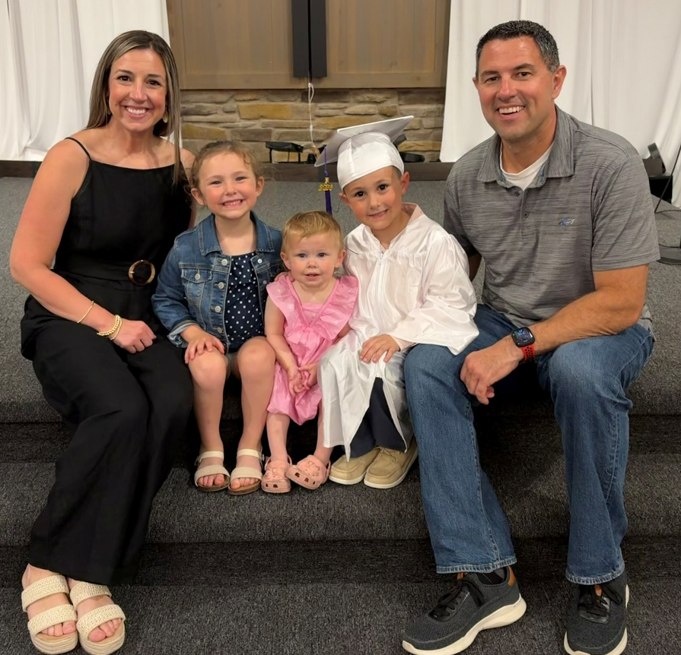
Introduction
B.S. Civil Engineering, The Ohio State University
MBA, Bowling Green State University
Professional Engineer
Engineer Intern – American Municipal Power
Council Member – City of Napoleon
Chief Deputy – Henry County Engineer
Executive Director – Henry County TID
District 2 Deputy Director – ODOT

Slide 3
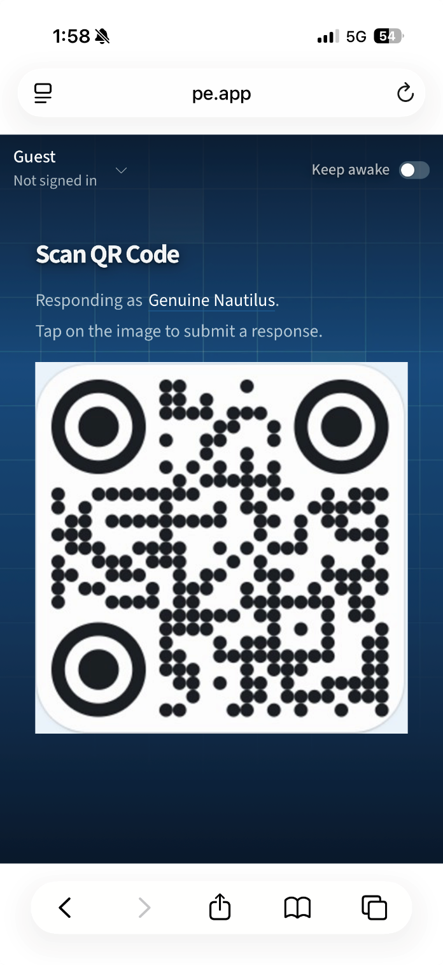

POLL EV
Keep Awake
Change your
“responding as” name
Website: https://pe.app/odotd2

Slide 4
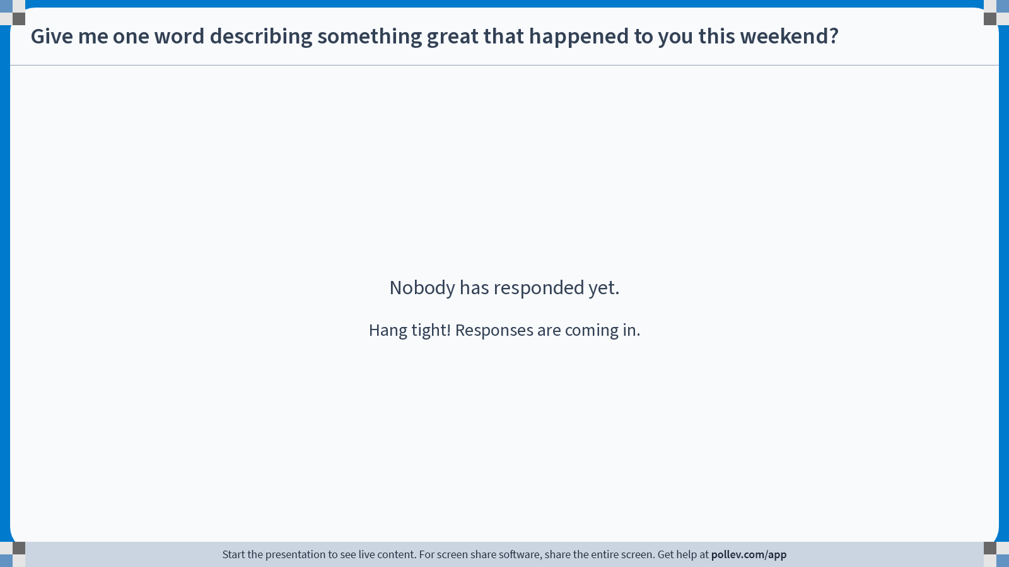
Notes:
Poll Title: Do not modify the notes in this section to avoid tampering with the Poll Everywhere activity.
More info at polleverywhere.com/support
Give me one word describing something great that happened to you this weekend?
https://www.polleverywhere.com/free_text_polls/Muddi07F2O4lHCv5oKfxS

Slide 5
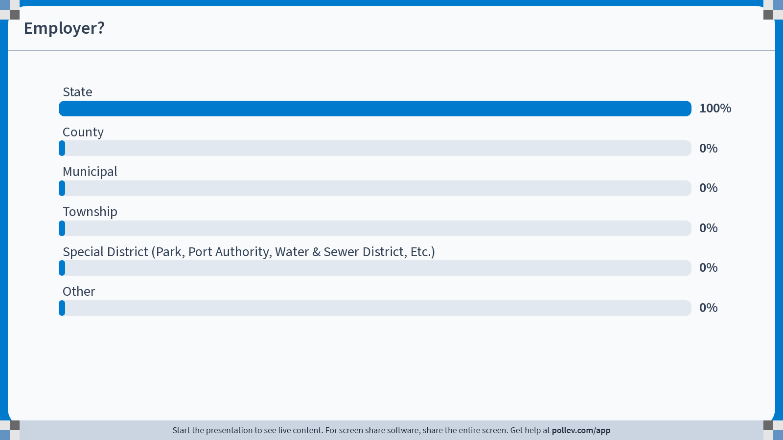
Notes:
Poll Title: Do not modify the notes in this section to avoid tampering with the Poll Everywhere activity.
More info at polleverywhere.com/support
Employer?
https://www.polleverywhere.com/multiple_choice_polls/zQAQEmjOIRdVF0OVrVyrw?state=opened&flow=Default&onscreen=persist

Slide 6
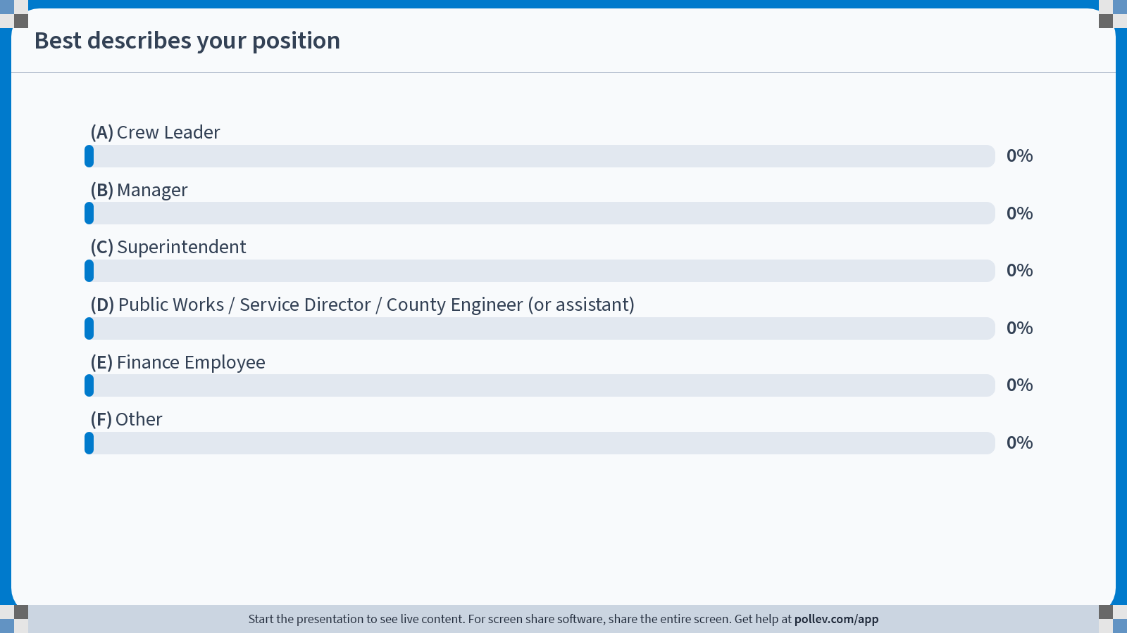
Notes:
Poll Title: Do not modify the notes in this section to avoid tampering with the Poll Everywhere activity.
More info at polleverywhere.com/support
Best describes your position
https://www.polleverywhere.com/multiple_choice_polls/Wq6jeiYJVbQI8hMZko16O?state=opened&flow=Default&onscreen=persist

Slide 7
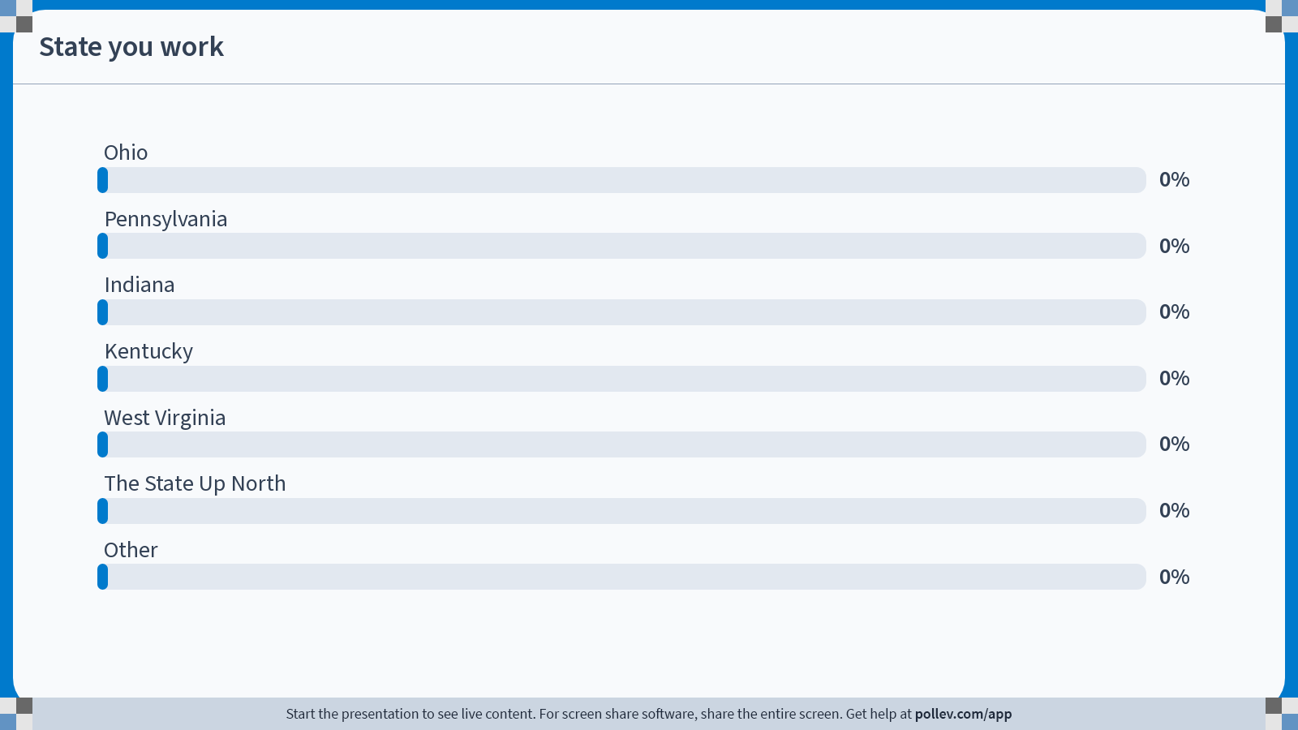
Notes:
Poll Title: Do not modify the notes in this section to avoid tampering with the Poll Everywhere activity.
More info at polleverywhere.com/support
State you work
https://www.polleverywhere.com/multiple_choice_polls/hMyP5xaVu8UrUsy68vhEN?state=opened&flow=Default&onscreen=persist

Slide 8
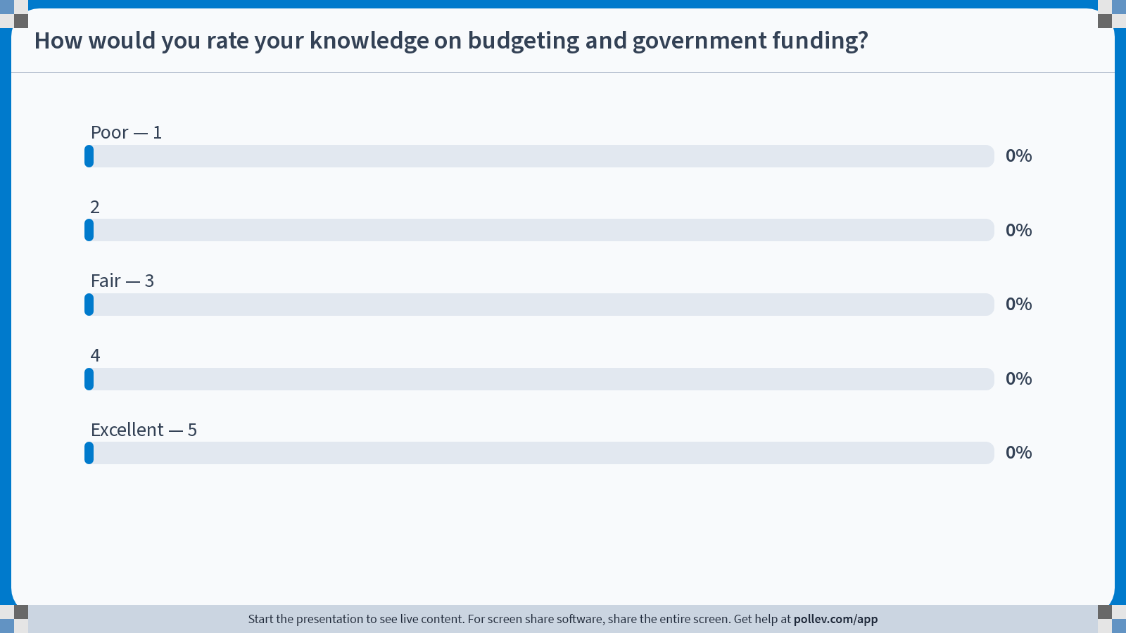
Notes:
Poll Title: Do not modify the notes in this section to avoid tampering with the Poll Everywhere activity.
More info at polleverywhere.com/support
How would you rate your knowledge on budgeting and government funding?
https://www.polleverywhere.com/multiple_choice_polls/03JqWuXNAYHiW8y0RVwxh?state=opened&flow=Default&onscreen=persist

Slide 9
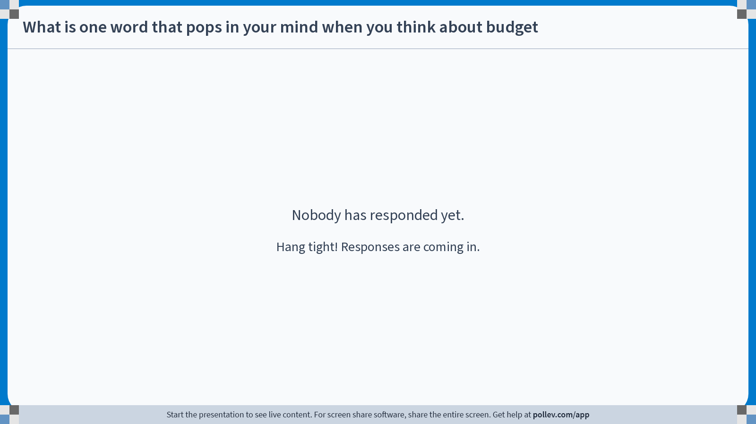
Notes:
Poll Title: Do not modify the notes in this section to avoid tampering with the Poll Everywhere activity.
More info at polleverywhere.com/support
What is one word that pops in your mind when you think about budget
https://www.polleverywhere.com/free_text_polls/CLZzi6zrtQxXFRn6cwpJo

Slide 10
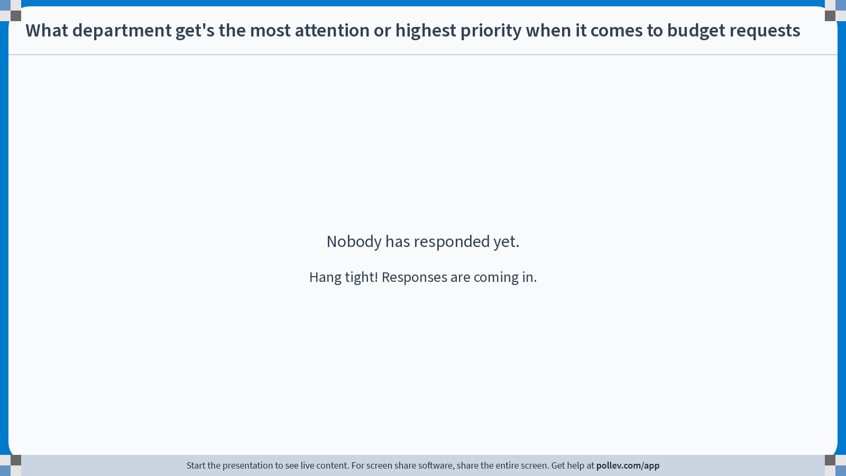
Notes:
Poll Title: Do not modify the notes in this section to avoid tampering with the Poll Everywhere activity.
More info at polleverywhere.com/support
What department get's the most attention or highest priority when it comes to budget requests
https://www.polleverywhere.com/free_text_polls/f0RHsdMgjw44i5D9ysv5V

Slide 11
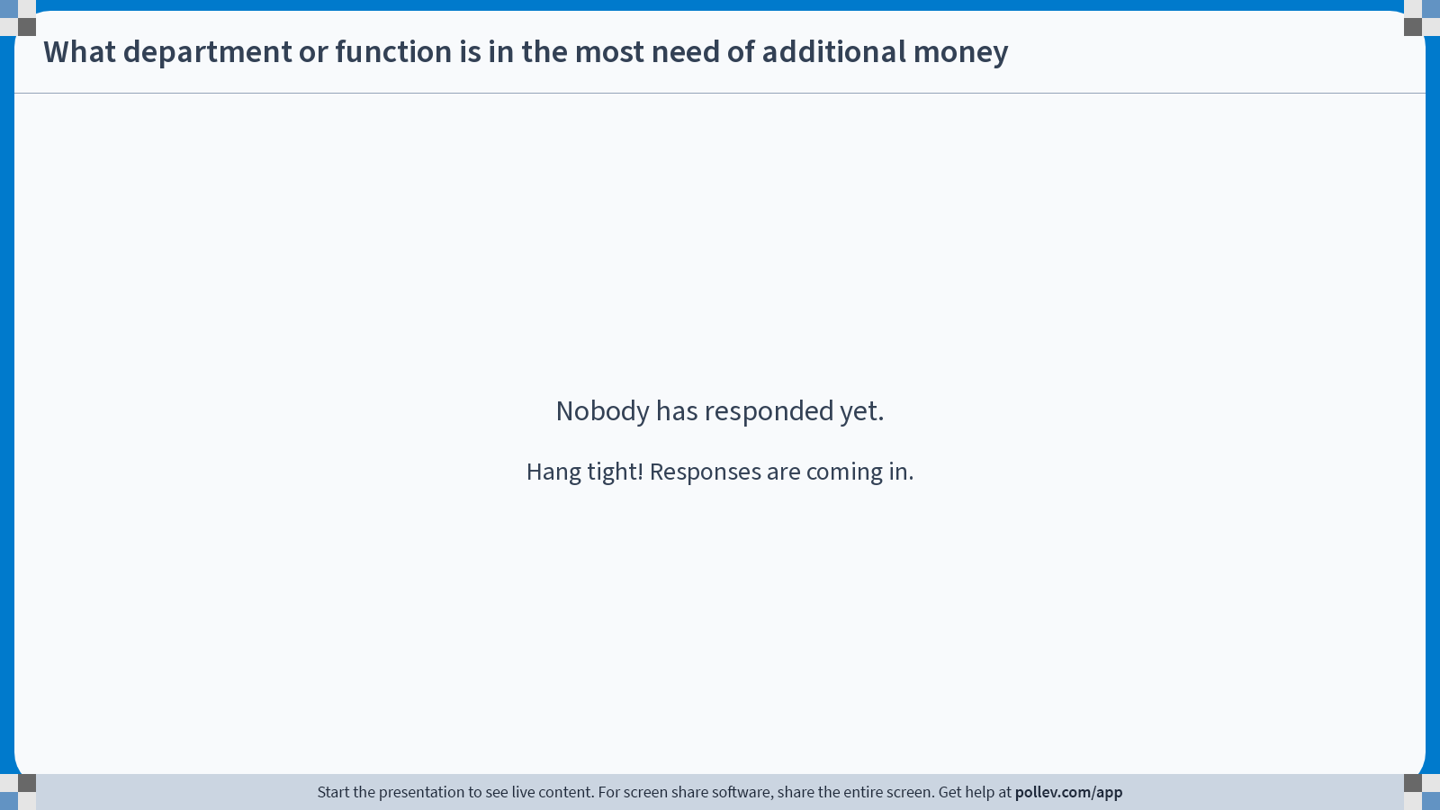
Notes:
Poll Title: Do not modify the notes in this section to avoid tampering with the Poll Everywhere activity.
More info at polleverywhere.com/support
What department or function is in the most need of additional money
https://www.polleverywhere.com/free_text_polls/UIvMSKqwO8Mvfrbsg59CE

Slide 12
Definition/Mission of Budget Process
Definition of the Budget Process: The budget process consists of activities that encompass the development, implementation, and evaluation of a plan for the provision of services and capital assets.
Mission of the Budget Process: To help decision makers make informed choices about the provision of services and capital assets and to promote stakeholder participation in the process.
[1} Source: National Advisory Council on State and Local Budgeting

Slide 13
Key Characteristics of Budgeting Process
Incorporates a long-term perspective;
Establishes linkages to broad organizational goals;
Focuses budget decisions on results and outcomes;
Involves and promotes effective communication with stakeholders; and
Provides incentives to government management and employees.
[1} Source: National Advisory Council on State and Local Budgeting

Slide 14
Best Practice : Structurally Balanced Budget
Most entities are required to pass a balanced budget (statutory) (ORC 118.02)
Should be financially sustainable for years in the future (best practice). Achieve a true structurally balanced budget.
Understand reoccurring and non-recurring revenues/expenditures and reserves
[1} Source: National Advisory Council on State and Local Budgeting

Slide 15
Ohio requirement for fiscal integrity
ORC 118.02(A) Pursuant to the authority of the general assembly to provide for the public health, safety, and welfare and to limit and restrict the powers of municipal corporations, counties, and townships to borrow money, contract debts, and levy taxes to prevent the abuse of such powers and to require reports and examination of their financial condition, transactions, operations, and undertakings, it is hereby declared to be the public policy and a public purpose of the state to require fiscal integrity of municipal corporations, counties, and townships so that they may provide for the health, safety, and welfare of their citizens, pay when due principal and interest on their debt obligations, meet financial obligations to their employees, vendors, and suppliers, and provide for proper financial accounting procedures, budgeting, and taxing practices. The failure of a municipal corporation, county, or township to so act is hereby determined to affect adversely the health, safety, and welfare not only of the people of the municipal corporation, county, or township but also of other people of the state. It is further determined that the fiscal emergency conditions described in division (A) of section 118.03 of the Revised Code result from and constitute abuses of the powers of a municipal corporation, county, or township to borrow money, contract debts, and levy taxes, and that such conditions impair and threaten the health, safety, and welfare of the people of the state within and beyond the municipal corporation, county, or township.

Slide 16
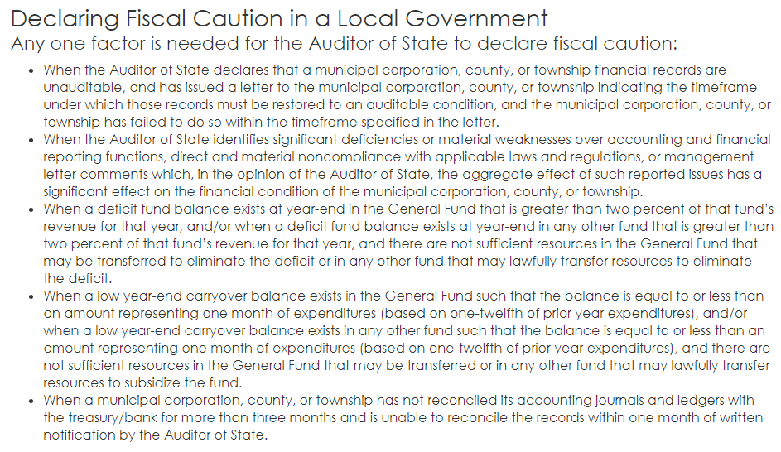
Fiscal Caution

Slide 17
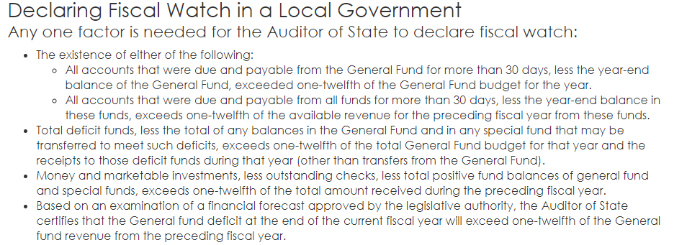
Fiscal Watch

Slide 18
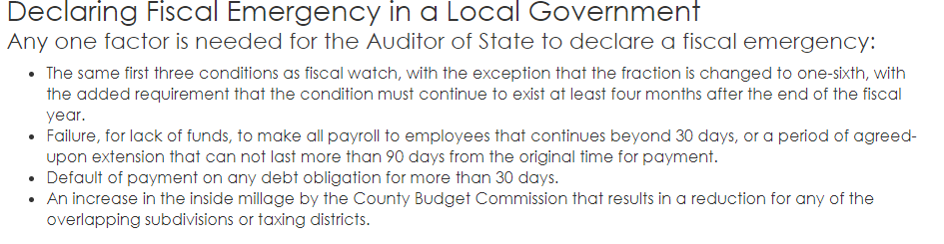
Fiscal Emergency

Slide 19
Appropriation Authority (ORC 118.13)
ORC 118.13 requires counties, townships, and municipal corporations to submit estimate of resources and amendments to county budget commission
Financial plan approved by commission
No appropriation measure may be adopted contrary to the financial plan
State must submit to the General Assembly (because of IIJA ODOT had to amend). No agency shall incur an obligation which exceeds the agency’s current appropriation authority (ORC 131.33)

Slide 20
Revenue classification
Recurring revenue – reasonably expect to continue year to year, with some degree of predictability (i.e. taxes, fees, rates)
Non-recurring revenue – one time or cannot reliably rely on (settlement from lawsuit, sale of property, grants, ARPA, etc.)
Some revenue could have components of both depending on volatility
[1} Source: National Advisory Council on State and Local Budgeting

Slide 21
Expense classification
Recurring expenses – reasonably expect to continue each year with a some degree of predictability (i.e. salaries, benefits, materials, services, ongoing maintenance and operational costs)
Non-recurring expenses – One-time costs or acquisitions (i.e. purchase of property or large equipment). Definition of what constitutes is somewhat relative to size of department or entity. Greater degree of flexibly to defer.
Some expenses could have components of both depending on volatility (i.e. road budget, police car purchase, etc.)
[1} Source: National Advisory Council on State and Local Budgeting

Slide 22

POLL EV

Slide 23
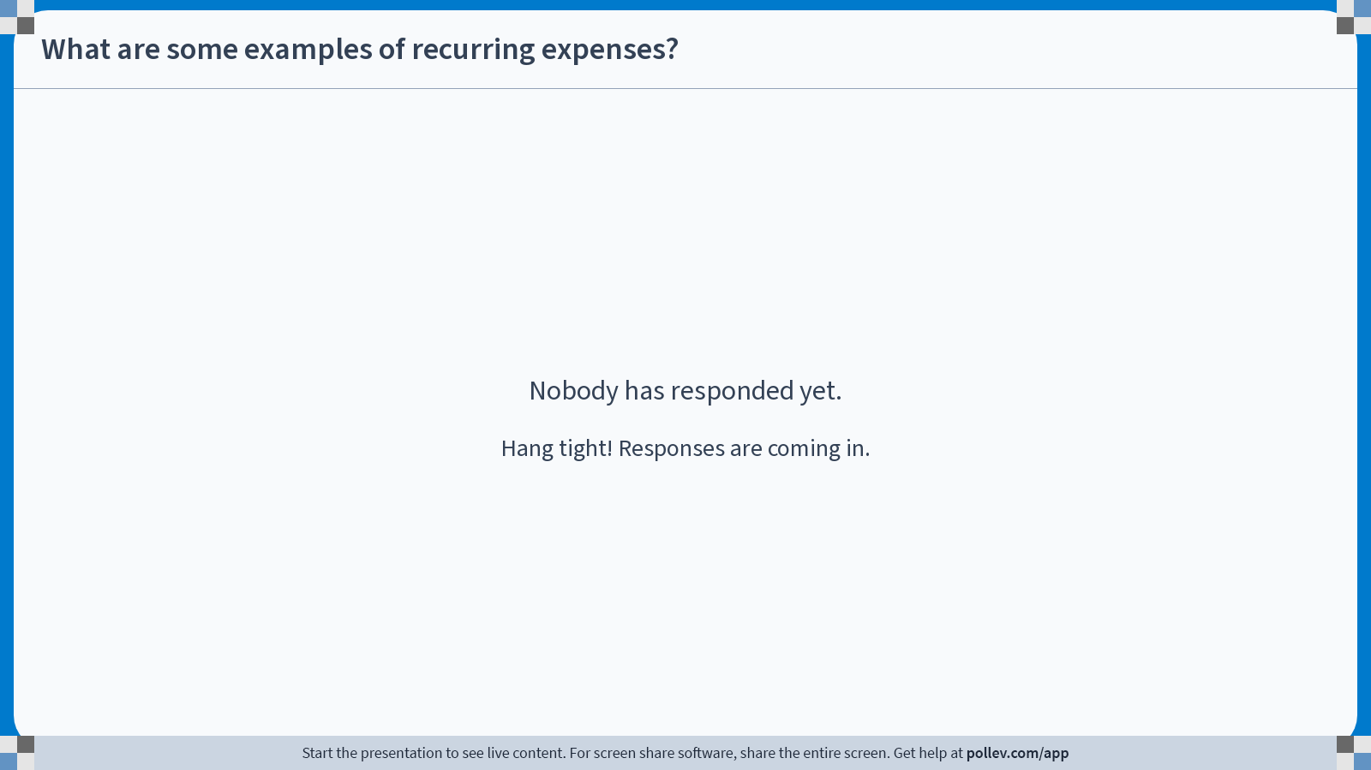
Notes:
Poll Title: Do not modify the notes in this section to avoid tampering with the Poll Everywhere activity.
More info at polleverywhere.com/support
What are some examples of recurring expenses?
https://www.polleverywhere.com/free_text_polls/ANUdn12l97uSO2Xxm3cn6

Slide 24
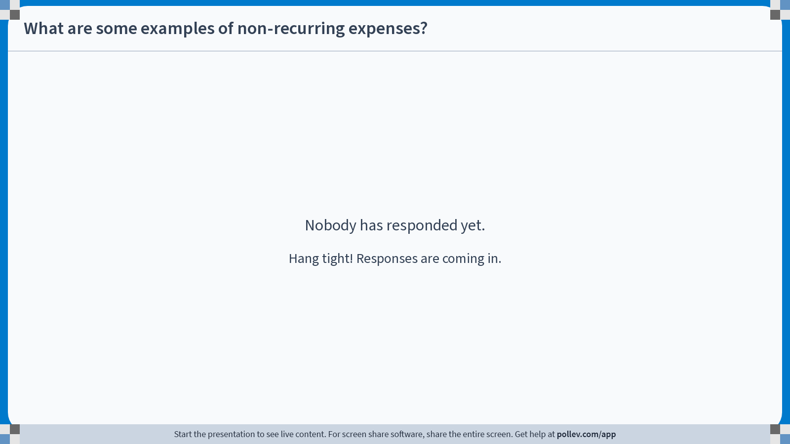
Notes:
Poll Title: Do not modify the notes in this section to avoid tampering with the Poll Everywhere activity.
More info at polleverywhere.com/support
What are some examples of non-recurring expenses?
https://www.polleverywhere.com/free_text_polls/Z7J7stQEN5TwKNWqRxskR

Slide 25
Best Practice : Structurally Balanced Budget
Reserves – Portion of the fund balance that is set aside as hedge against risk
  Government should define a minimum level of funds it will have in reserves
  Reserves are maintained is one indication of financial health and a structurally balanced budget
  If declining may indicate an imbalance in the budget
Government should adopt a policy calling for a structurally balanced budget, one where recurring revenue is equal or exceeds recurring expenses
[1} Source: National Advisory Council on State and Local Budgeting

Slide 26
Funds
Typical fund types
General revenue fund – Any proper public purpose
Restricted fund – designated for a specific use by ordinance, charter, taxing purpose, law, etc.
Enterprise fund (proprietary funds) – Self supporting government fund that sells goods and/or services for a fee (generally a restricted fund)

Slide 27

Match revenue activity with revenue fund GAME

Slide 28
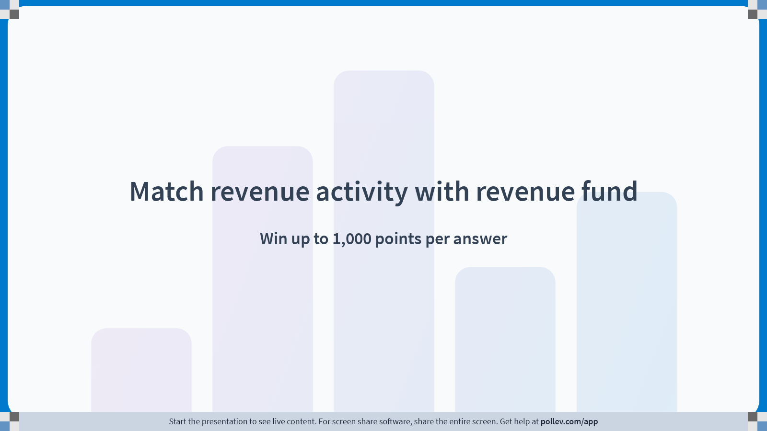
Notes:
Poll Title: Do not modify the notes in this section to avoid tampering with the Poll Everywhere activity.
More info at polleverywhere.com/support
Match revenue activity with revenue fund
https://www.polleverywhere.com/competitions/tLZlmSJGsRCaXizUk1N2P?display_state=welcome&controls=none&onscreen=persist

Slide 29
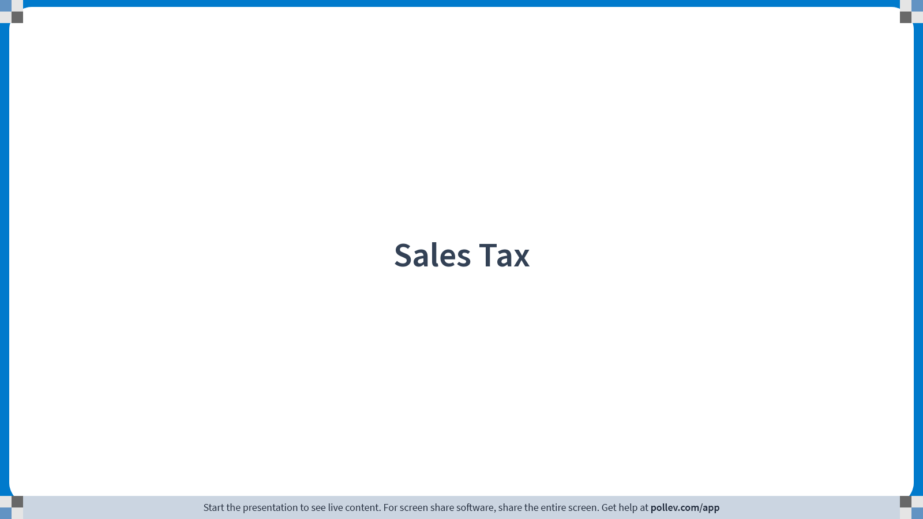
Notes:
Poll Title: Do not modify the notes in this section to avoid tampering with the Poll Everywhere activity.
More info at polleverywhere.com/support
Sales Tax
https://www.polleverywhere.com/multiple_choice_polls/FH7Yeu4TfvyEXTWiYB3f3?display_state=title&controls=none&onscreen=persist

Slide 30
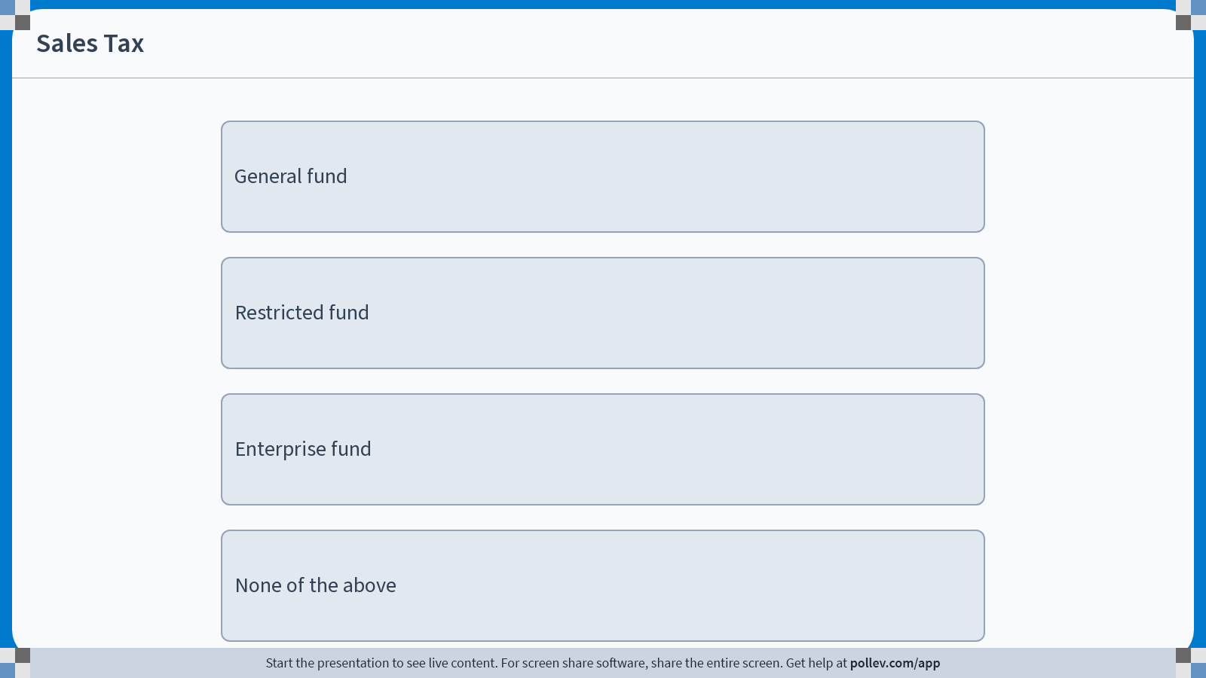
Notes:
Poll Title: Do not modify the notes in this section to avoid tampering with the Poll Everywhere activity.
More info at polleverywhere.com/support
Sales Tax
https://www.polleverywhere.com/multiple_choice_polls/FH7Yeu4TfvyEXTWiYB3f3?display_state=instructions&controls=none&onscreen=persist

Slide 31
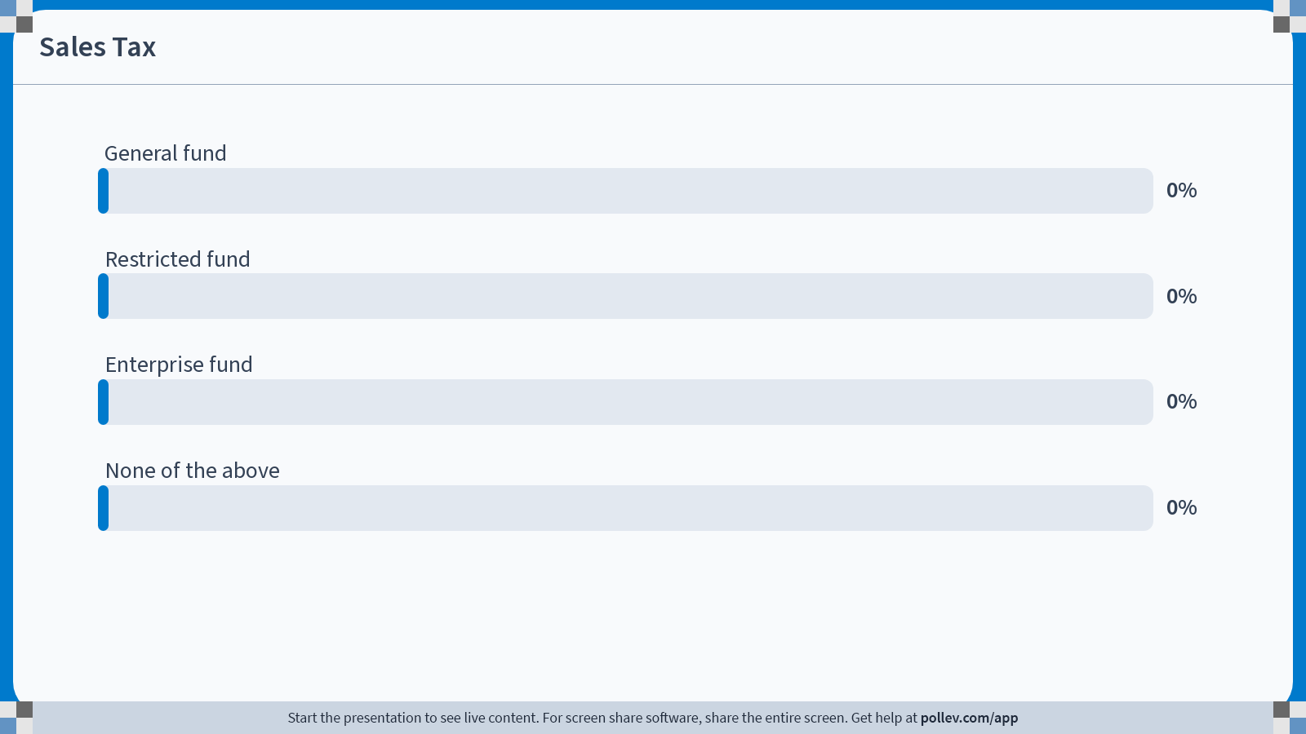
Notes:
Poll Title: Do not modify the notes in this section to avoid tampering with the Poll Everywhere activity.
More info at polleverywhere.com/support
Sales Tax
https://www.polleverywhere.com/multiple_choice_polls/FH7Yeu4TfvyEXTWiYB3f3?display_state=chart&display=correctness&controls=none&onscreen=persist

Slide 32
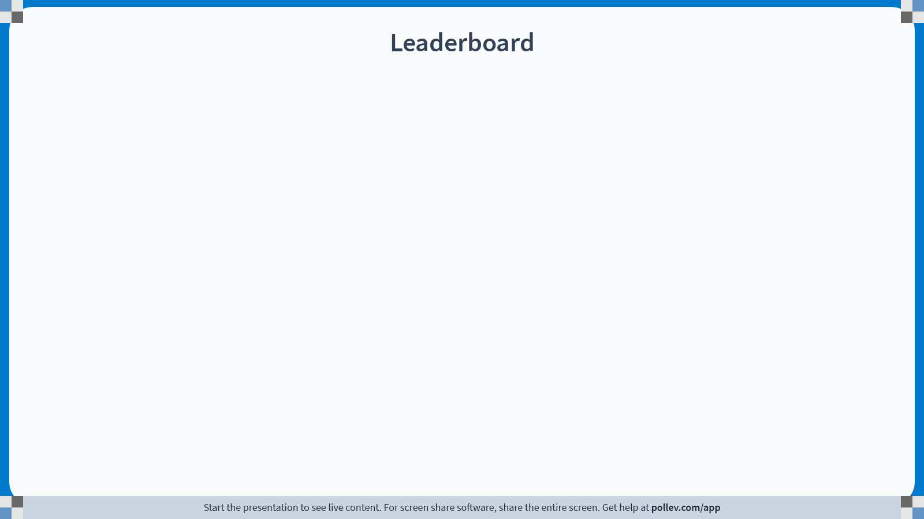
Notes:
Poll Title: Do not modify the notes in this section to avoid tampering with the Poll Everywhere activity.
More info at polleverywhere.com/support
Match revenue activity with revenue fund
https://www.polleverywhere.com/competitions/tLZlmSJGsRCaXizUk1N2P?display_state=leaderboard&onscreen=persist

Slide 33
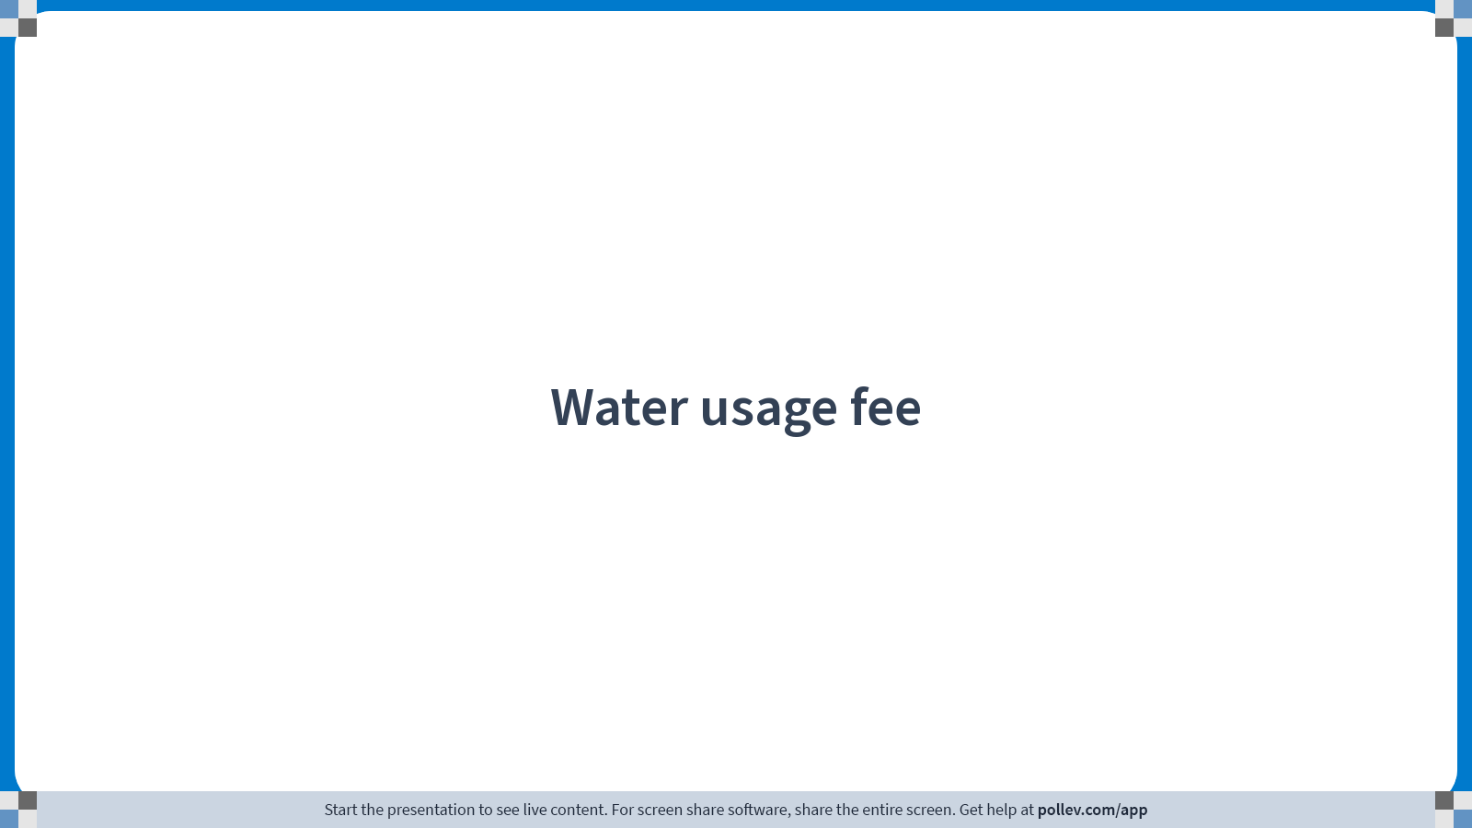
Notes:
Poll Title: Do not modify the notes in this section to avoid tampering with the Poll Everywhere activity.
More info at polleverywhere.com/support
Water usage fee
https://www.polleverywhere.com/multiple_choice_polls/eYksKUQVRfrcR2SnlhnwP?display_state=title&controls=none&onscreen=persist

Slide 34
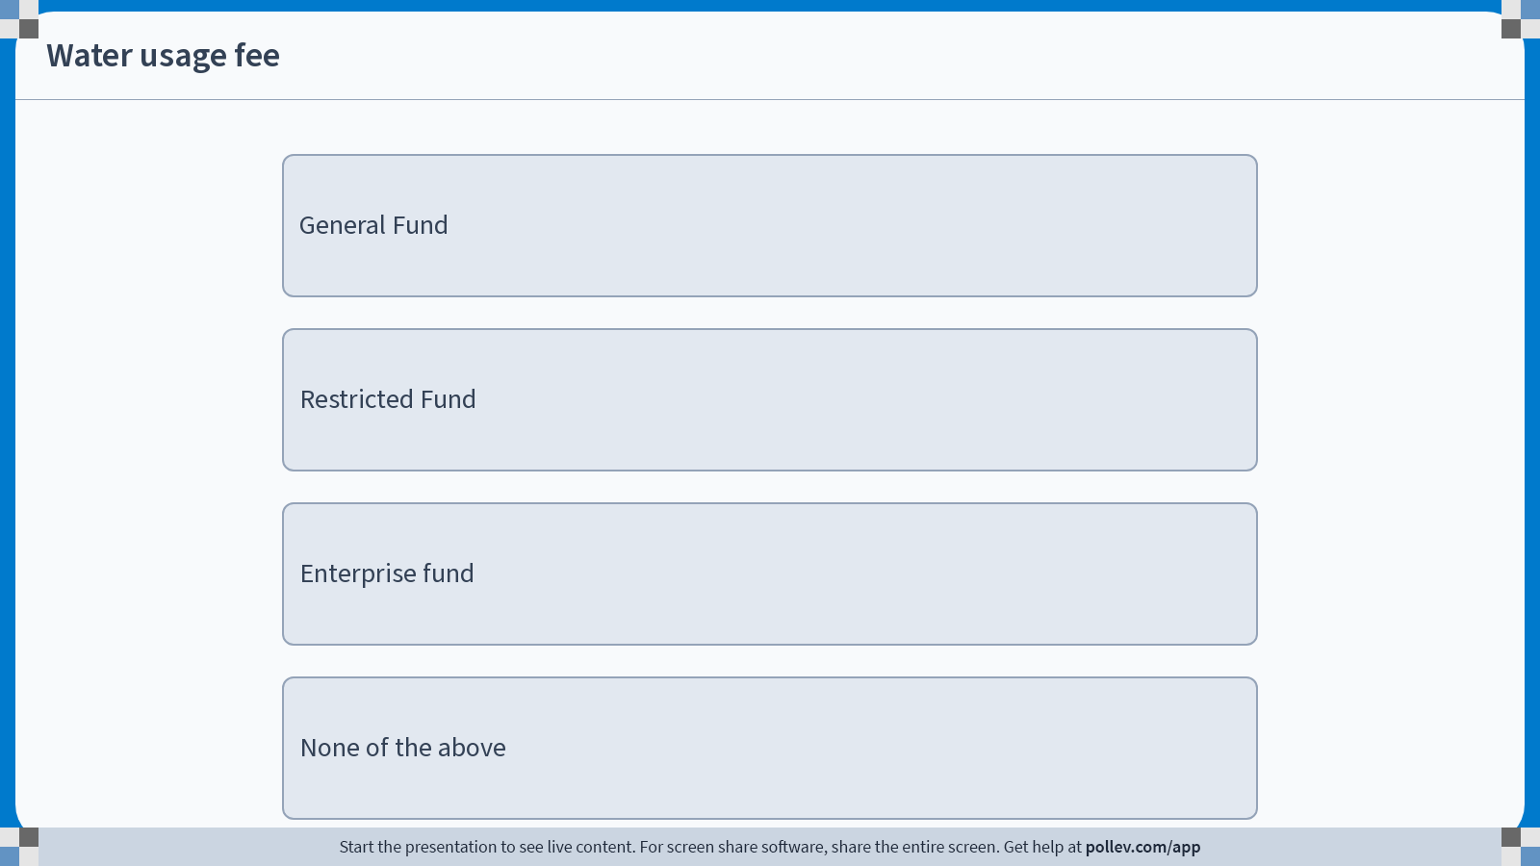
Notes:
Poll Title: Do not modify the notes in this section to avoid tampering with the Poll Everywhere activity.
More info at polleverywhere.com/support
Water usage fee
https://www.polleverywhere.com/multiple_choice_polls/eYksKUQVRfrcR2SnlhnwP?display_state=instructions&controls=none&onscreen=persist

Slide 35
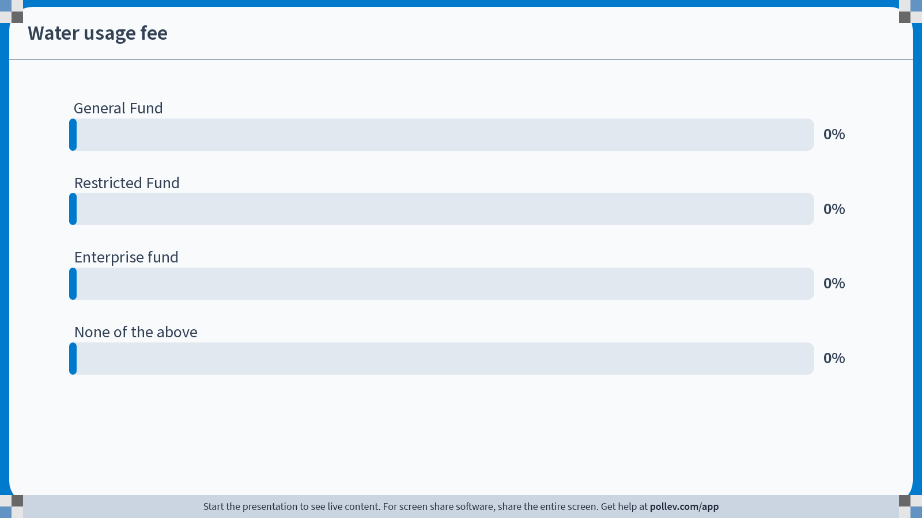
Notes:
Poll Title: Do not modify the notes in this section to avoid tampering with the Poll Everywhere activity.
More info at polleverywhere.com/support
Water usage fee
https://www.polleverywhere.com/multiple_choice_polls/eYksKUQVRfrcR2SnlhnwP?display_state=chart&display=correctness&controls=none&onscreen=persist

Slide 36
Notes:
Poll Title: Do not modify the notes in this section to avoid tampering with the Poll Everywhere activity.
More info at polleverywhere.com/support
Match revenue activity with revenue fund
https://www.polleverywhere.com/competitions/tLZlmSJGsRCaXizUk1N2P?display_state=leaderboard&onscreen=persist

Slide 37
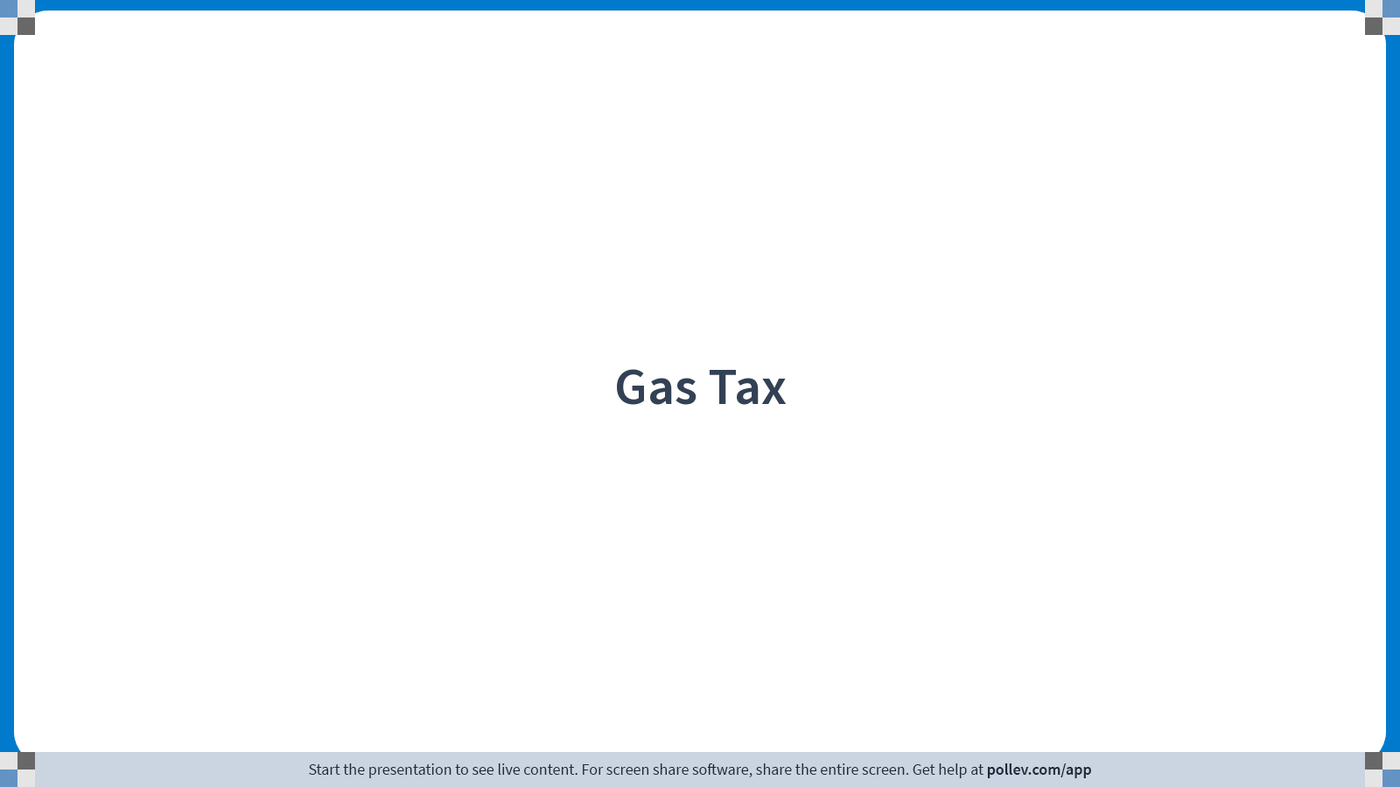
Notes:
Poll Title: Do not modify the notes in this section to avoid tampering with the Poll Everywhere activity.
More info at polleverywhere.com/support
Gas Tax
https://www.polleverywhere.com/multiple_choice_polls/mMeyK7aCHUMwjoALveoAe?display_state=title&controls=none&onscreen=persist

Slide 38

Notes:
Poll Title: Do not modify the notes in this section to avoid tampering with the Poll Everywhere activity.
More info at polleverywhere.com/support
Gas Tax
https://www.polleverywhere.com/multiple_choice_polls/mMeyK7aCHUMwjoALveoAe?display_state=instructions&controls=none&onscreen=persist

Slide 39
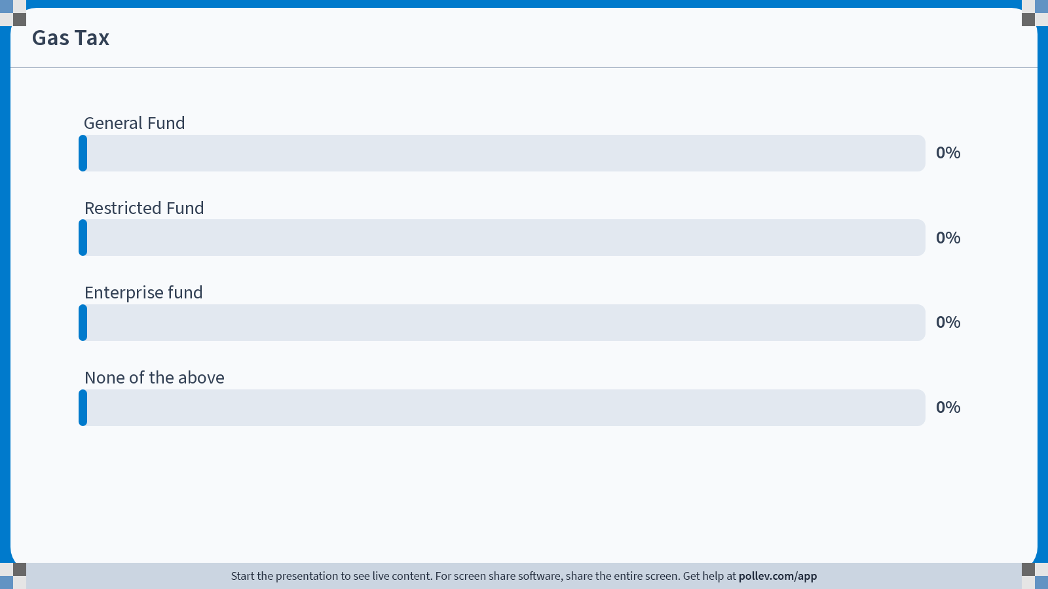
Notes:
Poll Title: Do not modify the notes in this section to avoid tampering with the Poll Everywhere activity.
More info at polleverywhere.com/support
Gas Tax
https://www.polleverywhere.com/multiple_choice_polls/mMeyK7aCHUMwjoALveoAe?display_state=chart&display=correctness&controls=none&onscreen=persist

Slide 40
Notes:
Poll Title: Do not modify the notes in this section to avoid tampering with the Poll Everywhere activity.
More info at polleverywhere.com/support
Match revenue activity with revenue fund
https://www.polleverywhere.com/competitions/tLZlmSJGsRCaXizUk1N2P?display_state=leaderboard&onscreen=persist

Slide 41
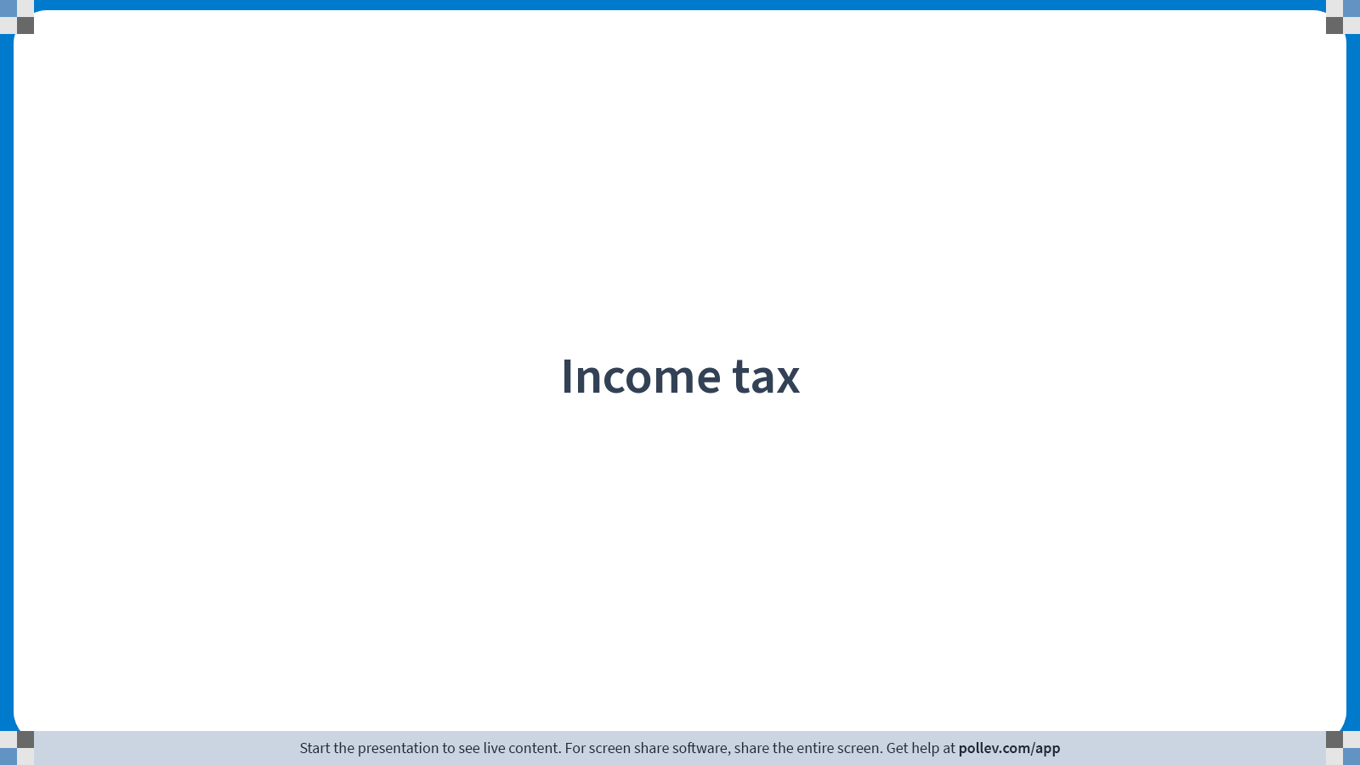
Notes:
Poll Title: Do not modify the notes in this section to avoid tampering with the Poll Everywhere activity.
More info at polleverywhere.com/support
Income tax
https://www.polleverywhere.com/multiple_choice_polls/LU82pIAj0ifRdgoIAJWLB?display_state=title&controls=none&onscreen=persist

Slide 42
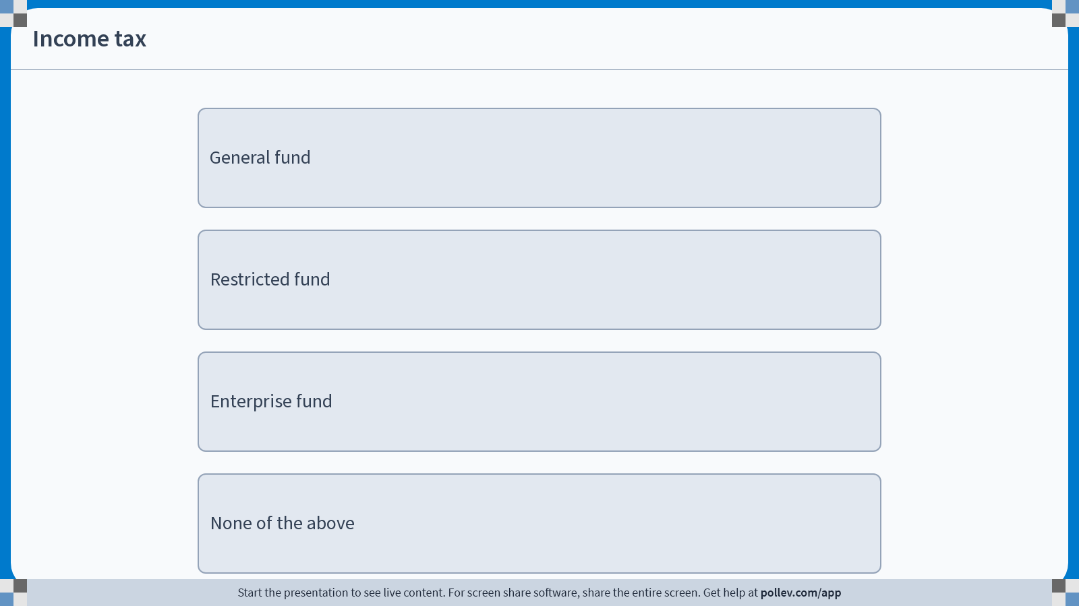
Notes:
Poll Title: Do not modify the notes in this section to avoid tampering with the Poll Everywhere activity.
More info at polleverywhere.com/support
Income tax
https://www.polleverywhere.com/multiple_choice_polls/LU82pIAj0ifRdgoIAJWLB?display_state=instructions&controls=none&onscreen=persist

Slide 43
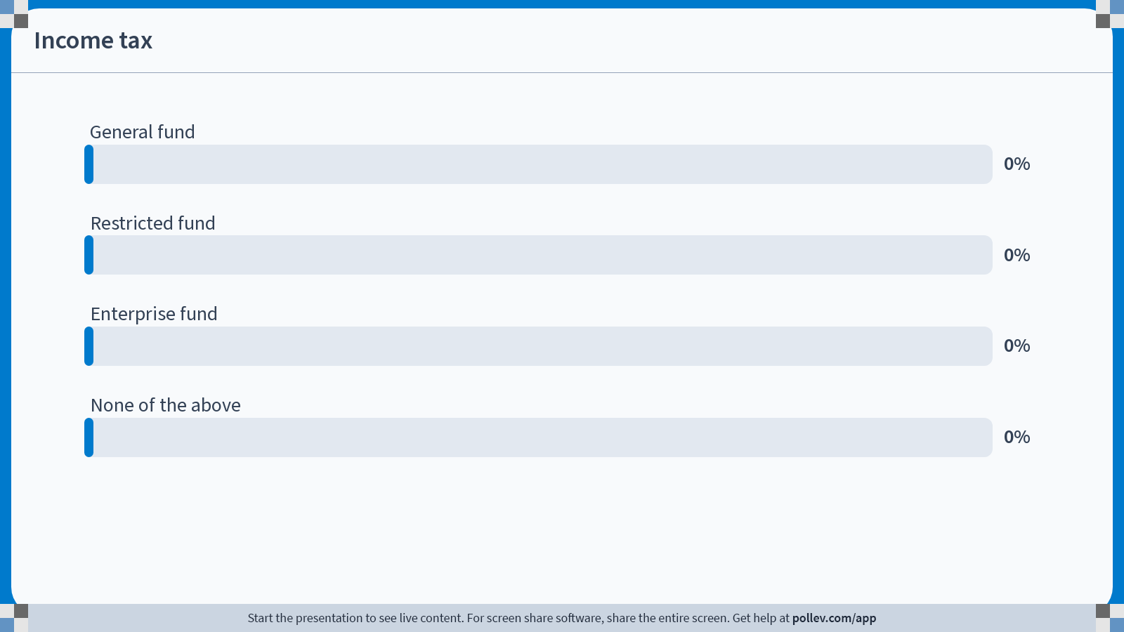
Notes:
Poll Title: Do not modify the notes in this section to avoid tampering with the Poll Everywhere activity.
More info at polleverywhere.com/support
Income tax
https://www.polleverywhere.com/multiple_choice_polls/LU82pIAj0ifRdgoIAJWLB?display_state=chart&display=correctness&controls=none&onscreen=persist

Slide 44
Notes:
Poll Title: Do not modify the notes in this section to avoid tampering with the Poll Everywhere activity.
More info at polleverywhere.com/support
Match revenue activity with revenue fund
https://www.polleverywhere.com/competitions/tLZlmSJGsRCaXizUk1N2P?display_state=leaderboard&onscreen=persist

Slide 45
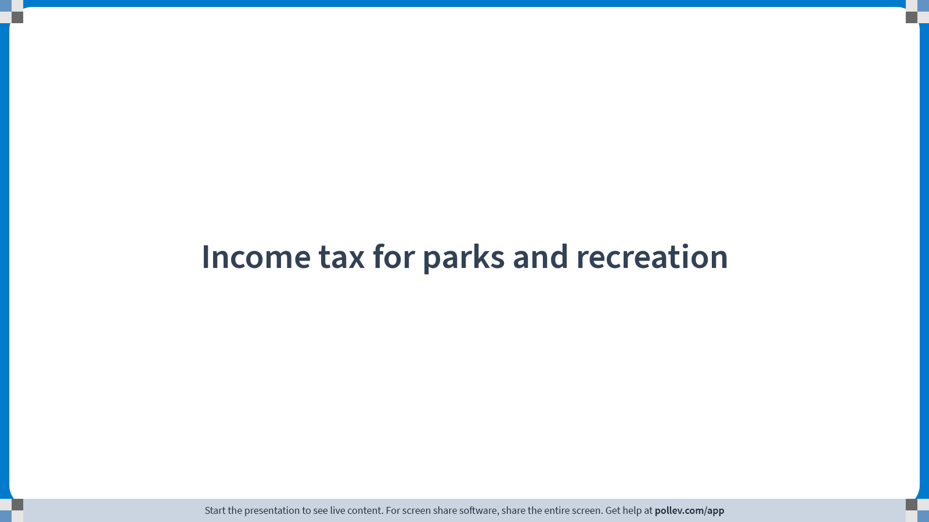
Notes:
Poll Title: Do not modify the notes in this section to avoid tampering with the Poll Everywhere activity.
More info at polleverywhere.com/support
Income tax for parks and recreation
https://www.polleverywhere.com/multiple_choice_polls/AnjnpkCgYyuwFdI0iuoCF?display_state=title&controls=none&onscreen=persist

Slide 46
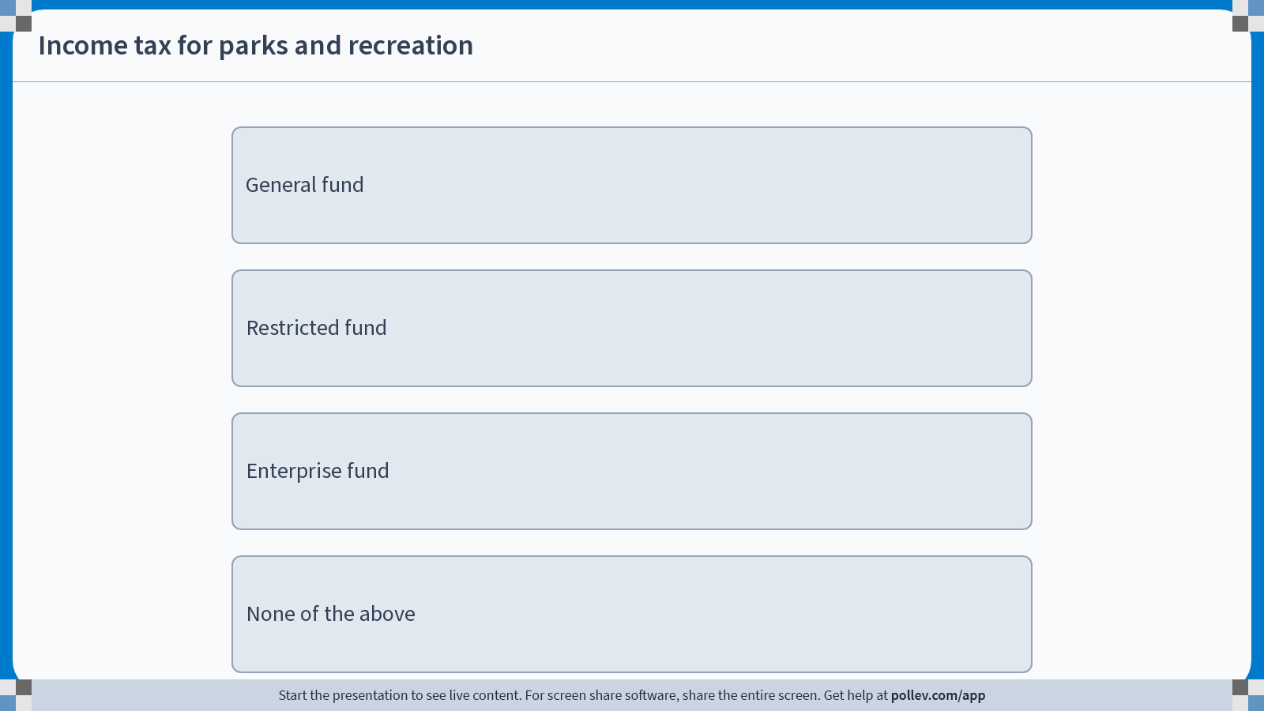
Notes:
Poll Title: Do not modify the notes in this section to avoid tampering with the Poll Everywhere activity.
More info at polleverywhere.com/support
Income tax for parks and recreation
https://www.polleverywhere.com/multiple_choice_polls/AnjnpkCgYyuwFdI0iuoCF?display_state=instructions&controls=none&onscreen=persist

Slide 47
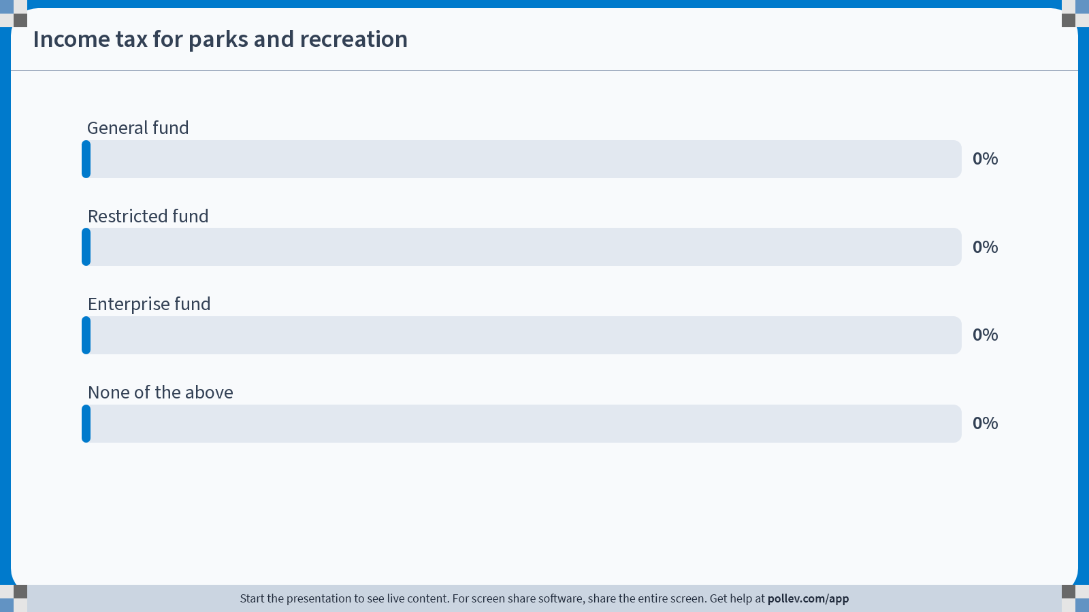
Notes:
Poll Title: Do not modify the notes in this section to avoid tampering with the Poll Everywhere activity.
More info at polleverywhere.com/support
Income tax for parks and recreation
https://www.polleverywhere.com/multiple_choice_polls/AnjnpkCgYyuwFdI0iuoCF?display_state=chart&display=correctness&controls=none&onscreen=persist

Slide 48

Notes:
Poll Title: Do not modify the notes in this section to avoid tampering with the Poll Everywhere activity.
More info at polleverywhere.com/support
Match revenue activity with revenue fund
https://www.polleverywhere.com/competitions/tLZlmSJGsRCaXizUk1N2P?display_state=finale&onscreen=persist

Slide 49
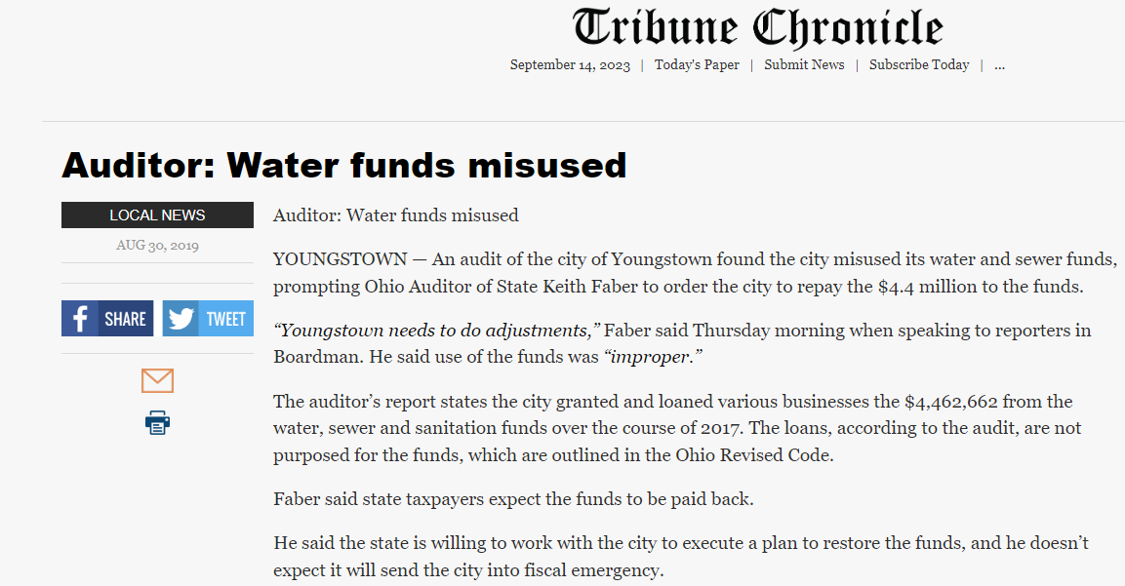
Misuse of Funds

Slide 50
Revenue Control
Rates (water, sewer, electric, landfill charges, parks and rec fees, etc.) – High control and fairly easy to adjust, but usually restricted
Assessments – Similar to rates, but impacted owners may balk
Income tax credit (or reciprocity) – Medium control. Can do quickly, but can be controversial with a perception of pushing people out of a municipality. Is usually for general fund, so can be used for any proper purpose.
Tax increase or new tax – Low control. Often has to go before voters and usually for a defined purposed (will make funds restricted). Can play a shell game if passed (i.e. new police/roads/fire levy, etc.)

Slide 51
Match revenue activity with revenue fund GAME

Slide 52
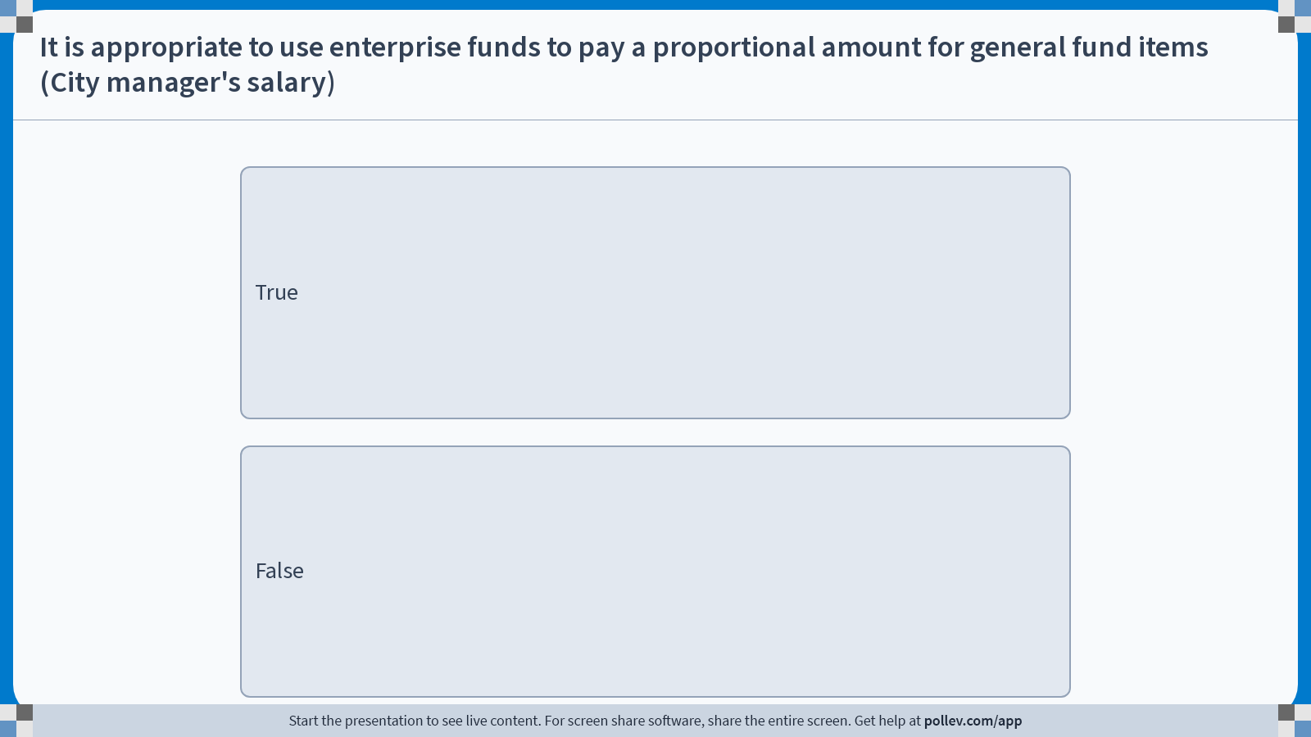
Notes:
Poll Title: Do not modify the notes in this section to avoid tampering with the Poll Everywhere activity.
More info at polleverywhere.com/support
It is appropriate to use enterprise funds to pay a proportional amount for general fund items (City manager's salary)
https://www.polleverywhere.com/multiple_choice_polls/3wYPbUZ5pLV6fCUXOgOkz?display_state=instructions&activity_state=opened&state=opened&flow=Engagement&onscreen=persist

Slide 53
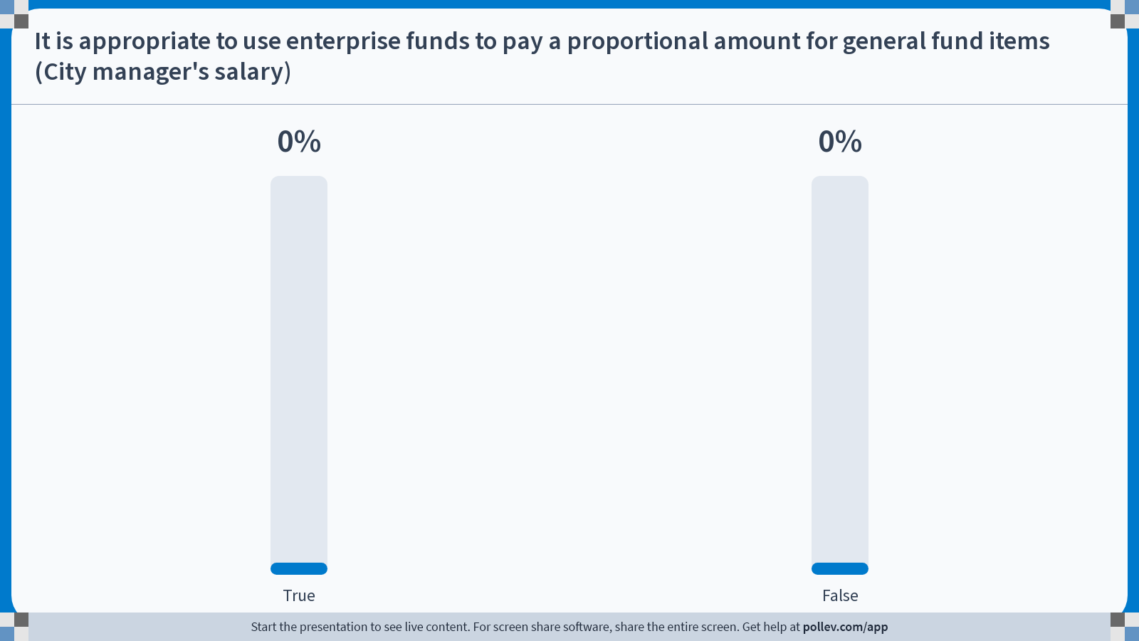
Notes:
Poll Title: Do not modify the notes in this section to avoid tampering with the Poll Everywhere activity.
More info at polleverywhere.com/support
It is appropriate to use enterprise funds to pay a proportional amount for general fund items (City manager's salary)
https://www.polleverywhere.com/multiple_choice_polls/3wYPbUZ5pLV6fCUXOgOkz?display_state=chart&activity_state=opened&state=opened&flow=Engagement&onscreen=persist

Slide 54
Chargeback/reimbursables
Can charge a fund for usage of the asset's resources (people, equipment, material)
  Generally, shows up as a revenue in one fund and an expense in another
  Examples
    Water distribution employees plow snow
    Electric department’s excavator used for a water break
    City Engineer designs water line
    City Manager is on an electric co-op board

Slide 55
Assessments
ORC 727 for municipalities
Assess the property owners (usually based on their share of the usage or frontage) for roads, ditches, sewer lines, sidewalks, etc.
Usually is collected with the property taxes
Putting a ditch “on maintenance” is a form of assessment
May be levied
  by a percentage of the tax value
  In proportion to the benefits that may result from the improvement
  By the front foot of the property bound and abutting upon the improvement

Slide 56
Bonding
Bonding – debt security issued by a local, county, state or other government entity. Usually for some type of infrastructure/capital, not operations expenses
  Generally lower coupon (interest) rates for political subdivision
  Federally tax exempt for investors – helps investor part ways with lower return
  Usually less risky option for investors. Default rates are low.
  Congress occasionally looks to repeal the tax exempt status
  Must commit revenue source
Bonding programs also can administer loan programs (i.e. port bonds, Ohio infrastructure bank, etc.)

Slide 57
Loans
Government loan programs (OPWC, EPA DEFA, USDA, etc.)
Typical bank loan
Short term municipal note
  Typically mature in one year or less
  One usage is to fund construction until construction is complete then rolled over to a bond
  Usually one payment made upon maturity
  Tax exempt for investors

Slide 58
Tax Increment Financing (TIF)
Can put in infrastructure for development and take a percentage of the increase in tax revenue to pay off infrastructure investment over a period
Political subdivision can do this for 75% of the tax value increase for 10 years without getting approval. Window triggered when land is developed
Can get a higher rate or longer term, but must get approval from school board(s) and additional government entity (up to 100% for 30 years)
  Mixed feelings depending on the school district
  Can do this without concurrence if payments in lieu of taxes will be made to the affected board of education
Someone has to be the bank
More and more common

Slide 59
Joint economic development District (JEDD)
Quasi-governmental agency
Board of trustees is established that is appointed by the government agencies
Created from a partnership between a municipality (or multiple) and a township
Is outside of municipal corporation borders
The municipality collects the income tax (usually the same as what the municipality has levies) and distributes to government entities to provide for services and for overall revenue (usually in developing areas)
Used to provide services or infrastructure for that district
Have been abused in the past

Slide 60
Understanding budget ledger
Open encumbrance balance – is the total value of purchase orders that have been issued that have not been disbursed
Unencumbered balance (or available budget) – balance that has not been encumbered (assigned) or disbursed (spent) yet
Disbursements – money that has been disbursed (check issued/payment made)
Total budget – encumbrances – disbursements = available budget

Slide 61
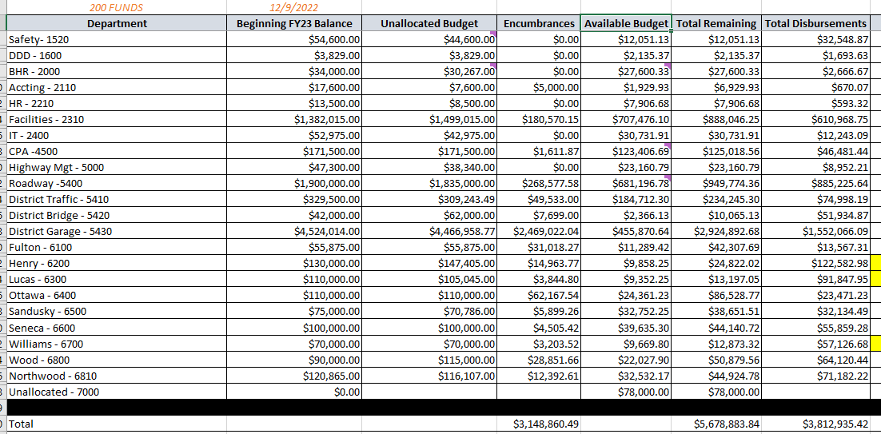
Understanding budget ledger

Slide 62
Managing your budget through the year
Have regular budget meetings, especially if you have multiple departments with budgets reporting to you.
Identify acceptable priorities
Understand your ability to transfer money around to achieve your priorities
Make sure priorities are in line with the overarching budget
Many finance professionals view encumbrance as money already gone. This is usually the case. POs open for a specific purchase are.
Stay on top of departments on purchases and departments with large open POs that may not spend (asphalt, stone, etc.). Some departments are overly conservative in purchasing and the silos leave money on the table (that could be used for other priorities)

Slide 63
Managing your budget through the year
Unless operating in a restricted fund, most budgets (expense accounts) wipe clean at the end of the year
Can ask for carryforward into next year or can keep POs open for a period of time into the next fiscal year
Usually can modify or close out POs. Will impact unencumbered balance

Slide 64
Funds
City of Buckeyeville
Council/City Manager form of government
Departments
City Manager | Human Resources | Law | Municipal Court
Finance/Utility Billing | Police | Fire & EMS | Parks & Rec
Water Treatment | Wastewater Treatment | Electric | Streets/Sewers
Zoning/Code | Public Works | Water Distribution | City Council
Mayor

Slide 65
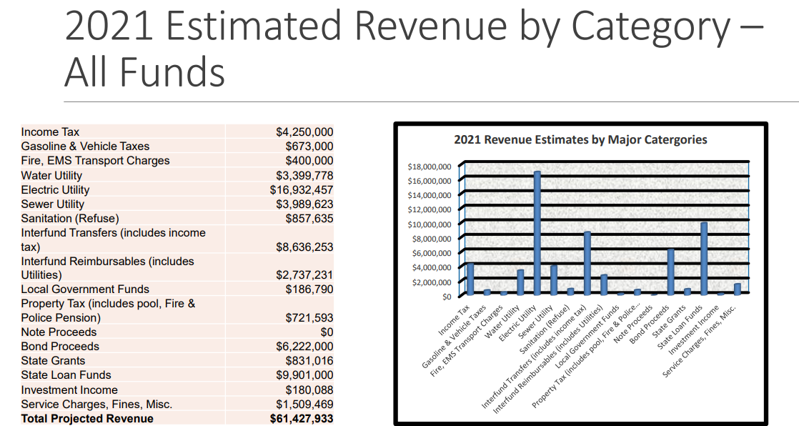
Revenue

Slide 66
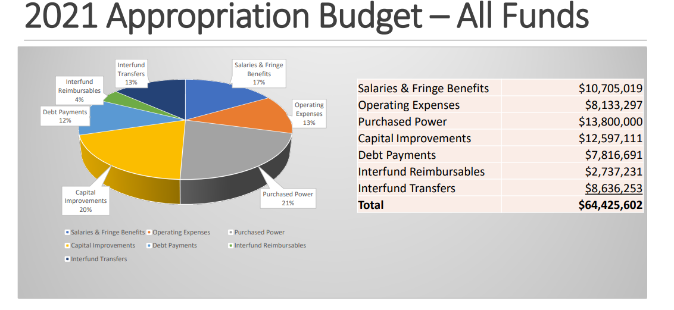
Expenses

Slide 67
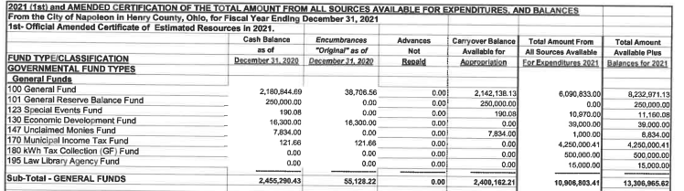
Fund Balances

Slide 68
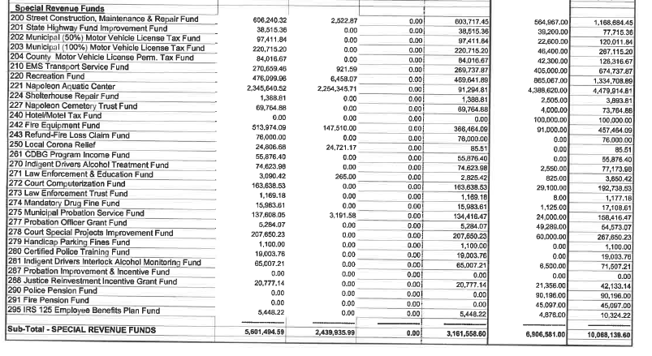
Fund Balances

Slide 69
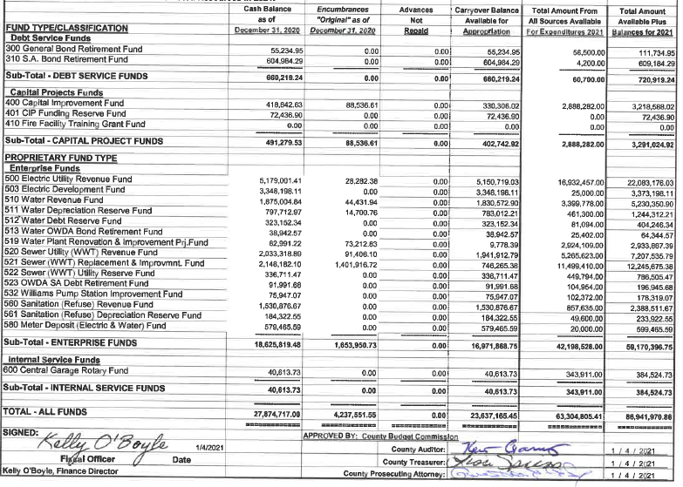
Fund Balances

Slide 70
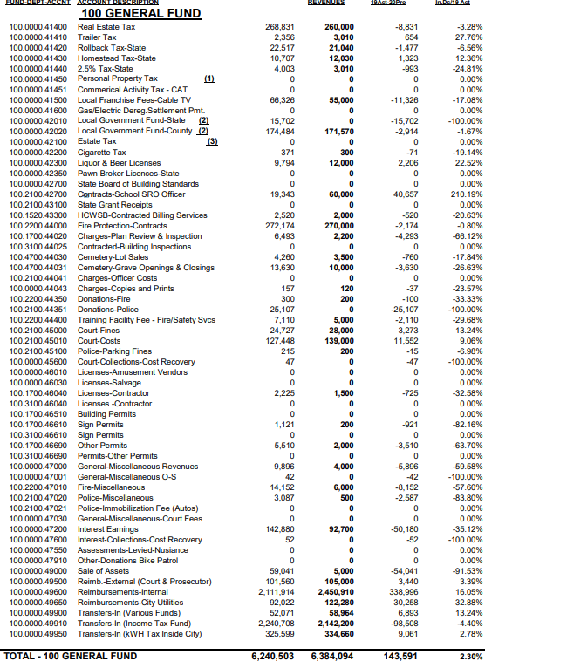
General Fund

Slide 71
Exercise 1
Revenue
Taxes (unrestricted) | $5,000,000
Gas/Vehicle Tax | $673,000
Unrestricted fees | $600,000
Water Utility | $3,399,778
Electric Utility | $16,932,457
Sewer Utility | $3,989,623
Sanitation (refuse) | $857,635
Property Tax - Parks & Rec Levy | $700,000
Local Government Funds | $1,500,000
Investment Income | $180,000
Service Charges, Fines, Misc | $1,509,469
Total | $35,341,962
Type of Fund (General, Restricted, Enterprise)
General Fund
Restricted – Road Construction
General Fund
Enterprise – Water Utility
Enterprise – Electric Utility
Enterprise – Sewer Utility
Enterprise – Refuse
Restricted – Parks and Rec
General Fund
Mix – For exercise will consider all General Fund
Mix – For exercise will consider all General Fund

Slide 72
exercise
Expenses
General | $ 6,659,598
Parks and Rec | $ 1,053,119
Water | $ 2,731,109
Sewer | $ 2,297,233
Electric | $ 16,727,199
Sanitation | $ 770,589
Capital | $ 8,569,500
Total | $ 38,808,347
Surplus/Deficit | $ (3,466,385)

Slide 73
Budget Asks
Capital (or additional asks)
Non enterprise funds
Police Cars x 2 | $104,000
Small Dump Truck (streets) | $105,000
Engineering Truck | $40,000
Storm siren replacement | $60,000
New Street Sweeper | $250,000
New tree trimming chipper - streets | $70,000
Replace and equip fire truck | $55,000
Ladder truck reserve commitment (10 Years) | $150,000
IT upgrade new telephone system | $55,000
Fire replace and pickup truck | $37,500
Replace large dump truck - Streets | $180,000
Replace Loader - Streets | $200,000
Switch street lighting to LED (3.5 year return on investment) | $300,000
Total | $1,606,500
Road
American Road Reconstruction | $1,850,000
Annual Road Program | $900,000
Total | $2,750,000
Parks and Rec
Replace Parks and Rec Truck | $45,000
Replace 6 golf carts | $36,000
Total | $81,000
Electric Enterprise Fund
Mini Excavator for Electric Department | $60,000
New tree trimming chipper - Electric | $70,000
Replace body truck - electric | $65,000
Replace Line Bucket Truck | $300,000
Total | $495,000
Water Enterprise Fund
Water leak testing and repair program | $50,000
Glenwood Waterline improvement | $458,000
Industrial Drive River Bridge Waterline | $438,000
Total | $946,000
Sanitation Enterprise Fund
Refuse Replace packer unit | $360,000
Total | $360,000
Sewer Enterprise Fund
Euclid Sanitary Improvements | $300,000
Oberhaus Interceptor (Sewer) improvements | $410,000
Williams Pump State Improvements | $1,621,000
Total | $2,331,000

Slide 74
Carry forward
Categorizing as | Carryover balance | Revenue | Expenses before asks | Surplus/ Deficit before asks | Capital Ask | Surplus/ Deficit if approved
General fund | $2,455,000 | $8,789,469 | $6,659,598 | $2,129,871 | $1,606,500 | $523,371
Gas tax fund (capital only) | $38,515 | $673,000 | $0 | $673,000 | $2,750,000 | -$2,077,000
Electric Fund | $8,527,199 | $16,932,457 | $16,727,199 | $205,258 | $495,000 | -$289,742
Water Fund | $1,875,004 | $3,399,778 | $2,731,109 | $668,669 | $946,000 | -$277,331
Sewer Fund | $2,033,318 | $3,989,623 | $2,297,233 | $1,692,390 | $2,331,000 | -$638,610
Sanitation | $980,454 | $857,635 | $770,589 | $87,046 | $360,000 | -$272,954
Parks and Rec | $476,099 | $700,000 | $1,053,119 | -$353,119 | $81,000 | -$434,119
Total |  | $35,341,962 | $30,238,847 | $5,103,115 | $8,569,500 | -$3,466,385

Slide 75
Good things to take note of
2 tree trimmers?
LED street lights
American road reconstruction
Mini excavator for electric department
Anything else?

Slide 76
General Fund
General fund can be used for any proper public purpose
  Disclaimer: Consult your legal and finance department regarding purchases
What is the total of our General Fund revenue?
General Fund recurring revenue = $8,789,469
What was your regular reoccurring expenses?
General Fund recurring expenses = $6,659,598
What is the general fund recurring surplus?
General fund recurring surplus = $2,129,871 (before capital considerations)

Slide 77
Things to help budget Better
Make sure to charge back time, equipment and material to proper funds
Actively pursue grants (for all funds). Do not look at it like it is too heavy of a lift. Granting agencies are generally very helpful
Not all funds can stand on their own, but need to push boards and commissions to due what is right for the city
Revaluate needs, priorities, and past assumptions
Benchmark with other entities (superiority syndrome)
Understand Level of Service expectations and law of diminishing returns

Slide 78

Simpsons Garbage Man

Slide 79
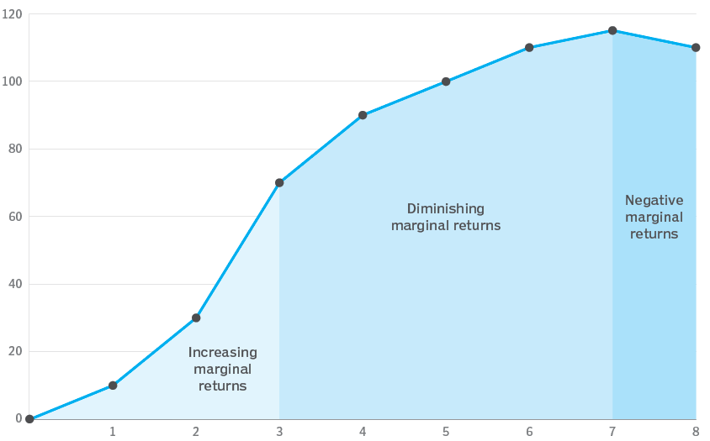
Level of Service and point of diminishing returns
Level of Service / Product / Output
Resources

Slide 80
Sunk cost fallacy
The tendency to continue an endeavor, project, or relationship because you have already invested time, money, effort into it, even when current costs outweigh any future benefits
Throwing good money after bad

Slide 81

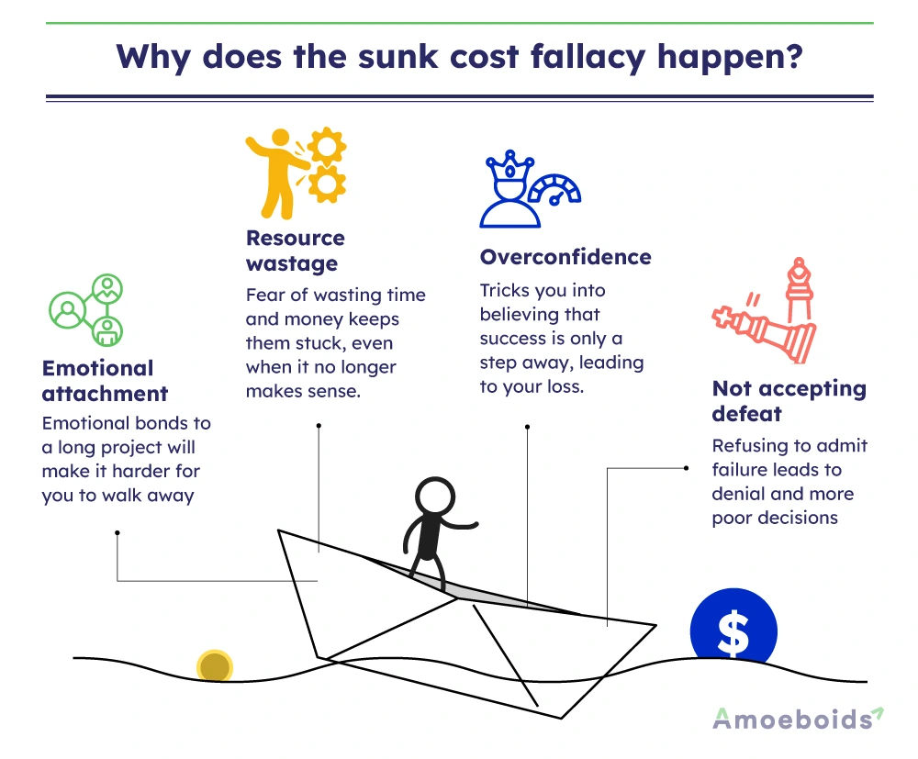
Sunk cost fallacy

Slide 82
Sunk cost decision making
What is irrelevant – Sunk cost
  All previous costs (purchase cost, maintenance cost, etc.)
What is relevant
  Salvage value (selling or trade in value)
  Future maintenance/operating cost
  Usage
“We shouldn’t get rid of the that piece of equipment because we already have it”

Slide 83
Exercise 2
State reduces LGF by $1M
Telework causes your income tax revenue to decrease by $1M
Get hit with a $1M lawsuit
What is reoccurring losses and what is non-reoccurring
Determine who at each table will play a role

Slide 84
Roles
City Council/Mayor
City Manager
Public Works Director
Police Chief
Fire Chief
Union Leader
Finance Director
Angry Citizens

Slide 85
Exercise 2
Wipe out all asks and start over
Review savings measures. What should you consider implementing
What items asked for previously should you consider retaining?
Feel free to take liberties and make assumptions, this is just an exercise, have fun with it

Slide 86
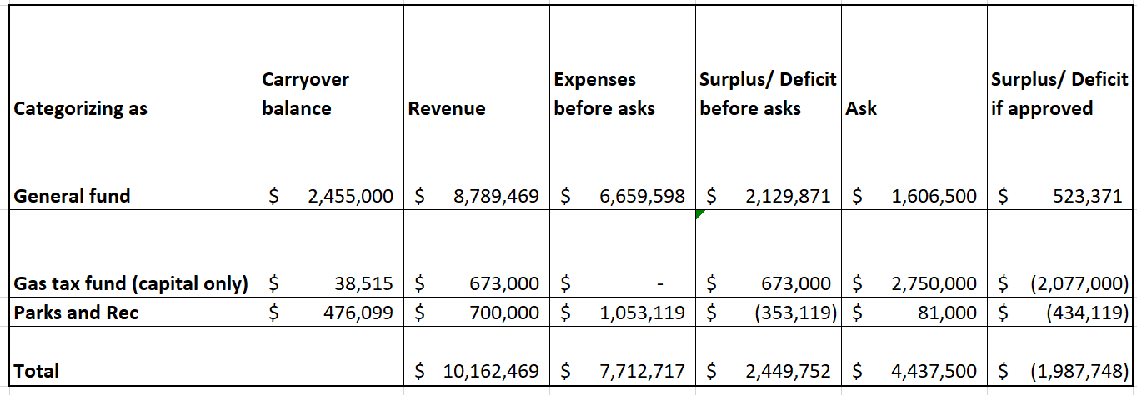
Prior GF impacted budgets

Slide 87
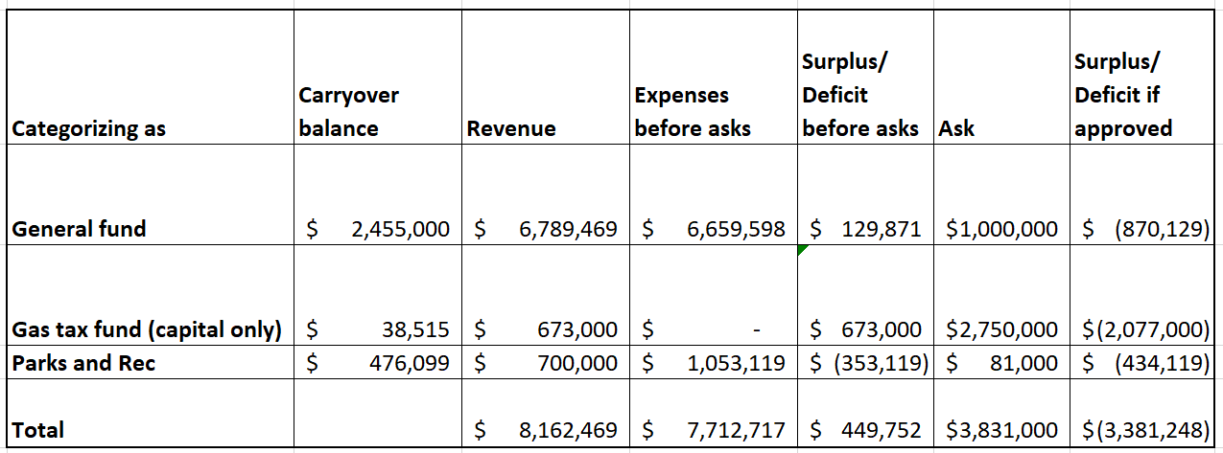
New GF impacted budgets

Slide 88
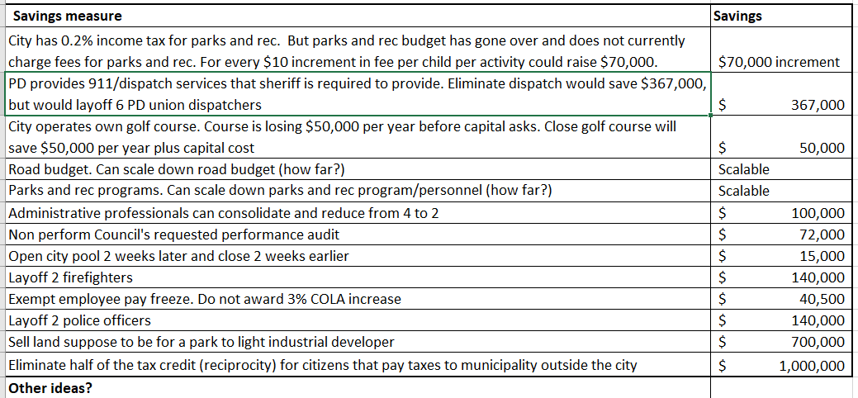
Potential Savings measures (other ideas?)

Slide 89
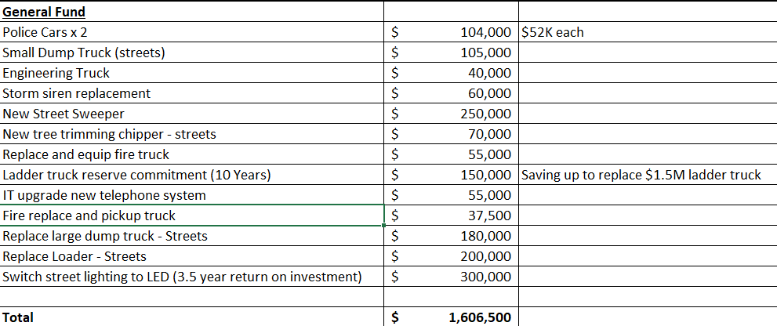
Old Budget Asks

Slide 90
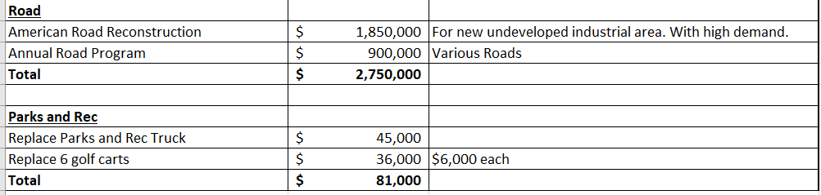
Old Budget Asks

Slide 91
Make your case
Each role has to work with the city manager to recommend items to city council
City manager can recommend a-la-carte options to council and can get feedback from council
Feel free to make recommendations for long term financial stability of the city (future planning)
City council can choose to go with recommendation of the city manager or can make other choices.
Try your best to work together, but there should not be agreement. Looking for alignment not agreement.

Slide 92
Report out
City Council reports out to the whole group on decisions
Think about these questions
  Which party had the greatest impact on decisions?
    (City Council/Mayor, City Manager, Public Works Director, Police Chief, Fire Chief, Union Leader, Finance Director, Angry Citizens)
  How did the personalities impact the decision?
  What items absolutely had to stay in?
  What were some of the easiest items to not fund (or cut)?
  What was the hardest item to not fund (or cut), but ultimately cut?
  Any ideas on how to fund that water park? (might have forgot about that one)

Slide 93
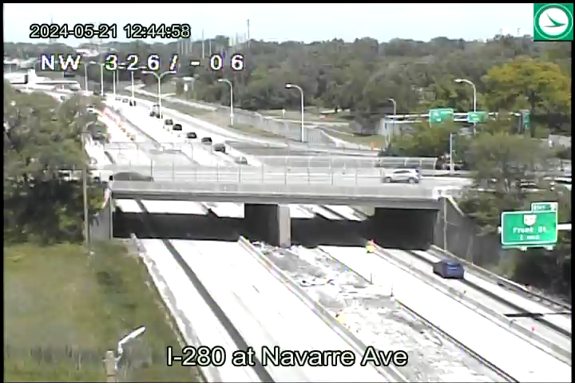
ANDRETTI MANEUVER

Slide 94
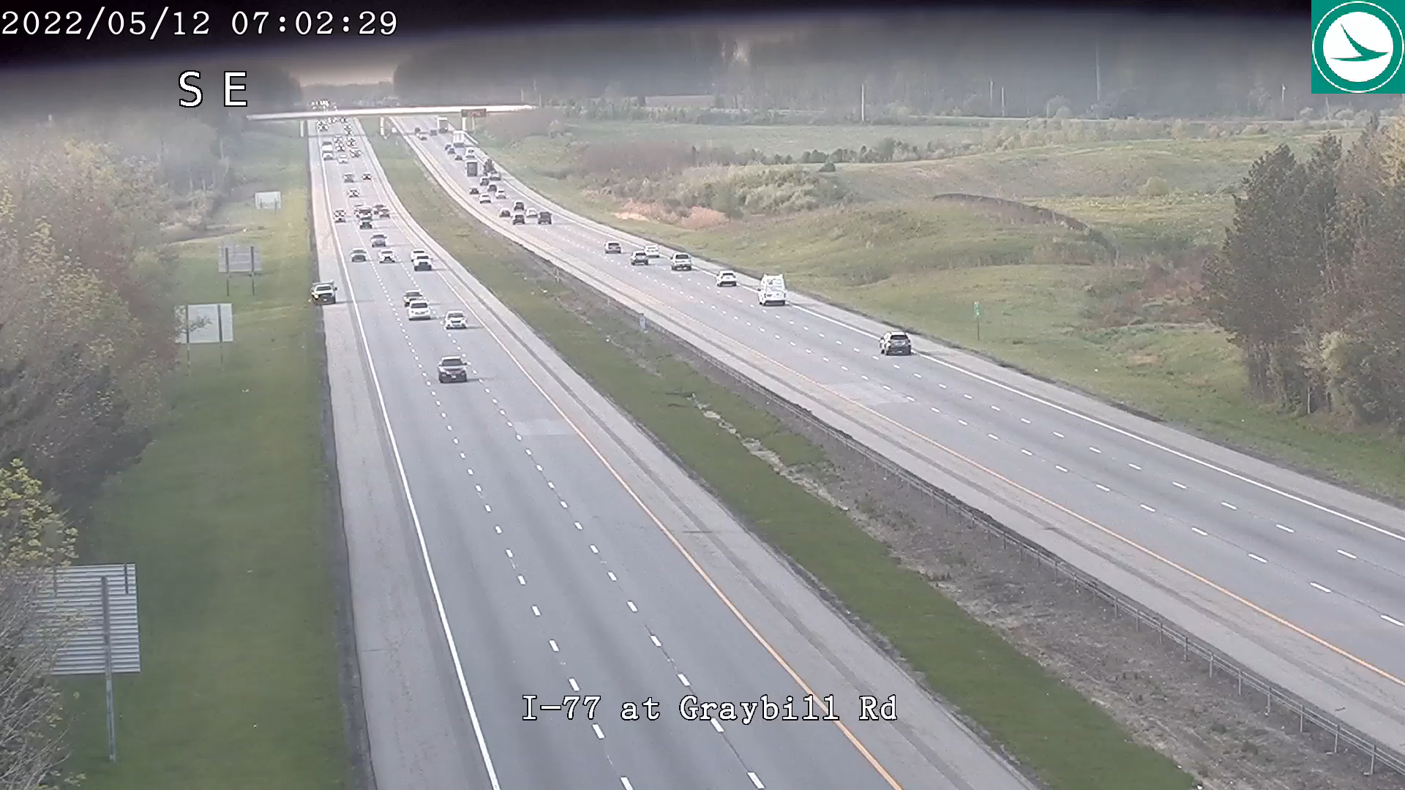
Distracted Driving

Slide 95

Rossford Police

Slide 96


Slide 97

Blues Brothers

Slide 98



Questions
Pat McColley, PE, SI, MBA
District 2 Deputy Director

