Slide 1
WOO-93592 Potential errors and omissions
Mike Benton, P.E. Project Engineer
David Geckle, P.E. District Bridge Engineer

Slide 2
Luc-75-0029l structure details
Twelve span, multi-unit, prestressed concrete I-beam bridge with composite reinforced concrete deck on stub abutments and cap-and-column piers that carries I-75 Southbound over the Maumee River in Toledo, OH
Total length = 1948.66’
Roadway width = Varies (72’-0” Minimum)
Loading = HL-93 with 60 PSF Future Wearing Surface

Slide 3
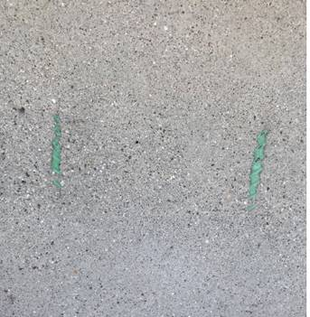
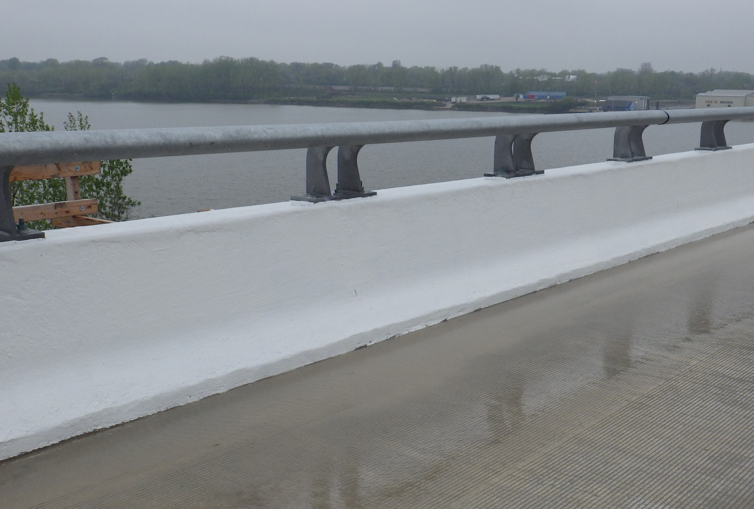
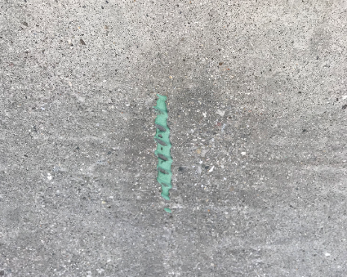
Issue

Slide 4
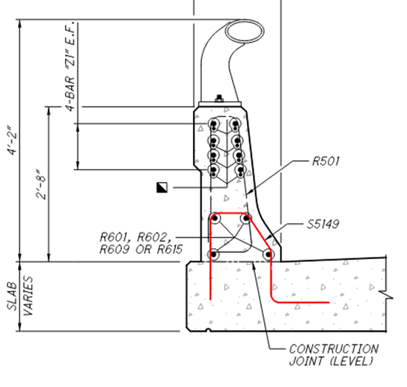
Dispute resolution
Proposal Note 108 – Dispute Resolution Board Process
Advisory Recommendation Process (verbal recommendation)

Slide 5
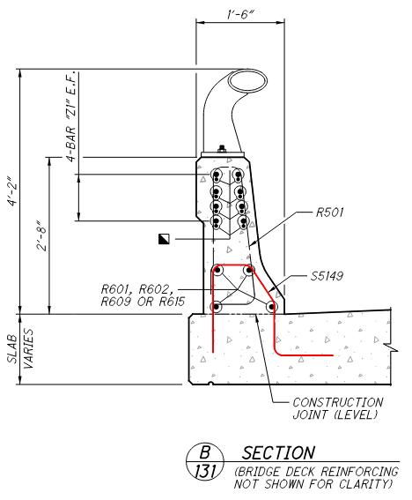
issue
Reinforcing steel dimensions for S5149 epoxy coated reinforcing steel did not allow for sufficient cover on inside face of exterior parapet.
Details from plan sheets 1424 & 1426 of 1792

Slide 6
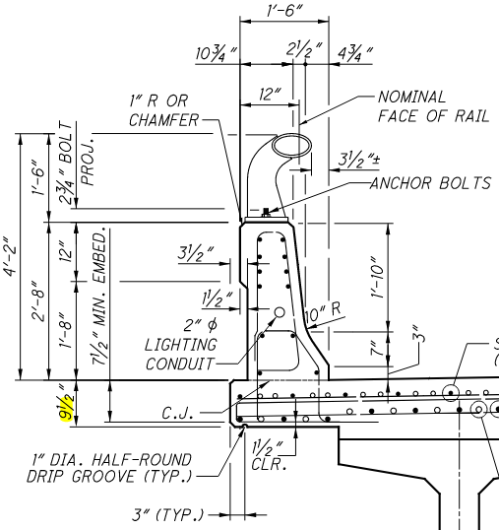
Plan dimensions
Detail from plan sheet 1428 of 1792

Slide 7
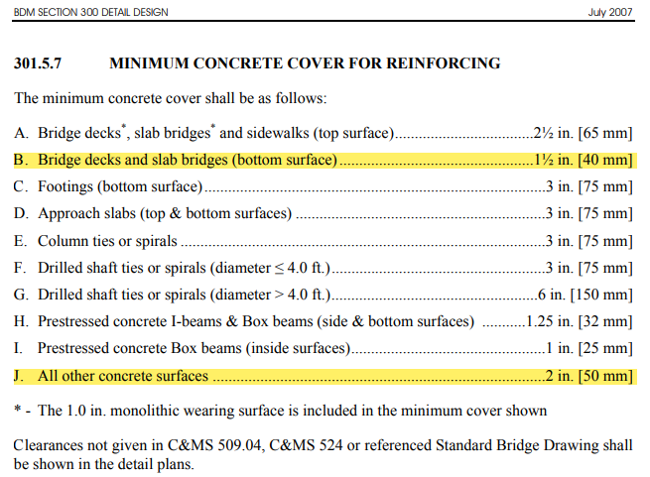
Bridge design manual, 2007

Slide 8
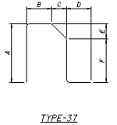
Reinforcing list for luc-75-0029l

Slide 9
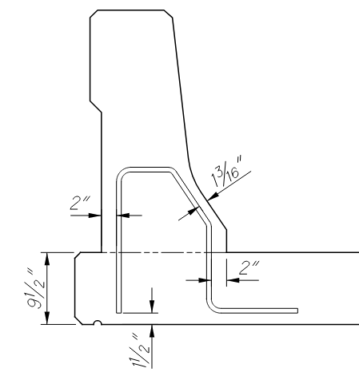
calculated clearance
Design does not meet 2” minimum concrete cover as required in BDM 301.5.7.

Slide 10
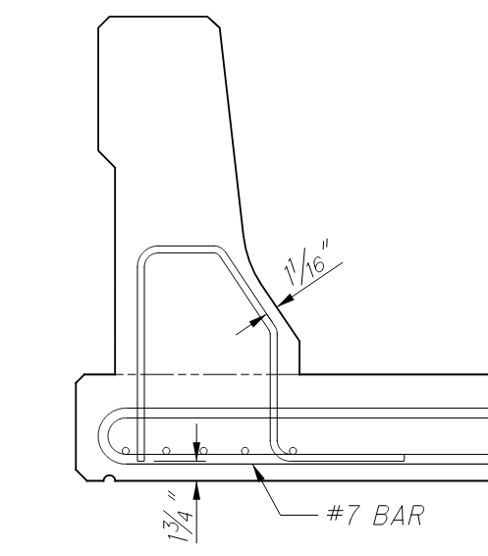
Actual field clearance
Design does not meet 2” minimum concrete cover as required in BDM 301.5.7.

Slide 11
Dispute resolution board
Advisory Recommendation
Oral Opinion - Contractor has no responsibility for any costs associated with insufficient clearance

Slide 12
correspondence
Email from AECOM on 6/6/23:
“AECOM agrees, the bar should have been 18” tall, let us know what additional you need from us with the repair.”
Email from AECOM on 7/6/23:
“AECOM maintains that we provided a buildable design with 1.25” cover over the bars in question.”

Slide 13
Initial Repair recommendation from aecom

Slide 14
subsequent Repair recommendation from aecom

Slide 15
final accepted Repair recommendation

Slide 16
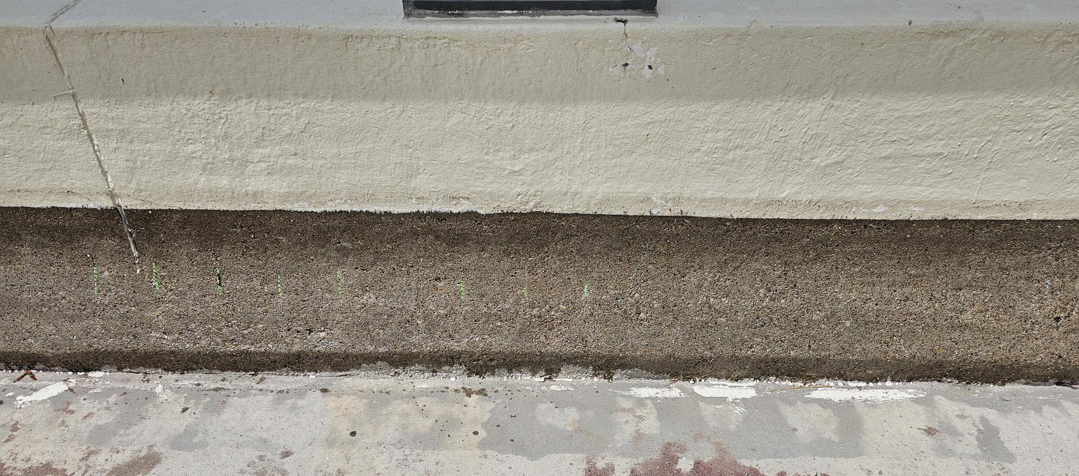
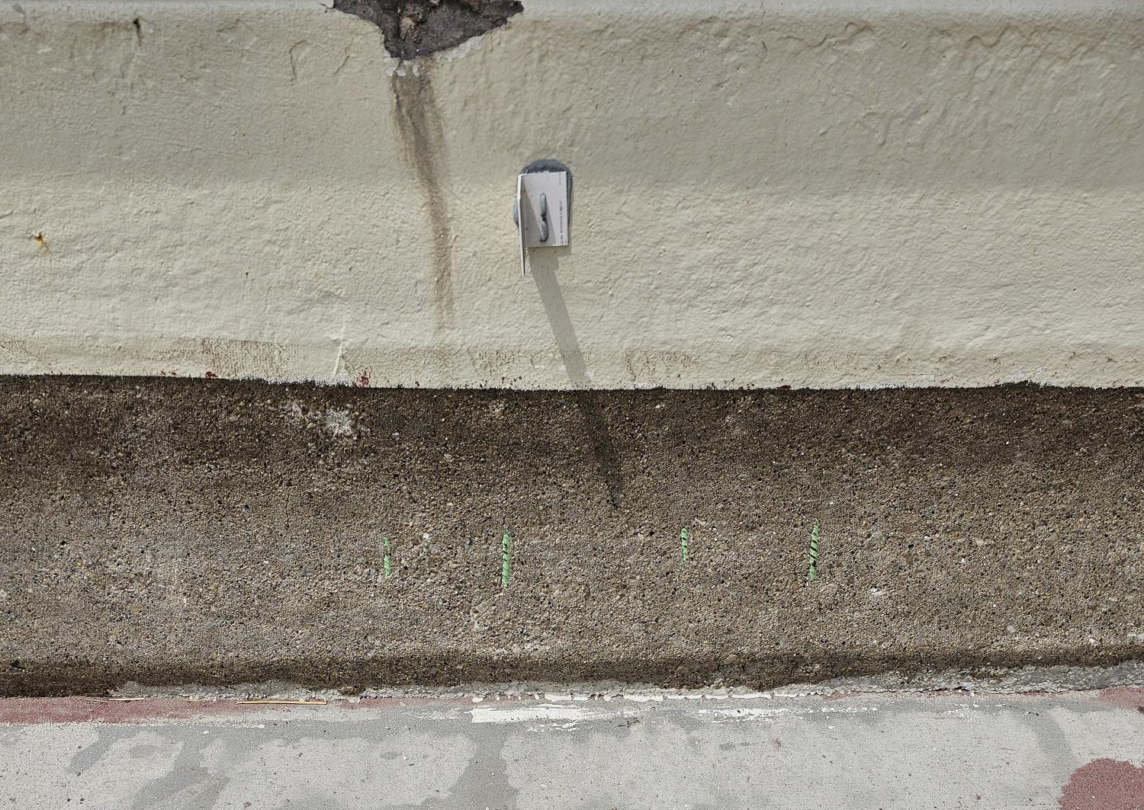
Barrier condition (while performing repair work)

Slide 17
Cost for repair
ODOT’s Cost to Complete Repair
Epoxy-Urethane Sealer Removal/Prep - $13,400 (Estimated)
Installation of Fiber Wrap - $141,882
Re-application of Epoxy-Urethane Sealer - $10,110 (Estimated)
Maintenance of Traffic - $57,000 (Estimated)
Total (Estimated) - $222,392

Slide 18
Questions

