Slide 1
Hamilton/butler Ir 75/Ir 275 Interchange trac presentation • October 25, 2023
Brianne Hetzel, P.E.
District 8 Traffic Studies Engineer
Notes:
Welcome and intro

Slide 2
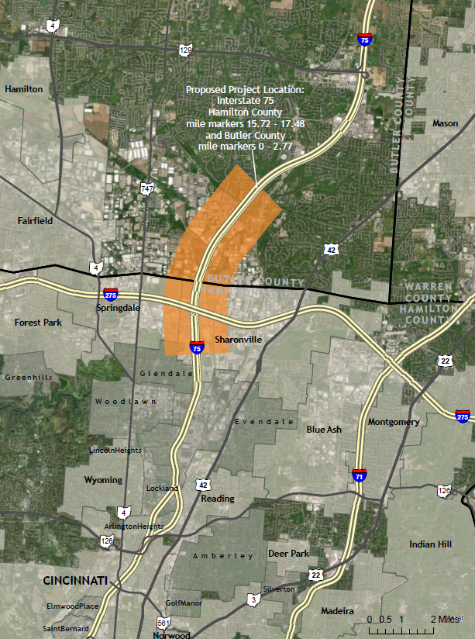
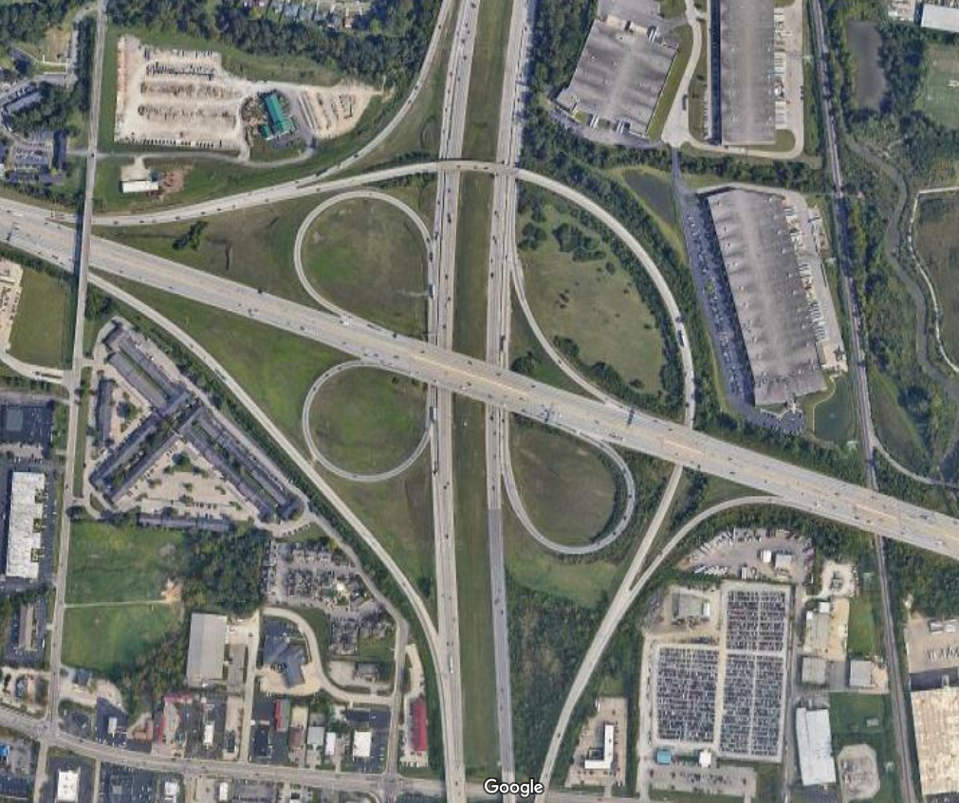
location
Test text

Slide 3
safety
Crashes Per Year | 350.33
Fatal and All Injury Crashes | 240
Percent Injury | 22.8%
Equivalent PDO Index Value | 2.32
IR-75
81
108
137
146
160
182
194
222
237
311
319
321
322
374
499
2021 ODOT Safety Analyst Rankings
IR-275
86
101
115
140
204
205
260
261
386
387
393
470

Slide 4
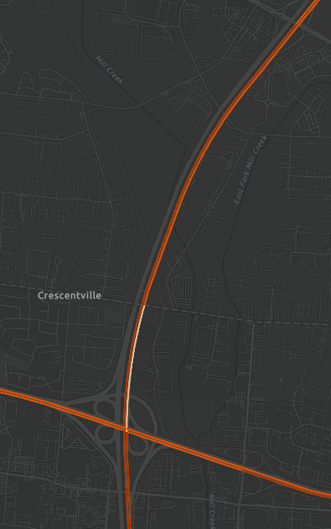
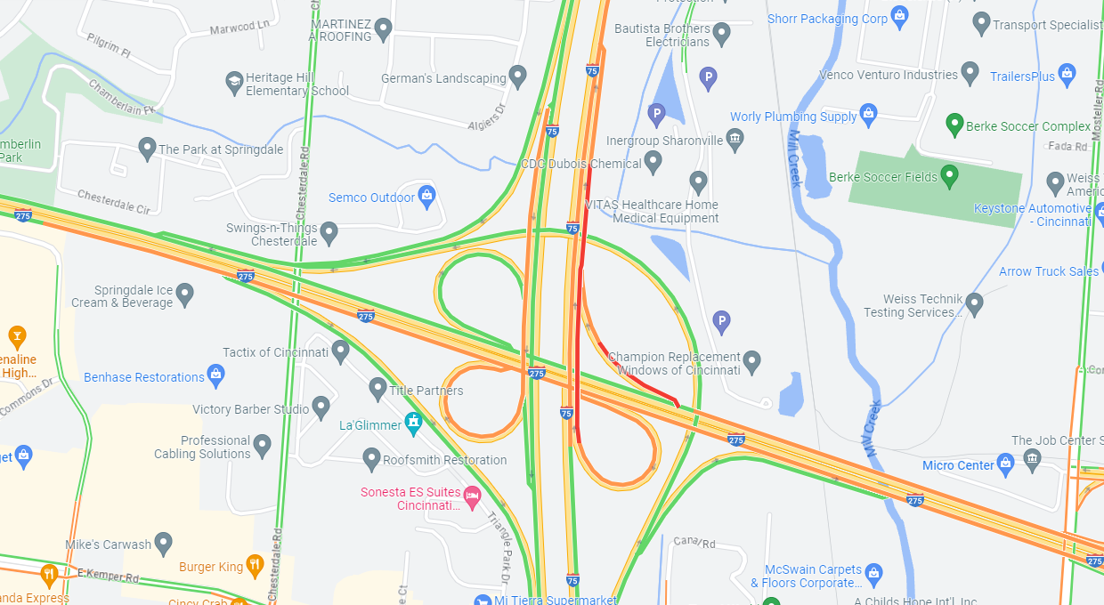
operations
2022 TOAST Map

Slide 5
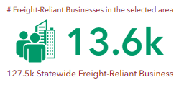
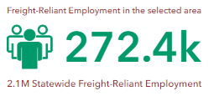
freight

Slide 6
history
2013
HSIP application to reconfigure EB & WB to NB ramps
2014
Gannett Fleming study of the interchange
2015
HSIP application for flyover ramp from SB 75 to EB 275
Denied
Options included fly over ramps from EB 275 to NB 75 and from SB 75 to EB 275
Denied
2016
HSIP application from “ramp clear” for SB 75 to I-275
Separate out EB/WB ramps
Project completed in 2017
2019
Received funding to extend ramp from WB 275 to NB 75 instead
Project completed in 2015
HSIP application to reconfigure EB & WB to NB ramps
Denied
2023
TRAC application

Slide 7
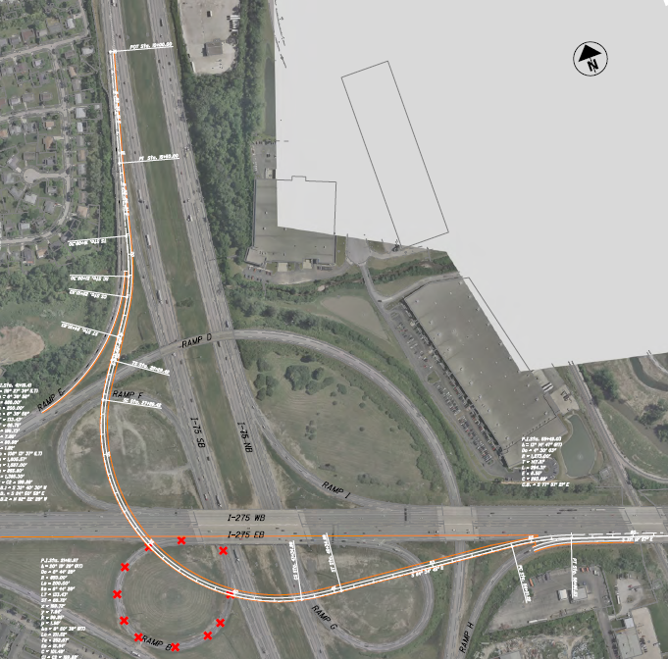
Project overview
Proposed flyover ramp
SB 75 to EB 275
Eliminates entrance/exit weaving on 275 over 75
Eliminates entrance/exit weaving on C-D road under 275
Improved safety for ramp movements
Increased ramp capacity
Stand-alone ramp alternative

Slide 8
Project overview
Reconfiguration of EB and WB 275 ramps to NB 75
New auxiliary lane between I-275 interchange and Union Center Blvd

Slide 9
Additional improvements
Eliminates merging of the EB and WB 275 ramps together
Eliminates merging of the 275 ramps to NB 75
Improved safety for ramp movements
Increased ramp capacity
New auxiliary lane between I-275 interchange and Union Center Blvd

Slide 10
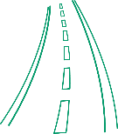
Trac request summary
Requested Tier II (New Project)
Funding request for Preliminary Engineering only to get through the NEPA process, including traffic analysis and interchange modification study
Improve safety
Increase capacity
Reduce congestion

Slide 11
Trac request summary
2023 Request
Future Request
$7.0
$7.0
$-
$-
Right-of-Way
$-
Construction
$64.0
$-
$3.0
$-
Right-of-Way
$61.0
Construction
Preliminary
Engineering
Detailed
Design
Preliminary
Engineering
Detailed
Design
* PE request for FY25

Slide 12
schedule
Fall 2024
Authorize Design Consultant
Summer 2025
Feasibility Study approved
Fall 2025
IMS approved
Winter 2025
Stage 1 Plans approved
Fall 2026
Stage 2 Plans approved
Summer 2026
Apply for DD and Construction to TRAC
Winter 2027
Stage 3 Plans approved
Spring 2028
Sale/Award
FY2028
Winter 2026
NEPA approved

Slide 13
Questions
?
Last updated 10/16/2023

