Slide 1
JermiaH Morrow- Crack Detection Software

Slide 2
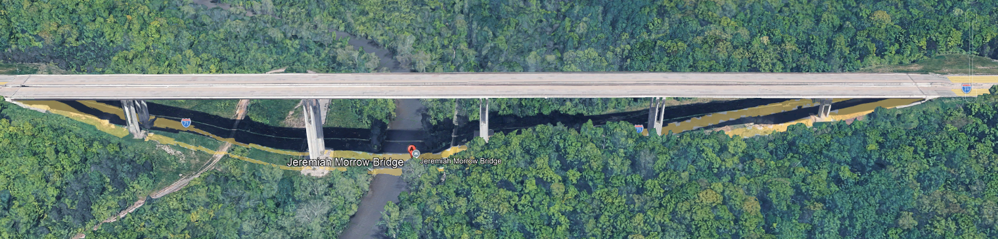
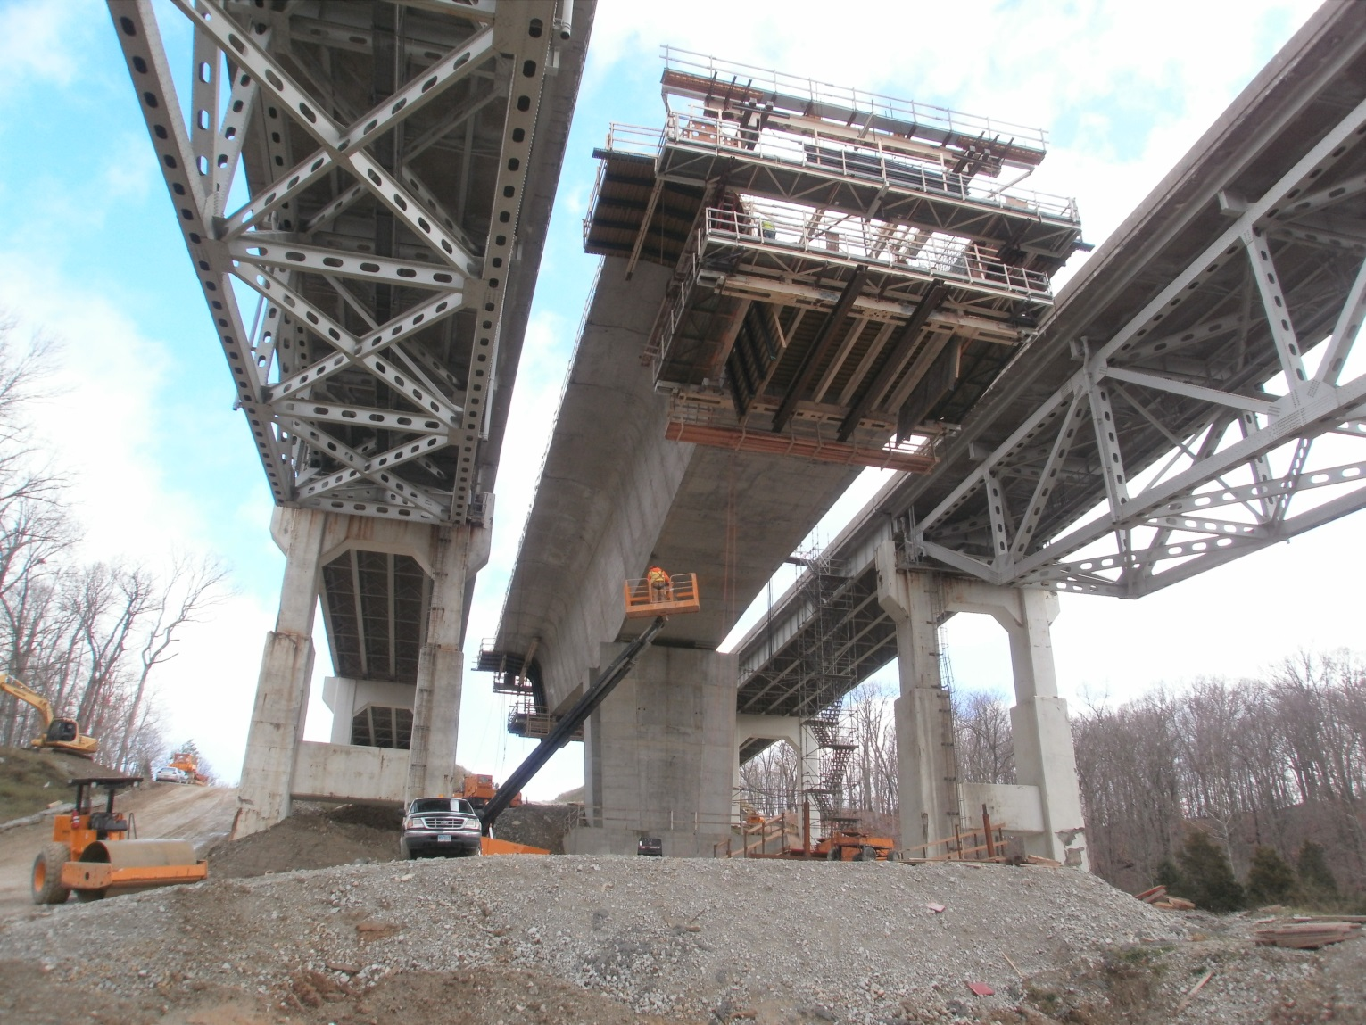
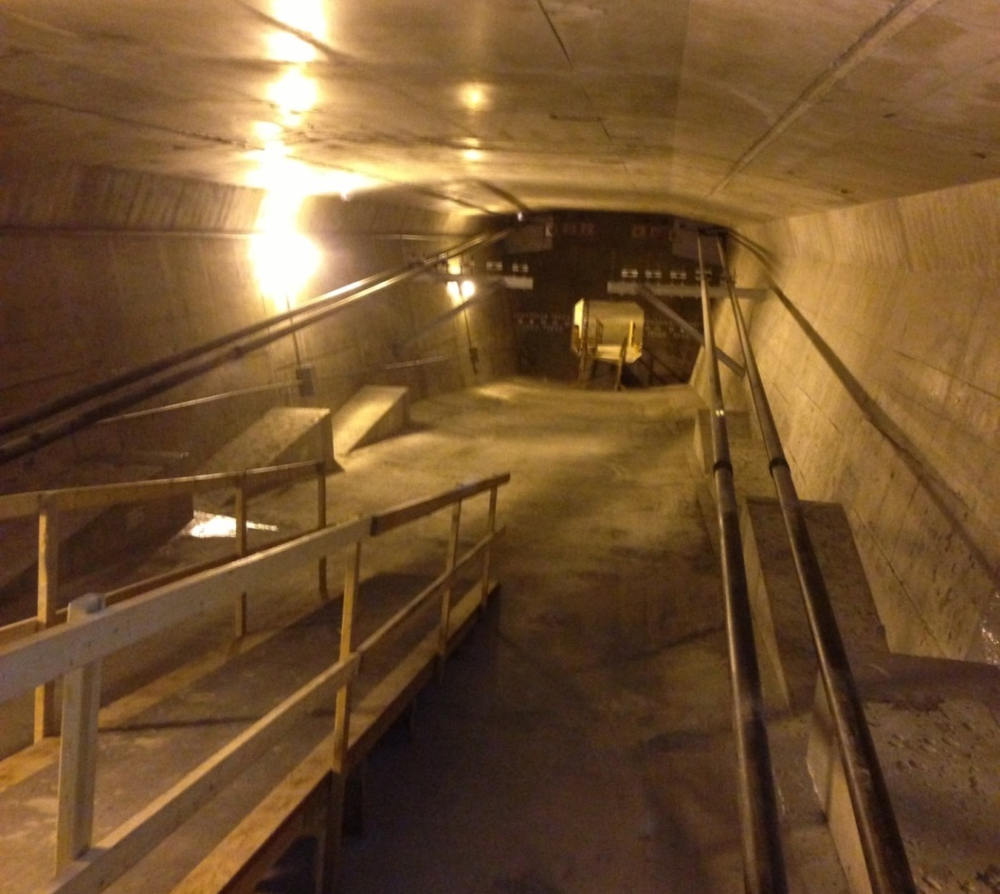
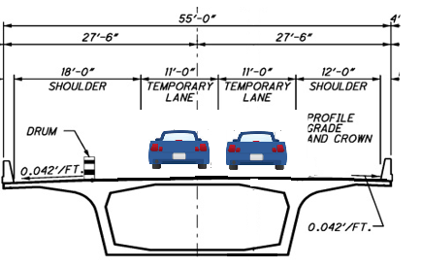
Jeremiah MorroW Bridge

Slide 3
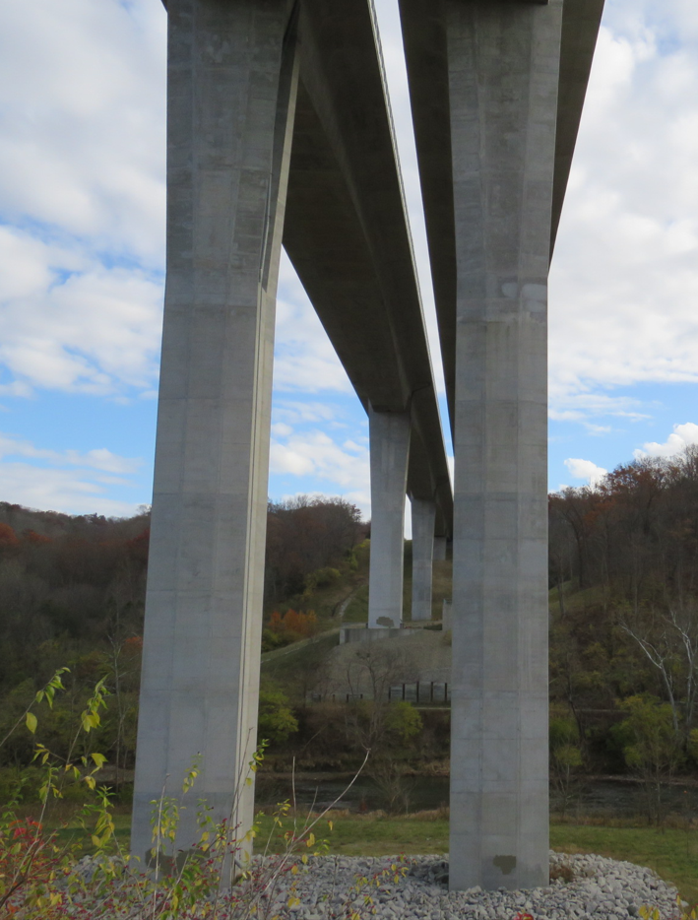
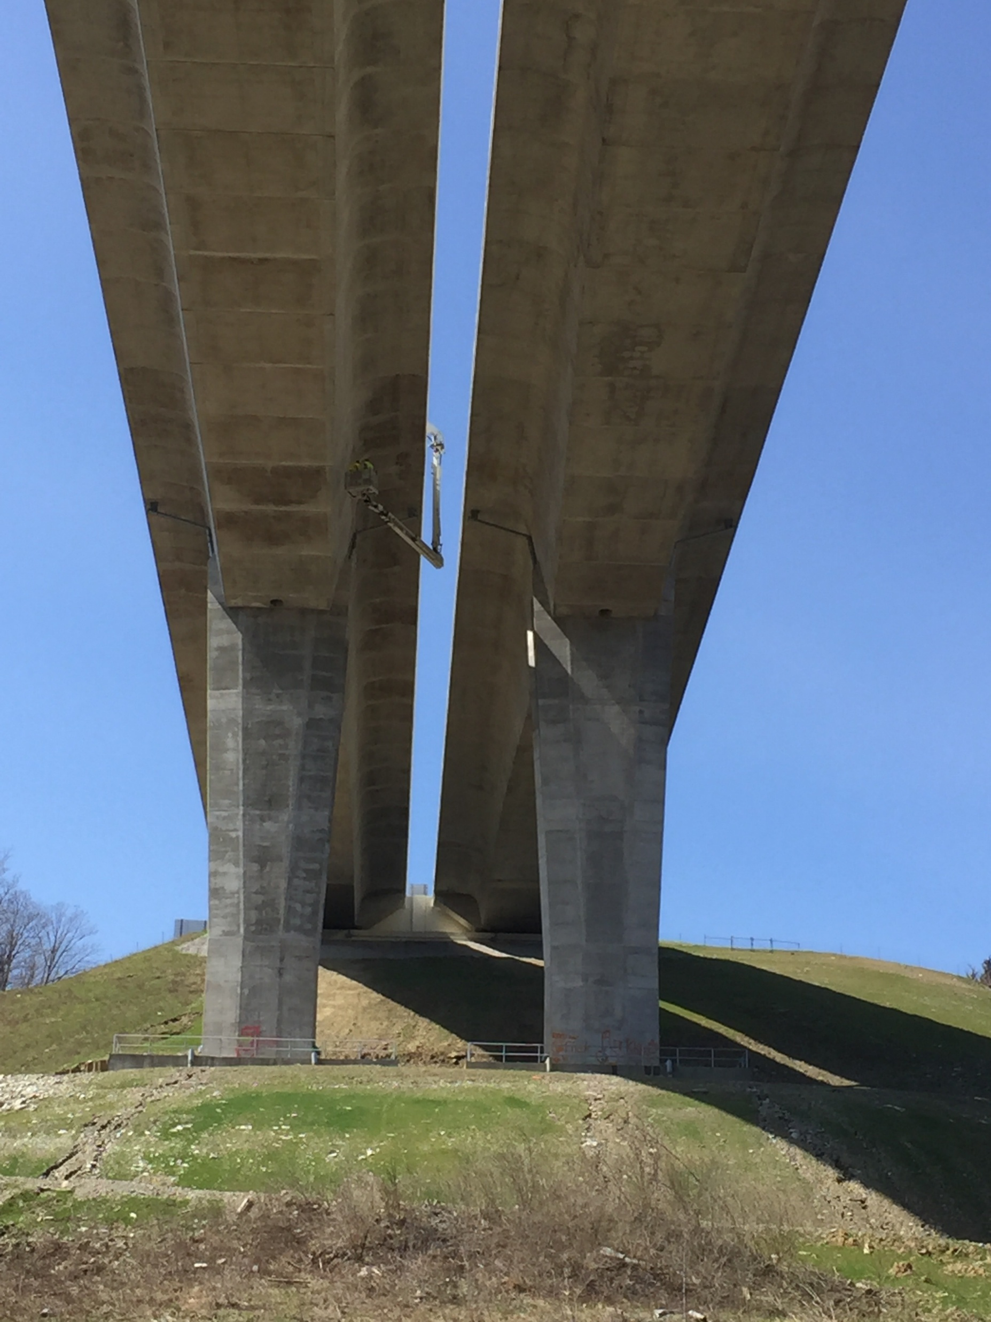
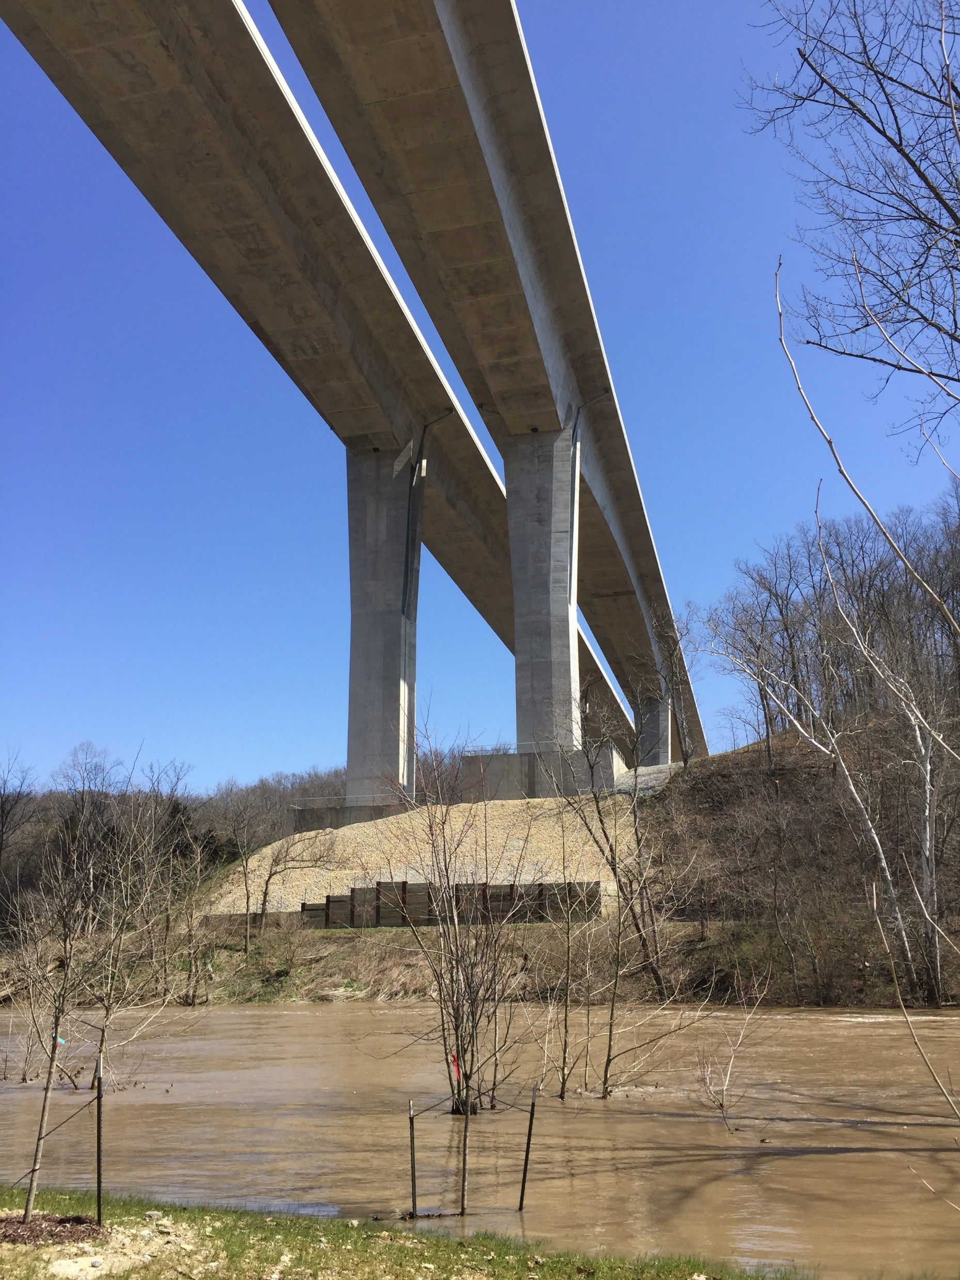
Each Bridge is a Half a mile long. Tallest Bridges in Ohio

Slide 4
Post Tensioned Balanced Cantilever construction
  Typically 12, 19, or 22 strands
  527, 835 or 967 Kips, respectively
  Stressed 2 Tendons per Segment
  26 tendons in concrete you cannot see/inspect
  4 tendons you can inspect sheathing only

Slide 5
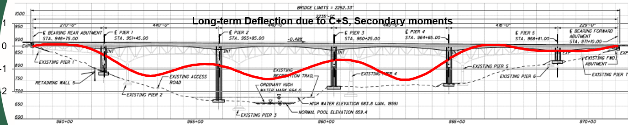
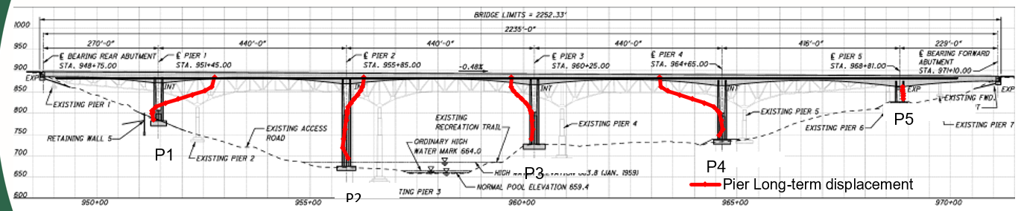
Post Tension Behavior
Exaggerated Vertical Deformation over Time
Exaggerated Horizontal Deformation over time due to Concrete Creep, PT relaxation

Slide 6
Failure Mechanism of these types of bridges is Excessive cracking
Seattle Bridge Closed due to Excessive Creep over Time in 2020
Greater Cleveland Regional Transit Authority bridge closed in 2022 due to excessive creep over time.
Creep, Shrinkage, relaxation, corrosion, landslide, etc. are all possible factors here.

Slide 7
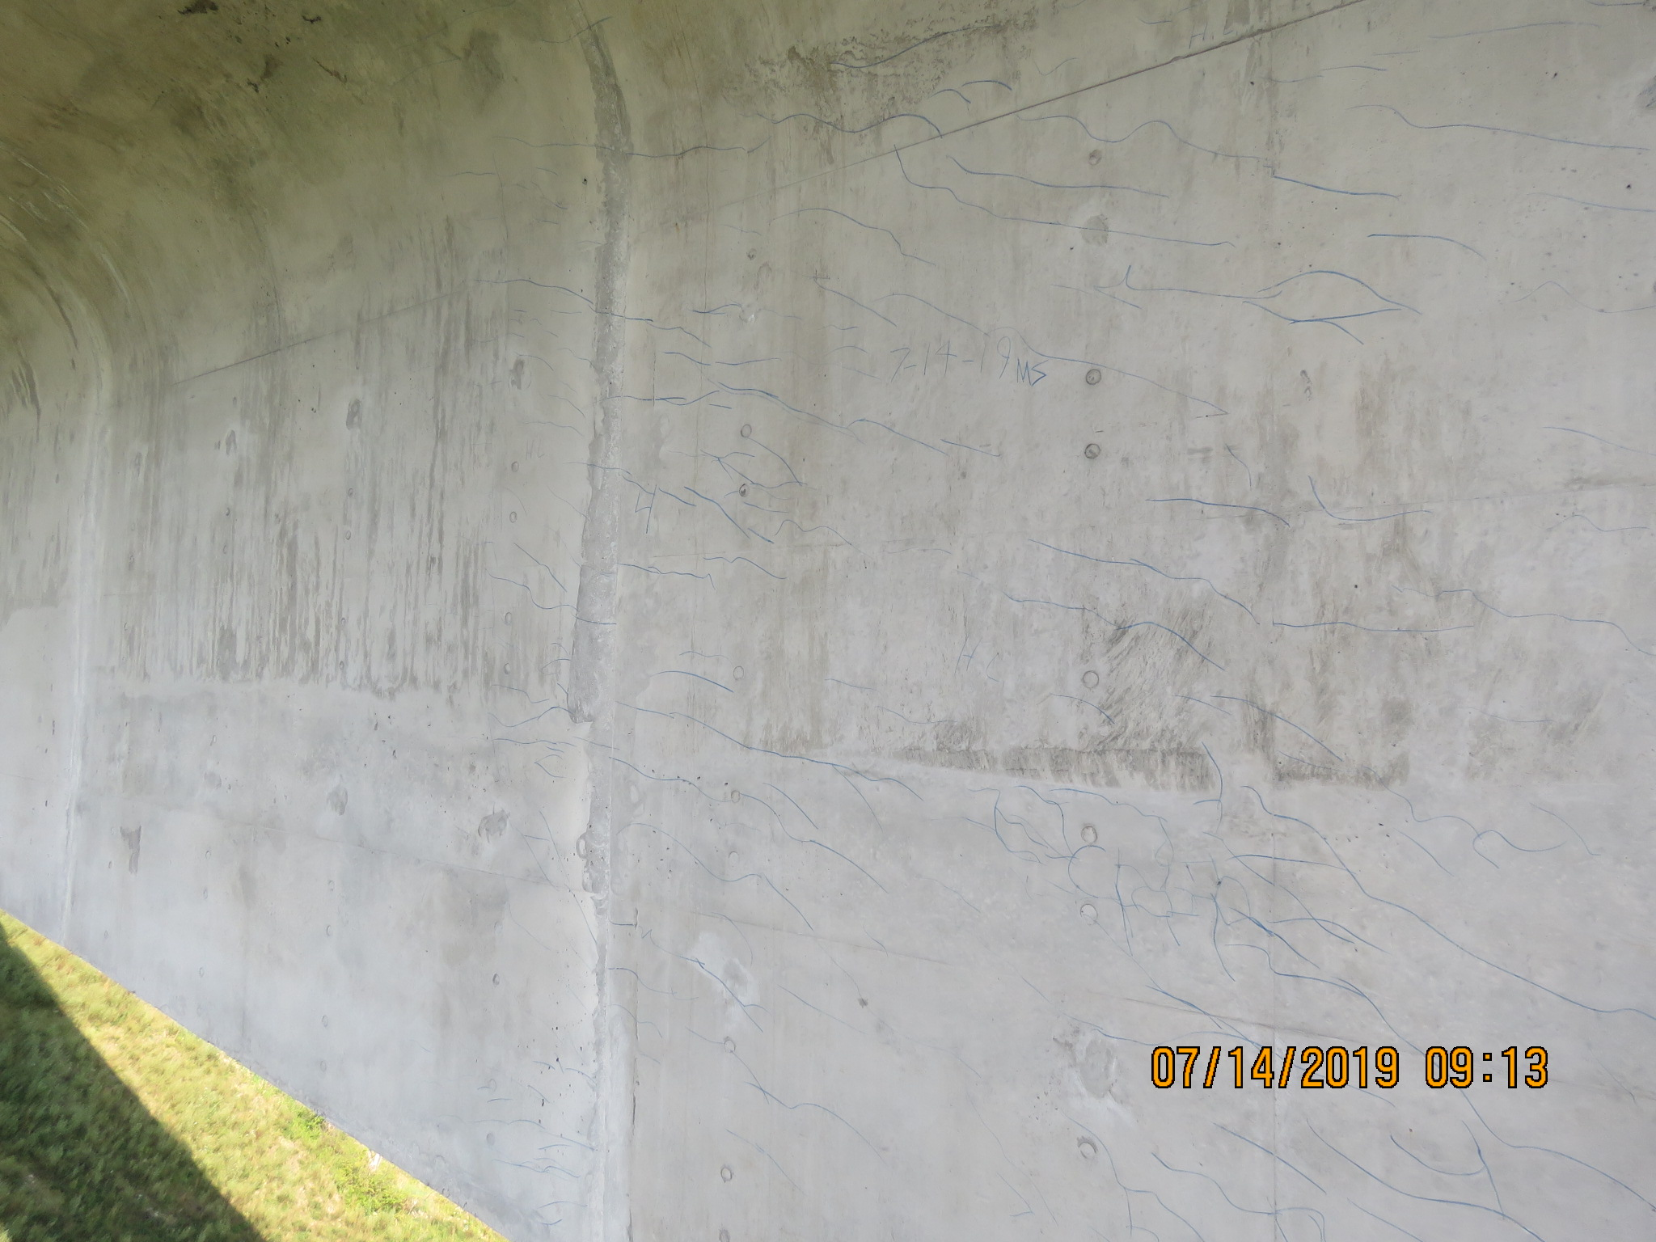
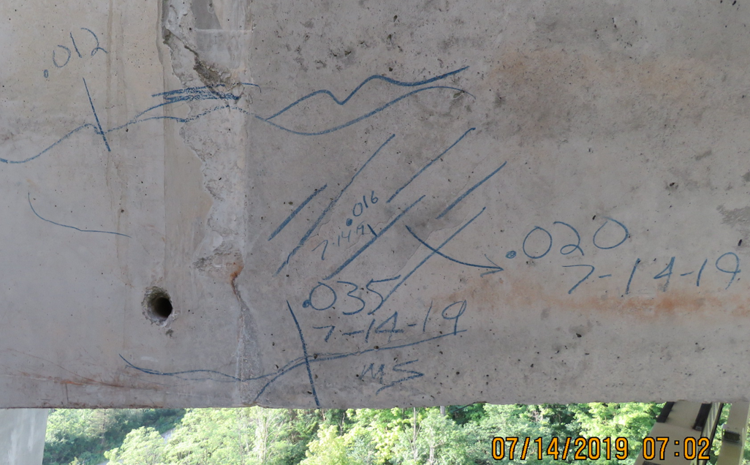
Problem- We have thousands of cracks
Exaggerated Vertical Deformation over Time
Because of the number of cracks and size of the bridges, we are unable to quantify, measure, and document each crack
Proper Inspection is technique is to field measure and date cracks

Slide 8
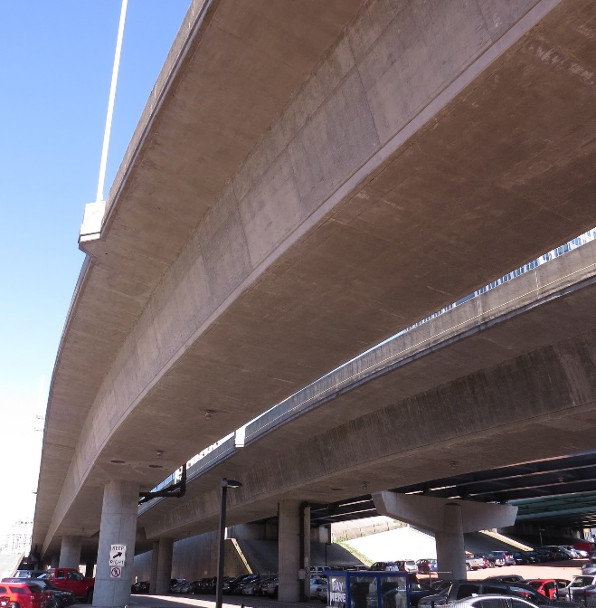
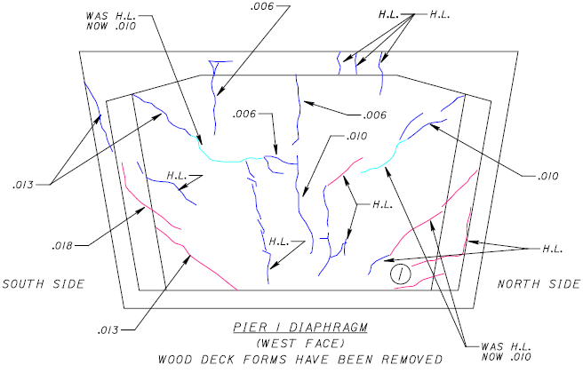
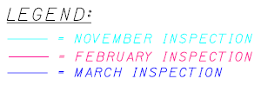
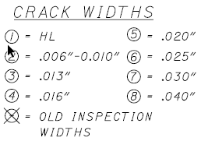
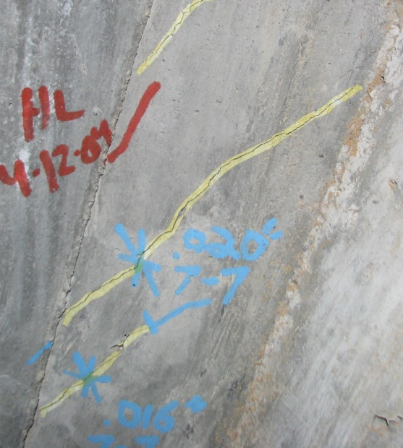
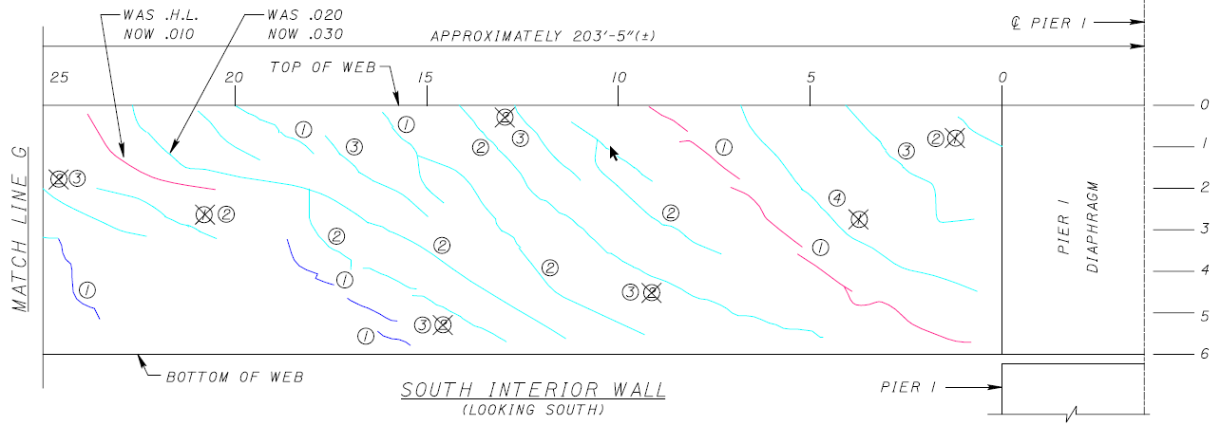
D8 has two other bridges with similar issues

Slide 9
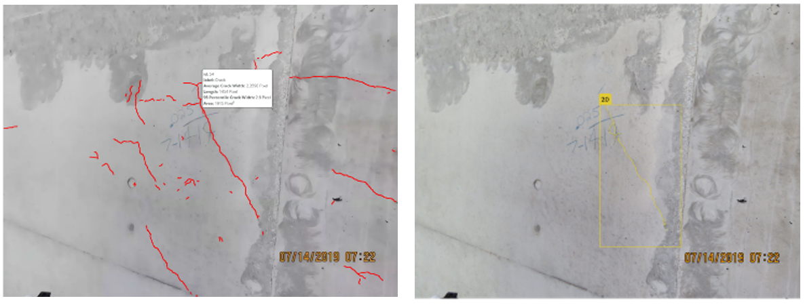
Used Research On Call to identify capable crack detection software
GNext Labs
StructInspect

Slide 10
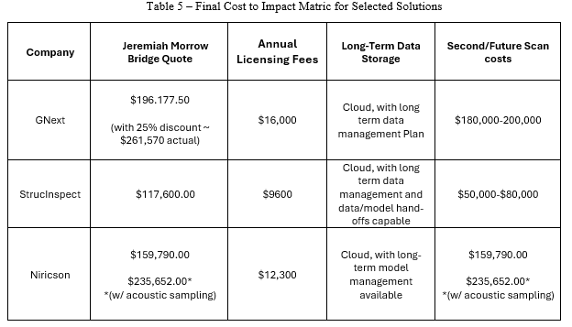
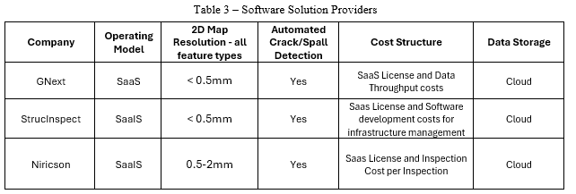
Research on Call Findings

Slide 11
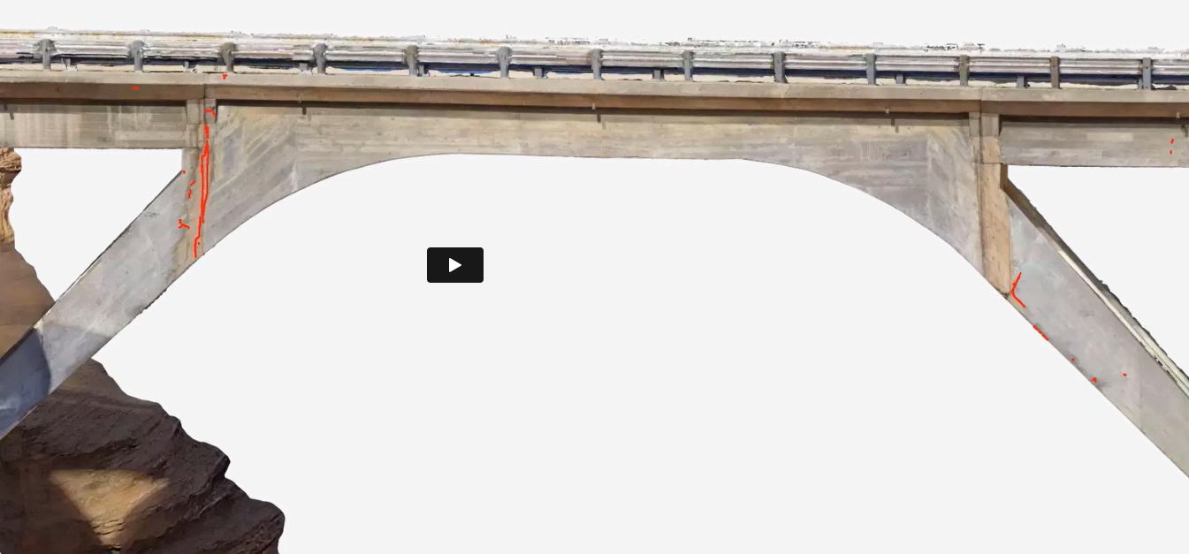
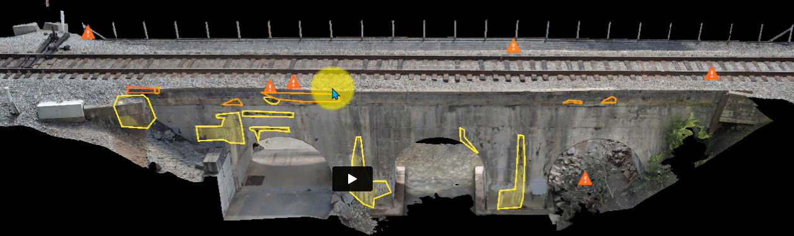
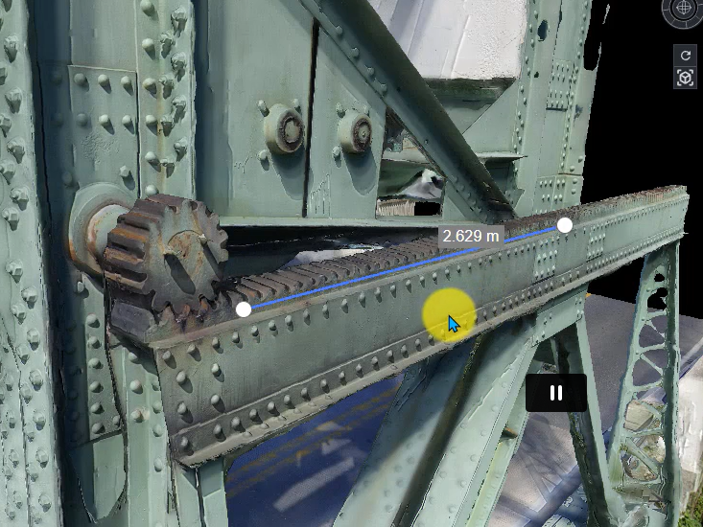
Defect Notation/Tracking
Crack Detection
Defect Measurement in Model

Slide 12
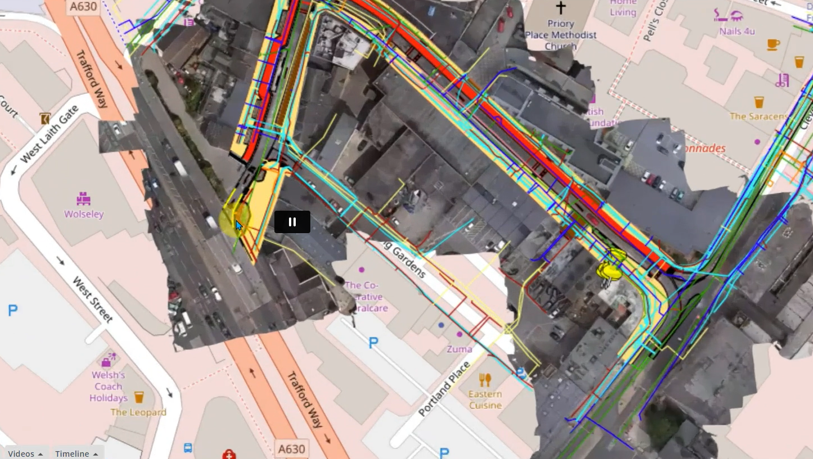
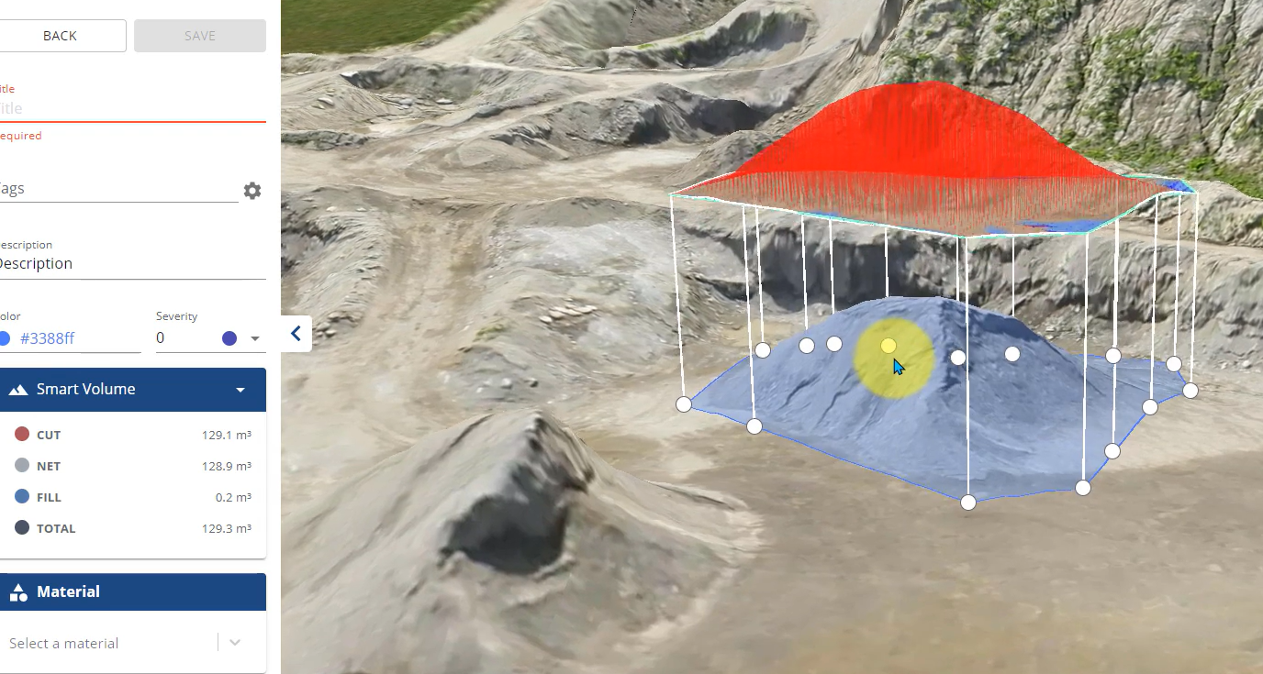

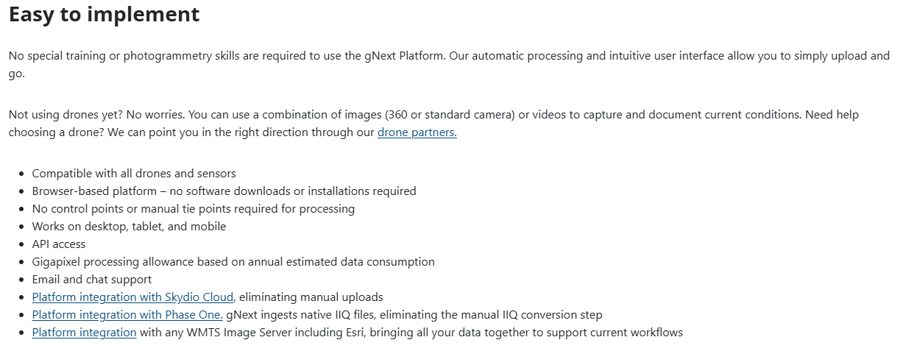
Other functions
Overlay CAD files and Data
Area and Volume Calculations

Slide 13
Thank you

Slide 14
Alternate Title

Slide 15
Alternate Sample Slide

