Slide 1
District 8 presentation April 2026
6-Year Capital Work Plan: FYs 27-32
2-Year Operations Work Plan: CYs 26-27
Notes:
Overview
Program Management will open the meeting with a 20-minute presentation on work plan and asset conditions. Each District is provided 10 minutes for their presentation.
District Presentations should be uploaded to the appropriate District folder in O:\Planning\Multi Year Work Plan Guidelines\2025 MYWP QUERIES AND DOCUMENTS\Work Plan Presentations by April 13, 2026
Instructions
Please introduce in-person District attendees.
Presentation Purpose
Program transparency,
Communication between stakeholders,
Highlighting District resource needs,
Celebrating success.

Slide 2
D8 attendees
Doug Gruver – DDD
Suzanne Enders – CPA
Rochelle Jones - BHR
Bob Lenser – HMA
Josh Wallace – Roadway Services Manager
Scott Brown –Planning Engineer
Jennifer Elston – Pavement Engineer
Brandon Collett – Bridge Engineer
Jeff Meyer – Assist Bridge Eng/Culvert Program Manager
Notes:
Please introduce in-person District attendees.

Slide 3
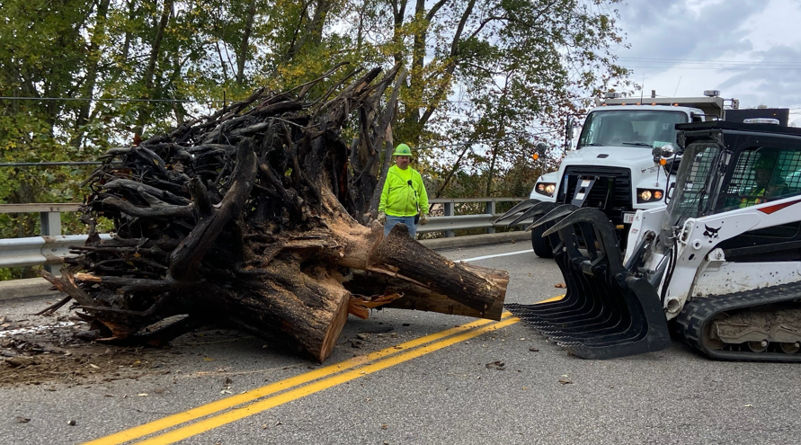
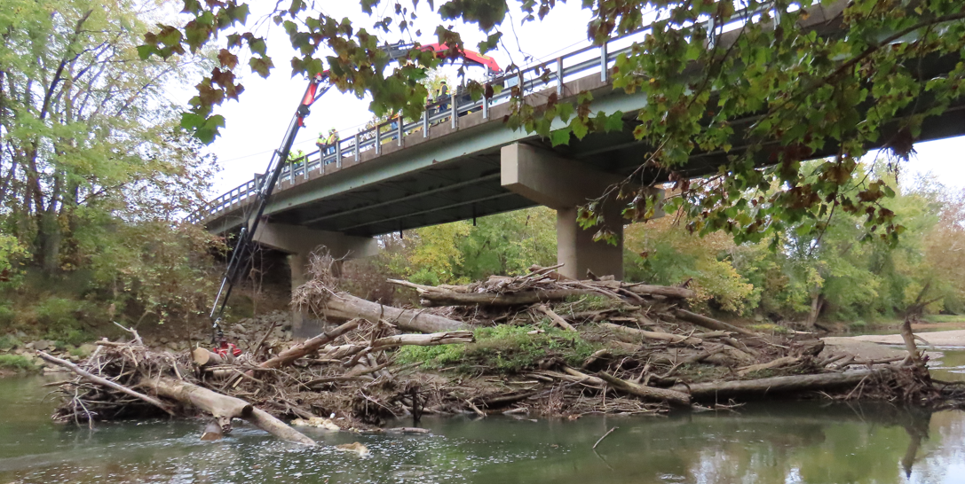
Knuckleboom!
Continued debris removal of approximately 100 bridges in Districts 5, 6, 7, 8, 9, 10, 11, and 12.
This includes 15 bridges already in 2026.
Four active crane operators (three HT’s and a BS2)

Slide 4
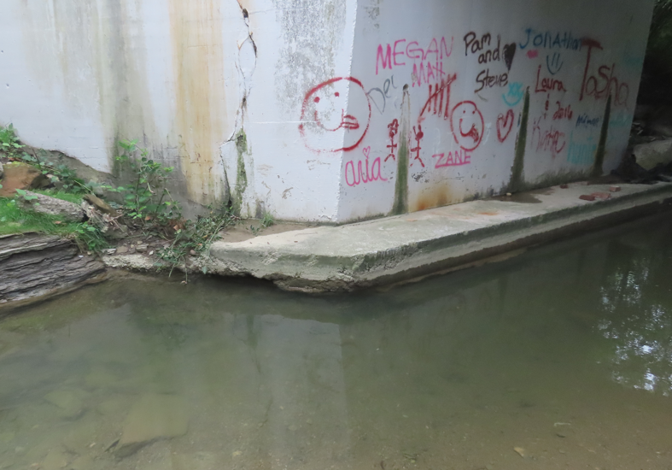
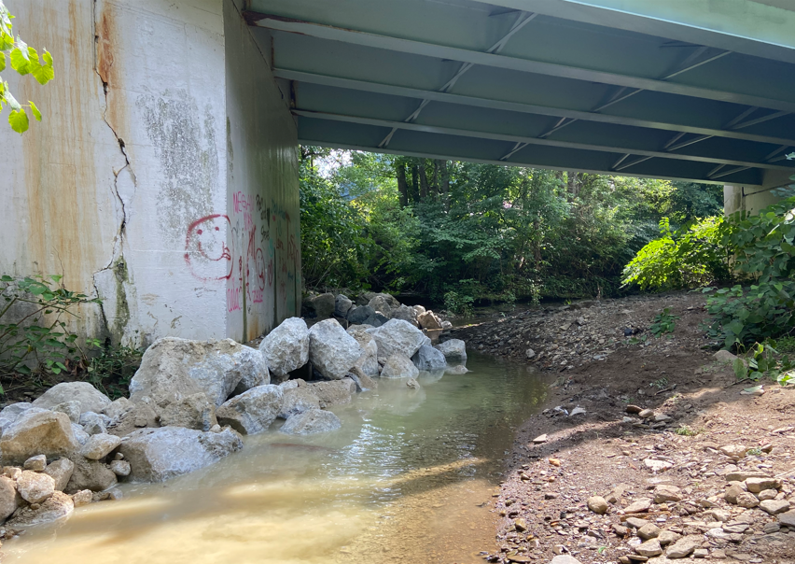
Scour Repair in District 11- Bel-647-0216
Scour Before placement of RCP Footing Protected in One Day with Crane
Notes:
Please introduce in-person District attendees.

Slide 5
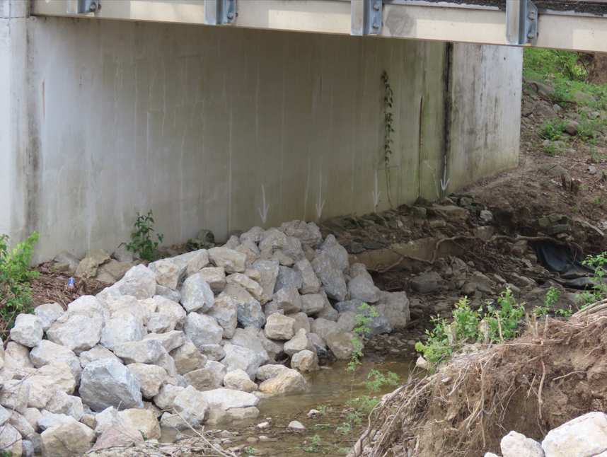
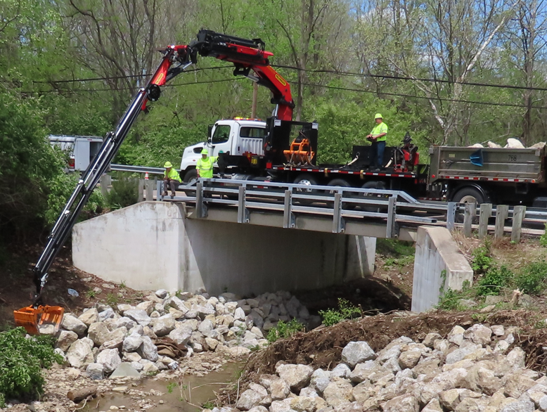
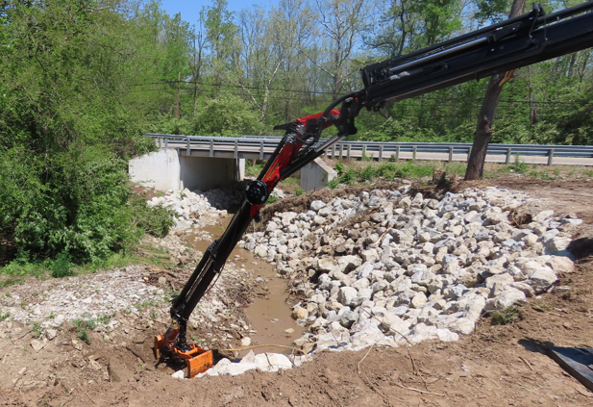
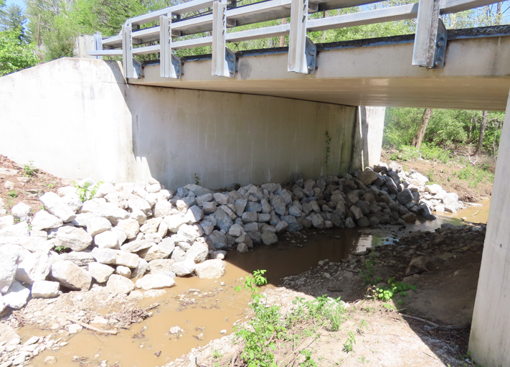
Scour & stream repairs – Bridge: BUT-122-0076
BUT-122-0076 bridge on spread footing found to be scoured and exposed.
Repair by a capital project would have cost around $100,000 and taken 1 to 2 years for plan prep and Env coordination.
Crane and excavator allowed repair without getting in the water.
No plan prep, reduced env, field work took 1 week, total cost was $40k
Notes:
<District Notes Here>

Slide 6
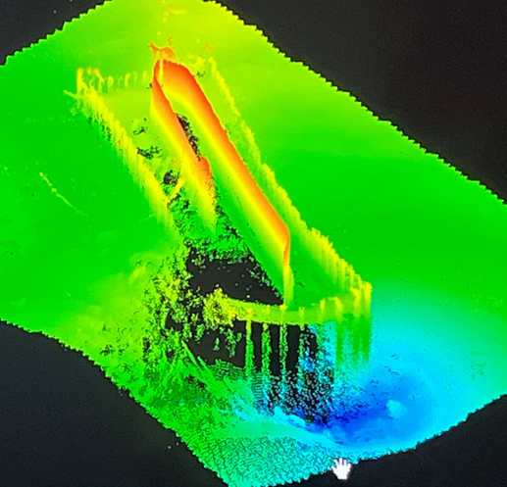
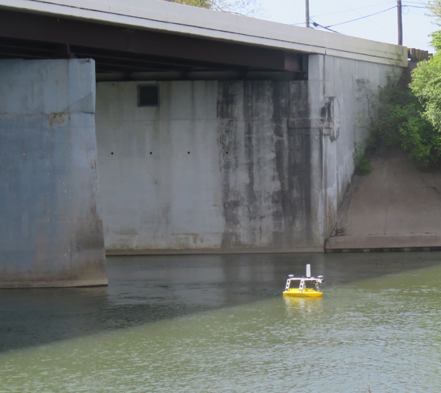
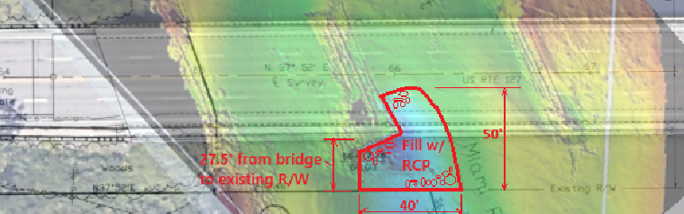
Scour hole – Bridge: BUT-127-0858
15’ deep scour hole is approaching our bridge (from upstream railroad bridge). Sonar boat provided high quality underwater topo.
Repair with a contract would require causeway/TAF, R/W and significant environmental coordination. Estimate cost as a capital project would be $700k and 2 years.
Using crane and sonar boat, we expect to be able to repair this for under $50k this Fall in 1 week. Plan prep & Environmental is substantially reduced.
Notes:
<District Notes Here>

Slide 7
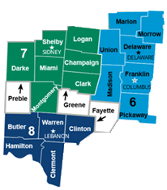
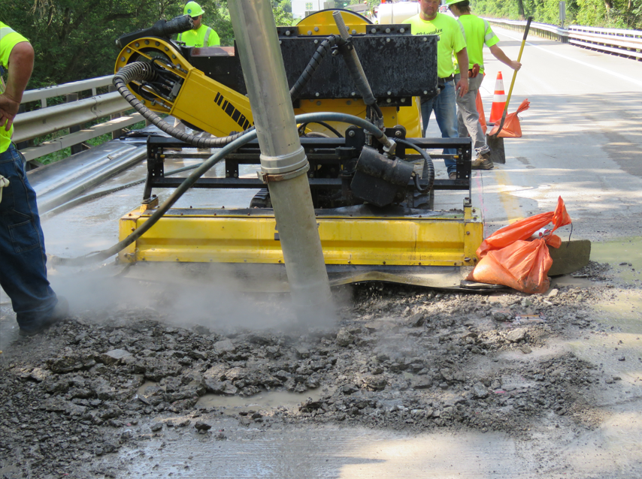
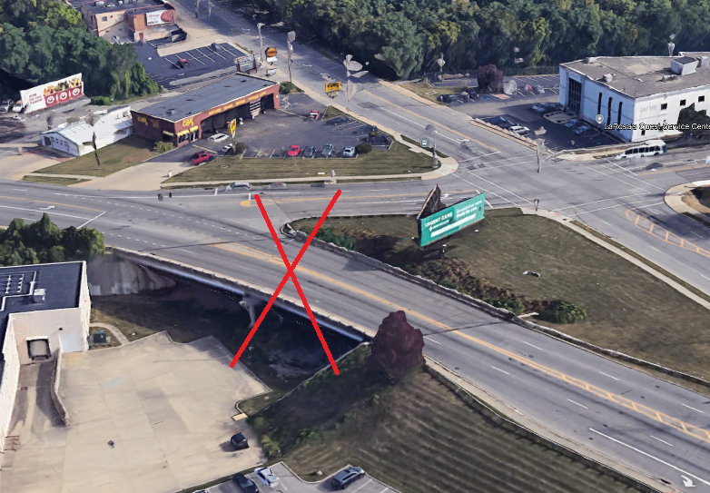
Other Unique Preservation happenings
Partnered with D7 crews to use their hydro-demolition equipment for the repair of the GRE-68-1428 wearing surface.
Transitioning projects GRE and PRE to D7 and accepting projects in FAY from D6 is facilitating collaboration and sharing of resources in Engineering, inspection, and maintenance.
Instead of rehabilitating a 49-year old bridge that spanned over a now abandoned railroad, we are removing the bridge and eliminating all future maintenance costs.
Working with Dean Alatsis to add a State Term Bridge Wearing Surface Patching Contract. This contract will expedite proper pothole repairs, extend the life of wearing surfaces, and ultimately increase the longevity of our bridge decks.

Slide 8
Funds Transfer
Capital to Operations
NO TRANSFER REQUEST FOR D8
Notes:
<District Notes Here>
This template is provided for any Districts wanting to transfer funds from Capital to Operations.

Slide 9
Thank you

