Slide 1

HIG-50-2.80 (SR 134)

Slide 2

Location/Geometrics

Slide 3
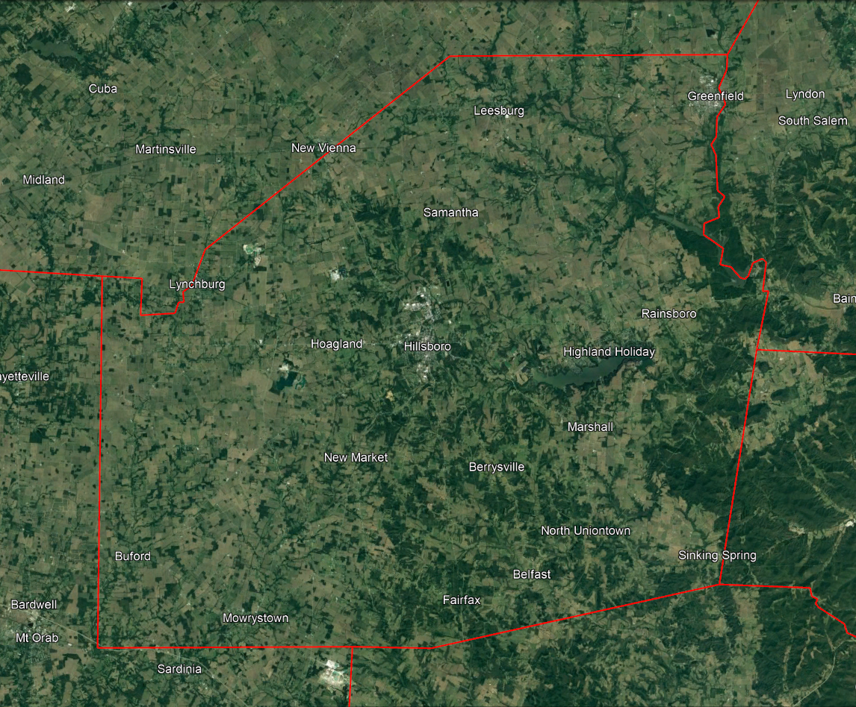

Location
Intersection of US 50 and SR 134
Approximately 11 miles west of Hillsboro on US 50.
Speed Limit: 45 MPH
AADT: 998/1,287 on SR 134

Slide 4
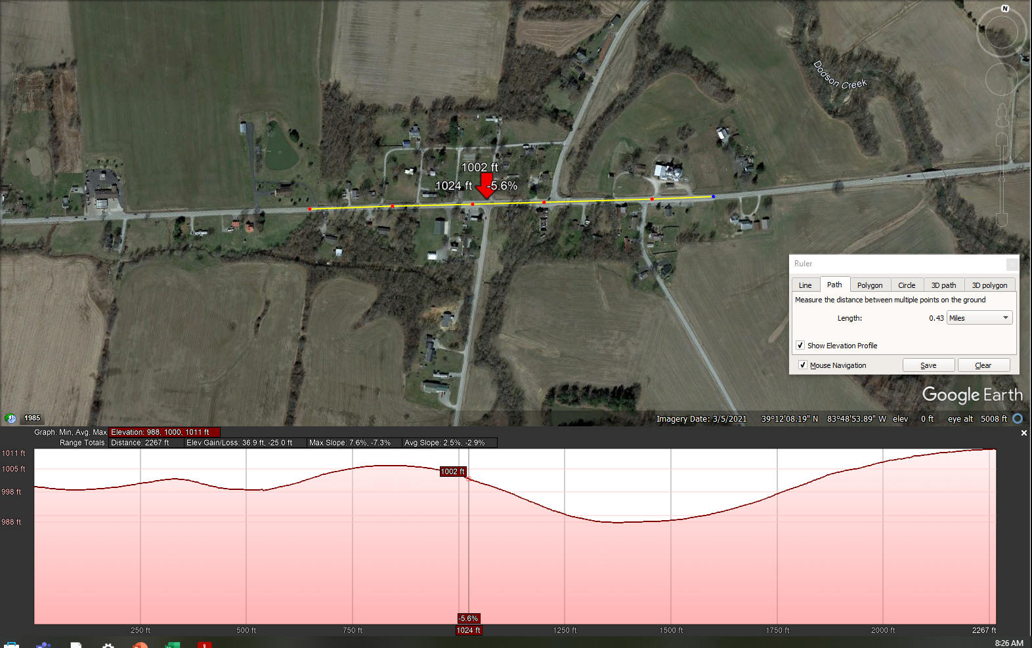
Geometrics
Intersection is located just beyond the crest of a vertical curve.
Vertical curve causes sight distance concerns involving eastbound/westbound traffic on US 50 and northbound traffic on SR 134.

Slide 5
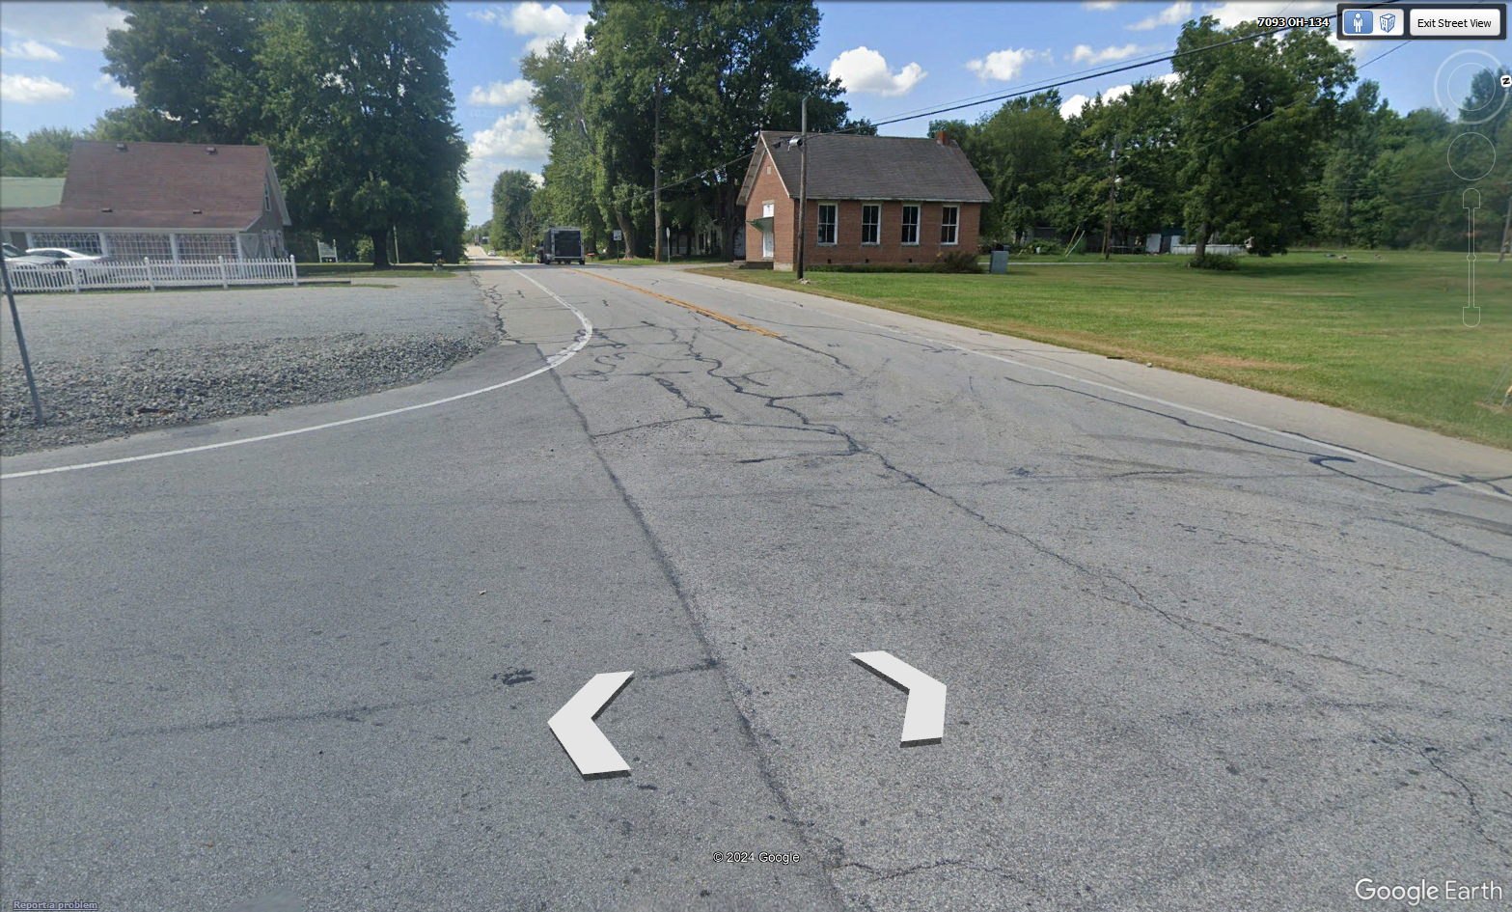
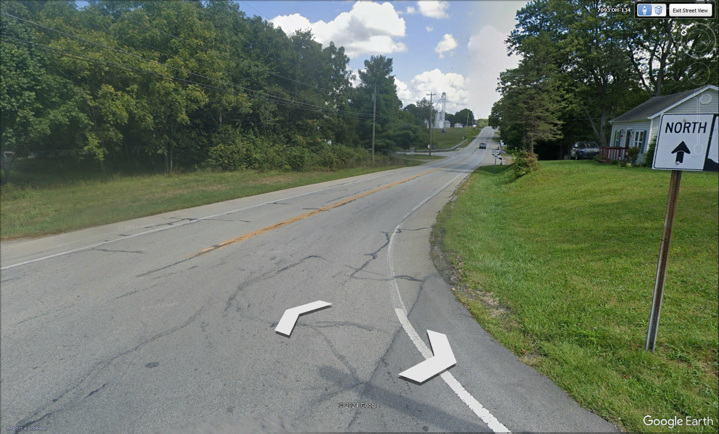
Geometrics
Looking west
Looking east

Slide 6
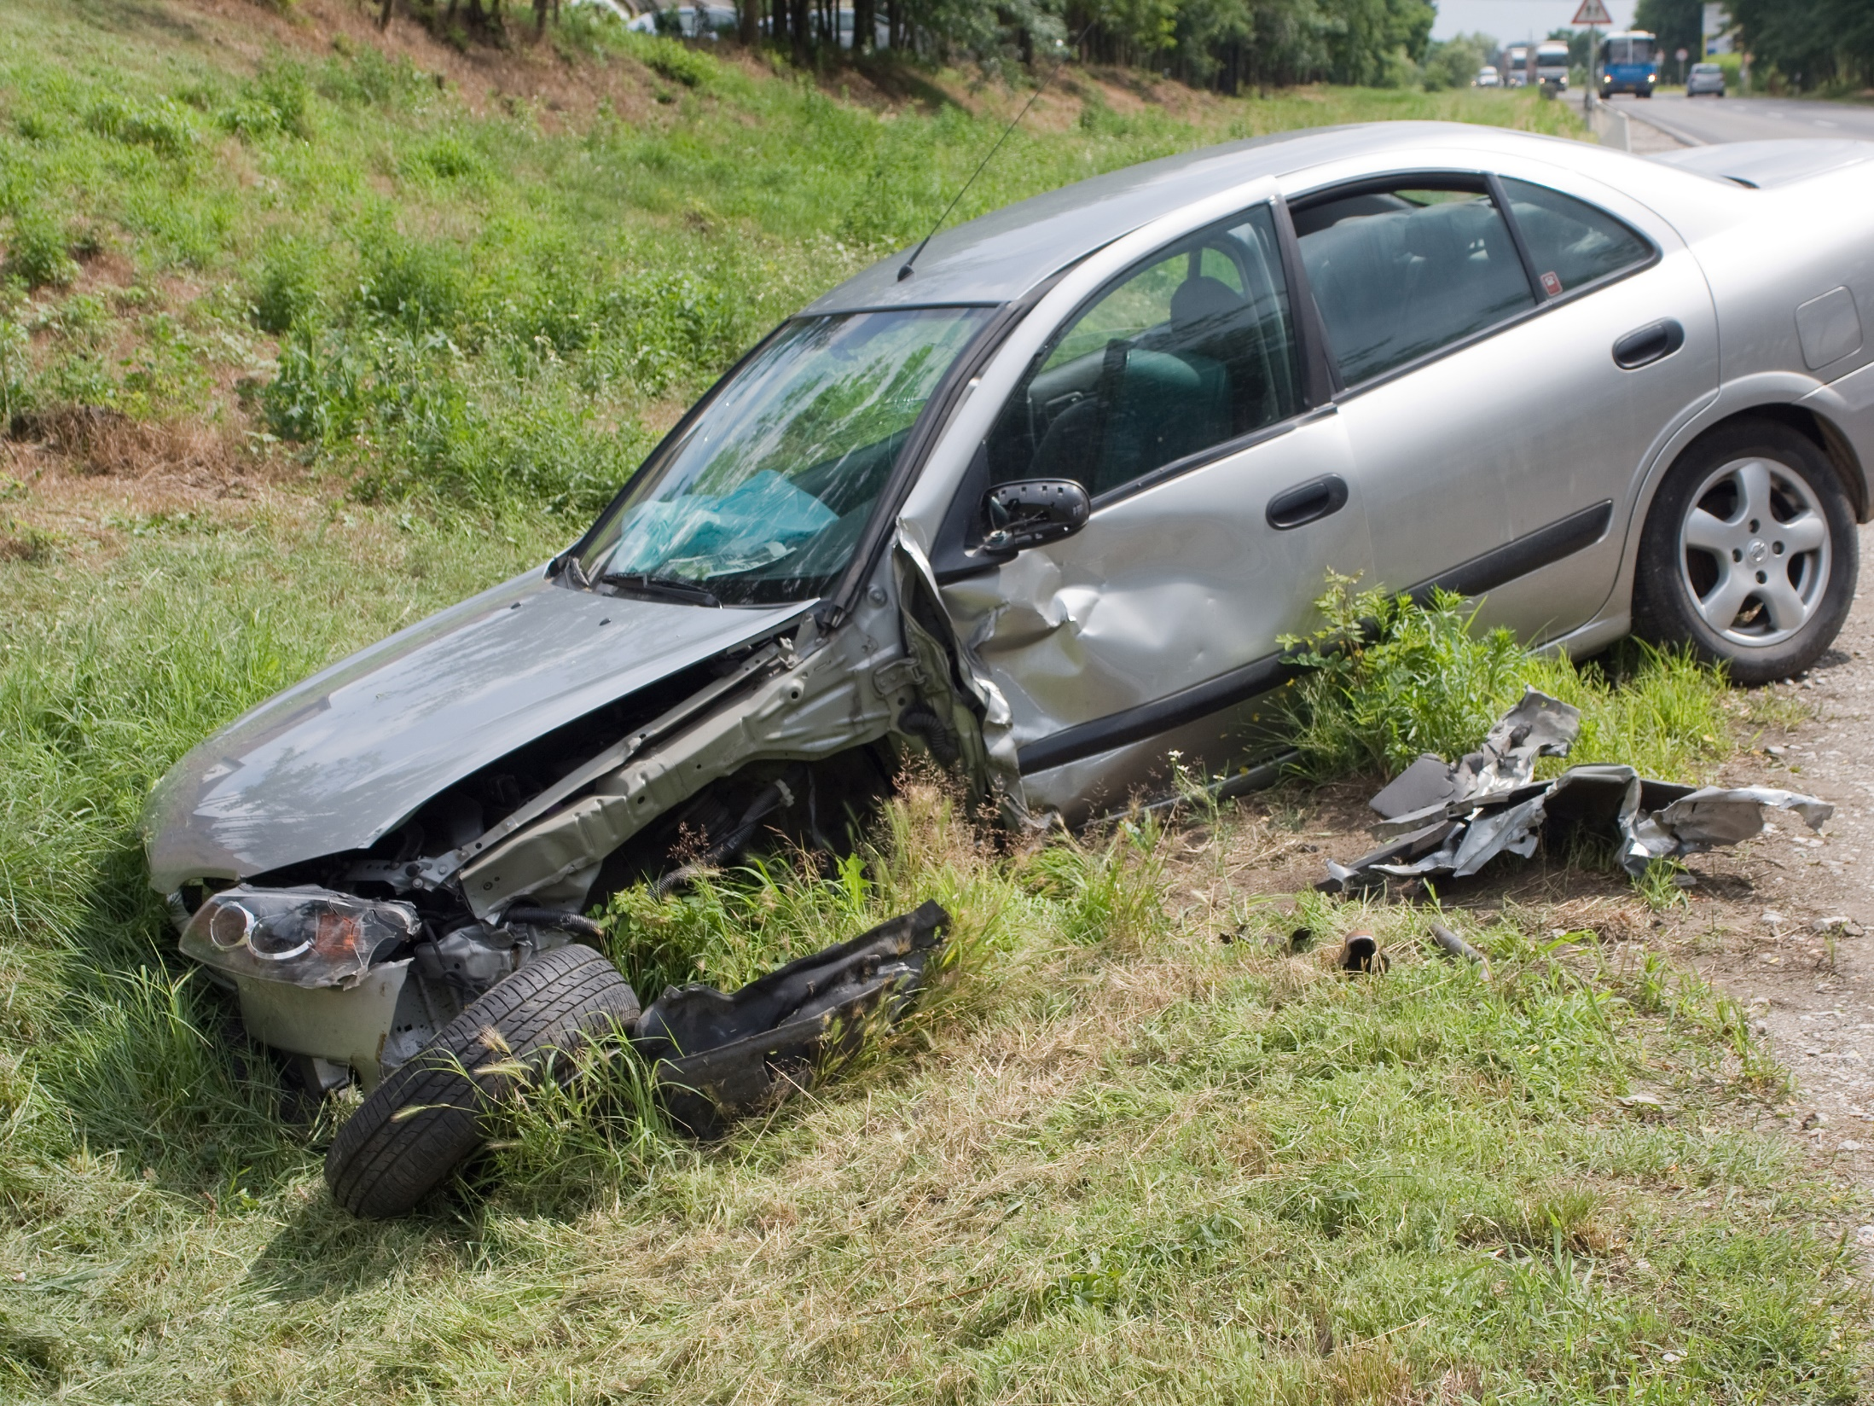
Crash Trends

Slide 7
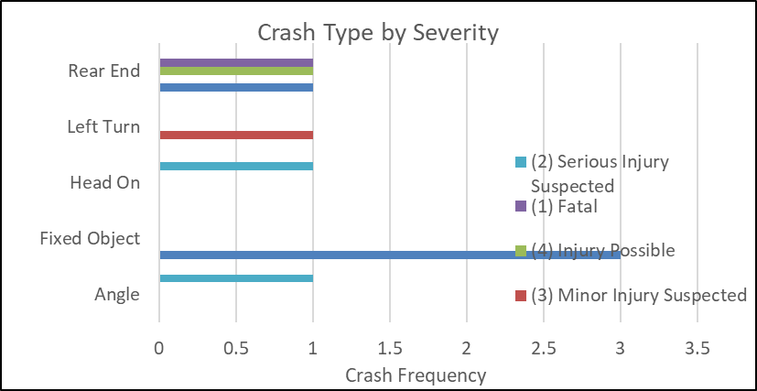
Crash Trends (2020-2023)

Slide 8
Crash Trends (2020-2023)

Slide 9
Crash Trends (2020-2023)

Slide 10
Crash Trends (2020-2023)

Slide 11
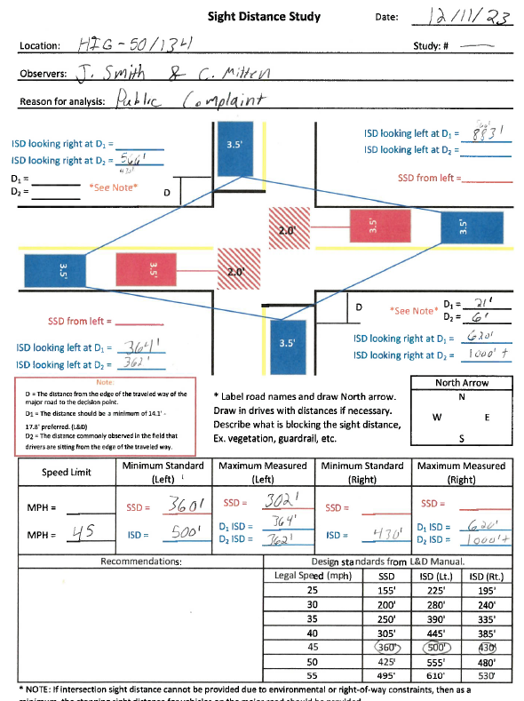
Sight Distance Study (2013)

Slide 12
Recommendations

Slide 13
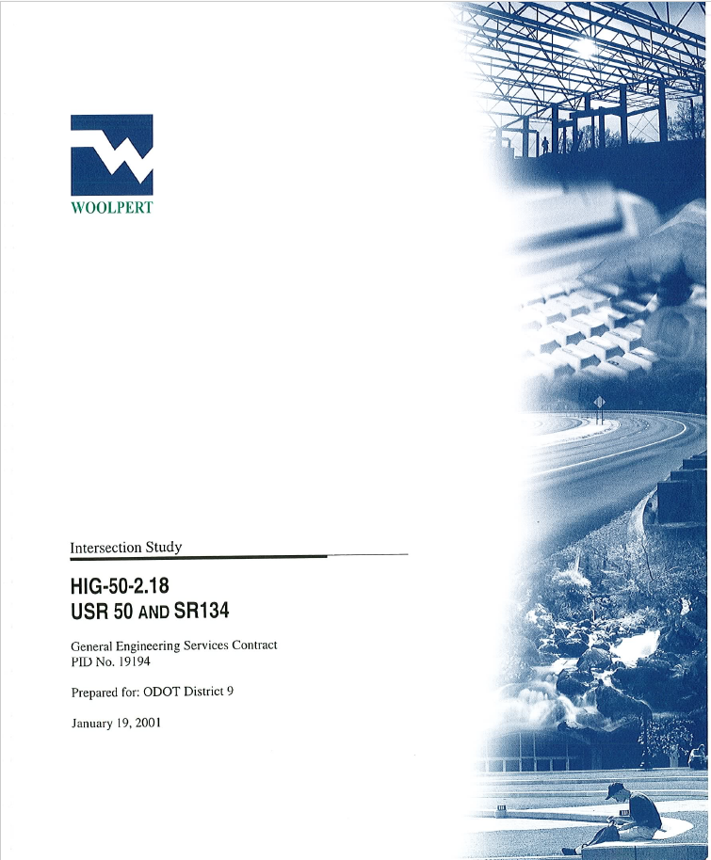
2001 Study

Slide 14
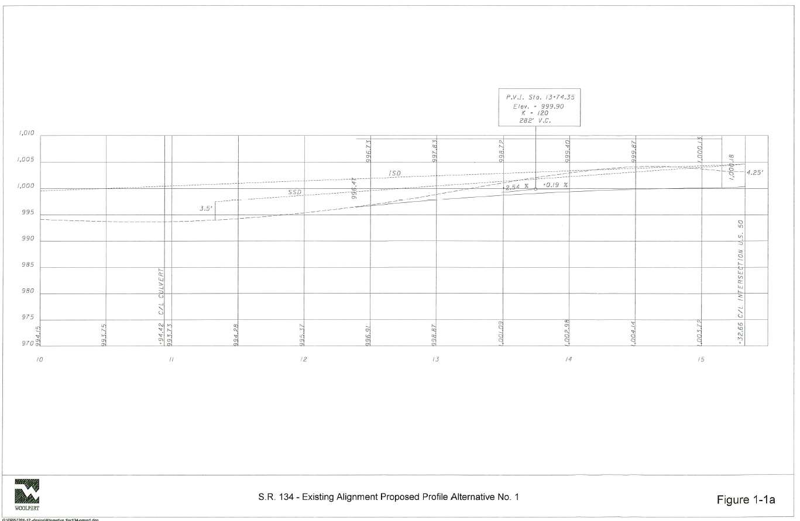
2001 Study

Slide 15
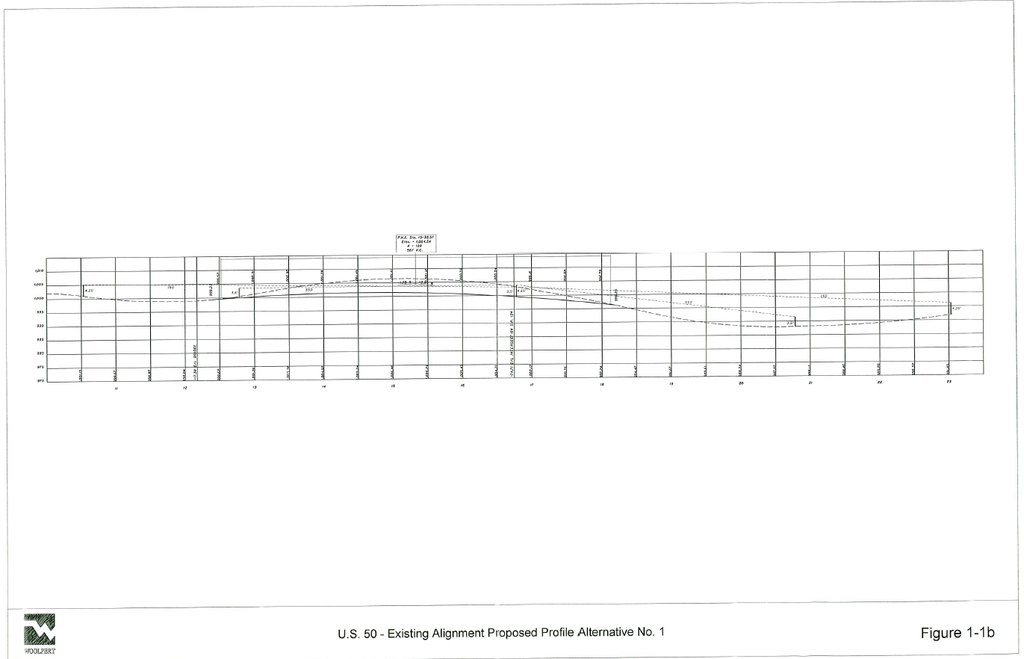
2001 Study

Slide 16
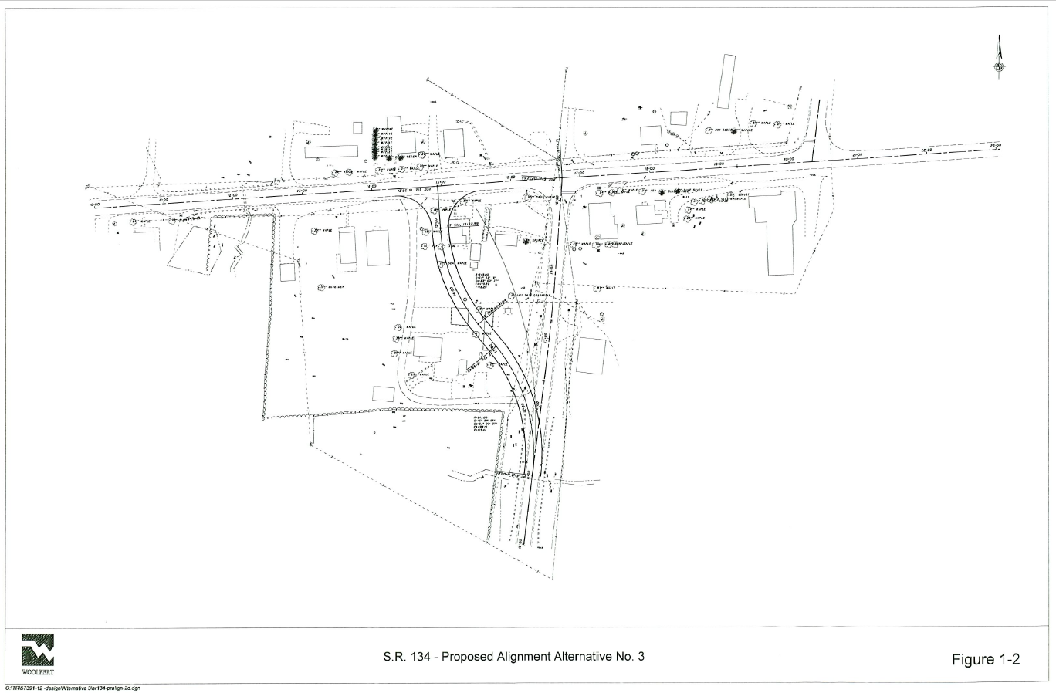
2001 Study

Slide 17
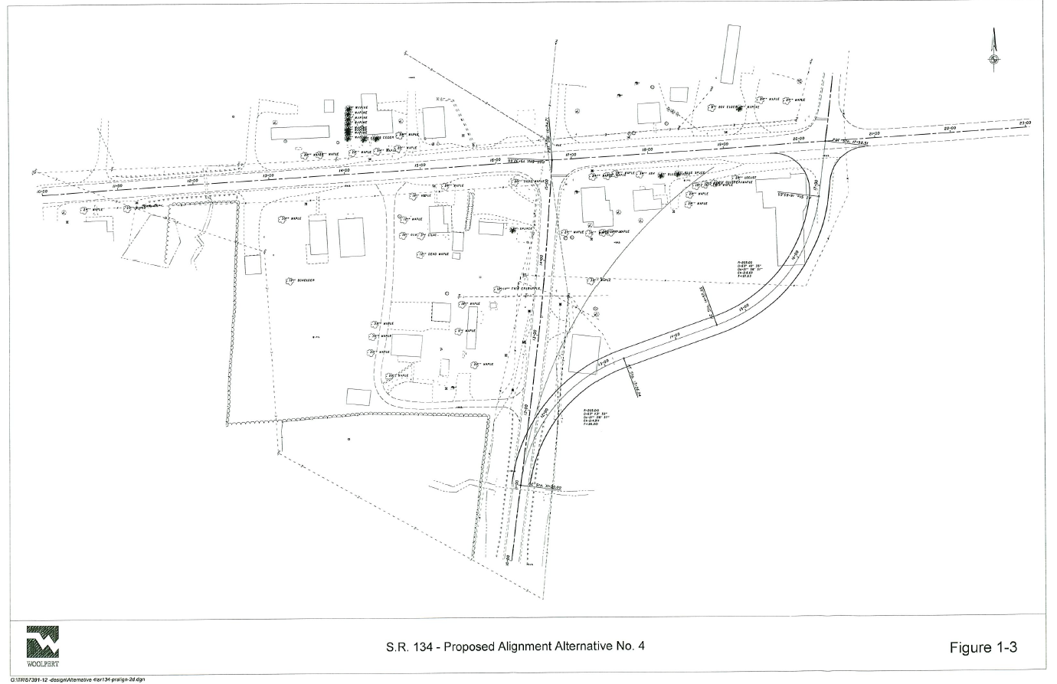
2001 Study

Slide 18
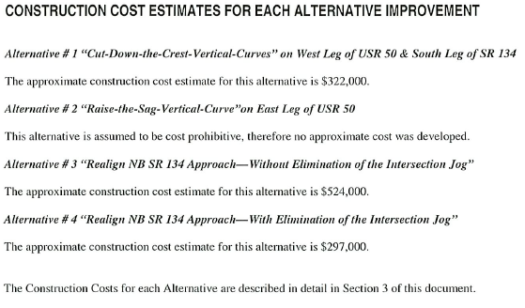
2001 Study

Slide 19
Things to Consider

Slide 20
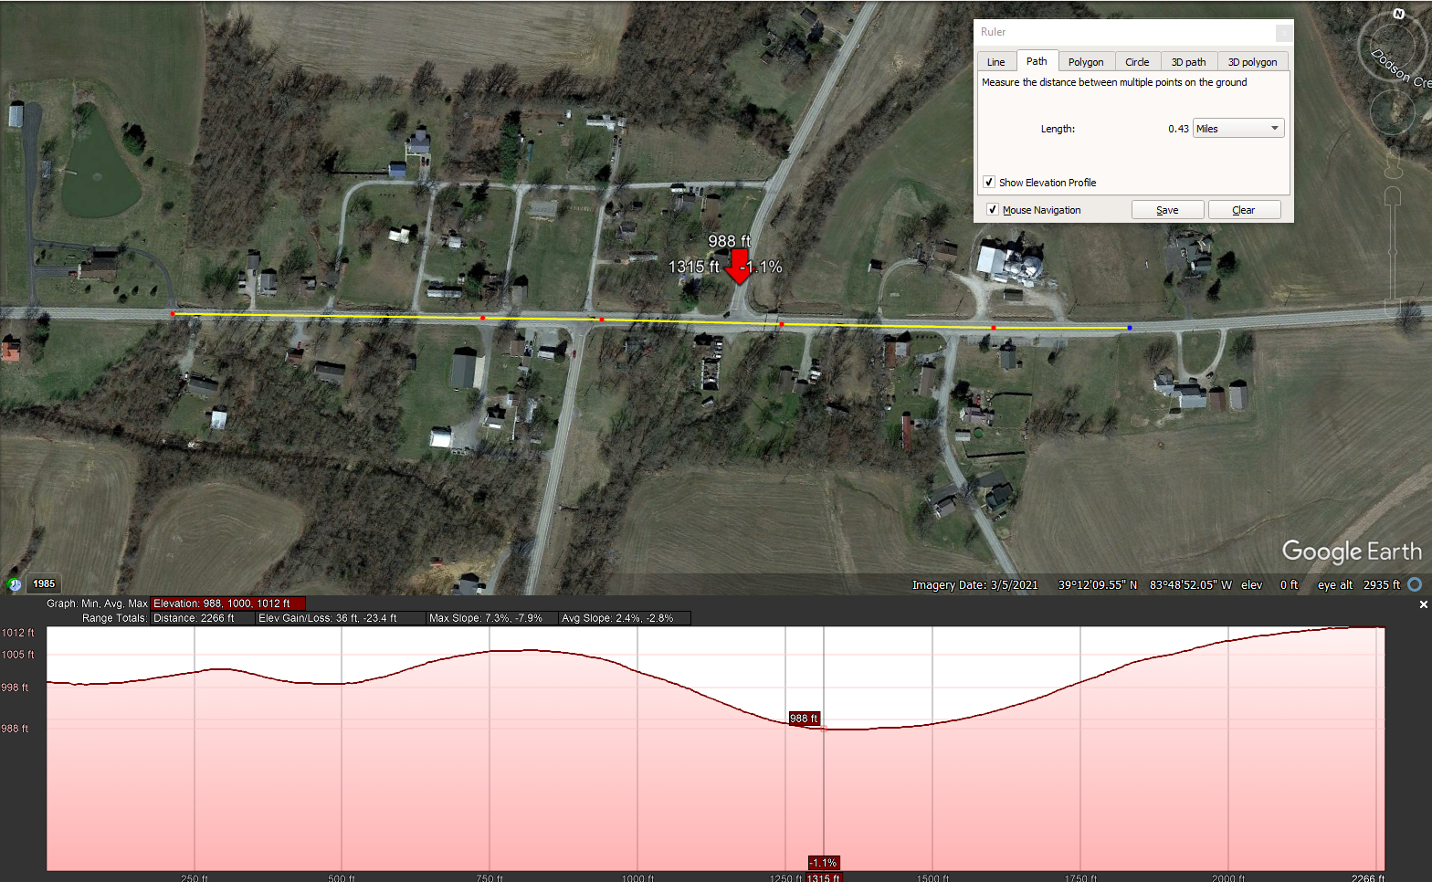
Sight Distance

Slide 21
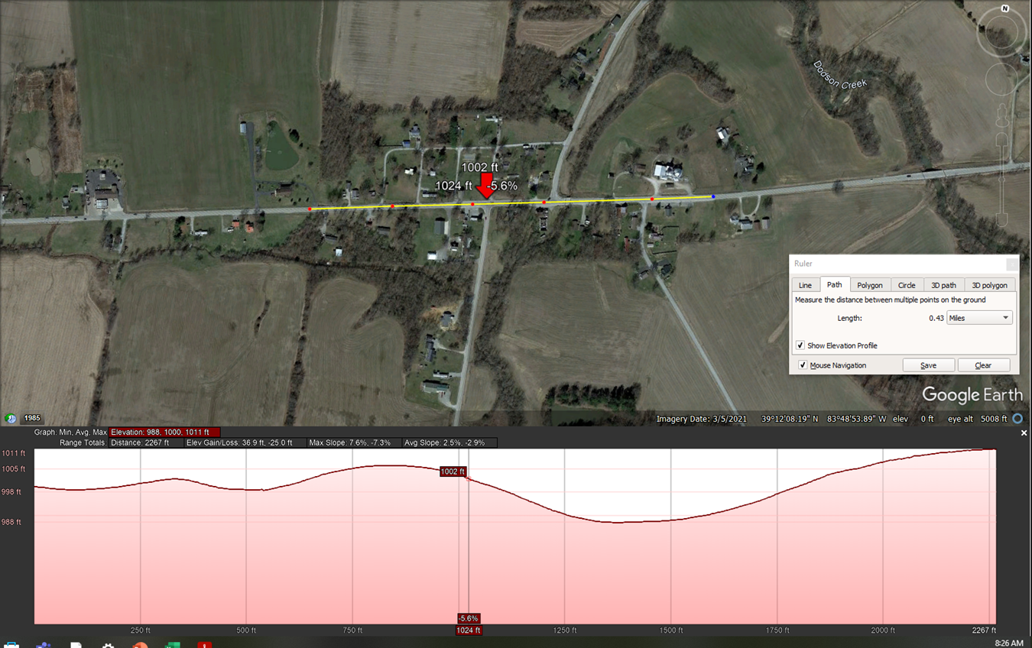
Sight Distance

Slide 22
jonas.smith@dot.ohio.gov
740.774.8864

