Slide 1

MAY 2025 Programmatic
D11 Proj.: TUS-416-3.13 PID 117704
Notes:
This presentation will provide an overview of the subject project that will be placed on the upcoming programmatic selection for consultant design services.

Slide 2
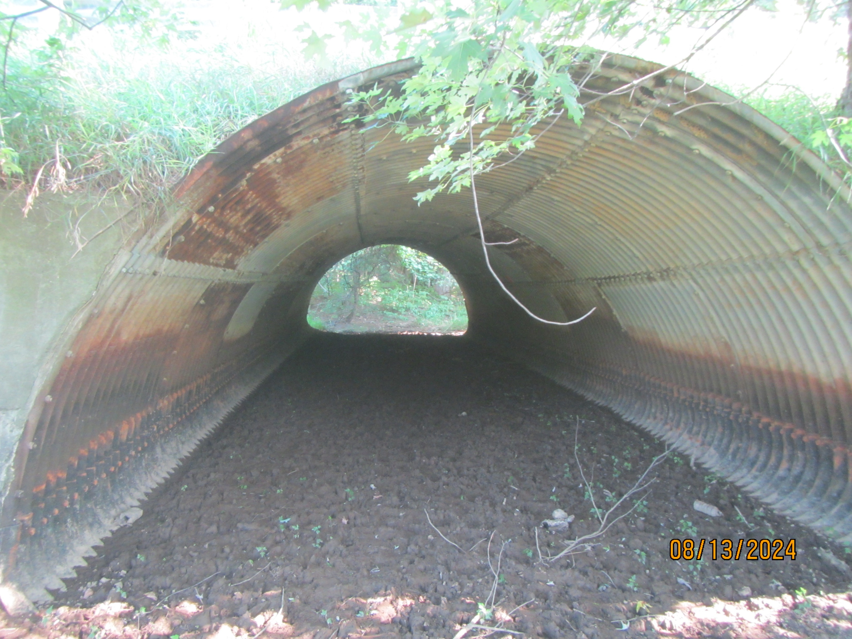
TUS-416-3.13 PID 117704
Proj. Description: Replace bridge carrying State Route 416 over Unnamed Tributary to Tuscarawas River.
Notes:
The project will replace bridge TUS-416-3.13 (SFN 7905890) carrying SR 416 over an Unnamed Tributary to Tuscarawas River.

Slide 3
Available project information
Some project information is available at the following FTP site:
  https://ftp.dot.state.oh.us/pub/Districts/D11/117704
  Internet Explorer recommended for the ftp site
  The PIP will be released through SAFE on the programmatic scheduled date
  D11 does not release the PIP early
  All information on the FTP site is subject to change, please review the information in SAFE to create your LOI
Notes:
Additional project information is available on the District 11 ftp site, at the link shown on your screen. The Project Initiation Package document, along with a more complete and detailed scope of work will be released through The ODOT Scope and Fee System (or SAFE) at the request for LOIs. All information on the FTP site is subject to change. Ensure you review the ftp site and the information in SAFE before completing your LOI for this project.

Slide 4
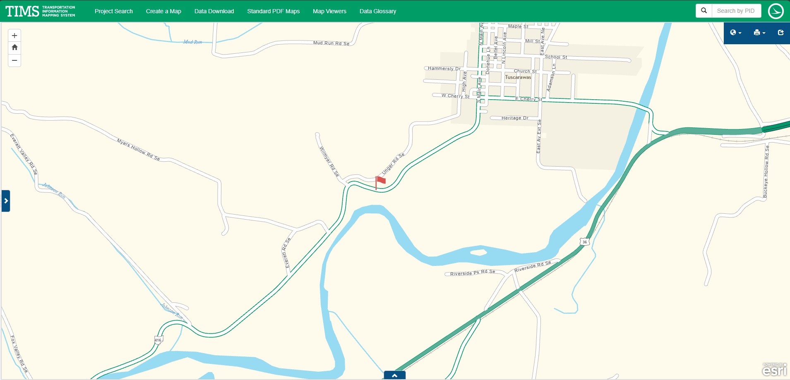
TIMS MAPPING
Notes:
Here is an image showing the anticipated project limits from ODOT’s TIMS application. The project will follow the existing horizontal and vertical alignments as much as practical.

Slide 5
Project scope
  The major items of work include:
    Replace Sectional Plate Pipe Arch Culvert-Type Bridge with new structure.
      Replace in-kind or replace with box structure.
      If possible, implement clear zone grading by extending culvert–type bridge structure to diminish need for guardrail.
      Design Exception anticipated due to existing lane width.
    Soil Borings Required
    Right-of-Way Acquisition possible.
    Detour SR 416 for Maintenance of Traffic during school recess.
Notes:
The major scope items are listed here. An updated and more complete list will be released in SAFE at the beginning of the LOI process.

Slide 6
Consultant Prequalifications
Level 1 BRG INSP
Level 2 BRG DSGN
Non-Complex ROAD
Various ENV
Various GEO
Limited RW ACQ & RW PLANS
Notes:
The consultant prequalifications required for this project are shown here.

Slide 7
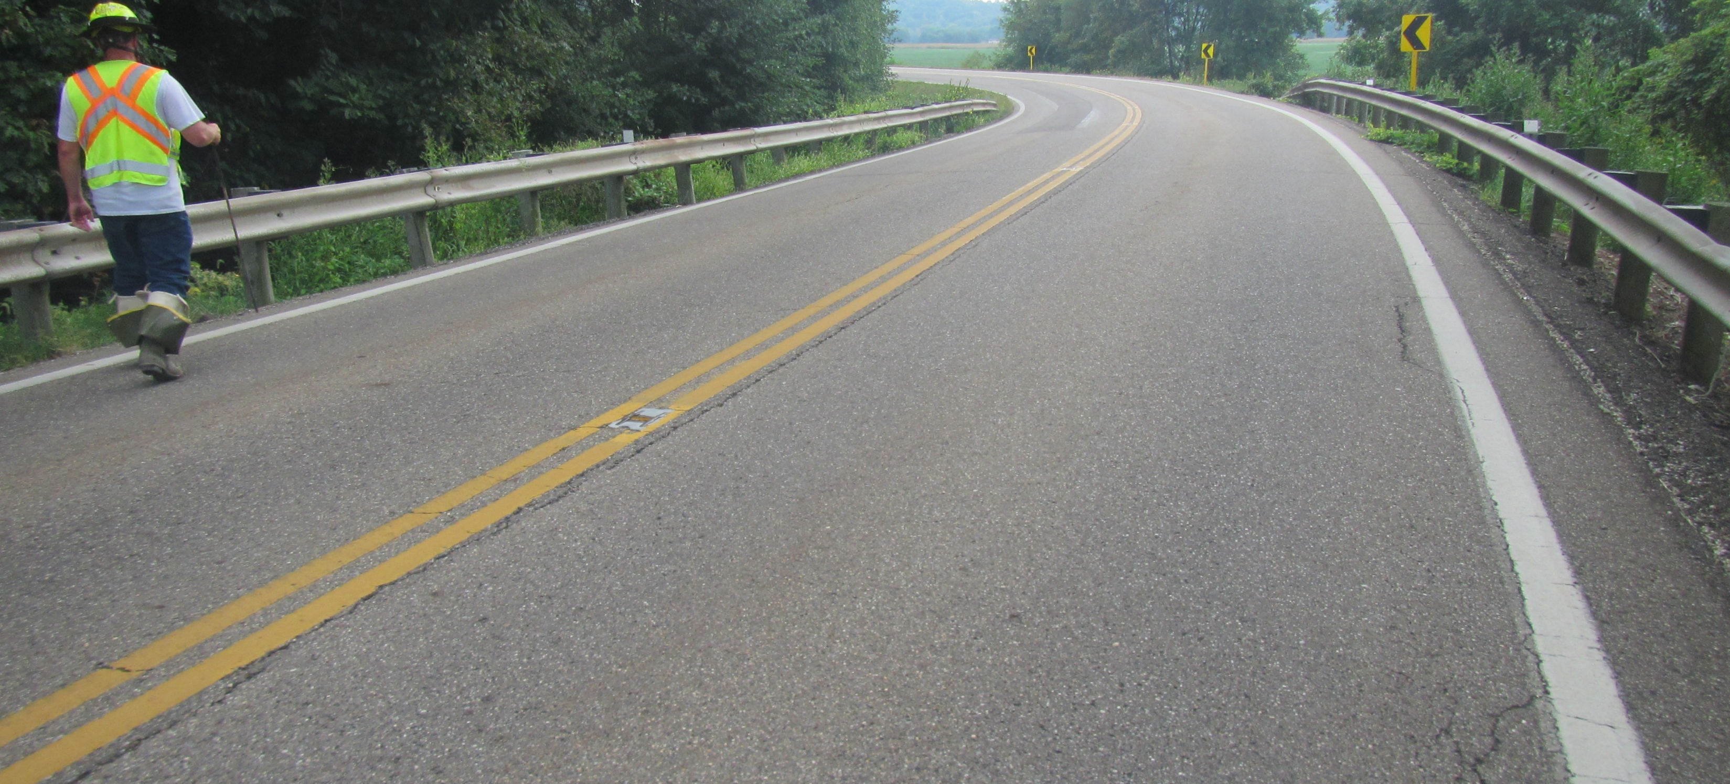
Field Photos
Notes:
The following slides will show you some of the scoping field visit photos, as well as structure inspection report photos, to illustrate how the District arrived at the current scope of work. More photos are available on the ftp site shown earlier.

Slide 8
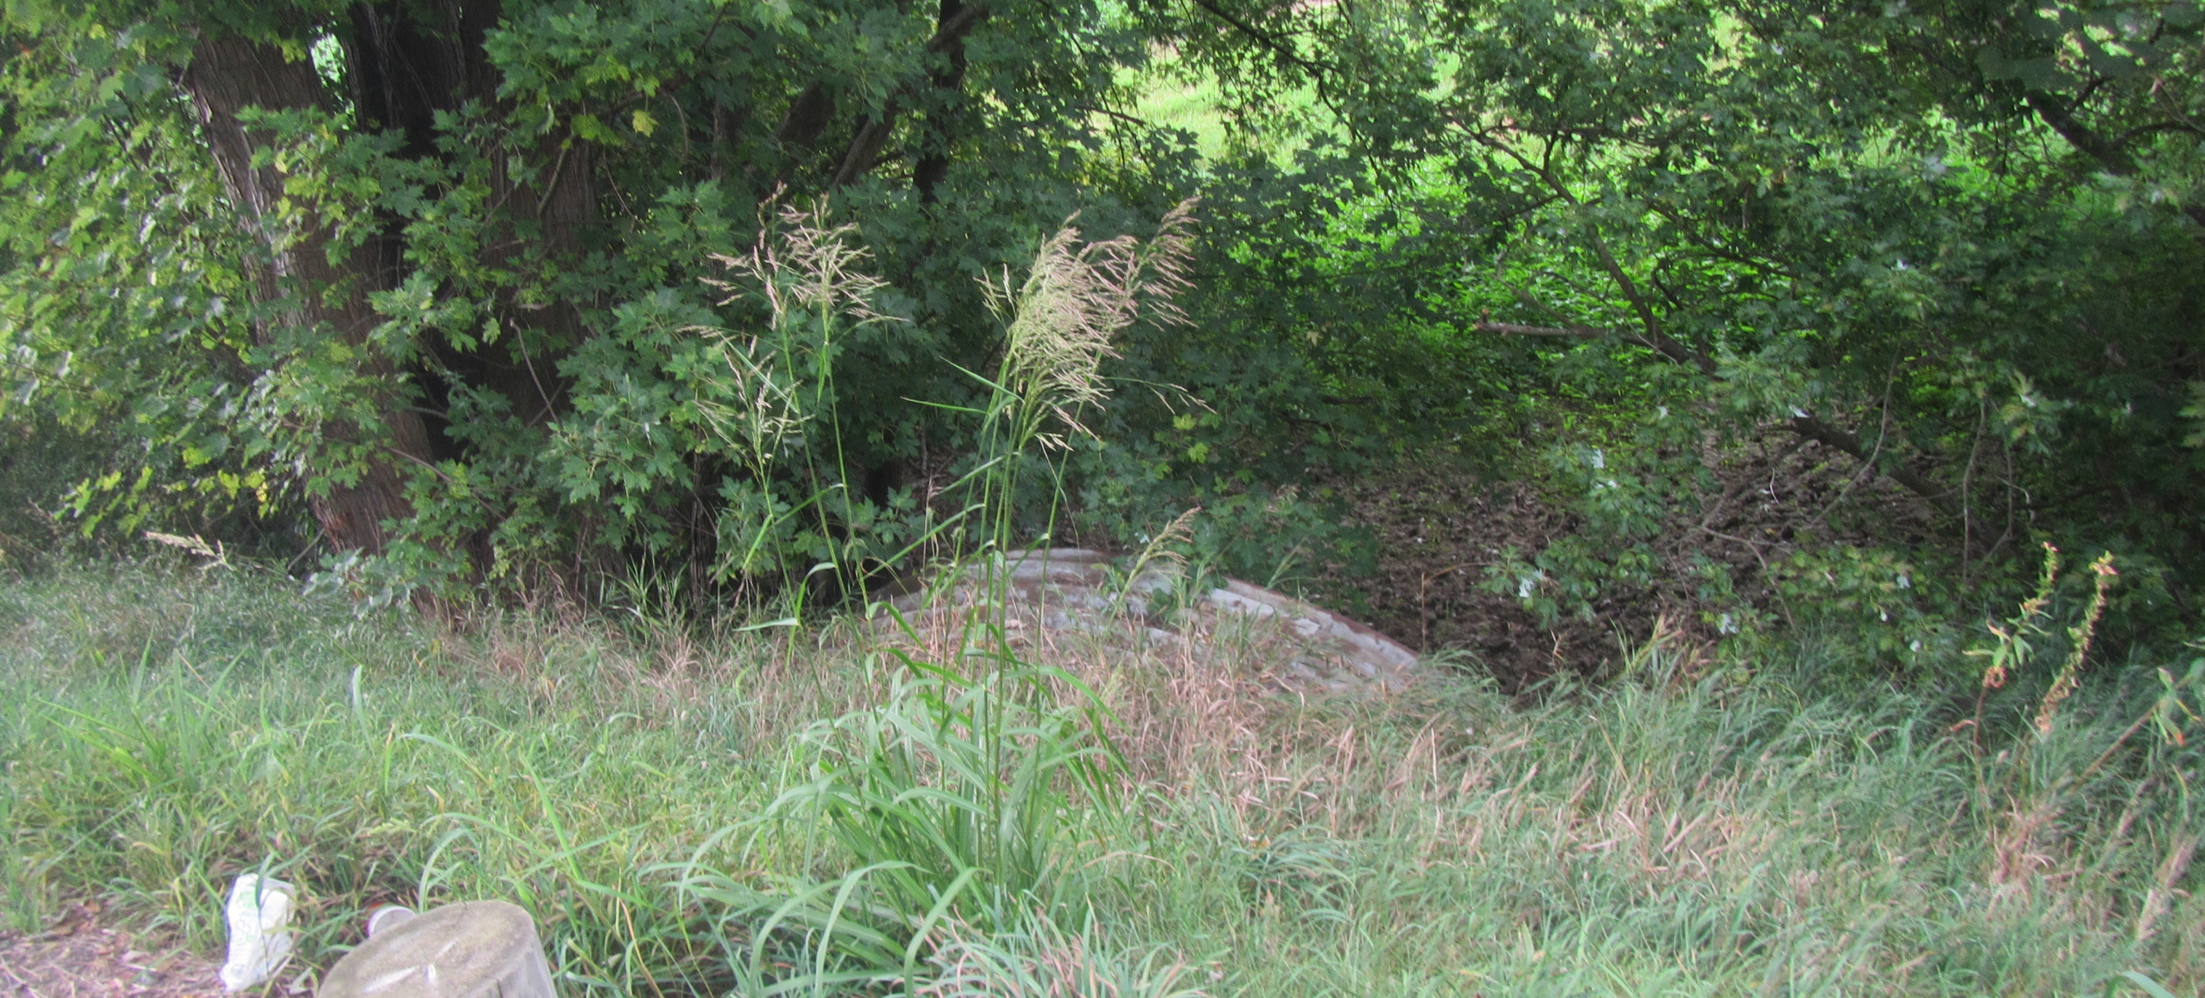
Field Photos

Slide 9
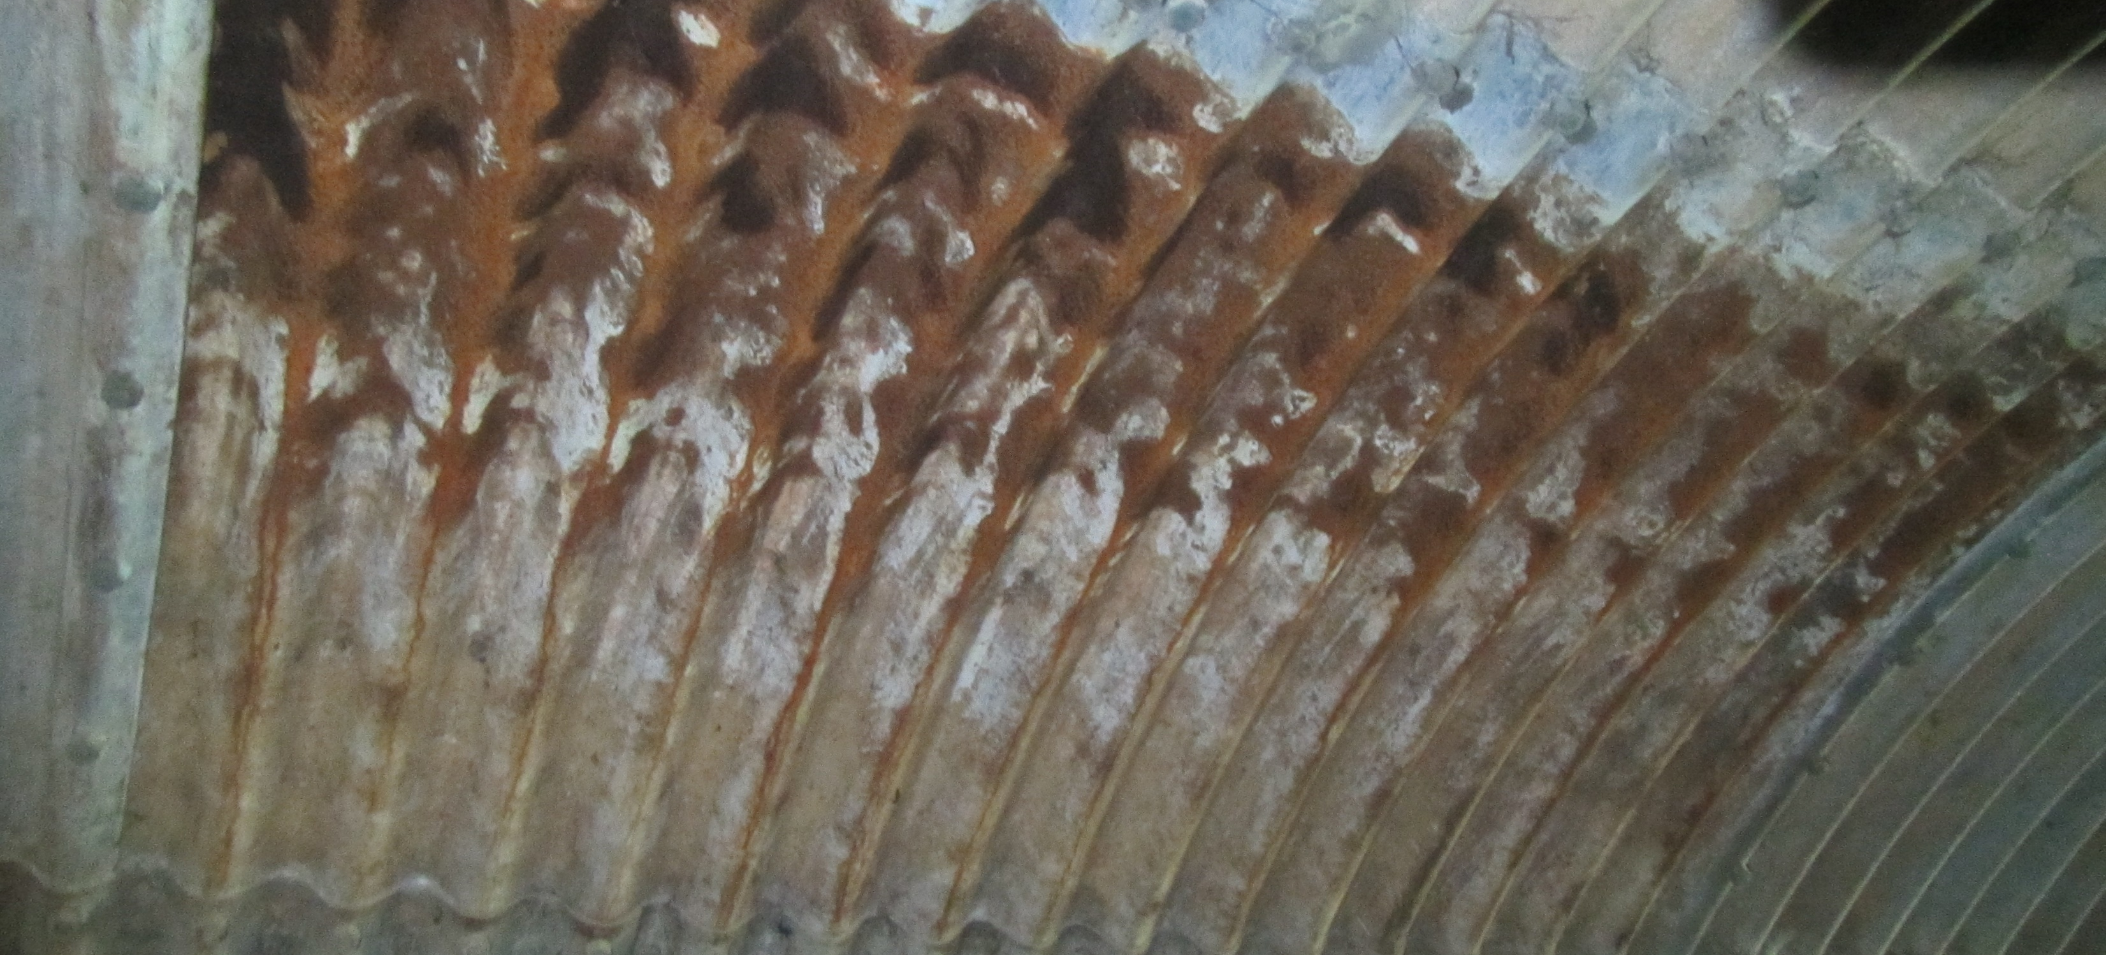
Field Photos

Slide 10
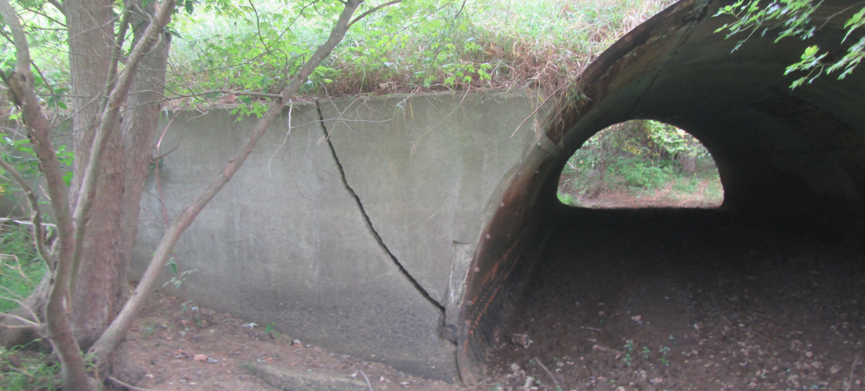
Field Photos

Slide 11
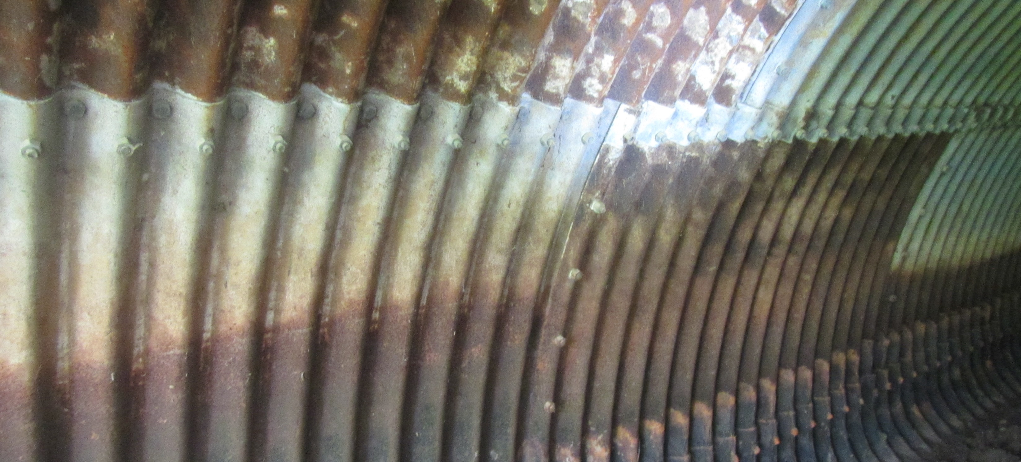
Field Photos

Slide 12
Thank you
Additional photos are available on the FTP Site.
Thank you for watching this video presentation for Proj. TUS-416-3.13 PID 117704.
District 11 appreciates your interest in partnering with us for a successful project.
Notes:
Thank you for watching this video. Visit the ftp site for more photos and information. Please remember that changes to this information and the detailed scope of work are possible. Review the information in SAFE prior to submitting your LOI.

Slide 13
Thank you

