Slide 1

May 2026 Programmatic
D11 Proj.: TUS-800-0.38 PID 97498
Notes:
This presentation will provide an overview of the subject project that will be placed on the upcoming programmatic selection for consultant design services.

Slide 2
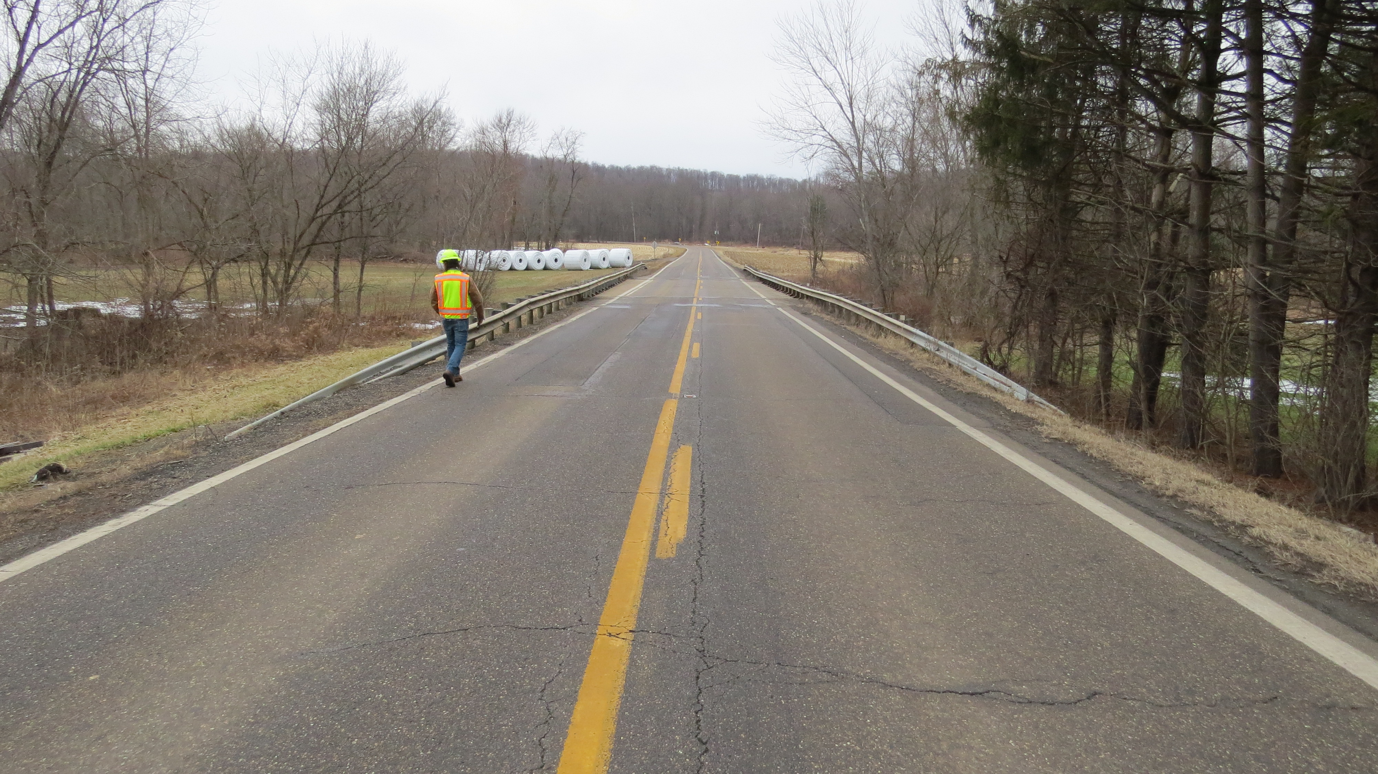
TUS-800-0.38 PID 97498
Proj. Description: Replace bridge carrying State Route 800 over Weavers Creek.
Notes:
The project will replace bridge TUS-800-0.38 (SFN 7906374) carrying state route 800 over Weavers Creek.

Slide 3
Available project information
Some project information is available at the following FTP site:
  https://ftp.dot.state.oh.us/pub/Districts/D11/97498/
  The PIP will be released through SAFE on the programmatic scheduled date
  D11 does not release the PIP early
  All information on the FTP site is subject to change, please review the information in SAFE to create your LOI
Notes:
Additional project information is available on the District 11 ftp site, at the link shown on your screen. The Project Initiation Package document, along with a more complete and detailed scope of work will be released through The ODOT Scope and Fee System (or SAFE) at the request for LOIs. All information on the FTP site is subject to change. Ensure you review the ftp site and the information in SAFE before completing your LOI for this project.

Slide 4
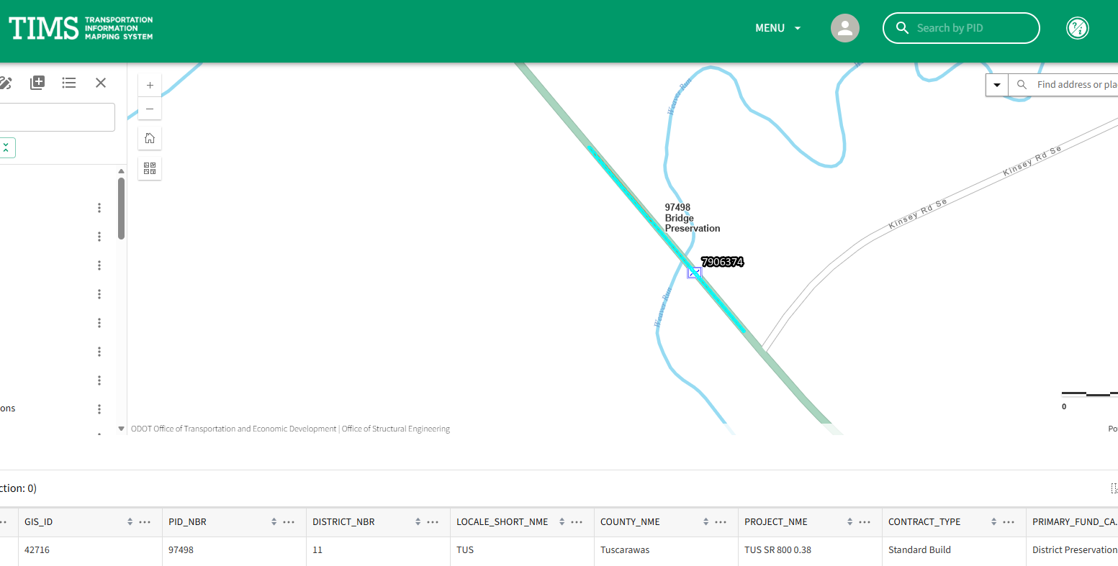
TIMS MAPPING
Notes:
Here is an image showing the anticipated project limits from ODOT’s TIMS application. The project will follow the existing horizontal and vertical alignments as much as practical.

Slide 5
Project scope
  The major items of work include:
    Replace superstructure on three-span continuous concrete slab bridge.
      Replace abutment breastwalls.
      Encase piling
        Design exception for graded shoulder width anticipated.
      Protect bridge from scour
    Soil Borings are not required. Historic borings will be used to determine the scour parameters.
Notes:
The major scope items are listed here. An updated and more complete list will be released in SAFE at the beginning of the LOI process.

Slide 6
Consultant Prequalifications
Level 1 bridge inspection
Level 2 bridge design
Non-complex roadway design
Various Environmental
Notes:
The consultant prequalifications required for this project are shown here.

Slide 7
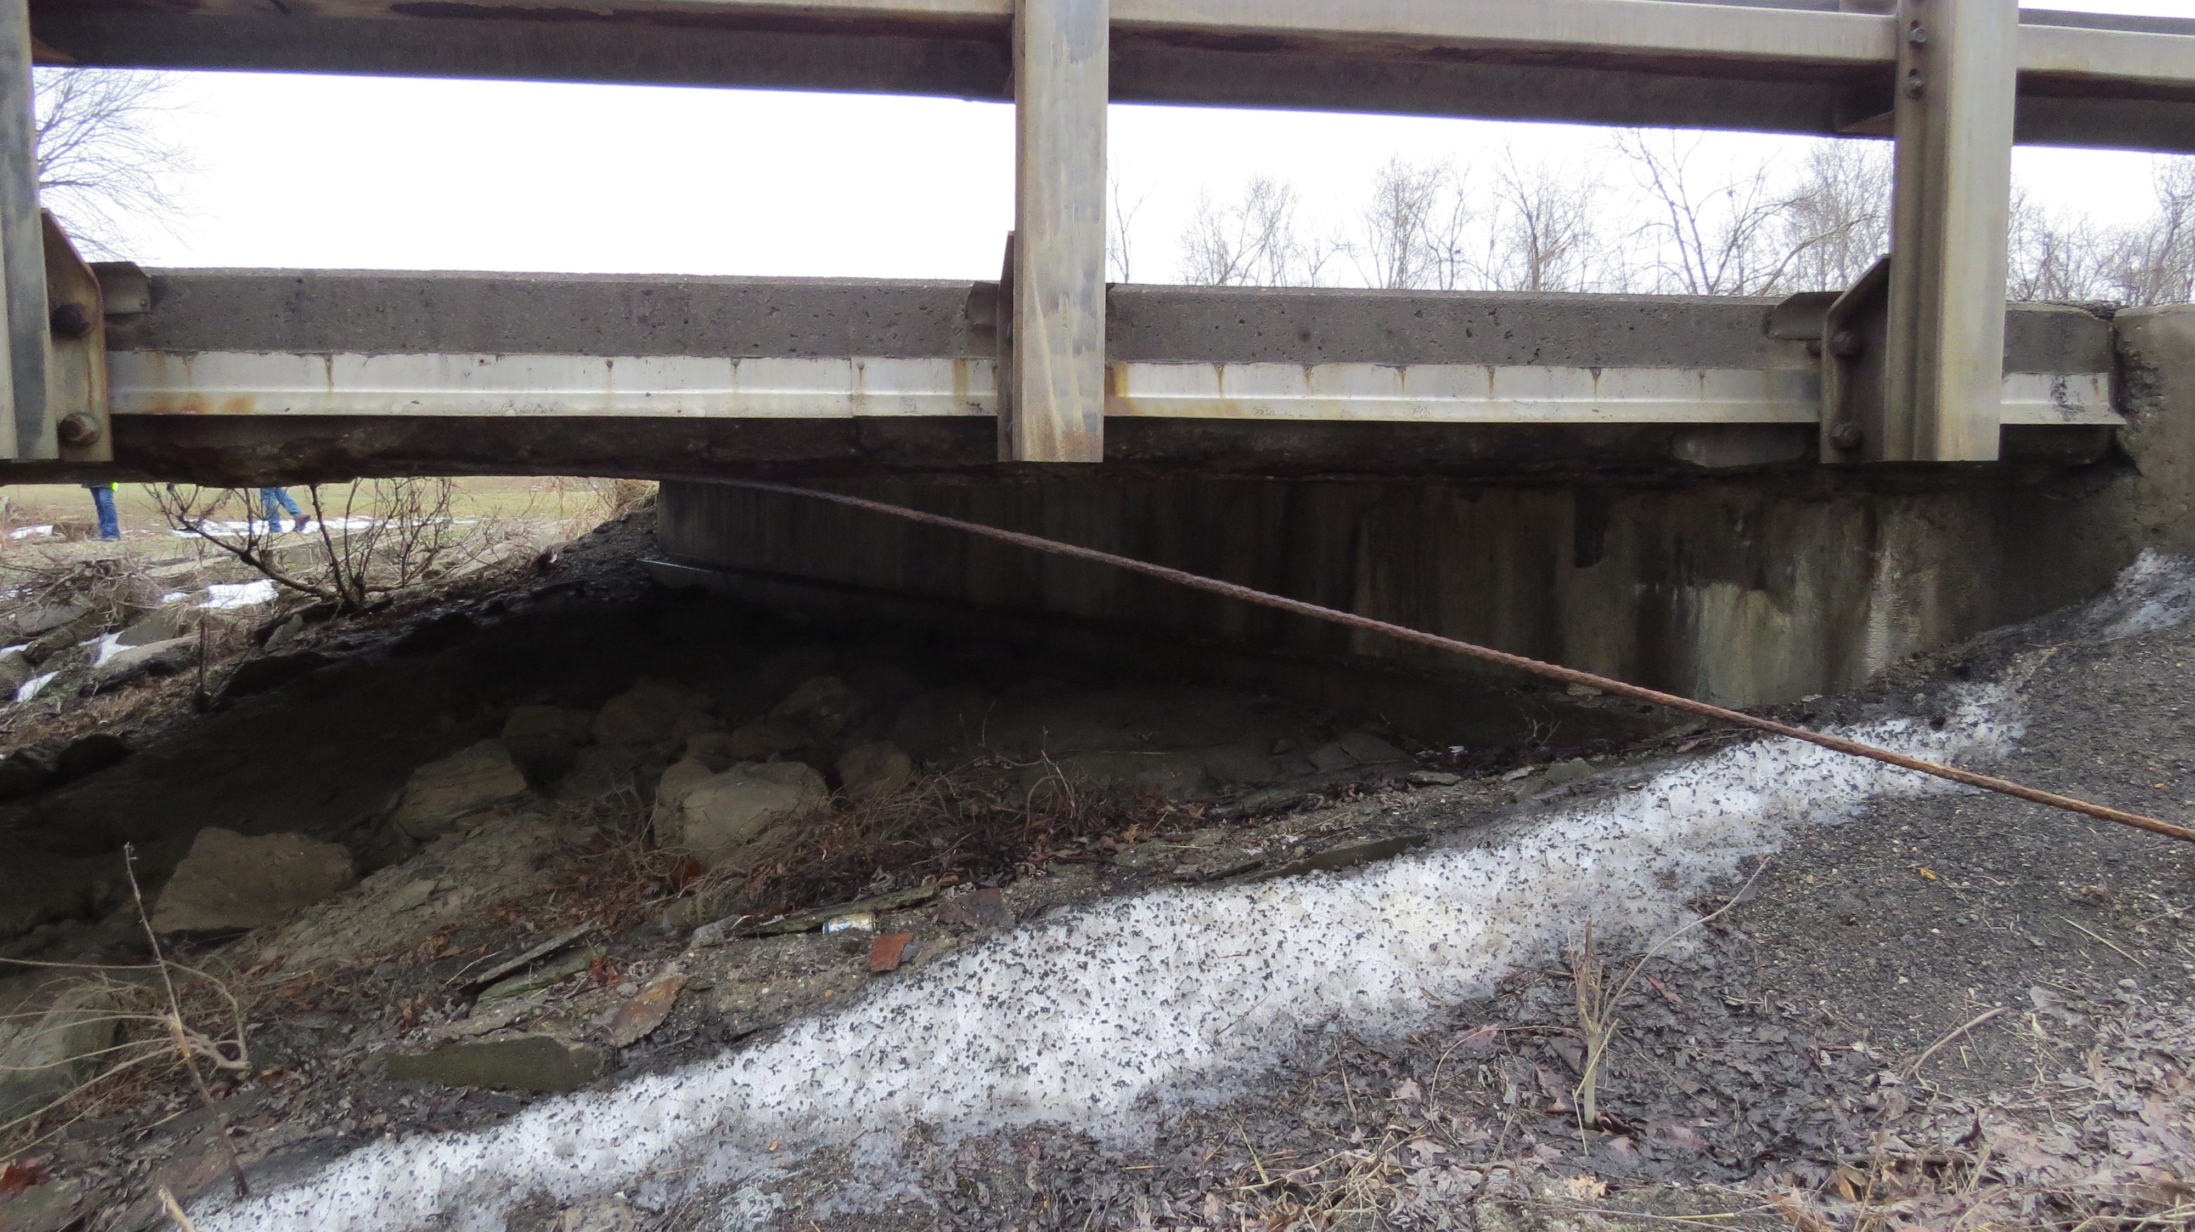
Field Photos
Notes:
The following slides will show you some of the scoping field visit photos, to illustrate how the District arrived at the current scope of work. More photos are available on the ftp site shown earlier.

Slide 8
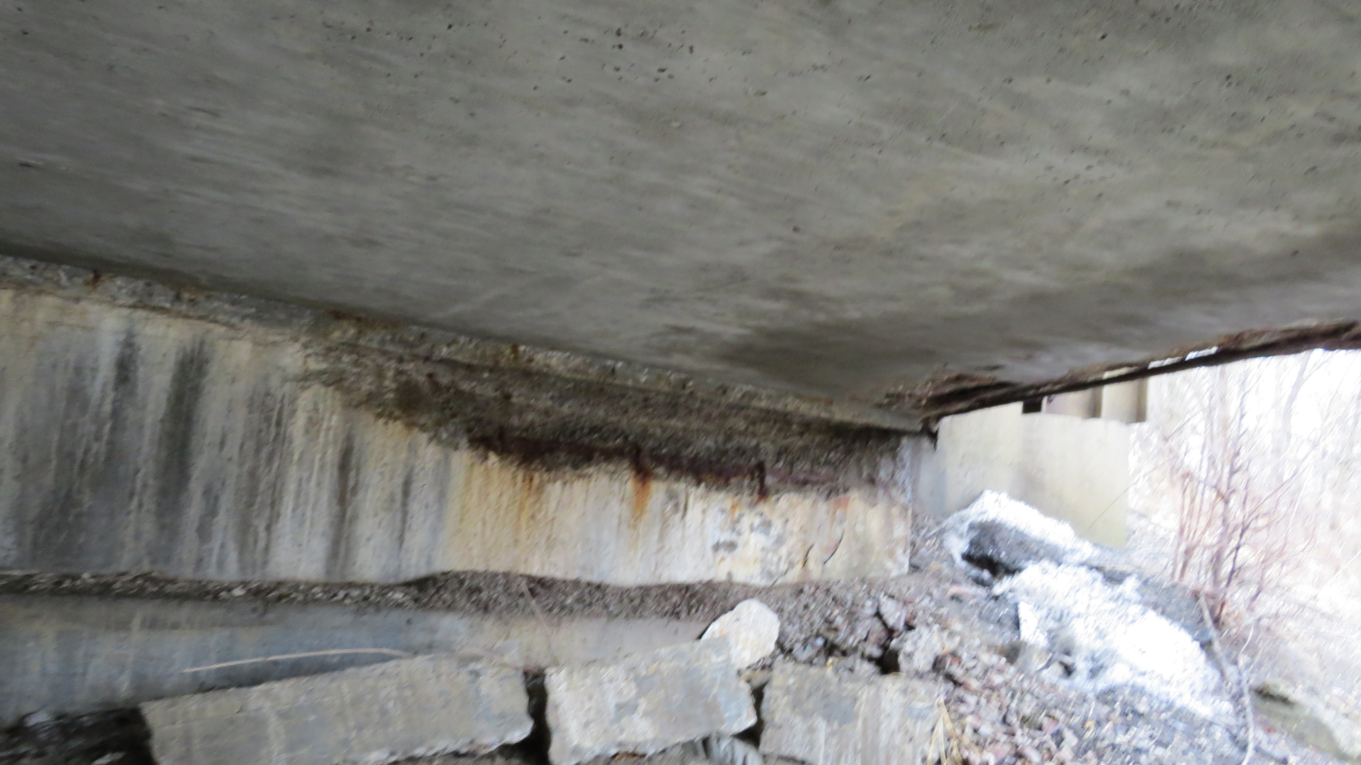
Field Photos

Slide 9
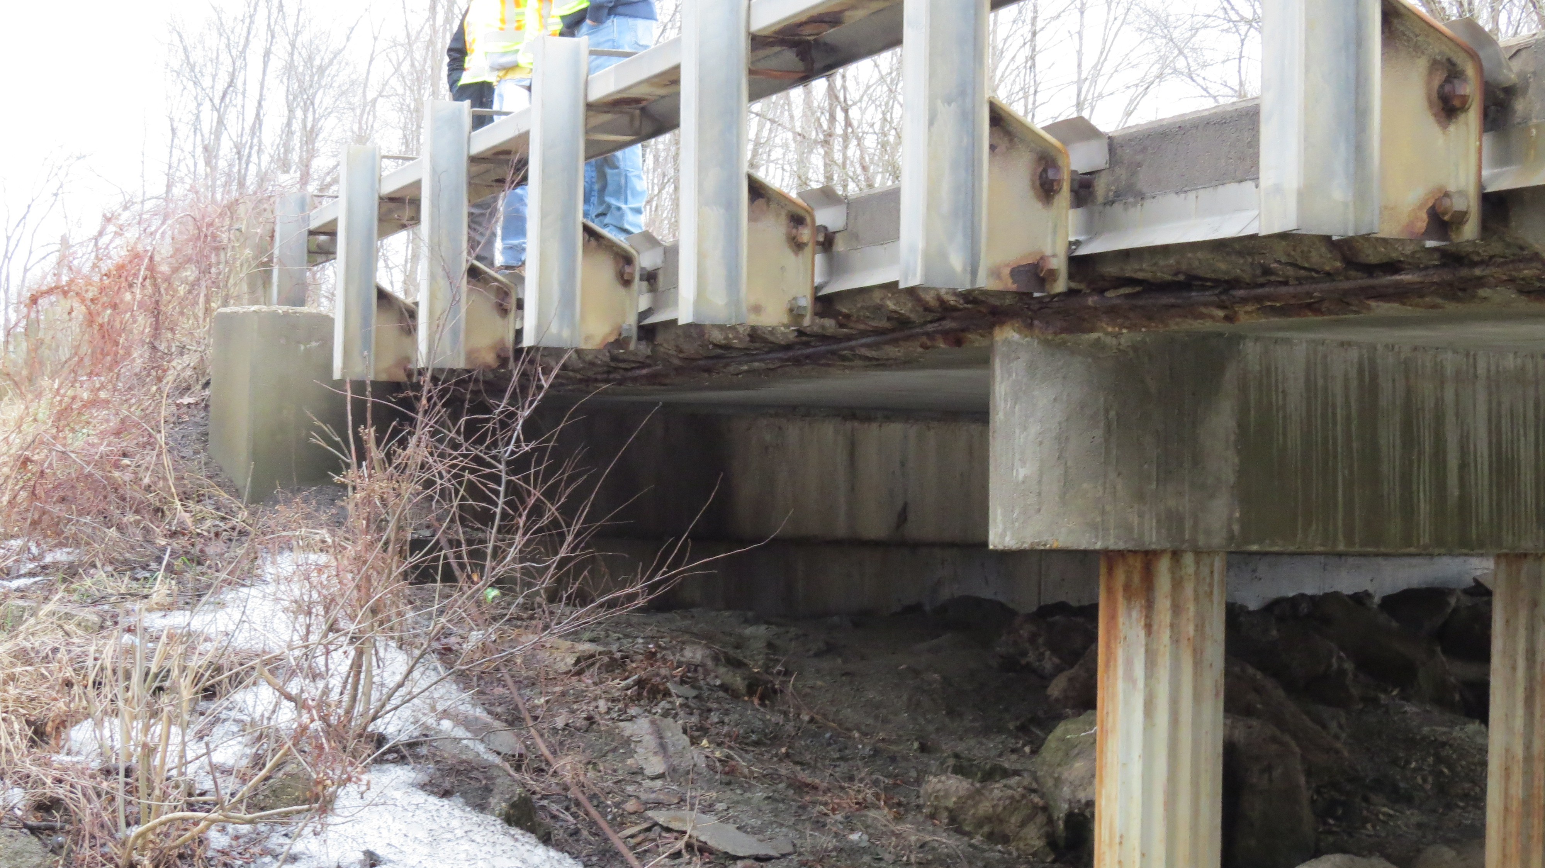
Field Photos

Slide 10
Thank you
Additional photos are available on the FTP Site
Thank you for watching this video presentation for Proj. TUS-800-0.38 PID 97498.
District 11 appreciates your interest in partnering with us for a successful project
Notes:
Thank you for watching this video. Visit the ftp site for more photos and information. Please remember that changes to this information and the detailed scope of work are possible. Review the information in SAFE prior to submitting your LOI.

Slide 11
Thank you

