Slide 1

September 2025 Programmatic
D11 Proj.: BEL-7-19.75 PID 106237
Notes:
This presentation will provide an overview of the subject project that will be placed on the upcoming programmatic selection for consultant design services.

Slide 2
BEL-7-19.75 PID 106237
Proj. Description: Design the replacement for major bridge BEL-7-1975 SFN 0700541.
Originally scoped as a design build project to replace the major bridge with smaller bridges.
Local opposition to that effect was received during the Public Involvement portion of preliminary development.
Notes:
The project will replace bridge BEL-7-19.75 (SFN 0700541) carrying State Route 7 over various features within the Village of Bridgeport.

Slide 3
BEL-7-19.75 PID 106237
The major bridge will now be replaced with a new major bridge.
Notes:
The project will replace bridge BEL-7-19.75 (SFN 0700541) carrying State Route 7 over various features within the Village of Bridgeport.

Slide 4
Available project information
Some project information is available at the following FTP site:
  ftp.dot.state.oh.us - /pub/Districts/D11/106237
  The PIP will be released through SAFE on the programmatic scheduled date
  D11 does not release the PIP early
  All information on the FTP site is subject to change, please review the information in SAFE to create your LOI
Notes:
Additional project information is available on the District 11 ftp site, at the link shown on your screen. The Project Initiation Package document, along with a more complete and detailed scope of work will be released through The ODOT Scope and Fee System (or SAFE) at the request for LOIs. All information on the FTP site is subject to change. Ensure you review the ftp site and the information in SAFE before completing your LOI for this project.

Slide 5
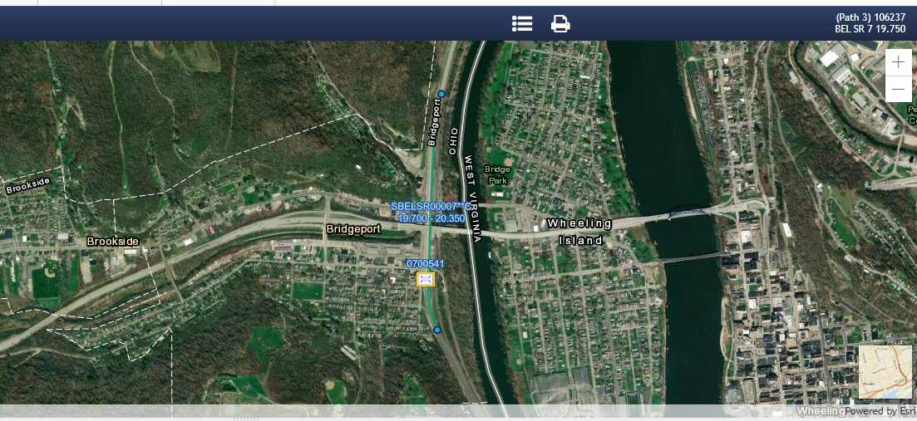
Ellis MAPPING
Notes:
Here is an image showing the anticipated project limits from ODOT’s Ellis application for PID 122470. The project will follow the existing horizontal and vertical alignments as much as practical.

Slide 6
Project scope
  The major items of work include:
    Replace bridge BEL-7-1975 (SFN 0700541) with structure of similar type and length.
      Soil Borings may be required.
      Foundation Design will be required.
      Utility relocation anticipated along with in plans work for water and sewer design.
      Maintenance of Traffic via cross over design, but MOTAA is required.
      Increase Vertical Clearance under IR 70
      Increase Vertical Clearance under SR 7
      A new Structure Type Study will be required that provides:
        Analyze pier stems to see if they can be reused
          Must be able to meet all design loadings/criteria
        Multiple bridge superstructure (and potentially substructure types)
        Determine location and condition of drainage structures under the existing bridge
      Design exception will be required for graded shoulder width, to be submitted with Pre-Stage 1 review.
Notes:
The major scope items are listed here. An updated and more complete list will be released in SAFE at the beginning of the LOI process.

Slide 7
Consultant Prequalifications
Level 1 bridge inspection
Level 2 bridge design
Non-complex roadway design
Various Environmental
Various Geotechnical
Limited R/W
Notes:
The consultant prequalifications required for this project are shown here.

Slide 8
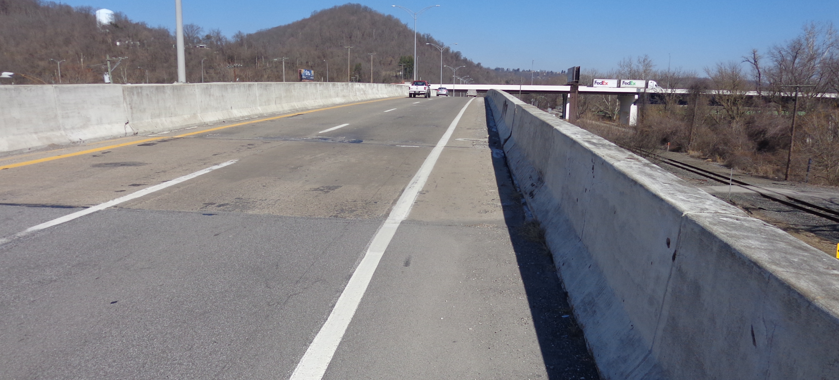
Field Photos – BEL-7-1975
Notes:
The following slides will show you some of the scoping field visit photos, to illustrate how the District arrived at the current scope of work. More photos are available on the ftp site shown earlier.

Slide 9
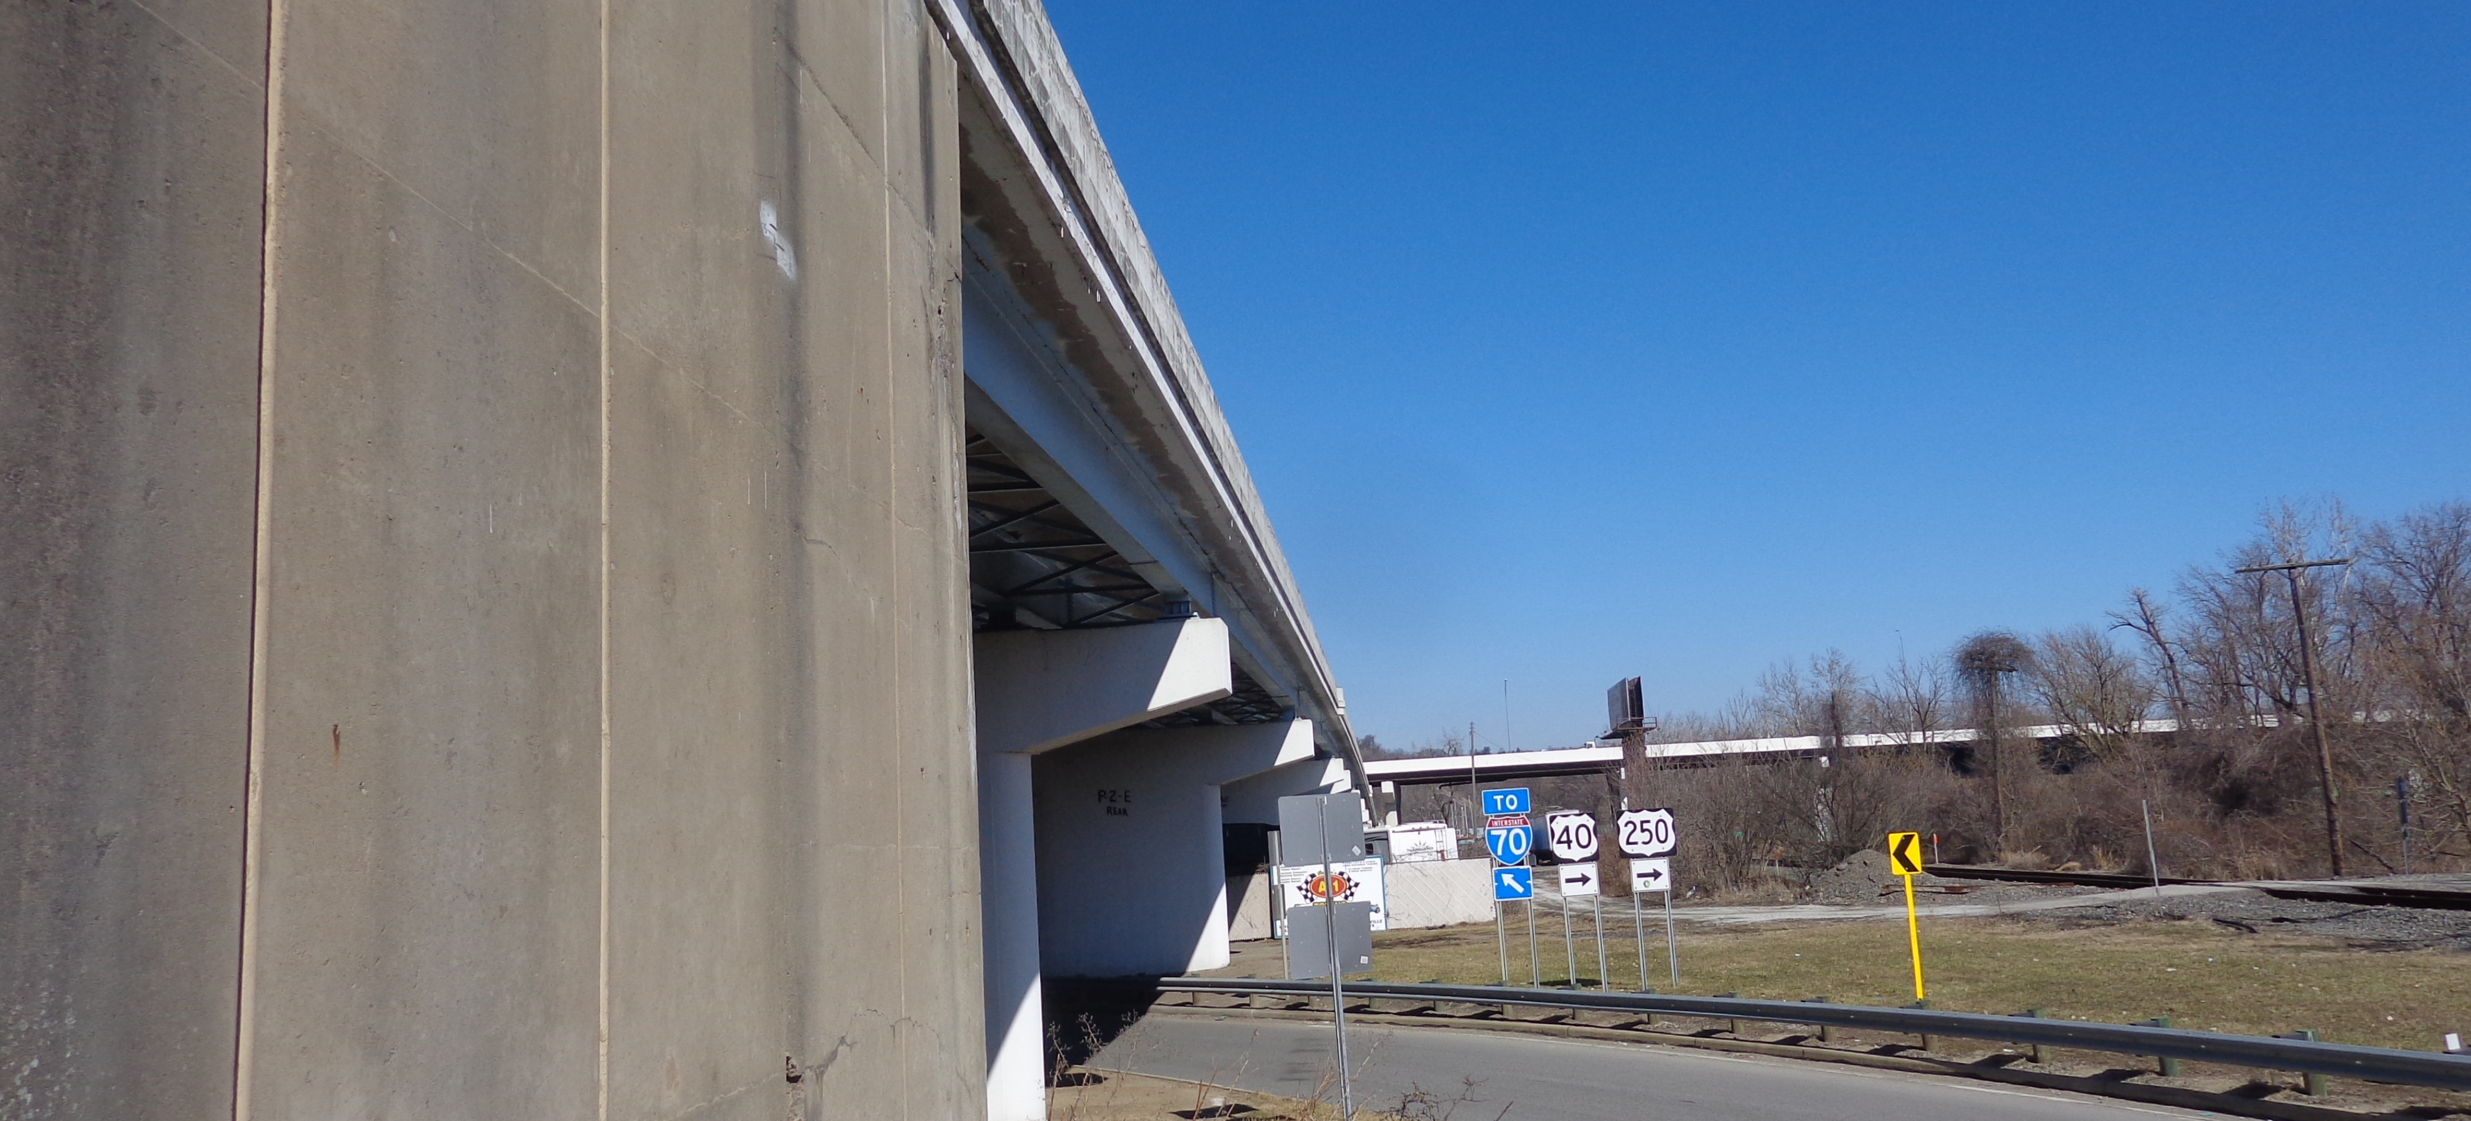
Field Photos – BEL-7-1975

Slide 10
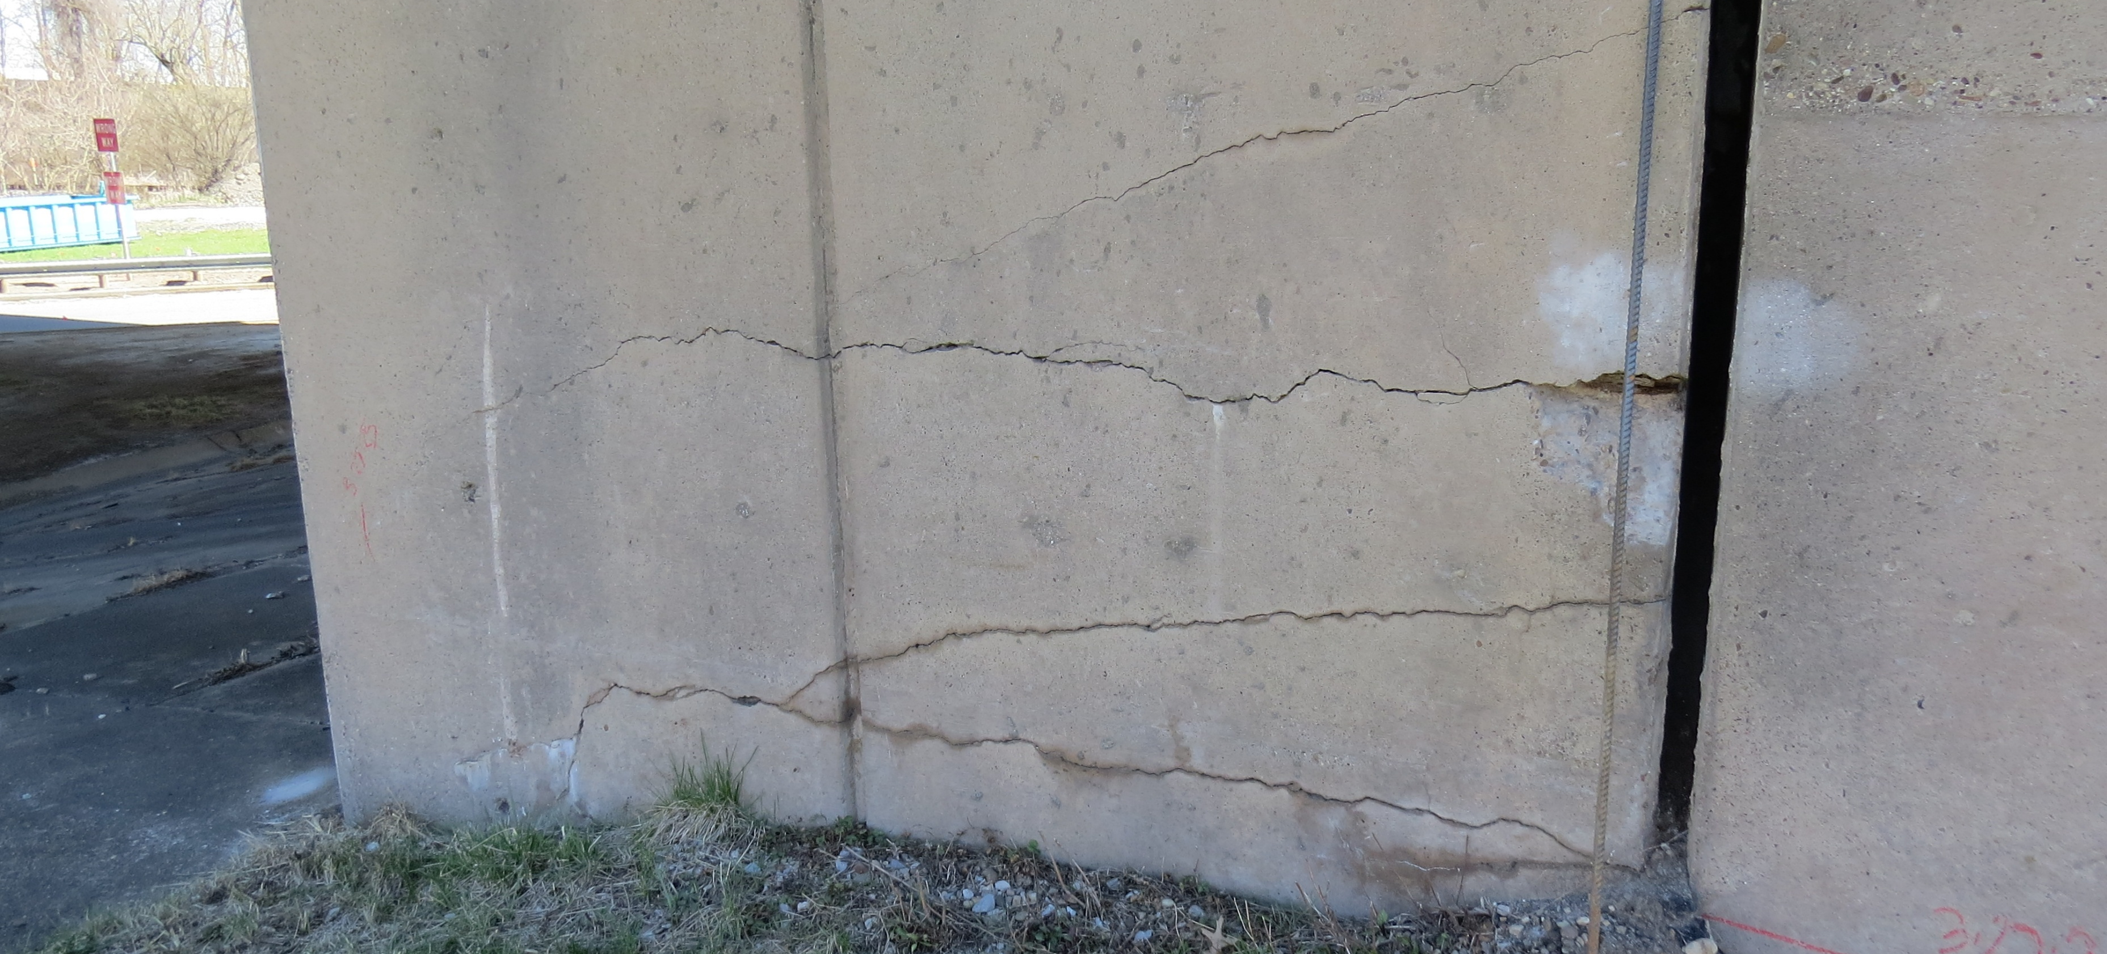
Field Photos – BEL-7-1975

Slide 11
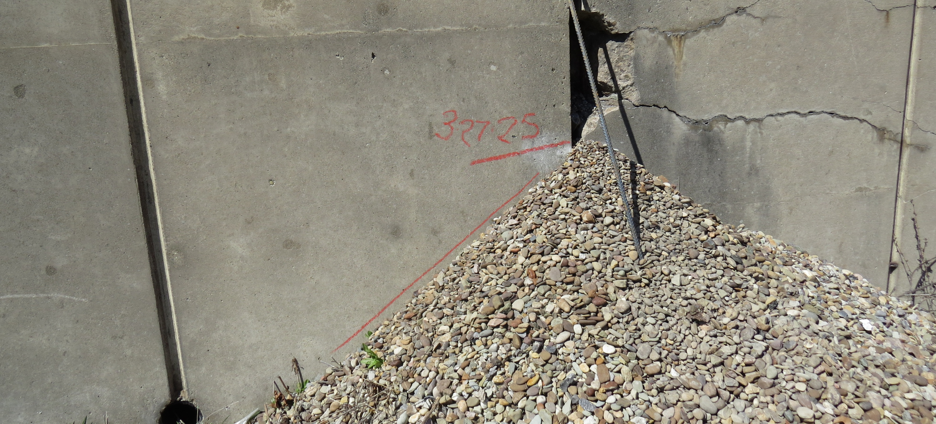
Field Photos – BEL-7-1975

Slide 12
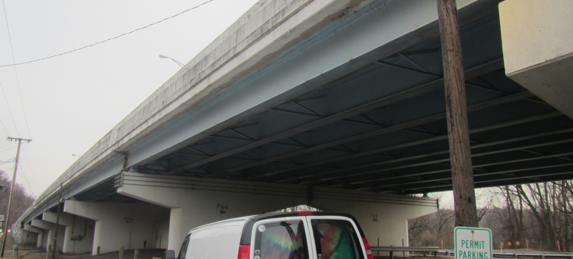
Field Photos – BEL-7-1975

Slide 13
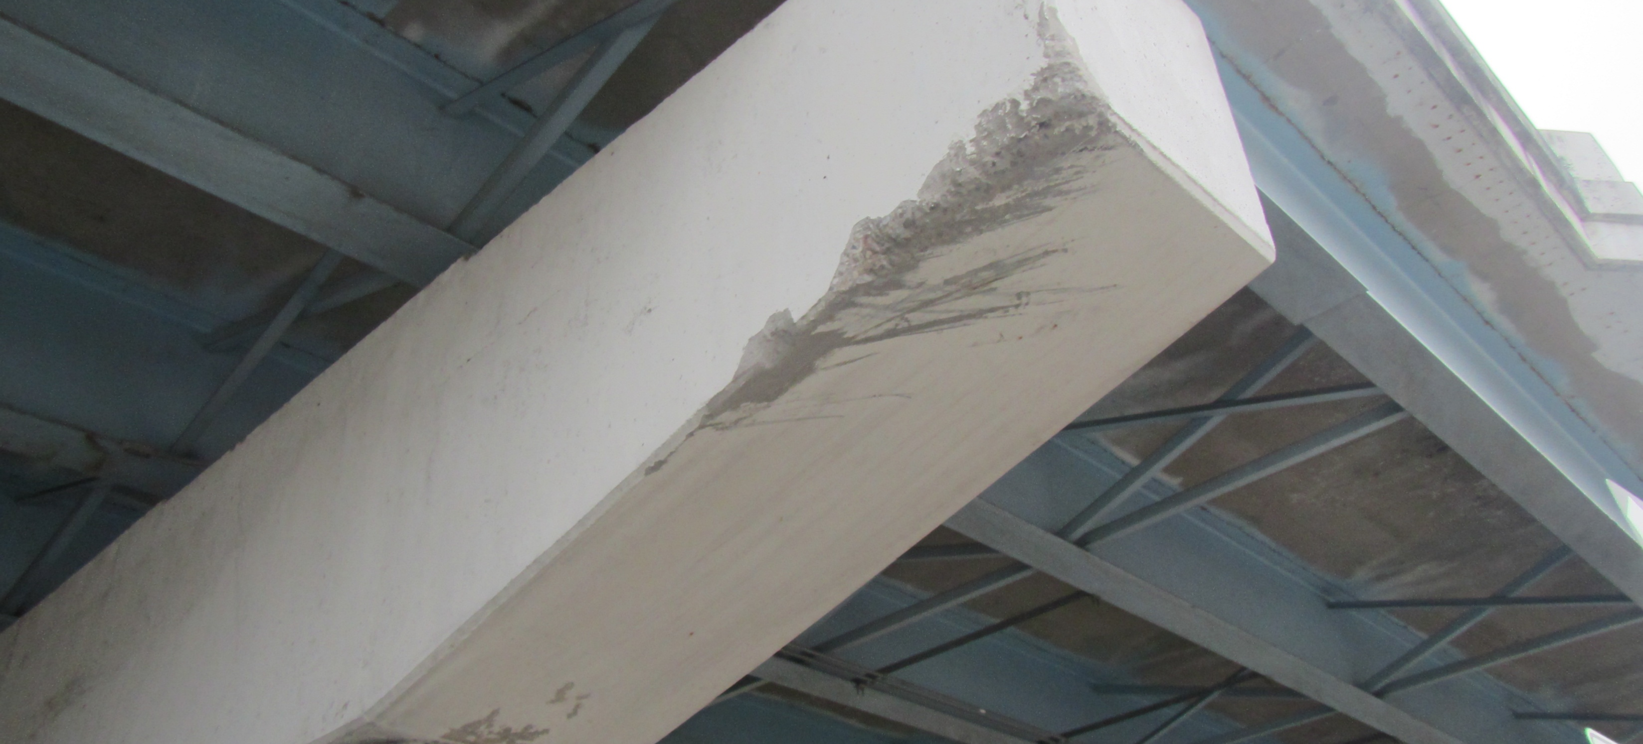
Field Photos – BEL-7-1975

Slide 14
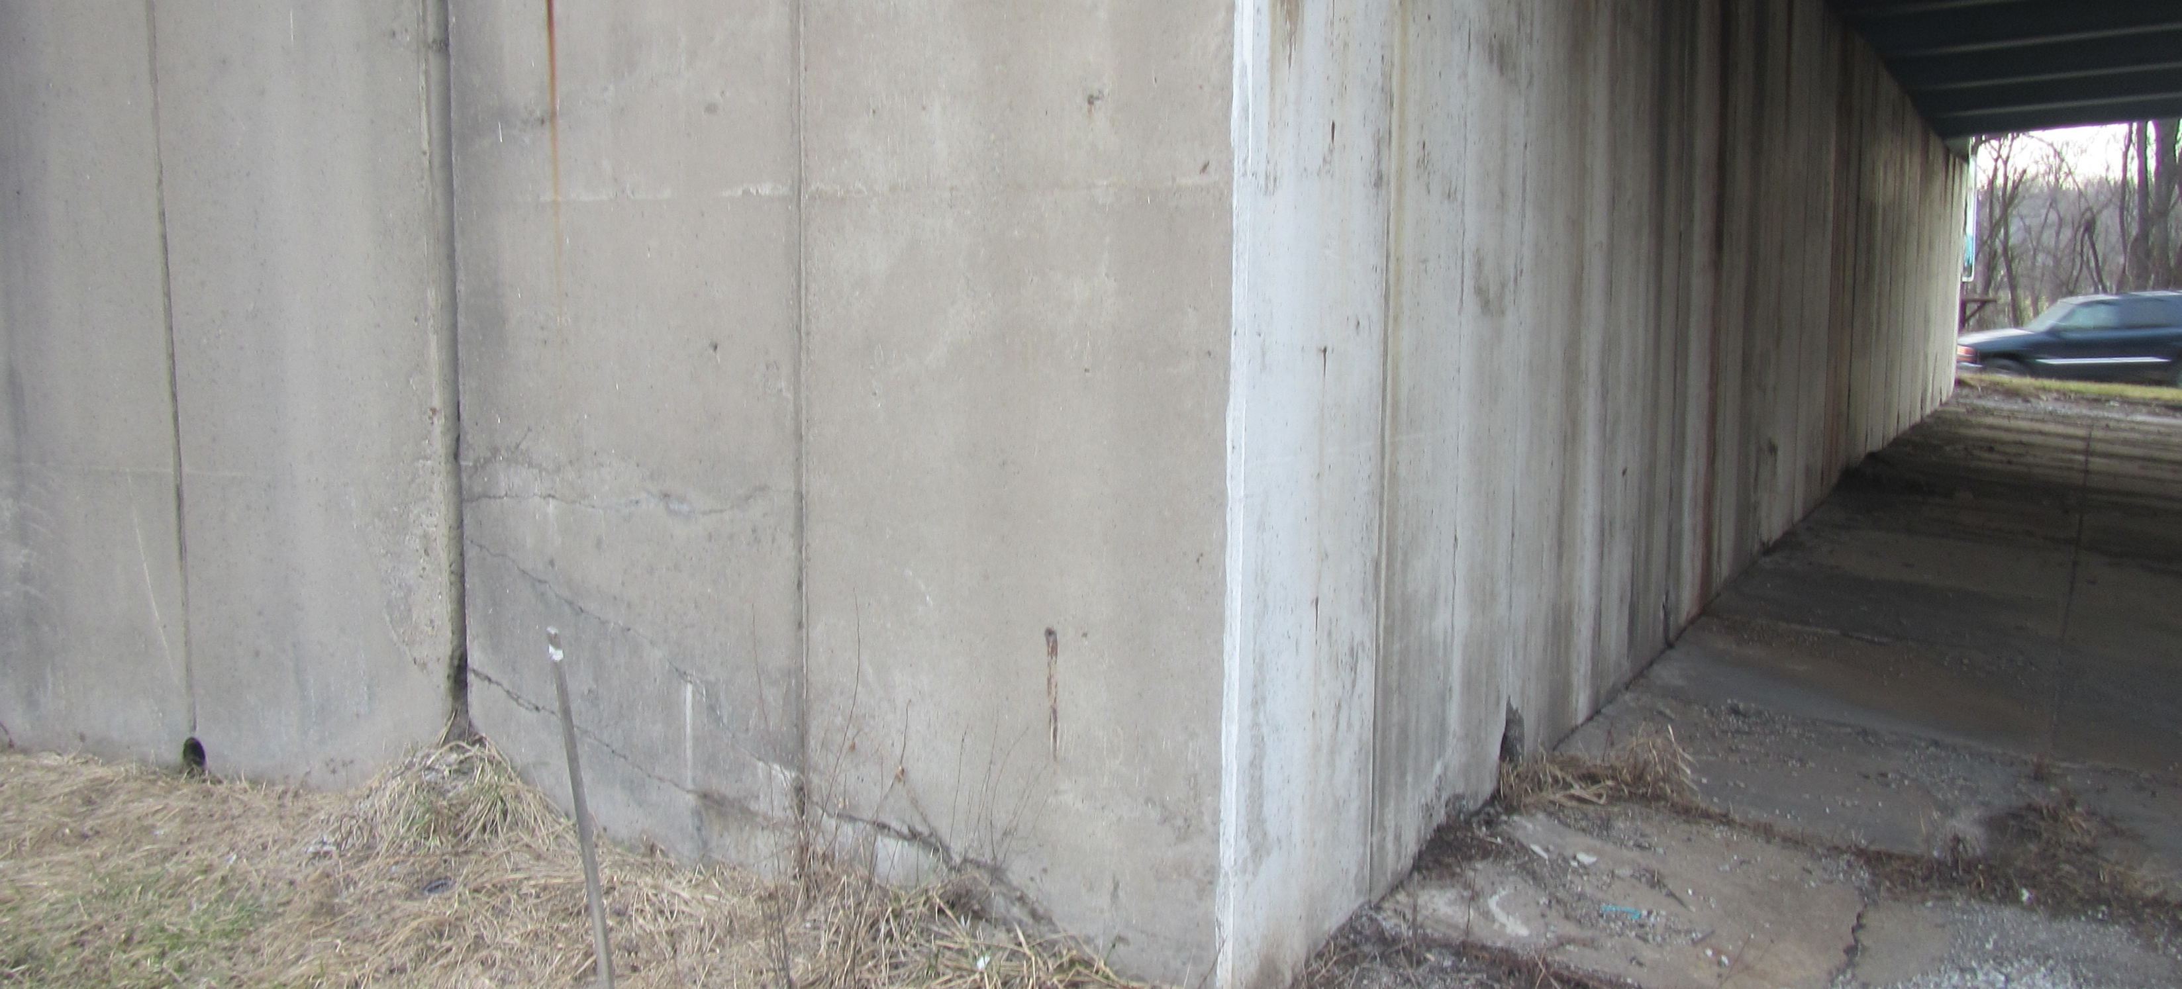
Field Photos – BEL-7-1975

Slide 15
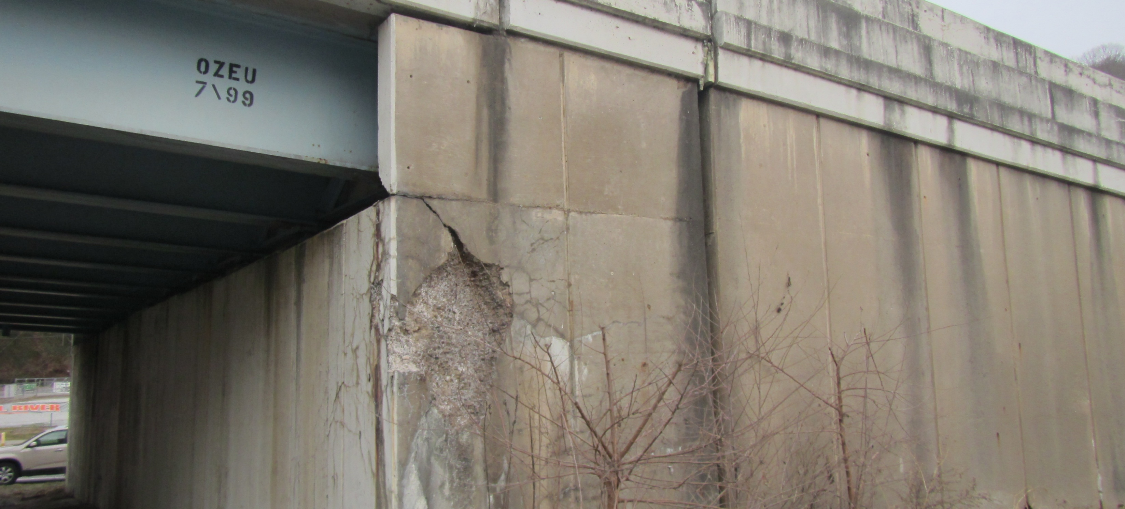
Field Photos – BEL-7-1975

Slide 16
Thank you
Additional photos are available on the FTP Site
Thank you for watching this video presentation for Proj. BEL-7-19.75 PID 106237.
District 11 appreciates your interest in partnering with us for a successful project
Notes:
Thank you for watching this video. Visit the ftp site for more photos and information. Please remember that changes to this information and the detailed scope of work are possible. Review the information in SAFE prior to submitting your LOI.

Slide 17
Thank you

