Slide 1
Sept. 2022 Programmatic D11 Proj.: jef-213-15.18 pid 86872
Notes:
This presentation will provide an overview of the subject project that will be placed on the upcoming programmatic selection for consultant design services.

Slide 2
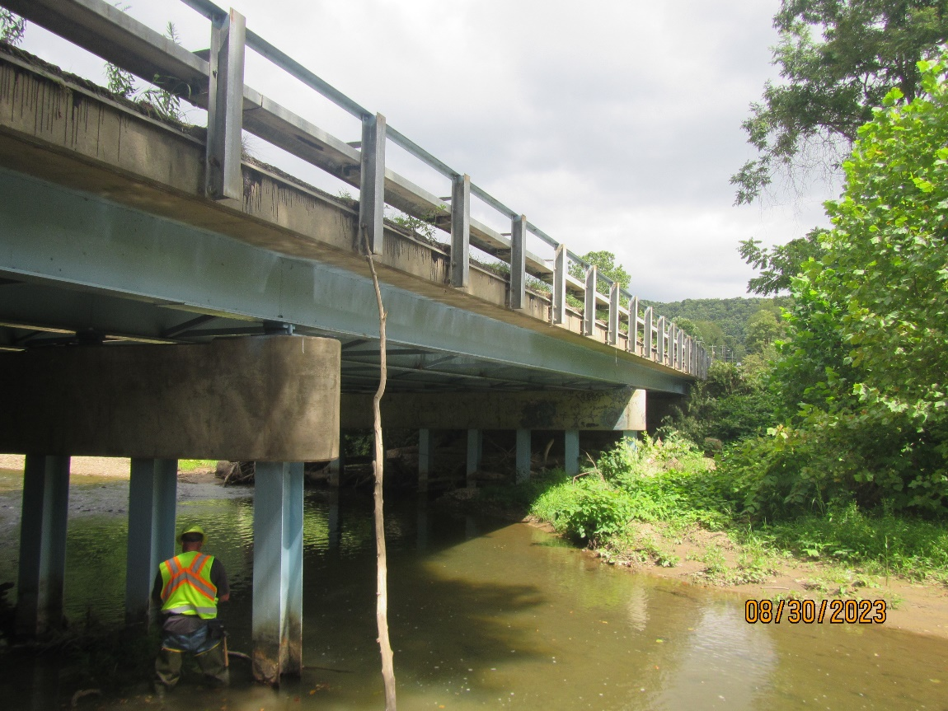
JEF-213-15.18 PID 86872
Proj. Description: Replace bridge carrying SR 213 over North Fork Yellow Creek. In stream work is required.
Notes:
The project will replace bridge JEF-213-15.18 ( SFN #4103181) carrying state route 213 over North Fork Yellow Creek. In stream work is required.

Slide 3
Available project information
Some project information is available at the following FTP site:
ftp://ftp.dot.state.oh.us/pub/Districts/D11/86872
Internet Explorer recommended for the ftp site
The PIP will be released through SAFE on the programmatic scheduled date
D11 does not release the PIP early
All information on the FTP site is subject to change, please review the information in SAFE to create your LOI
Notes:
Additional project information is available on the District 11 ftp site, at the link shown on your screen. The Project Initiation Package document, along with a more complete and detailed scope of work will be released through The ODOT Scope and Fee System (or SAFE) at the request for LOIs. All information on the FTP site is subject to change. Ensure you review the ftp site and the information in SAFE before completing your LOI for this project.

Slide 4
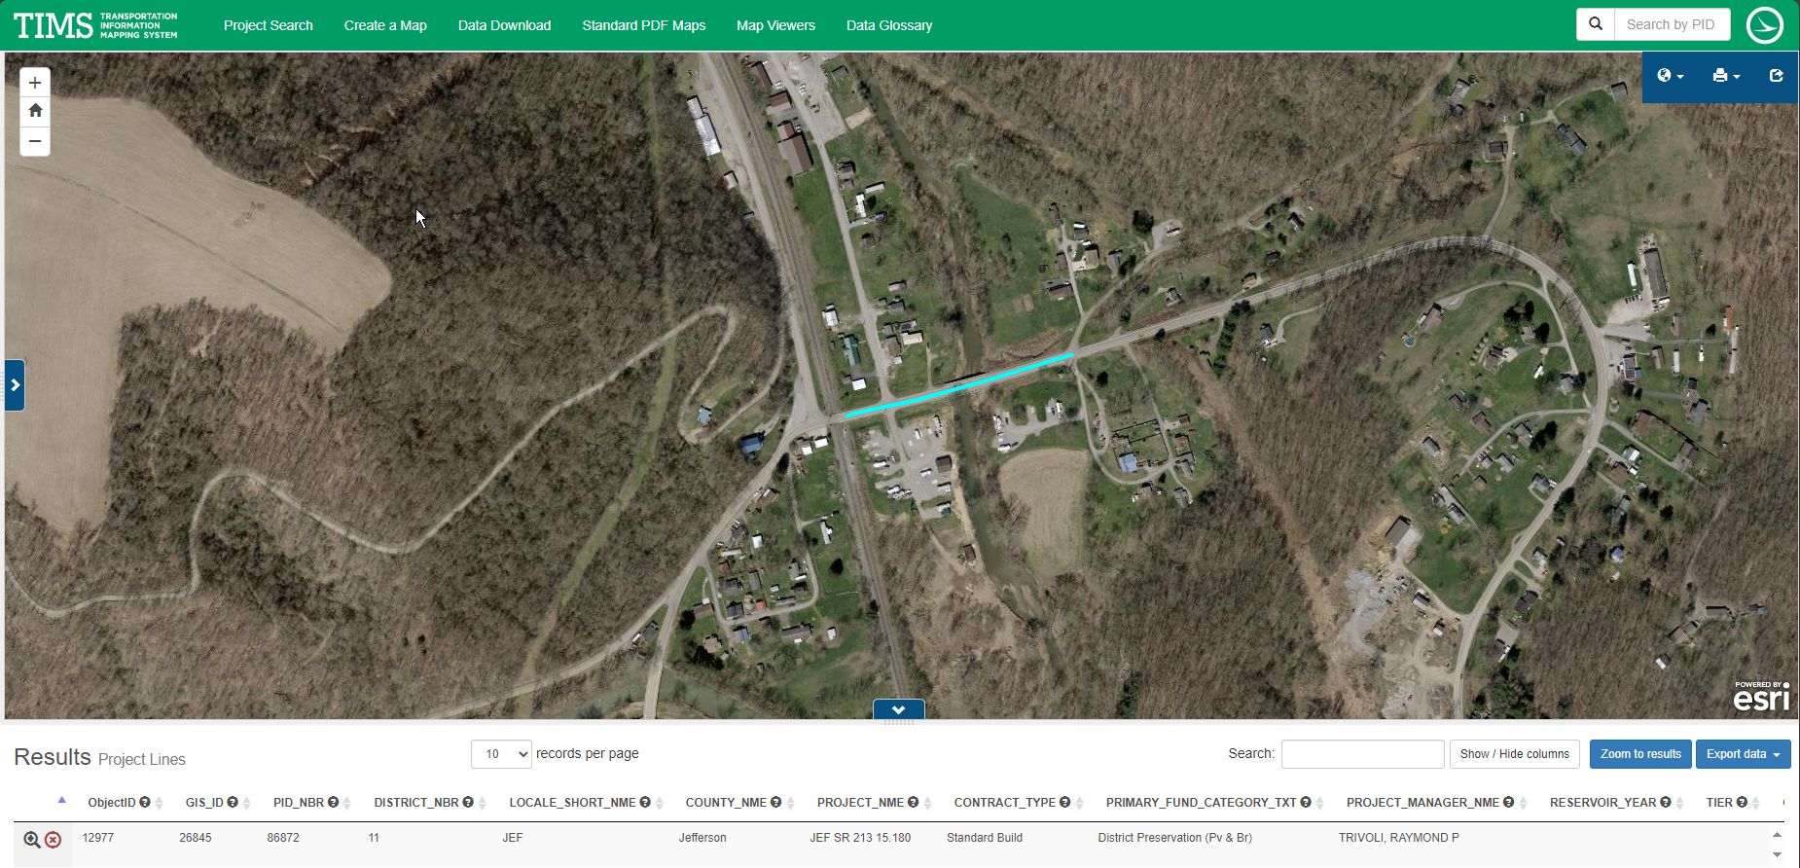
TIMS MAPPING
Notes:
Here is an image showing the anticipated project limits from ODOT’s TIMS application. The project will follow the existing horizontal and vertical alignments as much as practical.

Slide 5
Project scope
The major items of work include
Replace three span steal beam bridge w/new bridge.
Obtain soil borings for foundation design and scour analysis.
Provide temporary sheeting design.
Rebuild embankment on left-forward approach to protect SR 213 from meandering of Dry Run Creek.
Maintain one-lane – two-way operation of SR 213 via signalized closure.
Part Width Construction
Notes:
The major scope items are listed here. An updated and more complete list will be released in SAFE at the beginning of the LOI process.

Slide 6
Consultant Prequalifications
Level 1 bridge inspection
Level 2 bridge design
Non-complex roadway design
Various Environmental
Various Geotechnical
Notes:
The consultant prequalifications required for this project are shown here.

Slide 7
Field Photos
Notes:
The following slides will show you some of the scoping field visit photos, to illustrate how the District arrived at the current scope of work. More photos are available on the ftp site shown earlier.

Slide 8
Field Photos

Slide 9
Field Photos

Slide 10
Thank you
Additional photos are available on the FTP Site
Thank you for watching this video presentation for Proj. JEF-213-15.18 PID 86872
District 11 appreciates your interest in partnering with us for a successful project
Notes:
Thank you for watching this video. Visit the ftp site for more photos and information. Please remember that changes to this information and the detailed scope of work are possible. Review the information in SAFE prior to submitting your LOI.

