Slide 1

SEPTEMBER 2025 Programmatic
D11 Proj.: TUS-250-2.22 PID 121654
Notes:
This presentation will provide an overview of the subject project that will be placed on the upcoming programmatic selection for consultant design services.

Slide 2
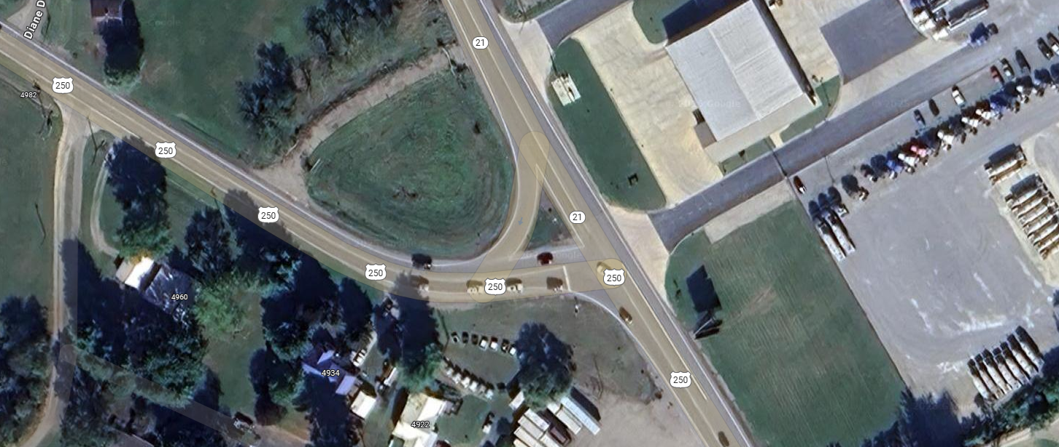
TUS-250-2.22 PID 121654
Project Description: Construct a single-lane roundabout at the intersection of US 250 and SR 21 to improve safety and reduce congestion.
Notes:
The project will improve the safety and congestion by constructing a new single-lane roundabout at the intersection of US 250 and SR 21 in Tuscarawas County, just north of the Village of Strasburg. The project is located at SLM TUS-250-2.22.

Slide 3
Available project information
Some project information is available at the following FTP site:
  https://ftp.dot.state.oh.us/pub/Districts/D11/121654
  The PIP will be released through SAFE on the programmatic scheduled date
  D11 does not release the PIP early
  All information on the FTP site is subject to change, please review the information in SAFE to create your LOI
Notes:
Additional project information is available on the District 11 ftp site, at the link shown on your screen. The Project Initiation Package document, along with a more complete and detailed scope of work will be released through The ODOT Scope and Fee System (or SAFE) at the request for LOIs. All information on the FTP site is subject to change. Ensure you review the ftp site and the information in SAFE before completing your LOI for this project.

Slide 4
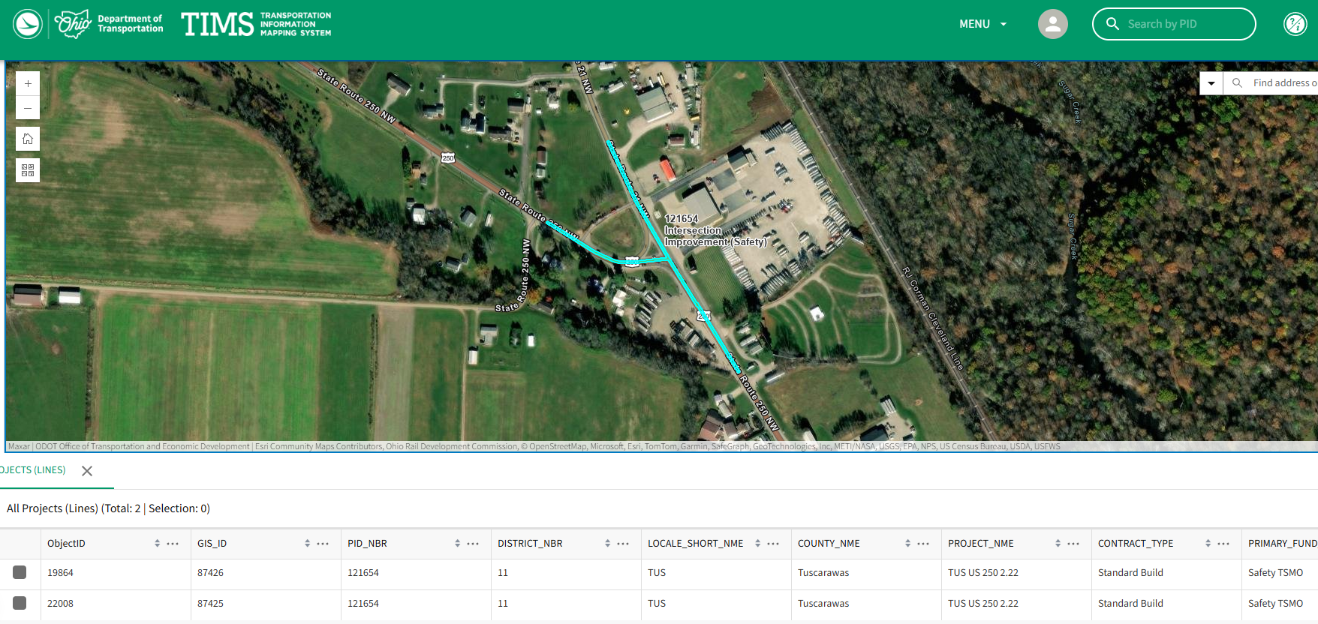
TIMS MAPPING
Notes:
Here is an image showing the anticipated project limits from ODOT’s TIMS application.

Slide 5
Project scope
  The major items of work include:
    Replace the stop-controlled T-intersection with a modern single-lane roundabout
    Replace existing drainage facilities with new drainage all the way to the outlet structure near the railroad tracks
      A combination of new ditches and enclosed storm sewers is anticipated
    Install new highway lighting
    Maintain traffic with flaggers and temporary traffic signals
    Utility relocation is anticipated
    Only temporary right-of-way is anticipated
Notes:
The major scope items are listed here. An updated and more complete list will be released in SAFE at the beginning of the LOI process.

Slide 6
Consultant Prequalifications
Non-Complex Roadway Design
Limited Lighting Design
Various Environmental Services
Various Geotechnical Services
Subsurface Utility Location Services
Limited ROW Plan Development
Notes:
The consultant prequalification's required for this project are shown here.

Slide 7
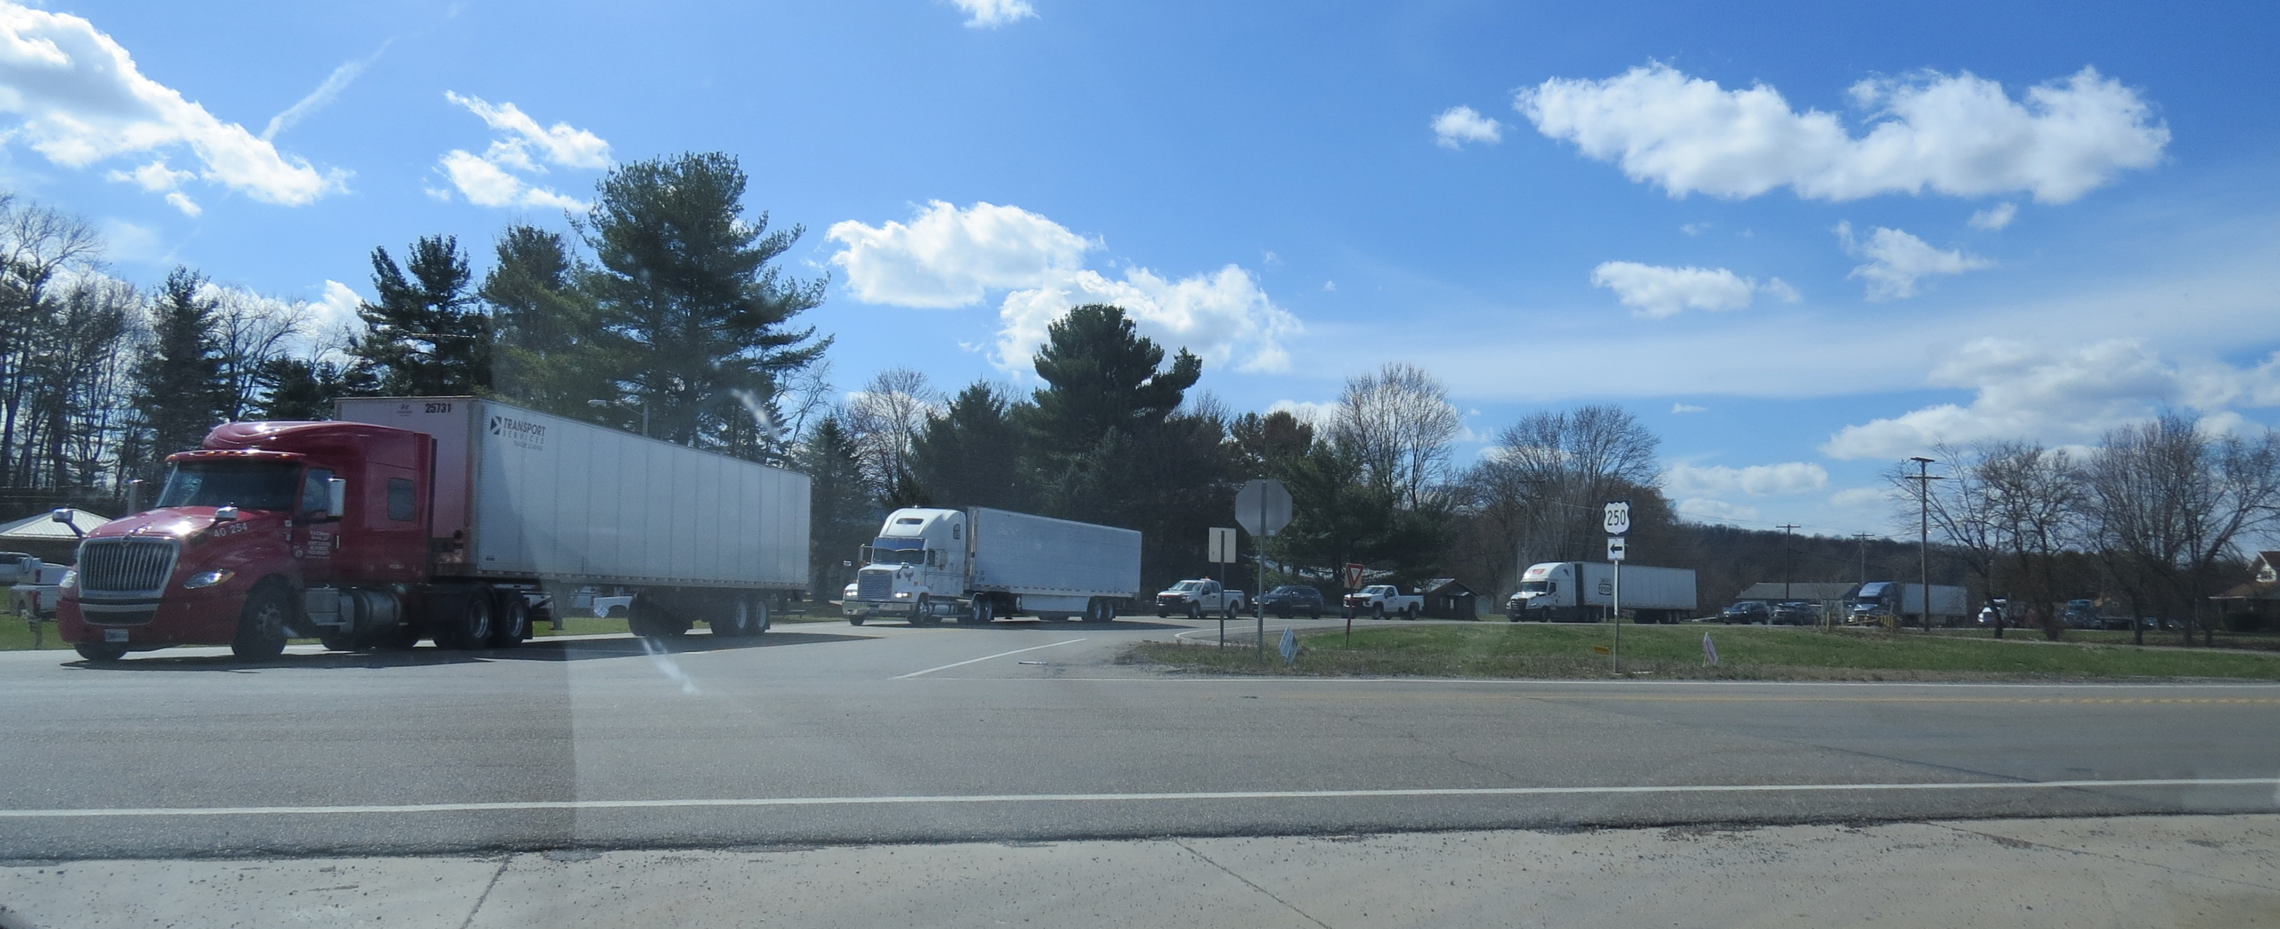
Field Photos
Notes:
The following slides will show you some of the scoping field visit photos, to illustrate how the District arrived at the current scope of work. More photos are available on the ftp site shown earlier.

Slide 8
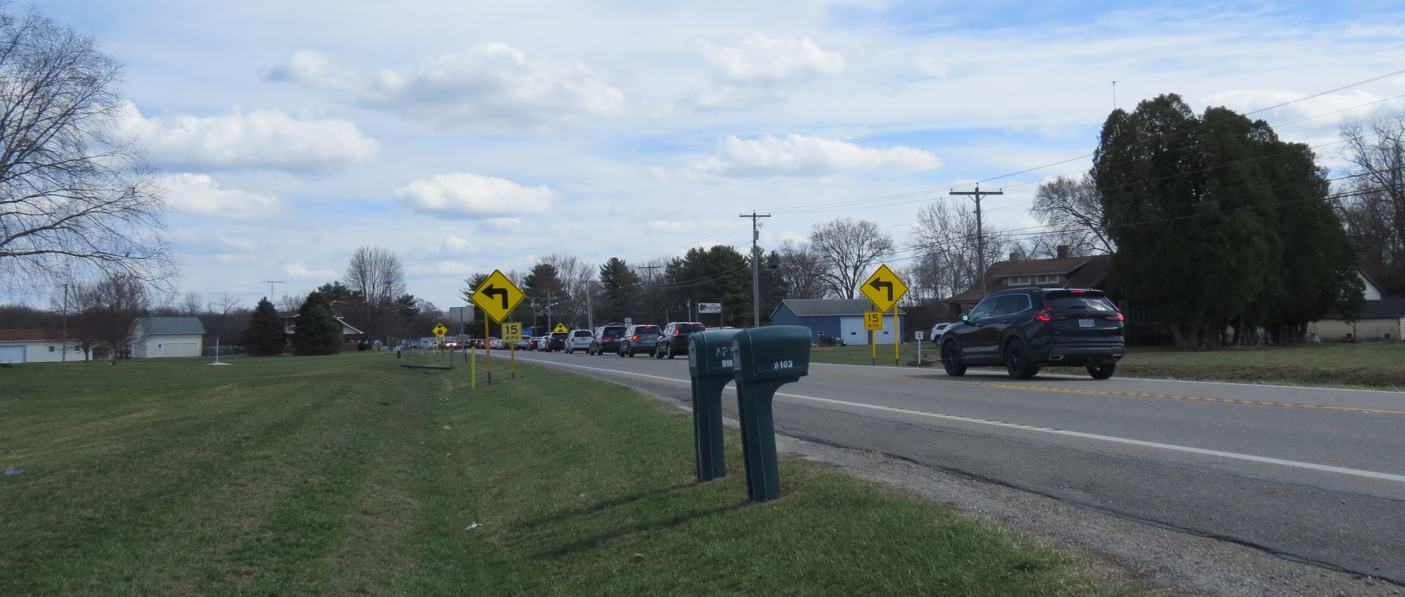
Field Photos

Slide 9
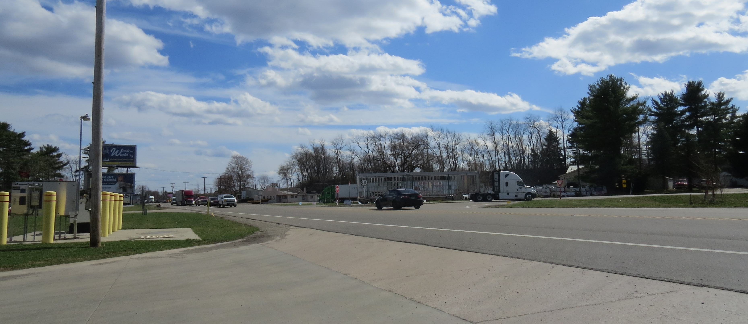
Field Photos

Slide 10
Thank you
Additional photos are available on the FTP Site
Thank you for watching this video presentation for Proj. TUS-250-2.22 PID 121654.
District 11 appreciates your interest in partnering with us for a successful project
Notes:
Thank you for watching this video. Visit the ftp site for more photos and information. Please remember that changes to this information and the detailed scope of work are possible. Review the information in SAFE prior to submitting your LOI.

Slide 11
Thank you

