Slide 1

JANUARY 2026 Programmatic
D11 Proj.: TUS-36-18.00 PID 122460
TUS-39-12.94 PID 122459
Notes:
This presentation will provide an overview of the subject project that will be placed on the upcoming programmatic selection for consultant design services.

Slide 2
TWO PROJECTS – ONE DESIGN CONTRACT
The consultant contract will include the design of two separate construction projects.
TUS-36-18.00 PID 122460
TUS-39-12.94 PID 122459
They may be combined at plan file as a Part 1/Part 2 construction contract, however through Stage 3 the design and project management will be treated as if they are separate projects under one consultant contract.
Notes:
One consultant contract will be created to design both projects separately. The design, environmental clearances and any potential Right-of-Way will all be developed separately. Currently, ODOT does not expect to need additional Right-of-Way. The projects will be managed separately for the design, environmental and Right-of-Way timelines. After the Stage 3 review, the District will determine if the projects will be sold as one construction contract. If so, they would be combined as a Part 1/Part 2 contract that requires minimal re-work by the design consultant.

Slide 3
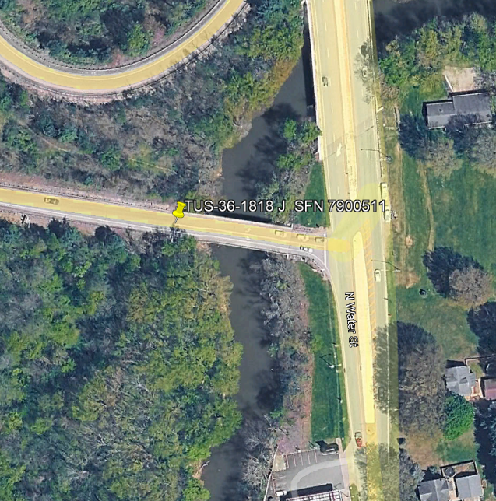
TUS-36-18.00 PID 122460
Project Description: PROTECT bridge TUS-36-18.00 SFN 7900511 from scour.
Notes:
The project will include Scour Analysis and implementation of scour countermeasures and remediation to protect bridge TUS-36-18.00 SFN 7900511.

Slide 4
Available project information
Some project information is available at the following FTP site:
https://ftp.dot.state.oh.us/pub/Districts/D11/122460
The PIP will be released through SAFE on the programmatic scheduled date
D11 does not release the PIP early
All information on the FTP site is subject to change, please review the information in SAFE to create your LOI
Notes:
Additional project information is available on the District 11 ftp site, at the link shown on your screen. The Project Initiation Package document, along with a more complete and detailed scope of work will be released through The ODOT Scope and Fee System (or SAFE) at the request for LOIs. All information on the FTP site is subject to change. Ensure you review the ftp site and the information in SAFE before completing your LOI for this project.

Slide 5
Project scope
The major items of work include:
Scour analysis and design of countermeasures
Maintenance of Traffic
Construction Access
ODOT will provide Survey and Soil Borings
Additional soil borings may or may not be necessary
Notes:
The major scope items are listed here. An updated and more complete list will be released in SAFE at the beginning of the LOI process.

Slide 6
Consultant Prequalifications
Non-Complex Roadway Design
Various Geotechnical Services
Bridge Design Level 2
Bridge Inspection Level 1
Notes:
The consultant prequalification's required for this project are shown here.

Slide 7
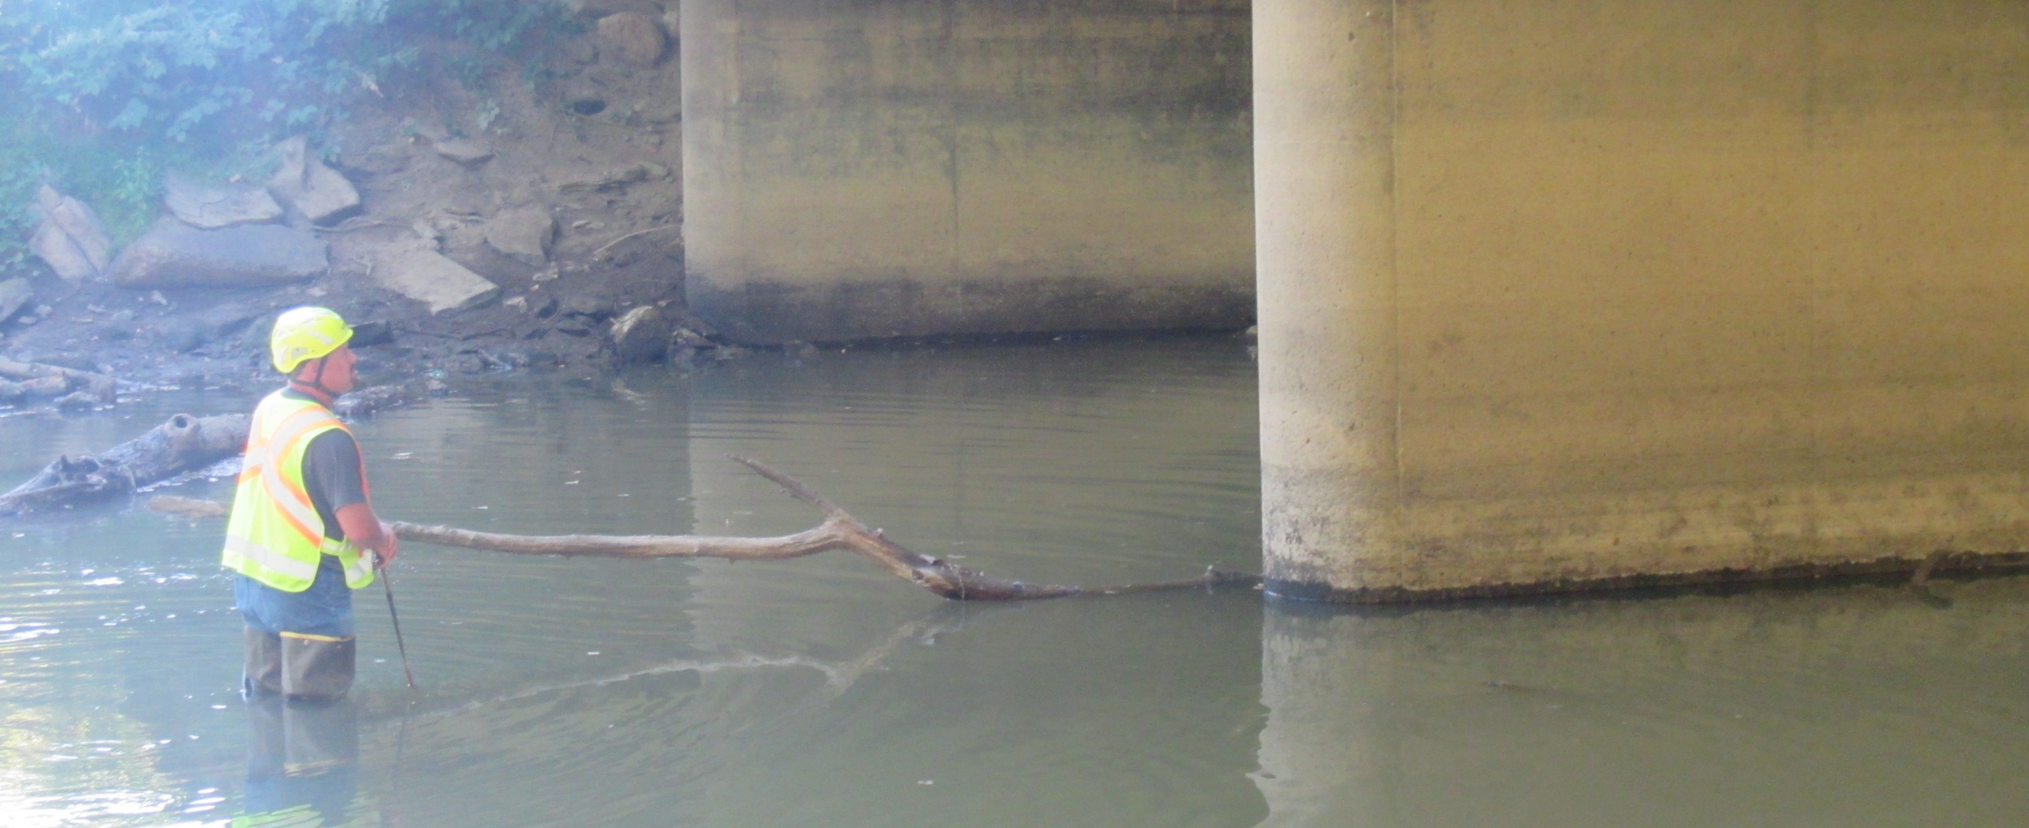
Field Photo
Notes:
The following slides will show you some of the scoping field visit photos, to illustrate how the District arrived at the current scope of work. More photos are available on the ftp site shown earlier.

Slide 8
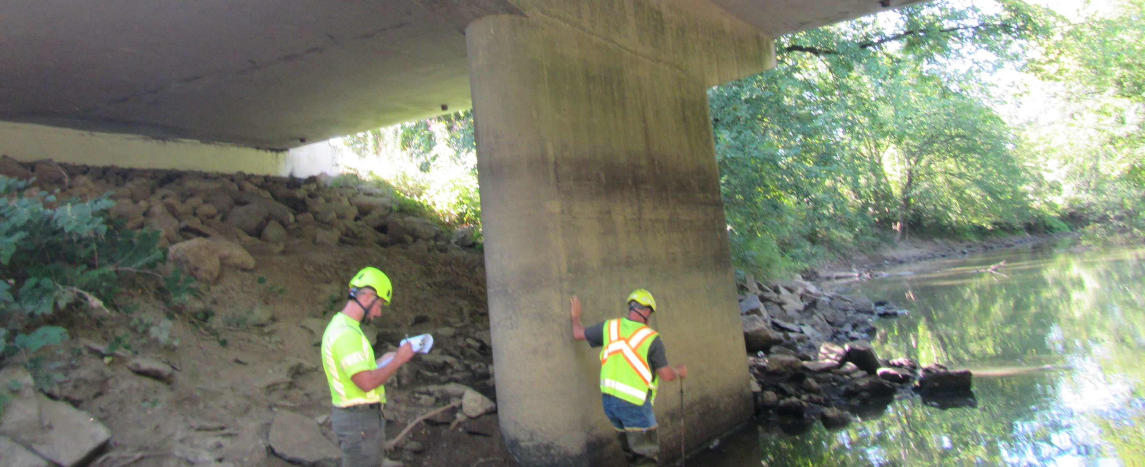
Field Photo

Slide 9
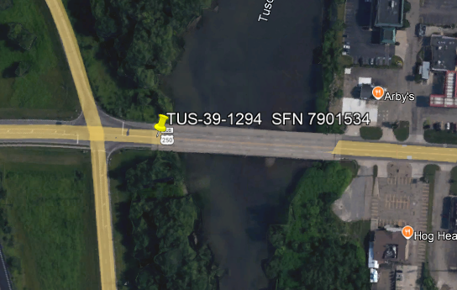
TUS-39-12.94 PID 122459
Project Description: PROTECT bridge TUS-39-12.94 SFN 7901534 from scour.
Notes:
The project will include Scour Analysis and implementation of scour countermeasures and remediation to protect bridge TUS-39-12.94 SFN 7901534.

Slide 10
Available project information
Some project information is available at the following FTP site:
https://ftp.dot.state.oh.us/pub/Districts/D11/122459
The PIP will be released through SAFE on the programmatic scheduled date
D11 does not release the PIP early
All information on the FTP site is subject to change, please review the information in SAFE to create your LOI
Notes:
Additional project information is available on the District 11 ftp site, at the link shown on your screen. The Project Initiation Package document, along with a more complete and detailed scope of work will be released through The ODOT Scope and Fee System (or SAFE) at the request for LOIs. All information on the FTP site is subject to change. Ensure you review the ftp site and the information in SAFE before completing your LOI for this project.

Slide 11
Project scope
The major items of work include:
Scour analysis and design of countermeasures
Maintenance of Traffic
Construction Access
ODOT will provide Survey and Soil Borings
Additional soil borings may or may not be necessary
Notes:
The major scope items are listed here. An updated and more complete list will be released in SAFE at the beginning of the LOI process.

Slide 12
Consultant Prequalifications
Non-Complex Roadway Design
Various Geotechnical Services
Bridge Design Level 2
Bridge Inspection Level 1
Notes:
The consultant prequalification's required for this project are shown here.

Slide 13
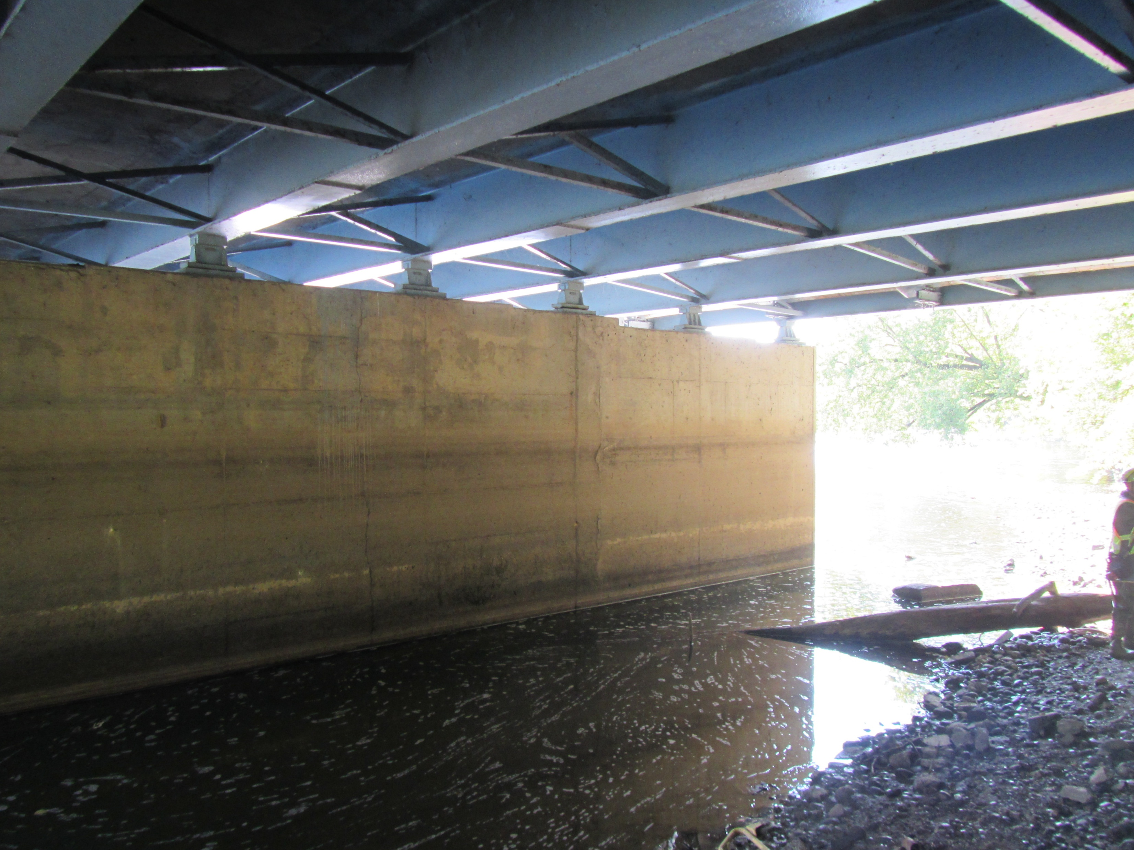
Field Photo
Notes:
The following slides will show you some of the scoping field visit photos, to illustrate how the District arrived at the current scope of work. More photos are available on the ftp site shown earlier.

Slide 14
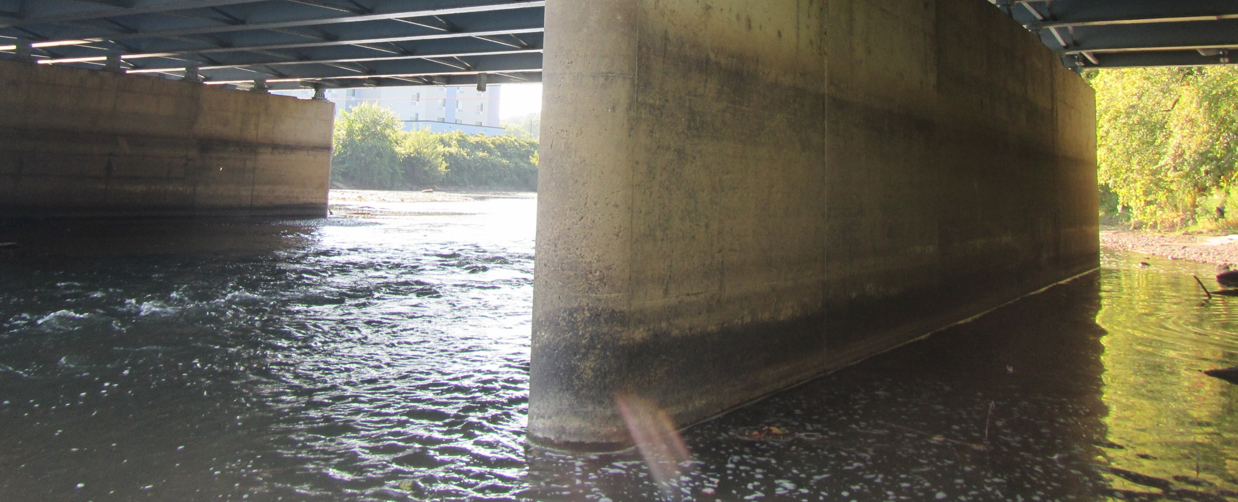
Field Photo

Slide 15
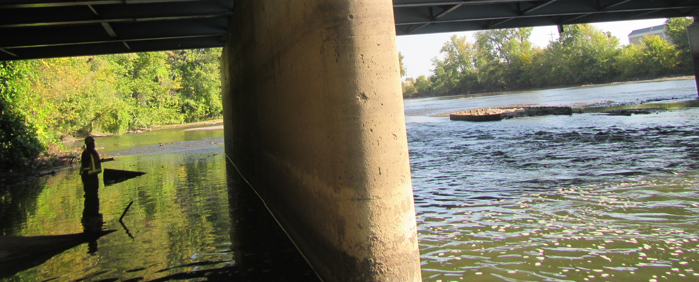
Field Photo

Slide 16
Thank you
Additional photos are available on the FTP Site links shown above
Thank you for watching this video presentation for Projs. TUS-36-18.00 PID 122460 and TUS-39-12.94 PID 122459
District 11 appreciates your interest in partnering with us for successful projects
Notes:
Thank you for watching this video. Visit the ftp site for more photos and information. Please remember that changes to this information and the detailed scope of work are possible. Review the information in SAFE prior to submitting your LOI.

Slide 17
Thank you

