Slide 1

MAY 2025 Programmatic
D11 Proj.: TUS-77-23.40 PID 122689
Notes:
This presentation will provide an overview of the subject project that will be placed on the upcoming programmatic selection for consultant design services.

Slide 2
TUS-77-23.40 PID 122689
Proj. Description: Installation of new median cable barrier along 5.22 miles I.R.-77. Project includes removing the existing raised median and updating the existing drainage structures.
Project Location: I.R.-77 from S.R. 39 north side of structure (approximate SLM 23.40) to structure (Reed Rd/T.R. 420 overpass) north of Strasburg Interchange (approximate SLM 28.62)

Slide 3
Available project information
Some project information is available at the following FTP site:
  https://ftp.dot.state.oh.us/pub/Districts/D11/122689
  Internet Explorer recommended for the ftp site
  The PIP will be released through SAFE on the programmatic scheduled date
  D11 does not release the PIP early
  All information on the FTP site is subject to change, please review the information in SAFE to create your LOI
Notes:
Additional project information is available on the District 11 ftp site, at the link shown on your screen. The Project Initiation Package document, along with a more complete and detailed scope of work will be released through The ODOT Scope and Fee System (or SAFE) at the request for LOIs. All information on the FTP site is subject to change. Ensure you review the ftp site and the information in SAFE before completing your LOI for this project.

Slide 4
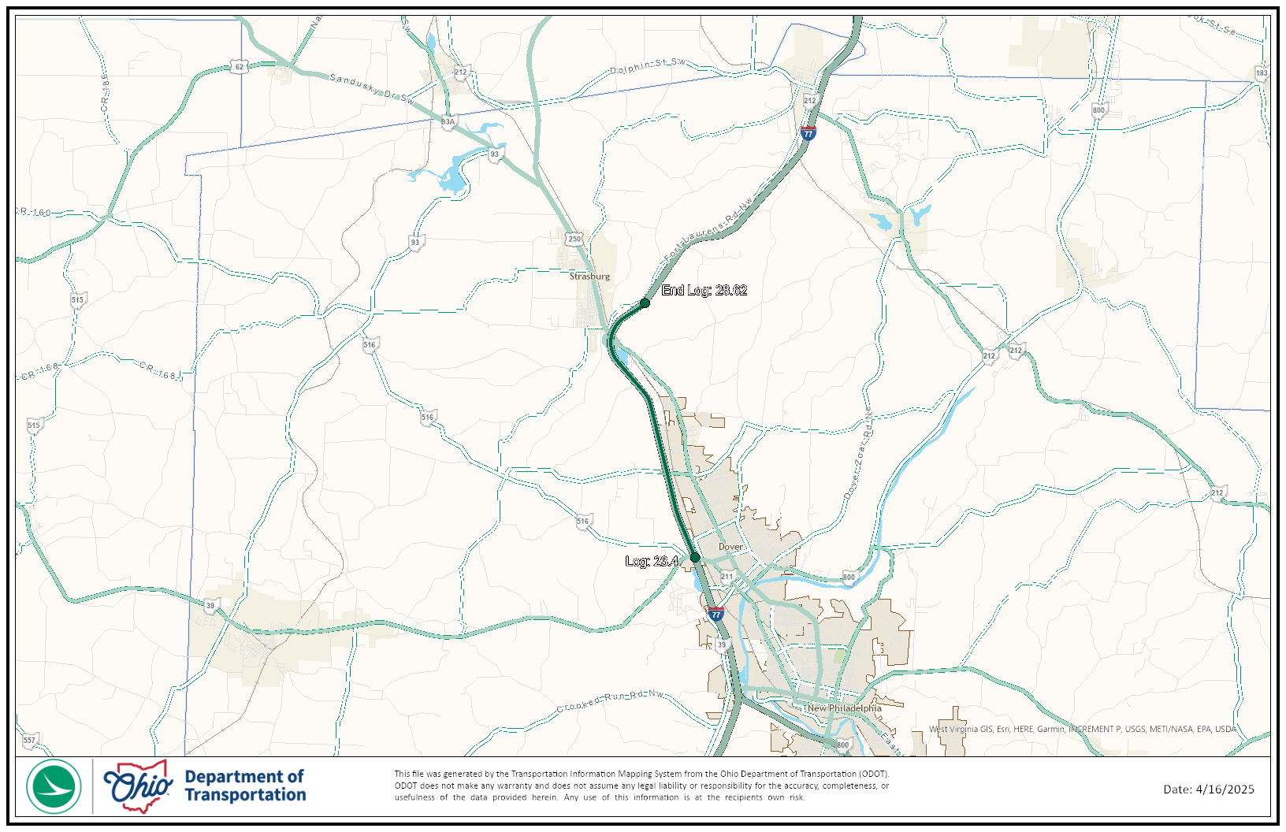
TIMS MAPPING
Notes:
Here is an image showing the anticipated project limits from ODOT’s TIMS application. The project will follow the existing horizontal and vertical alignments as much as practical.

Slide 5
Project scope
  The major items of work include:
    Installation of new median cable barrier
    Removal of the existing raised median
    Removal and replacement of median drainage structures. Currently, in most of the locations there are 2 ditch lines, we are anticipating the proposed to only have 1 ditch line.
    Traffic is to be maintained with 2 lanes due to permitted lane closures
      Consideration should be given to portable barrier on the median shoulder with access points for the Contractor.
  Stage 2 and 3 Review. Stage 1 review to be omitted with a Preliminary Stage 1 submission for Utilities.
  There are no anticipated Environmental tasks.
Notes:
The major scope items are listed here. An updated and more complete list will be released in SAFE at the beginning of the LOI process.

Slide 6
Consultant Prequalifications
Non-Complex ROAD
Notes:
The consultant prequalifications required for this project are shown here.

Slide 7
Thank you
Thank you for watching this video presentation for Proj. TUS-77-23.40 PID 122689.
District 11 appreciates your interest in partnering with us for a successful project.
Notes:
Thank you for watching this video. Visit the ftp site for more photos and information. Please remember that changes to this information and the detailed scope of work are possible. Review the information in SAFE prior to submitting your LOI.

Slide 8
Thank you

