Slide 1
I-71 Corridor Study
PID 104972 CUY/MED IR 0071 Corridor Study

Slide 2
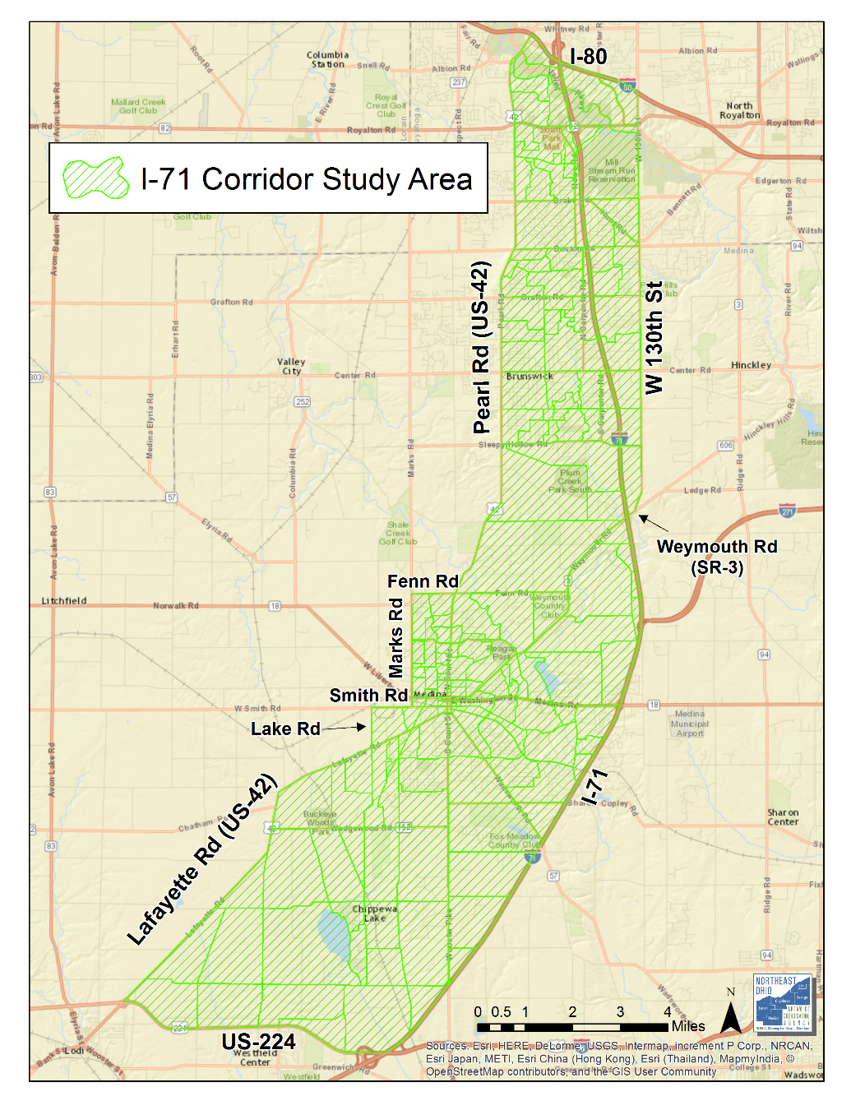
Suggested Study Area

Slide 3
Select Link Analysis
NOACA Travel Forecasting Model Select Link Analysis Scenario Year: 2040 Modeling Periods:
AM Peak Period
PM Peak Period

Slide 4
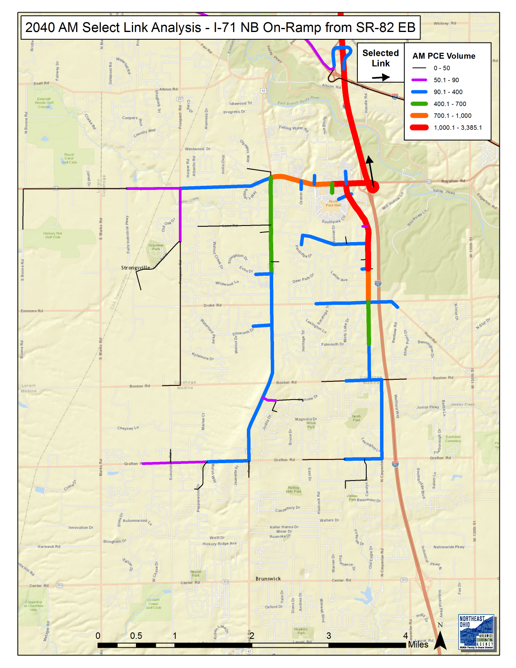
Northern Area
2040 AM

Slide 5
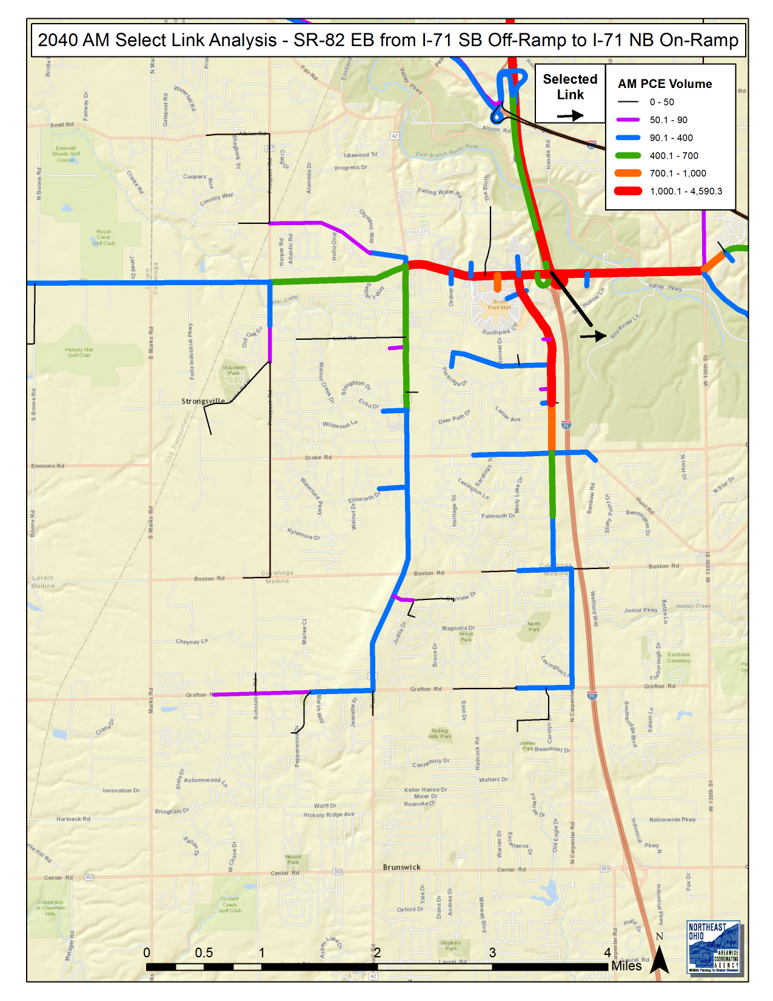
Northern Area
2040 AM

Slide 6
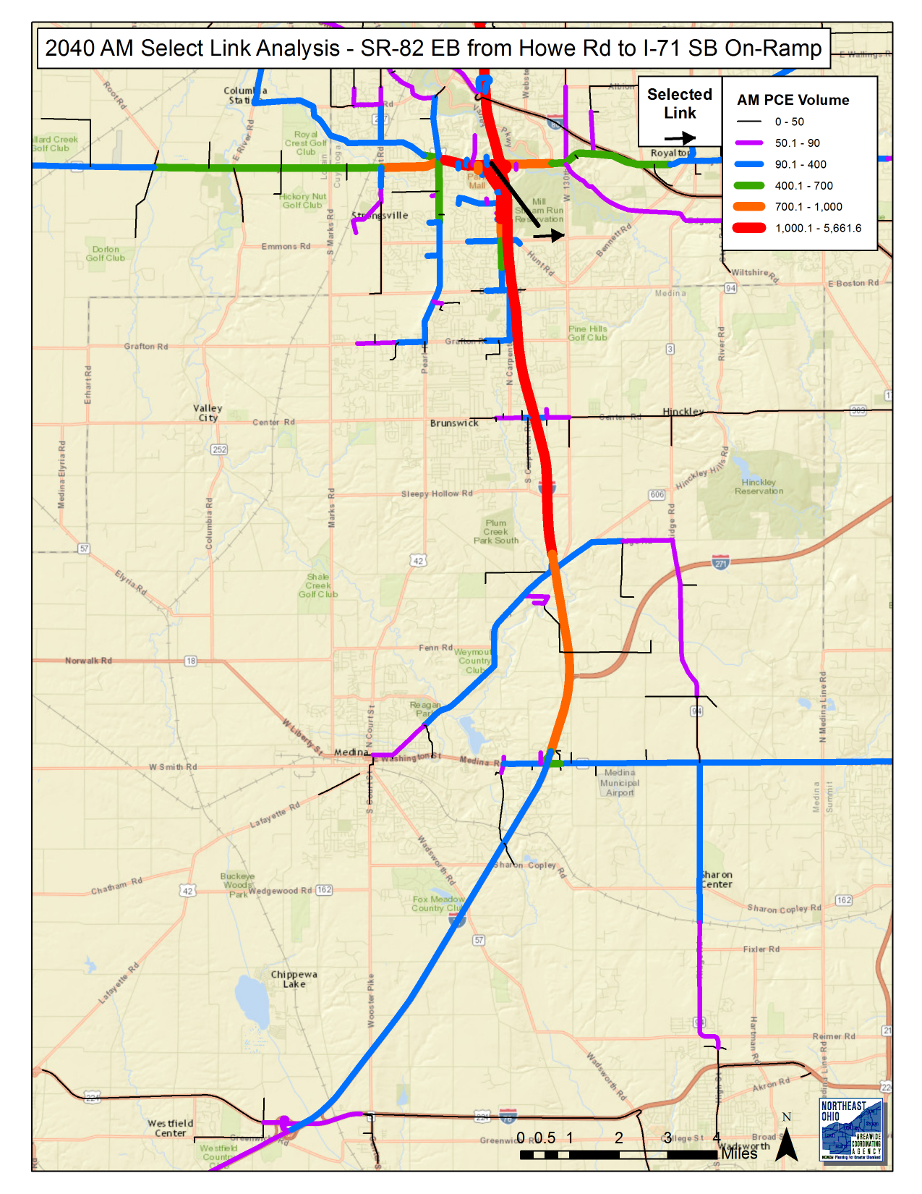
Northern Area
2040 AM

Slide 7
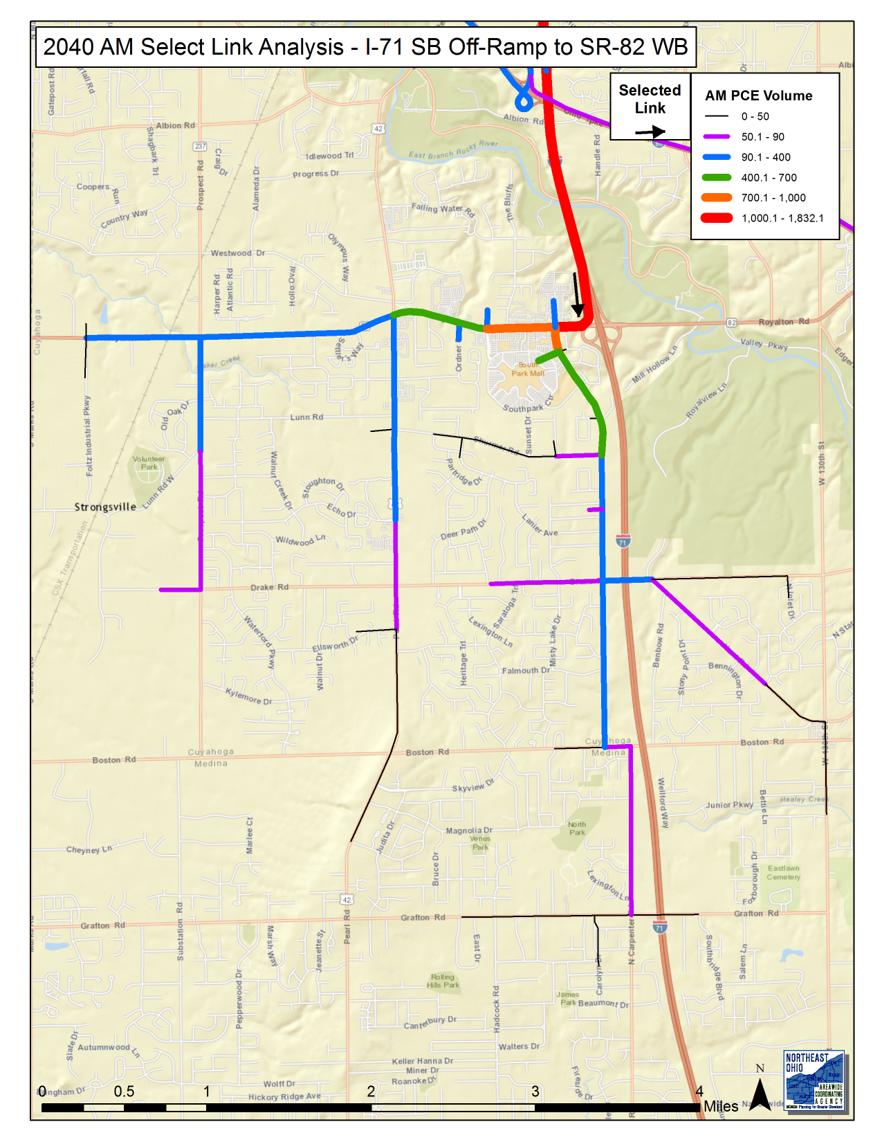
Northern Area
2040 AM

Slide 8
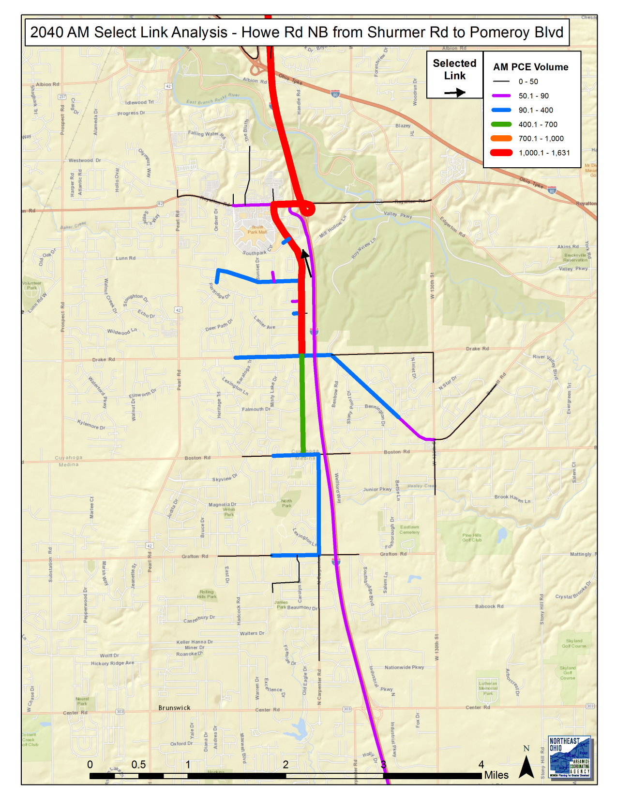
Northern Area
2040 AM

Slide 9
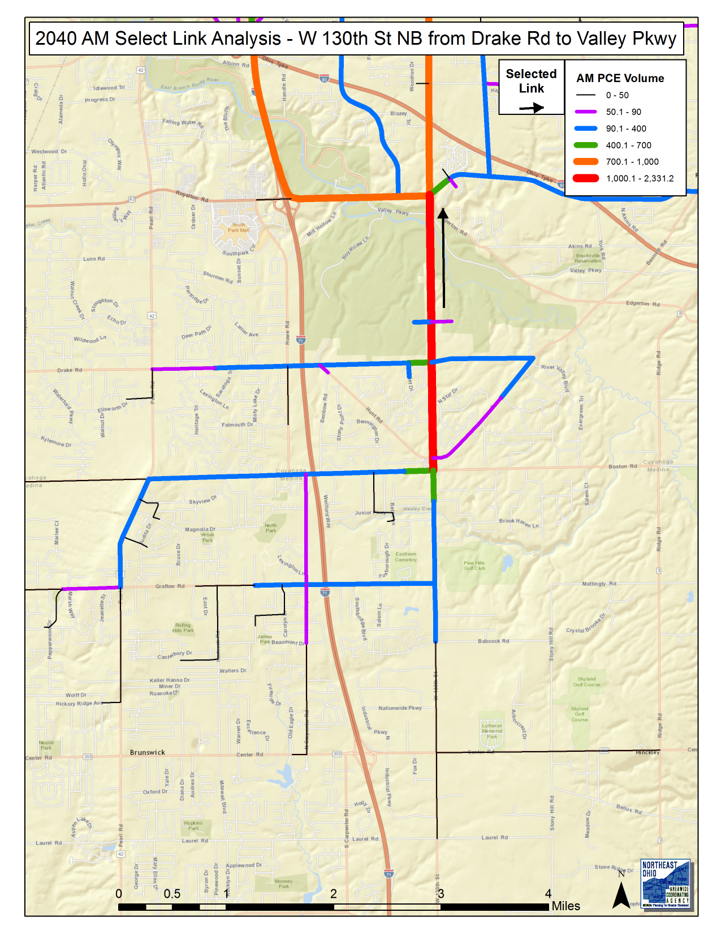
Northern Area
2040 AM

Slide 10
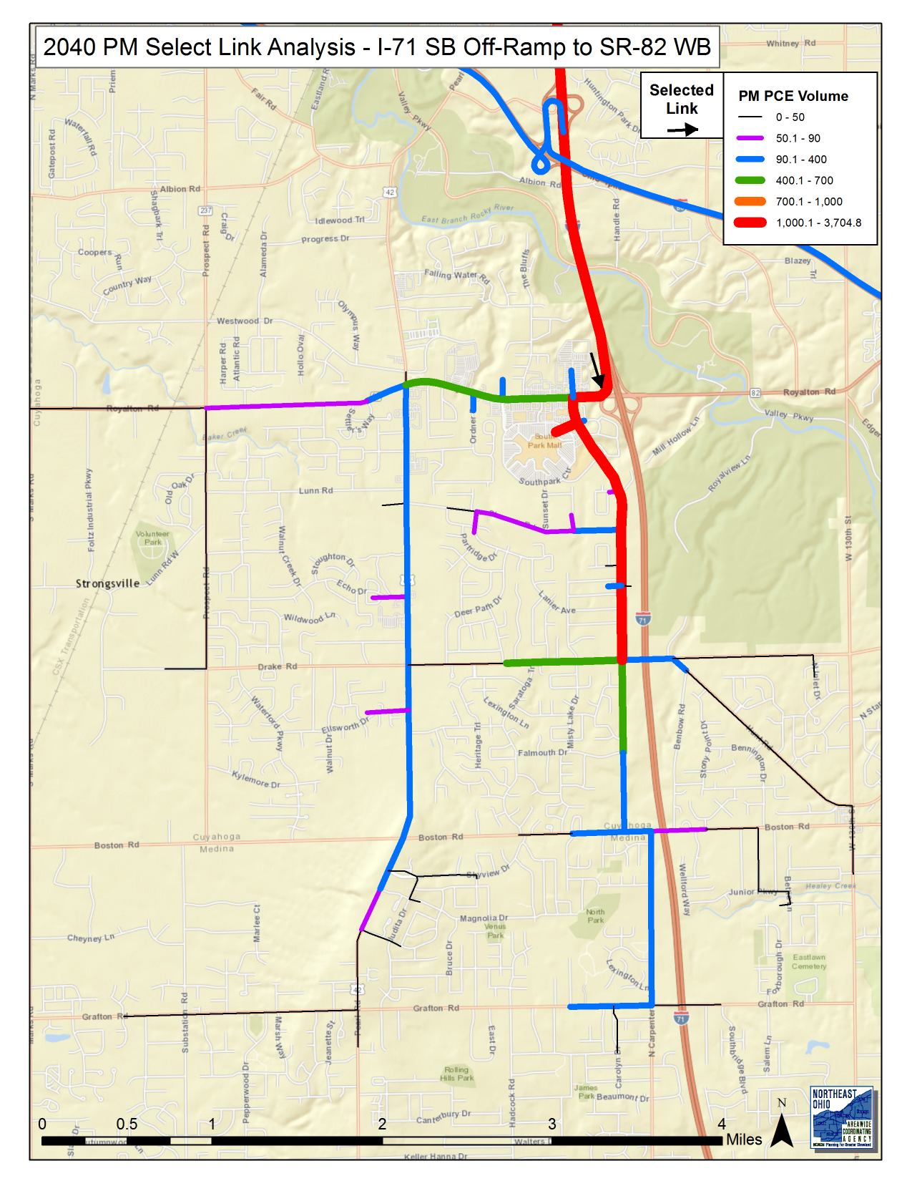
Northern Area
2040 PM

Slide 11
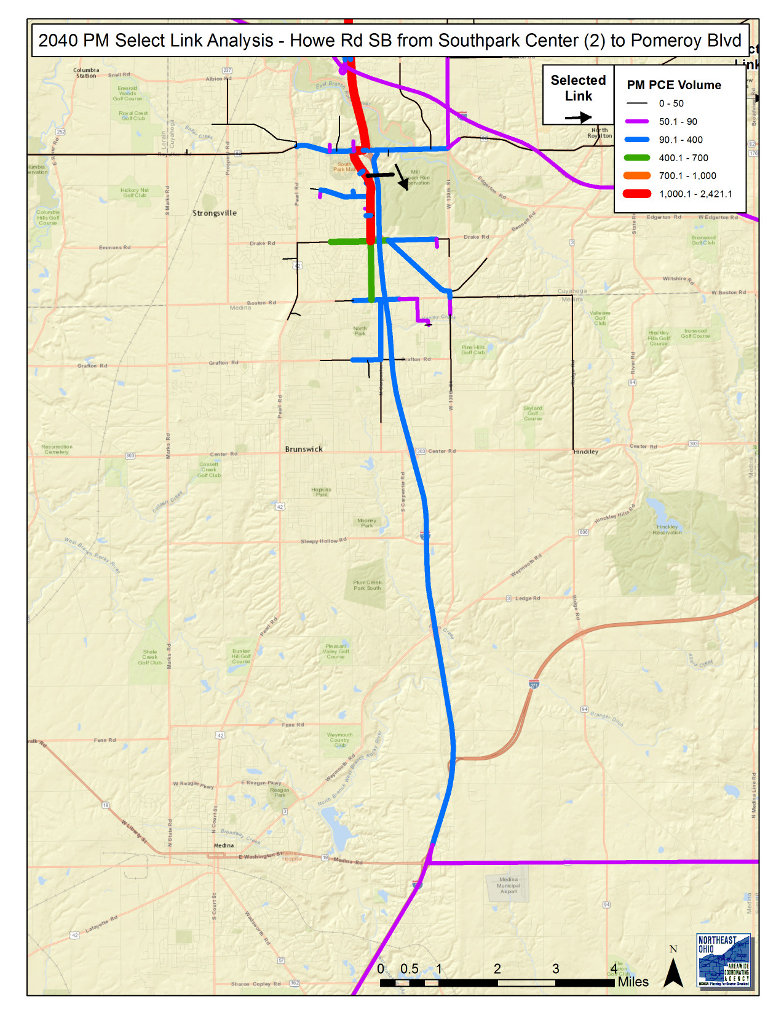
Northern Area
2040 PM

Slide 12
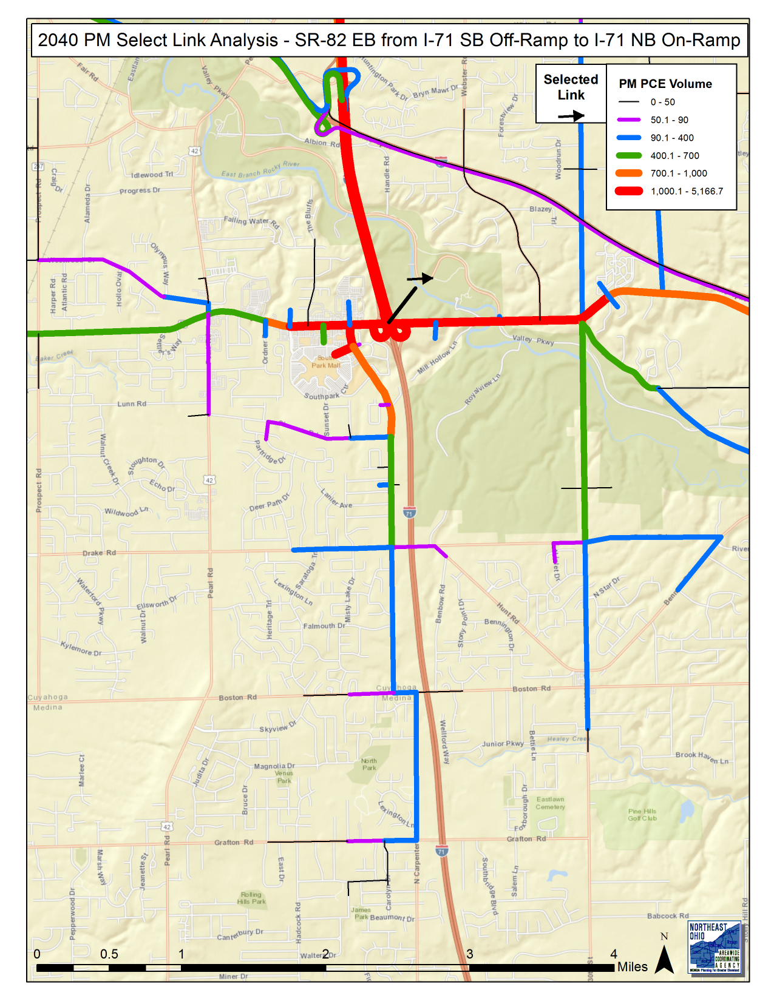
Northern Area
2040 PM

Slide 13
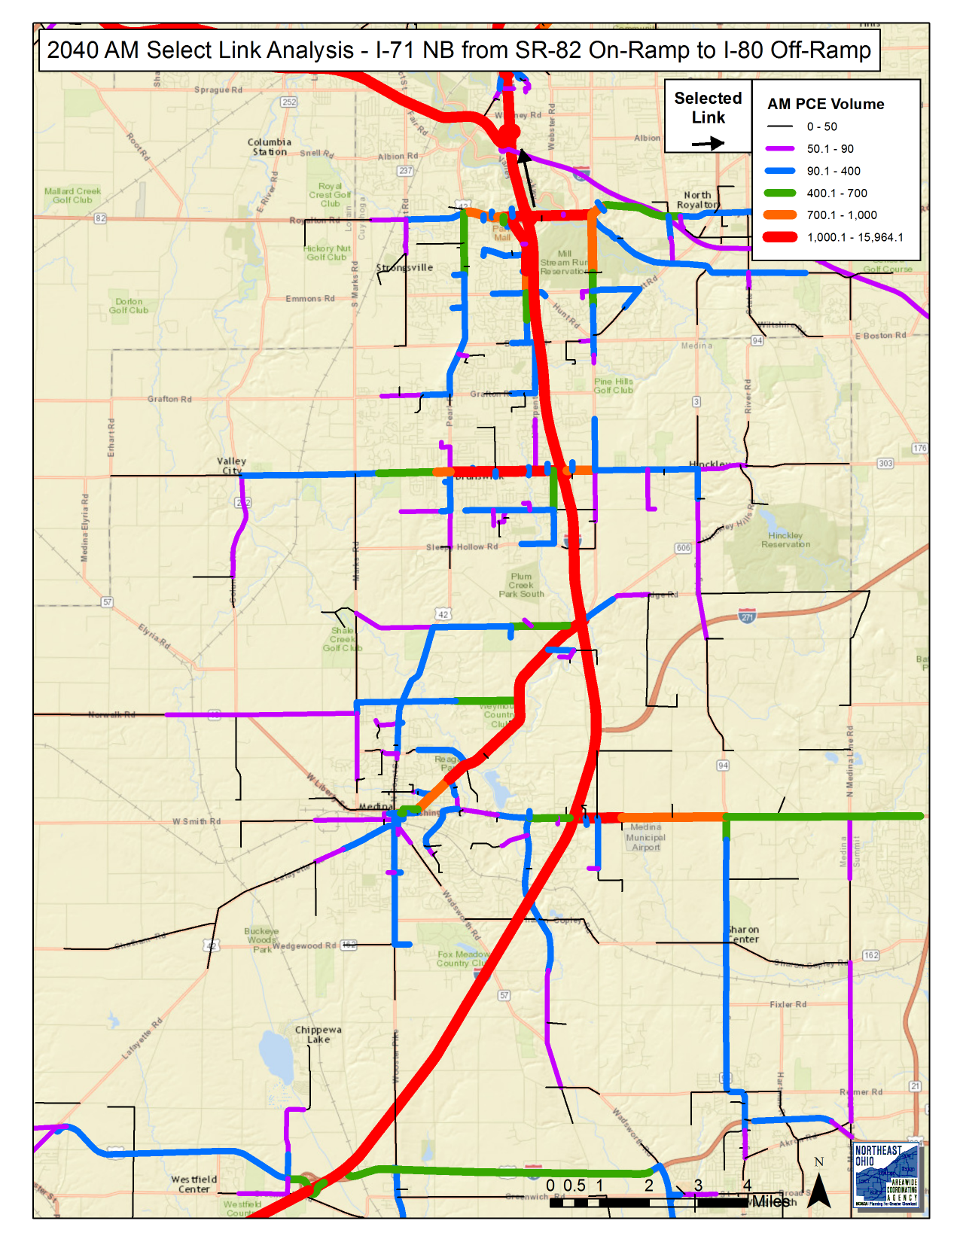
I-71
2040 AM

Slide 14
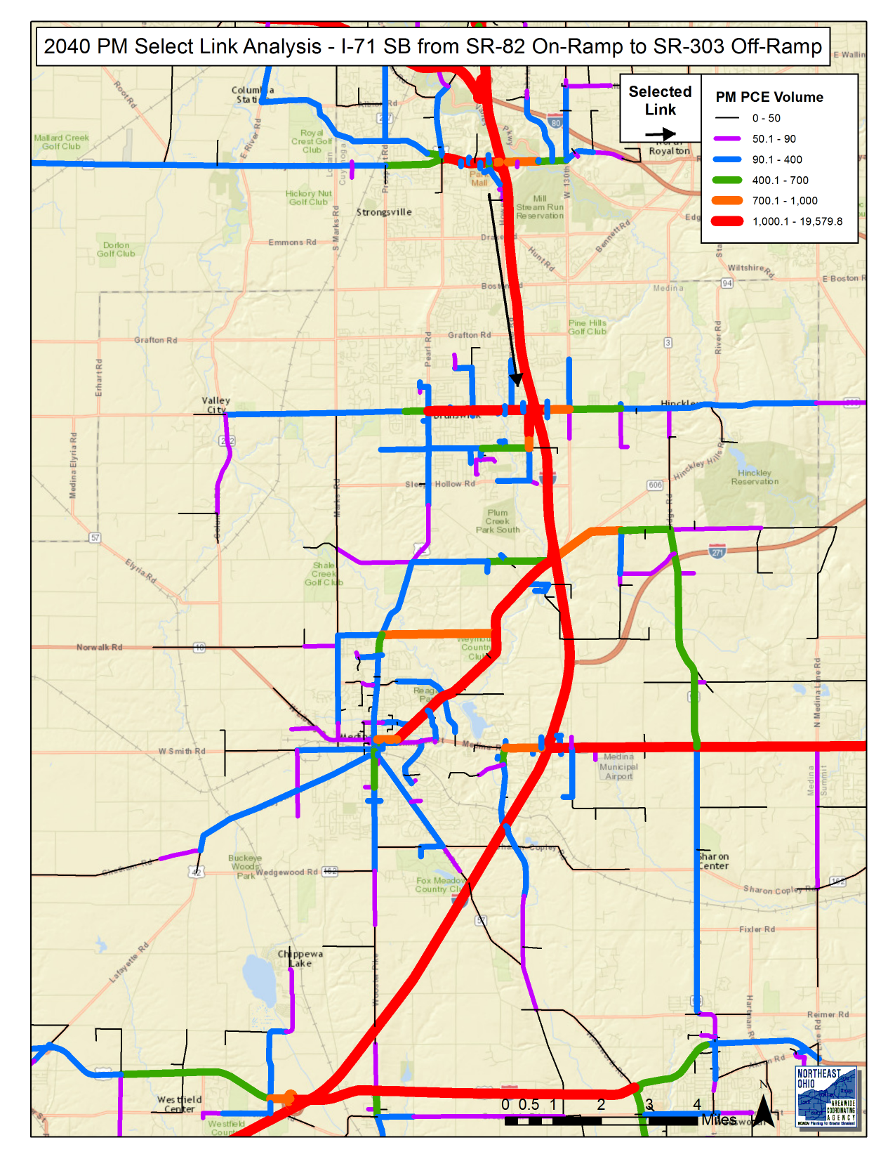
I-71
2040 PM

Slide 15
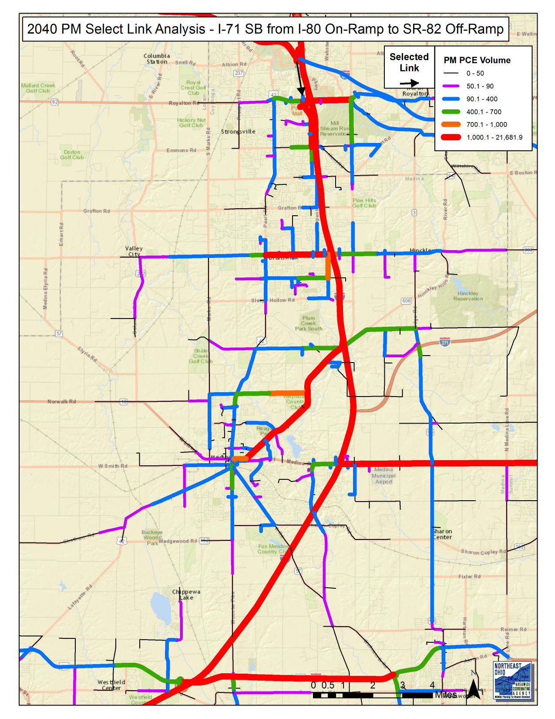
I-71
2040 PM

Slide 16
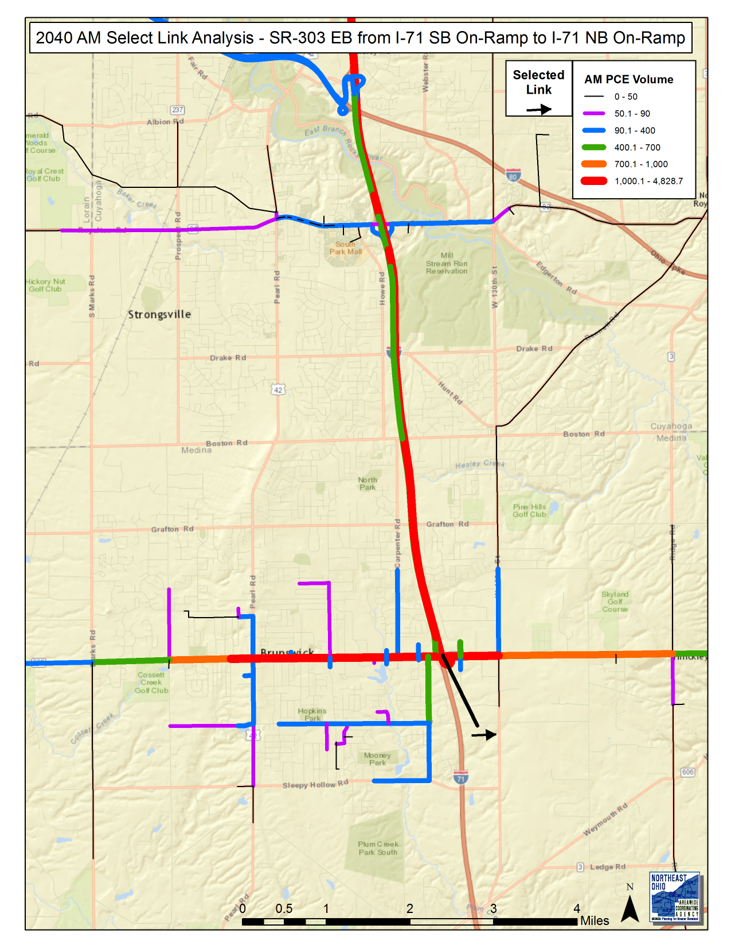
Southern Area
2040 AM

Slide 17
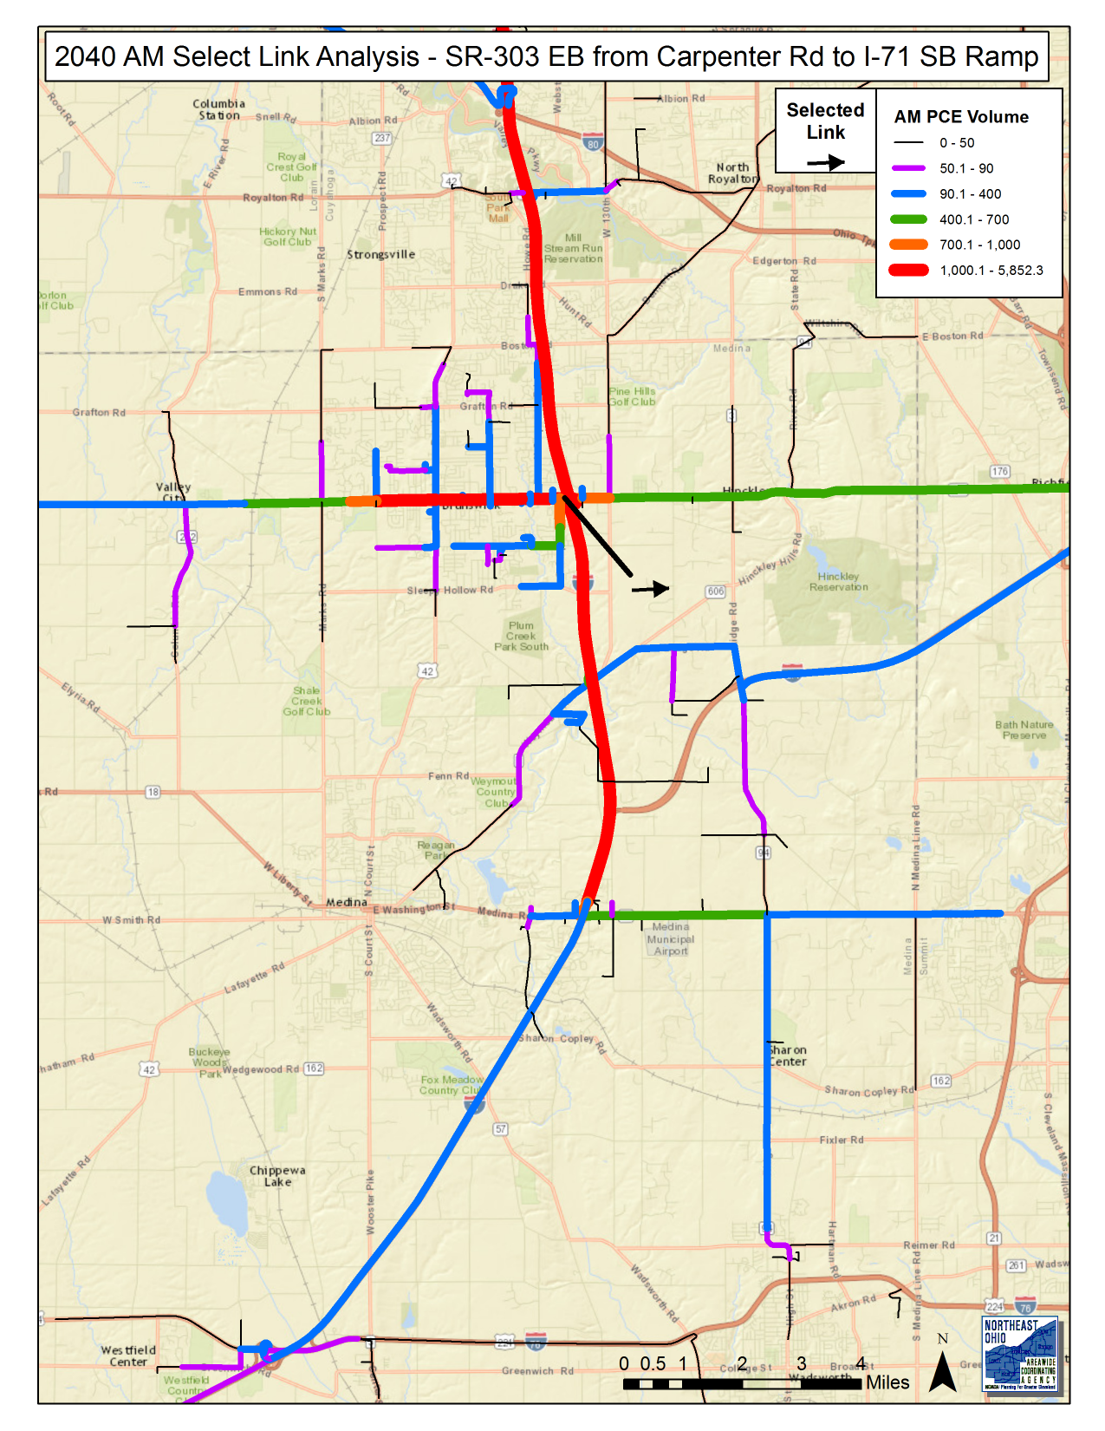
Southern Area
2040 AM

Slide 18
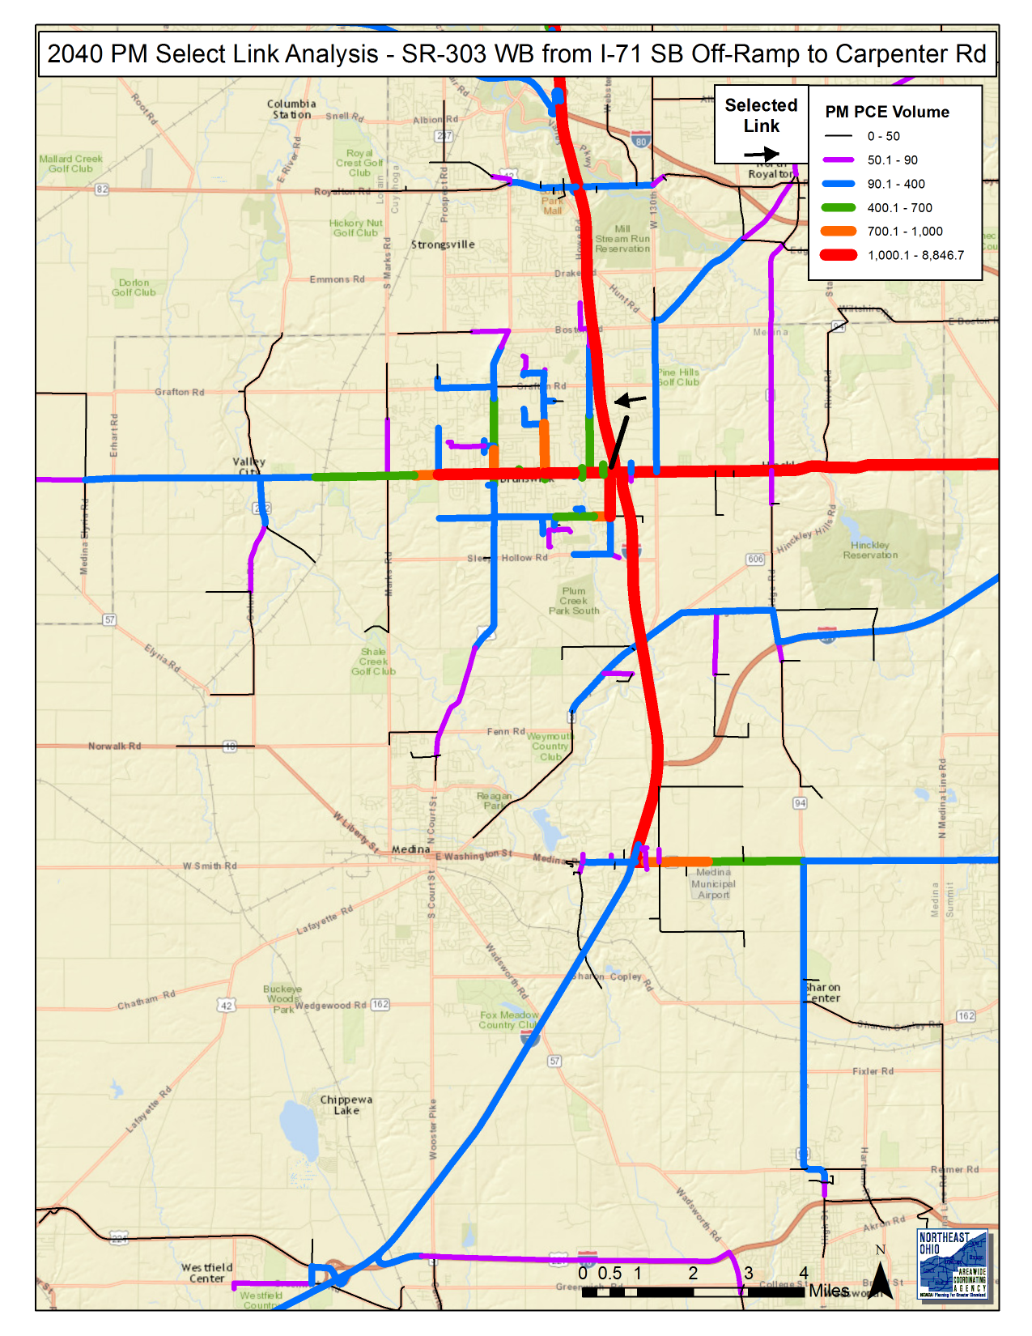
Southern Area
2040 PM

Slide 19
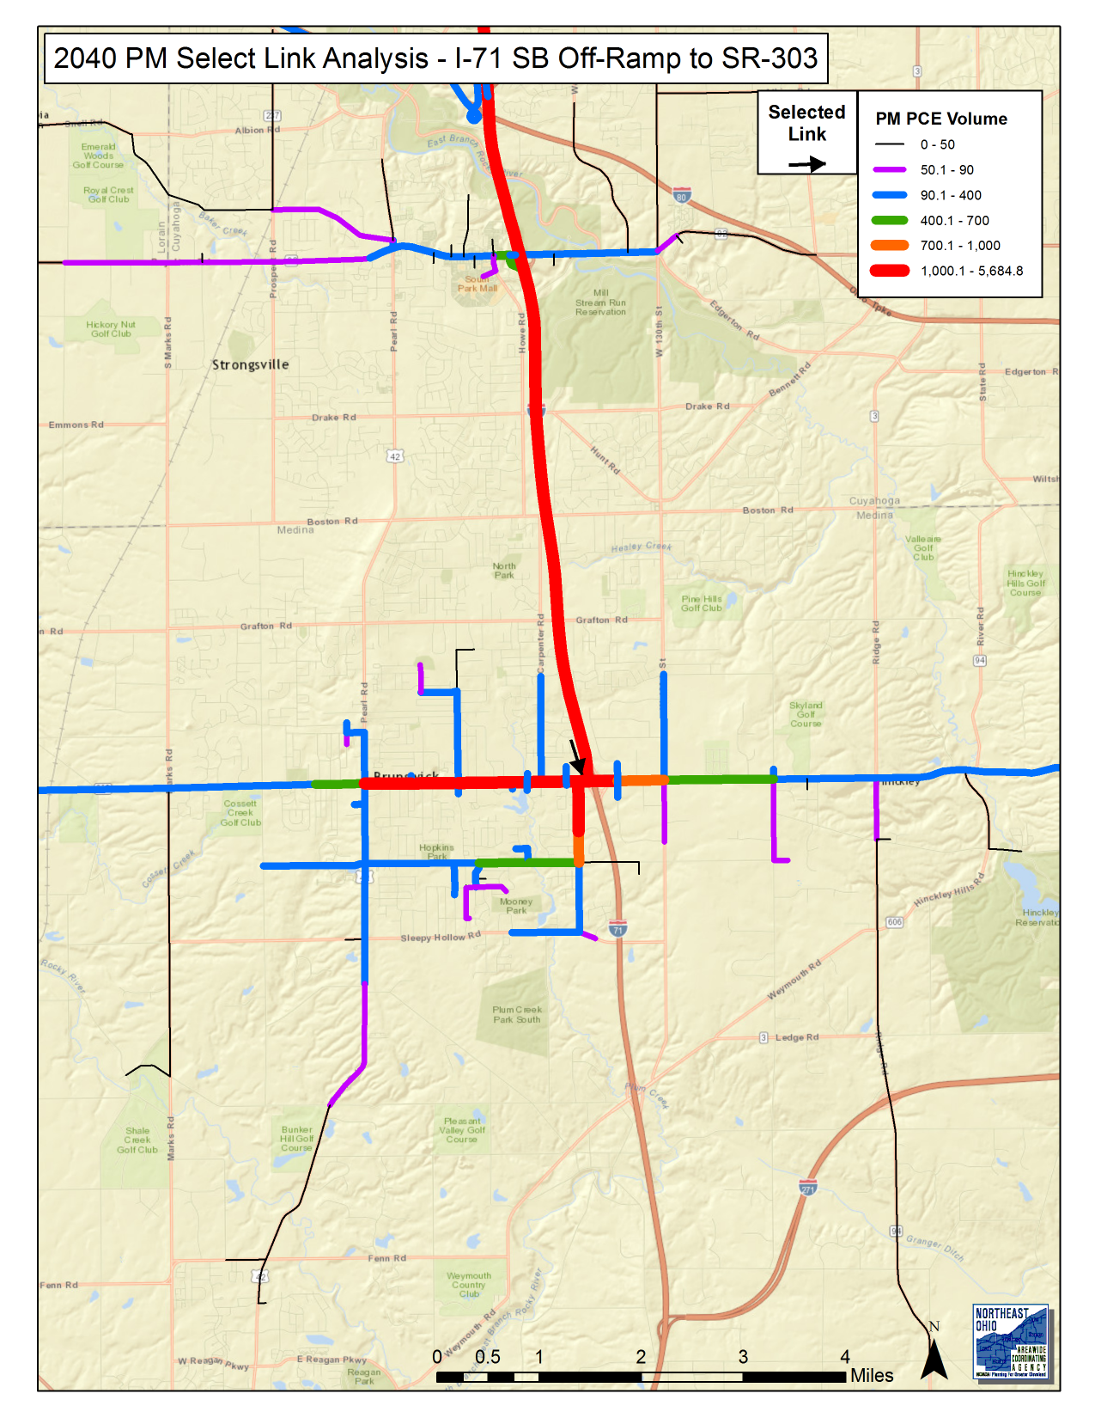
Southern Area
2040 PM

Slide 20
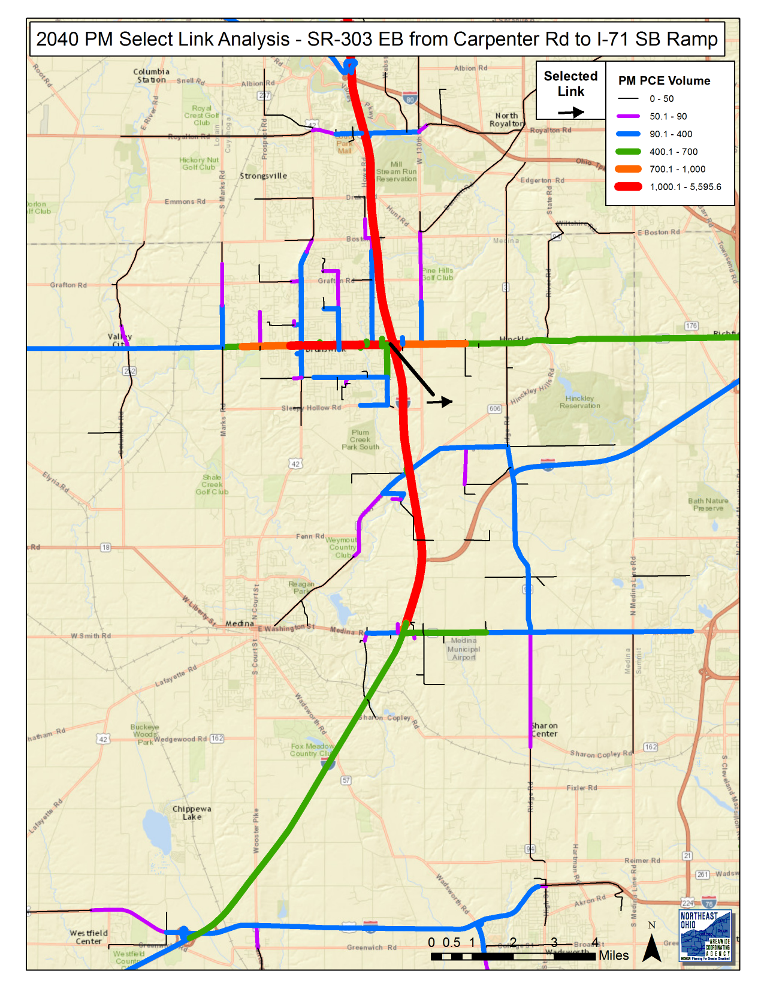
Southern Area
2040 PM

Slide 21
Conclusions
Ramps and collector streets in the northern portion of the study area are mainly used by traffic with origins and/or destinations in the northern area.
Ramps and collector streets in the southern portion of the study area are mainly used by traffic with origins and/or destinations in the northern area.
I-71 is a regionally significant highway and used by traffic with origins and/or destinations in the NOACA region and even other Counties.

Slide 22
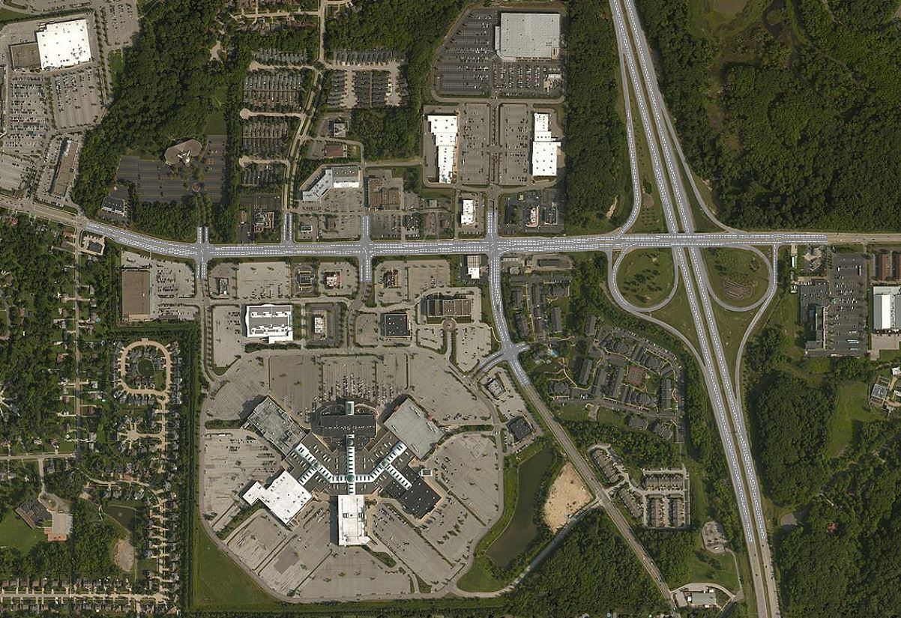
I-71/SR-82 – Vissim 2D View

Slide 23
I-71/SR-82 – Vissim 3D Video

