Slide 1
Cost Estimating Workshop March 14-17, 2011

Slide 2
Project Phase Update
Phase 1 and 3
Brad Hyre, P.E.
Transportation Manager
HDR
Phase 2
Manoj Sethi, P.E.
Executive Vice President
DLZ

Slide 3
Phase 2 C.R. 28 to U.S. 23
Typical Section

Slide 4
Typical Section

Slide 5
Roadway Design
Horizontal Alignment (No change)
Vertical Alignment (Significant change)
Interchanges (Refinement)

Slide 6
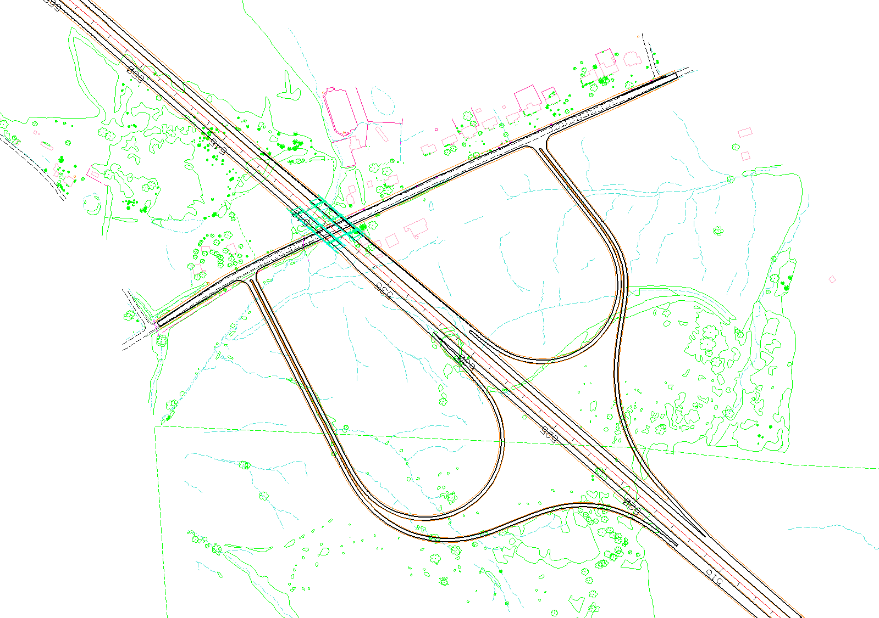
Interchanges
Lucasville-Minford Rd (CR 28)

Slide 7
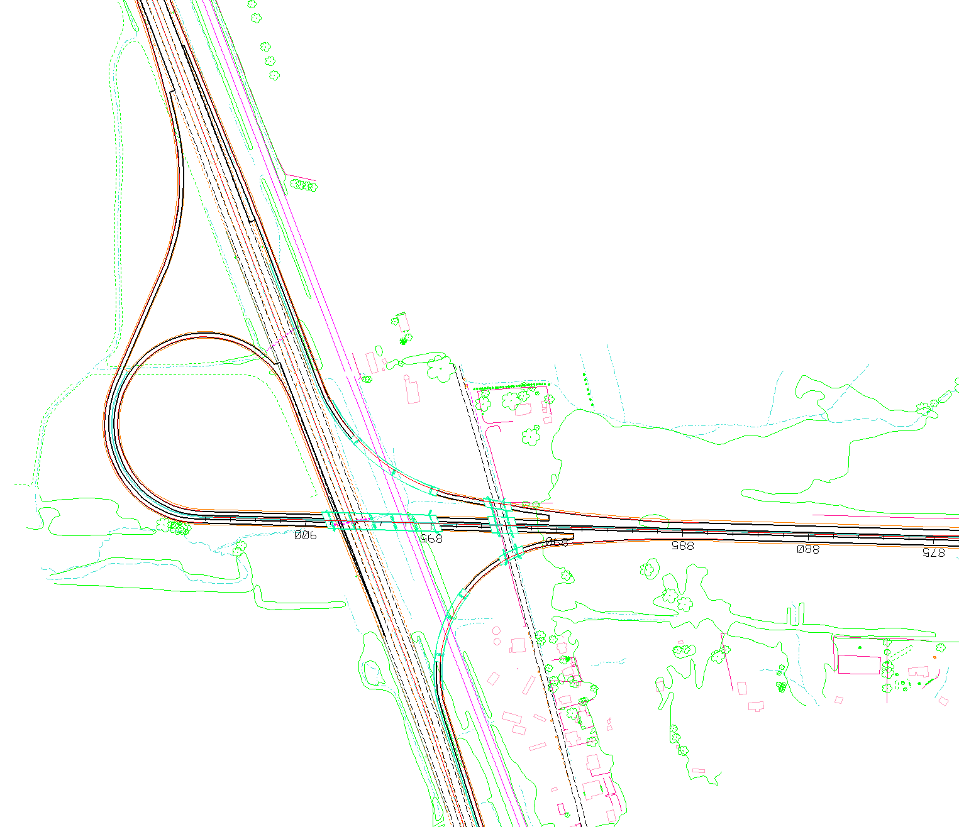
Interchanges
US 23

Slide 8
Utilities
Relocations Expected
AEP Transmission – 138KV facility (near STA 857+20)
Electric Dist. Line along CR-28, CR-29, CR-54, Flatwood Fallen Timber Road, Fairgrounds Road and R/R Tracks
Water, Gas & Sanitary Lines run parallel along Fairgrounds Road

Slide 9
Geotechnical
Bridge foundations
Spread footings
Driven piles
Drilled shafts

Slide 10
Geotechnical
Embankments
High fills
Soft soils
May require 3H:1V slopes, staged construction
US 23 Interchange
Lucasville-Minford Road Interchange

Slide 11
Geotechnical
Embankments (cont’d)
Special benching for sidehill fills
Embankment materials mostly rock
Durable rock at base of embankments for drainage

Slide 12
Geotechnical
Cut Slopes
Cut slopes higher than 150 feet
0.5H:1V cut slopes in competent sandstone
1H:1V cut slopes in weathered rock
2H:1V cut slopes in weak rock and overburden
Benches
Construction deviation benches every 60’ vertical
Overburden benches
Geotechnical benches

Slide 13
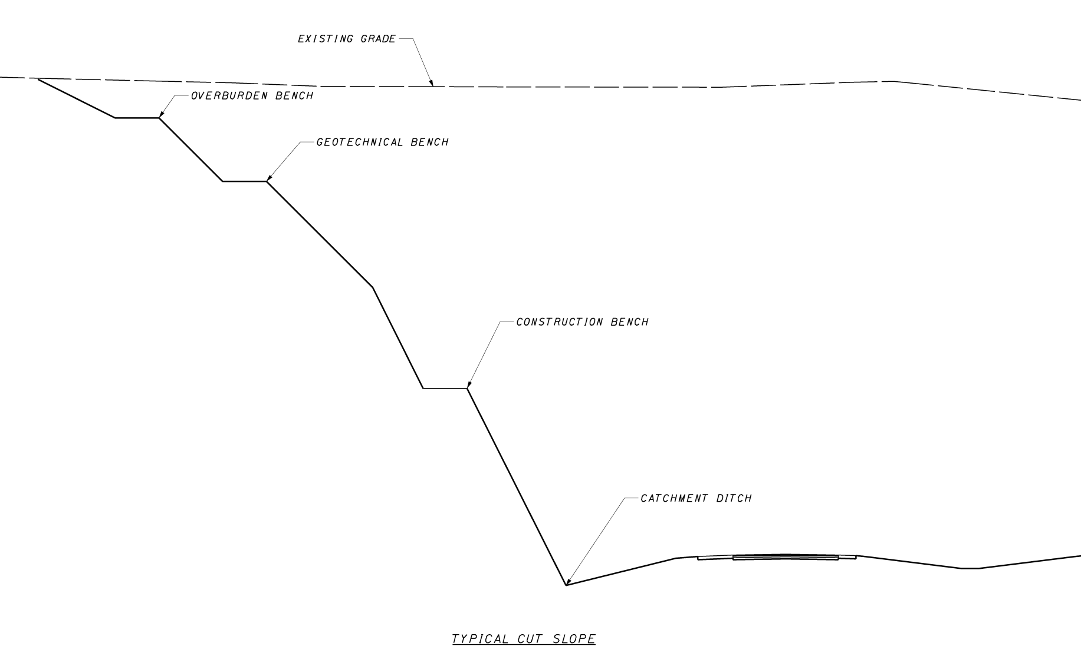
Geotechnical
Cut Slopes (cont’d)

Slide 14
Geotechnical
Cut Slopes (cont’d)
Catchment ditches for rockfall
Several different options proposed

Slide 15
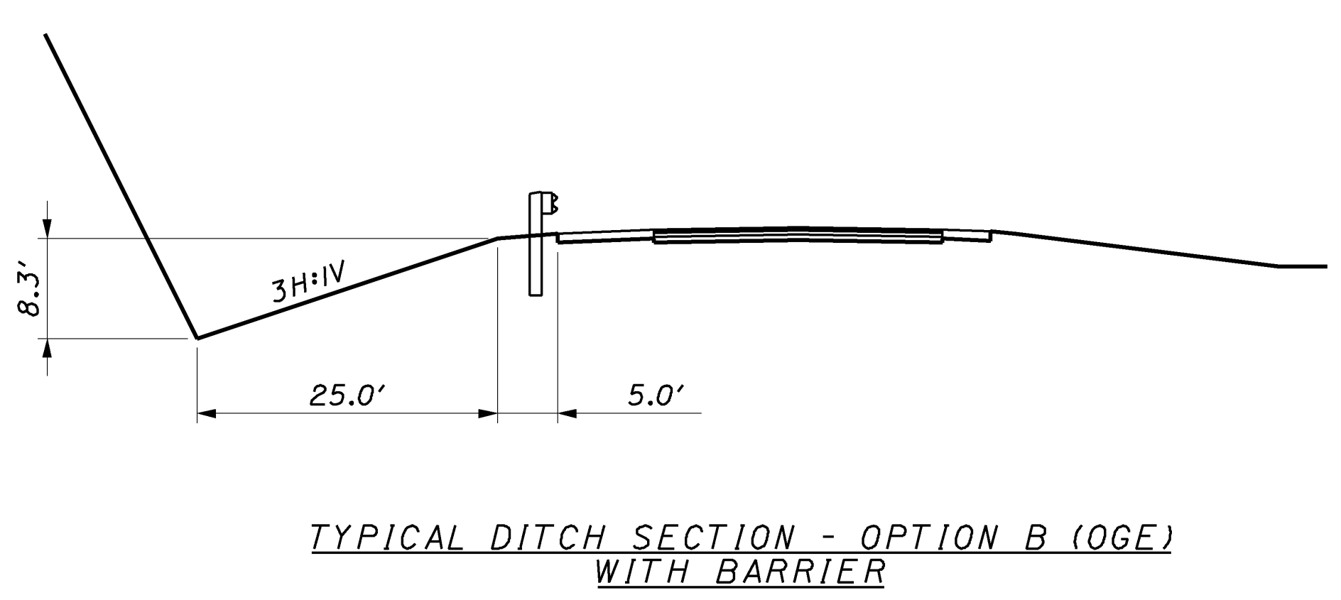
Geotechnical
Cut Slopes (cont’d)

Slide 16
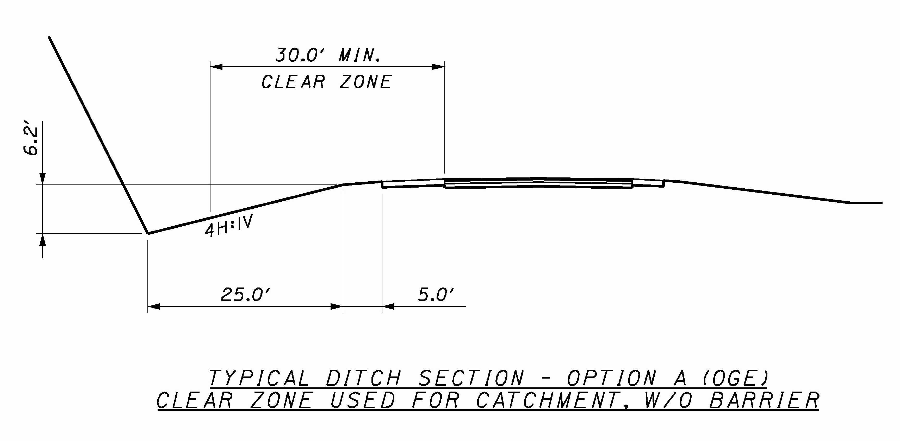
Geotechnical
Cut Slopes (cont’d)

Slide 17
Structures
10 Structures in this Phase

Slide 18
SCI-823-MAINLINE 4 bridges
Bridge No. | Bridge Description | Structure Type | Estimated Cost
1018 L&R | S.R. 823 over Lucasville-Minford Road L/R (VC = 28.83 feet) | 3-span prestressed concrete 60” I-beam with integral abutments, cap and column piers | $3,978,000
1096 L&R | S.R. 823 over Blue Run (CR-29) L/R (VC = 40.0 feet) | Single span prestressed 60” I-Beam on semi-integral abutments w/MSE wall supported abutments | $2,656,000
1357 L&R | S.R. 823 over Morris Lane Blue Run Road L/R (VC = 52.0 feet) | 5-span prestressed I-Beam with semi-integral abutments and T-type piers on spill thru slopes | $10,838,000
1431 | S.R. 823 Under Flatwood-Fallen Timber Road (CR-184) (VC = 71.0 feet) | 2-span steel plate girders with semi-integral abutments on spill thru slopes (1:1) | $3,012,800
 |  | Total | $20,484,800

Slide 19
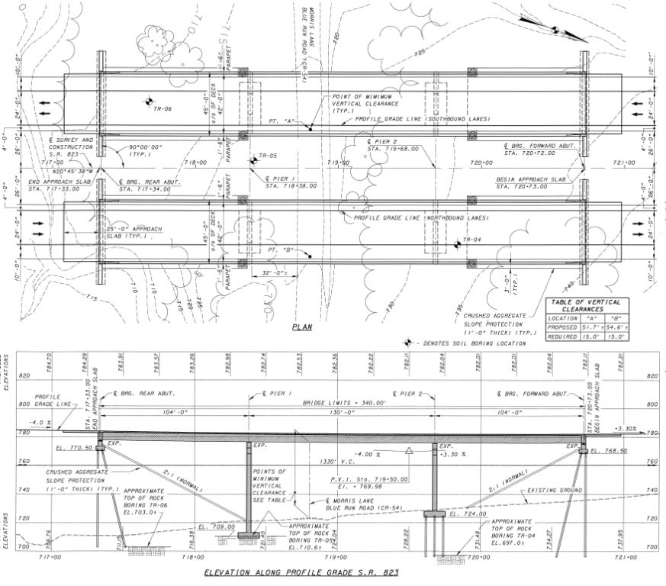
Morris Lane -Blue Run
Significant change to this Design is proposed

Slide 20
US 23 INTERCHANGE: 6 Bridges & MSE Walls
Bridge No. | Bridge Description | Structure Type | Estimated Cost
1593 | Ramp B over Fairground Road (C.R. 55) | Single-span prestressed concrete with semi-integral abutments behind MSE walls | $542,000
1598 | Ramp B over Norfolk Southern Railway | 3-span steel plate girders with conventional stub abutments. A pill thru slope is used at forward abutment, rear abutment is behind an MSE wall supported by Geopiers | $3,205,000
1594 | S.R. 823 over Fairground Road (C.R. 55) | Single-span prestressed concrete beams with semi-integral abutments behind MSE walls | $1,046,000
1601 | S.R. 823 over Norfolk Southern Railway and US 23. | 3-span steel plate girders with semi-integral abutments behind MSE walls | $3,186,000

Slide 21
US 23 INTERCHANGE (contd.)
Bridge No. | Bridge Description | Structure Type | Estimated Cost
1595 | Ramp C over Fairground Road (C.R. 55) | Single-span prestressed concrete beam with semi-integral abutments behind MSE walls | $583,000
1603 | Ramp C over Norfolk Southern Railway | 3-span steel plate girders with conventional stub abutments. A spill thru slope is used at the rear abutment and the forward abutment is behind an MSE wall supported by Geopiers | $3,655,000
Walls |  | 6 MSE Walls at the Interchange. Geopiers for Ramp B and C | $5,674,400
 |  | Total | $17,891,400

Slide 22
S.R. 823 over NS Railway and US 23

Slide 23
Hydraulics
Open drainage system using culverts and ditches
Closed drainage systems using catch basins, manholes and storm sewers
Culverts range from 36-in. to 72-in.
10’x5’ Box under U.S. 23
Length of culverts up to 900-ft.
Height of fill above some culverts up to 120-ft.

