Slide 1
CADD Services
Consultant Users Group
March 3rd, 2015
Division of Engineering
Office of CADD and Mapping Services

Slide 2
Agenda for Today
9:00am – 9:15am
  Introduction
    Rachel Lewis, CADD and Mapping Services
9:15am – 10:15am
  GEOPAK (SELECTseries 2, 3, and 4)
    Don Lee, Bentley Systems, Inc.
10:30am – 11:00am
  ODOTcadd Standards: Configuration
    Mark McCloud, CADD and Mapping Services
11:00am – 11:45am
  ODOTcadd Standards: Project Management Applications
    Eric Thomas, Eric Thomas Consulting LLC

Slide 3
Agenda for Today
11:45am – 12:45pm
  Lunch
12:45pm – 2:00pm
  ODOTcadd Standards: VBA Application Updates
    Eric Thomas, Eric Thomas Consulting LLC
2:00pm – 2:15pm
  ODOTcadd Standards: PDF Printing
    Jack Kerstetter, CADD and Mapping Services
2:15pm – 2:30pm
  Every Day Counts Initiative for 3D Modeling
    Mark McCloud, CADD and Mapping Services

Slide 4
Agenda for Today
2:30pm – 2:45pm
  Question and Answer Session
CPD Credits
  4.00 Total Credits Awarded (see agenda notation)
  2.25 Credits Awarded for Morning Session
  1.75 Credits Awarded for Afternoon Session

Slide 5
Introduction of Staff Members
Rachel Lewis
  Administrator, CADD and Mapping Services
Dave Slatzer
  Deputy Director, Division of Engineering
Mark McCloud
  CADD Manager, CADD and Mapping Services

Slide 6
Introduction of Staff Members
Fanita Cheek
  L & D Volume 3
  Plan Development Process (PDP)
  CADD Standards Manual
  MicroStation 3D Modeling Support
Jack Kerstetter
  Hardware Support
  Software Support
  Plotting Support
  VB Application Support

Slide 7
Introduction of Staff Members
Terri Silleck
  MicroStation Support
  Standard Drawing and Cell Library Updates
  CADD Application Support (i.e. AutoTurn, GuideSign, etc.)
  Special CADD Projects (i.e. Aviation Directory/5010 Drawings)
John Drsek
  OpenRoads Development
  Geopak Support
  VB Application Support
  GENSUM Spreadsheet Support

Slide 8
Introduction of Staff Members
Eric Thomas, Consultant
  OpenRoads Development
  Geopak Support
  VB Application Support

Slide 9
Office of CADD and Mapping Initiatives
ProjectWise Pilot
e-Construction
Unmanned Aerial Systems Research (UAS)
  http://www.dot.state.oh.us/Divisions/Engineering/CaddMapping/Survey/Pages/UnmannedAerialVehicles.aspx
Every Day Counts Initiatives
Ohio Transportation Engineers Conference (OTEC)
  October 27th and 28th, 2015
  Call For Abstracts Due By April 3rd
  www.otecohio.org

Slide 10
Bentley Civil V8i SELECTseries 4
Don Lee, Consultant - Bentley Professional Services

Slide 11
V8i SELECTseries 2, 3, and 4?
GEOPAK SELECTseries 2 | GEOPAK SELECTseries 3
Data Acquisition | Civil Survey
Roadway Designer | Corridor Modeling
Site | Analysis & Reporting, Geometry, Terrain Modeling, Civil Cells, 3D Geometry, Model Interoperability
SELECTseries 4?

Slide 12

Upcoming Bentley Civil Releases
V8i SELECTseries 3 (Update 3)
  Q4, 2014
V8i SELECTseries 3 (Update 4)
  Q1, 2015
V8i SELECTseries 4 (Released on Dec. 24th)
Will now be
V8i SELECTseries 4
(Update 1)

Slide 13
V8i SELECTseries 4
08.11.09.789 (replaces 08.11.09.788 release)
Full Install
Power products will include new MicroStation platform version (08.11.09.655).
Suite products will require a new version of MicroStation (08.11.09.655).
Same version of Descartes (08.11.09.601).
Updated the version of Bentley Map (08.11.09.503)

Slide 14
Why V8i SELECTseries 4?
Two reasons compelled us to change the name of the release from an update of V8i SELECTseries 3 to V8i SELECTseries 4:
New Features/Tools – Several new tools and features have been added to the OpenRoads technology and are supported in all products. Updates are normally defect/bug fixes with limited new functionality.
Model Interoperability – Extensive programming to the civil object model has been done behind the scenes to position our technology and our users for the future.

Slide 15
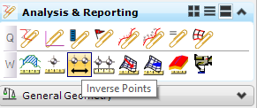

New Features/Tools
Inverse Points - The Inverse Points tool computes and displays the distance and direction between each pair of specified points.
Point Feature Station Offset Elevation Report - The Point Feature Station Offset Elevation Report tool creates a report that contains point name, point feature, station, and offset from selected points to a baseline (MicroStation, civil horizontal geometry or survey elements).

Slide 16
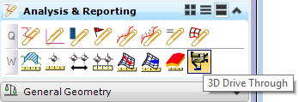

New Features/Tools
3D Drive Through - The 3D Drive Through tool gives the user the capability of viewing 3D models in a realistic visualization. The visualization can also be published to a MicroStation camera script file, where it can be used with the Animation Producer tool.
Geometry LandXML Import/Export – The importing and exporting of geometry via LandXML is now fully supported.

Slide 17
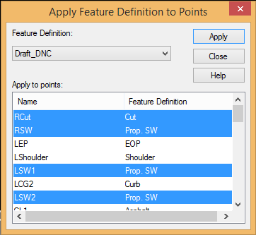
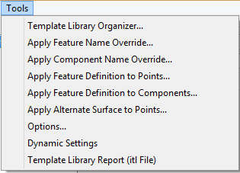
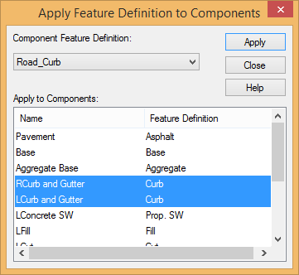
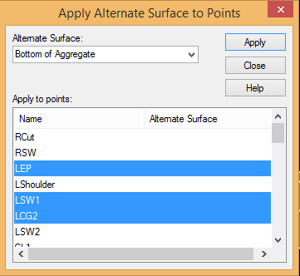
New Features/Tools
3 New Create Template Tools

Slide 18
New Features/Tools
Modeling Performance Updates
Client case: reported that after importing an interchange from SELECTseries 2, it took in excess of 7 minutes to process an update to the corridor (e.g. adding a key station).
Granted, this was a large project, containing over 20 different corridors as well as multiple corridor clipping references.
After making changes to enhance the performance, the same testing now processes in about 2.5 minutes.
However, keep in mind that the improved performance can fluctuate depending on variables within the project.

Slide 19
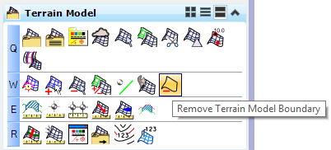

New Features/Tools
Remove Terrain Model Boundary
Previously, you could not add additional survey to a non-ruled terrain if the additional survey extended beyond the original boundary. This was especially prevalent when importing GEOPAK .DAT or InRoads .DTM files.

Slide 20
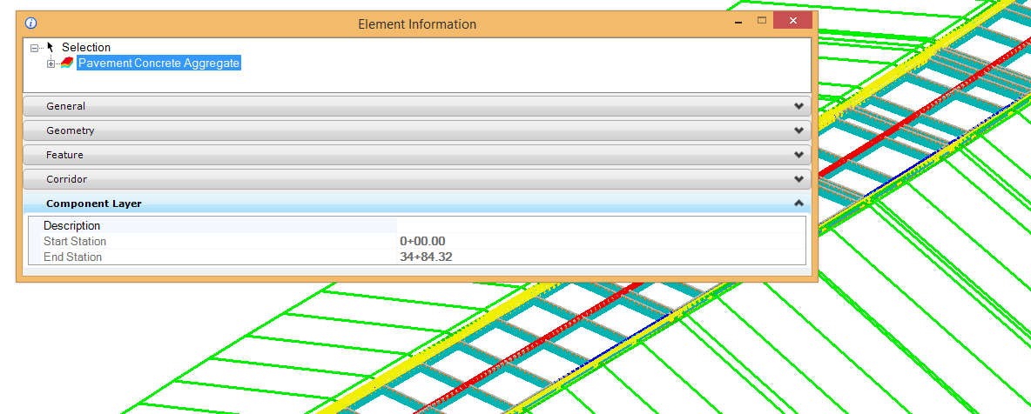
New Features/Tools
Stations Reported on Meshes
We now report the station limits of individual mesh elements.

Slide 21
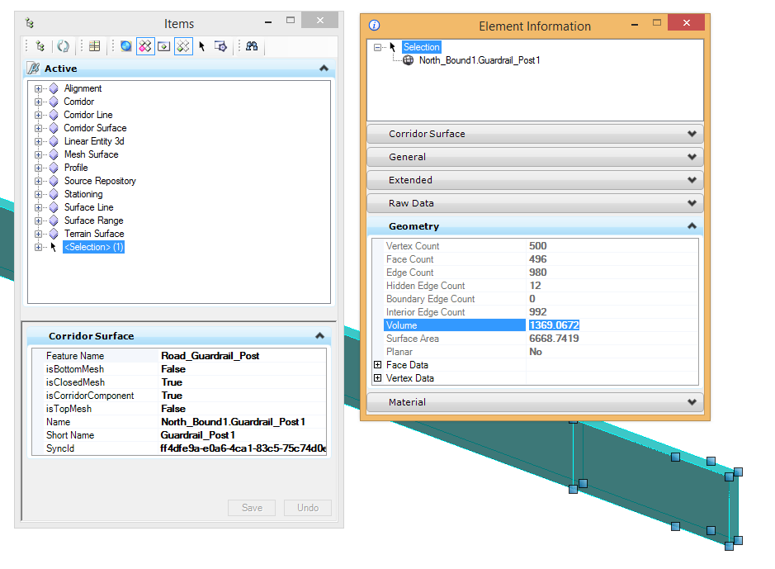
New Features/Tools
Populate i-model with areas and volumes

Slide 22
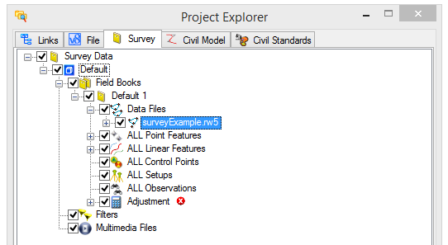
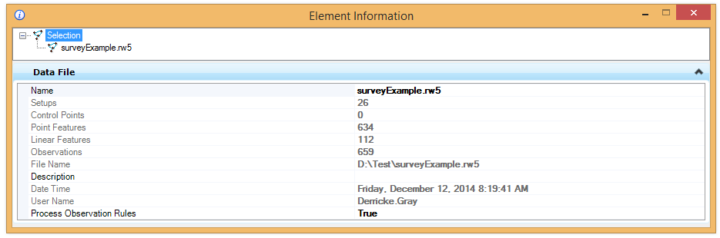
New Features/Tools
Survey – Process Observation Rules
New property attached to each survey dataset. Allows for the enabling/disabling of the processing of observation rules. Default=ON, OFF results in no re-processing of observations on any update.

Slide 23

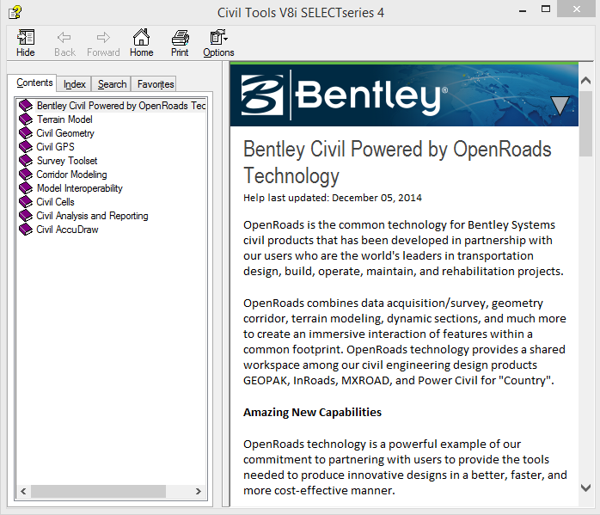
New Features/Tools
OpenRoads Help
We have separated the OpenRoads help from the legacy help and made it accessible via Task Navigation.

Slide 24
Relevant Fixes
Skewed Cross Sections
Components now honor the “Ignore” classification in End Area Volumes command
GEOPAK can now Auto Annotate a simple tangential alignment (2 point chain)
Survey - Control points now prompt for update.
Survey - TMPL linking codes now work even when converting to point list on import.

Slide 25
SUE - New Features/Tools
Added new functionality to Model Builder to provide data exchange between Subsurface Utility Engineering and XFM data produced by Bentley Map or Bentley Utility Designer.
Improved the generic nodes (“fittings”) created when use Extract Utility From Graphics command.
Place Node Command – added an option to define bottom elevation by an existing conduit.
  This change then provides a workflow for ability to break, gap or abandon utility lines.
Node Properties – Exposed node rotation in Element Information for bulk editing of node rotation.
Node Properties – Exposed top elevation reference surface in Element Information which allows ability to change the reference surface for single or multiple nodes.
Conduits – in previous versions the 3D line string which results from horizontal/vertical alignment was hidden. This has been un-hidden in the 3D model to support legacy workflows.

Slide 26
SUE - New Features/Tools
Extract Utility From Graphics – replaced the best fit profile with a segment length derived profile for better performance. In this release, the profile is derived by offsetting the depth at an interval equal to the unit length defined in feature definition, with additional checks to prevent conduit from popping above the reference surface in sags.
The changes in profile method also provided improvements in editing of the draped profile:
  After convert the profile to a VPI rule, the drag handles are easier to use
  Partial delete of a portion so that it can be replaced by new profile design is now easier.
Improvements to modeling allow better performance when utilities are shown in dynamic cross-sections
Place node - Added ability to pick a plan horizontal alignment for elevation reference if the alignment has an active profile
Extract Utility from Graphics – Enhanced the ability of defining invert elevation in a hierarchy of found point, found conduit and default height. See help file for details.
Flex Tables – Added predefined node tables

Slide 27
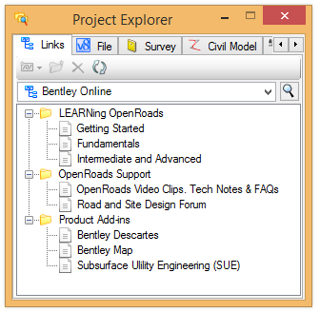
V8i SELECTseries 4 Bentley Civil Workspace
Project Explorer File Linksets
  Learning OpenRoads
  Access to free “QuickStart” introductory training on Bentley Learn
  OpenRoads Support
  Access to video clips, technical notes and FAQ’s on OpenRoads, as well as access to the Road and Site Design Forum.
  Product Add-Ins
  Provides direct access to the Communities Forums for Bentley Descartes, Bentley Map and SUE.

Slide 28
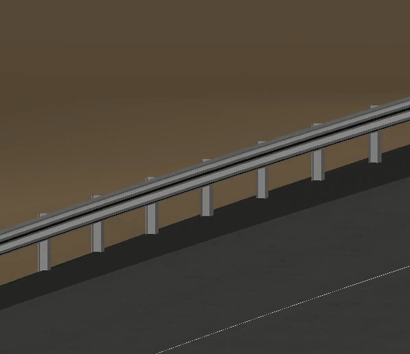
V8i SELECTseries 4 Bentley Civil Workspace
New Point, Linear and Surface Features Added
  Bridge Features
  Structural Features
  ROW Features used for labeling right of way on cross sections
  Guardrail Features used for modeling guardrails in 3D
  Conceptual Design Features used for auto-modeling corridors
  Terrain Model Features added to display triangles and contours at same time
  Many additional Point Features

Slide 29
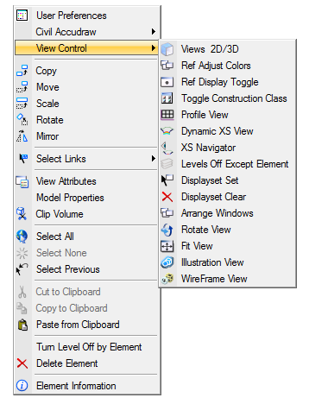
V8i SELECTseries 4 Bentley Civil Workspace
Right-Click View Control Menu
  Combines many of the common view tools for modeling.
View 2D/3D
  Also accessible via F9 function key
  Now maintains screen coordinates
Ref Adjust Colors
  Mutes reference file colors

Slide 30
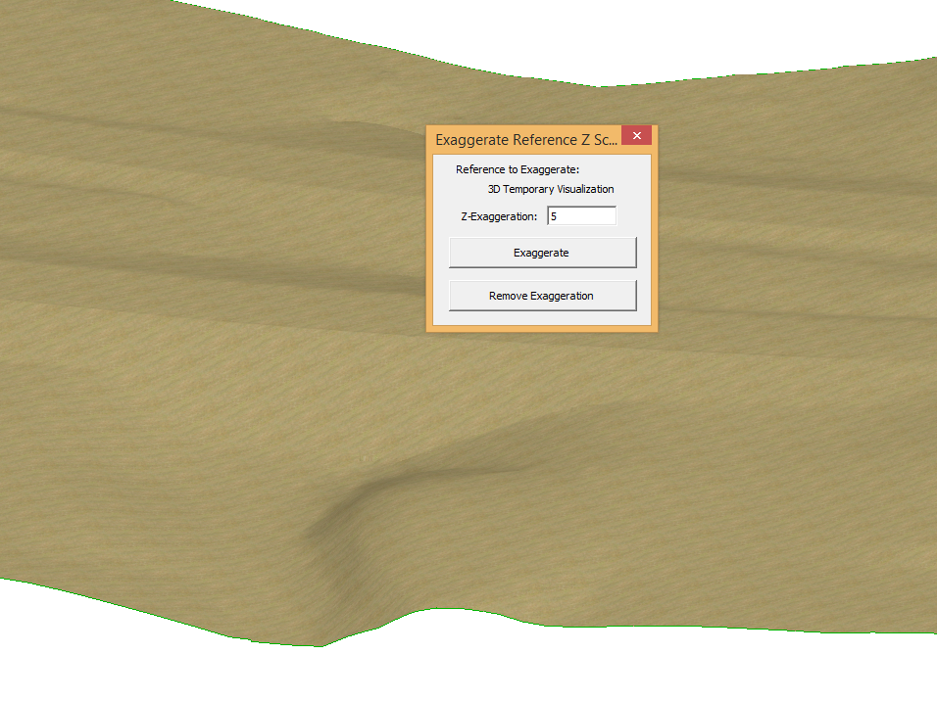
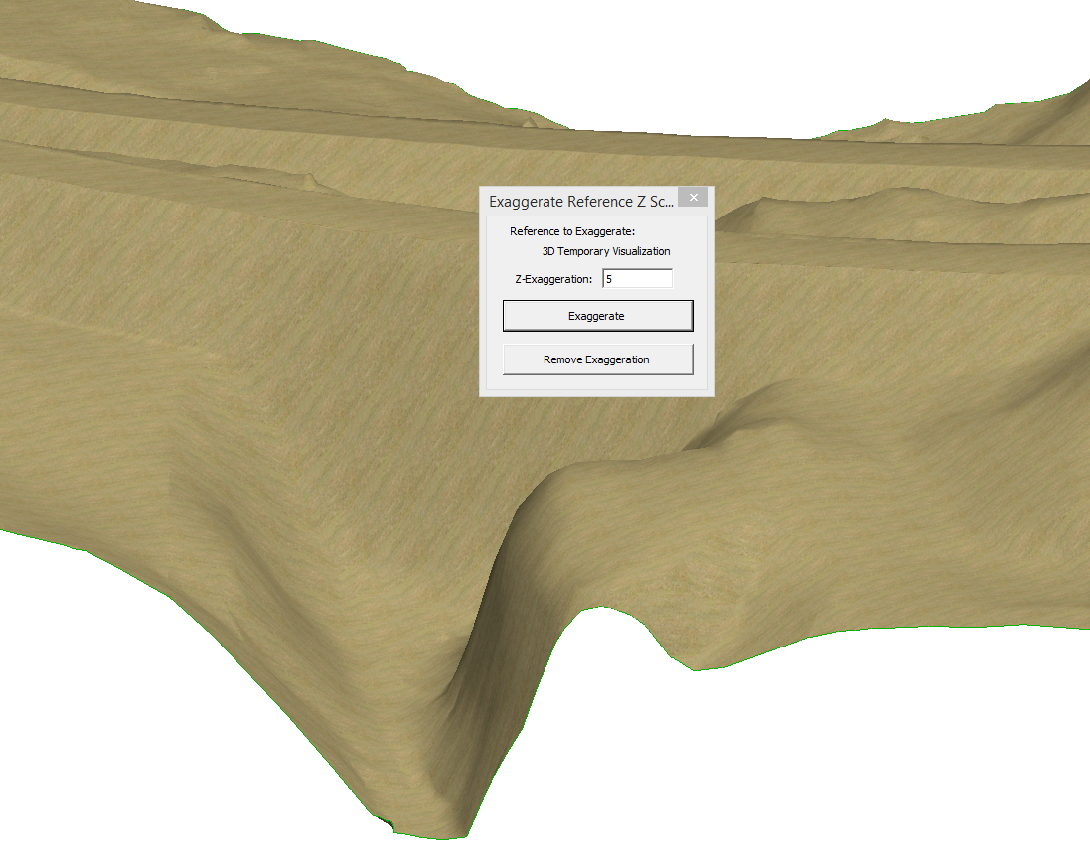
V8i SELECTseries 4 Bentley Civil Workspace
Exaggerate Vertical Z
A new function was added to exaggerate the vertical Z for the purposes of examining a 3D terrain model.
  Accessible using <Shift>+F1.
  Should only be run from the actual terrain model file.
  Creates a temporary visualization DGN model. When the application is dismissed, the temporary DGN model will be removed.

Slide 31
V8i SELECTseries 4 Bentley Civil Workspace
New civil related materials have been added and assigned to the surface features
Minor tweaks to the default survey settings to auto-assign terrain model feature and triangulation method
Added level filters to the metric dgnlib
Compatible with SELECTseries 3 or SELECTseries 4
What’s New in SELECTseries 4 Bentley Civil Examples workspace:
      https://bentley-my.sharepoint.com/personal/chuck_lawson_bentley_com/_layouts/15/guestaccess.aspx?guestaccesstoken=cGoT%2fCIxfzIseXaym35i%2b1fmSKngGsU%2beOrGcWngKL4%3d&docid=0e9a8cd217bf34d0091625a937f80a2da

Slide 32
Model Interoperability
Data exchange between different systems, software, technologies or disciplines is a common requirement.
Yet even today it’s done in bits and pieces. For example, to exchange data we use propriety formats, ASCII formats, LandXML or CAD graphics.
These workflows have their own inherent problems:
All of these are just pieces of the model, and the user on the other side has to continually re-create the missing pieces.
There is a lot of missing intelligence. Most of the formats we use to exchange data are ‘dumbed-down’ in order to be more readily accessible by other technologies.

Slide 33
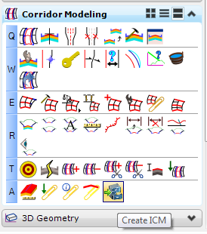
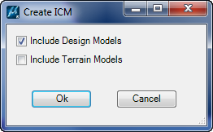
Model Interoperability in V8i SELECTseries 3
In our last V8i SELECTseries 3 Update (08.11.09.722), we introduced the Integrated Civil i-model (ICM).
This is an i-model based on a defined schema that allows other software packages to read and reproduce the entire model.
Notes:
The Infrastructure Consensus Model (ICM) enhances this fidelity using Bentley i-model file format (i.dgn) with an embedded Civil Consensus Model (icm.dgn).

Slide 34
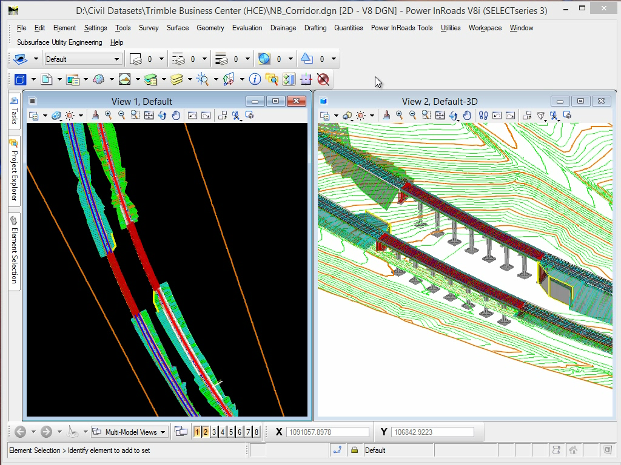
OpenRoads Technology
Notes:
.
Integration of the Luxology rendering engine enables you to aim higher and deliver faster with exceptional speed and quality that produce a high-performance, scalable distributed rendering system.

Slide 35

Model Interoperability in V8i SELECTseries 3
Although we worked closely with Trimble to define this schema, it is not proprietary to Trimble.
The Integrated Civil i-model can be accessed by other applications using Bentley’s Software Development Kit (SDK).
Notes:
The Infrastructure Consensus Model (ICM) enhances this fidelity using Bentley i-model file format (i.dgn) with an embedded Civil Consensus Model (icm.dgn).

Slide 36
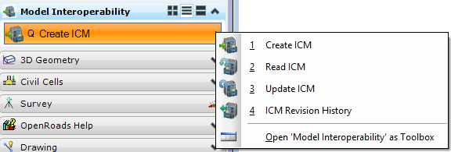
Model Interoperability in V8i SELECTseries 4
In SELECTseries 3 (08.11.09.722), the functionality was limited to creating an Integrated Civil i-model (ICM). In the upcoming release of SELECTseries 4, we have enhanced the functionality to now include the following:
Reading – We have extended the capability of the object model so that OpenRoads can read Integrated Civil i-model’s that have been modified/created in any application that supports them.
Change Tracking – OpenRoads can now compare Integrated Civil i-model’s and display the graphical and property differences between them.

Slide 37
Why are Integrated Civil i-Model’s a better option?
Why are Integrated Civil i-model’s a better option when it comes to exchanging data? Why are they better than LandXML, for example?
There are several advantages:
Provide the entire 3D Model, not just pieces
Get business and engineering data in addition to the graphical data
Ability to manage and track changes in the data
Accurate
Maintain fidelity and provenance
Efficient
Time savings
Protects proprietary investment/knowledge

Slide 38
Where can it be used?
Keep in mind that Integrated Civil i-model interoperability can be utilized with both internal and external data transfer.
For example, within Bentley, other applications will be able to read the Integrated Civil i-Model’s. This can be advantageous when a user needs to move or share data between Bentley products, but still wants to safeguard the data.
Externally, third party products will not only be able to read Integrated Civil i-Models, they will be able to create Integrated Civil i-Models that can then be read by Bentley products.

Slide 39
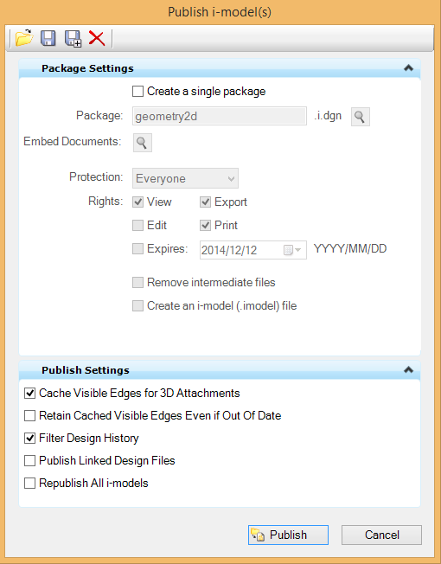
What’s the difference?
Keep in mind that there are now 2 different ways to create an i-model:
Using MicroStation’s File > Publish i-model
This option should be used when creating an i-model for publishing, reporting or presentation purposes.

Slide 40
What’s the difference?
Keep in mind that there are now 2 different ways to create an i-model:
Using Bentley Civil
This option should be used when creating an i-model for data exchange purposes.

Slide 41
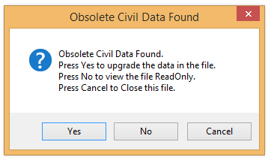
Object Model Change
However, in order to obtain this increased functionality and value inherent in the ability to use the Integrated Civil i-models to exchange and manage data, it does require an object model change within OpenRoads.
Therefore, any OpenRoads civil data created with previous versions of V8i SELECTseries 3 will have to be upgraded when opened with V8i SELECTseries 4.
By default, the following upgrade prompt will be encountered:

Slide 42
New Configuration Variables
If you wish the upgrade prompt to be hidden from the user, there are two configuration variables that can be used to control it’s behavior:
CIVIL_UPGRADE_PROMPT_OFF = 1
When this variable is set, it will hide the upgrade prompt and automatically upgrade the file with no warning (i.e. the upgrade prompt will not appear).
CIVIL_OPEN_OLD_READONLY = 1
When included on its own this variable will do nothing, as it requires the previous configuration variable. However, when both are set, it will hide the upgrade prompt and open the file as read-only without performing any upgrade.
Note: Both of these variables can be set to any value (i.e. what number is used is of no consequence).

Slide 43
FAQ
Q: Is this a DGN format change?
No, it is not a DGN format change, it is a change to civil objects only.
Q: Do I need to update all my dgn files?
No, you do not need to update files that do not contain civil elements (e.g. seed files, MicroStation cell files, border drawings, etc.).
Q: What about reference files?
You do not need to upgrade all your reference files. Only files that contain civil data (survey, horizontal & vertical geometry, terrain, corridor, civil cells, etc.) will require updating, and only when you open them.
For example, if you open a corridor file and upgrade it to SELECTseries 4, you can still process that corridor even if all the references file remain in a SELECTseries 3 format.

Slide 44
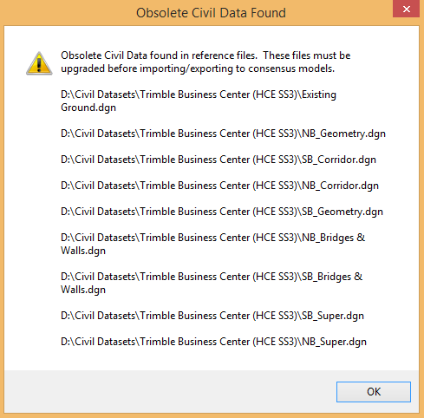
FAQ
Q: Is there any situation where I would need to upgrade all my reference files?
Only one. If you are going to create an Integrated Civil i-model, then all files to be included in the ICM would need to be upgraded.

Slide 45
FAQ
Q: I have a SELECTseries 3 workspace already developed … do I need to upgrade all my dgnlibs?
No. SELECTseries 4 can use dgnlibs that were created with SELECTseries 3. They are used as reference files, so in that sense they do not need to be upgraded.
However, if anyone tried to directly access one of these dgnlibs with SELECTseries 4, it will require upgrading.
Q: If I do decide to upgrade my workspace, do I then have to upgrade all the dgnlibs?
No. As mentioned earlier, only files that contain civil elements (survey, horizontal & vertical geometry, terrain, corridor, civil cells, etc.) will require updating. If the dgnlib only contains features, project settings or design standards but no civil elements, it will not require upgrading.

Slide 46
FAQ
Q: If I have SELECTseries 2 files, will they require upgrading if I open them with SELECTseries 4?
Only if the file contains OpenRoads horizontal geometry data, which was introduced in SELECTseries 2.
Survey files processed with Data Acquisition will not result in an upgrade prompt when opening with SELECTseries 4.
Q: What happens if I try and open SELECTseries 4 civil data using SELECTseries 2?
Just as with previous versions of OpenRoads, you can open a SELECTseries 4 file containing civil data in SELECTseries 2 and you can view the civil elements, but not manipulate them.

Slide 47
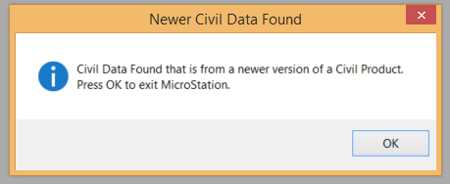
FAQ
Q: What happens if I try and open SELECTseries 4 civil data using SELECTseries 3?
Any OpenRoads civil data created in or upgraded to SELECTseries 4 will not be backward compatible with previous versions of SELECTseries 3.
You will have one option and one option only, and that is to exit.
Q: Is there any way at all to open SELECTseries 4 civil data in SELECTseries 3?
Yes, there are two options:
  You can open it with MicroStation only (no civil).
  You can reference it to a SELECTseries 3 dgn file.

Slide 48
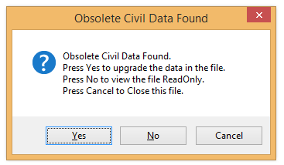
FAQ
Q: Is there any way at all to open a SELECTseries 3 file that contains civil elements in SELECTseries 4 without upgrading?
Yes. You can choose the ‘Read-Only’ option.
Q: Is this version 64-bit?
No.
Q: Is there any ability to ‘batch’ upgrade an entire project?
No.

Slide 49
FAQ
Q: Is there anything else I need to be aware of?
We would suggest going ahead and re-processing your corridor after upgrading. Certain tools, such as the Average End Area tool and Process Cross Sections, will only work if you re-process your corridor.
Q: Can I install all of these SELECTseries products together?
No. Some of the releases share common civil technology and installing them together is not recommended.
Q: So which SELECTseries products can I install together?

Slide 50


Install Combinations
Bentley Civil Products (GEOPAK and/or PowerGEOPAK)
SELECTseries 2 and SELECTseries 3
SELECTseries 2 and SELECTseries 4
SELECTseries 3 and SELECTseries 4
MicroStation
Ruled by the latest Bentley Civil Product installed.
  Refer to Civil Products installation “dependancies” at Bentley’s Software Fulfillment Center.
When installing a new version of MicroStation, we’d recommend that you first un-install the previous version.

Slide 51
Thank You!

Slide 52
ODOTcadd Standards: Configuration
Mark McCloud, CADD and Mapping Services

Slide 53
ODOTcadd Standards: Configuration
What is ODOTcadd?
  Latest release of CADD Standards at ODOT
    Published in January, 2015
  Support for Bentley SELECTseries 3 and Beyond
    Element Templates
    DGN Libraries (DGNLIB’s)
    VBA Application Updates
    Training Materials for GEOPAK Survey
  Deployed as Installation Package
  Quarterly Update
    Q1 – January
    Q2 – April
    Q3 – July
    Q4 - October

Slide 54
ODOTcadd Standards: Configuration
ODOTcadd Configuration Files
  z_ODOT_redirect.cfg (Local / Network)
    C:\ProgramData\Bentley\MicroStation V8i (SELECTseries)\WorkSpace\Standards
  Variables Defined for ODOTcadd
    ODOT_ROOT = c:/ODOTcadd/
    ODOT_STD = c:/ODOTcadd/Standards/
    ODOT_LOCAL = c:/ODOTcadd/Local/
    ODOT_USER = c:/ODOTcadd/BentleySS3/
    ODOT_PROJECT = c:/ODOTcadd/ProjectPCF/
    ODOT_TEMP = c:/Temp/

Slide 55
ODOTcadd Standards: Configuration
ODOTcadd Configuration Files
  z_ODOT_redirect.cfg (Local / Network)
    C:\ProgramData\Bentley\MicroStation V8i (SELECTseries)\WorkSpace\Standards
  Variables Defined for ODOTv8istd
    ODOTSTD : c:/ODOTstd
    V8iSTD : $(ODOTSTD)\V8istd
    HOMEV8i : c:/ODOTcadd/V8iUser/
    V8iSTD_PROJDIR : $(ODOTSTD)/Projects/

Slide 56
ODOTcadd Standards: Configuration
ODOTcadd Configuration Files
  ODOT_Site_V8iSS3.cfg (Site Configuration)
    \ODOTcadd\Standards\config\Standards
    ODOT Site Specific MicroStation/GEOPAK Variables
  User Configuration (Folder)
    \BentleySS3, \BentleySS4
    User Configuration Files (UCF’s)
    Function Keys
    Button Assignments
    User Custom Interface (GUI)
    User Macros
    User Preferences

Slide 57
ODOTcadd Standards: Configuration
ODOTcadd Application Shortcuts
  Used to Configure MicroStation/GEOPAK for ODOTcadd
  ODOTcadd MicroStation SS3
  ODOTcadd GEOPAK SS3
  ODOTcadd GEOPAK SS4
  Used to Configure MicroStation/GEOPAK for ODOTv8istd
  ODOTv8istd MicroStation SS3
  ODOTv8istd GEOPAK SS3
  ODOTv8istd GEOPAK SS4

Slide 58
ODOTcadd Standards: Configuration
ODOTcadd Configuration Utilities
  ODOTcadd Client Configuration Tool
  ODOTcadd MicroStation Utilities
  Demo

Slide 59
ODOTcadd Standards
Project Management Applications
Eric Thomas, CADD Consultant
Office of CADD and Mapping Services
ODOT Consultant Meeting, March 3, 2015

Slide 60
Presentation Overview
This presentation will cover the following topics:
  Project Folder Structure
  Project Configuration Files (PCF)
  New Project Creation
  DGN File Names
  Geographic Coordinate Systems (GCS)
  Change PID Number

Slide 61
Detour…
SS3 to SS4 Updating
  Only required if there is Civil Data in the file
  ODOT’s 3D seed files from the October 2014 release accidently contained Civil Data
  Design files created with SS2 or SS3 using these 3D seed files will prompt for updating
  ODOT will most likely add the variable to automatically update to ODOT_Site.cfg in the next update.

Slide 62
Jan 2015 ODOTcadd Release
New CADD Standards for use with MicroStation and GEOPAK SS3 (and beyond)
New Standards Folder:
  \ODOTcadd\Standards

Slide 63
Jan 2015 ODOTcadd Release
Three Primary Differences between V8istd and ODOTcadd:
  New Project Folder Structure
  New DGN File Names
  Modified Sheet Cells (tags)

Slide 64
Jan 2015 ODOTcadd Release
These changes impact multiple ODOT VBA applications
Current projects should be completed using \ODOTstd\V8istd

Slide 65
Project Folder Structure
Updated based on input from all 12 District offices
Includes folders for specific workflow applications
Intended to be used for the lifecycle of the project
All data related to the project stored in the same location

Slide 66
Project Folder Structure
Two new folders for new projects and configuration files:
  I:\ProjectData
  I:\ProjectPCF

Slide 67
Project Folder Structure
PID is the parent folder for the project
  County folders above the PID are optional
  PID numbers may be supplemented with an optional description
  Examples:
    I:\ProjectData\11111
    I:\ProjectData\11111_AAA-111-12.34
    I:\ProjectData\AAA\11111
    I:\ProjectData\AAA\11111_AAA-111-12.34

Slide 68
Project Folder Structure
5 sub-folders under the PID
  Construction
  Design
  Environmental
  ProjAdmin
  ReaLEstate
The Design folder is used for plan production

Slide 69
Project Folder Structure
Design Folder contents:
  No longer using the Major/Minor project designation
  Optional discipline specific \Design sub-folders created as needed
      Aerial, Drainage, Geotechnical, Landscape, Lighting, MOT, RW, Signals, Structures, Traffic, Utilities

Slide 70
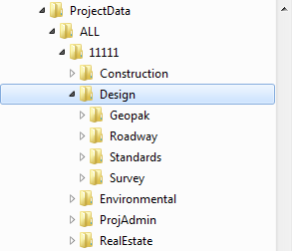
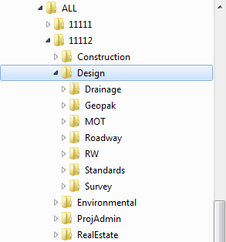
Project Folder Structure
  The \Design\Roadway folder is used in the absence of discipline folders
    Examples:

Slide 71
Project Folder Structure
ODOT_CreateNewProject.exe
  Creates the project folder
  Creates the MicroStation PCF file
  Creates project specific files:
    Seed files
    Template Library
    Survey Basemap
    GCS .dty file

Slide 72
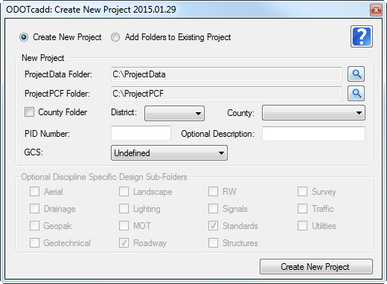
Project Folder Structure
ODOT_CreateNewProject.exe Demo

Slide 73
Design File Names
An underscore is inserted after the PID number for readability
    11111_BE001.dgn
    11111_BP001.dgn
The use of multiple models within Sheet files is acceptable.
    Only sheets of a like type are permitted
    One Sheet Per Model

Slide 74
Design File Names
ODOT_CreateNewProject.exe creates three design files for the project:
    \Design\Survey\Basemaps\#####_BE001.dgn
    \Design\Standards\seed\#####_Seed2d.dgn
    \Design\Standards\seed\#####_Seed3d.dgn

Slide 75
PCF FIles
ODOT using MicroStation Project Configuration Files (.pcf) for new projects
PCF files define project specific configuration variables
ODOT_CreateNewProject.exe creates the PCF file for the project

Slide 76
PCF Files
Stored in the \ProjectPCF folder
The variable ODOT_PROJECT (defined in the Redirect file) defines the location of the ProjectData folder
    ODOT_PROJECT = I:/ProjectPCF

Slide 77
PCF Files
The configuration variable _USTN_PROJECTDATA is necessary for some of the ODOTcadd Standards
    This variable defines the starting folder for MicroStation when the PCF file is selected
    Set to the …\PID\Roadway\Design folder
The variable ODOT_PID is added to define the PID number

Slide 78
PCF Files
MicroStation files MUST be opened from the MicroStation File Open dialog
  MicroStation is opened by a Desktop Shortcut to select the CADD Standards
  The PCF File is selected for the project
When the PCF file is selected, MicroStation will default to the \Design folder for the project

Slide 79
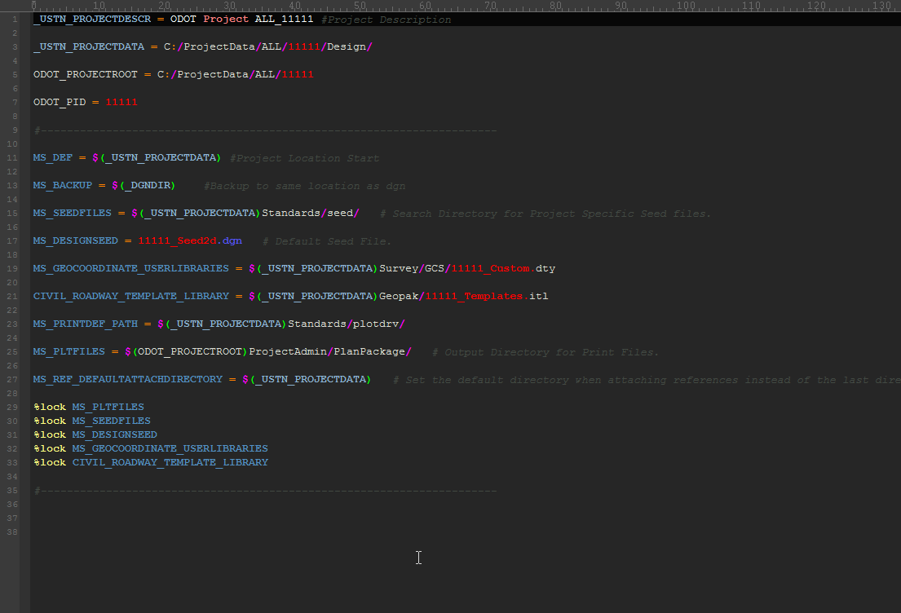

Slide 80
Geographic Coordinate Systems
Geographic Coordinate Systems (GCS)
  Allow users to specify the position of the design contents on the earth´s surface
  Provides integration with other geo-referenced processes
  The GCS for a project can be defined using the appropriate State Plane Zone or defined using a custom CGS to define a project specific ground coordinate system

Slide 81
Geographic Coordinate Systems
ODOT_CreateNewProjects.exe
  Allows the selection of State Plane coordinate systems
  Copies a MicroStation .dty file into the \Design\Survey\GCS folder
    The DTY file is used to define custom GCS definitions for grid-to-ground conversions
    Bentley Map is used to create custom GCS definitions

Slide 82
Geographic Coordinate Systems
ODOT_CreateNewProjects.exe
  Creates project specific seed files in the \Design\Standards\Seed folder
  These seed files are named using the PID number for the project
  The Seed files are set to the GCS defined when the project is created
  The variable MS_SEEDFILES is defined in the PCF file for the project

Slide 83
Geographic Coordinate Systems
Grid or Ground?
  The decision to use a custom GCS should be made before the project is started
  The intent of the custom GCS is to identify the data location on the earth surface, not to apply the transformation on the fly
  The GPK file is not adjusted when the GCS is changed

Slide 84
Geographic Coordinate Systems
Use of a GCS is recommended, but not required
  We have seen problems applying the GCS to design files and have logged these problems with Bentley
If a custom GCS is defined, the Survey Basemap and Seed Files for the project must all be updated with the GCS definition

Slide 85
Geographic Coordinate Systems
Demonstration…

Slide 86
Geographic Coordinate Systems
Remember, the decision as to whether the data is on the grid or on ground should be made before the project is started
If a custom GCS for Ground Coordinates is used, it should be applied before to the seed files and Survey basemap any other work is done on the project

Slide 87
Geographic Coordinate Systems
For more information:
  Search Bentley Communities for the following PDF:
    U.S. Coordinate Systems in MicroStation V8i & Bentley Map V8i
  See ODOT’s OpenRoads Survey training guide
\ODOTcadd\Standards\ODOT\Training\Guides

Slide 88
Change PID Number
Occasionally work is started on a project before a PID number is assigned
ODOTcadd_ChangePID.exe is used to facilitate changing PID numbers
  ODOTcadd_UpdateActiveGCS.mvba can be used after editing the GCS name to apply it to all the dgn files/models in the project

Slide 89
Change PID Number
ODOTcadd_ChangePID.exe
  Renames the PCF
  Edits the PCF
  Renames the PID folder
  Renames all occurrences of the PID number in any file name found under the PID folder
  Opens ever MicroStation file/model to correct reference file attachments

Slide 90
Change PID Number
ODOTcadd_ChangePID.exe does NOT do the following
  Does not edit PID number occurrences within MicroStation text elements or other documents
  Does not edit the GCS Name (it does change the .dty file name, but not the GCS definition)

Slide 91
Change PID Number
Will be released with the April CADD Standards update
Caution!

Slide 92

Contact Info
ODOT:
Eric.Thomas@dot.state.oh.us
Consulting:
eric@ericthomasconsulting.com

Slide 93
ODOTcadd Standards
VBA Application Updates
Eric Thomas, CADD Consultant
Office of CADD and Mapping Services
ODOT Consultant Meeting, March 3, 2015

Slide 94
Presentation Overview
This presentation will cover the following topics:
  ODOT_Files.exe
  Use of Multiple Sheet Models
  Changes to Sheet Cells
  Sheet Manager and XS Sheet Manager
  Sheet Model Properties
  Sheet Cross References

Slide 95
Jan 2015 ODOTcadd Release
New CADD Standards for use with MicroStation and GEOPAK SS3 (and beyond)
New Standards Folder:
  \ODOTcadd\Standards
Current projects should be completed using \ODOTstd\V8istd

Slide 96
Jan 2015 ODOTcadd Release
The VBA applications covered today are relevant to new projects started with the ODOTcadd Standards

Slide 97
ODOT_Files.mvba
Revised for ODOTcadd Standards
  Uses the new folder structure
  Uses the new file names
  Allows creation of multiple sheet models
  Added more sheet cell types
  Uses the _USTN_PROJECTDATA variable
  Uses the ODOT_PID variable

Slide 98
ODOT_Files.mvba
Access from the MicroStation Pull-Down Menu:
  ODOT > File Management > Create Design Files

Slide 99
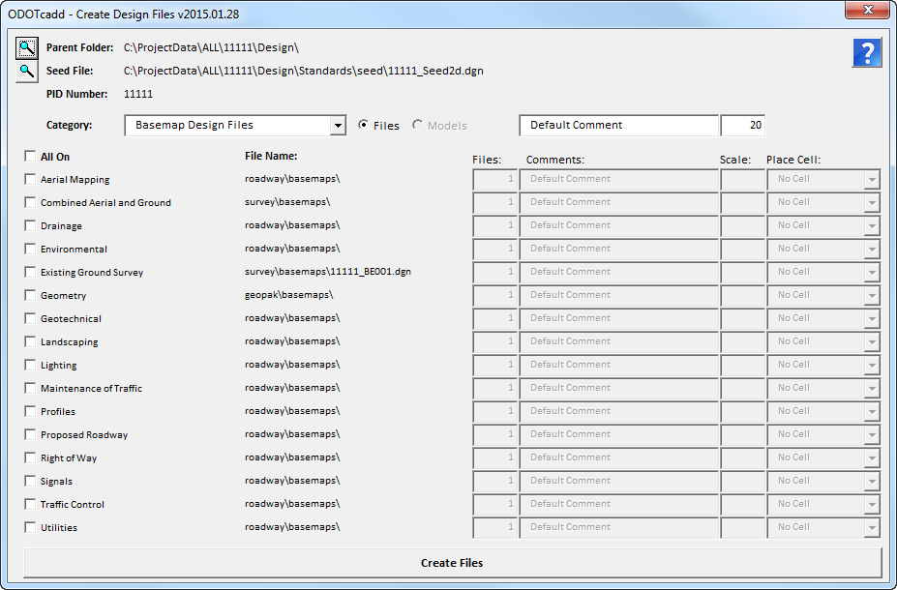

Slide 100
ODOT_Sheets.Cel
Data Entry Regions replaced by MicroStation Tags
Every Sheet Title Block attribute has been assigned a Tag Element
Tags accessed programmatically or with ProjectWise

Slide 101
ODOT_Sheets.cel
Tags are assigned to the Cell Header
    If the cell is dropped, the tags are lost
Cells that are commonly dropped for editing are split into two cells. Ex:
    TITLE1
    TITLE1_INTERIOR

Slide 102
Sheet Manager Apps
Two new apps:
  ODOT_SheetManager.mvba
    Allows manipulation of all sheet title block attributes
    Uses the _USTN_PROJECTDATA variable
  ODOT_XSSheetManager.mvba
    Specifically optimized for multi-model cross section sheet design files

Slide 103
Sheet Manager Apps
ODOT_SheetManager.mvba
  Reads/Writes Tags contained in ODOT’s Sheet Cells
  Supports Multi-Model Sheet Files
  Allows single-file or bulk editing
  Import/Export to Excel option
    Data is not linked

Slide 104
Sheet Manager Apps
ODOT_XSSheetManager.mvba
  Optimized for Cross Section sheets
  Used to annotation XS Sheet information
  Works with multi-model xs sheet files
  Normally run before using the general sheet manager application

Slide 105
Sheet Manager Apps
Access from the MicroStation Pull-Down Menu:
  ODOT > Sheet Management > Sheet Manager
  ODOT > Sheet Management > XS Sheet Manager

Slide 106
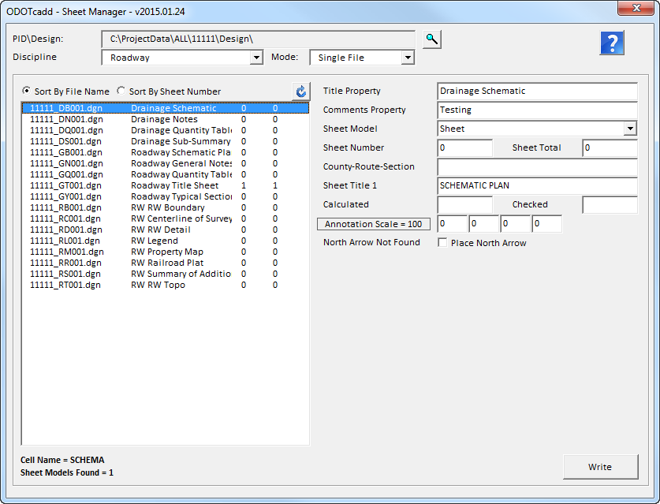

Slide 107
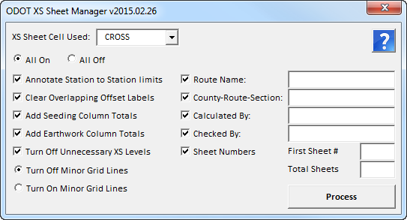

Slide 108
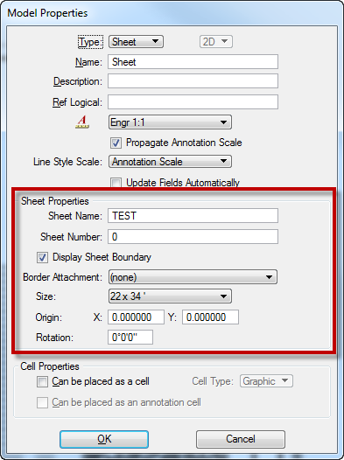
Sheet Model Properties
ODOT VBA apps turn on the Model’s Sheet Border
    ODOT_Files
    ODOT_Sheets
    ODOT_XSSheetManager
    ODOT_SheetManager

Slide 109
Sheet Model Properties
The Model’s Sheet Border is placed at the active Annotation Scale
The Sheet Name property can be used for the name in a multi-page PDF
    Populated by the Sheet Manager applications
ODOT may (will?) transition to using the Model sheet border for plotting

Slide 110
Sheet Cross References
New application for ODOTcadd
  ODOT_SheetCrossRefs.mvba
Reads Tag elements from ODOT Sheets
  Does NOT read Data Entry Regions
  NOT compatible with legacy projects

Slide 111
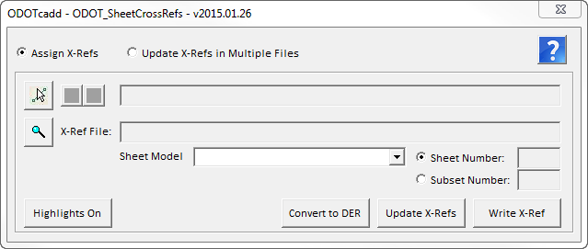
Sheet Cross References
Access from the MicroStation Pull-Down Menu:
  ODOT > Sheet Management > Cross References

Slide 112
Contact Info
ODOT:
Eric.Thomas@dot.state.oh.us
Consulting:
eric@ericthomasconsulting.com

Slide 113
Every Day Counts Initiative for 3D Engineered Models
Mark McCloud, CADD and Mapping Services

Slide 114
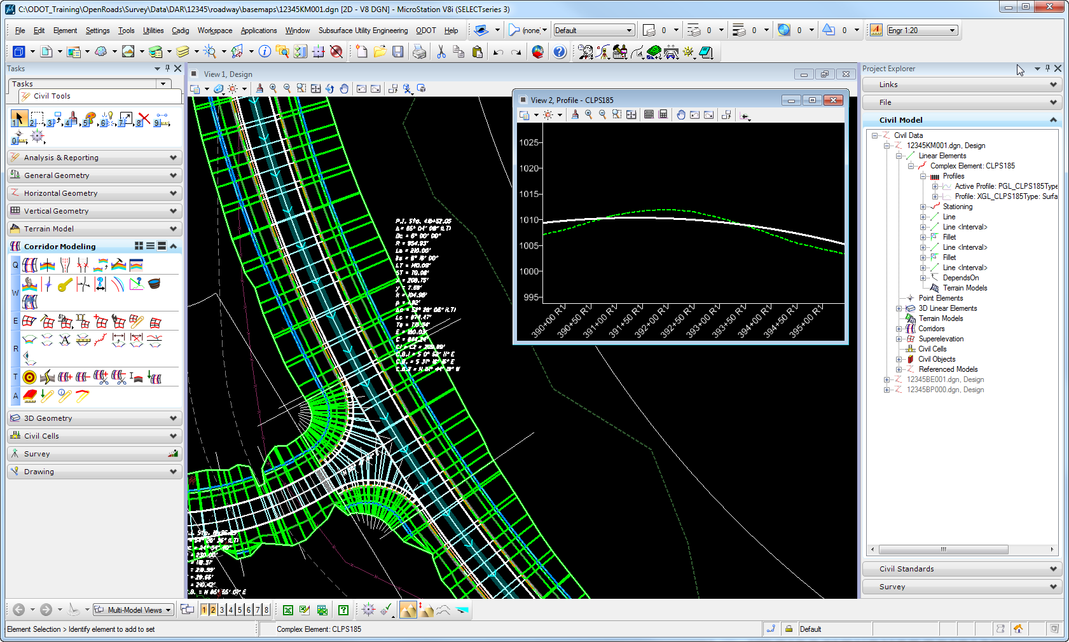
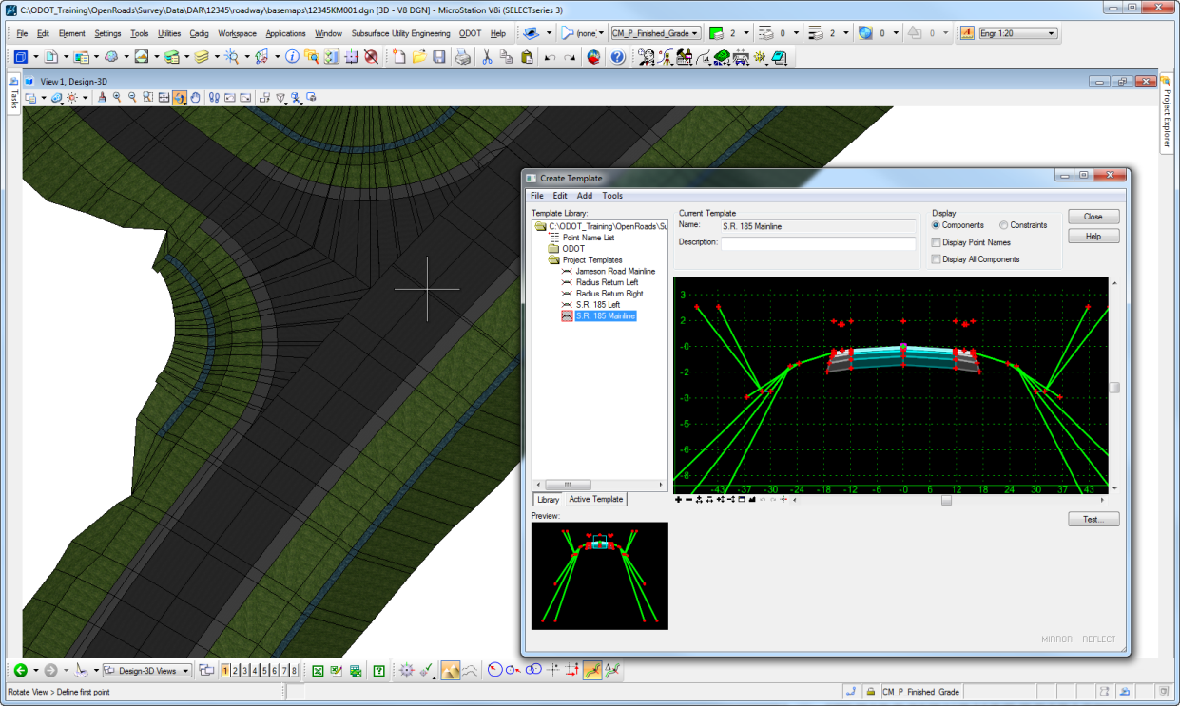
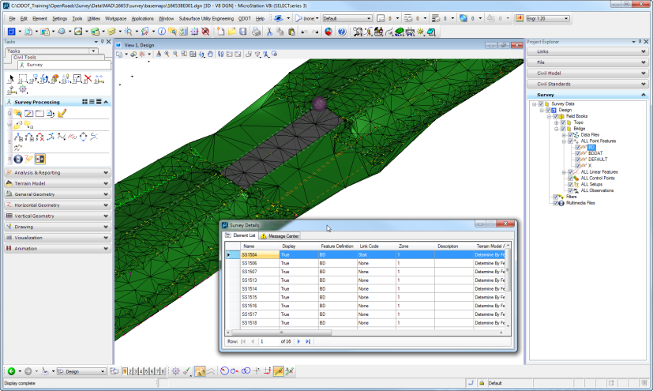
FHWA Every Day Counts
Initiative for 3D Engineered Models
Develop tools and workflows in CADD to create 3D engineering models to be used with automated machine guidance (AMG), for use in earthmoving equipment.

Slide 115
EDC Initiative for 3D Engineered Models
March, 2014
  FRA-71-5.29 (PID: 84868) Project Selected
  Consultant - E.L. Robinson Engineering
  Bentley SELECTseries 3 with OpenRoads Technology not Ready
  Based on current technology from GEOPAK SELECTseries 2
  Basic workflow concept for corridor modeling and roadway design will move forward into GEOPAK SELECTseries 3 with OpenRoads Technology
August, 2014
  Generate List of Electronic Deliverables
  3D Triangles, 3D Linestrings, LandXML Surfaces, Bentley i-Model
  Contractor - Shelly and Sands
  Contractor - Kokosing Construction
  Contractor - Great Lakes Construction

Slide 116
EDC Initiative for 3D Engineered Models
December, 2014
  FRA-71-5.29 (PID: 84868) Final Tracings
  670 Plan Sheets
  Coordinate with Consultant to Submit Listed Electronic Deliverables
February, 2015
  Consultant Delivered 3D Model for FRA-71-5.29 (PID: 84868)
  ODOT to Start 3D Model Review
July, 2015
  FRA-71-5.29 (PID: 84868) Project Sale Date July 16th, 2015
  3D Model to be used as Bid Document
  3D Model to be the Contract Document for Earthwork Quantities
  Awarded Contractor will supply 4D Modeling Schedule for Construction Phasing and Earthwork Quantities
  Awarded Contractor will supply some As Built Information

Slide 117
EDC Initiative for 3D Engineered Models
ODOT’s Implementation Plan to Support 3D Models
  March, 2014
    Survey Staff Trained in GEOPAK Survey SELECTseries 3
    District Survey Departments Upgraded to SELECTseries 3
    First DOT to Implement GEOPAK Survey SELECTseries 3
  October, 2014
    Preliminary release of MicroStation/GEOPAK SELECTseries 3 CADD Standards
    OTEC Presentation
    Gather Feedback from Districts and Consultants
  February - March, 2015
    Select group of ODOT designers to receive GEOPAK SELECTseries 4 training and coordinate testing among districts
    GEOPAK SELECTseries 4 First Look Class Scheduled Next Week
    Gather Feedback from Districts and Consultants

Slide 118
EDC Initiative for 3D Engineered Models
ODOT’s Implementation Plan to Support 3D Models
  January - May, 2015
    GEOPAK SELECTseries 4 Testing
    CADD Standards Updates (Files, Manuals, Training Materials)
    Development District Training Schedule for SELECTseries 4
    Possible Project Scoping Process for Receiving 3D Models
    Possible Plan Note(s) for 3D Models
    Lockdown Deliverables for 3D Models
  May - June, 2015
    Statewide CADD Desktop Purchase (HP Z230 Workstations)
    Standard CADD Software Build Developed and Deployed on new Desktops
    MicroStation SELECTseries 3
    GEOPAK SELECTseries 4

Slide 119
EDC Initiative for 3D Engineered Models
ODOT’s Implementation Plan to Support 3D Models
  June - September, 2015
    Begin Full Implementation and Training of SELECTseries 4
    1 - 2 Weeks Per District for Onsite Training
    Supplemental Online Training through Bentley LEARN
    Standardization of new Project Folder Structure and File Naming within ODOT for all new SELECTseries 4 projects
    Plan dependent on Bentley’s Software Release Schedule

Slide 120
EDC Initiative for 3D Engineered Models
Learn More About EDC Initiatives for 3D Modeling
  http://www.fhwa.dot.gov/construction/3d/

Slide 121
Questions and Answers

