Slide 1
OHIO DOT CADD Users Group
September 6th, 2023
Notes:
Welcome and intro

Slide 2
House Keeping Items
No CPDs for this meeting
Please mute yourself until open discussion
  Please use the chat to ask questions
Recording will be posted by end of the week on wiki page
https://communities.bentley.com/communities/user_communities/ohio_dot__consultants/w/ohiodot---wikis/68432/september-6th-2023

Slide 3
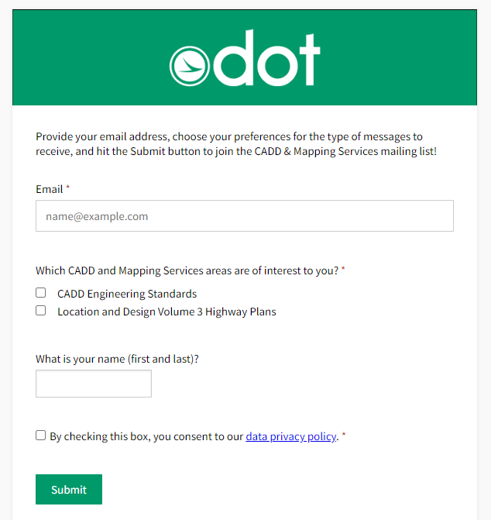
General Updates
Reminder that our E-mailing list is now using GovDelivery
  Ohio Department of Transportation (govdelivery.com)

Slide 4
DBE Knowledge Cafes
In response to the survey recently completed by DBE Firms concerning various software utilized for ODOT design work.
A Knowledge Café is an open discussion with a subject matter expert on a specific topic. It provides some foundational information on the topic, but more importantly it allows participants to ask questions and receive answers on the topic.
The Knowledge Cafes will be held virtually via Microsoft Teams. If you do not have this software, don’t despair. As long as you have an internet connection, you will be able to join the café via a web browser page.
Also please note that Knowledge Cafes are not recorded. This is on purpose because we want there to be a free flow of questions without concern of the questions being recorded.
The Knowledge Cafes are being hosted as a joint effort by the ODOT CADD Section, the Office of Diversity and Inclusion Supportive Services Program and the Ohio LTAP Center.
We look forward to your participation in an upcoming Knowledge Café!

Slide 5
DBE Knowledge Cafes - Schedule
All Knowledge Cafes will be held on the last Wednesday of each month from 2 PM to 3PM eastern.
September 27th - Meet & Greet with ODOT CADD Section
October 25th – CADD Standards: Setting Up
November 29th – CADD Standards: Details on Standards (e.g. Folder Structure, File Naming, etc.)
January 31st – Custom Applications
February 28th – Digital Signatures
March 27th – Survey
Teams invites have already been sent out!

Slide 6
Ohdot’s move to
ORD 10.12
Matt Eiben
John Drsek P.E.

Slide 7
OHDOT’s Move to ORD 10.12
August 10th, 2023
Civil labeler .dgnlib was added and configured
August 14th, 2023
August 15th, 2023
Sept. 2nd, 2023
Sep. 6th, 202
OHDOTCEv02 updated to work with ORD 10.12
Email send out about update to CADD mailing list.
Email sent to all external users who have logged into OhioDOT’s datasource with in the past 90 days informing them.
ODOT users were updated to ORD 10.12.02.04
User Group Meeting

Slide 8

OHDOT’s Move to ORD 10.12: does this Affect me?
OHDOT has never required Externals to use a specific version of ORD. They can move ahead of us, with us, or behind us.
  Care needs to be taken to make sure everyone working on a given project is using the same civil schema version.
  Sync tool helps to make sure your copy of OHDOTCEv02 workspace is up to date as well as stays compatible with the desired civil schema.

Slide 9
OHDOT’s Move to ORD 10.12: What should I Do?
Two Options:
  Maintain single OHDOTCEv02 workspace copy
    Update all users to ORD 10.12
    Update workspace to 10.12
    Let projects/.dgn files get civil schema update as users open them.
  Maintain multiple OHDOTCEv02 workspaces, one for each civil schema you want to use.
    Side by side install ORD versions for all users
    Set up workspace copies for each civil schema
    Worksets (projects) are specific to a workspace
      Users need to know to use the correct version ORD with for a given project
      Configuration can help prevent users from accidentally opening a project file with the wrong version of ORD.
      Time Stamped Link to 9-21-2021 user group meeting going over side by side installs and JD’s Recommendations

Slide 10
OHDOT’s Move to ORD 10.12: Working inside OHDOT DS
What if I'm a consultant working inside OHDOT’s ProjectWise DataSource?
While we don’t dictate which ORD version has to be used, if you're inside our PW DataSource then you must use what is compatible with what we set up.
What needs to be done?
If you’re an Ohio DOT employee, the new version of ORD was already pushed to your machines on September 2nd, 2023.
If you’re not an Ohio DOT employee AND use ORD within Ohio DOT’s ProjectWise Datasource, you will need ORD 10.12 installed on your machine as of September 2nd, 2023.
OHDOT’s PW DataSource does not have a OHDOTCEv02 workspace for different civil schemas.
We only have one OHDOTCEv02 workspace and it's kept up to date with our latest workspace updates.

Slide 11
OHDOT’s Move to ORD 10.12: Working inside OHDOT DS
ORD supports side by side installations (since ORD 10.10). You can have multiple versions of ORD installed.
What if I still need ORD 10.10 or other ORD versions for other clients?
Ohio DOT is not maintaining multiple copies of our workspace in our Datasource to work with each version of ORD.
What if I don’t want to update?
If you do not wish to update ORD, you may not be able to work on CADD files from within our ProjectWise Datasource.
When opening files within Ohio DOT’s ProjectWise Datasource ensure that your opening .dgn files with the correct version of ORD (“Right Click > Open With…” can be used to ensure the correct product is being used).
For more information on side by side installs see this wiki page.

Slide 12
OHDOT’s Move to ORD 10.12: Working inside OHDOT DS
What if I can’t update until after September 2nd, 2023?
There are two main issues to watch out for.
If you are working on a project that Ohio DOT is also working on (collaboration projects), then you might run into compatibility as files being edited by Ohio DOT will start to get their civil schema’s updated.
Currently the workspace within Ohio DOT’s datasource is compatible with ORD 10.10 (since the August 10th, 2023, update). But whenever the next update is pushed the workspace will no longer be compatible with ORD 10.10 and you will start to see compatibility issues like not being able to see feature definitions. We will try to delay the next update to provide organizations some more time to get ORD 10.12 installed but eventually this will have to happen.

Slide 13
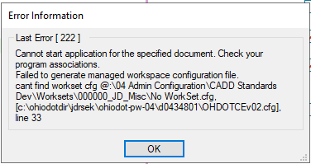
PW Managed workspace problem
Introduced with MSCE update 17
  Every time you load a different workspace it breaks the managed workspace.
    Bentley Defect:94175
        Lock variables higher in config, since we dynamically find workset this doesn’t work

Slide 14
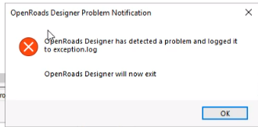

Managed workspace problem: Solutions
Best Solution!
  Clear and lock _USTN_CACHECFG and _USTN_CACHEWSCFG
  MUST BE AT PREDEFINED CSB LEVEL TO WORK!
    Have noticed in some cases an error message is shown when closing the file

Slide 15
PW Managed workspace problem: Solutions
Manual fix
  Delete the cache.ucf file
    C:\Users\<username?AppData\Local\Bentley\OpenRoadsDesigner\10.0.0_X\prefs\
Configure run on open vba.
  Needs to be set for all ORD configurations or wont work 100% of the time.
  startupManagedWSFix.mvba

Slide 16
PW Managed workspace problem: Solutions
To set up startupManagedWSFix.mvba
  Set the following two config vars
    MS_VBASEARCHDIRECTORIES > [folder path containing vba]
    MS_VBAAUTOLOADPROJECTS > [folder path containing vba]\startupManagedWSFix
  Download: https://ftp.dot.state.oh.us/pub/CADD/CADDSync/startupManagedWSFix.mvba
  Within PW data source, best to set up in Predefined!
  If you work inside and outside of ProjectWise consider added at Organization level to all Configuration locations
    Again, problem only within PW Datasource!
  This will make it, so your last used Configuration is not saved! (which doesn’t matter when your only within PW)

Slide 17
PW Managed workspace problem: Solutions
Cont: To set up startupMangedWSFix.mvba
  Downfall is this runs ever single time a dgn file is opened!
  Unfortunately, MS_VBAAUTOLOADPROJECTS is reset in the OHDOT_WorkSpace.cfg and OHDOT_v2_WorkSpace.cfg files.
  OHDOT (v1) workspace is retired, need to manually fix this line (change = to < or >)
  OHDOTCEv02 workspace has updated the OHDOT_v2_WorkSpace.cfg file already (since 9-1-2023)
OHDOT’s PW DS has this set at the predefined level already!
Waiting on true fix from Bentley
How do I fix the "Last Error [222]" message when opening a file in 10.12? - OhioDOT - Wikis - Ohio DOT & Consultants - Bentley Communities

Slide 18
L&D Vol. 3 Updates
John Drsek P.E.

Slide 19
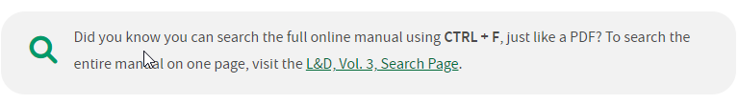
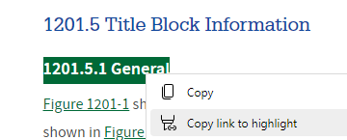
L&D Vol. 3 Updates
Location & Design Manual, Volume 3 - Highway Plans | Ohio Department of Transportation
Text searchable webpage added!
Link to anywhere on the page

Slide 20
L&D Vol. 3 Updates
SS800 Date
  July 21st 2023 DRRC update put the SS800 date BACK on the title sheet. (it was moved to the proposal on 7/15/2022 update)
  The SS800 date SHOULD be the current date at the time of filing unless this effects design and there is not enough time/resources to incorporate latest spec changes.
  Care should be taken to keep design up to date with spec changes.
  Effective for all plans Filing ON or after 7/21/2023!
  SCD app has been updated to no longer put SEE PROPOSAL as the SS800 date and be able to set the date like it has in the past.

Slide 21
L&D Vol. 3 Updates
Guidelines for Electronic Deliverables has been moved!
  Released in the 7/21/2023 DRRC Update.
  It is now Section 1600 of L&D Vol. 3!
  Content is still the same

Slide 22
L&D Vol. 3 Updates
OHDOT CADD Engineering Standards Manual will be moved into L&D Vol. 3 with the 1/19/2024 DRRC Update.
As you can tell we are making an effect to combine manuals and minimize the number of locations needed to find information.
We are also working on updating outdated language throughout the manual.

Slide 23
Open Discussion

Slide 24
Questions
?

