Slide 1
OHDOT’s move to a new Civil Schema and what it means for you

Slide 2
Agenda
Compatibility Overview
WorkSpace Updates
Scenarios
  Working Inside OHDOT’s ProjectWise Datasource
  Working outside OHDOT’s ProjectWise Datasource
    Setup/config options

Slide 3
What causes a Compatibility Issue
Anytime Bentley changes the Civil Schema within their OpenX products (OpenRoads Designer, OpenBridge Modeler, OpenRail, OpenSite…)
This is indicated when the first 2 parts in the version changes.
Version Number Part | Description
AA.BB | First two version number parts correspond to a major version, where: AA – last two digits of the major version year, BB – major version sequence number.
CC | Minor version number. Value is reset to “00” when incrementing AA or BB.
DD | Build number. Value is reset “01” when incrementing any other version part.

Slide 4
What causes a Compatibility Issue-Examples
Product Name | Version Number | Description
OpenRoads Designer 2023 | 23.00.xx.xx | Major version – 2023 Schema change*
OpenRoads Designer 2023 | 23.00.01.xx or 23.00.02.xx | Major version – 2023, Minor version(s) No schema change
OpenRoads Designer 2023 Update 1 | 23.01.xx.xx | Major version – 2023 Update 1 Schema change
OpenRoads Designer 2023 Update 1 | 23.01.01.xx or 23.01.03.xx | Major version – 2023 Update 1, Minor version(s) No schema change
OpenRoads Designer 2023 Update 2 | 23.02.xx.xx | Major version – 2023 Update 2 Schema change
OpenRoads Designer 2024 | 24.00.xx.xx | Major version – 2024 Schema change*
See Lifecycle Policy FAQs: https://www.bentley.com/support/bentley-lifecycle-policy/

Slide 5
Current workspace: OHDOTCEv02
We do not maintain multiple workspaces for each civil schema.
We simply update the OHDOTCEv02 workspace over time.

Slide 6
Workspace update TimeLIne
We push out updates to our workspace on an as needed bases.
There is a running updates doc that details all updates.
Emails about posted updates are sent to our mailing list (Please subscribe to our CADD email List)

Slide 7
Updating Workspace OPtions
Within OHDOT’s PW Datasource
  Updates handled by OHDOT
Outside OHDOT’s PW Datasource
  Use workspace ZIP file downloads
    Only the latest zip file is updated (older ones don’t get updated over time)
  User WorkSpace Sync tool
    Only brings down changes since last sync
    Select civil schema to maintain compatibility with
    Even if syncing for older civil schema all non-civil schema related updates will still be brought down.

Slide 8
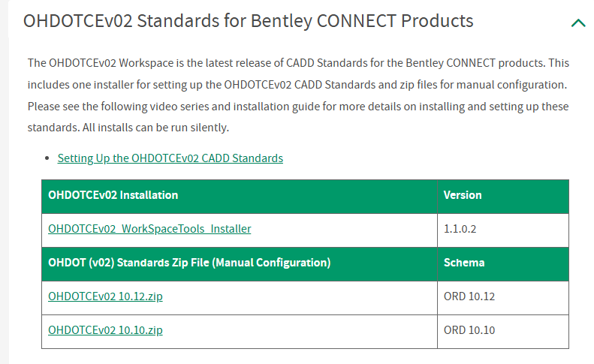
Updating Workspace OPtions
CADD Standards Downloads | Ohio Department of Transportation

Slide 9
Updating workspace for new civil schema
When OHDOT decides to move to a new OpenX year/major version (new civil schema) an email will be sent out to our mailing list notifying everyone what date the move will happen internally.
Current CADD Software | Ohio Department of Transportation
All external users who have logged into our Datasource will also receive email notification as well to let them know what version of ORD they will need installed to continue working on CADD files within our Datasource and not run into compatibility issues.

Slide 10
Updating OHDOT’s workspace for new civil schema
There will be some buffer time built in
  We wont you're any compatible issues in our workspace until after internal OHDOT users have their software updated (typically at least a month after the date indicated in the email to give some extra buffer time for externals to get updated).
  That means if you're using the Workspace Sync tool or looking for a new workspace zip file to download for the new civil schema, you won’t see that option till about a month later.

Slide 11
Scenarios
Working inside OHDOTs ProjectWise Datasource
Working outside OHDOT’s ProjectWise Datasource
No mandate on what OpenX version (civil schema) to use.
Free to move ahead or lag behind the OpenX version ODOT is using internally.
Just make sure all users working on a giving project are using the same civil schema to avoid compatibility issues.
Must use the same OpenX Year/major version (civil schema) OHDOT is using internally.
ODOT does not maintain compatibility with older civil schemas inside our PW Datasource.
All CADD standards are maintained/configured within the datasource.
No local/end user configuration needed
Simply load the dgn file with the correct version
Free to setup and configure workspace as desired.

Slide 12
Working Outside OHDOT PW Datasource
Two Options for setup and config
Don’t maintain compatibility with older civil schemas
Only need one copy of our workspace
Maintain compatibility with older civil schemas
Need separate copies of our workspace (one for each civil schema)
Need to keep workset cfg files separated by civil schema

Slide 13
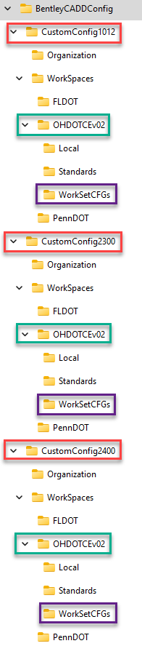
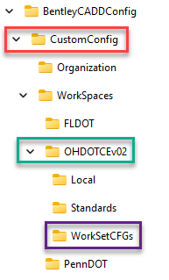
Setup/config options
Ohio DOT & Consultants - Getting Starting with OhioDOT CADD - Communities
Maintaining compatibility with older civil schemas
Don’t maintain compatibility with older civil schemas
Civil Schema Separation
Separate OHDOTCEv02 workspace copies specific to civil schema
WorkSet configs separated by civil schema
To move from an older civil schema to a newer on, simply move the Workset config file to the desired WorkSetCFGs folder!

Slide 14
Thank you

