Slide 1
ODOT District 8
48” Pipe Remove and Replace Dispute
Project CLE103954 21-0591

Slide 2
Backstory on Pipe
48” pipe (D-18) installed under Bach Buxton Road, North of SR 32, May 2022
Built before Bach Buxton Road fill was placed. Max fill is 26-27’ over 48” pipe. Fill completed August 2022
Encountered unsuitable soils, performed 1’ undercut of material, replaced with ODOT 57s after discussion with ODOT (CMS 611.05)
Pipe developed 12” sag, 10% deflection, by the time the first inspection was performed Oct 2022
Determined to monitor the pipe for the remainder of job. January 2025 report shows 13% deflection; CMS 611.13 allows max of 12% before total replacement

Slide 3
Determination on Pipe Thus Far
Pipe is to be removed and replaced due to >12% deflection
Pipe as is can not handle flow of a 10 year rain event
CIPP Liner can not be used to due to structural concerns and reduction in capacity for a 10 year rain event

Slide 4
Pipe Fill/Structural Issues
Pipe is only rated for 25’ of fill using 57s as backfill
Pipe supplier has stated that the pipe is potentially being pushed past its structural capacity
Per 611.02, ODOT gives contractor options in selecting pipe
  Selected pipe, while accepted has more fill than it’s rated for
Pipe Trench depth only shown as 8’.
  True at time of installation, but not the full scope of what the pipe would be subjected to once Bach Buxton fill was complete (>25’ of cover).
Concerns of further settlement if pipe joints separate over time
  Could lead to issues transferring up to the pavement over time
  Could become a maintenance issue if further settlement or joint separation occurs.
CIPP can not be performed due to lack of structural calculations

Slide 5
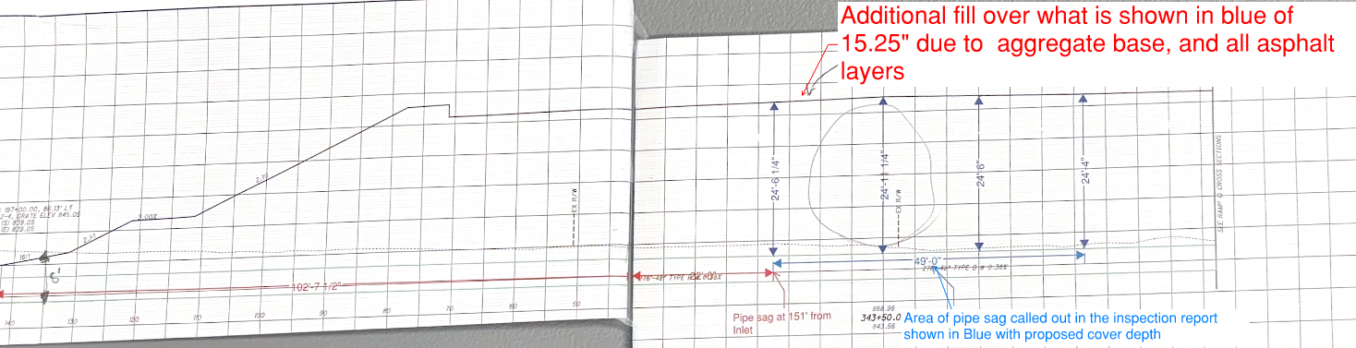
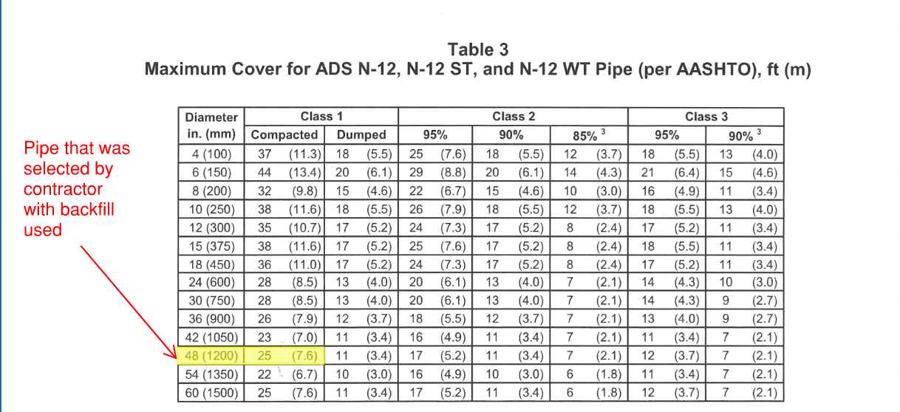
Cross section showing pipe had >25’ of fill
Max fill over pipe is 25’ per ADS using 57s as backfill

Slide 6
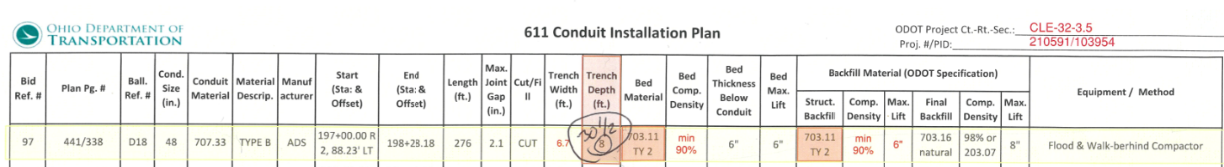
Accepted 611 plan showing trench dept of 8’ for D-18
If there was a column showing height of cover (>25’) the pipe would not have been accepted.

Slide 7
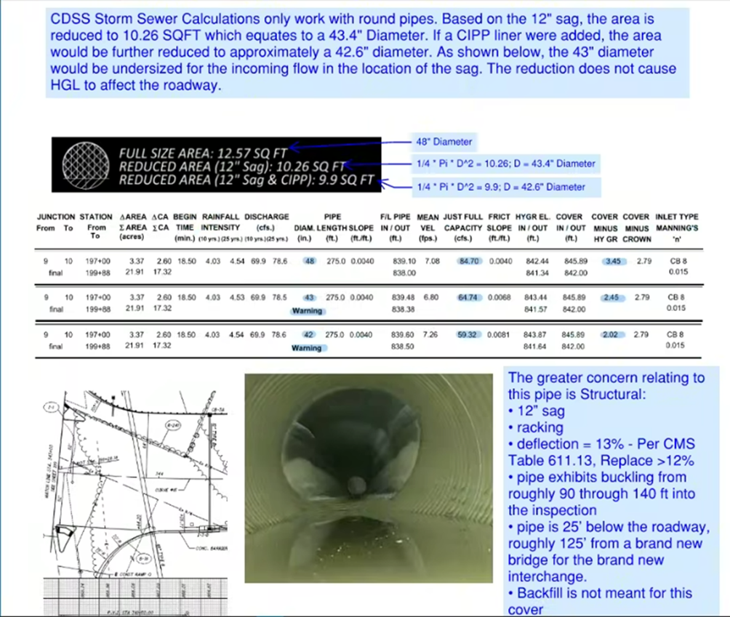
Hydraulic Issues
Pipe as is with sag and with CIPP liner can not adequately handle the capacity that would be produced from a 10-year flood, per ODOT Hydraulic Engineer calculations

Slide 8
Conclusion
Contractor’s Responsibility to provide suitable bedding prior to placing pipe (611.05)
Cover fill was left off the 611 installation plan. If this information was provided at the time both ADS and ODOT would not have accepted the ADS N-12 pipe (611.04.B).
If pipe continues to move, pipe joints could separate. Backfill could infiltrate into the pipe creating voids in the backfill and roadway settlement.
Could become a maintenance issue if further settlement/sag/bulging occurs
Pipe as it exist can not handle 10-year rain events, which is the intended design criteria of the pipe.

Slide 9
ODOT’s Stance
It is the contractor’s responsibility to make corrections to work that did not perform as expected due to factors within their control.

