Slide 2
Buy America / Build America, Buy America (BABA) Manufactured Products Phase-out and other info Dan Miller

Slide 3
“Mandatory disclaimer…”
Not all encompassing..
Key topics impacting ODOT transportation projects utilizing Federal Funding in Ohio

Slide 4
Two requirements to discuss
Buy America
Build America, Buy America
Different from “Buy American” - federal laws and policies that require the U.S. government to prefer American-made goods
All sound similar, but are all different

Slide 5
Buy America
Buy America - Not new
1982 Surface Transportation Assistance Act codifies Buy America in § 165; requires U.S.-made iron, steel, and manufactured goods on federally funded transit and infrastructure projects

Slide 6
Build America Buy America (BABA) Act “new-er”
Enacted under IIJA (2021)
Infrastructure Investment and Jobs Act
aka - Bipartisan Infrastructure Law (BIL)
Strengthens domestic sourcing for infrastructure improvement projects
Applies to iron, steel, manufactured products & construction materials
Notes:
BABA was enacted under the IIJA in 2021. It strengthens domestic sourcing requirements for infrastructure projects, covering iron, steel, manufactured products, and construction materials. This means that for federally funded projects, these materials must be produced in the United States.

Slide 7
Why we need to care?
Applies to federally funded infrastructure
$500,000 threshold
Non-compliance risks federal funding
Monies received and utilized for any phase, not just construction
“Default” FHWA Response for non-compliance: Remove and Replace
Notes:
“ODOT needs should care about BABA because it applies to federally funded infrastructure projects. If a project receives more than $500,000 in federal funds, it must comply with BABA provisions. This includes domestic sourcing requirements for iron, steel, manufactured products, and construction materials. Non-compliance can risk federal funding, so it's crucial to ensure all project phases, not just construction, meet these requirements.
Through ongoing discussions with FHWA, they have made it clear that if an item of work is installed on a project with do not meet the BABA requirements, their default response to what we need to do with the items it to “remove and replace”. While there are always potential exceptions, this should not be ever expected if an item is installed which don’t meet the requirements. Ultimately, federal funding could be removed in its entirety.

Slide 8
Buy America for Iron and Steel - Unchanged
For federally funded infrastructure projects, all iron, steel, & stainless-steel products must be produced in the United States, which includes:
Melting
Refining
Forming
Fabricating
Coating
All of these processes must occur domestically for the product to be compliant – always was a requirement per IIJA.
Notes:
For federally funded infrastructure projects, all iron and steel products must be produced in the United States. This includes processes such as melting, refining, forming, fabricating, and finishing. All these processes must occur domestically for the product to be compliant.
This is not new and has been a long-standing requirement and expectation on federally funded projects.

Slide 9
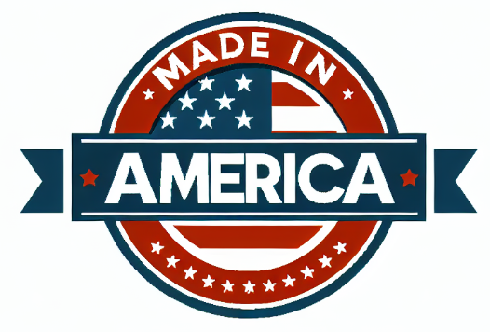
Additional BABA Covered Construction Materials under IIJA
Non-ferrous metals
Plastic/polymer-based products
Glass, lumber, drywall
Notes:
If your project uses plastic pipes, glass panels, or drywall, those materials must be fully manufactured in the U.S.—from melting to coating. Expands further than just Iron and Steel. BABA now covers additional construction materials, including non-ferrous metals, plastic and polymer-based products, glass, lumber, and drywall. BABA defines construction materials broadly and these materials must also be manufactured in the U.S. to comply with BABA requirements. Non-ferrous metals would be things like aluminum, copper, zinc, brass, lead, etc. Plastic and polymer-based products not necessarily previously considered could be PVC pipe, HDPE pipe, geogrids, plastic rebar chairs, and plastic based guardrail blocks. Glass / lumber products could be pavement marking beads, permanent guardrail posts, and permanent wooden structures.

Slide 10
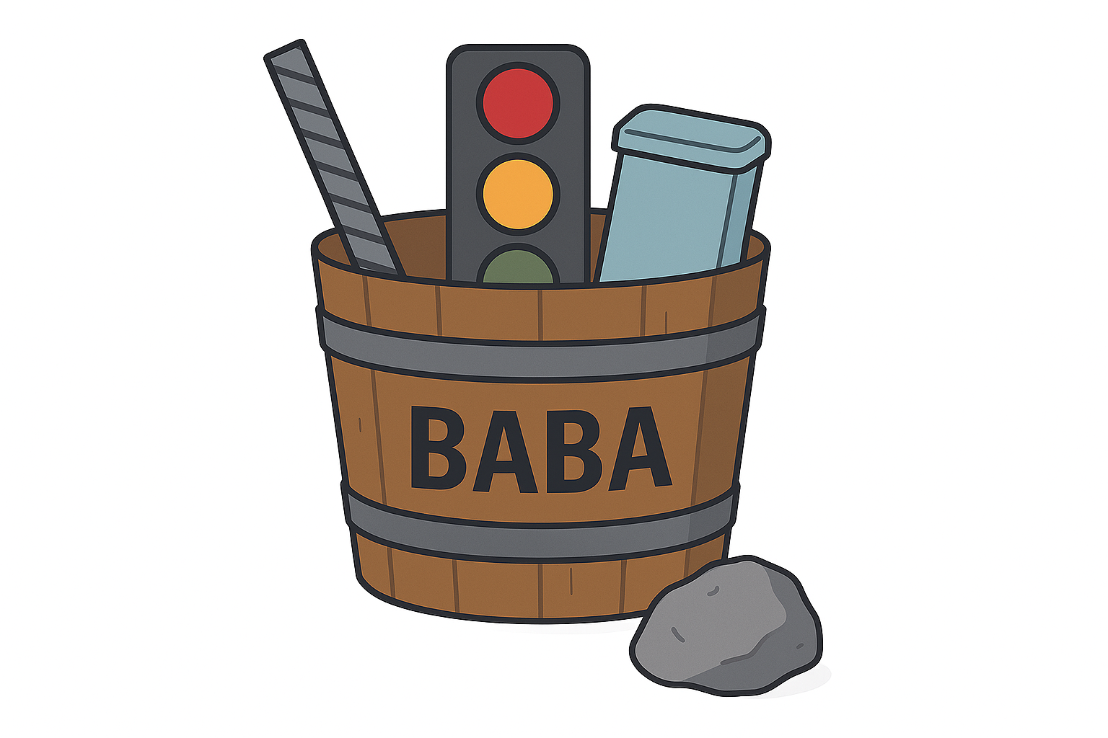
Build America, Buy America (BABA) – categories
1. Iron & Steel Products (predominately of iron or steel)
Must be produced entirely in the U.S. — from melting to coating (but not mined)
2. Manufactured Products
Items assembled from multiple parts (e.g., traffic signal heads). Must be manufactured in the U.S.
3. Construction Materials
Single-ingredient materials like glass, lumber, drywall, fiber optic cable, non-ferrous metals, plastics, etc., must be produced in the U.S.
4. Section 70917(c) Materials
Specifically excluded from “construction materials,” -Cement and cementitious materials, Aggregates (stone, sand, gravel), Aggregate binding agents/additives
Notes:
Materials are essentially looked at within differing “buckets” of materials, and requirements are different for each. BABA organizes materials into distinct categories to simplify compliance and ensure clarity. These categories are Iron and Steel, Construction Materials, and Manufactured Products.
Each material must be classified into only one category. This prevents double-counting and ensures consistent application of rules. For example, a steel beam is Iron and Steel—not a manufactured product. Why - Different categories have different compliance requirements. Iron and Steel must be fully U.S.-processed. Construction Materials must be produced in the U.S. Manufactured Products must meet Final Assembly and 55% Domestic Content rules.
There are two exceptions where a material falls under two requirements: Traffic Cabinets and ITS Hardware—considered manufactured products but must also meet Iron and Steel rules if predominantly steel .Precast Concrete Items—classified as manufactured products, but any iron or steel inside must comply with Iron and Steel requirements.”

Slide 11
Construction Materials Excluded…
Not considered “construction materials” under BABA
and therefore do not require domestic sourcing
Excluded Material Category | Examples
Cement and Cementitious Materials | Portland cement, fly ash, slag cement
Aggregates | Stone, sand, gravel
Aggregate Binding Agents or Additives | Lime, admixtures, chemical stabilizers
Notes:
Not all materials are considered 'construction materials' under BABA. For example, cement and cementitious materials, aggregates, and aggregate binding agents or additives are excluded. While this seems alittle counterintuitive as concrete and stone is the epitome of a construction material, they do not require domestic sourcing.
Materials like cement, fly ash, and slag are typically intermediate components used in the production of concrete or other manufactured products. Since BABA focuses on final construction materials, these inputs are not directly regulated under the rule. Requiring BABA compliance for bulk commodities like aggregates and cement would be extremely difficult to trace and certify due to their widespread and commingled sourcing, disrupt construction timelines and increase costs for public infrastructure projects, and offer limited benefit in terms of reshoring or domestic manufacturing, since these materials are already widely produced in the U.S.

Slide 12
Timeline of BABA Implementation
Final FHWA Rule: October 23, 2023
Applies to all Federal funding authorizations after this date
Federal Authorization date for Construction Funds – critical date
Notes:
Key dates for BABA implementation include the final FHWA rule on October 23, 2023. This rule applies to all authorizations after this date. The federal authorization date for construction funds is a critical date to keep in mind. This date needs to be clearly noted in the Contract.

Slide 13
Manufactured product definition
Per BABA - what is a manufactured product?
Any article, material, or supply that has been:
Processed into a specific form or shape, or
Combined with other articles, materials, or supplies to create a product with different properties than the individual components.
However, if the product is predominantly steel or iron (>50% of cost), the product is categorized as steel and iron except for precast concrete and ITS which are both.
Notes:
This means the item is not just a raw material—it has undergone significant transformation or assembly to become a finished product – think a Traffic Signal Assembly.

Slide 14
Initial waiver - BABA
What the Initial Waiver Allowed
Waiver for manufactured products:
Allowed foreign parts
Allowed foreign assembly
Now being phased out
Notes:
When these laws were first implemented, there weren’t enough U.S.-made manufactured products available. So FHWA issued a temporary waiver. This waiver allowed foreign parts and even foreign assembly for manufactured products. That waiver is now being phased out, and we’re moving toward full compliance

Slide 15
Key Implementation Dates – initial Waiver Phase-out for Manufactured Materials
October 1, 2025 – Final Assembly Requirement
Final assembly, must occur in the U.S.
October 1, 2026 – 55% Domestic Content Threshold
Manufactured products must contain at least 55% U.S.-produced components by cost
Notes:
Two major compliance thresholds take effect on October 1, 2025. First, the final assembly requirement means that not only must materials be sourced domestically, but the final product must also be assembled in the U.S. Second, the 55% content rule takes effect on October 1, 2026 and requires that at least 55% of the total cost of components in a manufactured product come from U.S. sources. These requirements will significantly impact procurement planning, especially for complex manufactured items like electronics, lighting, and signal systems.

Slide 16
Final Assembly (example Only - Oct 1 2025)
Scenario: A highway project includes the installation of LED traffic signal heads.
Before Oct 1, 2025: These could be sourced from a Canadian or Mexican manufacturer under the FHWA’s longstanding waiver for manufactured products.
After Oct 1, 2025: The final assembly of the LED signal heads must occur within the United States. This means:
The components (e.g., LED modules, housing, wiring) can be sourced globally.
But the final integration—where the components are assembled into a working signal head—must be done in the U.S.
Notes:
Let's look at an example. A highway project includes the installation of LED traffic signal heads. Before October 1, 2025, these could be sourced from a Canadian or Mexican manufacturer. However, after this date, the final assembly of the LED signal heads must occur within the United States. This means the components can be sourced globally, but the final integration must be done in the U.S.

Slide 17
55% Domestic Content (Example only - October 1, 2026)
Scenario: A highway project includes the use of a pre-assembled pedestrian push-button system.
After Oct 1, 2026, the system must:
Be assembled in the U.S., and
Contain at least 55% of its component costs (excluding labor and overhead) from U.S.-sourced materials.
Component | Material Only Cost | Country of Origin
Aluminum housing | $100 | USA
Circuit board | $80 | USA
LED module | $60 | Mexico
Wiring harness | $40 | USA
Mounting bracket | $20 | Canada
Total | $300
U.S. Content | $220 | 73%
Notes:
Let's look at an example. A highway project includes the installation of LED traffic signal heads. Before October 1, 2025, these could be sourced from a Canadian or Mexican manufacturer. However, after this date, the final assembly of the LED signal heads must occur within the United States. This means the components can be sourced globally, but the final integration must be done in the U.S.
Here's another example. Consider a product with components such as an aluminum housing, circuit board, LED module, wiring harness, and mounting bracket. The total cost is $300, with $220 of that being U.S. content, which is 73%. This exceeds the 55% domestic content requirement.

Slide 18
De Minimis Waivers – Steel and Iron
May allow some minor foreign content
Must be documented and justified
Steel and Iron
The cost of products to be used does not exceed 0.1 percent of the total Contract cost, or $2,500, whichever is greater. The cost is the value of the product as delivered to the project.
Notes:
Clint Bishop
Some exceptions exist. De minimis waivers allow small amounts of foreign material.
For steel and iron, the cost of products to be used does not exceed 0.1% of the total contract cost or $2,500, whichever is greater. This must be documented and justified.

Slide 19
De Minimis Waivers – construction Materials
Construction Materials and Manufactured Products
The total value of the non-compliant products is no more than the lesser of $1,000,000 or 5% of total applicable costs for the project
applicable costs are defined as the cost of materials (including the cost of any manufactured products) used in the project that are subject to a domestic preference requirement
the actual cost of the materials, not the anticipated cost of those materials.
Notes:
Clint Bishop
For construction materials and manufactured products, the total value of non-compliant products is no more than the lesser of $1,000,000 or 5% of total applicable costs for the project. Applicable costs are defined as the cost of materials used in the project that are subject to a domestic preference requirement.
In both situations, a waiver is based on the cost of material, not the total cost of the work which is typically labor, equipment, and material cost. To receive a de minimus waiver, a contractor must submit evidence of material costs which goes typically unknown.

Slide 20
De Minimis Waivers
NOTE – different thresholds between Iron/Steel and Manufactured products.
The iron and steel de minimis waiver and the construction materials/manufactured products de minimis waiver are independent of each other, each with its own threshold, scope, and tracking requirements.
Notes:
Clint Bishop

Slide 21
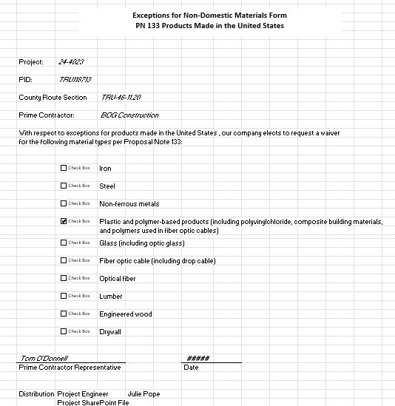
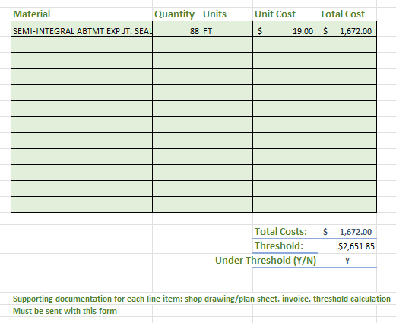
De Minimis Waiver – Tracking/Justification
BABA Exception Form.xlsx
Notes:
Clint Bishop
To document de minimis waivers, use the BABA Exception Form. This form helps ensure all waivers are properly recorded and justified.

Slide 22
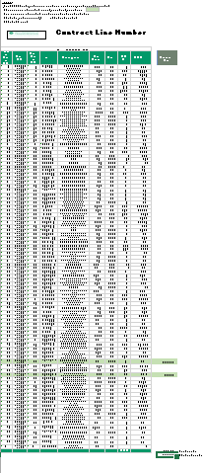
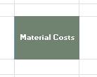
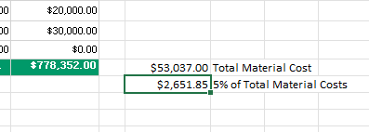
De Minimis Waiver - Tracking/Justification
Determine Threshold Value
5% of Total Material Cost
Notes:
Clint Bishop
To determine the threshold value for de minimis waivers, calculate 5% of the total material cost. This helps ensure compliance with BABA requirements.

Slide 23
Known Compliance Challenges (ODOT specs)
Items with limited ODOT approved BABA-compliant suppliers as of today:
LED Vehicle & Pedestrian Signals
Fiber Optic Termination Panels
Fiber Optic Splice Enclosures
CCTV Equipment
Ramp Meters
Ethernet Cables
LED Fixtures (Underpass Lighting)
LED Lanterns (Street Lighting)
Railroad Preemption Interfaces
Notes:
There are some items with limited or no known BABA-compliant suppliers, such as LED vehicle and pedestrian signals, fiber optic termination panels, and CCTV equipment. It's important to be aware of these challenges and plan accordingly.
We highly recommend that you incorporate a check point in the plan development to consider the risks of these items and consider adding flexibility in your allowable materials to enable the widest listing of sources possible.

Slide 24


Project segmentation
Why doesn’t ODOT break projects up into to multiple projects (Federal $ < $500k) to help keep the smaller project exempt from BABA?
Can’t.
See 23 USC 313(h)
Notes:
Can a project be separated in multiple projects smaller projects and keep it under $500k of federal funds, or do a separate project to be funded solely with local funds, so not be under the BABA requirements?
The answer is likely No for multiple reasons.
2 CFR Part 184 – Buy America Preferences for Infrastructure Projects. This regulation, issued by the Office of Management and Budget (OMB), implements the BABA provisions of the Infrastructure Investment and Jobs Act (IIJA). It states: “The Buy America preference applies to all infrastructure projects receiving Federal financial assistance... regardless of whether the Federal funds are used for the entire project or only a portion of the project.”
While NEPA (National Environmental Policy Act) doesn’t directly govern BABA, it does define how projects are scoped for environmental review. FHWA and ODOT typically align NEPA-defined project boundaries with funding and compliance boundaries. Artificially segmenting a project to avoid federal requirements could be viewed as “improper segmentation” under NEPA, which is also prohibited.
Segmentation may be allowed only if the segments are functionally independent, there is no intent to circumvent federal requirements, and the segmentation is clearly documented and justified. Even then, FHWA may review the segmentation post construction and reconsider.

Slide 25
Documenting Buy America Compliance
Material origin certifications
Delivery tickets with batch info
Test results (e.g., mill certs)
Signed Buy America certificates
No “official” certification form…yet.
Provide BEFORE items are incorporated, not after!!
Notes:
To prove compliance with Buy America, documentation must be thorough and traceable. This includes origin certifications from suppliers, delivery tickets showing batch numbers and sources, and test results for materials like steel and concrete. Daily diaries should note where and how materials were used. Most importantly, signed Buy America certificates must be included in the project file.
For example, if you’re using rebar, you’ll need mill test reports showing it was melted and manufactured in the U.S. And for every material, your inspector’s daily diary should match what was delivered and installed.
Many have asked what is required documentation FHWA requires, but there is no single certification form or format. FHWA, while not necessarily giving exact requirements necessary for proof, they do want to see a reasonable proof of domestic origin.
Its important, no matter what the format of the documentation, get it prior to incorporating and not after. It will eliminate questions.

Slide 26
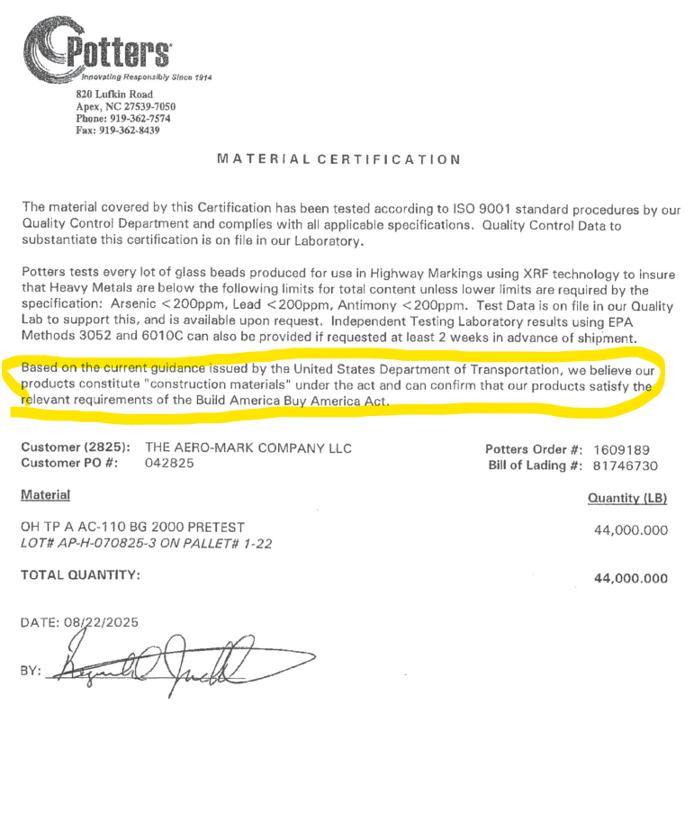
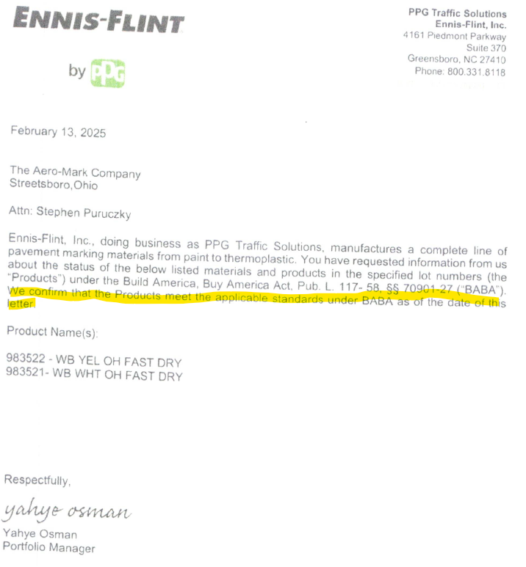
Example Certifications
Notes:
Here are some reasonable examples of “proof” of Buy America compliance from contractors. These are examples, but it could vary.

Slide 27
Another documentation method…
Material sources which are on ODOT’s QPL, APPR or TAP list…
If the material is not marked as non-BABA compliant, it may be considered acceptable for BABA compliance.
Provide ODOT evidence of use — invoices, delivery tickets, or other records.
ODOT will keep dated screenshot of the QPL, APPR, or TAP listing from the appropriate website showing the material and its compliance status. The compliance status must be clear.

Slide 28
Remember – Supplement 1136 (CML)
Contractor Material Controller (CMC)
Contractor’s personnel responsible for providing the information identifying intended materials, the sources of material, and contractor test results
Required to know the intended supply source
Point of Contact for providing proof of source documentation for all necessary and permanent material installed
Important Role with BABA / Buy America
Notes:
CMC is an important role in assuring compliance.

Slide 29
How do we know the “new’ requirements apply?
BABA driven by Fed $ amounts and Federal Authorization
Fed authorization date is on front of the Project Proposals
PN-133 is within the contract
No PN-133, then CMS 106.09 only applies (Iron and Steel)

Slide 30
Common Q & A
Q: What is a manufactured product?
A: A product made from multiple parts assembled into a finished item—like a light pole, traffic signal, or electrical cabinet.
Q: What does “final assembly in the U.S.” mean?
A: The last step of putting the product together must happen in the U.S., even if some parts come from other countries.

Slide 31
Common Q & A
Q: Would putting all the foreign parts together onsite of the Project meet the intent of the "final assembly"?
A: It depends. If the on-site work is simple installation (e.g., bolting together pre-assembled parts), it does not qualify. A true final assembly process—where the product is fully built and made functional from its material components on-site may qualify, but only if it is substantial, not just fitting or wiring, and the product is not functional until this step is completed.
Notes:
FHWA emphasizes that final assembly must be a meaningful manufacturing step, not just installation or minor adjustments.

Slide 32
Common Q & A
Q: Why aren’t we discussing construction materials following the 55% rule like manufactured products?
A:Construction materials are single-substance items (like a sheet of glass or a piece of lumber). They don’t have “parts” to add up. So instead of tracking percentages, the rule is simple: every step of making that material must happen in the U.S. Manufactured products, on the other hand, are made from many parts—so the 55% rule ensures that most of the value comes from U.S. sources.

Slide 33
Common Q & A
Q: How do I know if a product meets the rules?
A: The contractor provide certification or documentation. ODOT won’t calculate it—ODOT to verify the paperwork.

Slide 34
Common Q & A
Q: Can I use a product with a final assembly outside of the US after the Oct 1 2025?
A: Only if the PROJECT was FEDERALLY AUTHORIZED FOR CONSTRUCTION before Oct 1 2025.

Slide 35
Where to Get Help
ODOT Office of Materials Management
Dan Miller – Daniel.miller@dot.ohio.gov
JR Wolfe – James.Wolfe@dot.ohio.gov
ODOT Office of Construction Admin & Innovative Delivery
Clint Bishop – Clint.Bishop@dot.ohio.gov
Eric Kahlig – Eric.Kahlig@dot.ohio.gov
ODOT Office of Local Programs
Jeff Peyton – Jeff.Peyton@dot.ohio.gov
FHWA BABA Q&A
Notes:
"If you need assistance, resources are available from the ODOT Division of Construction Management, FHWA BABA Q&A, and your District LPA Construction Monitor."

Slide 36
Other resources
Buy America – Construction Program Guide
Q&As for the Waiver of Buy America Requirements for De Minimis Costs and Small Grants
Notes:
Additional resources include the Buy America – Construction Program Guide and Q&As for the Waiver of Buy America Requirements for De Minimis Costs and Small Grants.

Slide 37

Questions?
Notes:
Thanks for your attention. Let’s open it up for questions. If you’d like a copy of the slides or script, feel free to reach out.

Slide 38


Thank You Attendees & Sponsors

