Slide 1
Hydraulics Update
hans Gucker

Slide 2
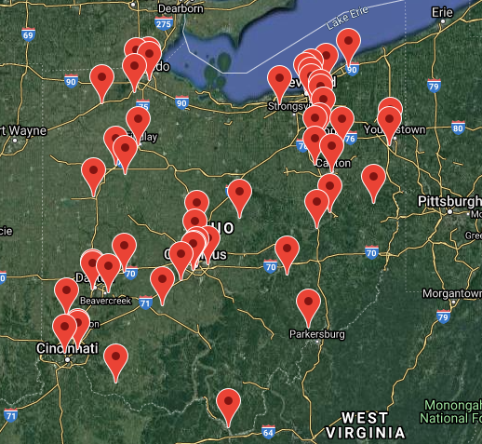
Supplemental specification 832
SS832 – State of State
  198 Active Projects
    107 Active projects in Urban Areas
  4,688 SWPPP Inspections
  6,348 Open Work Items
    3,265 (51%) OWI closed at next inspection
      21-day average closing OWI not closed at next inspection

Slide 3
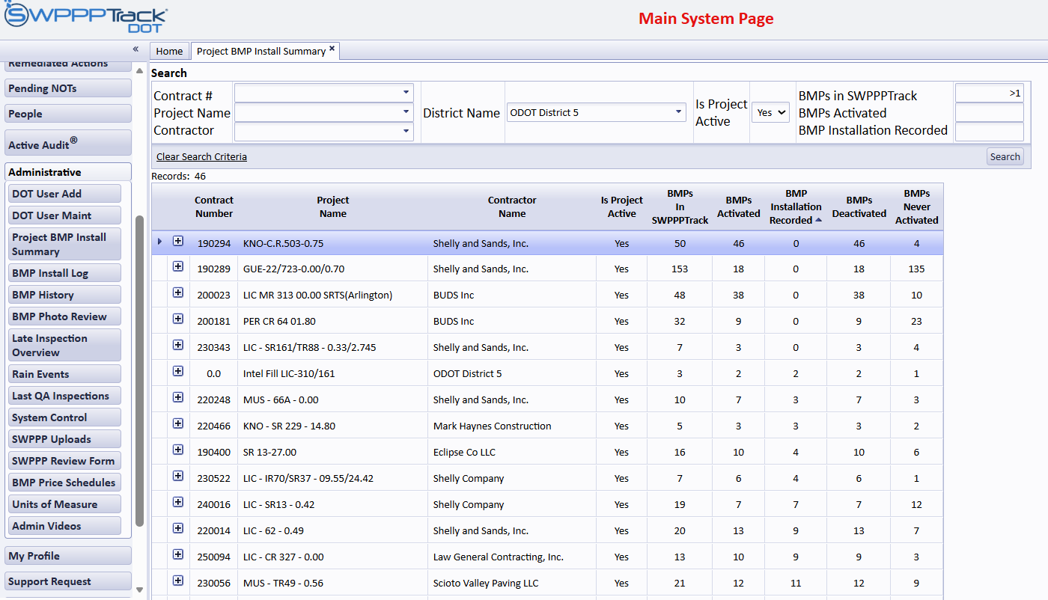
SS832 Updates
SS832 – Update July 18, 2025
  832.05 – Accurately record BMP types and quantities into the SWPPPTrack software application within 7-days of installing the BMP.

Slide 4
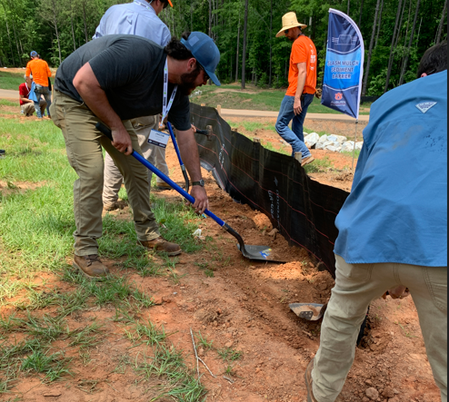
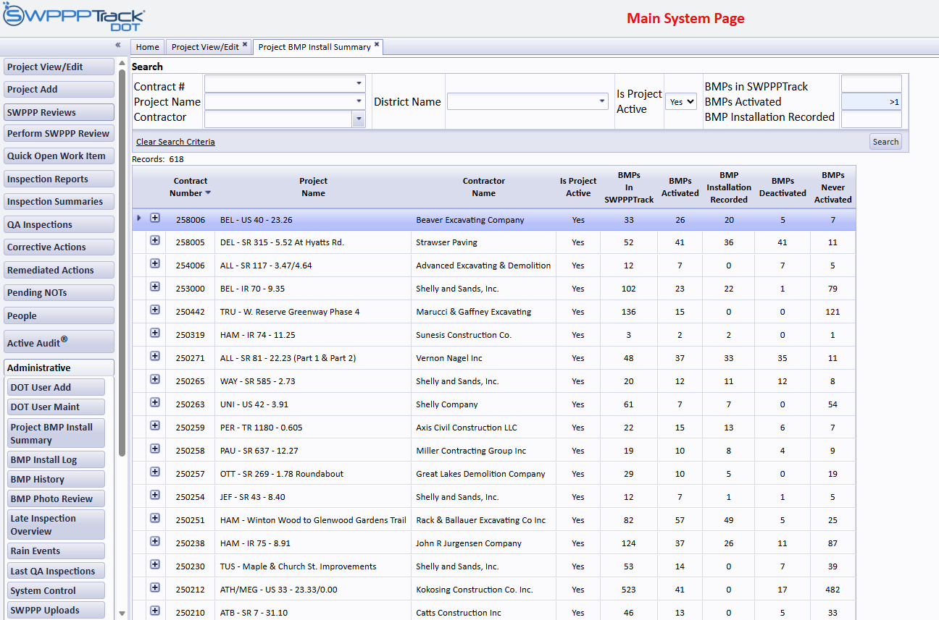
Supplemental specification 832
BMP Installs
  2025 project tracking
    Significant increase in contractor logged BMP
    Generally, all or nothing

Slide 5
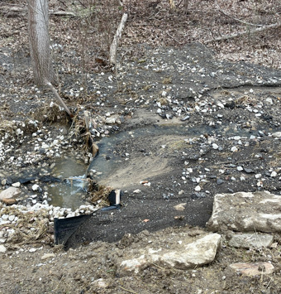
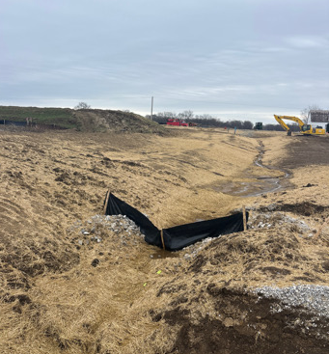
SS832 Updates
SS832.05 A. 7. – Filter Fabric Ditch Checks
  Additional design criteria
    Require minimum storage of 1,000 CF/Ac
    Install in series to increase capture
    Evaluate performance during inspections
  Sediment trap/basin considerations

Slide 6
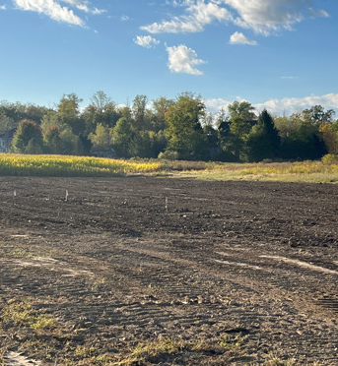
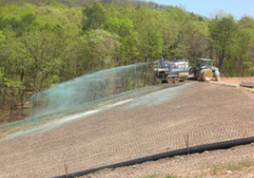
SS832 Updates
SS832.05 B.2. – Winter Seed and Mulch
  Winter Seed and Mulch
    Not to be used on finished grade unless accepted by Engineer
    Crimp or apply non-toxic tackifier
    Minimum 6-month effective cover
    Bonded Fiber Matrix – Min. 3,000 lb/ac

Slide 7
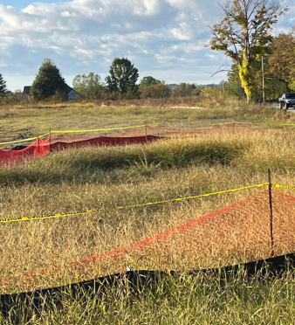
SS832 Updates
SS832.05 C. – Aquatic and Environmental Resource Protection
  Provide 50-foot natural vegetation buffer on all Contractor borrow/waste locations
  Ohio EPA Construction General Permit
    Part II. A. 6. – Non-Numeric Effluent Limitations

Slide 8
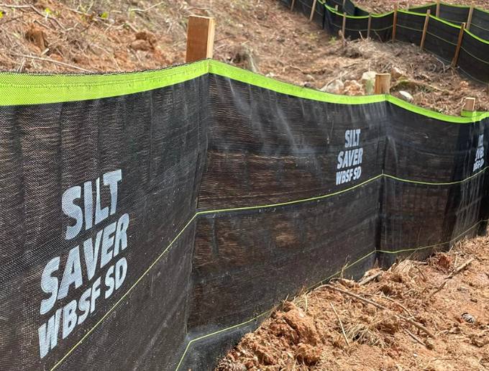
SS832 Updates
SS832.09 – Storm Water Pollution Prevention Plan (SWPPP)
  Require in person site assessment by SWPPP Designer prior to SWPPP development
  Critically assess areas within 50-feet of surface water
    Recommend structurally improved Alternative BMPs

Slide 9
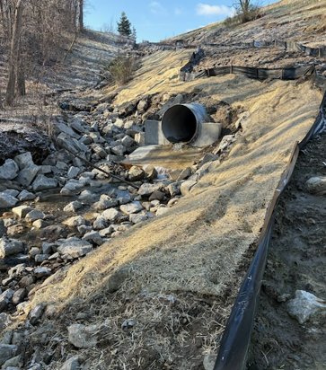
SS832 Updates
SS832.09 A. 3. – Storm Water Pollution Prevention Plan (SWPPP)
  Select BMPs based on 50-percent AEP (2yr-24hr storm event)
  Recommend more resilient BMPs with 50-feet of surface water or in areas susceptible to high rates of erosion
  50-Natural buffer around aquatic resources for borrow/waste locations

Slide 10
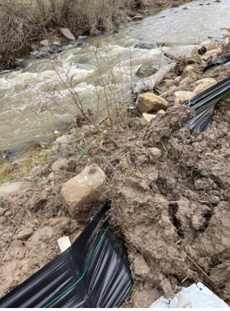
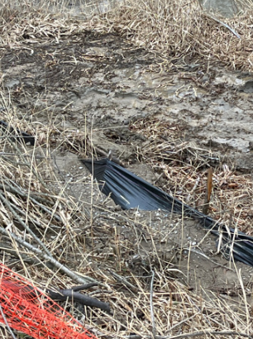
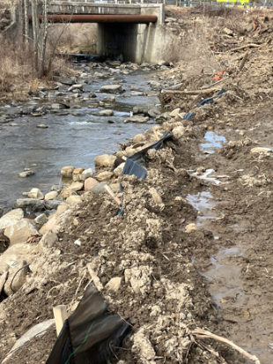
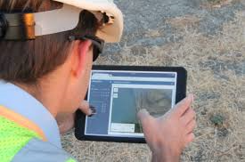
Supplemental specification 832
SS832.11 C. – Inspections and SWPPP Updates
  Evaluate BMP for stormwater treatment effectiveness…
  Provide recommendations for BMP improvements when inspections identify repeated deficiencies…

Slide 11
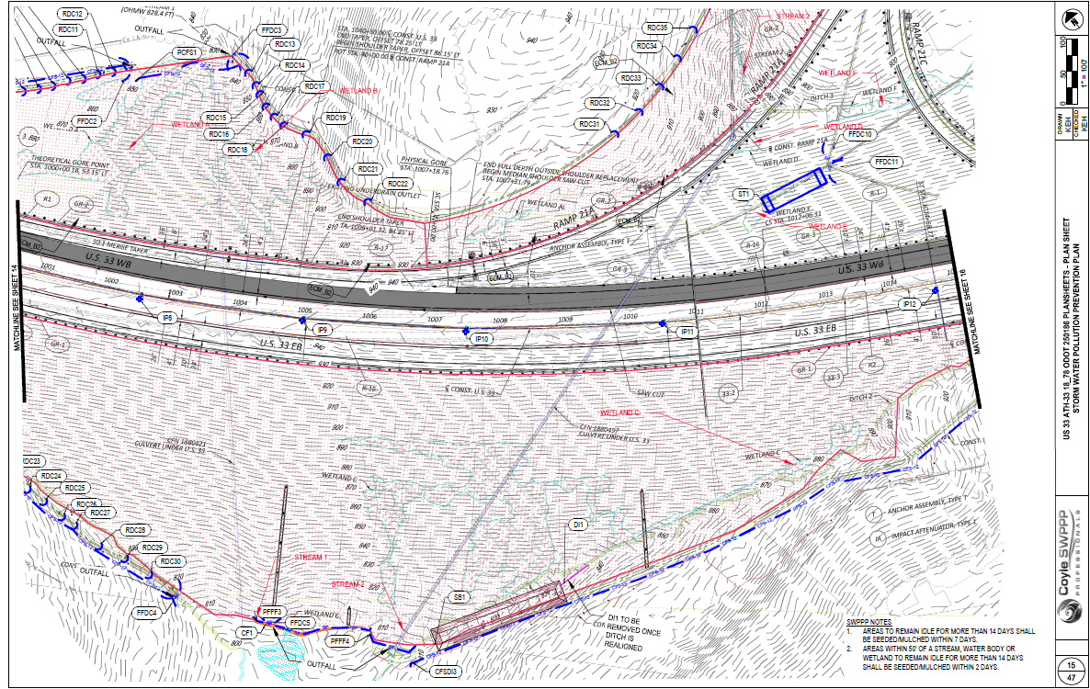
ss832 Updates
SWPPP Development
  SWPPP implementation details need to be commensurate with project complexity
    105.02 contract document
  Needs to address phases of construction
    Permit requirement
SWPPP Inspections
  Inspections provide critical communication
  Document BMP effectiveness
  Recommend SWPPP updates
  Inspect all areas of disturbance

Slide 12
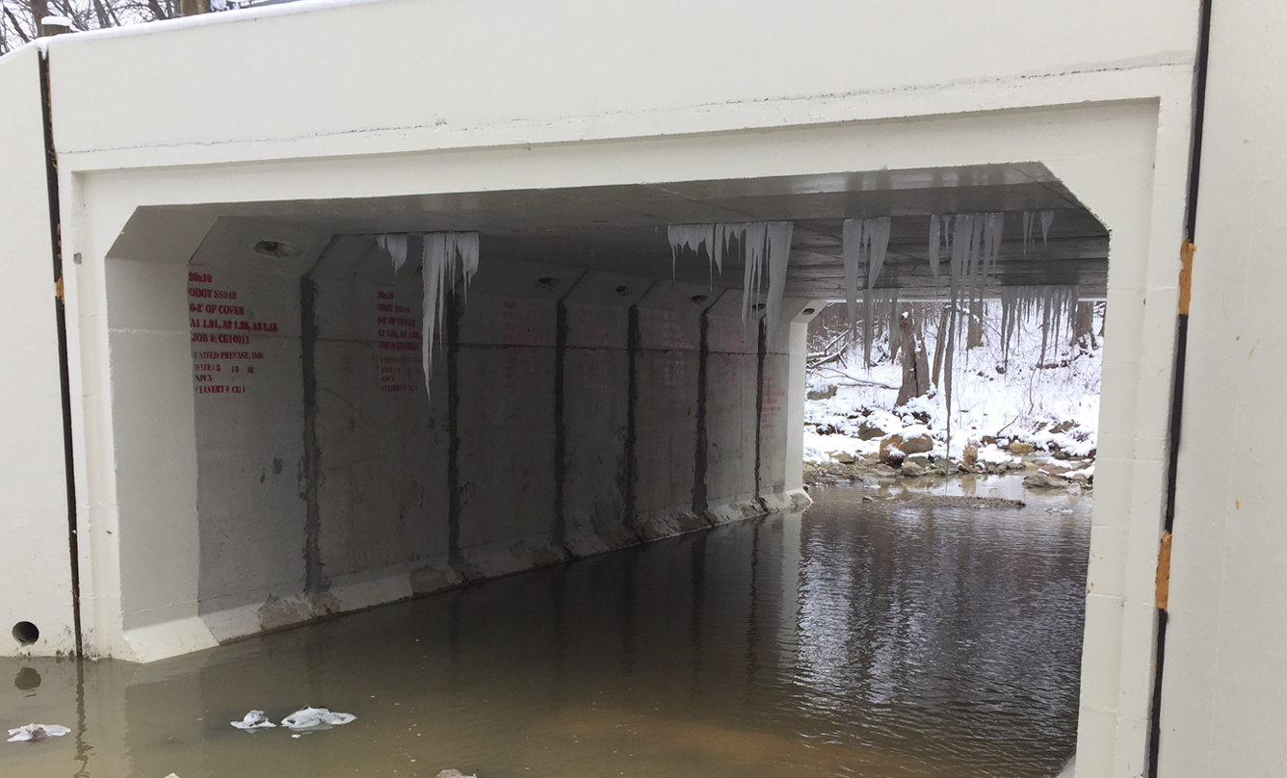
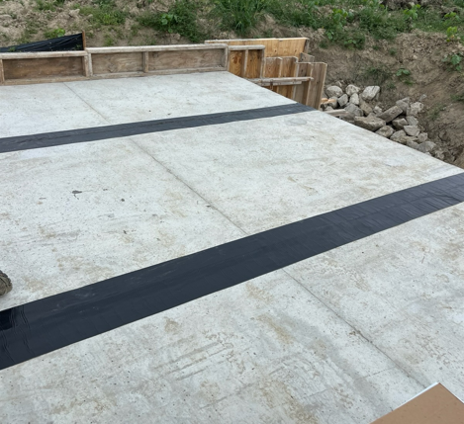
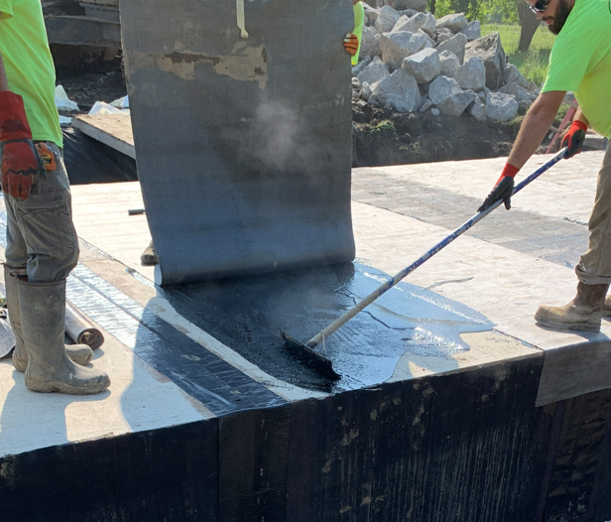
Item 611 Updates
611.08 B.3.a Box Culverts Joints
  Provide smooth exterior fit up >0.25-inch
  Cover joint with 12” joint wrap
  Cover with waterproofing membrane

Slide 13
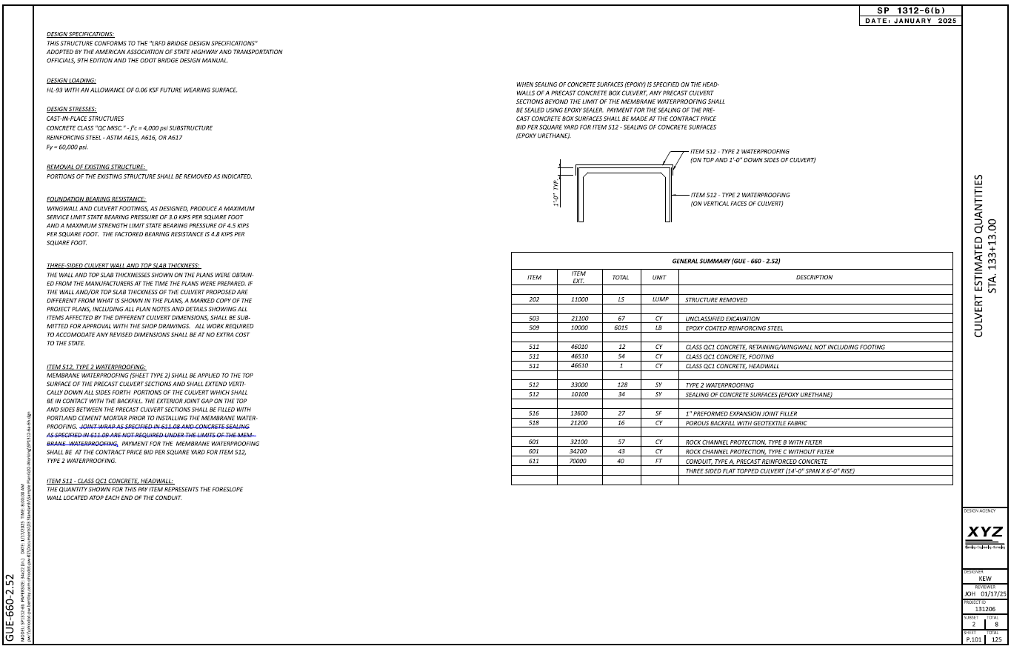
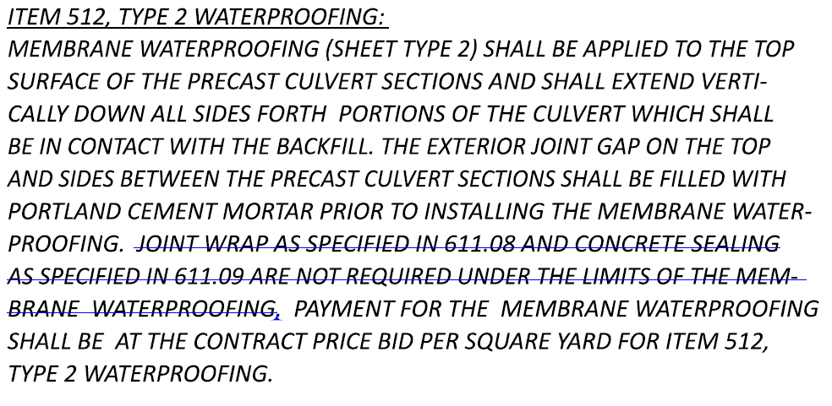
Item 611 Updates
611.08 B.3.a Box Culverts Joints

Slide 14
Item 611 updates
611 Pilot Projects
Plan Note:
611 TYPE A OR B CONDUIT AS PER PLAN
USE 703.11 STRUCTURAL BACKFILL TYPE 1 OR 613 LOW STRENGTH MORTAR, TYPE 2 AS STRUCTURAL BACKFILL FOR ALL TYPE A AND B FLEXIBLE CONDUITS 12-INCH DIAMETER AND LARGER. DETAIL THE SELECTED CONDUIT MATERIAL AND STRUCTURAL BACKFILL IN THE 611 INSTALLATION PLAN PER 611.04 B. NOTIFY THE ENGINEER IMMEDIATELY WHEN GROUNDWATER IS ENCOUNTERED DURING EXCAVATION. USE 703.11 STRUCTURAL BACKFILL TYPE 3 FOR BEDDING AND BACKFILL IN AREAS WHERE GROUNDWATER IS PRESENT. INSTALL 703.11 STRUCTURAL BACKFILL TYPE 3 AND GEOTEXTILE FABRIC ACCORDING TO 611.06. VERIFY THE CONDUIT MATERIAL AND REVISED BACKFILL MEET THE STRUCTURAL DESIGN REQUIREMENTS WITH THE CONDUIT MANUFACTURER PRIOR TO INSTALLATION.

Slide 15
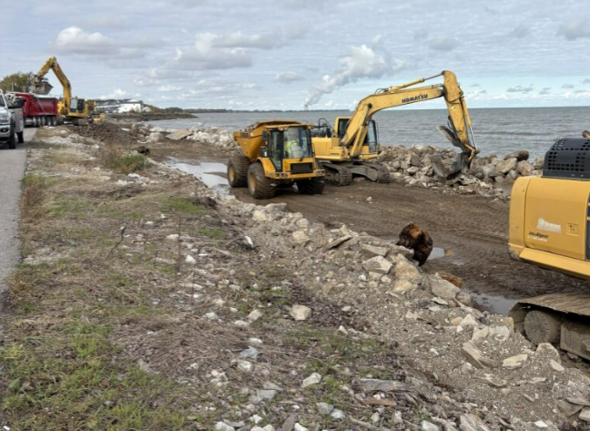


Questions?
Hans Gucker, PE, CESSWI, CPESC
ODOT Construction Hydraulic Engineer
Office of Construction Administration
Hans.Gucker@dot.ohio.gov
614-387-3058

