Slide 1
Traffic & Roadway
Spec Updates Abigail Helser, pe

Slide 2

Spec Updates – July 2025 & Jan 2026
C&MS, Supplements & other update Highlights
Construction & Material Specifications
202 Removal of Structures and Obstructions
606 Guardrail
621 Raised Pavement Markers (RPM)
622 Concrete Barrier
Supplements, SS, & Proposal Notes
PN 127 Lane Value Contract
PN 652 Piloting E-Ticketing for DLS Reports
SS804 Fiber Optic Cable and Components
SS809 Intelligent Transportation System (ITS) Devices and Components
SS997 Rectangular Rapid Flashing Beacons (RRFB) Sign Assembly
Standard Construction Drawings (SCDs)
HL-50.21 Structure Grounding
MGS-2.1 Midwest Guardrail System, Standard Type MGS
MT-103.10 Construction Access Points
MT-103.20 Steel Plate over Trench
RM-4.6 Concrete Barrier End Sections
RM-4.8 Single Slope Concrete Barrier, Type N
TC-87.20 School Speed Limit Sign with Flashing Beacons
Other Design Manuals
Quality Standards of Temporary Traffic Control Devices
Traffic Engineering Manual (TEM)
L & D Vol. I
Multimodal Design Guide (MDG)
Sign Design and Marking Manual (SDMM)

Slide 3
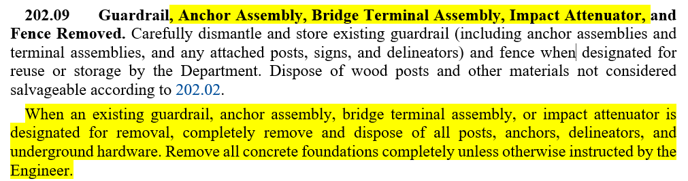
202.09 Guardrail, Anchor Assembly, Bridge Terminal Assembly, Impact Attenuator, and Fence Removed

Slide 4
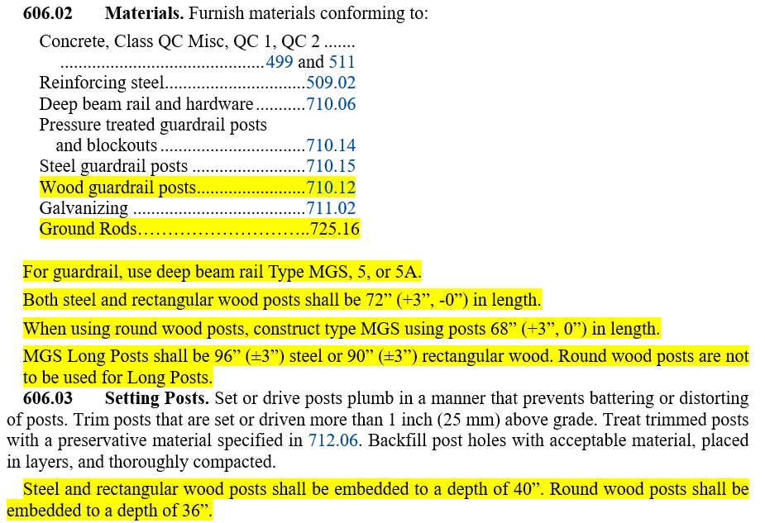
606 Guardrail

Slide 5
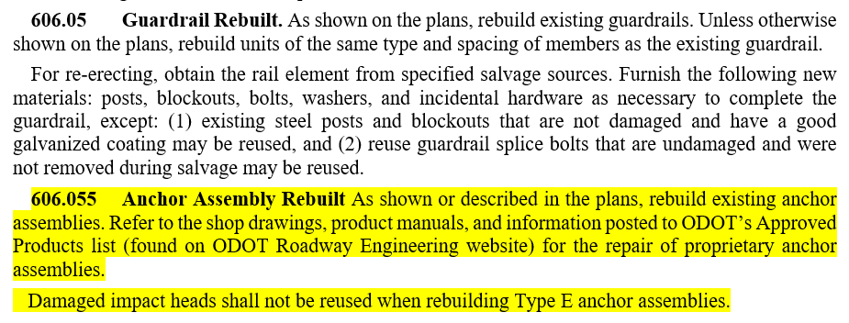
606 Guardrail

Slide 6
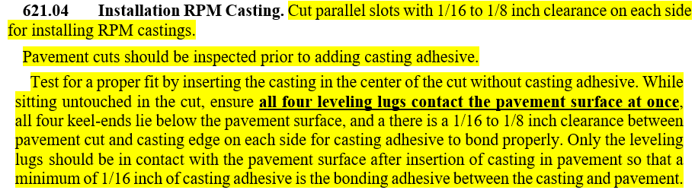
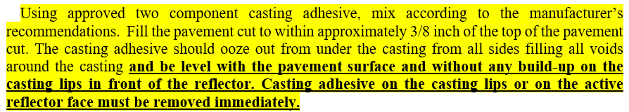
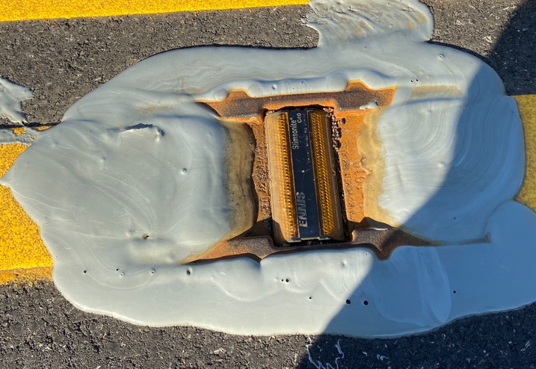
621 Raised Pavement Markings (RPM)
…

Slide 7
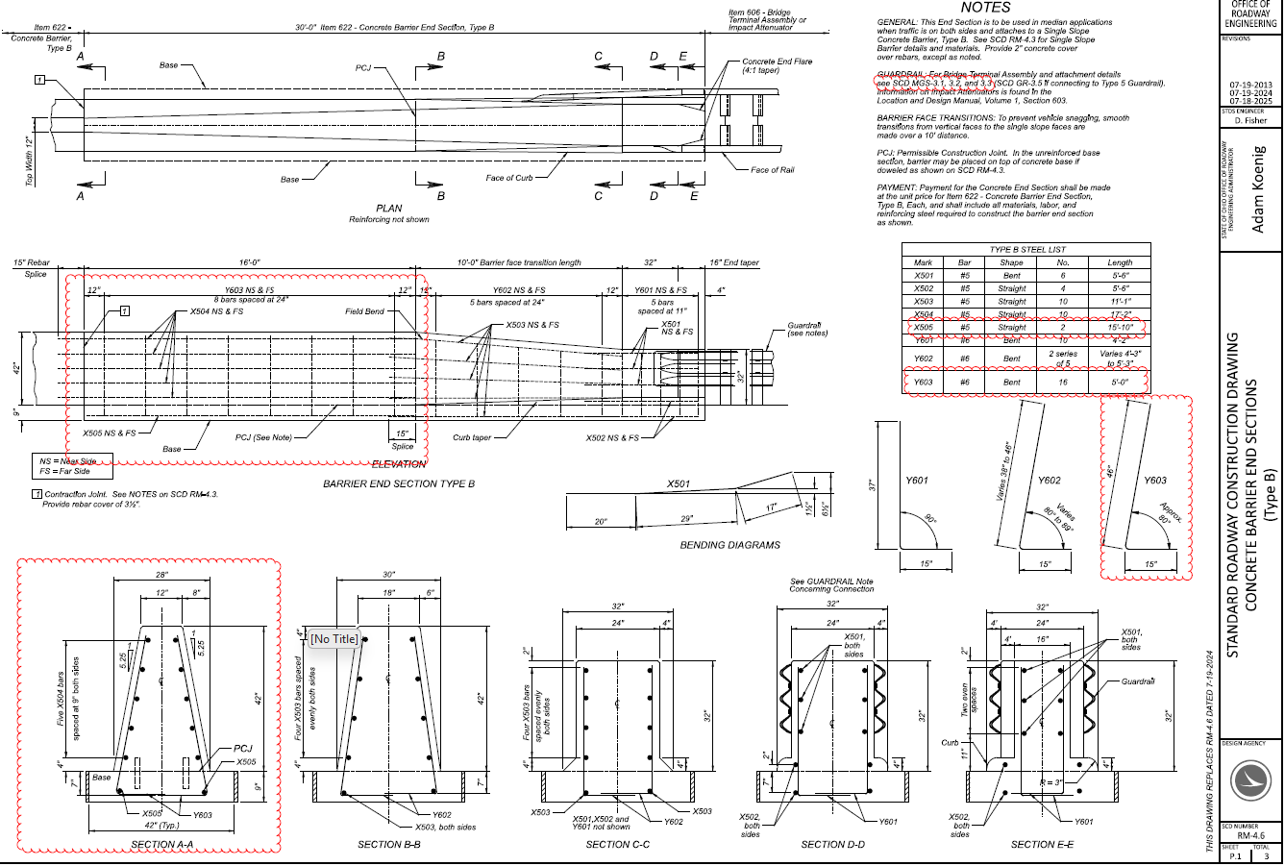

Slide 8
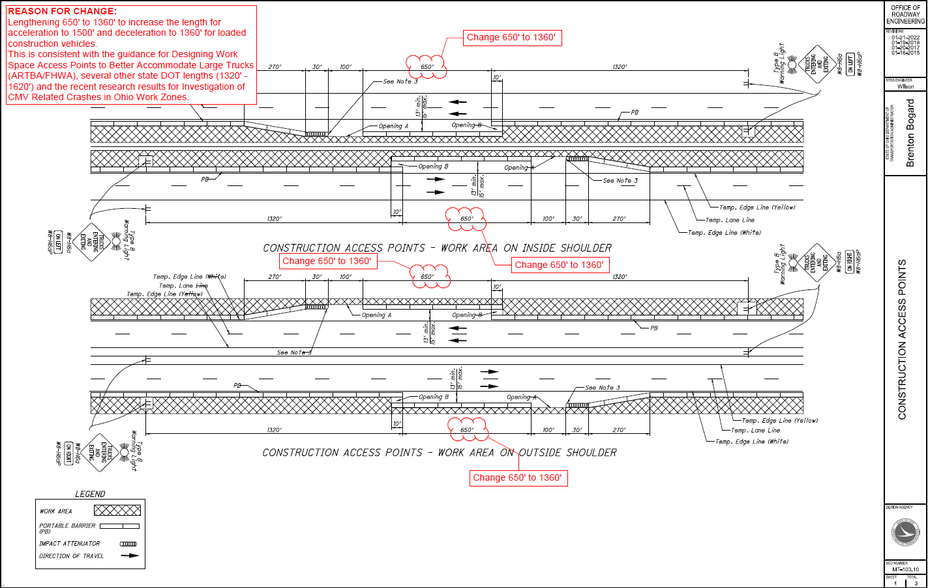

Slide 9

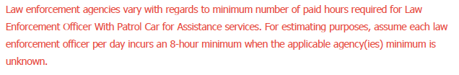
TEM 642-55, ITEM 614 -> LEO with Patrol Car
…

Slide 10
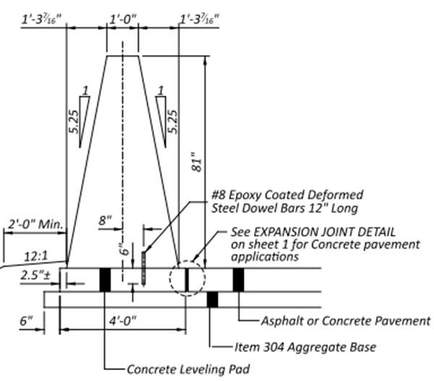
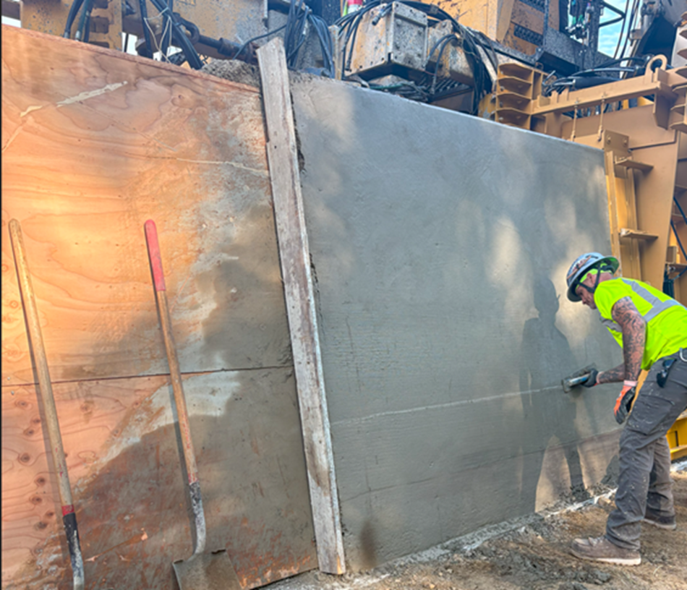
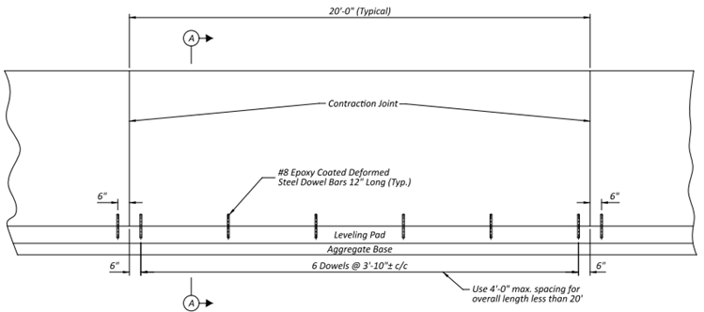
Concrete Barrier Wall – 81IN, Type N

Slide 11
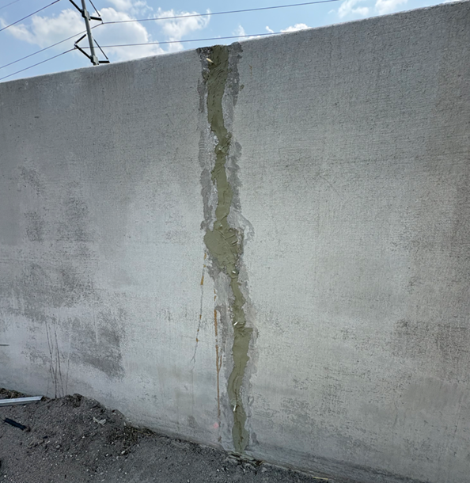
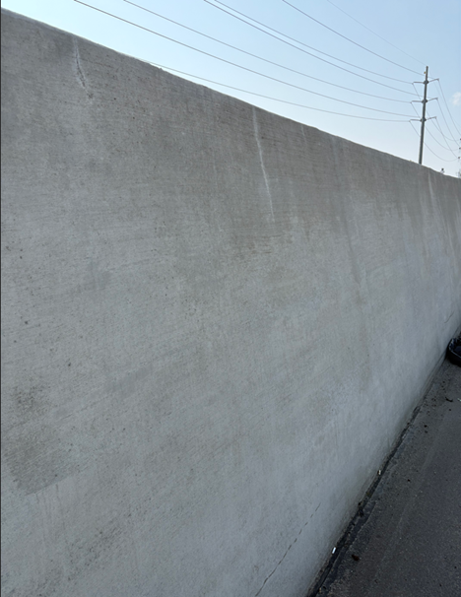
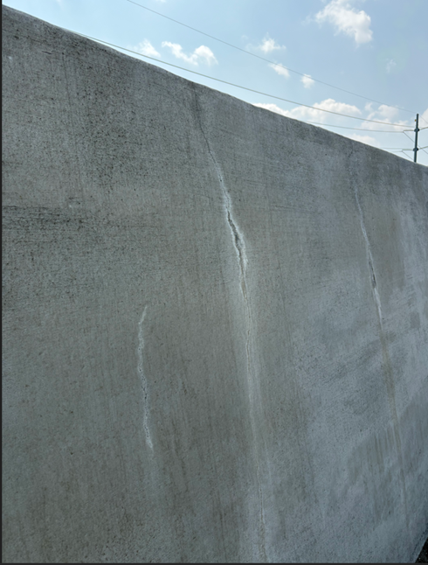
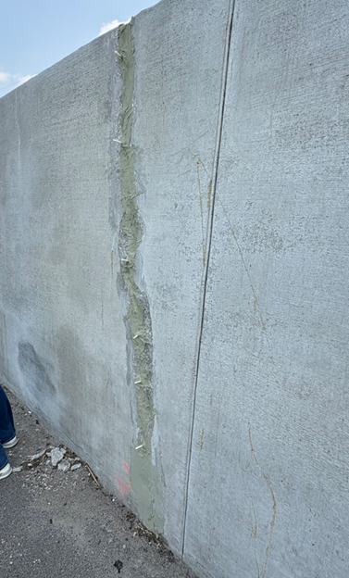
Concrete Barrier Wall – 81IN, Type N

Slide 12
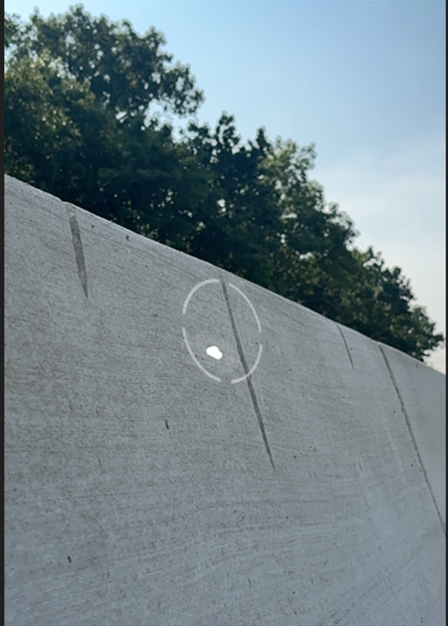
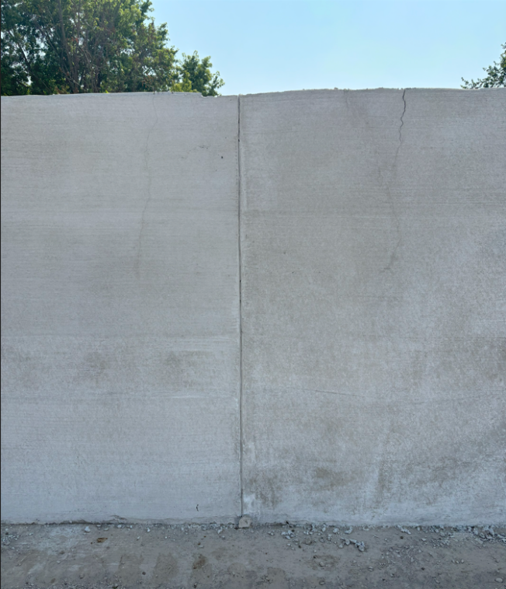
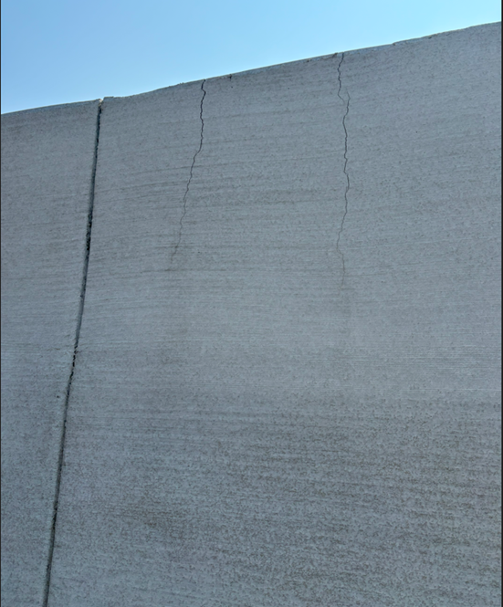
Concrete Barrier Wall – 81IN, Type N

Slide 13
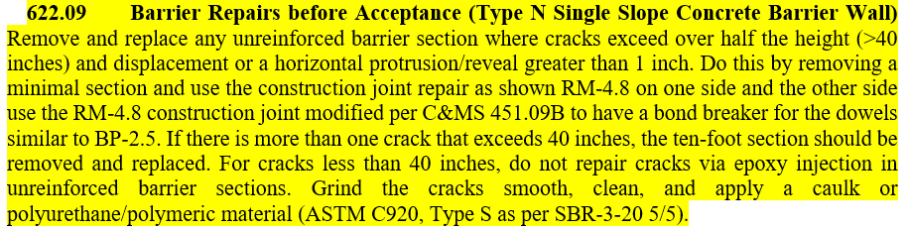
622 Concrete Barrier - 81IN = TYPE N

Slide 14


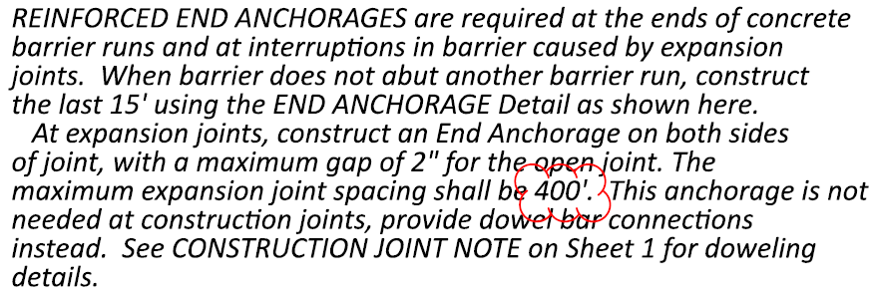


RM-4.8, 81IN Barrier = Type N Barrier

Slide 15
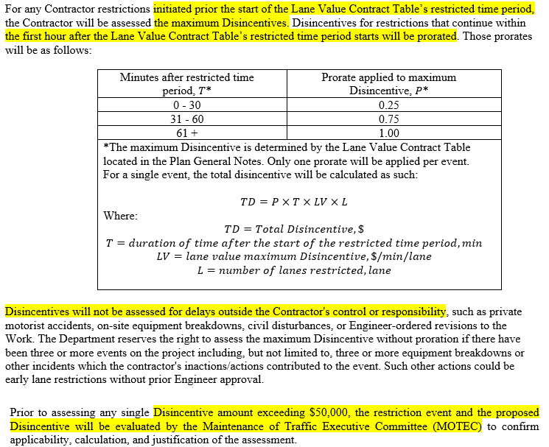
PN 127 Lane Value Contract

Slide 16
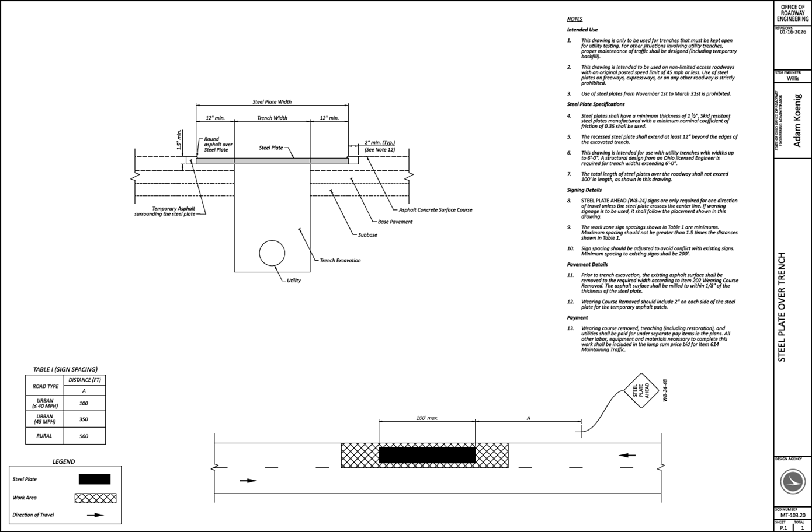
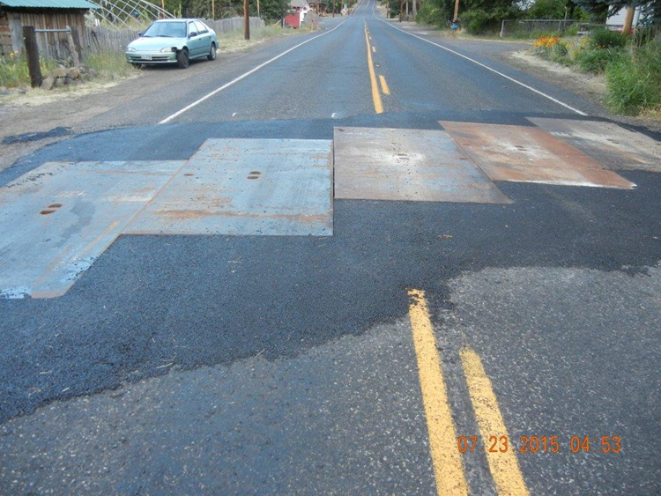
MT-103.20 - Steel Plate

Slide 17
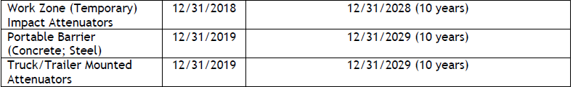
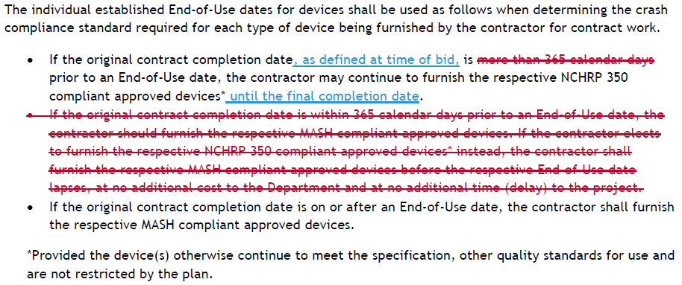
Quality Standards TTC

Slide 18
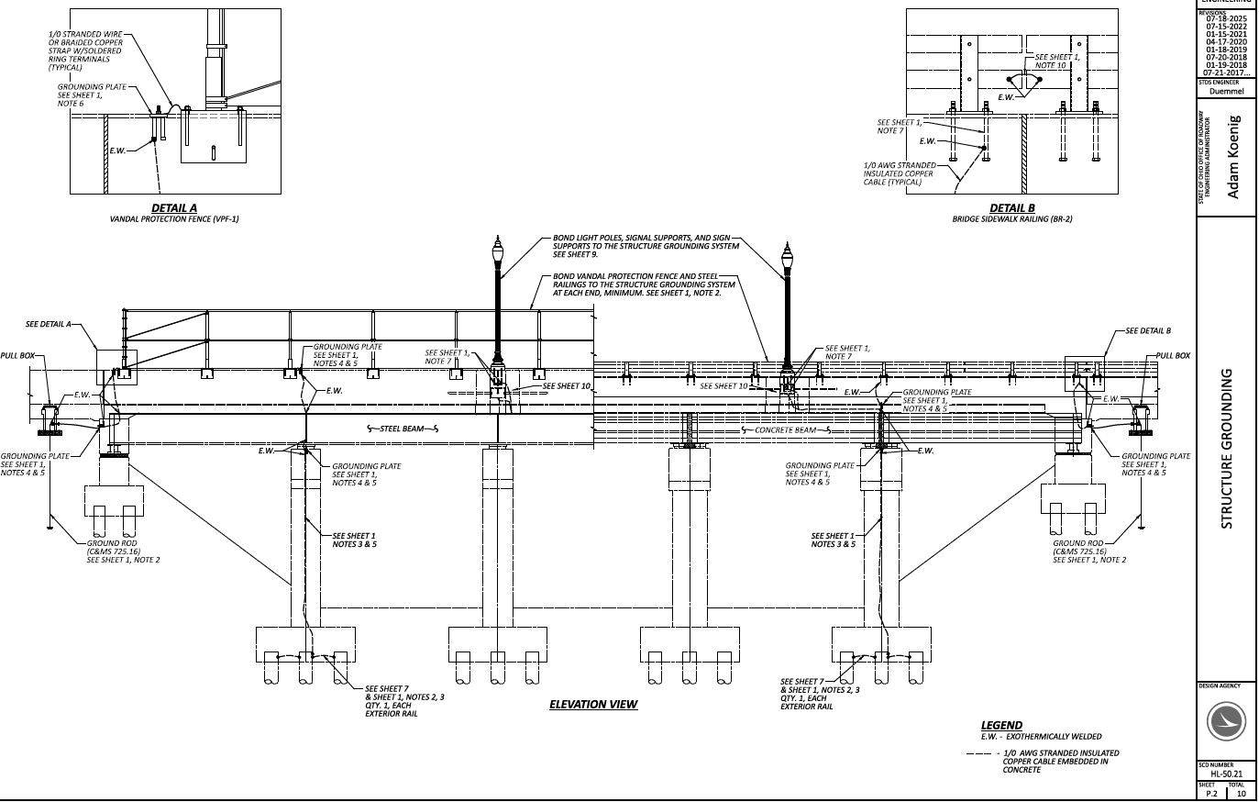

HL-50.21 Structure Grounding

Slide 19
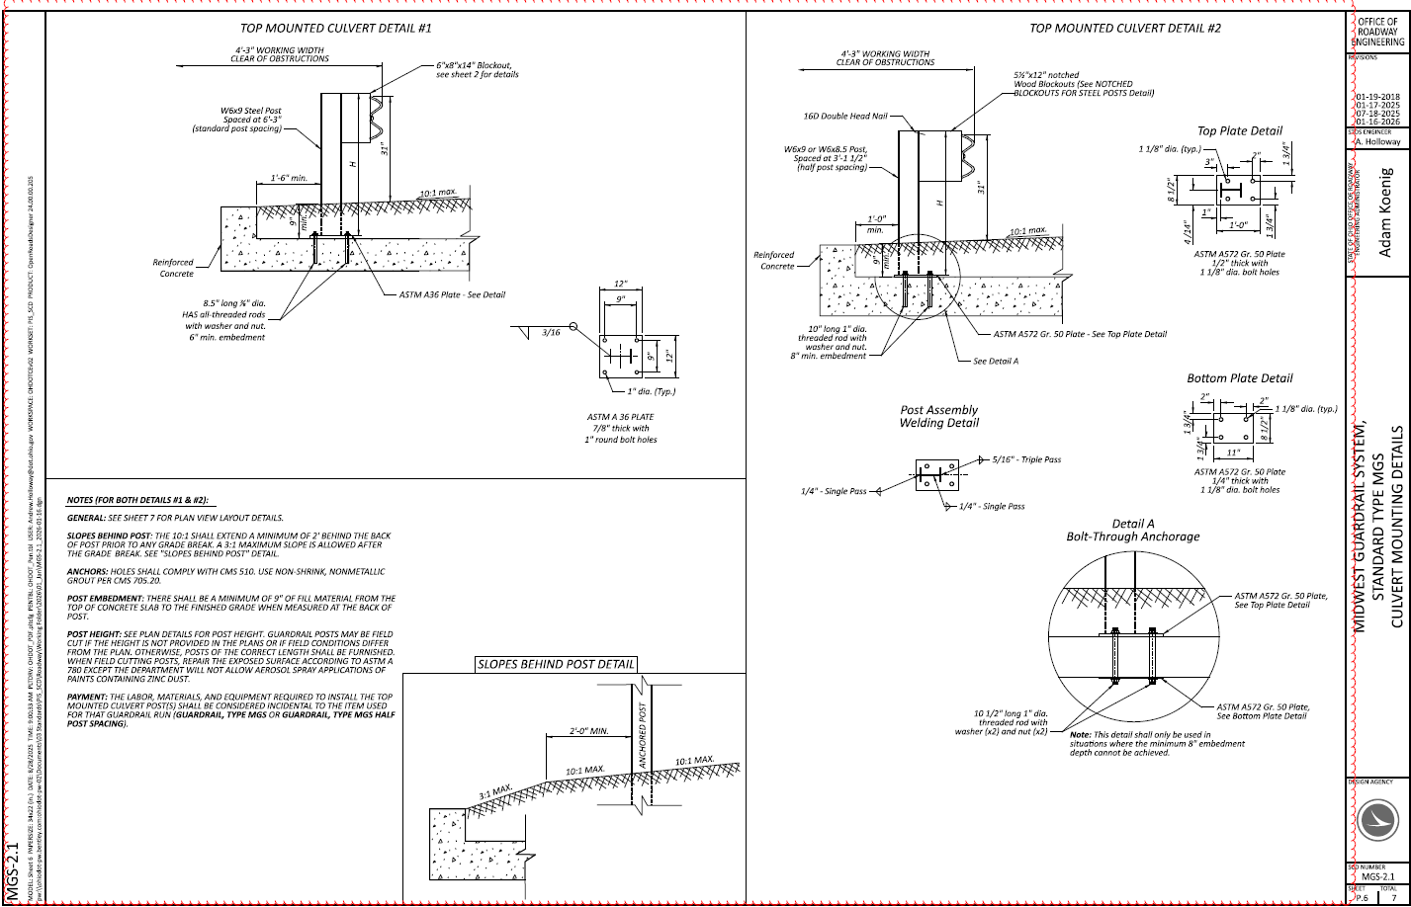

Slide 20
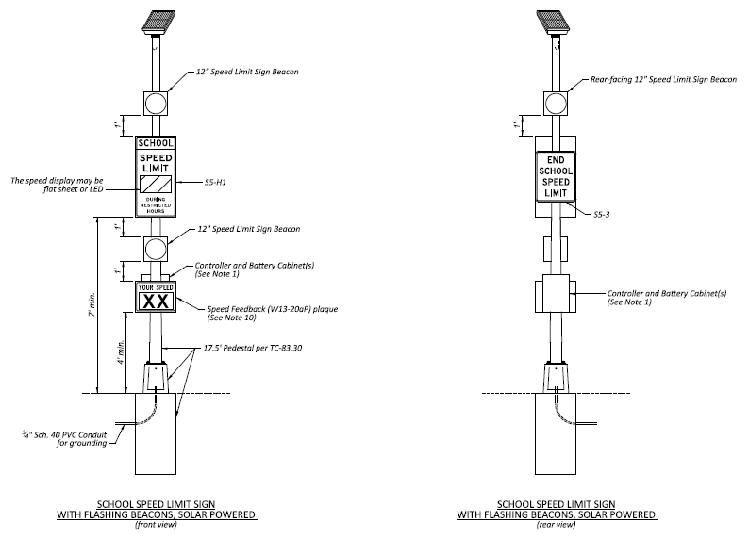
TC-87.20 School Speed Limit Signs

Slide 21
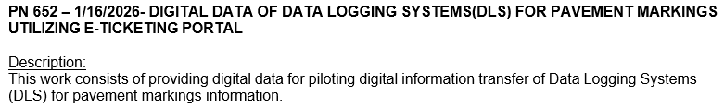
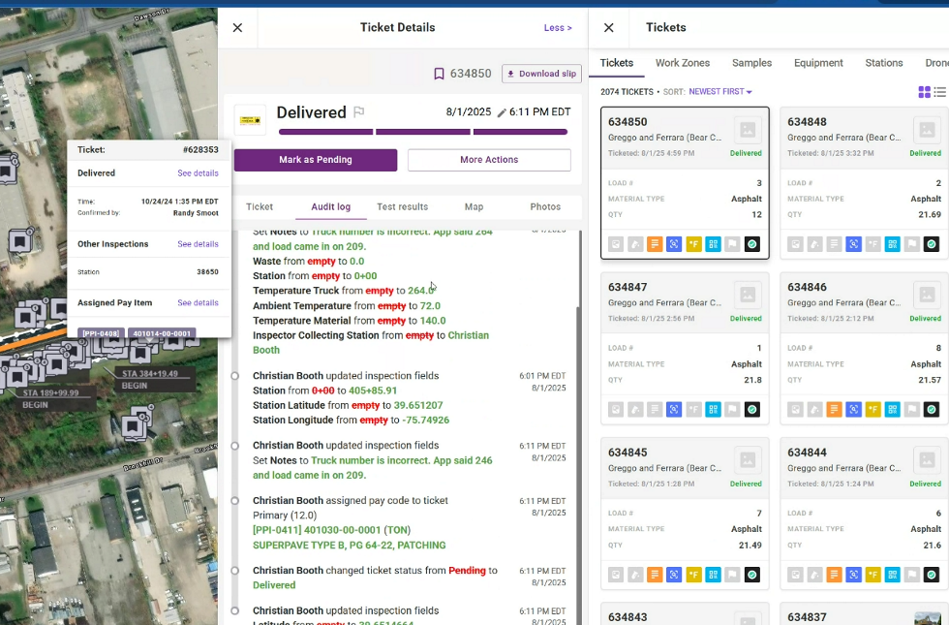
PN 652 Piloting E-Ticketing for DLS Reports

Slide 22
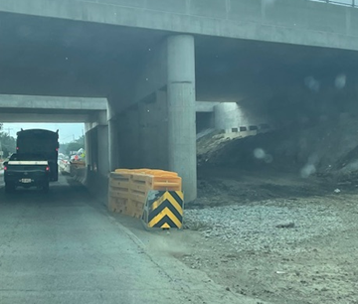
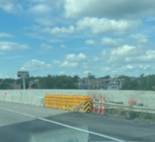
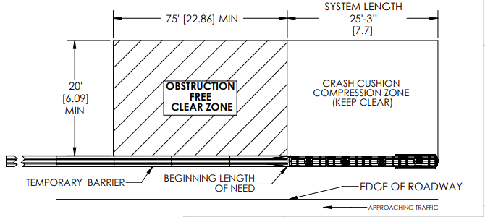
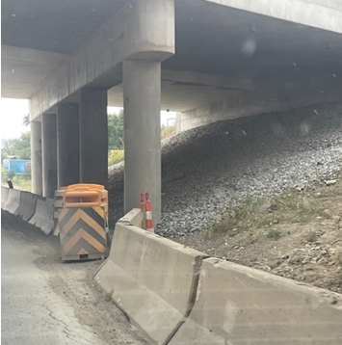
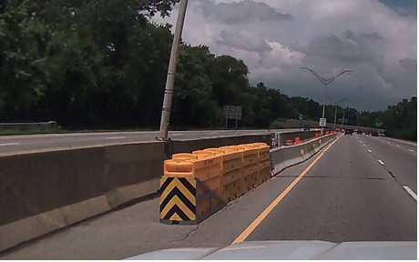
Work Zone impact Attenuators: water-filled non-redirective gating
Notes:
[top – this is the end of a curve, see skid marks]
[top – not 30’, pcb (see the yellow sheeting next to the street sweeper); just lazy]
[bottom – not 30’, this is a 35 mph road; storage is independent of speed]

Slide 23

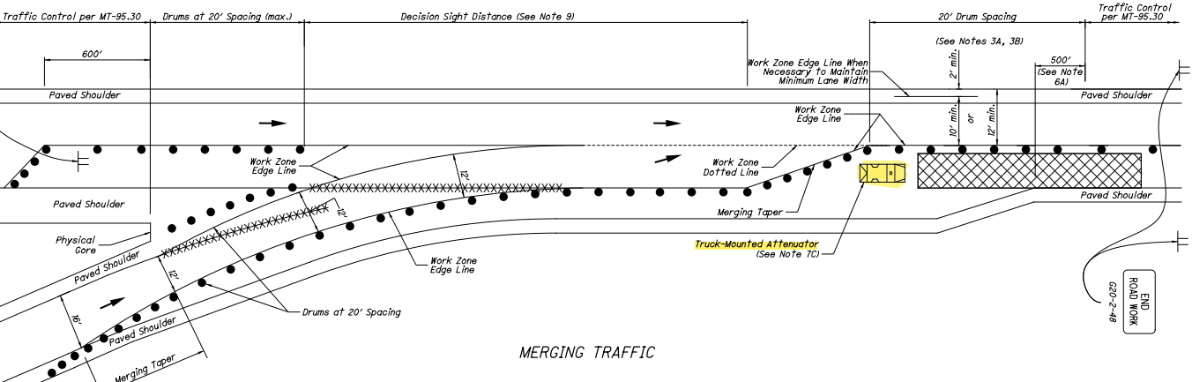
TMA

