Slide 2
Pavement Specifications Update Craig landefeld – odot pavement engineering

Slide 3
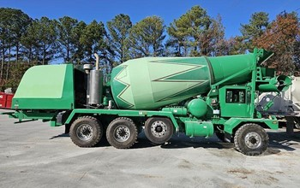
Concrete Specification Changes
499.04 Concrete Mix designs
Added a provision allowing QC 1P in lieu of QC 1
615.05 Pavement
Added QC 1P as an option for concrete temporary pavement

Slide 4
Concrete Specification Changes
455.02 QCP Requirement
Added requirement for ACI certified Self-Consolidating Concrete Technician when testing self consolidating concrete
499.03 Concrete Mix Designs
Added minimum surface resistivity requirement as an option to permeability requirements/testing
Deleted minimum cementitious content requirements

Slide 5

Concrete Specification Changes
S1126 Concrete Mix Design Approval Submittal
Added resistivity option throughout
Added requirement for an AASHTO accredited lab for QC 5 mix designs
Added language to QC SCC mixes to measure air content, temperature, unit weight, and yield and produce strength specimens from the same mix. Test strength at 3, 7, and 28 days and determine the aggregate correction factor.

Slide 6
Concrete Specification Changes
S1126 Concrete Mix Design Approval Submittal
Added allowance for third point flexural strength for QC MS and QC RS mix designs
Added Micro-Silica Modified, Latex Modified, and Superplasticized Dense Concrete Mix Design submittals
Added clarification to use the most recent aggregate specific gravity and absorption values from ODOT

Slide 7
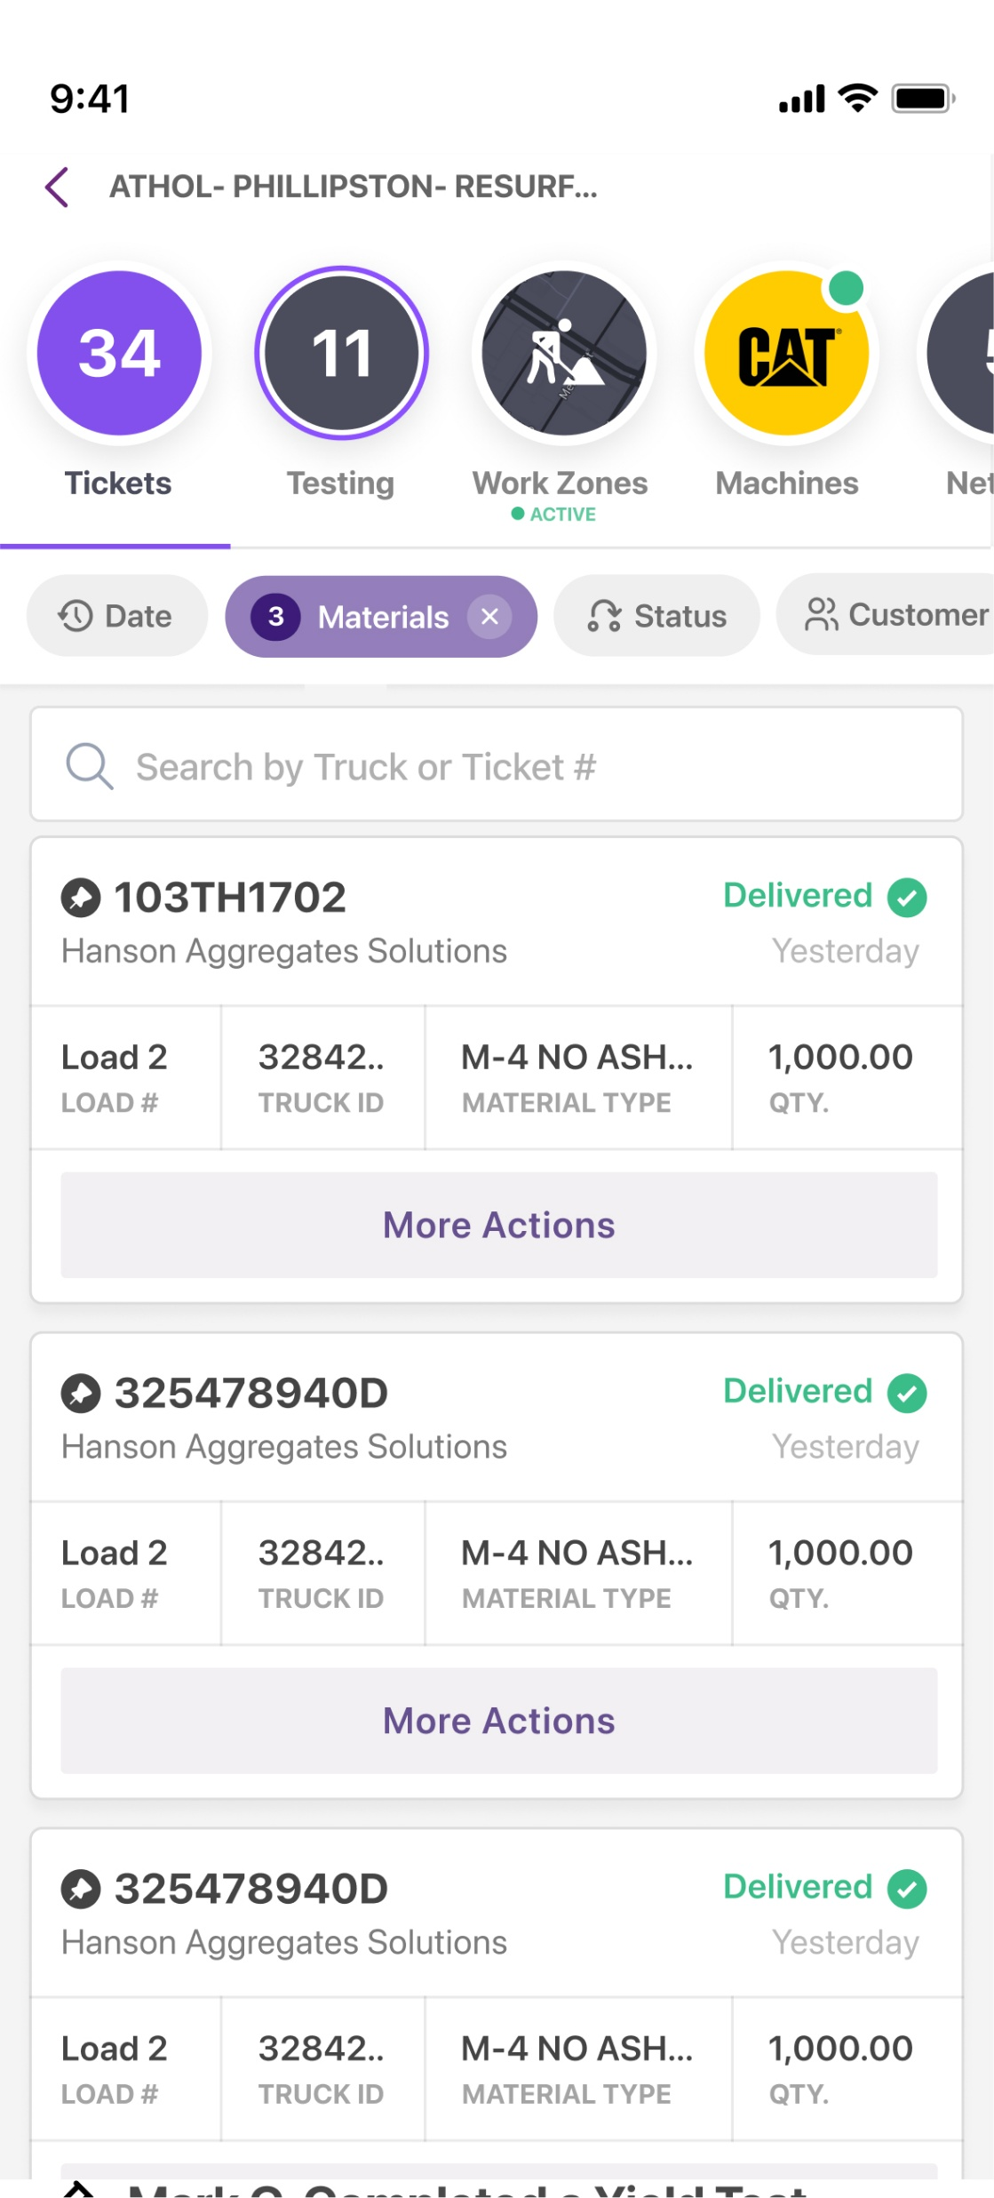
Concrete Specification Changes
PN 150 E-Ticketing
Added concrete batch tickets and aggregate delivery tickets to the e-ticketing proposal note

Slide 8
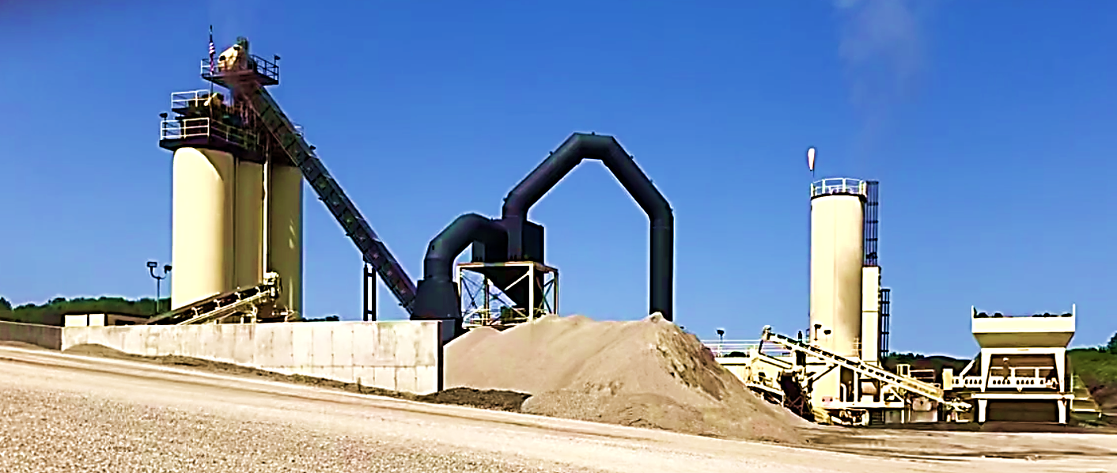
Asphalt Specification Changes
402.03 Plant Calibration
Updated plant calibration procedures to present-day standards and methods
S1101 Asphalt Concrete Mixing Plants
Updated the weight ticket requirements to be consistent with PN-150 E-Ticketing

Slide 9
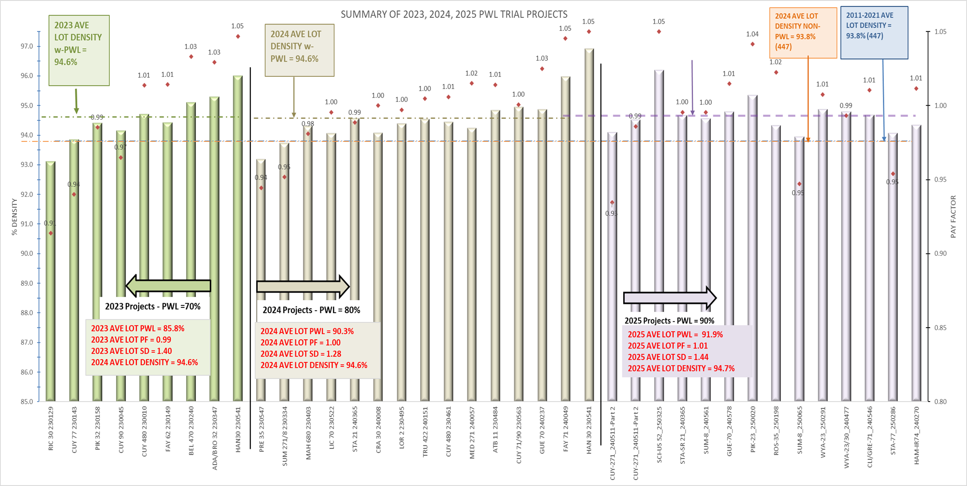
Pwl history 2023 - 2025
2025 AVE LOT DENSITY w-PWL = 94.7%

Slide 10
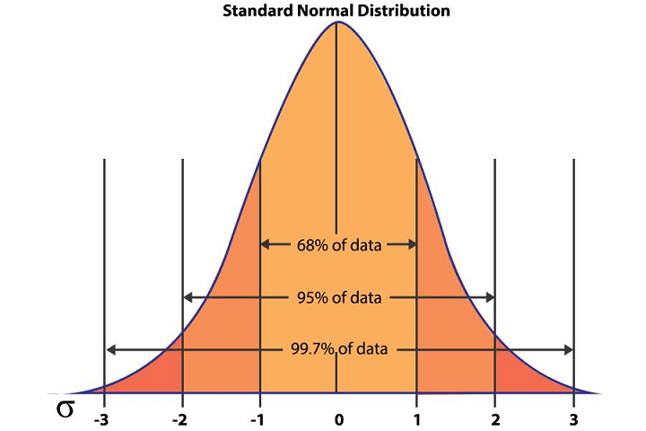
Asphalt Specification Changes - PWL
Percent Within Limits (PWL) Density Acceptance
PWL Cost Premium ~ 5% increase
Avg. Lot Density ~ 1% increase
Avg. Std. Dev. ~ 0.3 decrease

Slide 11
Asphalt Specification Changes - PWL
Percent Within Limits (PWL) Density Acceptance
Held for Jan. 2026, plan to release with July 2026 updates.
PWL Specs for use with 442 items only
447 – PWL for mat and joint cores
- 6in. cores for mat and joint
- Update pay calculations for mat cores
New acceptance method (882)
SS882: ASPHALT CONCRETE PERCENT WITHIN LIMITS DENSITY ACCEPTANCE
EX: Item 442 ASPHALT CONCRETE SURFACE COURSE, 12.5 MM, TYPE A (882)
S1044:Percent Within Limits Tolerance Procedure For Items 447 and 882

Slide 12
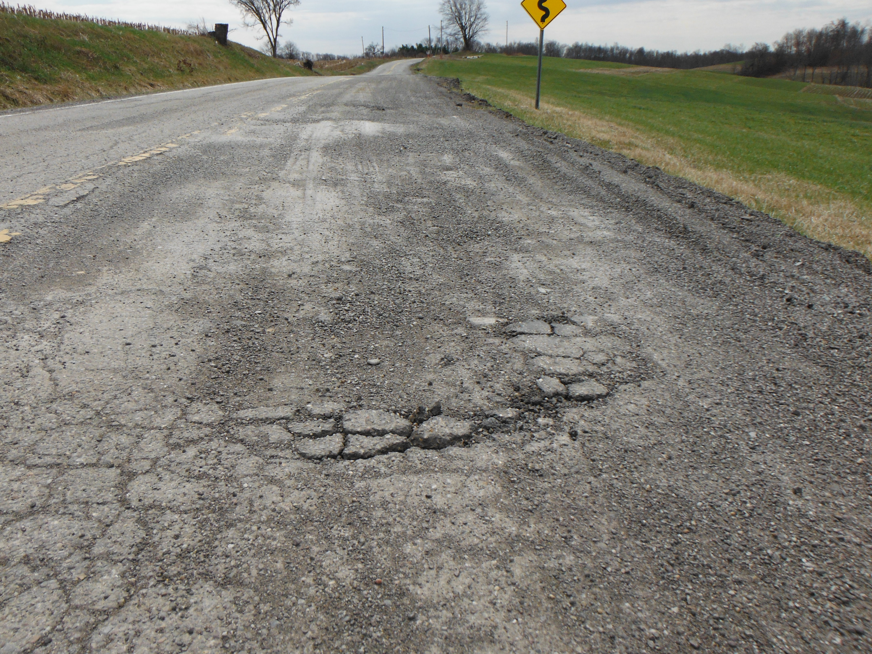
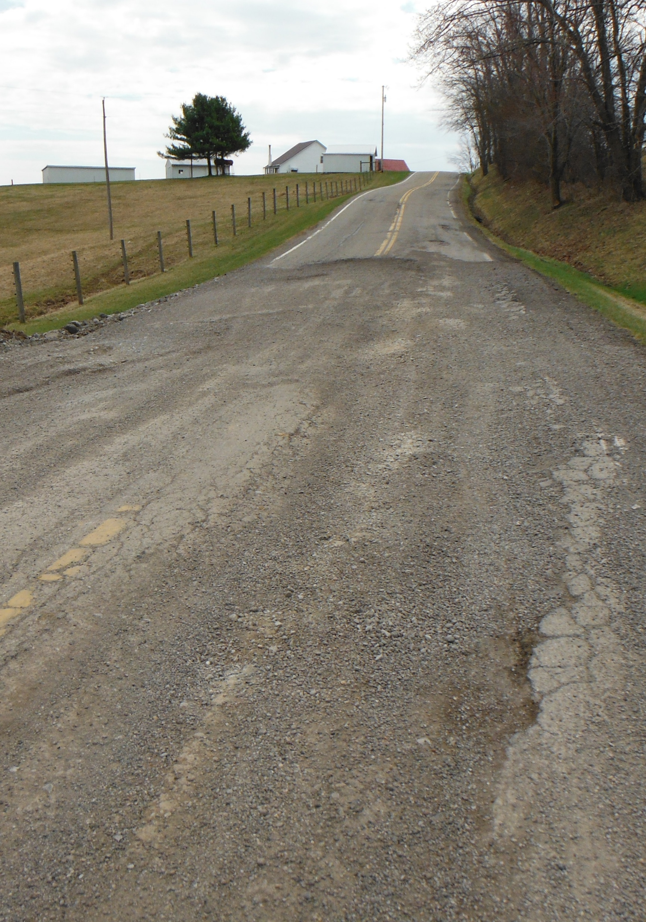
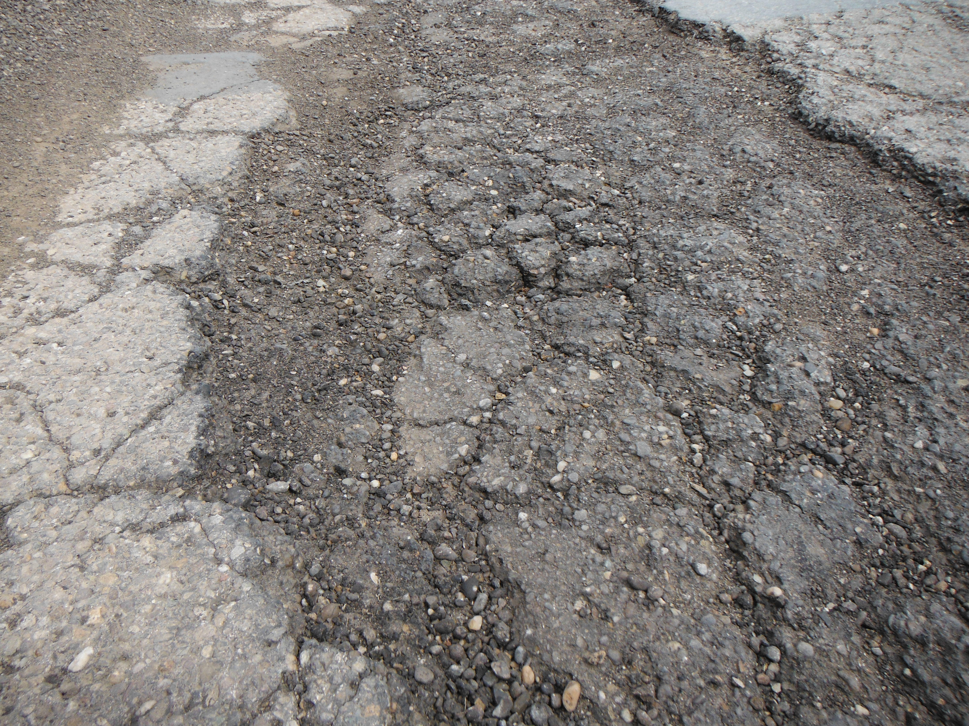
SS 827 Full Depth Reclamation w. Cement
General system major rehabilitation
Roads with large amounts of full depth repair required
Depth must extend into subgrade
Requires closing the road/detour
Use only with OPE coordination & approval
S1150 Mixture Design For Full Depth Reclamation With Cement
Source: Jason Wielinski

Slide 13
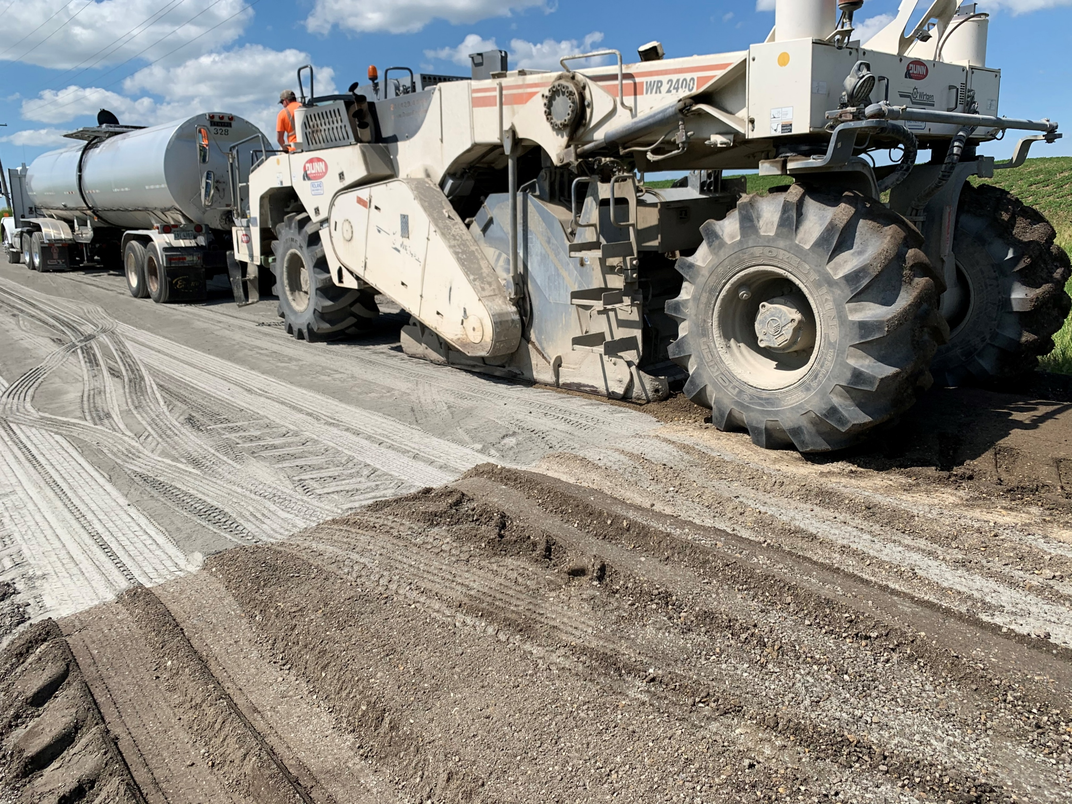
SS 827 Full Depth Reclamation w. Cement
Just-in-Time Training
C.O. will assist with mix design approvals
Must limit traffic for cure period
On-site testing (nuclear gauge) & Lab testing required by District
Source: Jason Wielinski

Slide 14
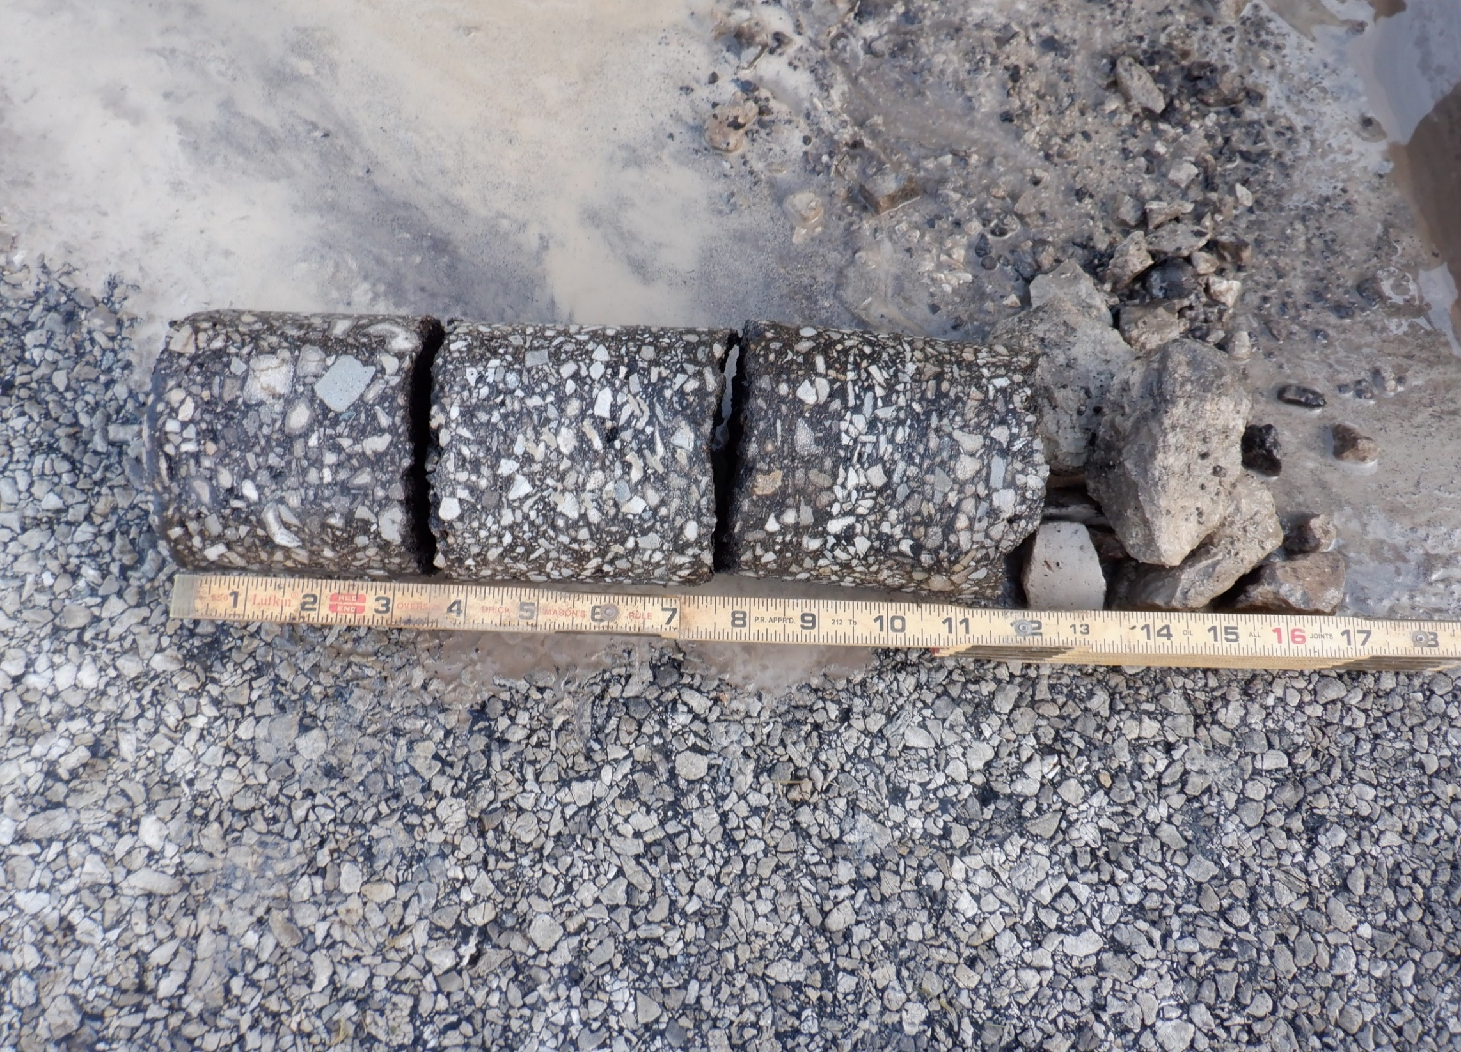
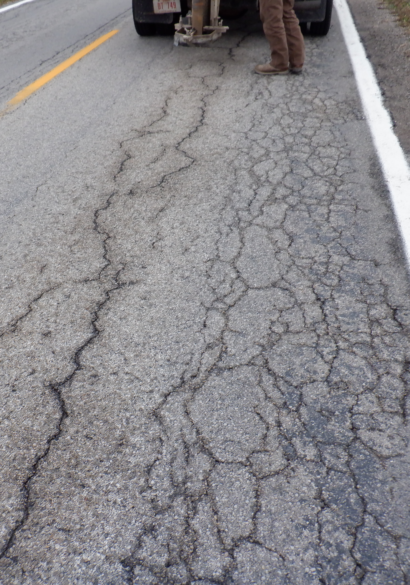
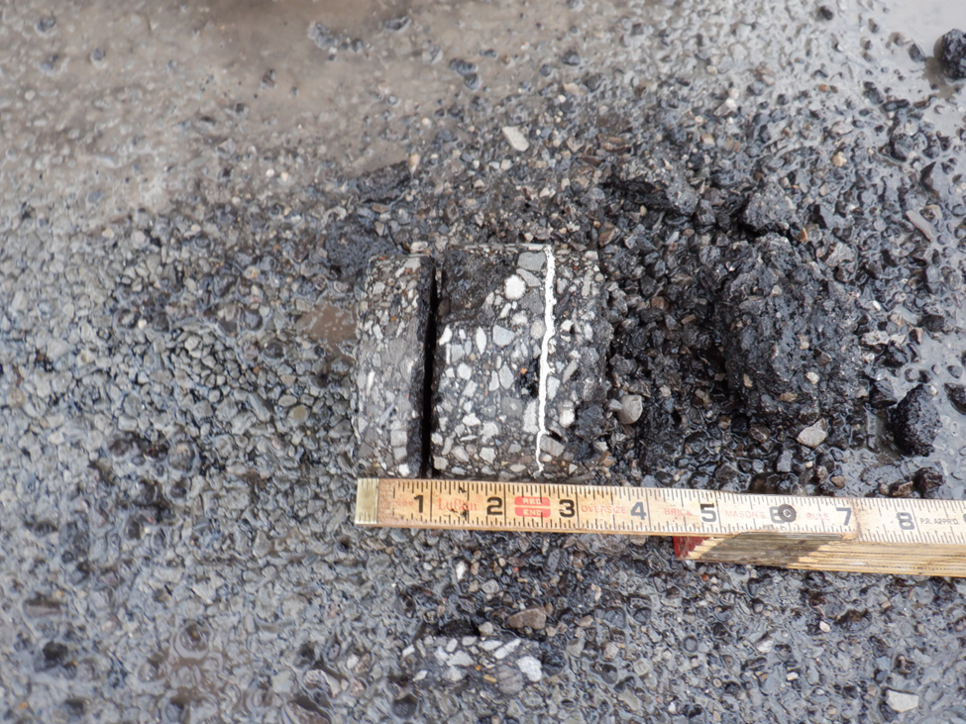
SS 881 Full Depth Reclamation w. Emulsion
General system major rehabilitation
Roads with macadam bases or very thick sections
Requires closing the road/detour
Use only with OPE coordination/approval
S1077 Mixture Design for Full Depth Reclamation with Emulsified Asphalt

Slide 15
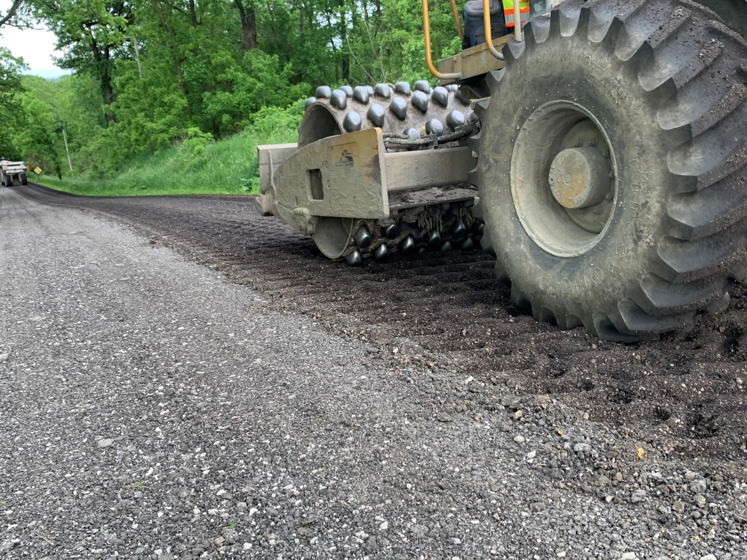
SS 881 Full Depth Reclamation w. Emulsion
Just-in-Time Training
C.O. will assist with mix design approvals
May 1 to Sept. 30th Time Limits
Weather limits (50°F & rising)
No cure requirement for local traffic
Moisture testing is critical for overlay performance.
On-site test (nuclear gauge) & Lab testing required by District
Source: Jason Wielinski

Slide 16


Thank You Attendees & Sponsors
Questions??
Craig Landefeld, P.E.
ODOT Office of Pavement Engineering
Craig.Landefeld@dot.ohio.gov
(614) 644-6622

