Slide 2
Structure update
Chris shonk
ODOT Bridge standards engineer

Slide 3
July 2025 sbd psbd-1-25
New Standard Drawing for Prestressed Concrete Box Beams, PSBD-1-25, (July 2025)
  Replaced PSBD-2-07
  Main Changes
    Larger more robust shear keys
    Stirrup bar shapes for the composite box beams

Slide 4
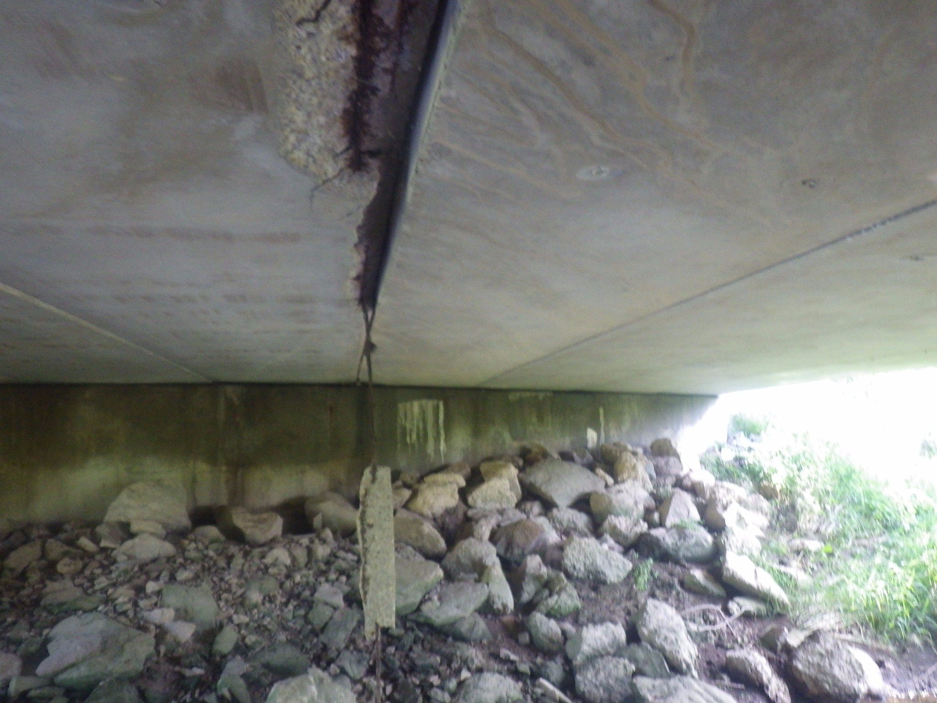
July 2025 sbd psbd-1-25
Reason for New Standard
Shear Key failure/cracking
  Leads to leaking joints
  Beam edge saturation
  Strand corrosion
  Spalling concrete
  Strand failure
Notes:
The primary reason for updating the Prestressed Box Beam standard was to address shear key failure which is common for bridges built with the old standard. Shear key failure or cracking causes leakage at the joints and in some cases a loss of load transfer. Leaking joints causes the beam edges to become saturated with chloride-laden water which results in premature corrosion of the strands. The corroding strands then cause the surrounding concrete to spall and eventually strand loss or failure.

Slide 5
July 2025 sbd psbd-1-25
New Standard Drawing PSBD-1-25
  Larger shear keys
    Research has shown that full depth shear keys provide more bonded area between the shear key and girder. No grout in the top 5” of the shear key throat. The top 5” experiences the greatest thermal stress. Not grouting this area reduces the overall stress in the shear key and greatly reduces chance of cracking. For more information refer to NCHRP Research Report 1026.
  Stirrup bars for composite box beams were modified.
    The new stirrup bar shape simplifies the fabrication process.

Slide 6
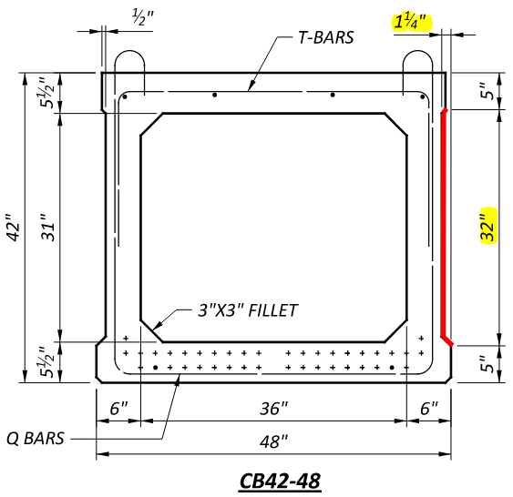
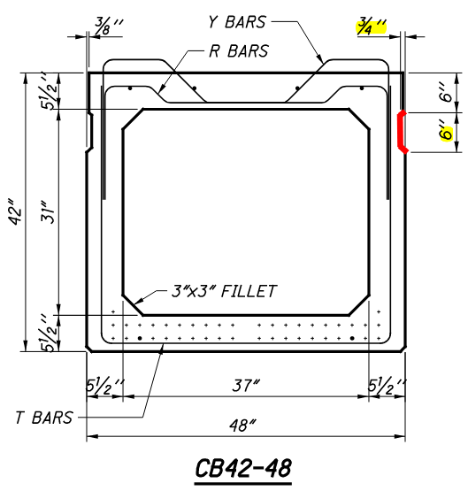
July 2025 sbd psbd-1-25
PSBD-1-25 (NEW) vs PSBD-2-07 (OLD)
Composite Beam Sections

Slide 7
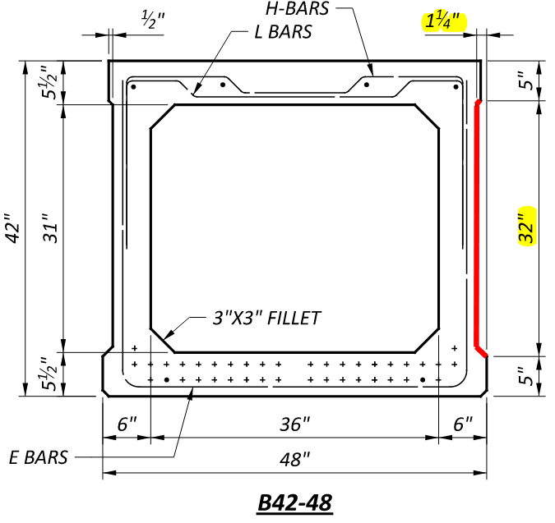
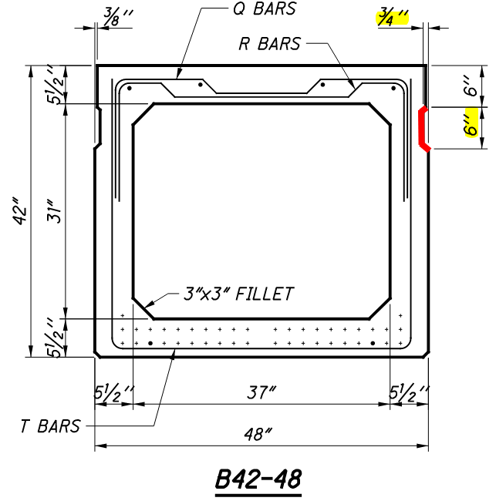
July 2025 sbd psbd-1-25
PSBD-1-25 (NEW) vs PSBD-2-07 (OLD)
NON-Composite Beam Sections

Slide 8
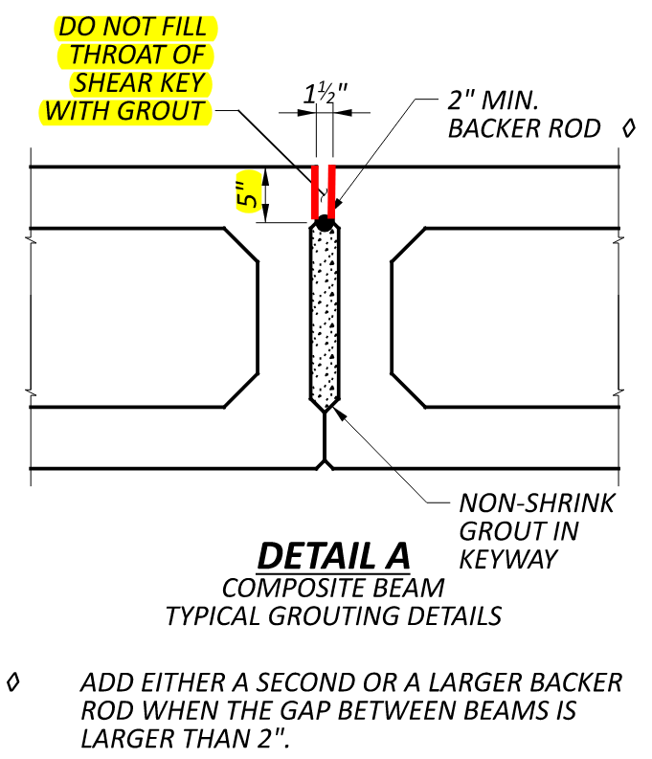
July 2025 sbd psbd-1-25
Keyways: Composite Beams
Fill keyway with non-shrink grout only to bottom of throat.
Insert backer rod and leave throat of shear key empty until grout is cured.
Allow throat to fill with concrete during deck placement.

Slide 9
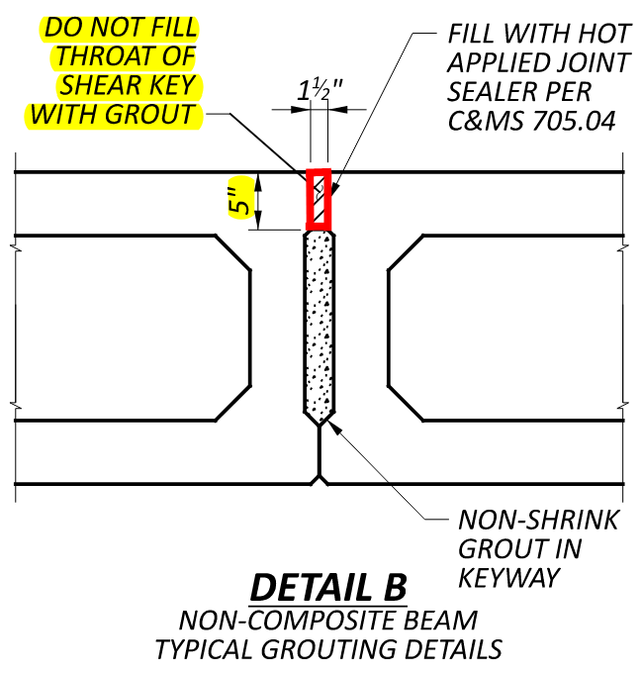
July 2025 sbd psbd-1-25
Keyways: Non-Composite
Fill keyway with non-shrink grout only to bottom of throat.
Leave the throat of shear key empty until grout is cured.
Non-Composite Beams: fill keyway throat with hot applied Joint Sealer.

Slide 10
July 2025 C&ms 515.14
C&MS ITEM 515 PRESTRESSED CONCRETE BRIDGE MEMBERS
515.14 Construction Methods.
Use metal forms capable of producing members within the tolerances shown on the plans. Forms made of material other than metal may be used for bulkheads, voids, and shear keys. Ensure that the surfaces of the forms in contact with the concrete are smooth and the joints between panels are tight.

Slide 11
July 2025 C&ms 515.19
C&MS ITEM 515 PRESTRESSED CONCRETE BRIDGE MEMBERS
515.19 Handling Storage, Transportation, and Erection.
Place box beams to ensure a correct fit of the shear keys and ensure proper grouting of the shear keys. After placing the beams and installing tie devices, fill the longitudinal shear keys as shown in standard drawing PSBD-1-25 using non-shrink shear key grouts, 705.22, approved by OMM. Stop the grout at the top of the shear key as shown. The grout in the shear key will crack if extended above the shear key into the throat. Mix, install, and cure the grout according to the manufacturer’s published recommendations to obtain a design compressive strength of 5000 pounds per square inch.

Slide 12
July 2025 C&ms 515.19
C&MS ITEM 515 PRESTRESSED CONCRETE BRIDGE MEMBERS
515.19 Handling Storage, Transportation, and Erection.
On full width construction, do not pour the bridge decks or allow vehicular loads on a prestressed concrete box beam structure until the grout in the shear keys obtains the specified design strength of 5000 pounds per square inch. On part width construction, do not allow the deck pour or vehicle loads on each stage until after the shear keys in that stage obtain 5000 pounds per square inch. Stage 1 can have vehicle loads during construction of stage 2. Do not open the stage 2 portion of part width construction or pour the closure pour portion of the deck as shown in PSBD-1-25 until after the grout in the shear key between stages obtains the specified design strength of 5000 pounds per square inch.

Slide 13
July 2025 C&ms 524.09
C&MS ITEM 524 DRILLED SHAFTS
524.09 Reinforcing Steel for Drilled Shafts.
Tie and support the reinforcing steel so it remains within the required tolerances. Securely tie spacers at quarter points around the cage perimeter and space at intervals not to exceed 5 feet along the length of the cage. If the size of the longitudinal reinforcing steel equals or exceeds 1 inch in diameter, the Contractor may increase the distance between the spacing devices to a maximum of 10 feet. Use the following spacer size to ensure a minimum annular space between outside of cage and side of hole.
A. 3.0 inches for shafts ≤ 3’-0” diameter.
B. 4.0 inches for shafts > 3’-0” but < 5’-0” diameter.
C. 6.0 inches for shafts ≥ 5’-0” diameter.
The Contractor may use round plastic spacers.
Notes:
The reinforcing steel, spacer size for drilled shafts was revised to match the guidance in the Bridge Design Manual.
Old Spec: 3 inches for shaft diameters up to 4 feet and 6 inches for shaft diameters larger than 4 feet.

Slide 14
January 2026 C&MS 202.03
C&MS ITEM 202 REMOVAL OF STRUCTURES AND OBSTRUCTIONS
202.03 Structures Removed
Where alteration of an existing structure requires removal of portions of the structure, remove those portions with sufficient care as to avoid damage to the remaining portion of the structure. In case of damage to the existing structure, repair or replace the structure at no expense to the Department. Remove any existing welded form hangers, welded attachments two inches or longer measured parallel to the long axis of the top flange of steel beams or girders, and welded attachments that interfere with the placement of welded shear connectors. Any items from this list not shown in the bid documents shall be removed per 109.05.
Notes:
This revision was requested by OCA. An example on a rehab project, where a bridge deck is being replaced and the steel girders are to remain or salvaged, contractors on occasion would find welded attachments that were not shown in the project plans or even the original plans for example welded form hangers. This would cause unforeseen work/delays. Those items will now be removed by change order if not shown in the bid documents.

Slide 15
January 2026 C&MS 511.12
C&MS ITEM 511 CONCRETE FOR STRUCTURES
511.12 Depositing and Curing Concrete During Cold Weather
If placing concrete when the atmospheric temperature is below 36 °F (2 °C), or if weather forecasts predict these temperatures during the curing period, follow the procedures of this subsection.
Maintain the concrete curing temperature using a heated enclosure, insulated forms, or by flooding, except cure deck slabs less than 10 inches (250 mm) thick using more than just insulated forms when temperatures are predicted to fall below 33 °F (0.5 °C).
Notes:
1st revision: The temperature increased from 32° F to 36°F
2nd revision: The temperature increased from 32° F to 33° F
This adjustment is closer to the industry standard and addresses the recent increase in cracking observed during cold-weather pours.
The changes gives us more breathing room, as opposed to being right at 32° F.

Slide 16
January 2026 C&MS 516.07
C&MS ITEM 516 EXPANSION AND CONTRACTION JOINTS JOINT SEALERS AND BEARING DEVICES
516.07B Elastomeric Bearings
Set elastomeric bearings on bridge seat areas that are flat with a smooth level surface measured using a level placed across the entire bearing area with a tolerance of +/- 1/8 inch.… Provide a Corrective Work Plan according to 501.05.C for bridge seat locations that are greater than 1/4-in below Plan elevations. The Department will pay the cost of the corrective work for a pre-existing bearing seat per 109.05 unless otherwise noted in the contract documents.
Notes:
Example: When the Department replaces bearings steel rocker bearings with elastomeric bearings, contractors would find after removing the existing bearing that the existing bridge seat would be out of spec. and need to be corrected. This is to clarify that if no pay item is present to level the bridge seat that it will be a change order negotiated per 109.05.

Slide 17
January 2026 C&MS 709.16
C&MS 700 MATERIAL DETAILS
709.16 Galvanized Steel Reinforcement
Provide galvanized steel reinforcement in accordance with ASTM A767, Class 1, 2 or ASTM A1094.
The following modifications apply to ASTM A767:
7.3.2 Fabrication after galvanizing: The Department will not accept reinforcement galvanized according to ASTM A767to be fabricated after galvanizing.
Notes:
Modified language for Galvanized Reinforcement to include Class 2 Hot-Dipped galvanizing. This will give contractors an additional option for galvanized steel reinforcement. Class 2 hot-dipped galvanizing has a thinner zinc coating, which allows for bending after the galvanization process. The modification to ASTM A767, 7.3.2 was removed.

Slide 18
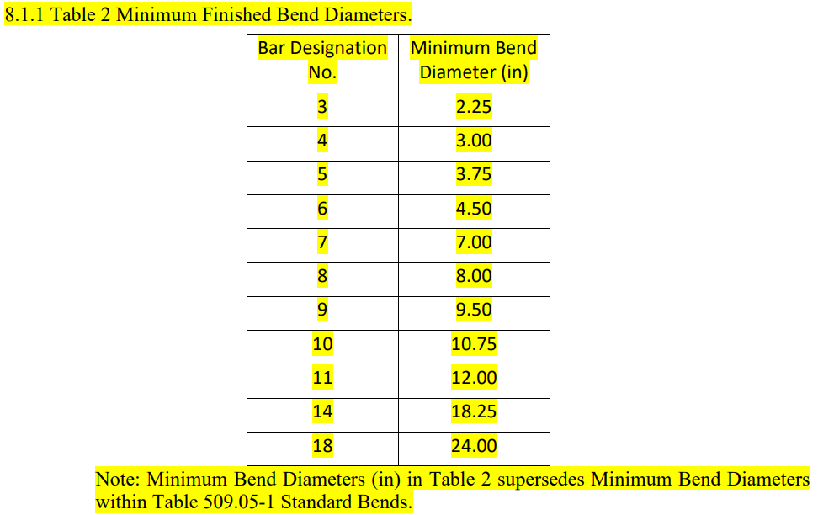
January 2026 C&MS 709.16
709.16 Galvanized Steel Reinforcement (Continued…)
The following modifications apply to ASTM A767:
Notes:
A table for minimum finished bend diameters was also added to the modifications to ASTM A767. This table also supersedes the minimum bend diameters shown in Table 509.05-1 Standard Bends.

Slide 19
Type 1L Cement – What to watch out for…
Type 1L has potential to increase water demand, reduce bleeding, impact set time, and create a narrower finishing window
Less forgiving when poor finishing or curing practices are used
Ensure full required cure – membrane and water cure quality and timing more critical
Reduced bleeding/lower bleed rate and leads to increased sensitivity to evaporation and shrinkage

Slide 20
Type 1L Cement - Seminar
  Type 1L Cement Concrete, Finishing, and Curing Seminar
  Date: March 13, 2026
  Time: 9:00am – 12:00pm
  Location: ODOT Auditorium
  1980 West Broad Street
  Columbus, OH
  COST: Free
  Register: OCA Website
  Host: ODOT/Ohio Concrete/Ohio Contractors Association (OCA)
Notes:
Next Friday, March 13th, ODOT in collaboration with Ohio Concrete and the Ohio Contractors Association, will be hosting a free seminar focused on Type 1L cement and concrete behavior with placement, finishing, and curing. Who should attend: Contractors involved in ODOT work, superintendents, concrete foremen, construction project managers (ODOT & Contractors).

Slide 21
Slipform parapet research update
Research will conclude this month
Mock-ups were poured in October
  Mock-up segments with the Improved Mix demonstrated:
    Superior consolidation and finish quality
    Stable edges with minimal tearing
    Placement speed nearly doubled
Implementation – ODOT will issue a memo with the improved mix parameters.
Notes:
In 2023, a collaborative study between Ohio State University, Oklahoma State University, Kokosing Construction, and ODOT was launched to improve slip-formed parapet performance. The research evaluated alternative concrete mixes designed to resolve consolidation, cracking, and edge stability issues common in the standard Ohio QC2 mixes. The study resulted in an optimized mix design that delivers superior consolidation, improved finish quality, and stable edges with minimal tearing—all while increasing placement speed.
Implementation:
ODOT will issue a memo of some sort saying that if a contractor wants a concrete mix that meets those requirements now, we, ODOT will allow it in lieu of the requirements of QC2. The ready-mix producer will then need to submit the mix to OMM per Supplement 1126.

Slide 22
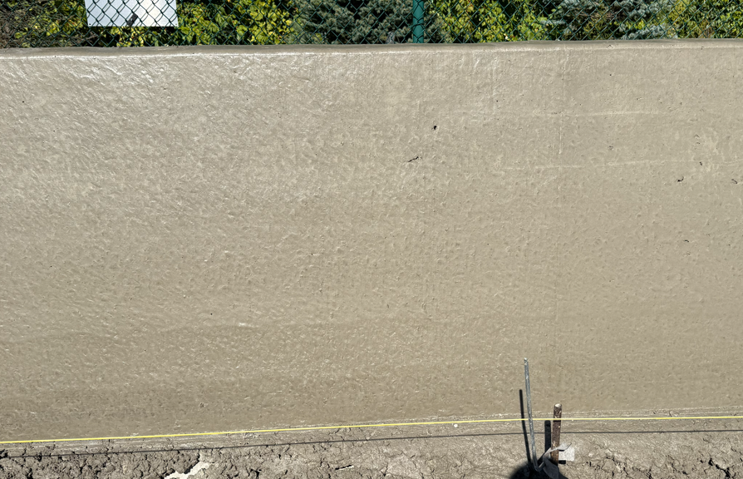
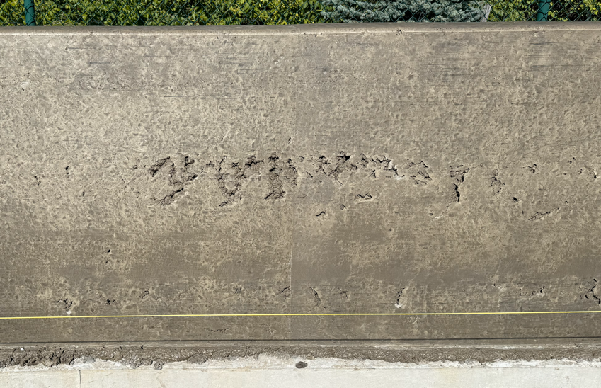
Slipform parapet research update
Improved Mix
Standard Ohio Mix

Slide 23
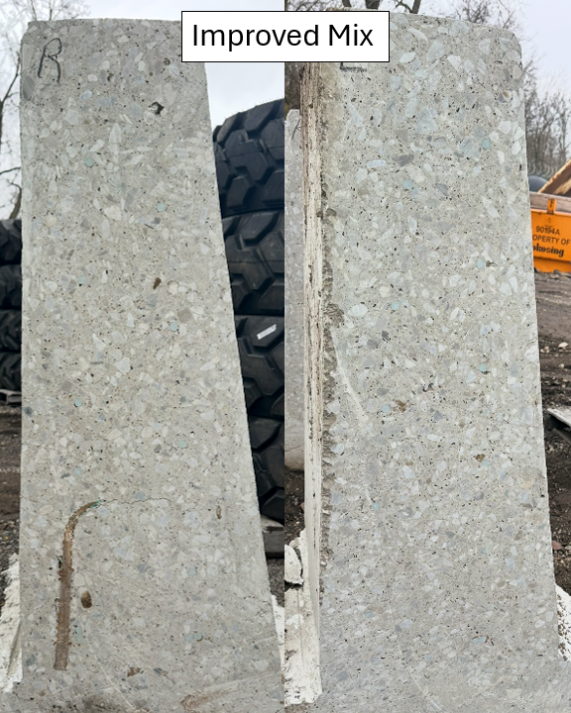
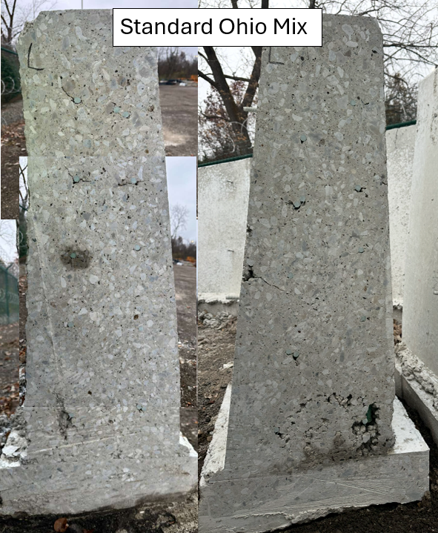
Slipform parapet research update
Notes:
Special Thanks to…
Lisa Burris – Ohio State University
Tyler Ley – Oklahoma State University
Kokosing
Jim Eudaly- Resource International.

Slide 24

Questions

Slide 25


Thank You Attendees & Sponsors

