Slide 2
Geotechnical updates Justin Gardner, p.e.

Slide 3
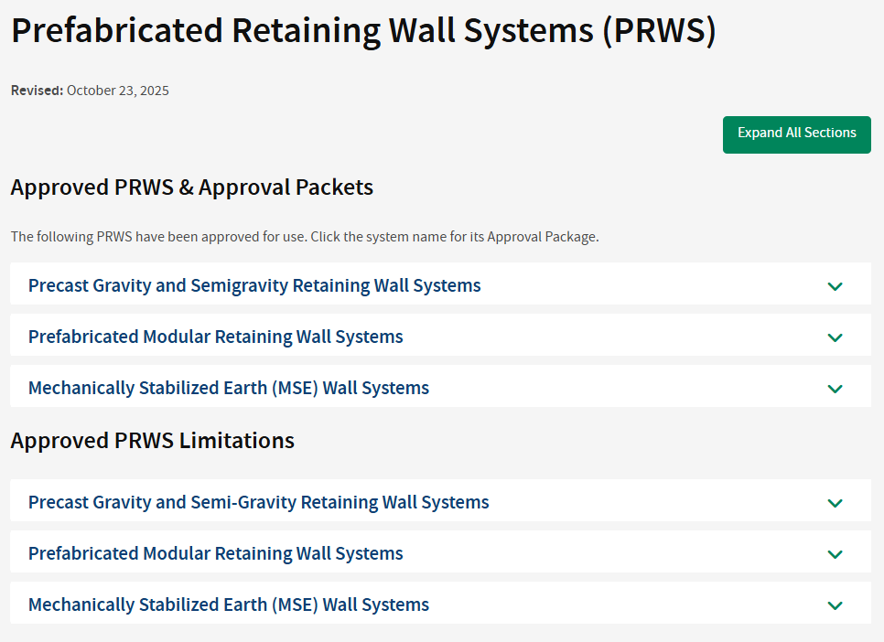
Prefabricated Retaining Wall Systems (PRWS)
SS840 Mechanically Stabilized Earth (MSE) Wall
SS851 Precast Gravity And Semigravity Retaining Wall
SS870 Prefabricated Modular Retaining Wall

Slide 4

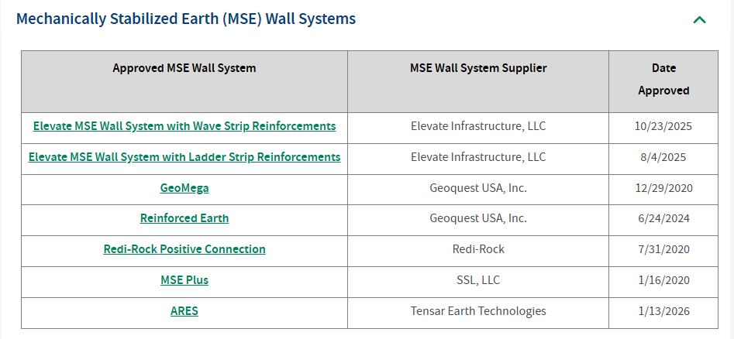
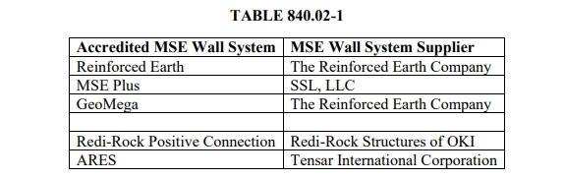
SS840 Mechanically Stabilized Earth Wall
Accredited MSE Wall System.
All approved Prefabricated Retaining Wall Systems are listed on the Approved Products & Materials Lists. More details of accredited systems and suppliers can be found on the Office of Geotechnical Engineering’s website. www.transportation.ohio.gov/working/engineering/geotechnical/prws/

Slide 5
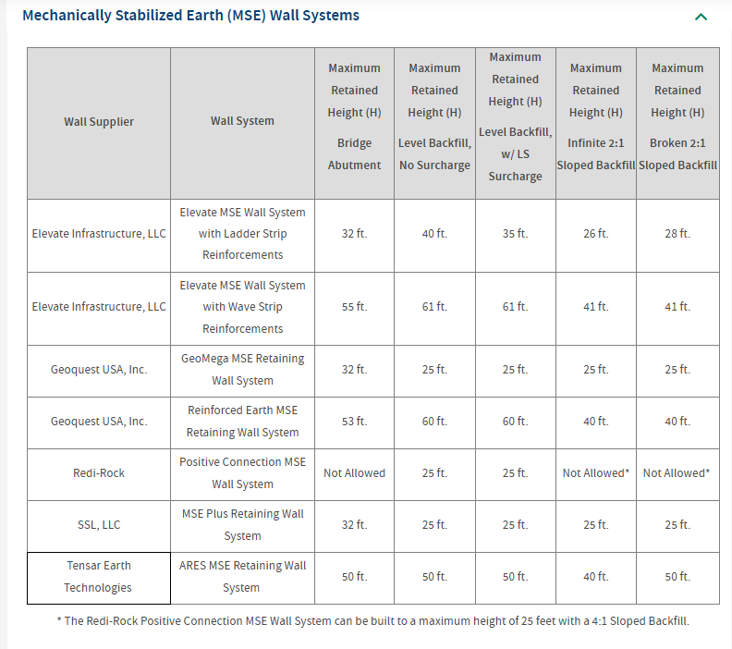
Accredited MSE Wall Systems
Approved Limitations

Slide 6
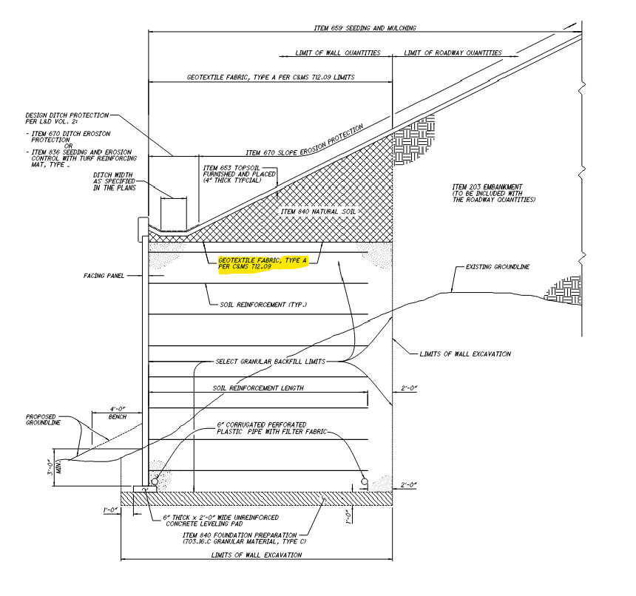
SS840 Mechanically Stabilized Earth Wall
Updated in the January update.
This fabric is incidental to Item 840 natural soil.
Notes:
This fabric is incidental to Item 840 natural soil.

Slide 7
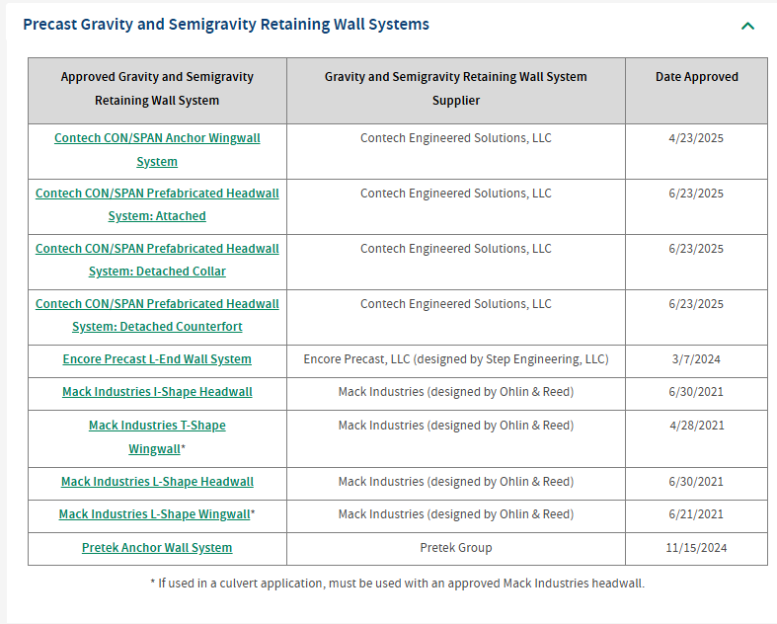
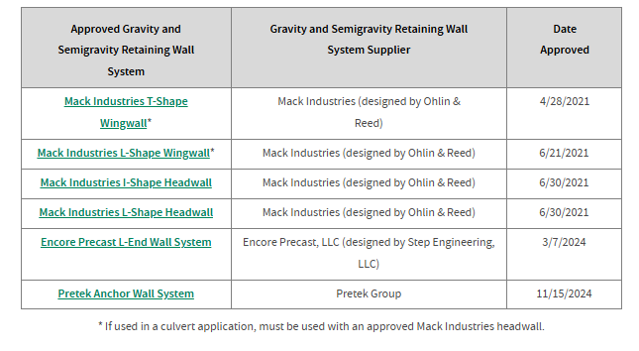
SS851 Precast Gravity And Semigravity Retaining Wall
Typically culvert headwall and wingwalls
Plans show either PGSRW on CIP footing or CIP Wall and footing
Notes:
Precast Gravity and Semigravity Retaining Wall (PGSRW).
If the plans show one way you can always change it by submitting VECP.

Slide 8
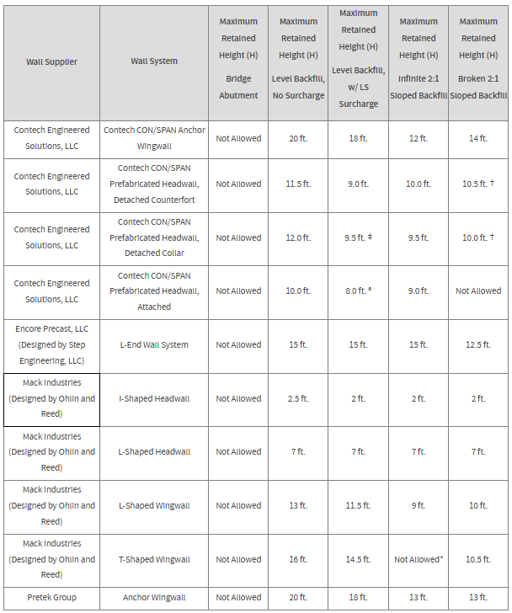
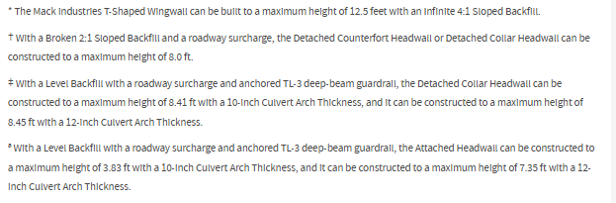
SS851 Precast Gravity And Semigravity Retaining Wall
Accredited Retaining Wall
Approved Limitations

Slide 9
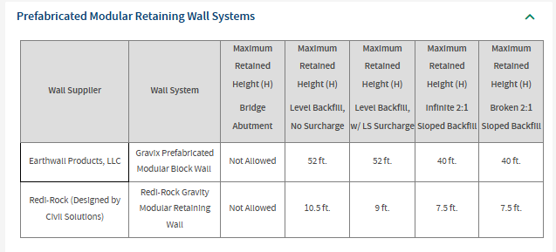
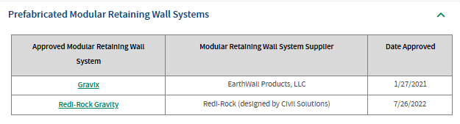
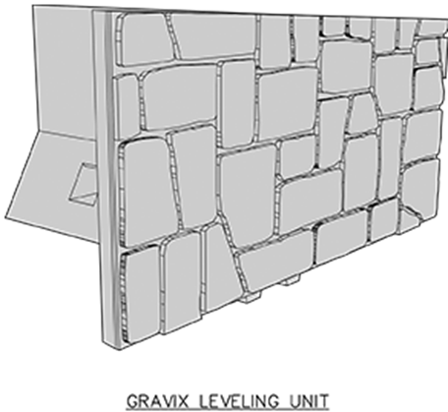
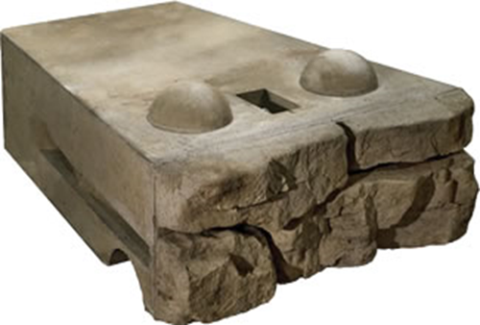
SS870 Prefabricated Modular Retaining Wall
Last July the specification was updated similar to the other walls discussed.
Notes:
Precast Gravity and Semigravity Retaining Wall (PGSRW).
If the plans show one way you can always change it by submitting VECP.

Slide 10
SS 878 Inspection & Compaction Testing
Perform inspection to ensure the placement and compaction of unbound materials conform with Contract Documents....
Update 878.03 Equipment …To follow current practices
Requiring verification every 12 months on the equipment and aligning calibration interval to 24 months.
Reminder
Immediately notify the Engineer and the Contractor when field testing or inspection indicate nonconformance.
878.04 Inspection and Field Testing
Inspection - Includes observations, measurements, Photographs showing initial condition, the daily progress of the work, unusual conditions, noncompliant work, and corrective actions.
878.05 Forms and Weekly Reports
Furnish the inspection forms, photographs, compaction test results and measurements to the Engineer daily.
USE CA-EW-5 and CA-EW-6 to record all tests & retests

Slide 11
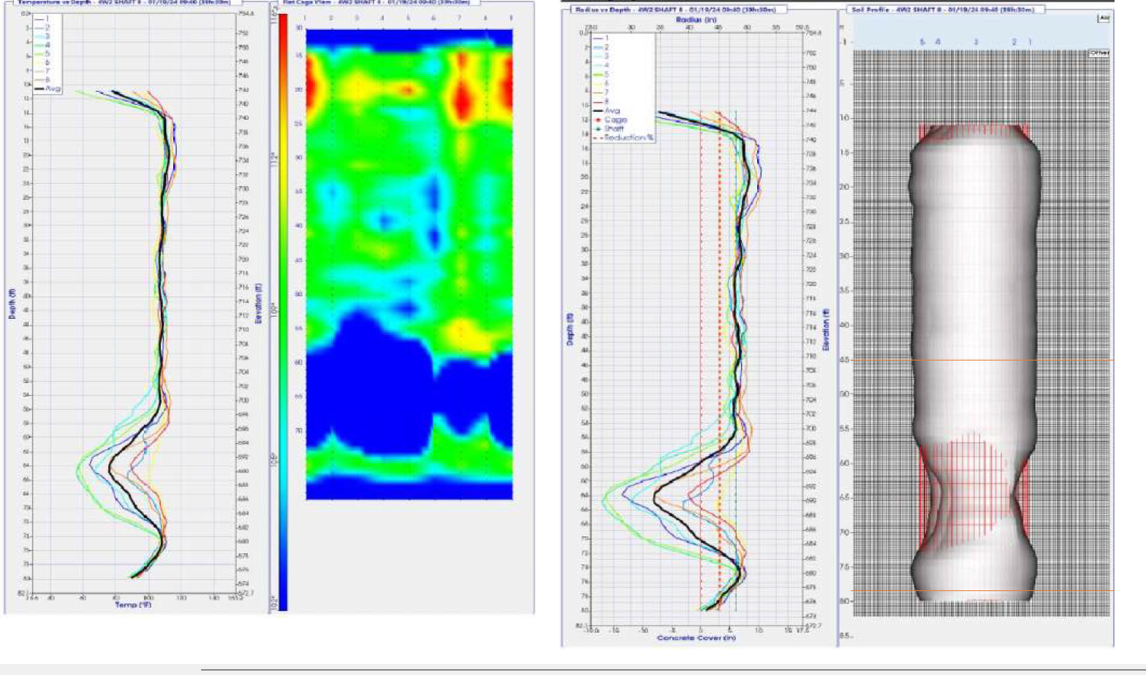
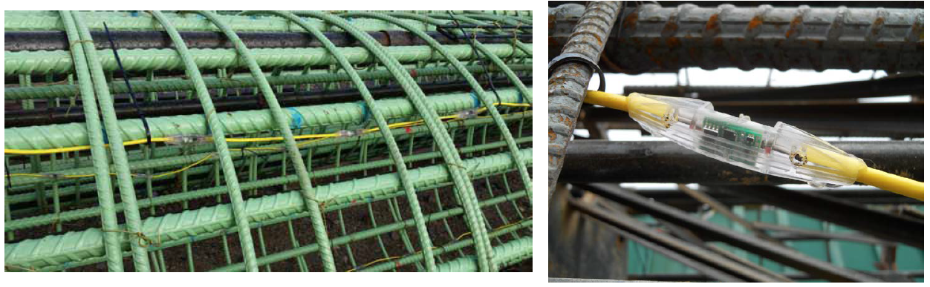
SS894 THERMAL INTEGRITY PROFILING (TIP)
Specification has been published for around 5 years.
Specified on almost all bridge drilled shaft projects.
Notes:
Update complete now for reminders. TIP testing stats
98 (2025) 10 projects
46 quantity in D10
370(2024) 8 projects

Slide 12
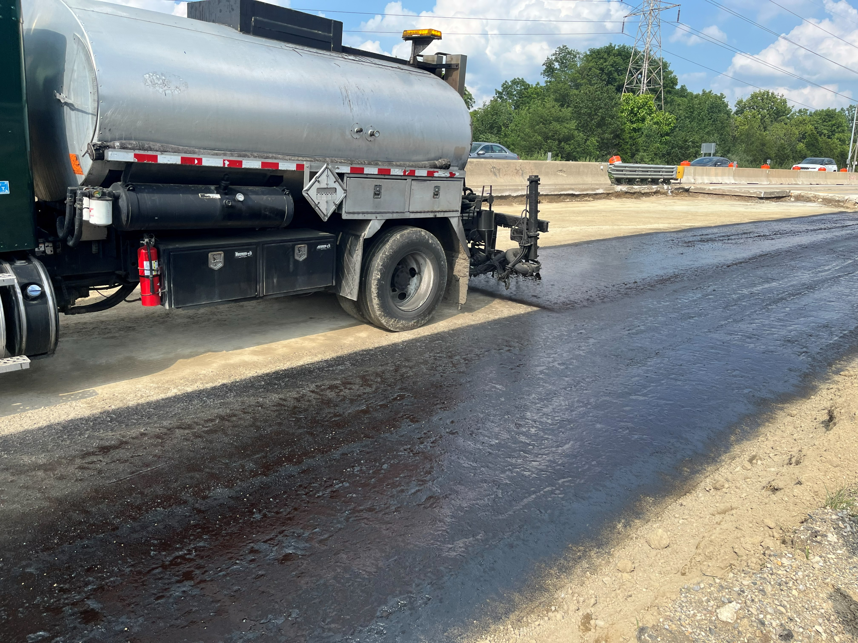
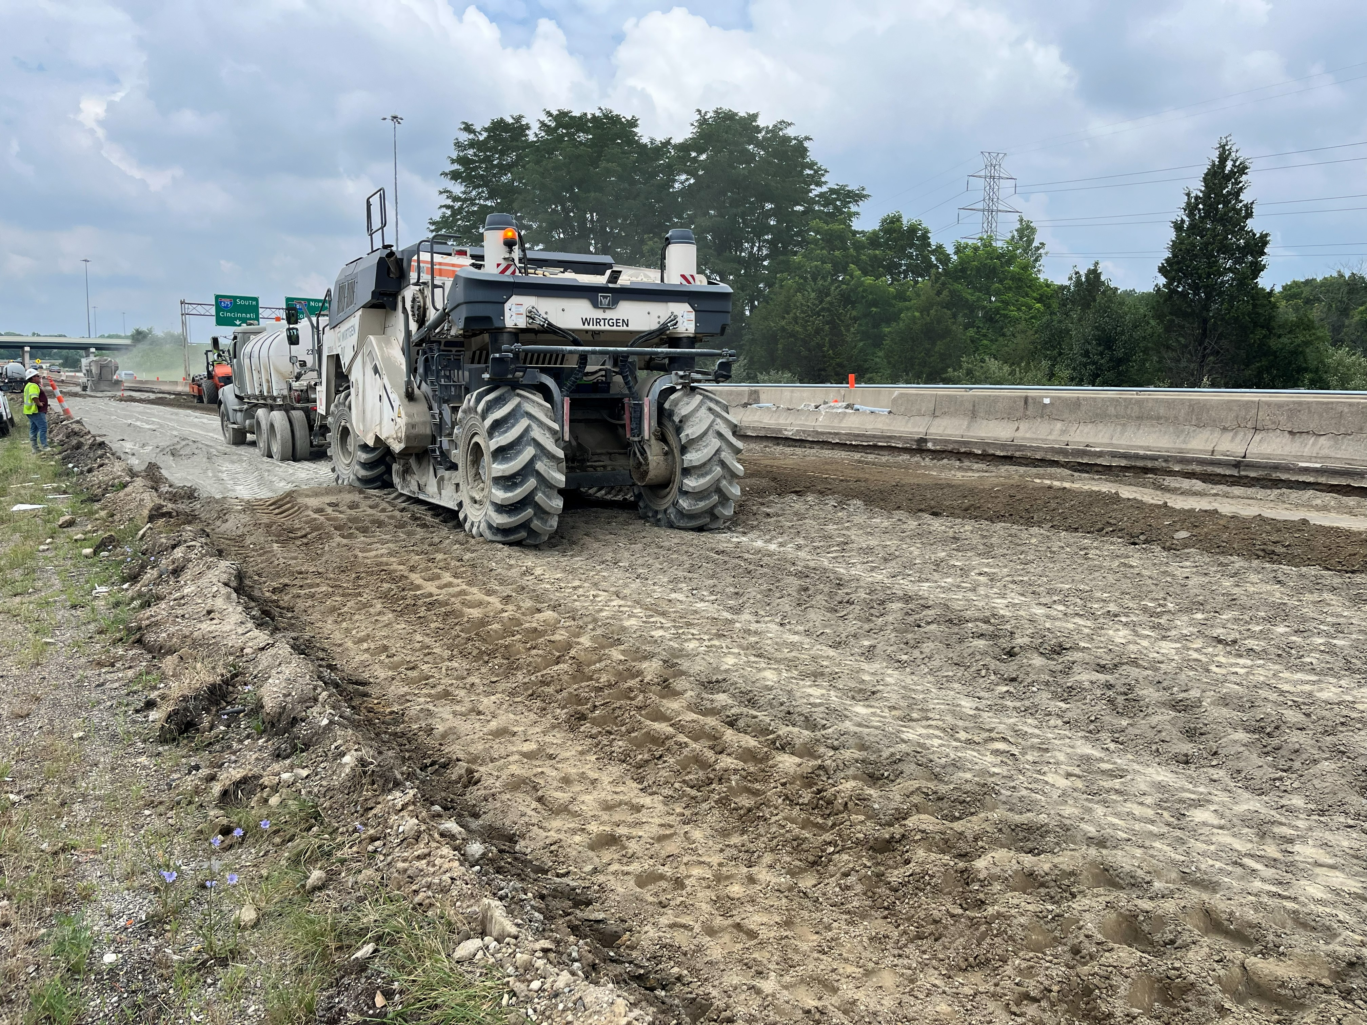
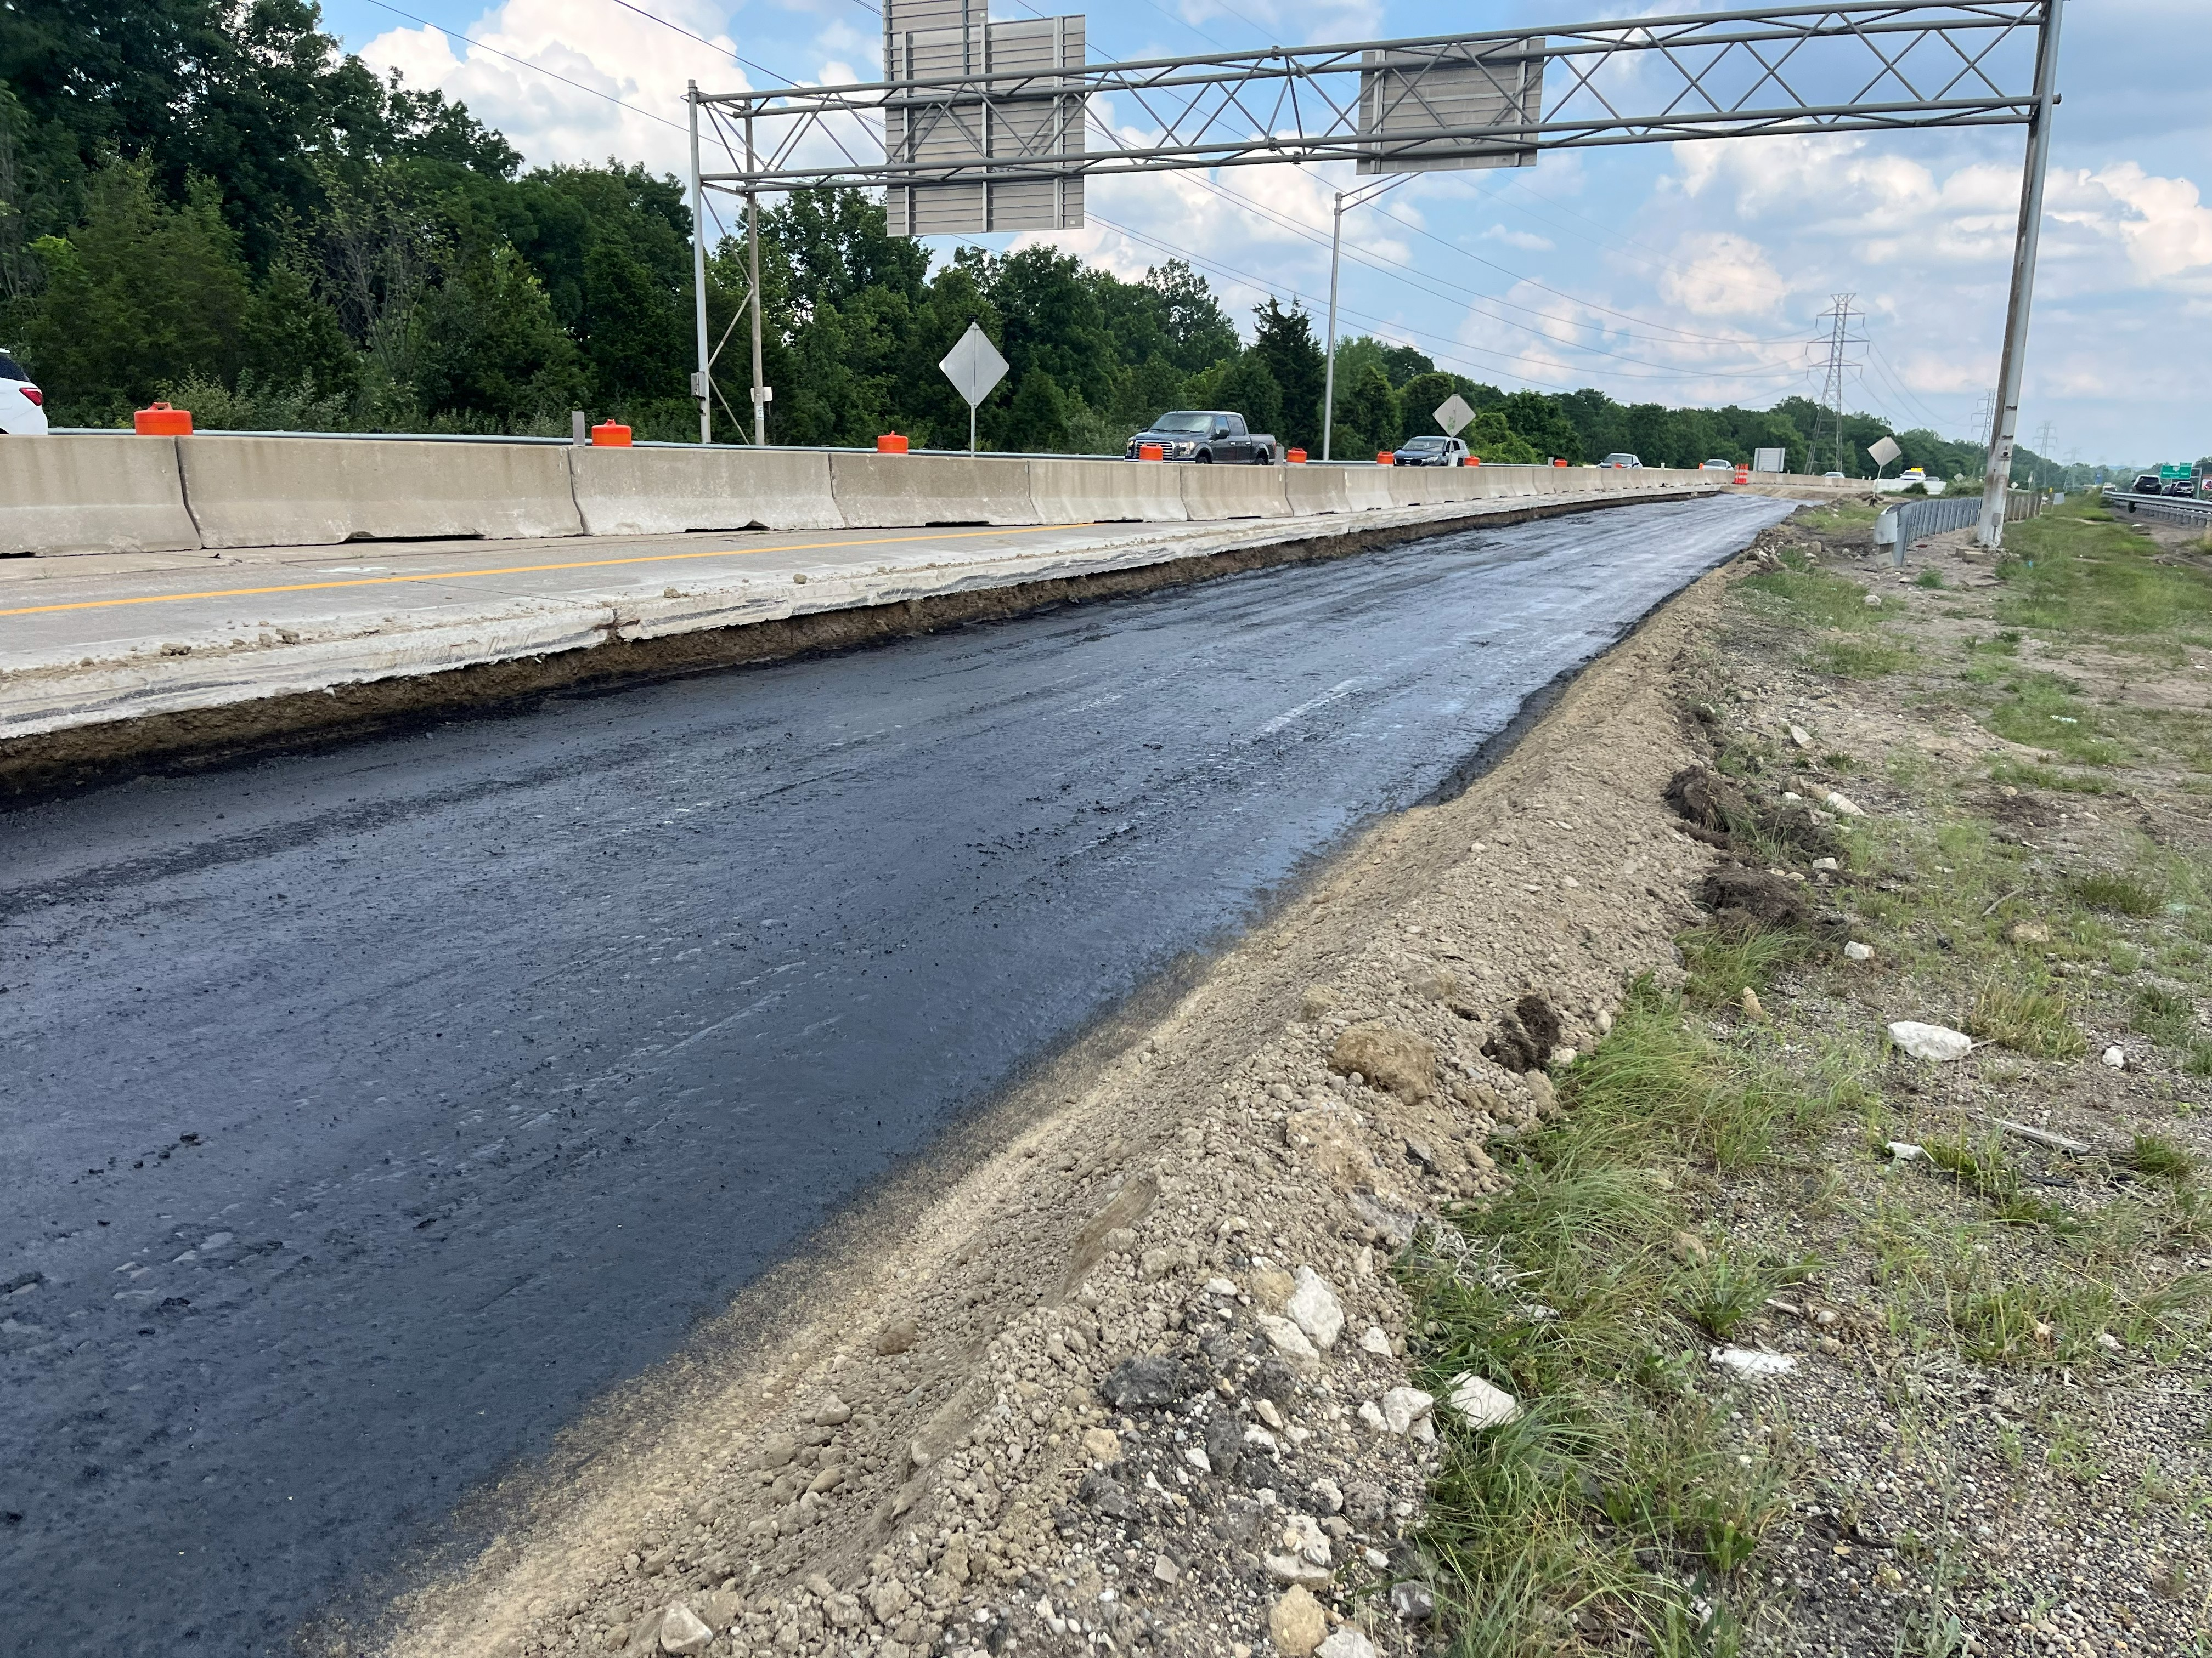
ITEM 206 CHEMICALLY STABILIZED SUBGRADE
To meet availability, construction concerns and current practice
Added non-tracking asphalt emulsion as a curing coat option

Slide 13
Miscellaneois Editorial Revisions
SS827 FULL DEPTH RECLAMATION WITH CEMENT
If the test section is acceptable but waiting on UCS results, pulverizing and initial shaping work may continue until UCS test results are received, but do not incorporate cement in additional areas until satisfactory UCS results are received for the test section.
Complete all mixing and compaction operations within three hours of start of application of cement. Protect all reclaimed areas from damage. Do not spread more cement than can be mixed and all work completed, including application of the curing coat, during the workday.
S1122 DETERMINING SULFATE CONTENT IN SOILS
Change the excel table to match L&D Vol. 4 requirements for the Ohio County coordinate system.

Slide 14
QUESTIONS

Slide 15


Thank You Attendees & Sponsors

