Slide 1
Ohio Truck Parking Mega-Project - Project TP26
Informational Meeting
November 13, 2024

Slide 2
ODOT Team Members
Mitch Blackford, Assistant Director of Operations
Meghan Altier, Deputy Director of Operations
Chris Hughes, District 1 Deputy Director
Rob White, District 1 Capital Programs Administrator
Project Managers:
-Travis McKibben, District 1 Consultant Contracts Manager
-Todd Grapner, District 1 Project Manager

Slide 3
ODOT Team Members
Support Personnel:
-Scott Phinney, Statewide Planning & Research Administrator
-Randy Lane, Statewide Planning Manager
-Eric Scheckelhoff, District 1 Design Engineer
-Adam Francis, District 1 Planning Engineer
-Justin Niese, District 1 Workplan Coordinator
-Patti Schnipke, District 1 Deputy Director’s Assistant

Slide 4
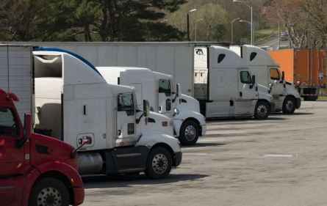

What is project TP26?
Project TP26 will substantially increase the number of ODOT owned and operated truck parking spaces statewide by the end of 2026.

Slide 5
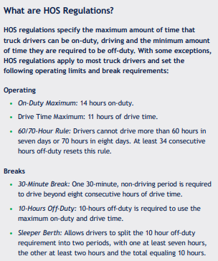
Why?
There are two types of demand for truck parking:
1. Getting rest in accordance with federal hours of service (HOS) regulations
2. Staging for pickup and delivery
In Ohio, there is currently 1 truck parking space available for every 11 trucks on the road.

Slide 6
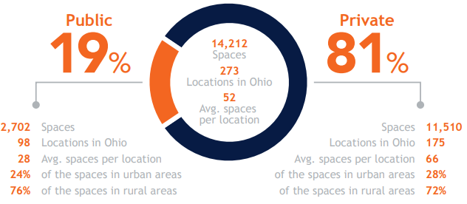
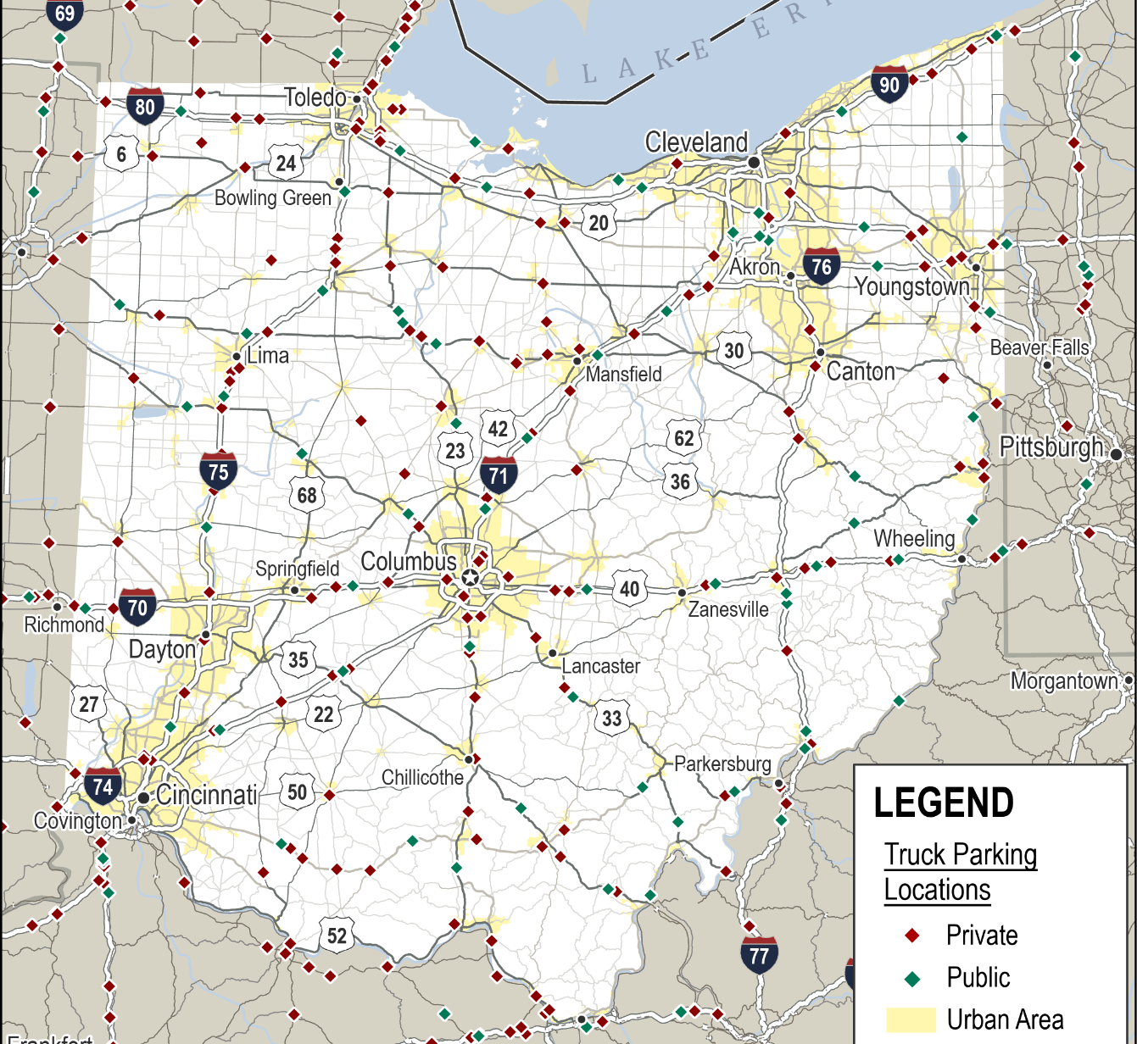
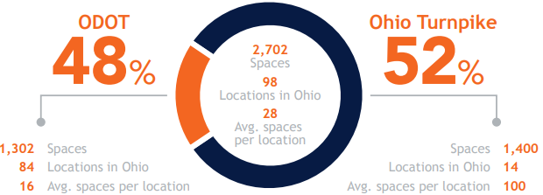
Why?

Slide 7
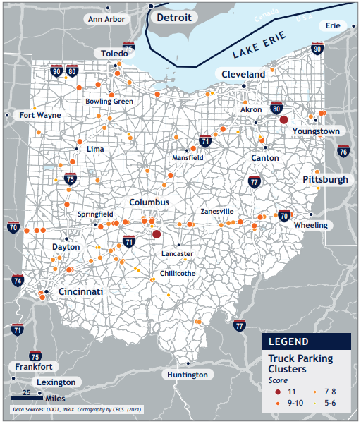
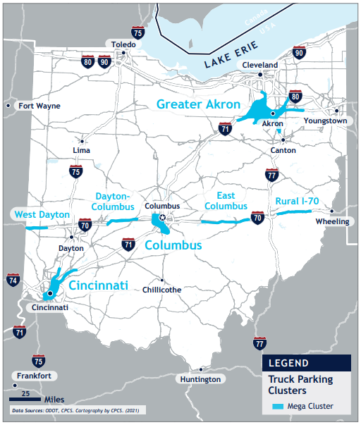
Why?

Slide 8
The objective
Add at least 1000 new truck parking spaces in strategic locations across Ohio, open for use by October 31, 2026.

Slide 9
How are we going to accomplish this?
Identify ODOT-owned property potentially suitable for truck parking across Ohio –complete (~83 sites identified)
Evaluate potential sites based on location, size, constructability, access, environmental, existing facilities, etc. –in progress (~21 sites currently in play)
Utilize consultant contracts to further evaluate sites, develop parking layout options, and design projects for construction

Slide 10
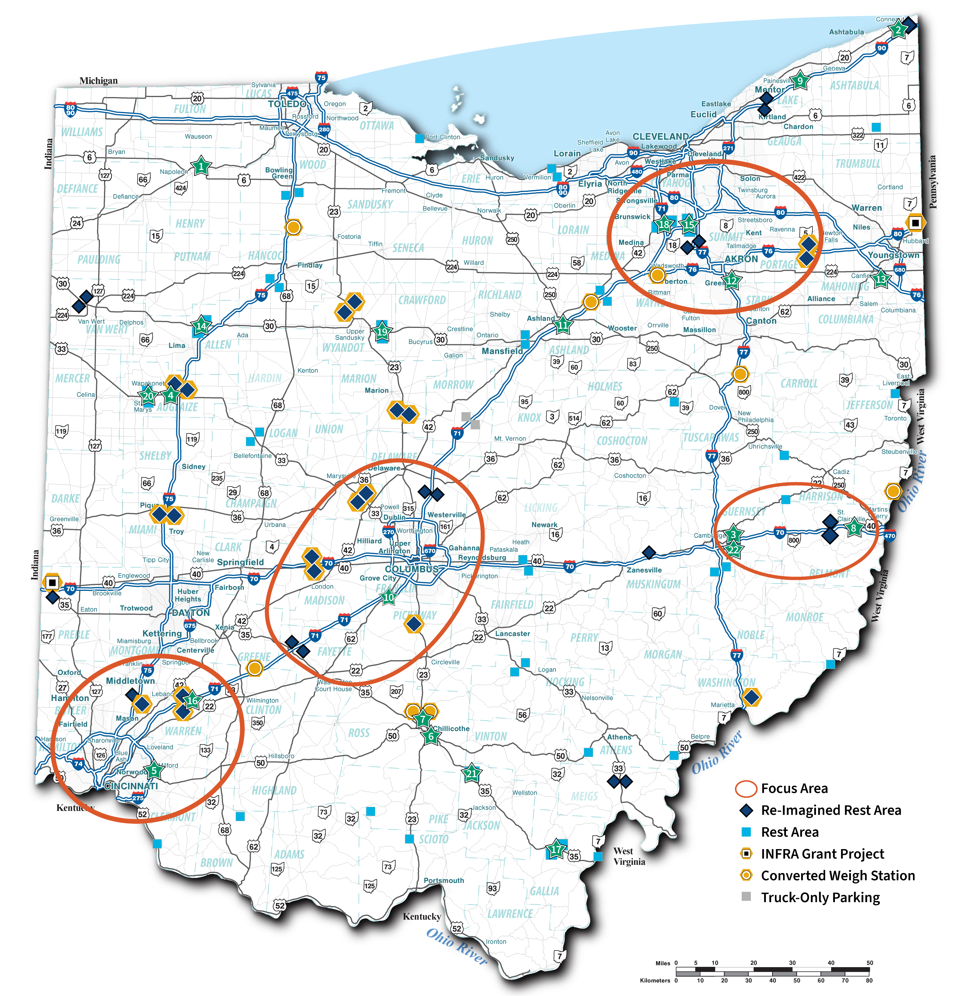
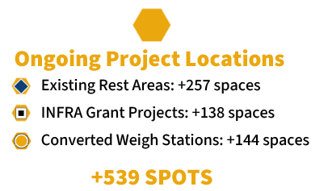
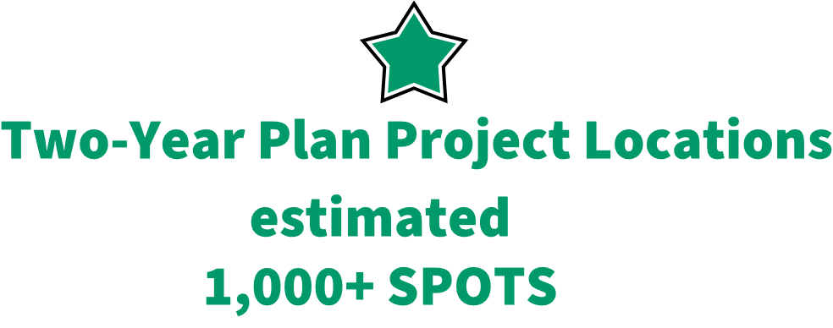
Truck Parking
These combined efforts will increase ODOT owned & operated truck parking in Ohio by an estimated 118%

Slide 11
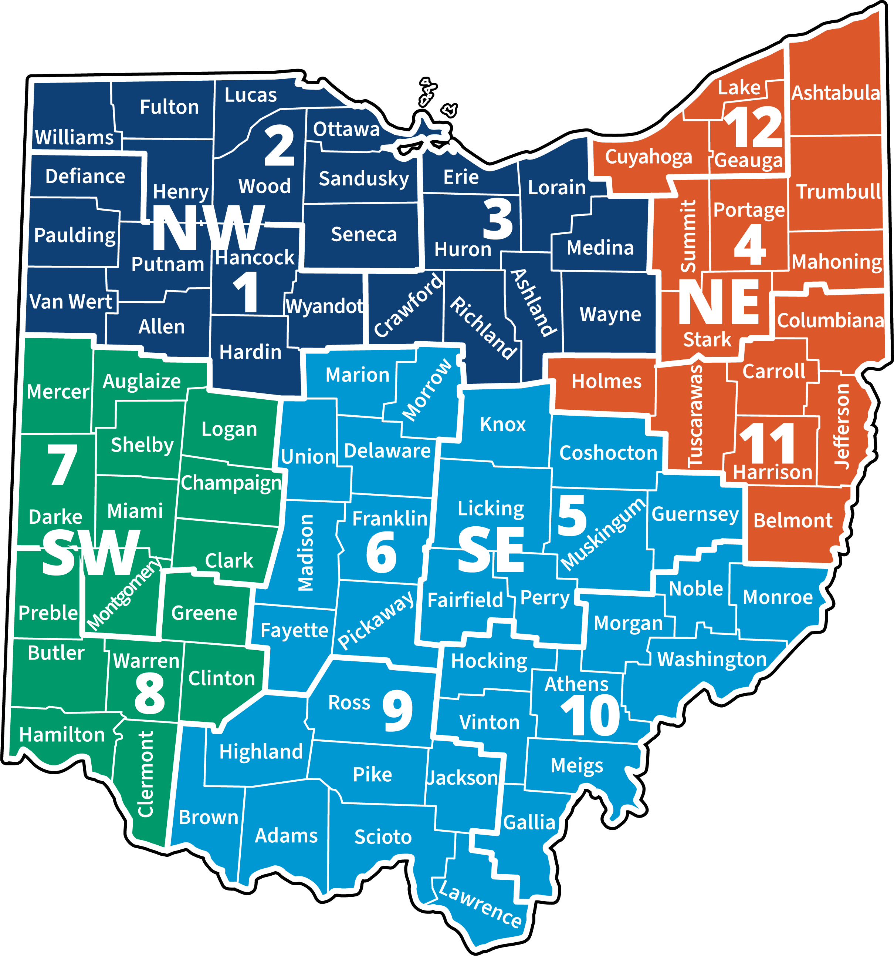
Regions
NW Region – ODOT Districts
1, 2 & 3
NE Region – ODOT Districts 4, 11 & 12
SW Region – ODOT Districts
7 & 8
SE Region – ODOT Districts 5, 6, 9 & 10

Slide 12
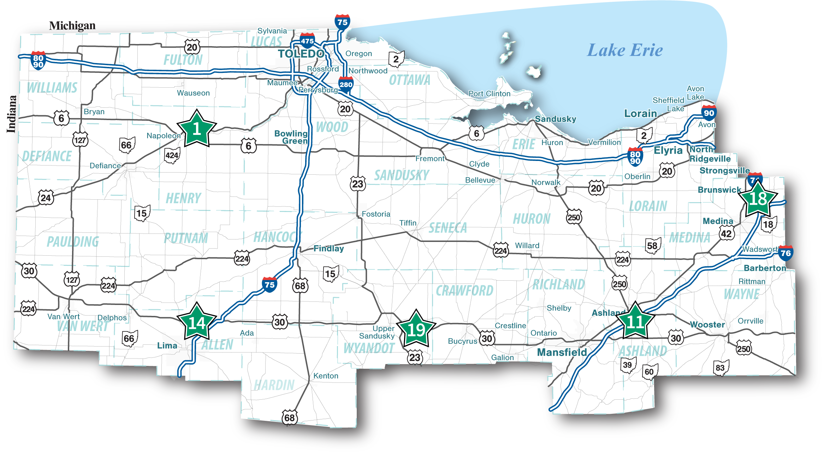
Northwest

Slide 13


Northwest Locations
Site | County | Region | Location | Total Area (acres) | Buildable Area (acres) | Target Spaces To Build
1 | Henry | NW | US Route 6 & State Route 424 Infield Eastbound | 8 | 4 | 48
 |  |  | US Route 6 & State Route 424 Infield Westbound |  | 3 | 36
11 | Ashland | NW | US Route 6 & State Route 424 Infield Eastbound | 8 | 4 | 12
 |  |  | US Route 6 & State Route 424 Infield Westbound |  | 3 | 9
14 | Allen | NW | US Route 30 Rest Area Westbound | 38.7 | 4 | 48
 |  |  | US Route 30 Rest Area Eastbound |  | 11 | 50
18 | Medina | NW | Interstate 71 Rest Area Northbound | 21.6 | 2 | 24
 |  |  | Interstate 71 Rest Area Southbound | 12 | 3 | 36
19 | Wyandot | NW | US Route 30 Rest Area Westbound | 86 | 10.3 | 50
 |  |  | US Route 30 Rest Area Eastbound |  | 6.8 | 50

Slide 14
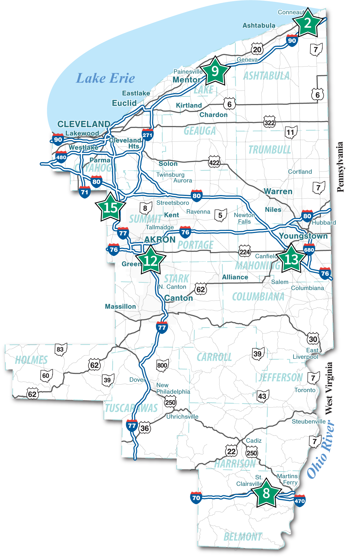
Northeast

Slide 15
Northeast Locations
Site | County | Region | Location | Total Area (acres) | Buildable Area (acres) | Target Spaces To Build
2 | Ashtabula | NE | Interstate 90 Vacant Land Westbound | 19.3 | 4.5 | 50
 |  |  | Interstate 90 Vacant Land Eastbound | 12.8 | 6 | 50
8 | Belmont | NE | Interstate 70 Closed Weigh Station Eastbound |  | 1.5 | 18
9 | Lake | NE | Interstate 90 Vacant Land Westbound | 33.3 | 2.5 | 30
 |  |  | Interstate 90 Vacant Land Eastbound |  | 2.5 | 30
12 | Summit | NE | Interstate 77 Vacant Land Northbound | 13.6 | 2.5 | 30
13 | Mahoning | NE | State Route 11 Vacant Land Southbound | 38.7 | 7.5 | 50
 |  |  | State Route 11 Vacant Land Northbound |  | 15 | 50
15 | Summit | NE | Interstate 271 Rest Area Westbound | 53.7 | 5 | 60
 |  |  | Interstate 271 Rest Area Eastbound |  | 5 | 60

Slide 16
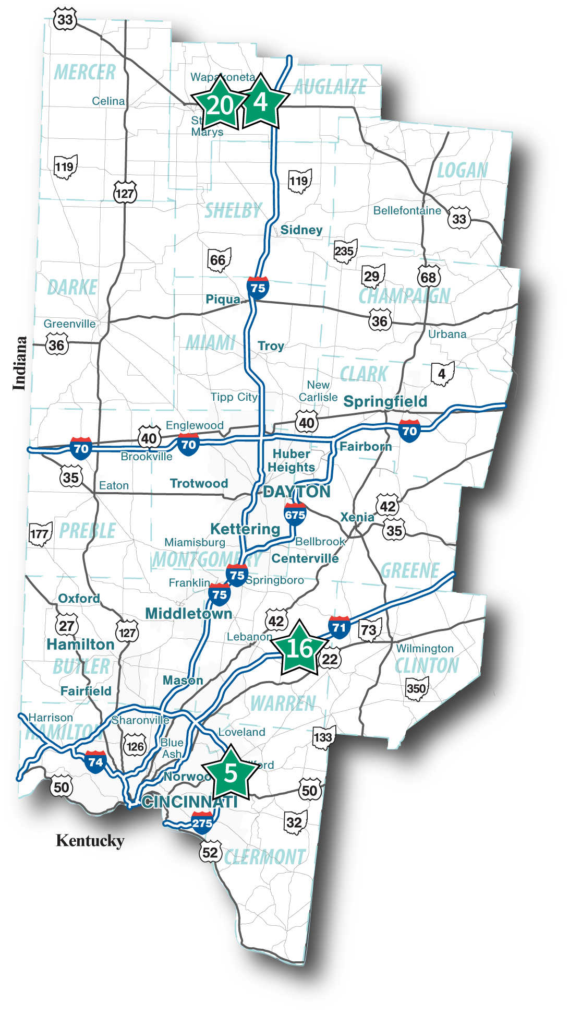
Southwest

Slide 17
Southwest Locations
Site | County | Region | Location | Total Area (acres) | Buildable Area (acres) | Target Spaces To Build
4 | Auglaize | SW | US Route 33/Hardin Pike Infield Westbound | 48.3 | 8 | 50
 |  |  | US Route 33/Hardin Pike Infield Eastbound |  | 6 | 50
5 | Clermont | SW | Interstate 275 Vacant Land Northbound | 58 | 1.75 | 21
 |  |  | Interstate 275 Vacant Land Southbound |  | 2.25 | 27
16 | Warren | SW | Interstate 71 Rest Area Northbound | 290 | 8.5 | 100
 |  |  | Interstate 71 Rest Area Southbound (Mega Site) |  | 100 | 100
20 | Auglaize | SW | US Route 33 Rest Area Westbound | 51.4 | 11 | 50
 |  |  | US Route 33 Rest Area Eastbound |  | 10 | 50

Slide 18
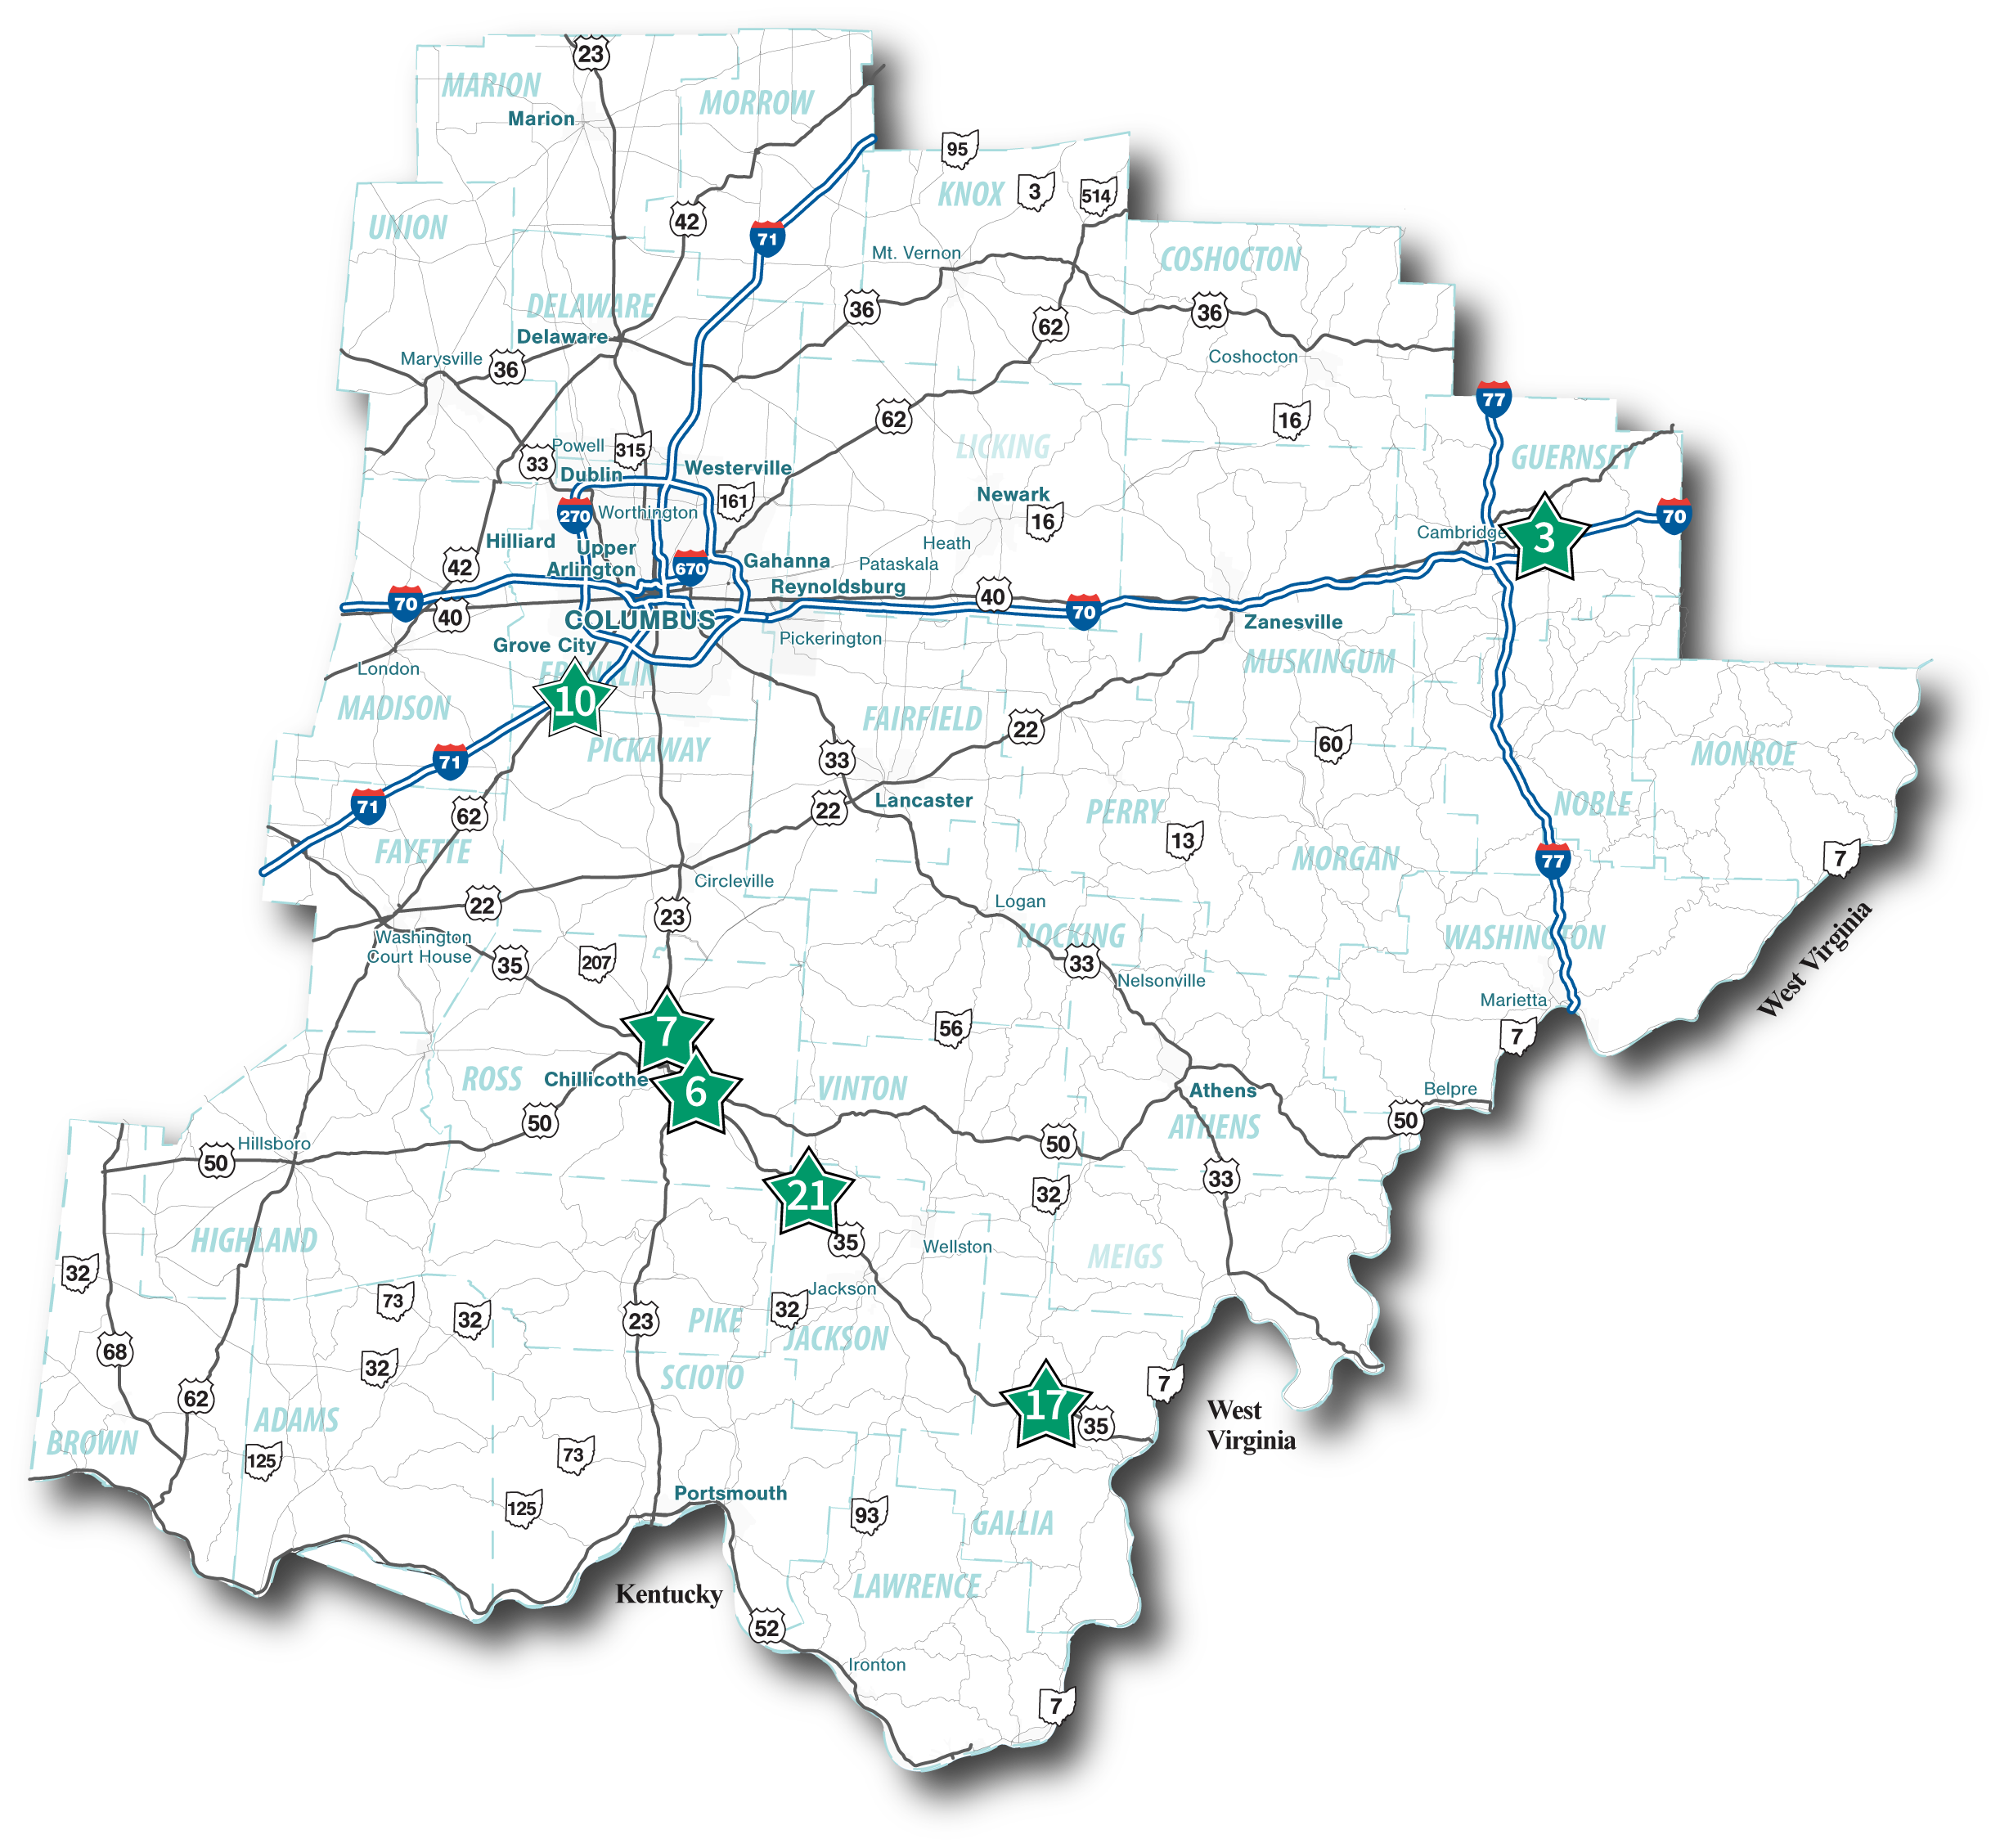
Southeast

Slide 19
Southeast Locations
Site | County | Region | Location | Total Area (acres) | Buildable Area (acres) | Target Spaces To Build
3 | Guernsey | SE | Interstate 70 Vacant Land Westbound | 23.1 | 2 | 24
 |  |  | Interstate 70 Rest Area Eastbound | 13 | 4 | 48
6 | Ross | SE | US Route 35/US Route 50 Interchange | 4.34 | 3 | 36
7 | Ross | SE | US Route 23/State Route 159 Interchange | 6.7 | 5 | 60
10 | Franklin | SE | Interstate 71/US Route 62 Infield Eastbound | 40.5 | 6 | 72
 |  |  | Interstate 71/US Route 62 Infield Westbound |  | 6 | 72
17 | Gallia | SE | US Route 35 Rest Area Westbound | 34.3 | 0.5 | 10
 |  |  | US Route 35 Rest Area Eastbound |  | 0.5 | 10
21 | Jackson | SE | US Route 35 Rest Area | 2.5 | 2 | 24

Slide 20
Regional Contract Breakdown
 |  | Estimated Possible | Estimated
Region | Districts | Parking Spaces | Sites
NW | 1,2,3 | 363 | 5
NE | 4,11,12 | 428 | 6
SW | 7,8 | 448 | 4
SE | 5,6,9,10 | 356 | 6
Totals: |  | 1595 | 21

Slide 21
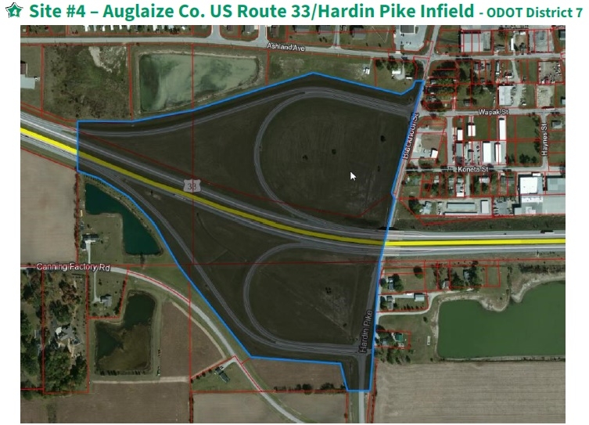
Truck Parking Sites
A sampling of sites

Slide 22
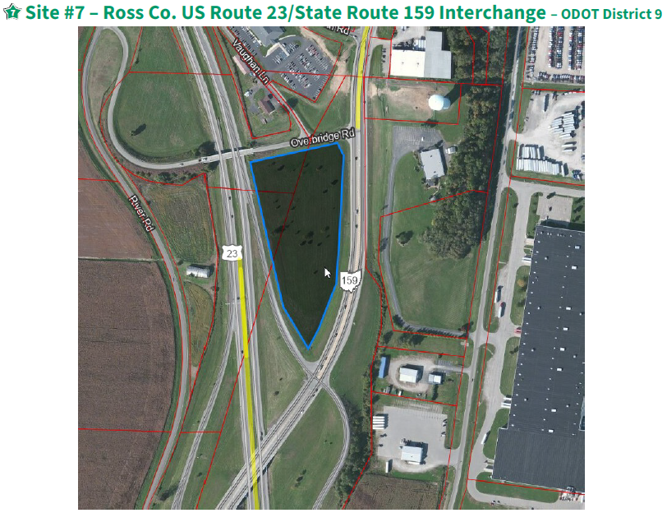
Truck Parking Sites
A sampling of sites

Slide 23
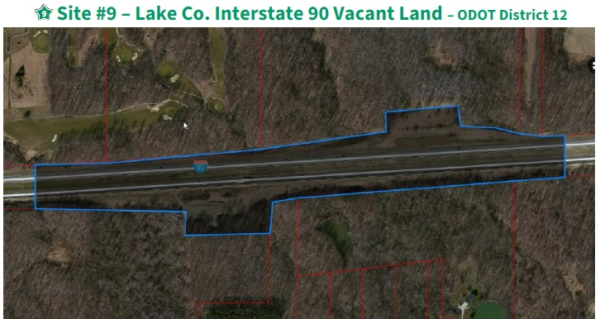
Truck Parking Sites
A sampling of sites

Slide 24
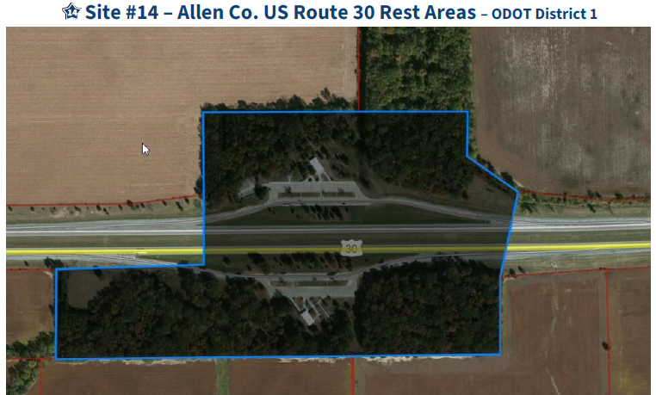
Truck Parking Sites
A sampling of sites

Slide 25
Scope of work
Prequalifications:
-Geotechnical
-Highway Lighting
-Environmental
-Roadway Design
-Subsurface Utility Location (SUL)

Slide 26
Scope of work
Consultants will be asked to:
-Evaluate sites for suitability for truck parking
-Develop parking/access/circuity options for each site
-Carry selected sites/layouts to detailed design
-Survey
-Geotechnical
-Environmental
-Prepare plan packages

Slide 27
Scope of work
Truck parking sites will need to contain at a minimum:
-ingress/egress
-parking lots
-drainage
-lighting
-restroom facilities (pit latrines if no existing facilities)
-trash facilities
-signing/striping/traffic control
-post construction BMPs

Slide 28
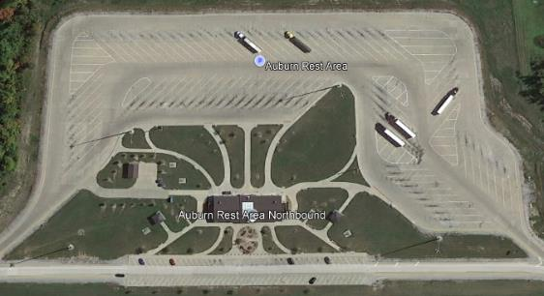
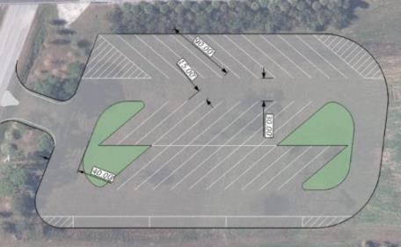
Parking Type / Circuity / access options
Parking Type:
Pull-Through
Angle
Reverse Angle
Parallel
Perpendicular
This list is not comprehensive, other options may exist

Slide 29
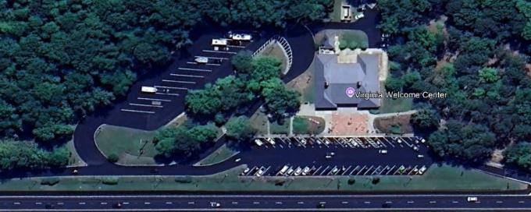
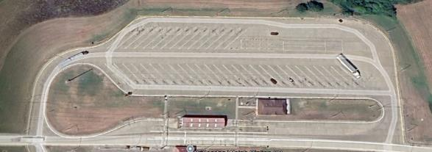
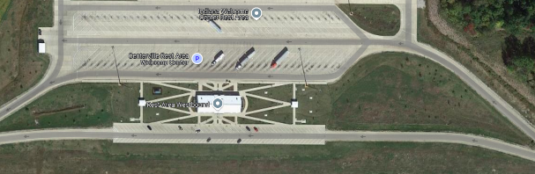
Parking Type / Circuity / access options
Circuity:
Split Ramps
Loop Through
Add-on Parking Lot
This list is not comprehensive, other options may exist

Slide 30
Tentative Schedule
11/15/2024………………….…………….Special Programmatic Posted
12/2/2024………………………………....LOI’s Due
12/12/2024………………………………..Selection Announcement
12/16-18/2024……………………………Kickoff Meetings
Late January 2025……………………….Consultants Authorized
3/14/2025…………………………………Site Concepts Delivered
10/01/2025………………………………..Stage 3 Delivered
11/14/2025………………………………..Final Tracings Delivered
3/19/2026……………….………………...Letting
10/31/2026………….……………………Finish Construction

Slide 31
Selection Committee
-Gery Noirot – District 4 Deputy Director
-Suzanne Enders – District 8 CPA
-Jamie Hendershot – D10 CPA
-Meghan Altier – Deputy Director of Operations
-District 1 Team

Slide 32
Other information
3% EDGE Goal
Plans will be prepared for each site to be constructed as an independent project.
If submitting for multiple contracts – LOIs do not need to be unique
Limited Review

Slide 33

Keys to success for consultant firms
Take ownership of designs
Contract management (efficiency, clarity, timeliness)
Leadership/PM buy-in
Reviews and QC/QA
Have the resources to meet the aggressive expectations

Slide 34
Q & A
We will take questions now.
We will have appointments tomorrow (11/14) for 15-minute TEAMS meetings with individual consultants for Q&A.
-See Patti Schnipke to schedule.

Slide 35
Thank you

