Slide 1

D03 Programmatic ∙ May 2026
PID 125469 MED-303-4.96/5.88
Marks Rd & Substation Rd Roundabouts
Notes:
Welcome! Thank you for your interest in Districts 3’s projects on the May 2026 programmatic.
This brief presentation will discuss PID 125469 Medina- 303-4.96/5.88, a project to install two roundabouts. Both are on SR 303, one at Marks Rd and the other at Substation Rd.

Slide 2
Programmatic information
All information shall be considered draft. Carefully review the final scope and official posting for final details. This information was prepared prior to the September programmatic posting. Any updates on Office of Consultant Service's website should supersede this information. Supplemental information is available via the following link: https://ftp.dot.state.oh.us/pub/districts/D03/Consultant_Programmatic/2026-05-04/
Notes:
As noted on this slide…(read text – first two sentences).

Slide 3
Project Overview
Convert two signalized intersections into single-lane roundabouts at SR 303 and Marks/Substation in Medina County
Safety and TSMO Funded Project
Anticipate Construction in Summer 2031 and 2032
Notes:
This project is converting two signalized intersections into single-lane roundabouts at the SR-303 and Marks Rd and SR-303 and Substation Rd intersections in Medina County. They are funded primarily through the safety program with some additional funding from the TSMO program. Construction is anticipated in the Summers of 2031 and 2032.

Slide 4
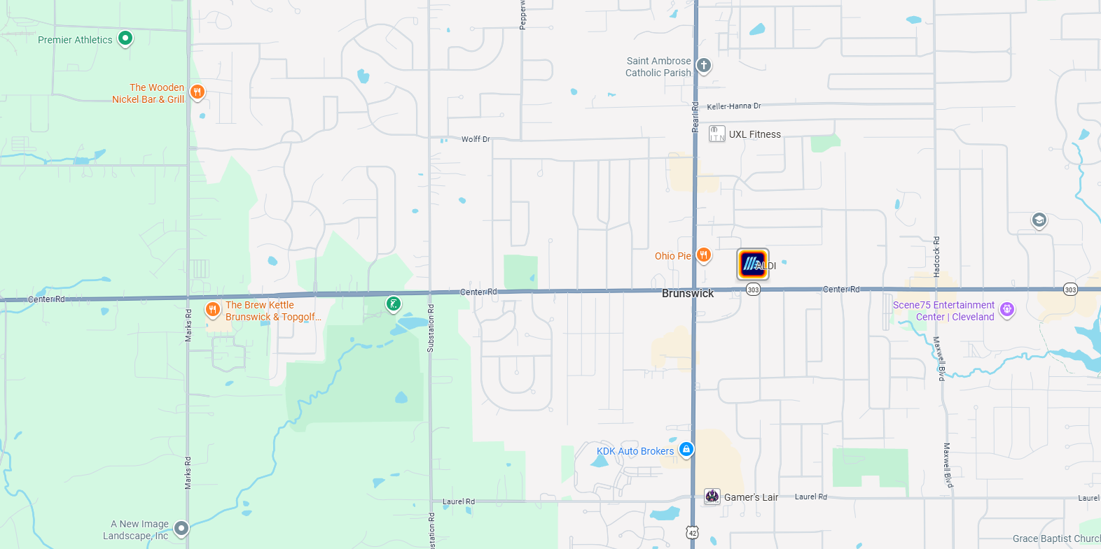
Background & Existing Conditions
Substation Rd
US 42
Marks Rd
SR 303
Existing Traffic Control | Two-phase signalized intersections
SR 303 | 13,500 vpd (6% Truck) | 45/50 mph
Marks Rd (CR 22) | 7,500 vpd (7% Truck) | 45 mph
Substation Rd (CR/TR 38) | 6,500 vpd (1% Truck) | 45 mph
Notes:
These intersections are in Brunswick Hills Township, except for the west side of the Marks Rd intersection, which is in Liverpool Township. There are commercial developments on the east side of Marks Rd and a lot of residential neighborhoods in the area, especially around Substation Rd. Marks Rd has a southbound left turn lane and westbound right turn lane. Substation Rd does not have any turn lanes and experiences significant queueing when vehicles trying to make a left turn from SR 303 are unable to find a gap in traffic. These routes have high AADTs for two-lane roads, with SR 303 having up to 13,500 AADT, Marks Rd has 7,500, and Substation has 6,500 AADT. The speed limit on all roads is 45 mph except the west leg of SR 303 is 50 mph. The recommendations to install roundabouts came from a traffic study on the SR 303 corridor in Brunswick Hills Township that was completed in 2020 and updated in 2025.

Slide 5
Crash Details
Substation Rd
Marks Rd
Notes:
SR 303 & Marks Rd was ranked #99 on ODOT’s 2025 HSIP Rual intersection list. From 2020-2024, there were 40 total crashes with 25% resulting in injury. There were 58% rear-end crashes and 25% angle and left-turn crashes.
SR 303 & Substation Rd was ranked #418 on ODOT’s 2025 HSIP Suburban intersection list. From 2020-2024 there were 48 total crashes with 29% injury crashes, 2 of which were serious injuries. There were 60% rear end crashes and 33% left turn and angle crashes. This corridor is also ranked #61 in District 3 on the Traffic Operations Assessment Systems Tool (or TOAST) with a score of 63.8%, which allowed the project to receive TSMO funding.

Slide 6
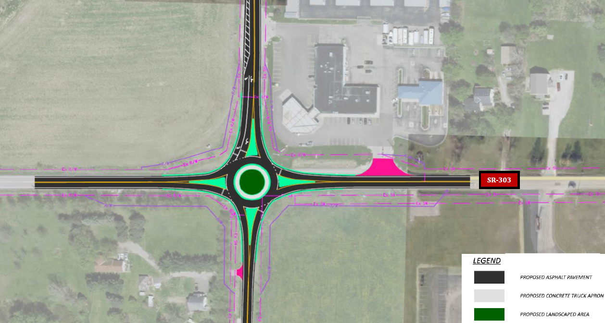
Conceptual Drawing
Marks Rd
Notes:
This slide has a preliminary conceptual drawing of a single lane roundabout with a 120 ft inscribed diameter with straight splitter islands and a southbound right turn lane at SR 303 & Marks Rd. There have been proposed additional commercial developments in the southeast and northwest corners. The consultant should confirm the design year traffic and the number of turn lanes required based on counts, growth rates, and updated developer information.

Slide 7
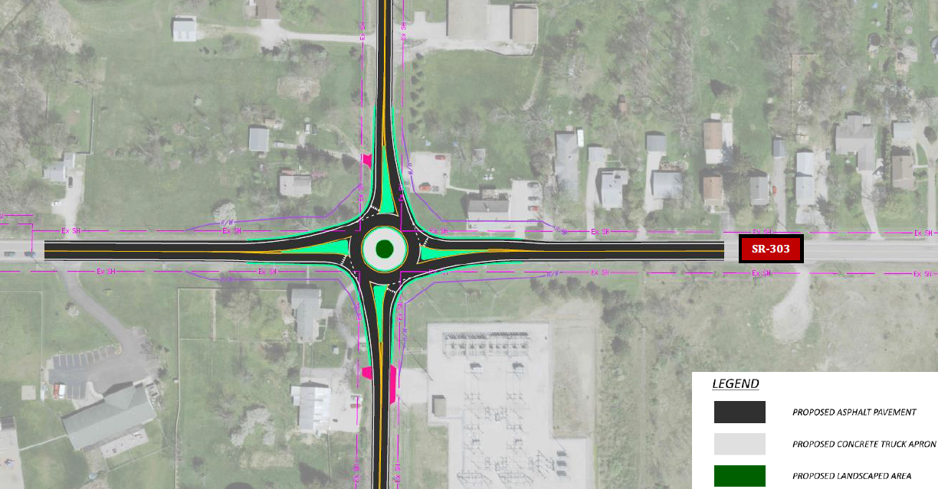
Conceptual Drawing
Notes:
This slide has a preliminary conceptual drawing of a single lane roundabout with a 105 ft inscribed diameter with chicane splitter islands at the SR 303 & Substation Rd intersection. The primary goal of the design of this roundabout is to avoid total takes of any properties, especially in the northeast corner where the existing right of way line is immediately adjacent to the porch on the multi-family residence. In the southwest corner there is a historical property that also needs to be avoided. It may be challenging to relocate utilities, especially transmission lines, and keep adequate clear distance to the existing structures without a total take, so this must be accounted for during preliminary layouts and through all design stages.

Slide 8
Scope & Design Details
MOT is full detour. Do not close both intersections concurrently. May be in different construction seasons.
Design vehicle is WB-62
Design consultant is to stipulate the final ICD
District 3 Roundabout Reference Packet
District 3 Consultant Utility Relocation Policy
Notes:
Reviewing some design items, the MOT type will be a detour with full closures anticipated. Do not close both intersections concurrently. This may result in the intersections being closed in different construction seasons. The design vehicle type is a WB-62. Design is to stipulate the final ICD. See the District 3 Roundabout Preference Packet for additional details. Utility relocation planning is to be performed by the consultant as well. Please see the District 3 Consultant Utility Relocation Planning Policy for additional information.

Slide 9
Thank you
QUESTIONS?
Please contact Shelley Pitcher (Shelley.Pitcher@dot.ohio.gov)
Notes:
Thank you again for your interest in this project. If you should have any questions, please reach out to District 3’s Consultant Contracts Manager, Shelley Pitcher

