Slide 1
MUS-146 Northpointe Dr. to Dillon Dr. Safety Study

Slide 2
Project Background

Slide 3

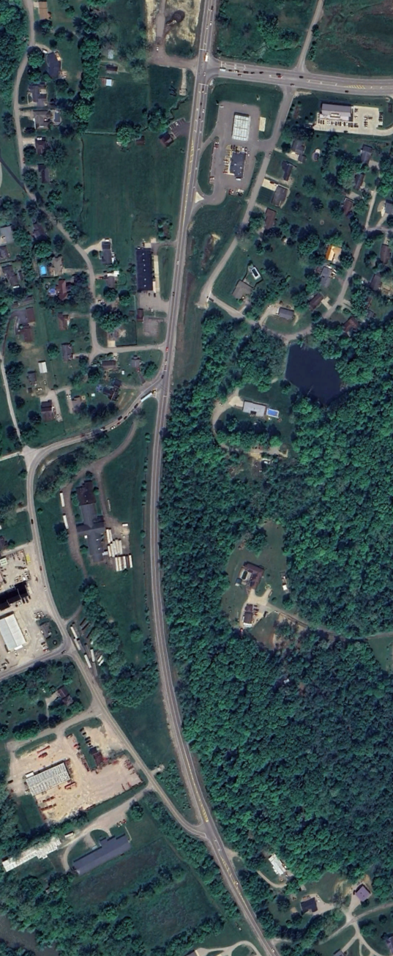

Project Location & Description
Project Limits
  SR 146: Northpointe Drive to Dillon School Drive (0.56 Miles)
  Mix of commercial and residential
Traffic Volumes:
  SR-146 North of Dillon (South entrance): 9,907
  SR-146 South of Dillon (South entrance): 12,569
  Northpointe Drive: 7,096
  Dillon School Drive (North): 7,567
  Dillon School Drive (South): 1,414
Functional Class
  US 142: Minor Arterial
  Northpoint Dr: Major Collector
  Dillon School Dr: Major Collector
PROJECT START
Northpointe Dr
SR 146
N
Dillon School Dr
PROJECT END

Slide 4
Crash Analysis Summary 2021-2023
Crashes per Year: 10.00
Percent Injury:
16.7%
EPDO: 1.64

Slide 5
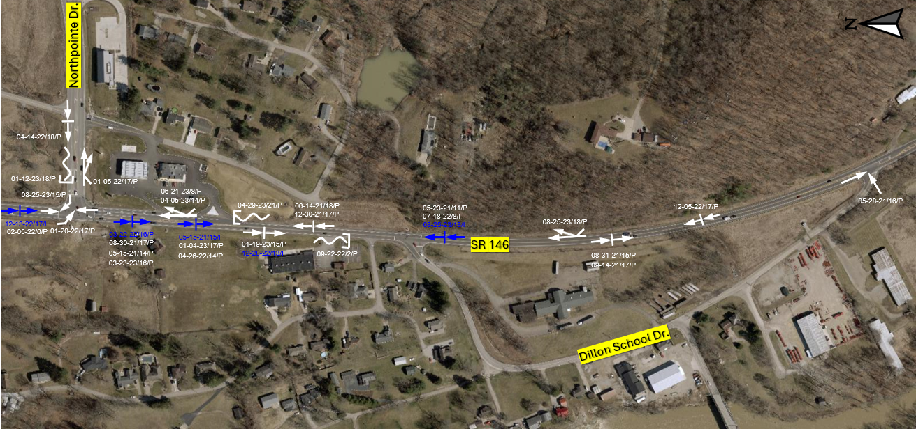
Crash Analysis Summary 2021-2023

Slide 6
Proposed Improvements

Slide 7
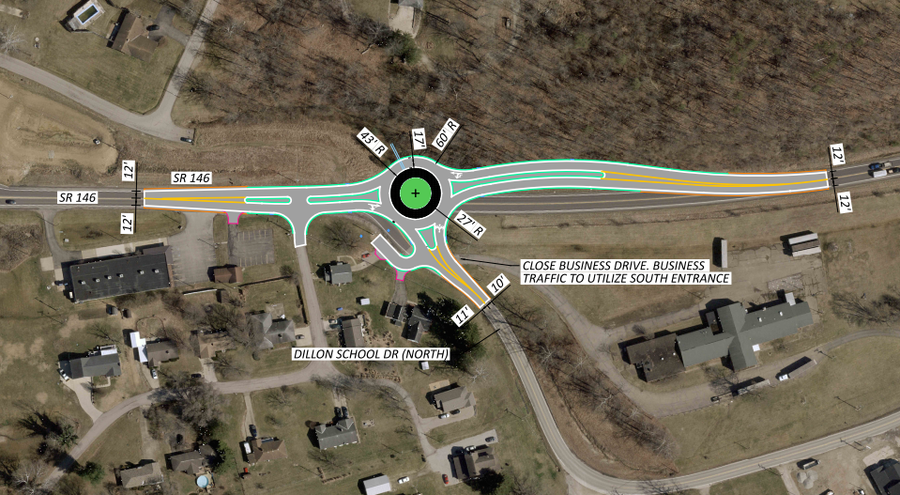
Proposed Improvements
Existing: Signalized
Proposed: Roundabout
  ICD: 120’
Business Drive closed

Slide 8
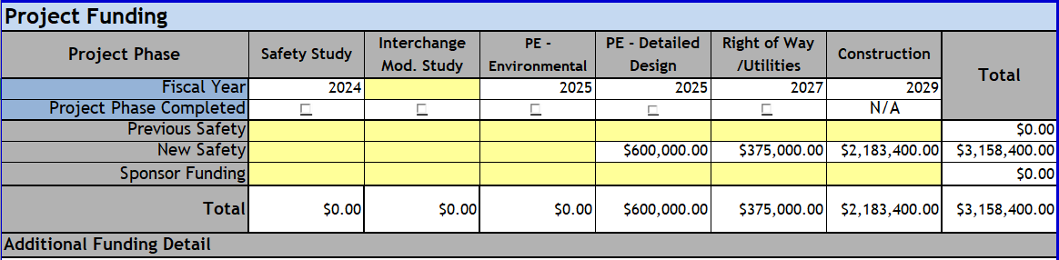
Project Estimate

Slide 9
Thank you

