Slide 1

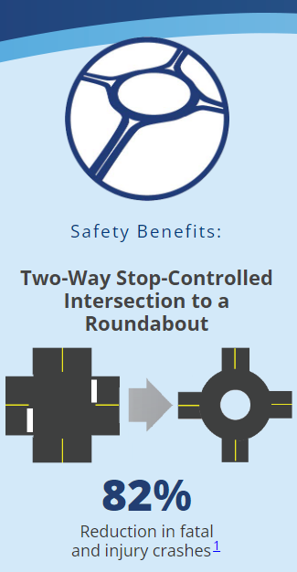
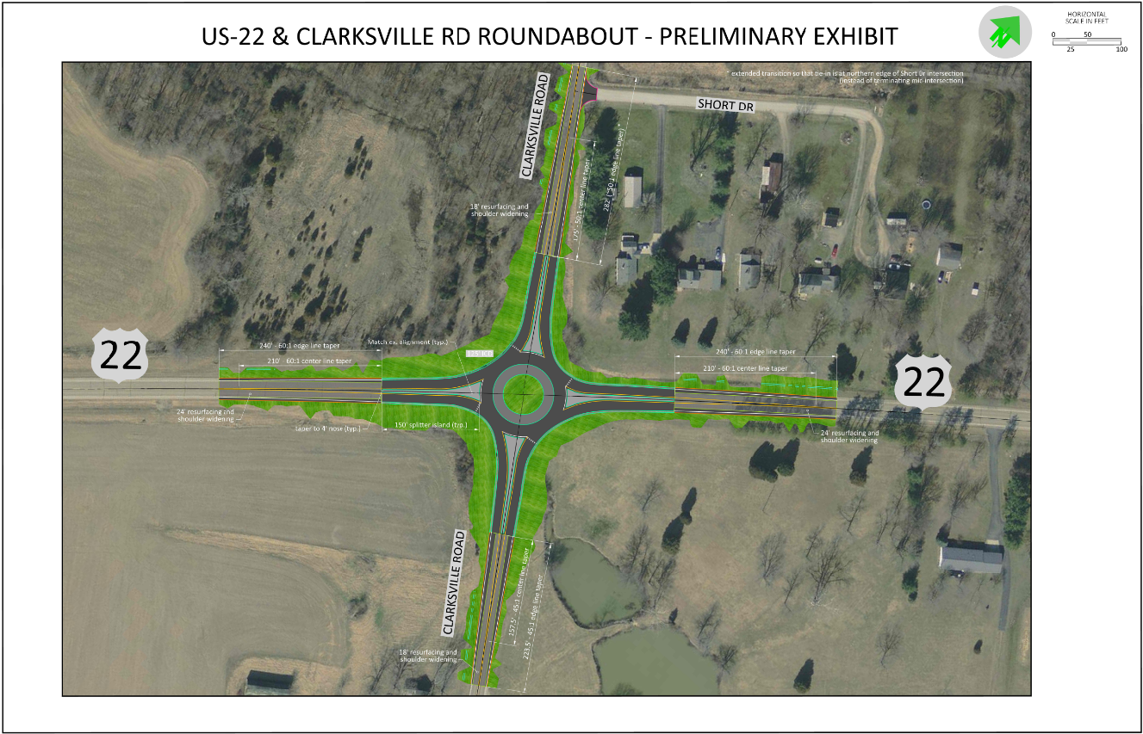
SAFETY APPLICATION
WAR US 22 19.24 (202503D08-01)
Priority Rankings: Rural Intersection #105
Construct a Single Lane Modern Roundabout
Warren County
2025 HSIP Formal Safety Application
Description
Construct a single lane modern roundabout at the US 22/Clarksville Rd intersection
Funding
Schedule
Project Phase | FY | Safety Funds | Total
PE – ENV | 2026 | $400,000 | $400,000
PE - DD | 2028 | $125,000 | $125,000
ROW | 2028 | $200,000 | $200,000
CC | 2029 | $2,373,862 | $2,373,862
Total |  | $3,098,862 | $3,098,862
Authorize Design Consultant | May 2026
Stage 1 Plans – Submitted | January 2027
Enviro Doc Approved | November 2027
Stage 3 Plans - Submitted | June 2028
R/W Acquisition Complete | December 2028
Award | April 2029

