Slide 1

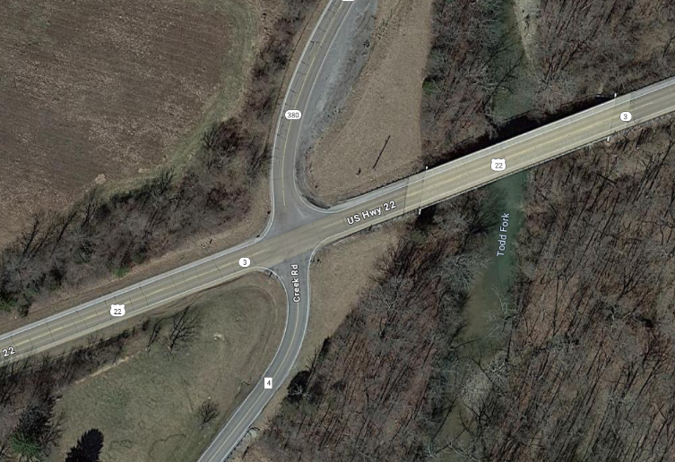
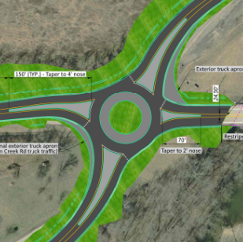
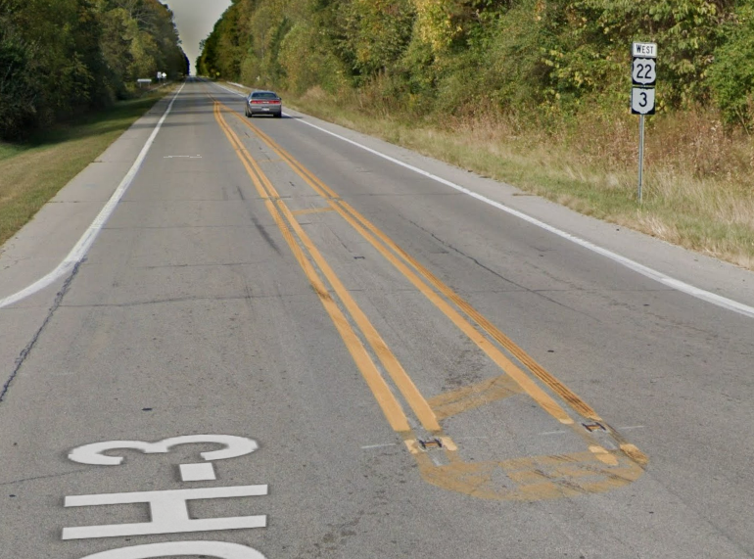
SAFETY APPLICATION
CLI-22-2.62 (202503D08-02)
CLI US-22 2.62(SR-380/Creek Rd)
March 2025
Project Description: Install single lane roundabout at US-22 & SR-380/Creek Rd
- Rural, 4 leg, TWSC intersection (55mph)
60% injuries with 15/20 crashes being angle crashes
Application scores 74/100
SB and NB/EB angle crashes are majority followed by NB and SB/WB angles
Low cost countermeasures have not reduced crashes or slowed operating speeds
AADT: US22 5,30 / SR-380 2,392 / Creek Rd 749
Funding
Project Phase | FY | Safety Funds
PE – ENV | 2026 | $400,000
PE - DD | 2028 | $125,000
ROW | 2028 | $200,000
CC | 2029 | $2,750,000
Total |  | $3,475,000

