Slide 1
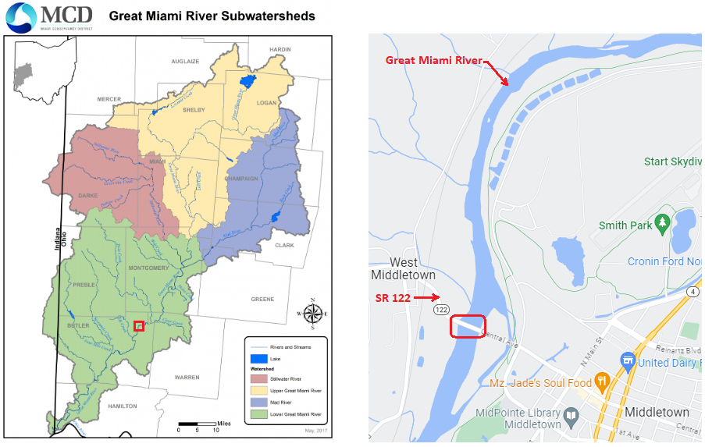
Great Miami River at Middletown, OH
Great Miami Watershed
6,600 Miles of streams & Rivers
5,702 square miles
Covers 10 Counties
At Middletown
Watershed is 3,134 square miles
USGS Gage for last 28 years
Qmax = 55,600 cfs
Gage height range 2’ to 14.2’
Notes:
- shifting flow away from pier reduces frequency of debris accumulation
- mitigates pier scour
- maintaining high flow through span should reduce sedimentation like island that formed before

Slide 2
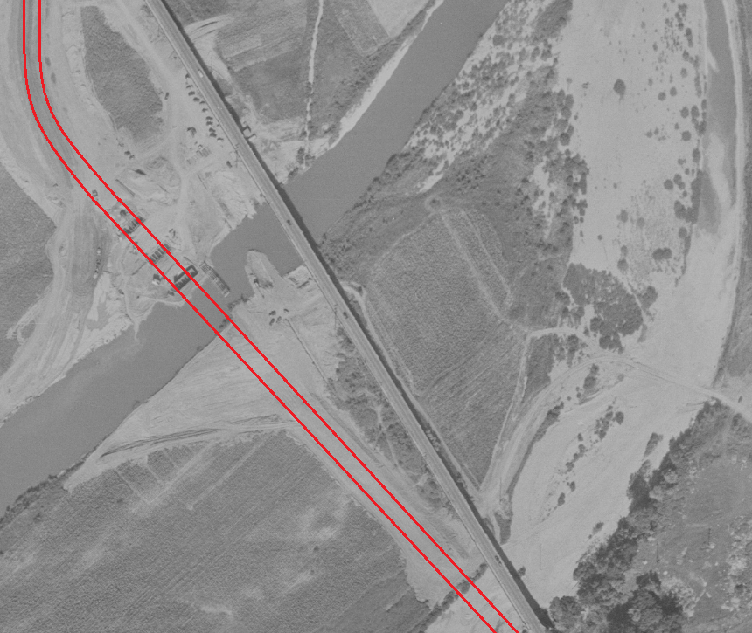
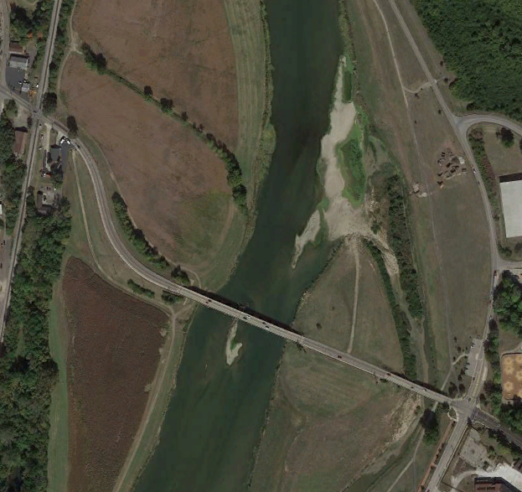
BUT-122-06.26 (SR 122 over Great miami River)
1947
2020
Notes:
- shifting flow away from pier reduces frequency of debris accumulation
- mitigates pier scour
- maintaining high flow through span should reduce sedimentation like island that formed before

Slide 3
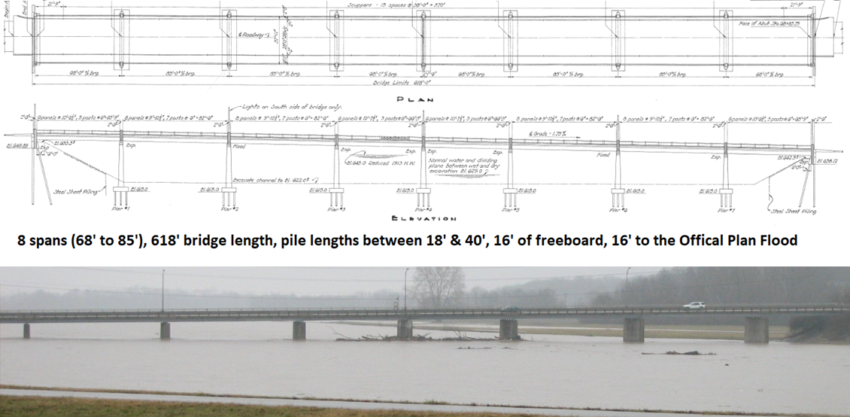
BUT-122-06.26 (SR 122 over Great miami River)
Notes:
- shifting flow away from pier reduces frequency of debris accumulation
- mitigates pier scour
- maintaining high flow through span should reduce sedimentation like island that formed before

Slide 4
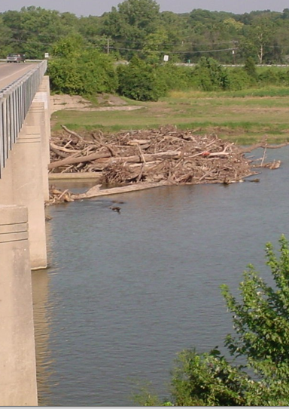
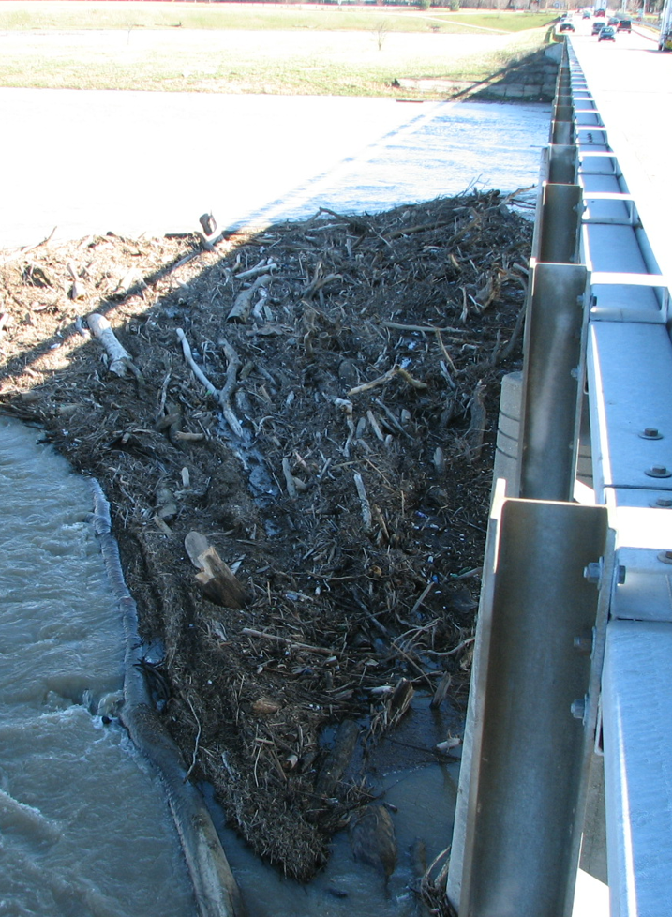
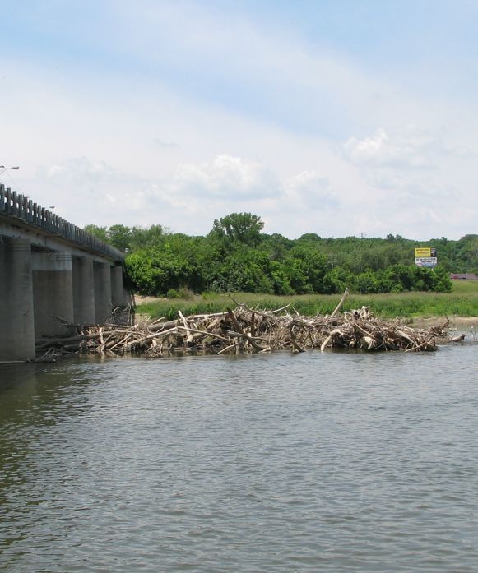
Typical Debris Build-ups
2003
2004
2007
Notes:
- shifting flow away from pier reduces frequency of debris accumulation
- mitigates pier scour
- maintaining high flow through span should reduce sedimentation like island that formed before

Slide 5
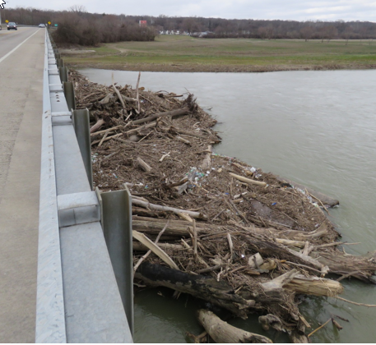
Concerns and Challenges
CONCERNS
1. Hydraulic Capacity
2. Hydrostatic (Transvers) Pressure
3. Scour
CHALLENGES
450’ wide river, 4’ to 10’ deep at low flow.
Can’t put equipment in water.
Contract- $150,00, requires plan preparation, and environmental coordination, 6 to 18 months.
Causeway requires Mussel Survey
Not safe during high flows.
Not safe to work by boat.
Working from bridge requires MOT
Logs can be up to 75’ long and 4’ diameter.
ODNR Long Reach
Excavator w/Thumb
D7 Knuckle Boom w/grapple
Notes:
- shifting flow away from pier reduces frequency of debris accumulation
- mitigates pier scour
- maintaining high flow through span should reduce sedimentation like island that formed before

Slide 6
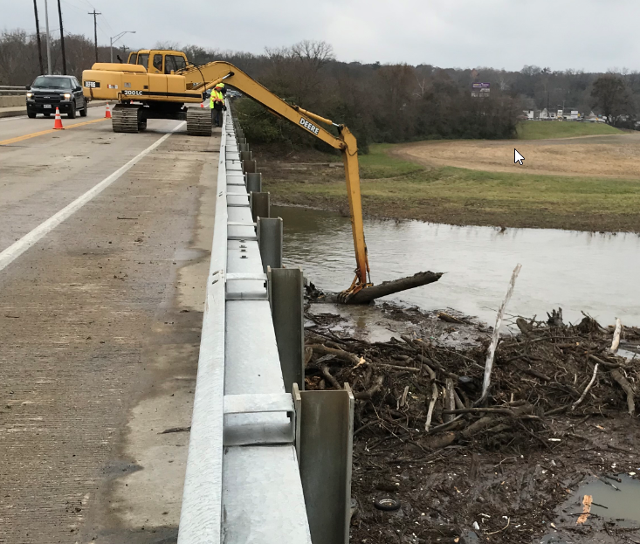
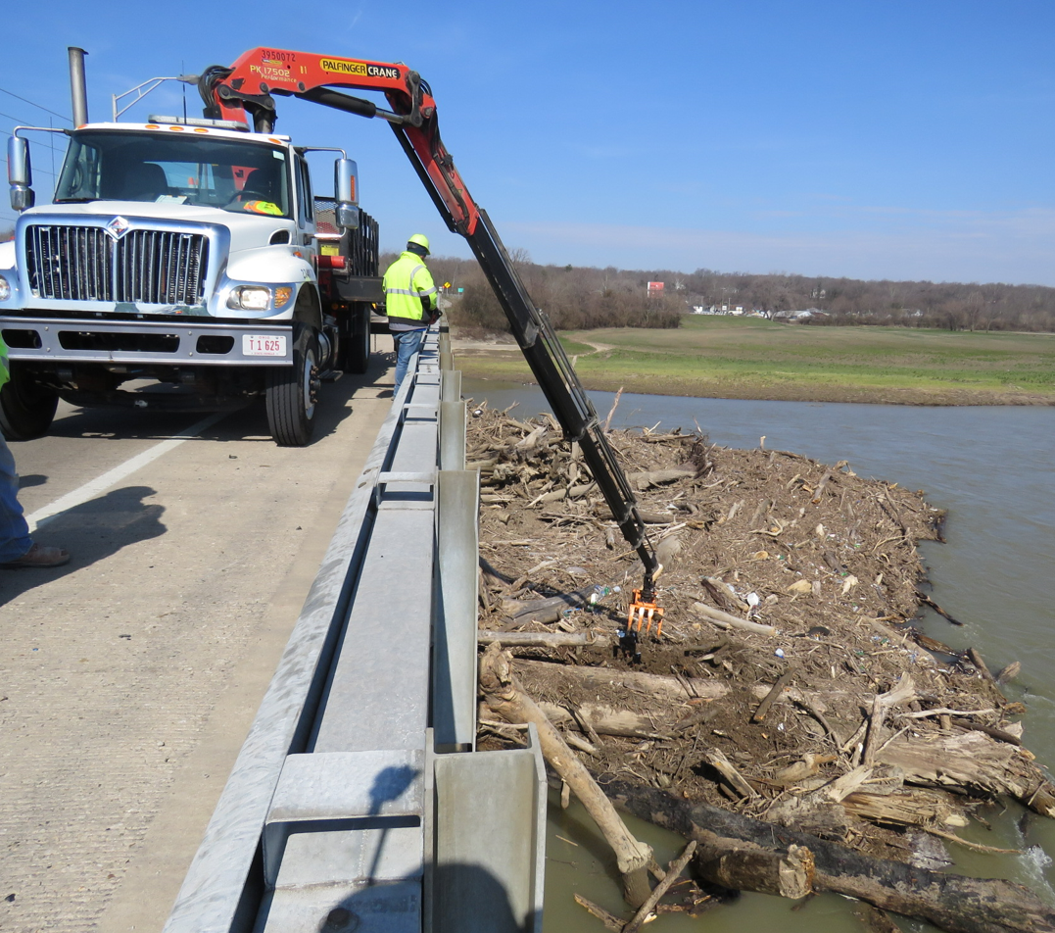
Typical Removal Methods
ODNR Long Reach
Excavator w/Thumb
D7 Knuckle Boom w/grapple
Notes:
- shifting flow away from pier reduces frequency of debris accumulation
- mitigates pier scour
- maintaining high flow through span should reduce sedimentation like island that formed before

Slide 7
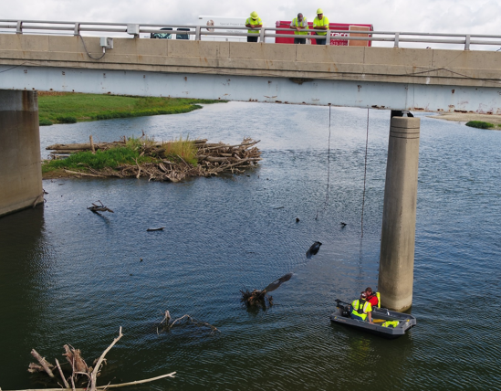
Removal methods are Not Perfect
Can’t reach everything under bridge.
Can’t see/remove more than a few feet down.
Can’t reach more than about 30’ from bridge
Had to have divers cut submerged debris with underwater chainsaws to perform dive inspection
Notes:
- shifting flow away from pier reduces frequency of debris accumulation
- mitigates pier scour
- maintaining high flow through span should reduce sedimentation like island that formed before

Slide 8
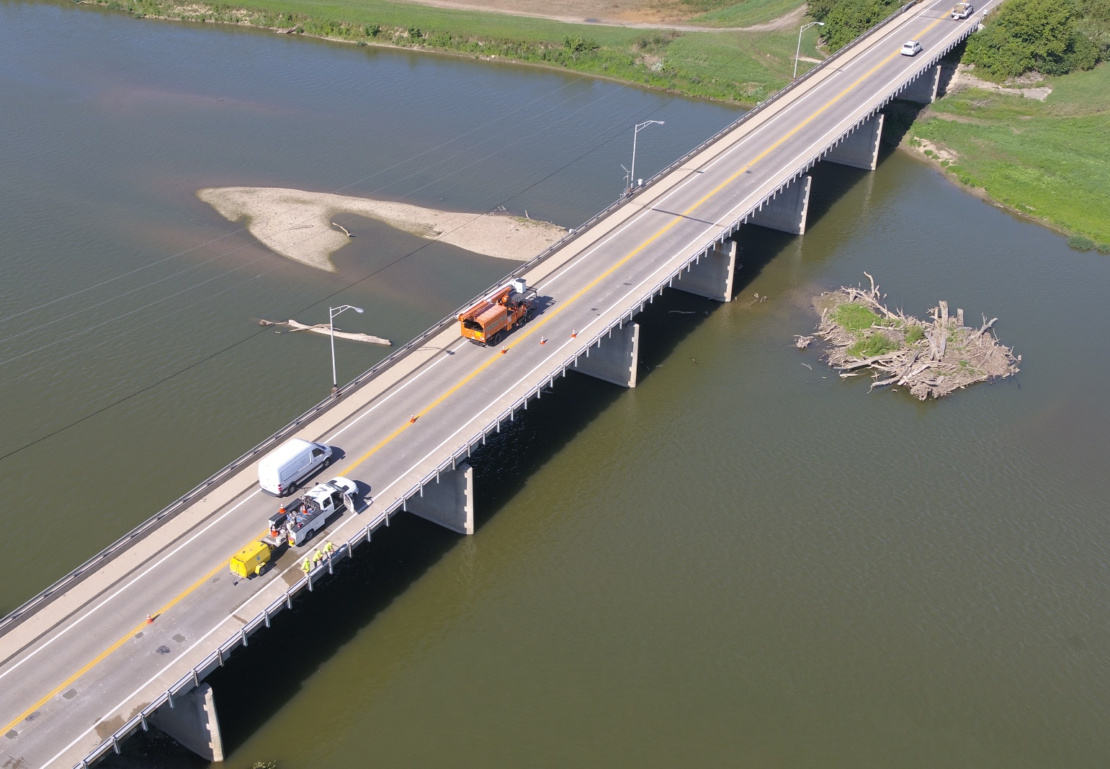
Changes Started
2018 Things Started to Change
Formation of Island Downstream.
Can’t reach Debris Island.
2019 Dive inspection now indicates we have exposed footings which we had never had before.
Notes:
- shifting flow away from pier reduces frequency of debris accumulation
- mitigates pier scour
- maintaining high flow through span should reduce sedimentation like island that formed before

Slide 9
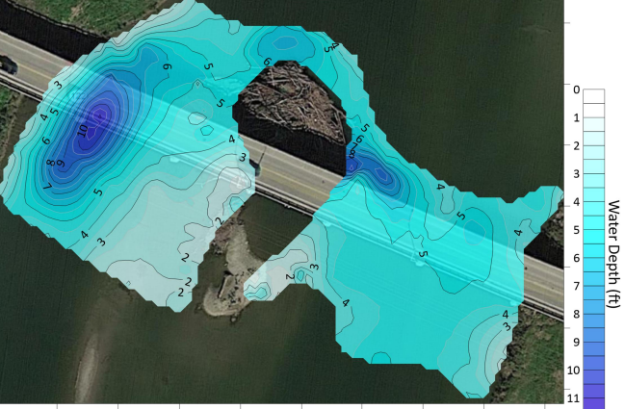
Bathymetric Survey with Sonar

Slide 10
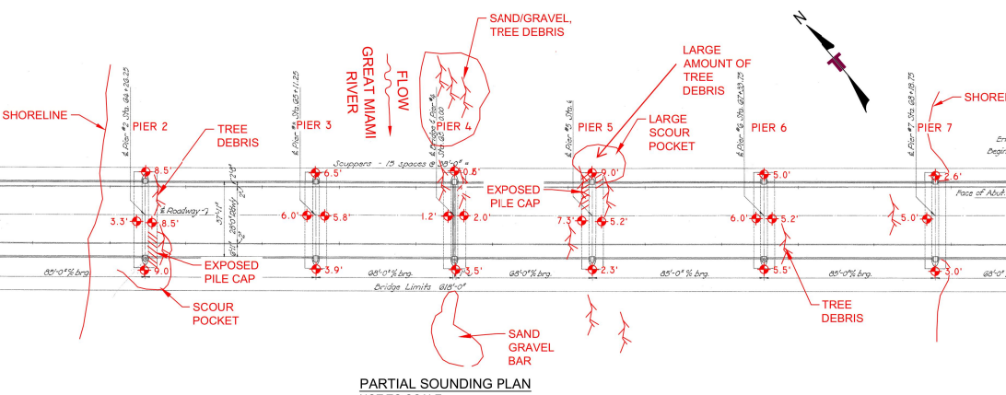
Dive Inspection Site Plan

Slide 11
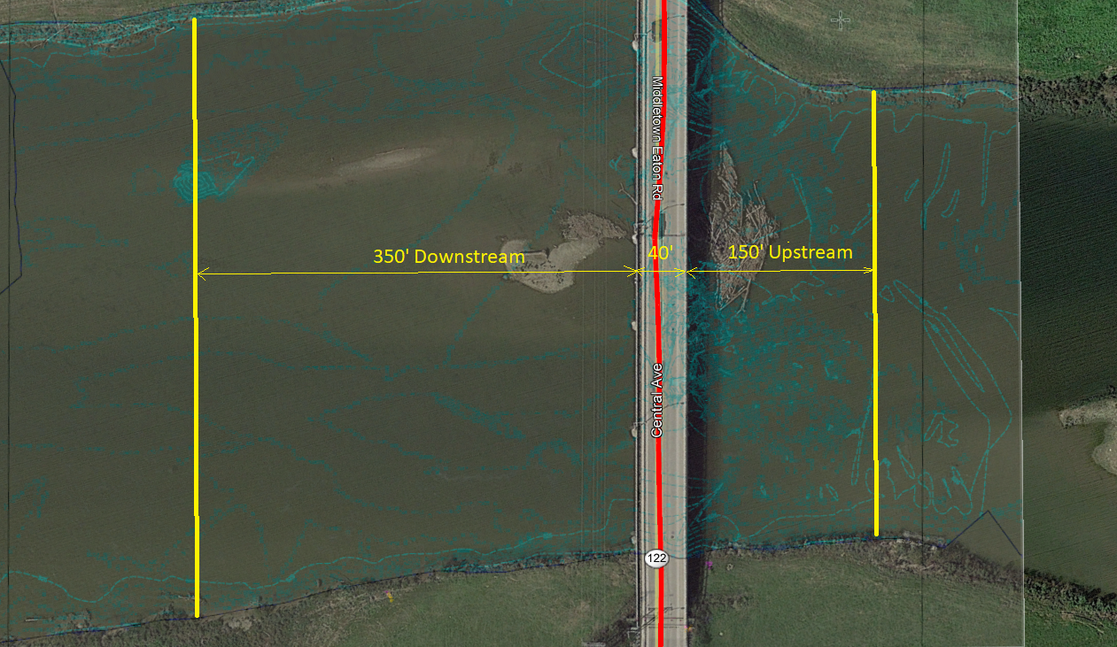
Significant stream channel work was needed

Slide 12
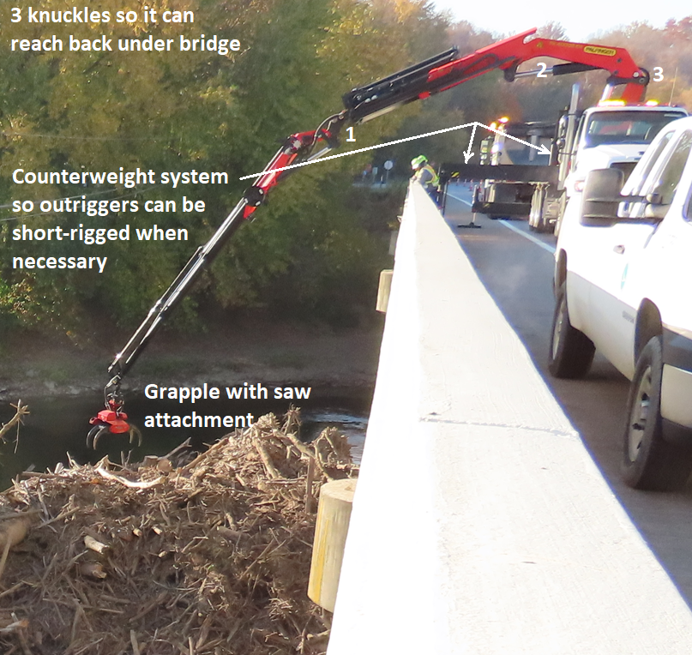
Research on Debris Removal and Prevention
In 2018 Started a Research Project
Develop Cost Effective Alternatives for Mitigating Debris and Environmental Impacts Around Bridge Piers
Goals
1. Find an Environmentally Friendly way to remove
debris from bridge piers safely and cost effectively.
2. Determine if anything can be done to minimize debris
build-up at problematic bridges. (Credit: Jill Martindale)
2019 ODOT Selected Ohio State University Agricultural and Engineering Technologies Division, Project Manager: Jon Witter
OSU/John Witter: Previous ODOT Research Project: Streamlining Implementation of Sustainable Channel Maintenance Practices.
Research budget included purchase of large equipment for debris removal.
Notes:
- shifting flow away from pier reduces frequency of debris accumulation
- mitigates pier scour
- maintaining high flow through span should reduce sedimentation like island that formed before

Slide 13
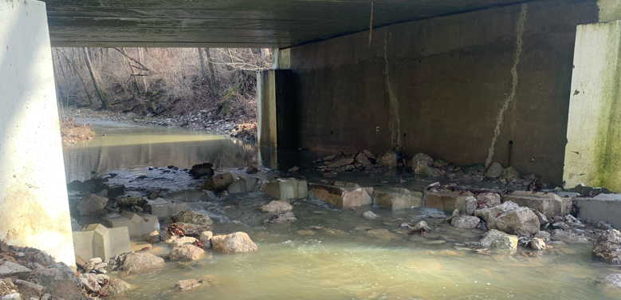
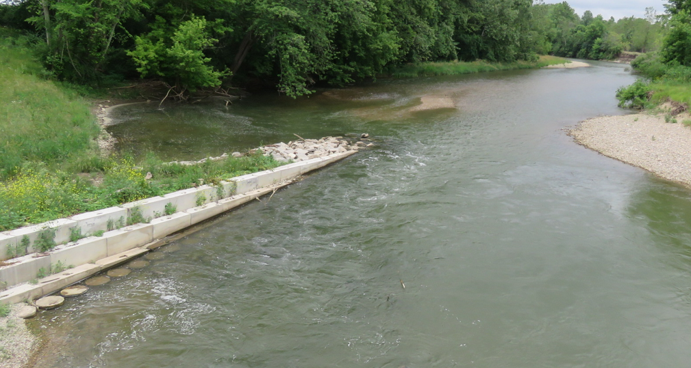
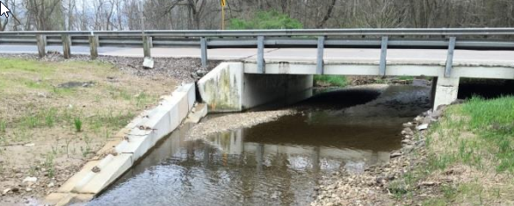
Previous use of vanes & weirs to control Stream
Vanes previously constructed with Rock, Concrete Block, and even on deep foundation to keep stream channels centered and prevent scour attach on abutments and piers.
Minimal use for debris control to our knowledge.
Never used on river of the size of Great Miami River to our knowledge.
Notes:
- shifting flow away from pier reduces frequency of debris accumulation
- mitigates pier scour
- maintaining high flow through span should reduce sedimentation like island that formed before

Slide 14
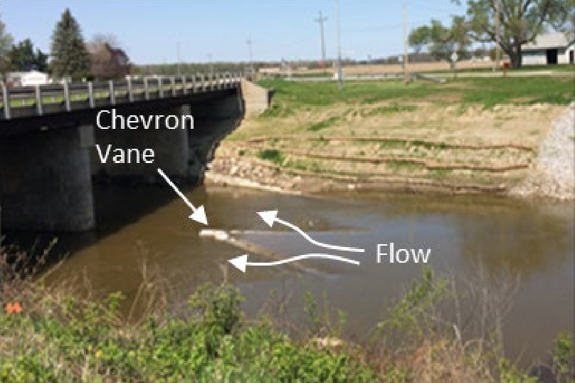
What is a chevron vane?
V-shaped structure placed upstream of an object that is meant to divide flow around that object
Notes:
- shifting flow away from pier reduces frequency of debris accumulation
- mitigates pier scour
- maintaining high flow through span should reduce sedimentation like island that formed before

Slide 16
What is a chevron vane?
V-shaped structure placed upstream of an object that is meant to divide flow around that object
Notes:
- shifting flow away from pier reduces frequency of debris accumulation
- mitigates pier scour
- maintaining high flow through span should reduce sedimentation like island that formed before

Slide 17
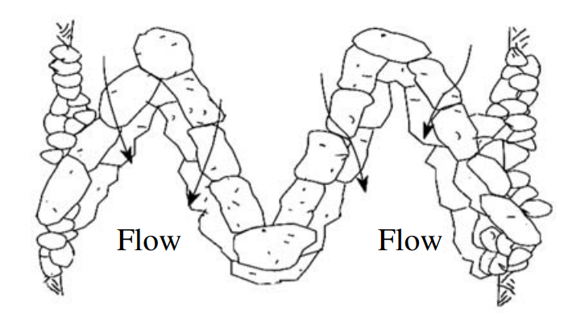
Modified from w-weir
BRIDGE PIER
Notes:
W-weir meant to direct flow to middle of stream and off of banks

Slide 18
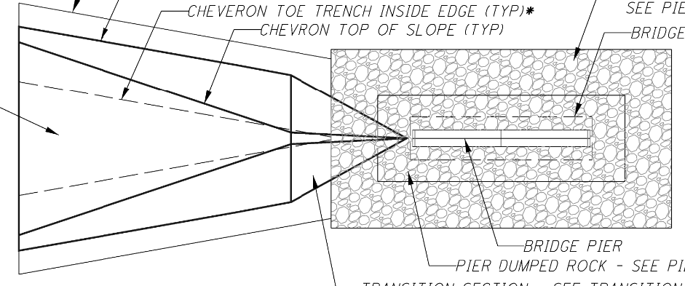
Scoping/Design of BUT-122-6.06 PID 110559
FLOW
BRIDGE PIER
Notes:
Water does not flow uphill so flow is directed to the sides

Slide 19



FLOW
FLOW
Notes:
- faster flow around sides of chevron vane should cause debris to not wind up parallel to flow or bridge piers

Slide 20
Chevron vane geometry
Top of vane (downstream end near pier) at or near bankfull depth (el. 629.0)
Vane arms extend from river bottom at upstream end up at a slope of about 7%
Width of vane extends to about 1/3 span opening
Notes:
- bankfull height based on visual observation and gage data from MCD - about 4-6 times per year last 5 years
- “bankfull” should be between a 1-year and 2-year storm event. 2D modeling found this to be 10,000 CFS
- river bottom around 622.0 and baseflow is around 627.0.
- vanes about 70’ in length from u/s end to top
- transitions back down at about 5:1 or 20% slope to bridge pier

Slide 21
Chevron vane material selection
Initially thought to use sheet pile
Geotech borings made this too expensive
Dumped rock was selected
Rock sized based on 2D modeling results of 100-year flow from FEMA and OPF from MCD
D50 = 18” (ODOT Type B), we used 24” (ODOT Type A)
Dumped rock toe trenched in about 4’
Notes:
- 100-year = 76,000 cfs, D = 14.1 FT, V = 8.6 fps
- MCD OPF = 150,000 cfs, D = 17.3 FT, V = 12.6 fps
- We increased rock size due to rock size already used for causeway AND for comfort. 1.5 Factor of safety already applied for a D50 of 18”
- A toe trench was included around sides to prevent scour

Slide 22
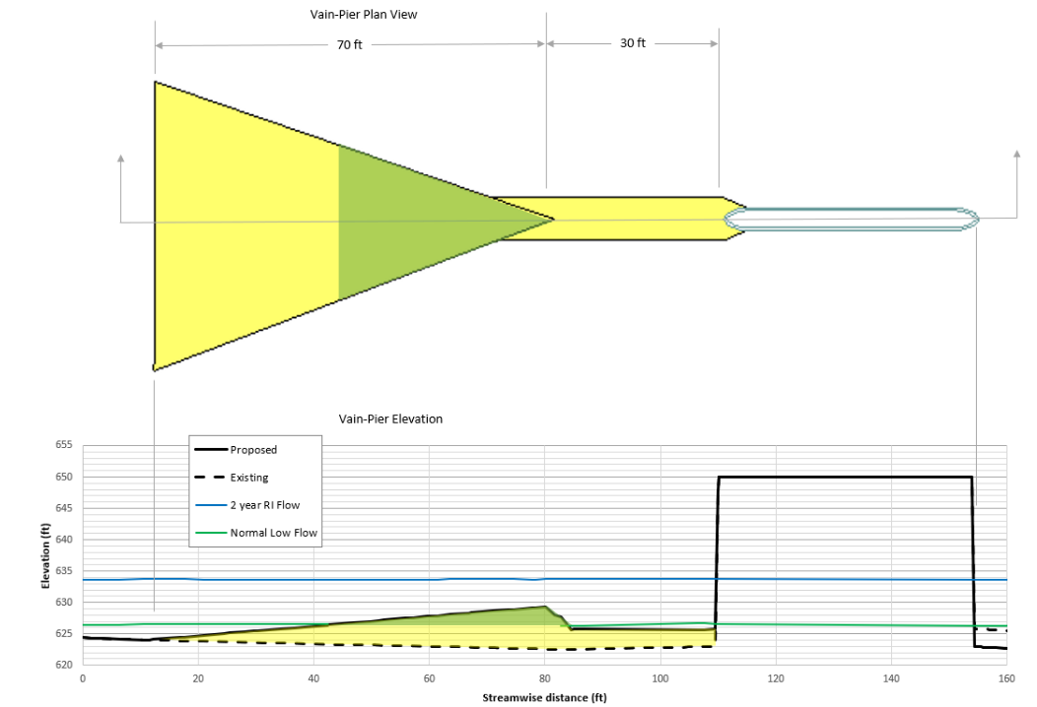
Location of chevron vane
Notes:
- 70 ft long and 30 ft from d/s end of vane (top of vane) to pier
- modeling showed a swirling effect in between the vane a pier so once the final material was selected we made sure to include rock connecting the 2 to mitigate scour on both structures

Slide 23
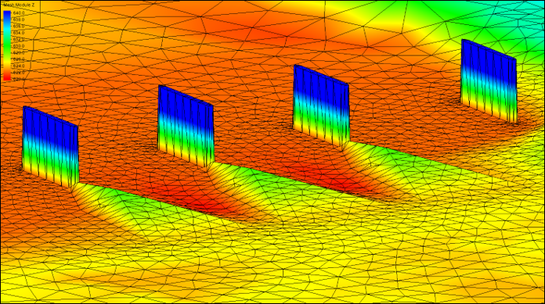
2D modeling results
SEDIMENTATION
SCOUR HOLE
SCOUR HOLE
Notes:
- thank you to John Witter with OSU Agricultural and Engineering and Technologies division and Ayres associates for 2D modeling expertise and plan production. Carpenter Marty also assisted with plan production seen in some image clips in this presentation
- Picture depicts terrain modeled with chevron vane as well as a “finger” to connect to the piers where swirling was shown in model
- Existing scour hole filled on right and left span
- Sediment island dredged to top-left of photo

Slide 24
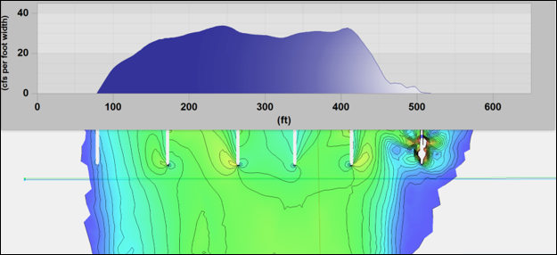
Bankfull flow model results - existing
Notes:
- bankfull = 10,000 cfs
- top depicts existing flow distribution, bottom depicts proposed with chevron vanes
- top shows lower flow in the middle with flow directly along the piers
- proposed shows higher distribution of flow in the middle of the span, directing flow away from the piers themselves
- modeling shows 66% reduction in flow rate at piers and redirects that flow to middle of span

Slide 25
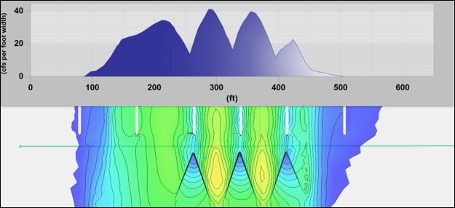
Bankfull flow model results - proposed
Notes:
- bankfull = 10,000 cfs
- top depicts existing flow distribution, bottom depicts proposed with chevron vanes
- top shows lower flow in the middle with flow directly along the piers
- proposed shows higher distribution of flow in the middle of the span, directing flow away from the piers themselves
- modeling shows 66% reduction in flow rate at piers and redirects that flow to middle of span

Slide 26
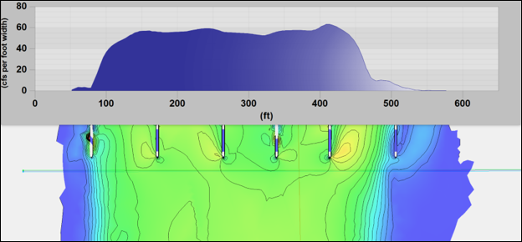
2-yr flow model results - existing
Notes:
- 2-yr = 22,400 cfs
- top depicts existing flow distribution, bottom depicts proposed with chevron vanes
- existing shows lower flow in the middle with flow directly along the piers
-
-

Slide 27
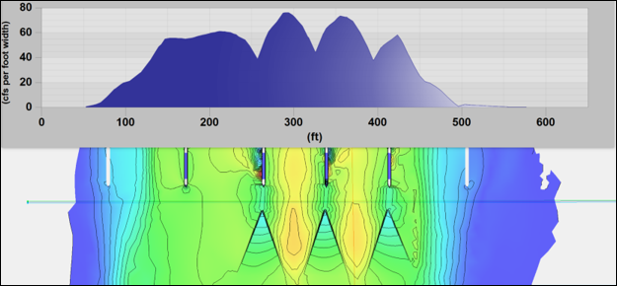
2-yr flow model results - proposed
Notes:
- 2-yr = 22,400 cfs
- top depicts existing flow distribution, bottom depicts proposed with chevron vanes
- proposed shows higher distribution of flow in the middle of the span, directing flow away from the piers themselves
- modeling shows 47% reduction in flow rate at piers and redirects that flow to middle of span

Slide 28
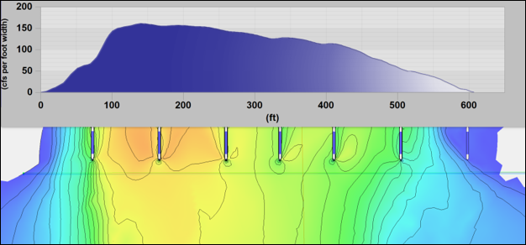
100-yr flow model results - existing
Notes:
- 100-yr = 100,000 cfs
- existing shows lower flow in the middle with flow directly along the piers and flow heavily distributed to the left (east) side of river
- proposed shows higher distribution of flow in the middle of the span, directing flow away from the piers themselves
- modeling shows 32% reduction in flow rate at piers with that flow being redirected to middle of spans

Slide 29
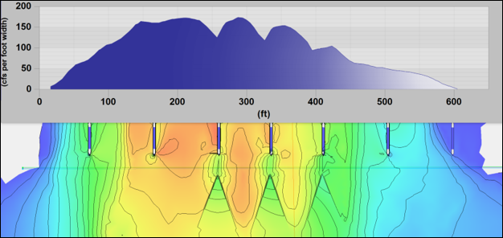
100-yr flow model results - proposed
Notes:
- 100-yr = 100,000 cfs
- top depicts existing flow distribution, bottom depicts proposed with chevron vanes
- top shows lower flow in the middle with flow directly along the piers and flow heavily distributed to the left (east) side of river
- proposed shows higher distribution of flow in the middle of the span, directing flow away from the piers themselves
- modeling shows 32% reduction in flow rate at piers with that flow being redirected to middle of spans

Slide 30
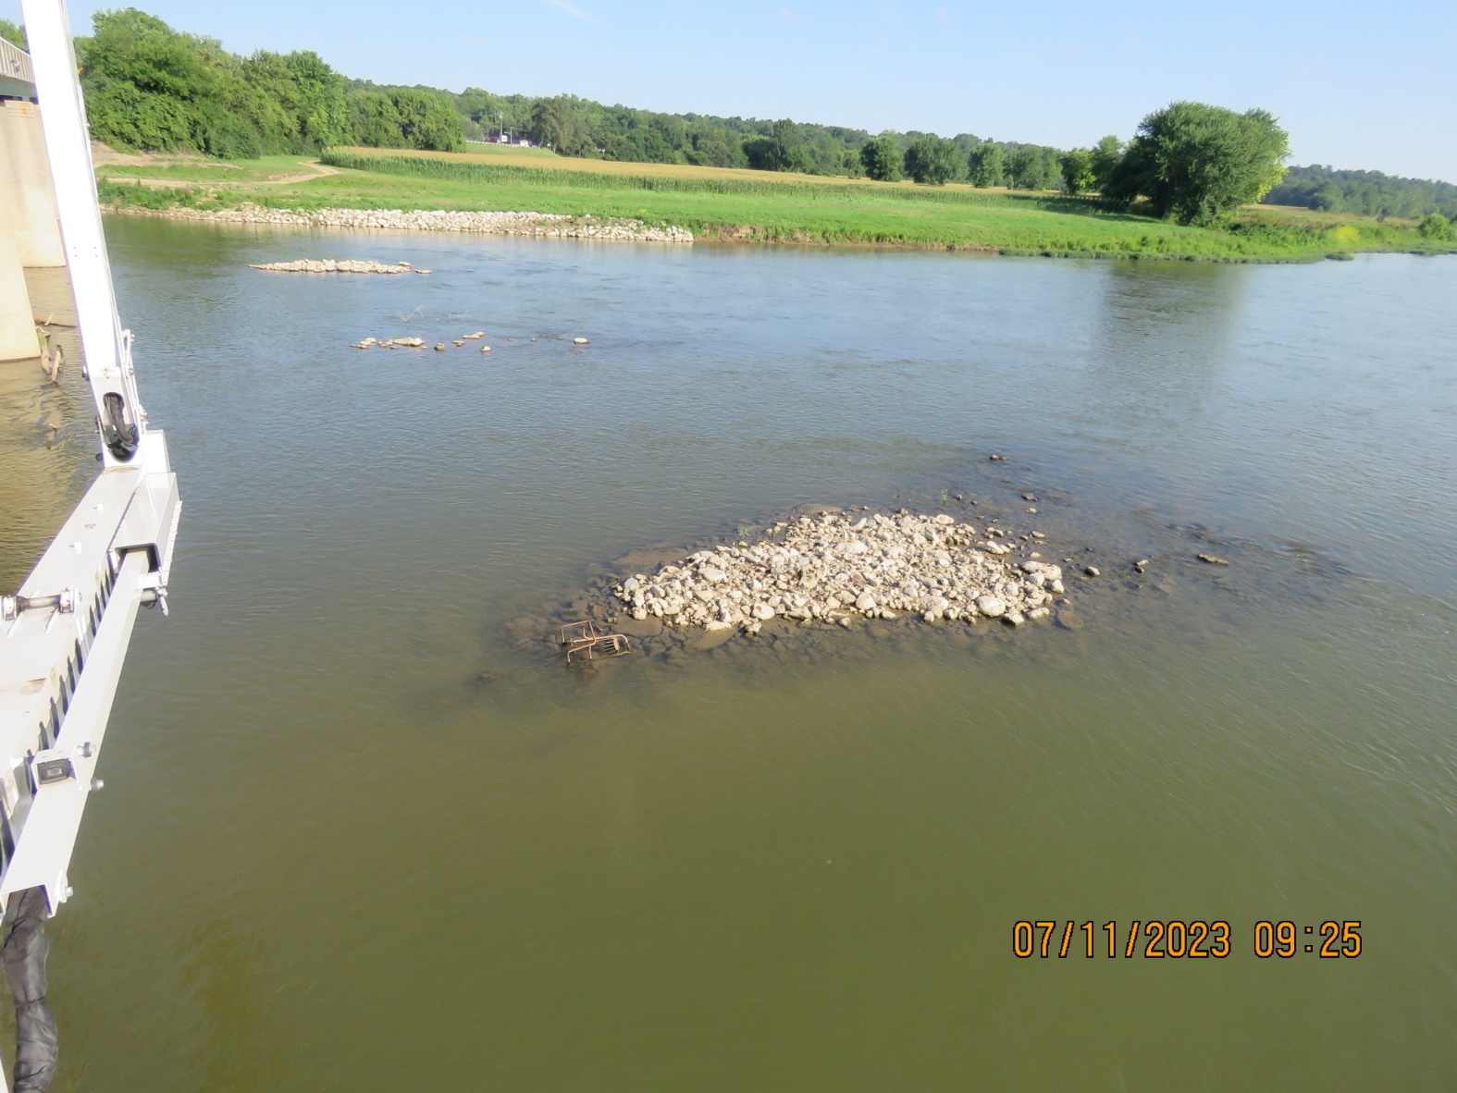
Notes:
- so after all the modeling and design, how are they working?
- in photo above you can make out flow lines as anticipated
- gage height shows 627.8, so about 1.2’ exposed
- small storm 1 week prior had these overtopped – shopping cart on vane

Slide 31
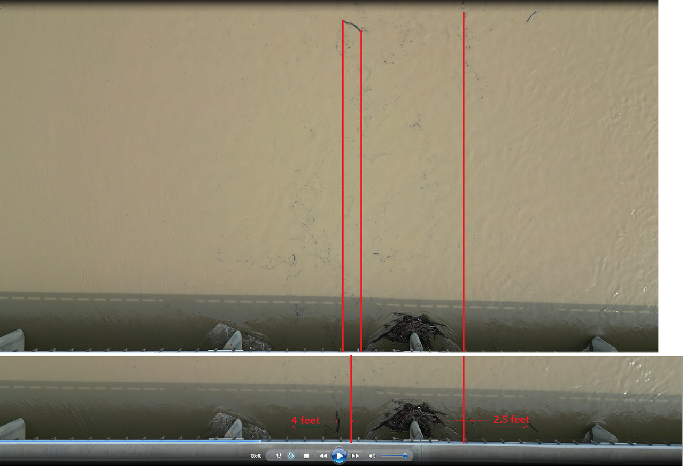

Slide 32
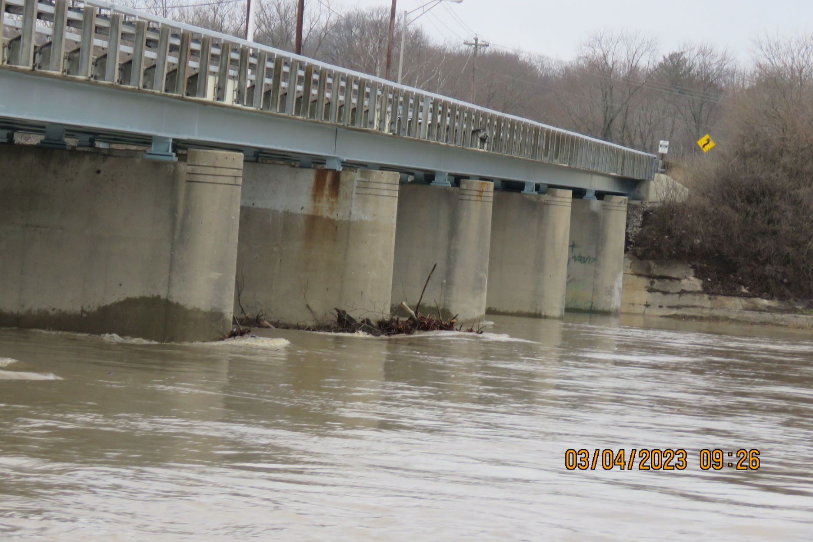
March 4, 2023
Notes:
- 3.4 inches of rain in 14 horus – about 10-year storm
- gage height = 635.5’ so vane 6.5’ under water
- peaked 1’ higher the next morning, 3/5
- the good news – this debris did not stay lodged and no cleaning effort

Slide 33
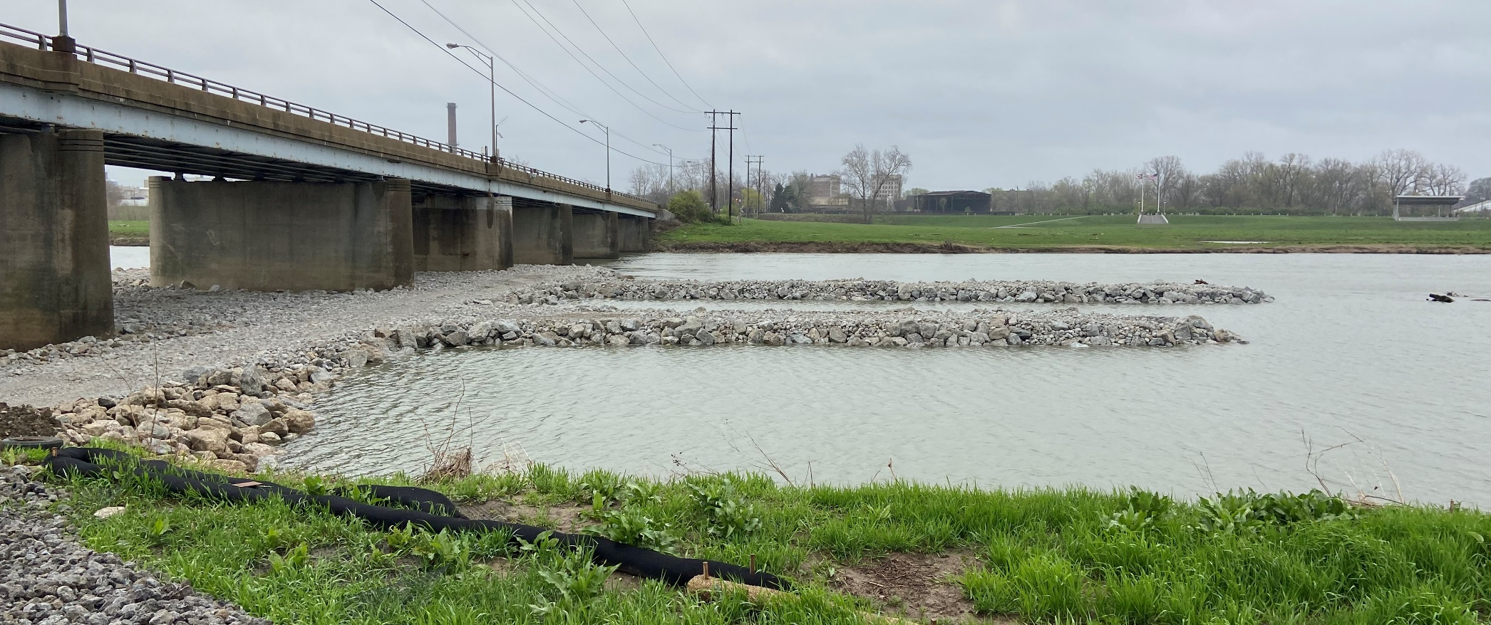
Lessons learned
2D modeling of causeway
River flow at surface follows thalweg
Notes:
- 1D model was only method scoped for permitting contract. 2D was part of research and added to 1D model once it was greenlit.

