Slide 1
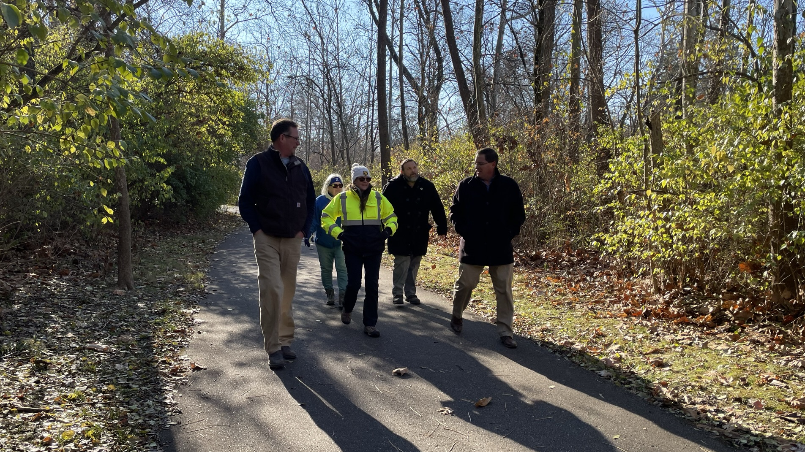
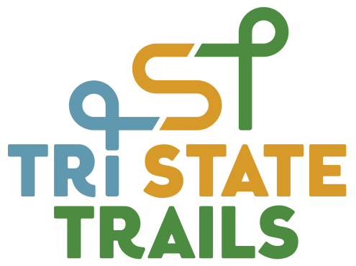

Collaborate, Connect, Communicate:
ODOT & Tri-State Trails’ Early Partnership and Use
of VPI for Mill Creek Triangle Trail

Slide 2
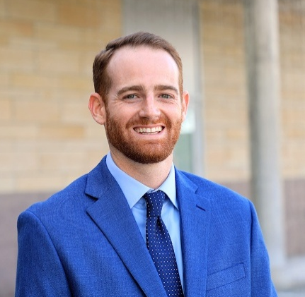

Presenters
Brad Bowers, AICP
Tri-State Trails
Project Manager
brad@tristatetrails.org
Anthony Pankala, PE
ODOT, District 8
Environmental Engineer
Anthony.Pankala@dot.ohio.gov
Provides technical assistance to local governments & community stakeholders on regional trail and bikeway projects in Ohio, Kentucky, and Indiana
Manages trail feasibility studies, comprehensive trail plans, and funding strategies
Experience coordinating public engagement using a variety of tools and strategies
Frequent commuter cyclist, bringing practical insight to active transportation planning
Scopes environmental tasks for LPA and ODOT projects with District 8 (Cincinnati)
Creates, reviews, and coordinates environmental documents per ODOT OES manuals and guidelines
Early adaptor and avid user of Virtual Public Involvement (VPI) and enthusiastic about sharing my knowledge and experience with using PublicInput through ODOT
Passionate about multimodal transportation, public transportation, and ADA accessibility
2

Slide 3
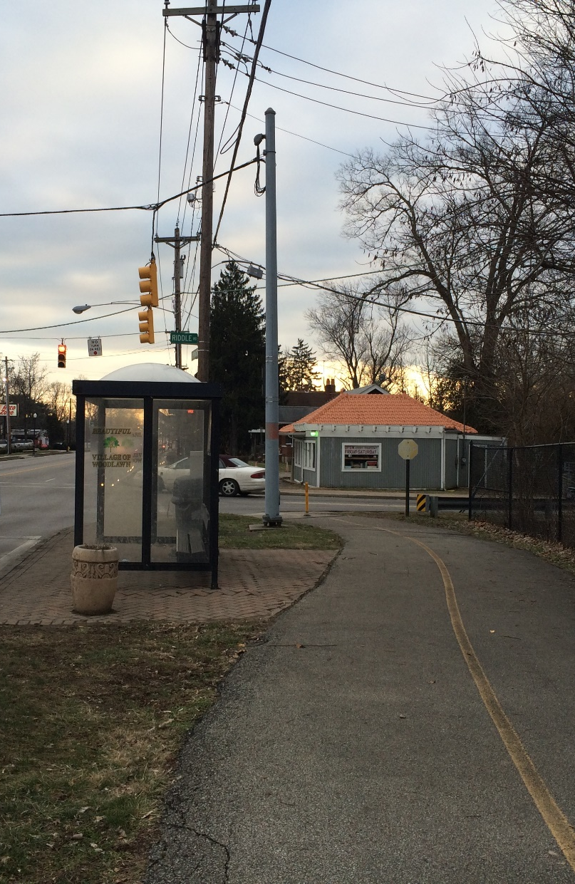
Outline
Background
Above & Beyond
1st Time Experience
Website Walk-thru
Benefits
Lessons Learned
3
Photo credit: Great Parks of Hamilton County

Slide 4

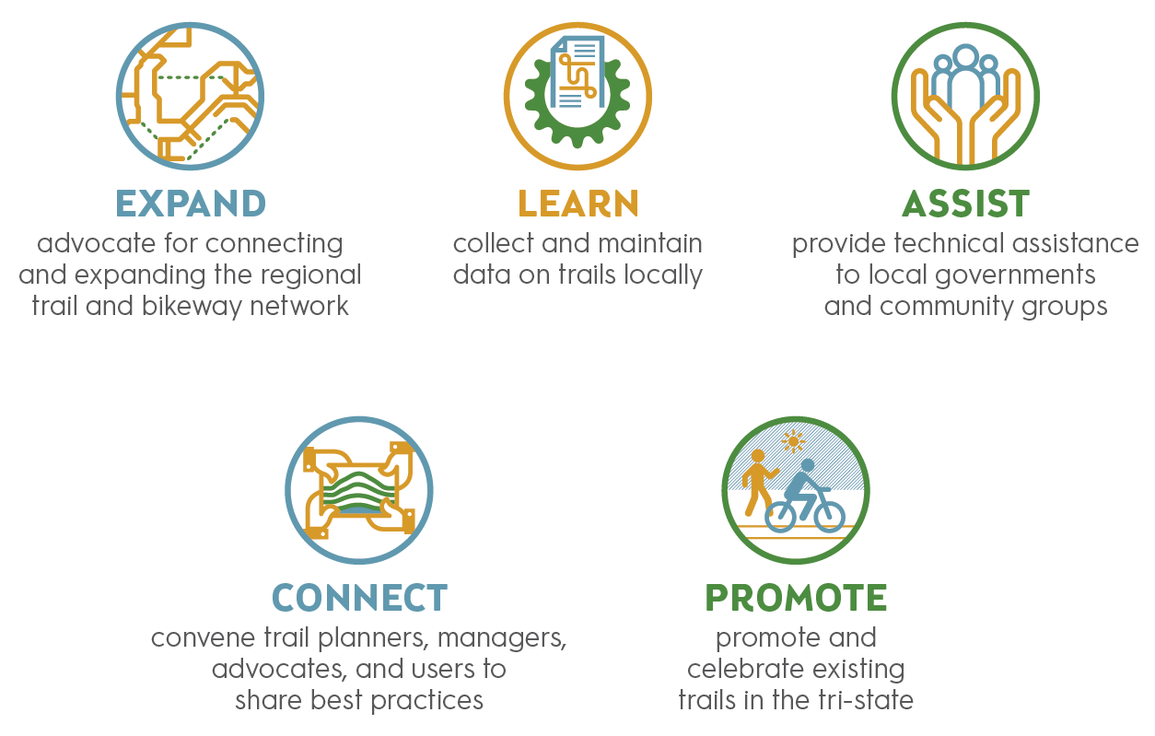
About Tri-State Trails
Background
4

Slide 5
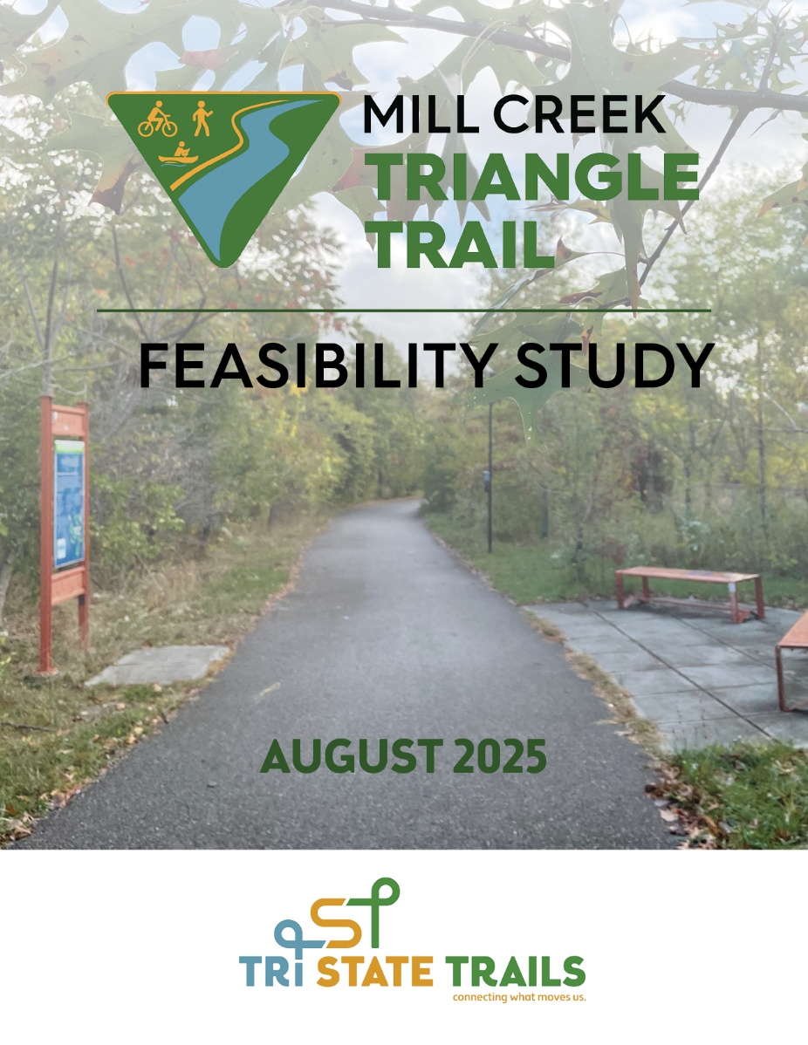
Mill Creek Triangle Trail
Feasibility Study
The MCT Feasibility Study is a multi-jurisdictional effort and vision for a 40+ mile regional trail network in central and northern Hamilton County. The trail will connect neighborhoods to the Mill Creek, local business districts, key destinations, and Great Parks’ regional greenspaces like Winton Woods, Glenwood Gardens, and Sharon Woods, while also linking to Cincinnati’s planned 34-mile CROWN loop. The vision is to create an equitable amenity for both transportation and recreation.
Background
5

Slide 6
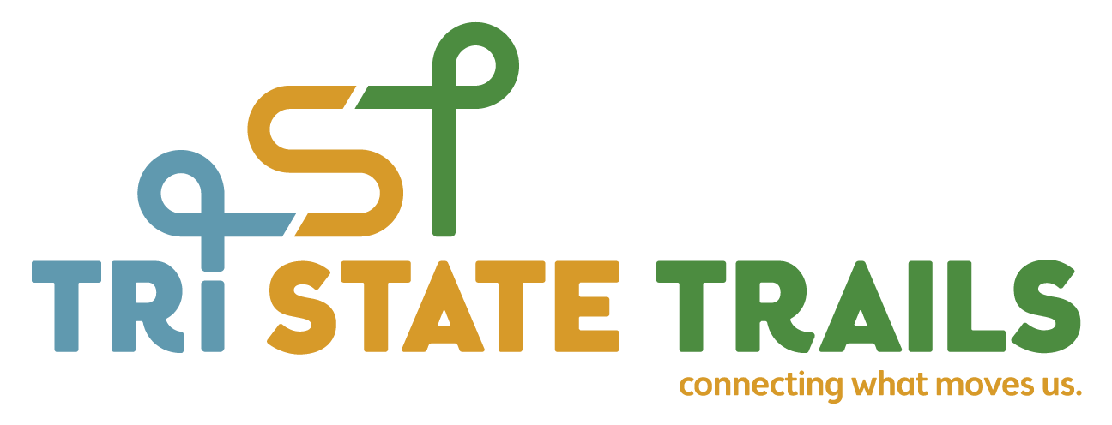


Project Team
Planning and Project Management
Engineering Consultant
Environmental Subconsultant
Background
6

Slide 7
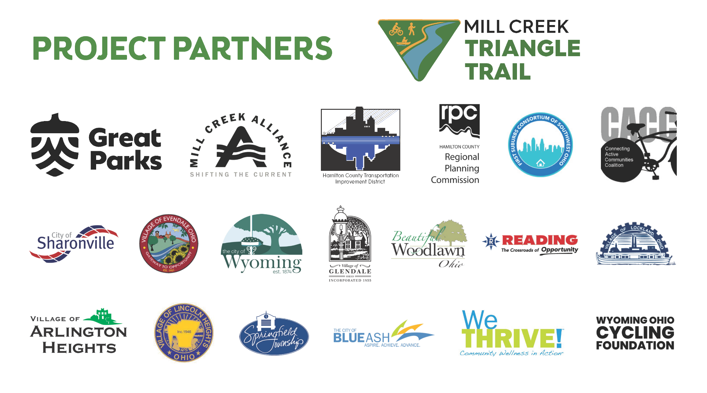
Background
7

Slide 8
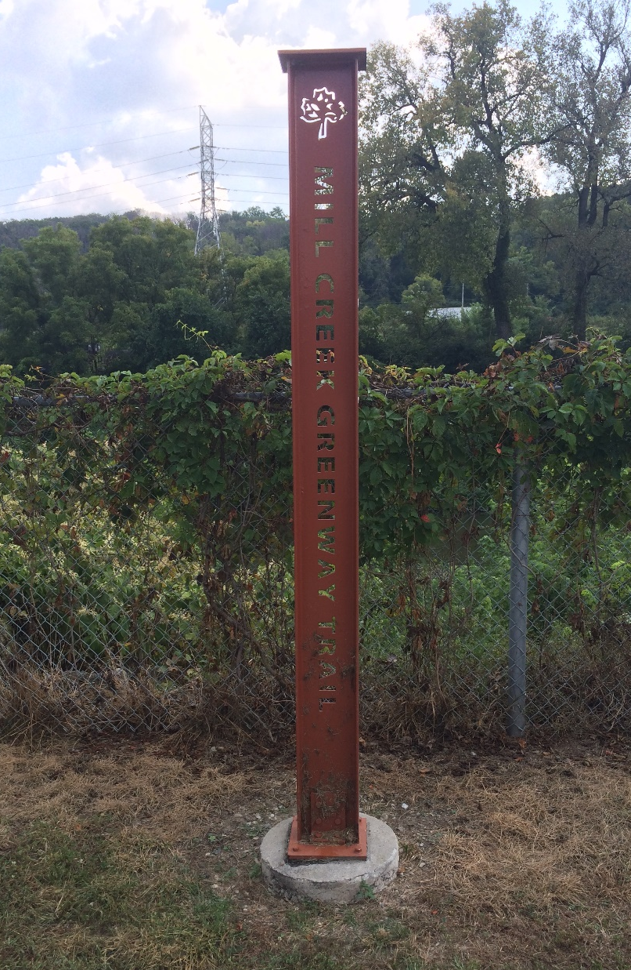
Mill Creek Triangle Trail
Feasibility Study Objectives
Form an active transportation network in the center of Hamilton County
Explore trail alignment options and recommend a preferred route
Conduct public engagement for the proposed Mill Creek Triangle Trail
Position trail segments to apply for federal and state grant funding for construction
Background
8
Photo credit: Great Parks of Hamilton County

Slide 9
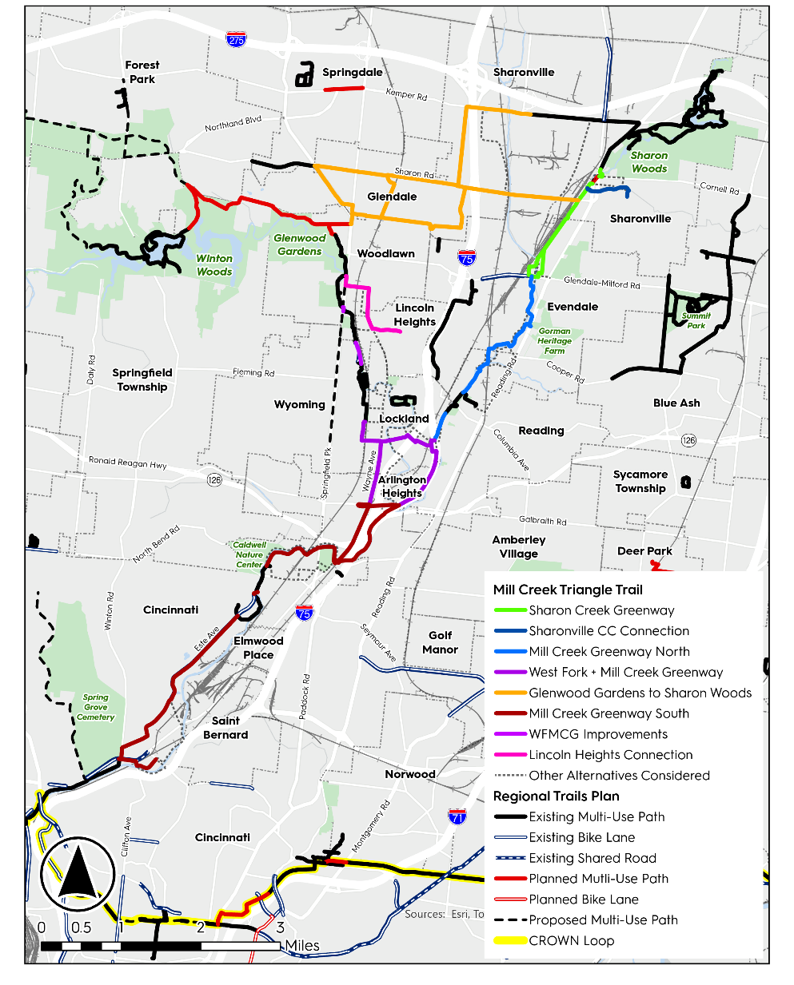
Mill Creek Triangle Trail
Overview Map
Study area includes ten cities and villages
Steering committee includes reps from each jurisdiction, along with county, state, and regional government agencies, and community organizations
Working Groups - Study area was broken into six focus areas
Background
9

Slide 10
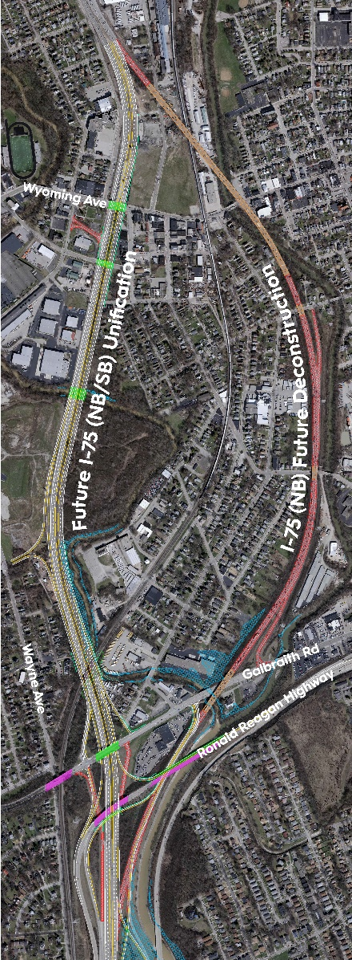
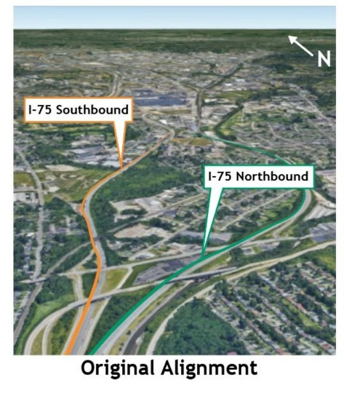
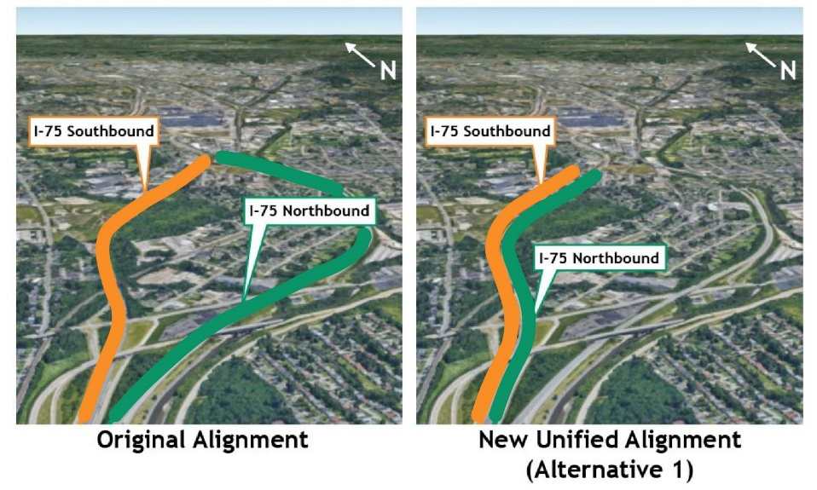
Mill Creek Triangle Trail
ODOT Coordination
I-75 Thru-The-Valley Project
Project Scoping – ODOT Project Development Process (PDP)
Public Engagement – NEPA Requirements
Funding Strategy - Setting Mill Creek Triangle Trail segments up for success for future federal funding
Property Acquisition Strategy
Above & Beyond
10

Slide 11
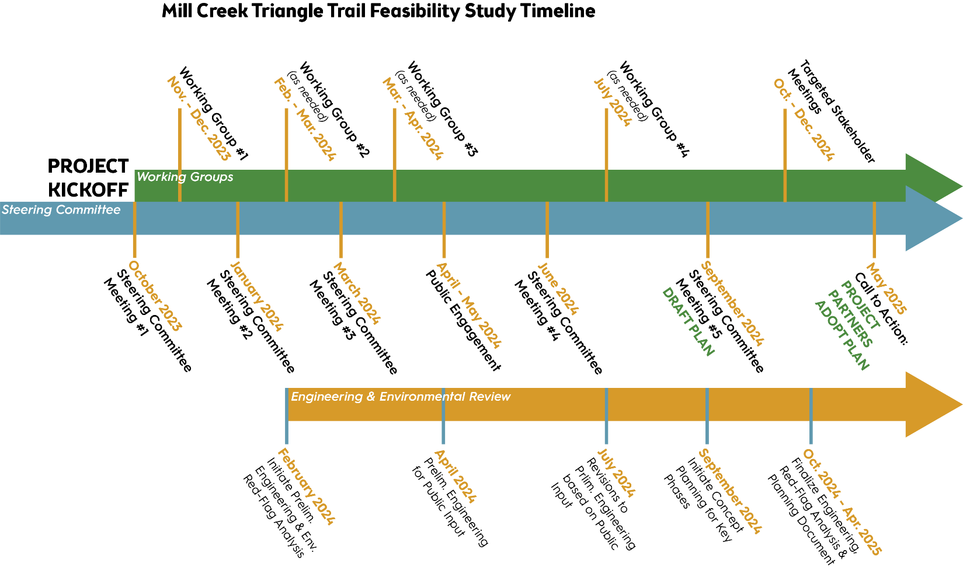
ODOT review of project scope (based on ODOT PDP) and early coordination on planning process
ODOT review of Public Input Plan – TST use of VPI software
ODOT review of draft feasibility study and preliminary engineering
Working Groups
Steering Committee
ODOT invited to attend Steering Committee & Public Involvement meetings
Public Engagement
Engineering & Environmental Review
ODOT
Coordination
Above & Beyond
11
Notes:
Another potential steering committee meeting in July?
- Need to confirm we have the budget for

Slide 12
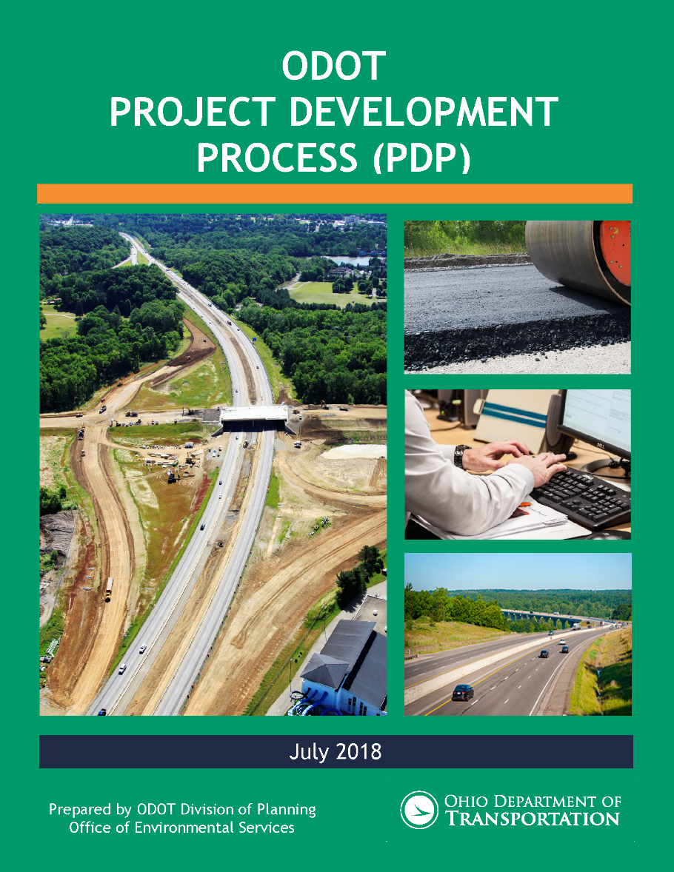
Project Scope – PDP
ODOT review of project scope – assistance in selecting required tasks and appropriate path
PDP Phases for MCT Study – Planning, Preliminary Engineering, and Environmental Engineering (red-flag analysis)
Review of Purpose & Need Statement
Design Standards – ODOT MMDG
Above & Beyond
12

Slide 13
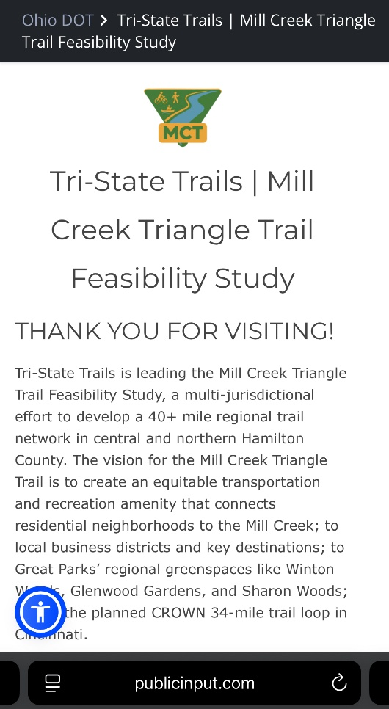

Virtual Public Involvement (VPI)
Tri-State Trails asked and received access to PublicInput to conduct Virtual Public Involvement (VPI)
First time use of VPI software to conduct public engagement survey
Ease of use to create project webpage
PublicInput training sessions
ODOT review and “tweaking” of project webpage to be more user-friendly
First Time Experience
13

Slide 14
Benefits of Using VPI
Survey / questionnaires
Ability to share a lot of information (background, alternatives, focus areas, etc.) using website tabs
Greater participation
Easier to ask and get responses at the convenience of each survey respondent
Allows participants to directly interact with other comments by responding or “upvoting” comments they agree with
Easy to share with QR codes and social media posts
First Time Experience
14

Slide 15
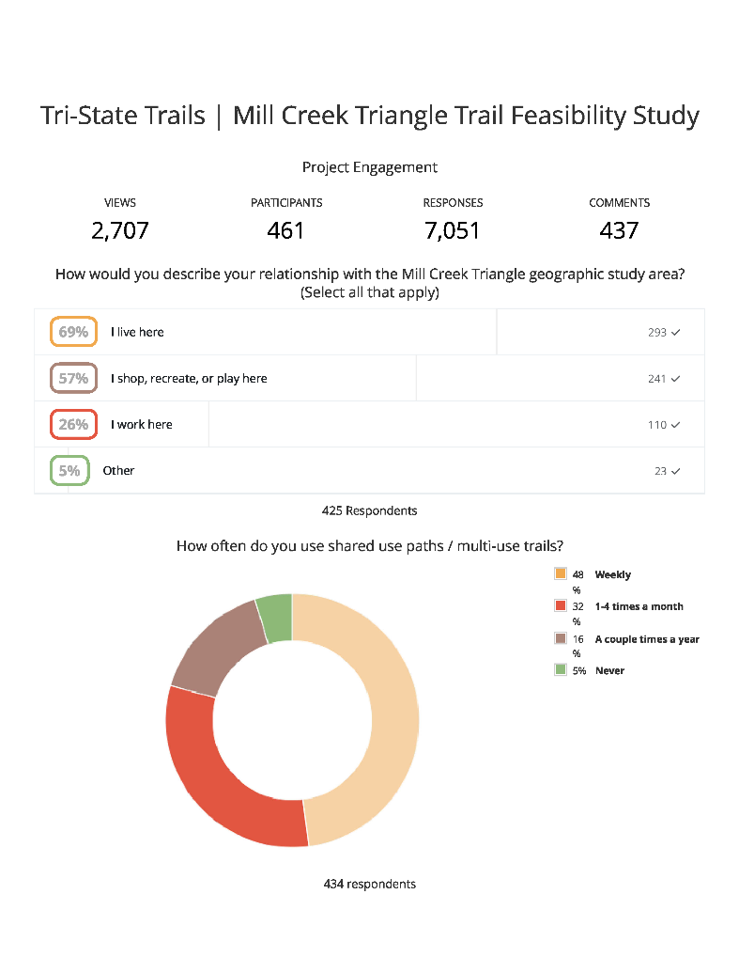
Benefits of Using VPI
Mobile friendly version of project webpage
Built-in reports / analysis functions to present public feedback data to steering committee
Ability to use templates / language from previous VPI surveys
PublicInput Vs. other PI software / methods
ODOT assistance through the process
First Time Experience
15

Slide 16
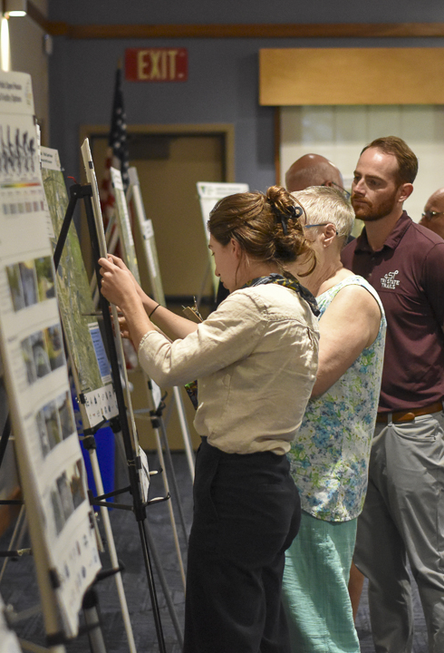
Challenges of Using VPI
More data to process
Moderating responses to clarify project details
Difficulty integrating paper survey responses from in-person open house
First Time Experience
16

Slide 17
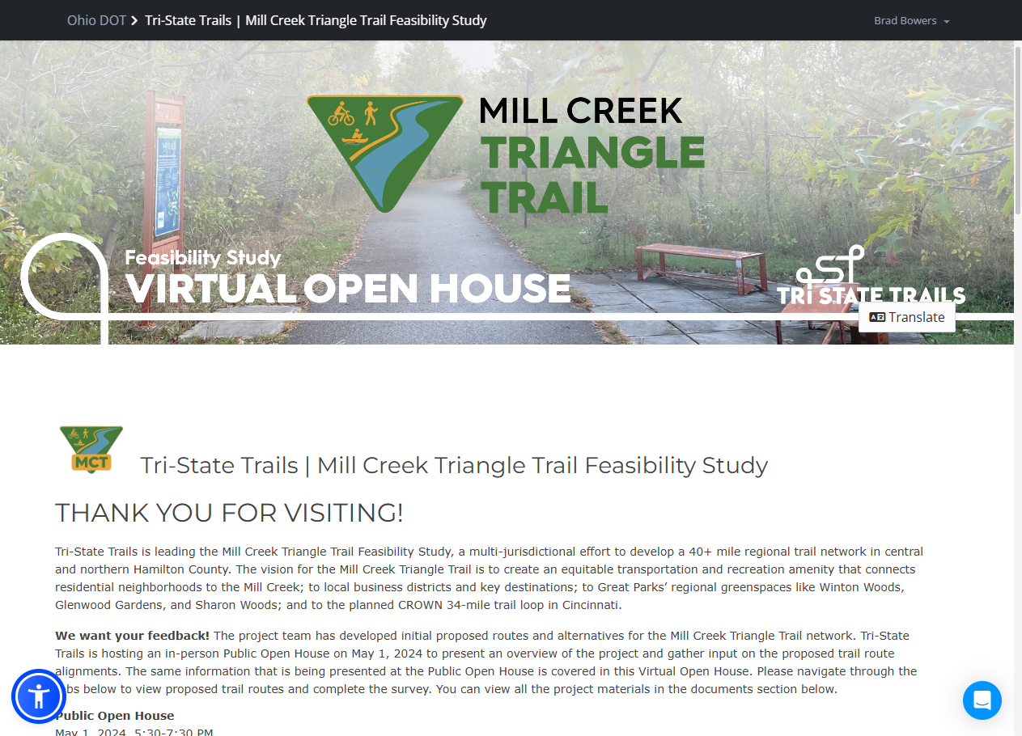
Website
Walk-Thru
MCT VPI Site: https://publicinput.com/k4641
MCT VPI Report:
https://PublicInput.com/Report/gxkvmmd4gkx
MCT Project Website:
https://tristatetrails.org/millcreektriangle/
Website Walk-Thru
17

Slide 18
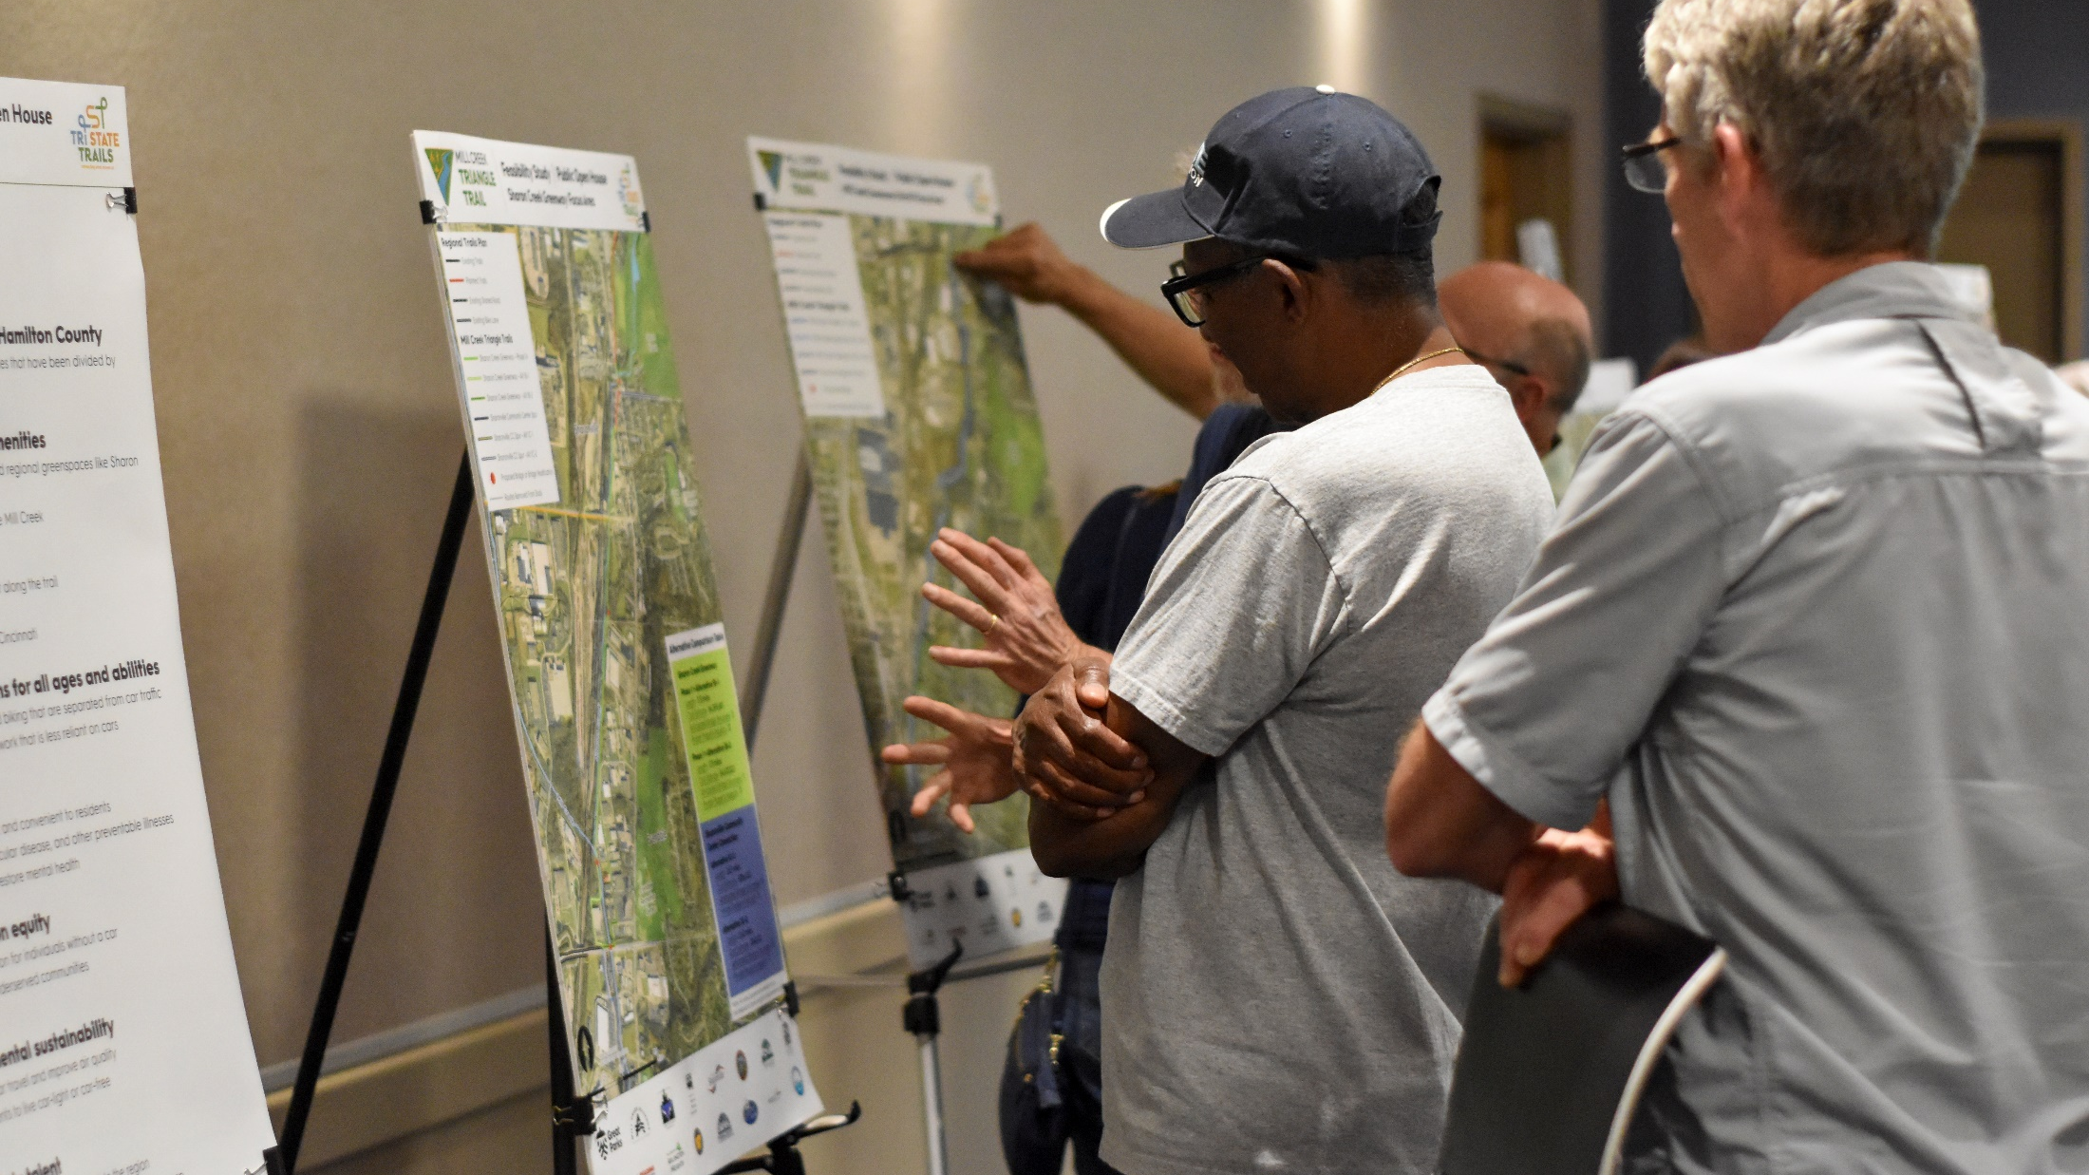
Survey Results
5/1/2024 Public Open House: 65-70 attendees
Virtual Open House:
2,707 Views
461 Participants
437 Comments
Website Walk-Thru
18

Slide 19
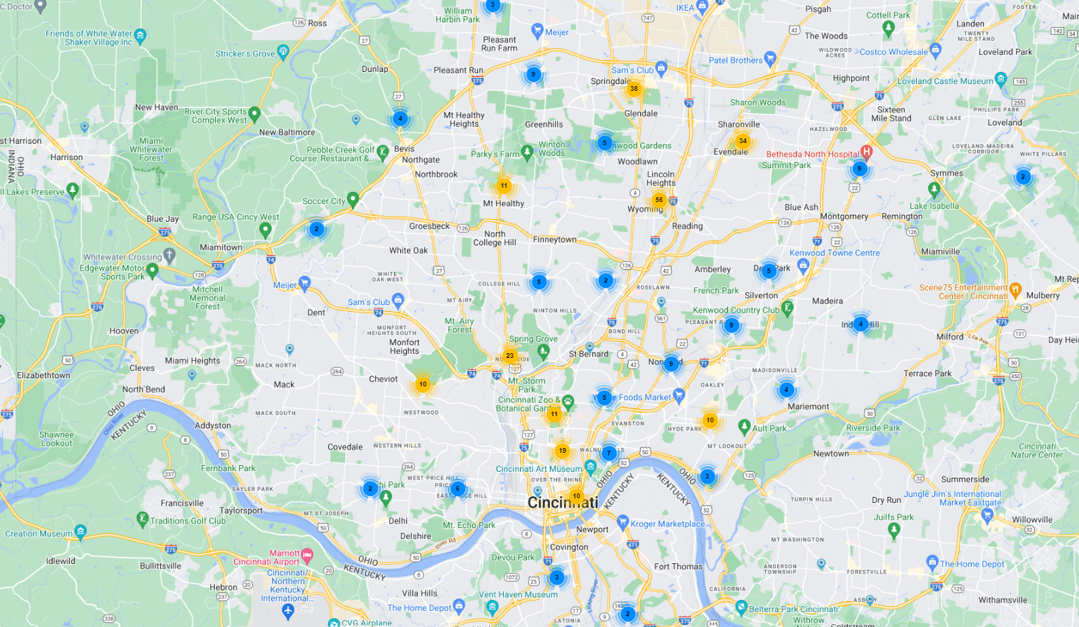
Participant Location Map
Greater Cincinnati Region
Website Walk-Thru
19

Slide 20
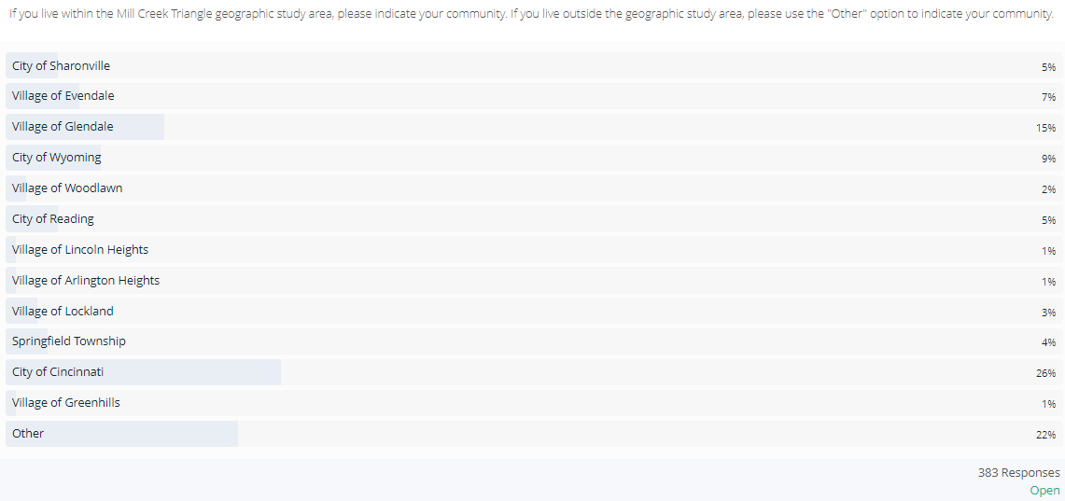
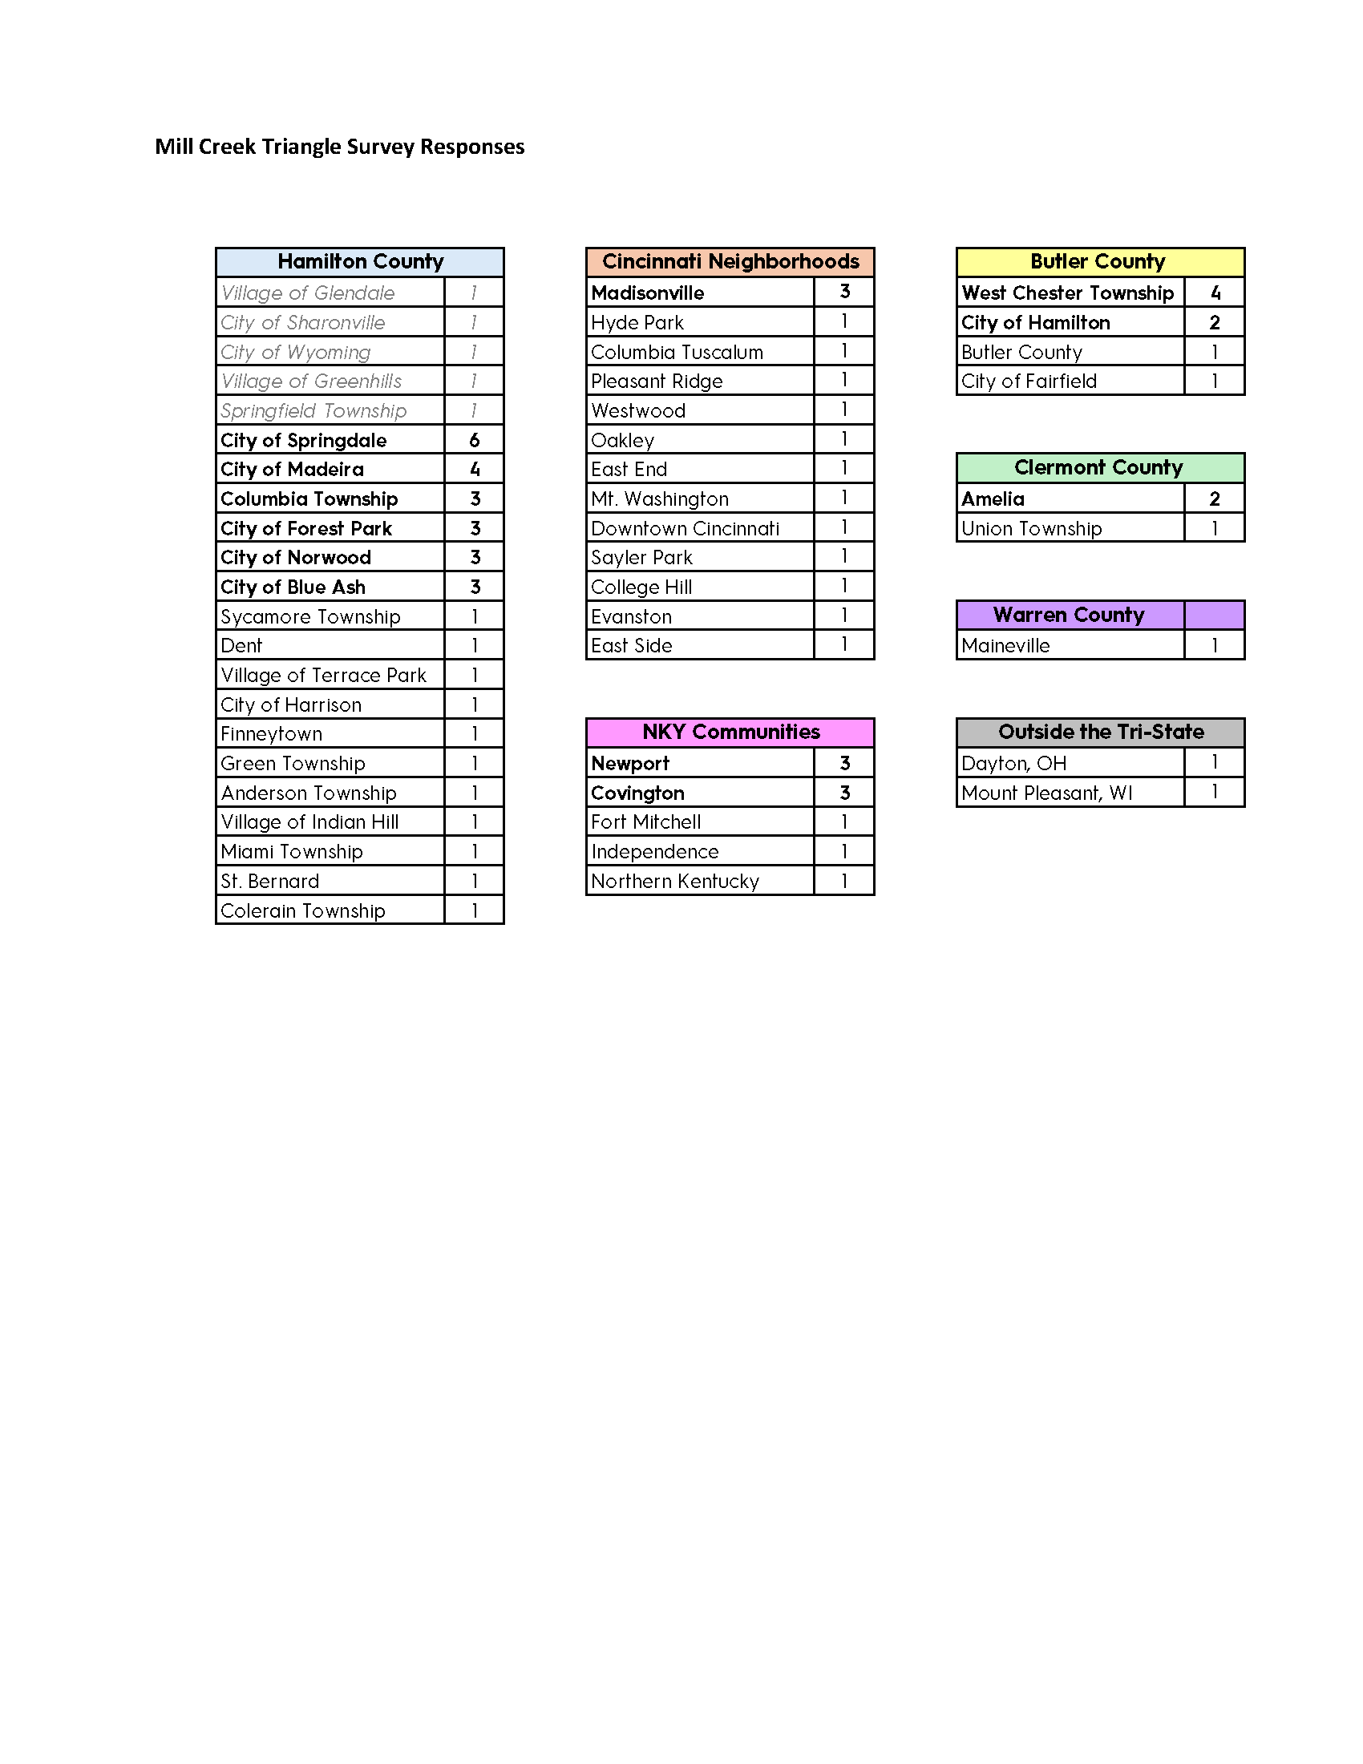
Participant Location
20 participants
25 participants
56 participants
35 participants
8 participants
20 participants
3 participants
4 participants
11 participants
14 participants
101 participants
2 participants
86 participants
Website Walk-Thru
20

Slide 21
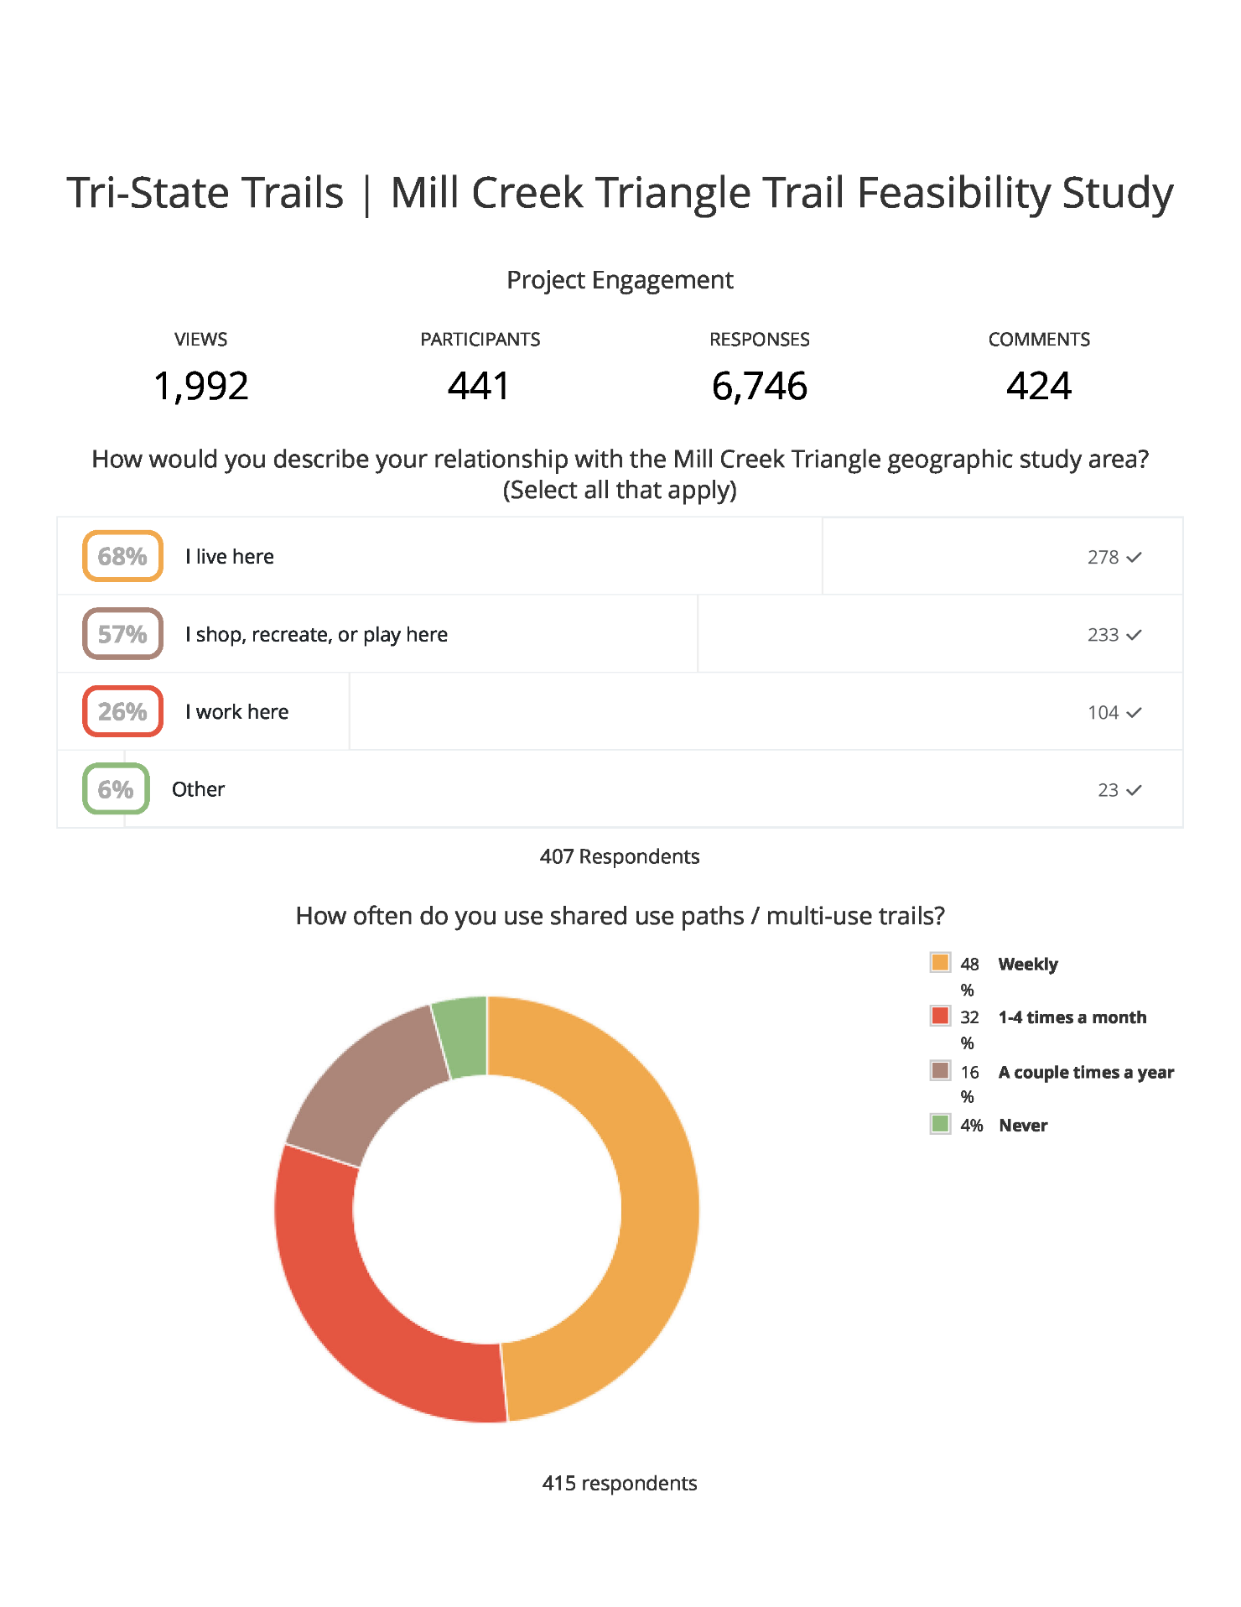
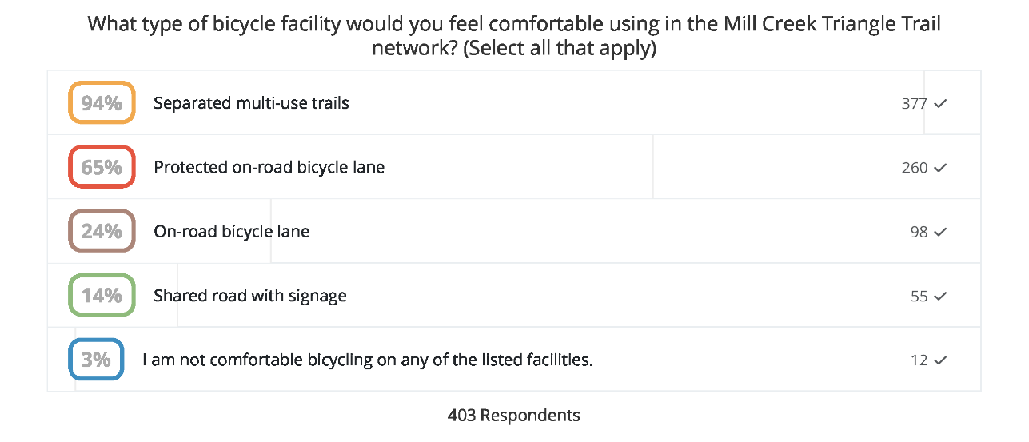

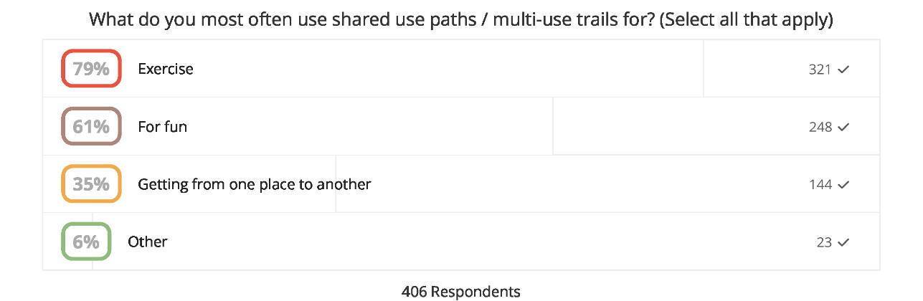
Shared Use Path Usage
Website Walk-Thru
21

Slide 22
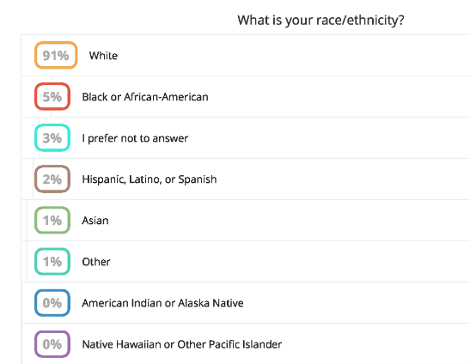
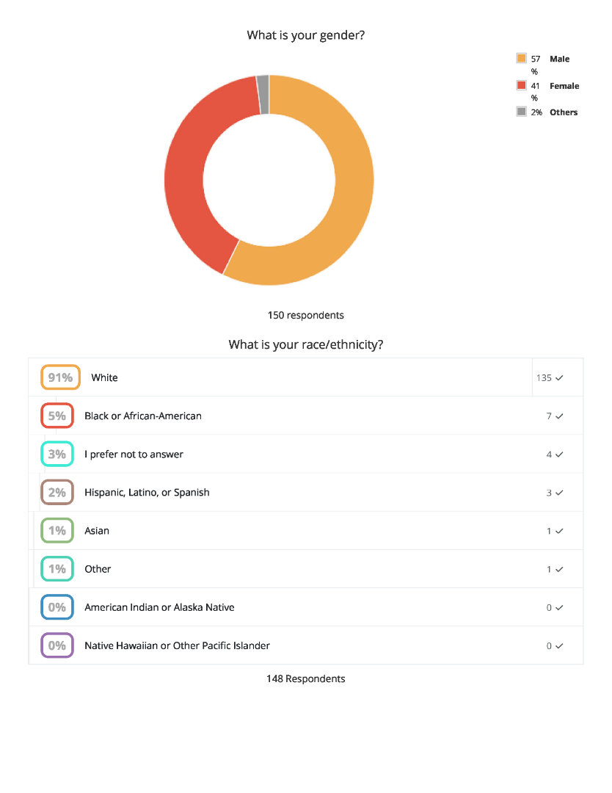

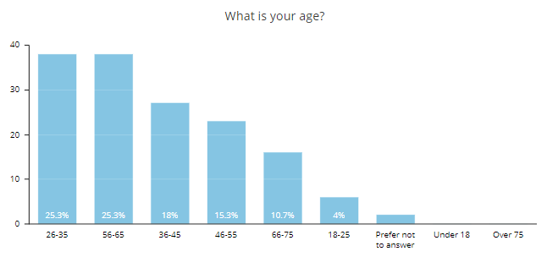

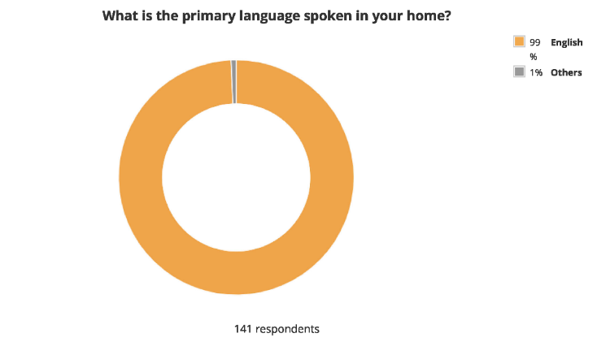
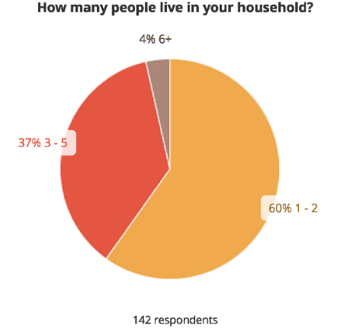
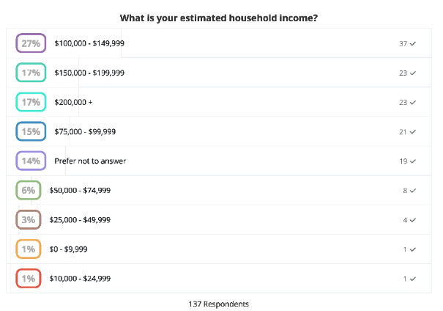
Participant Demographics
150 Respondents
Website Walk-Thru
22

Slide 23
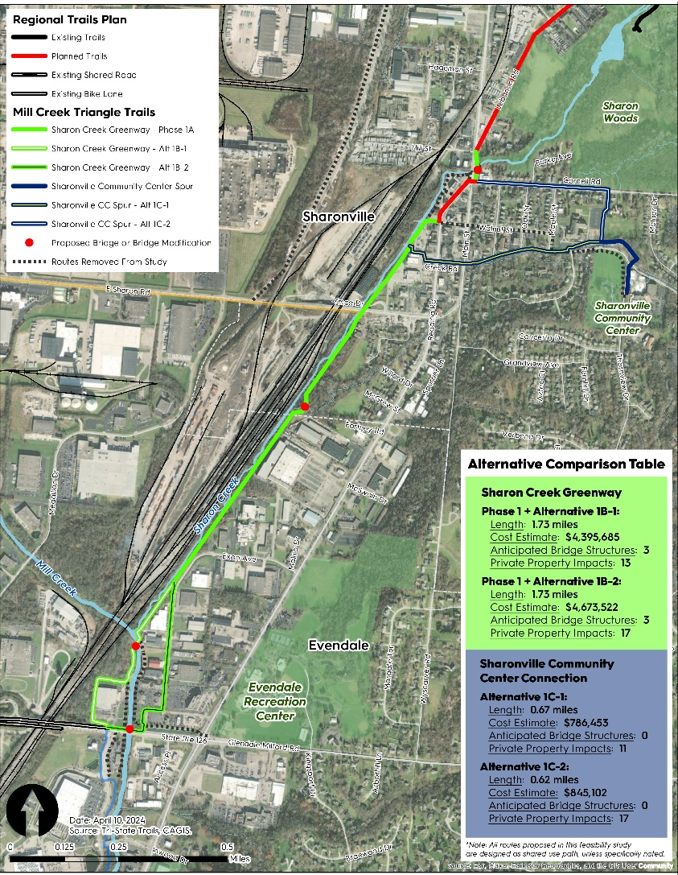
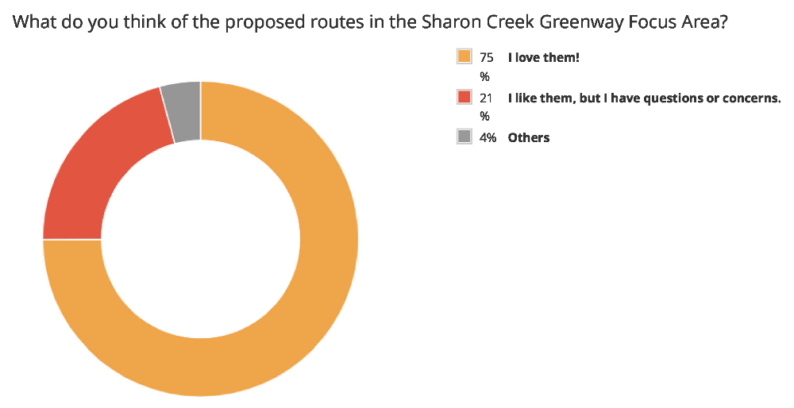
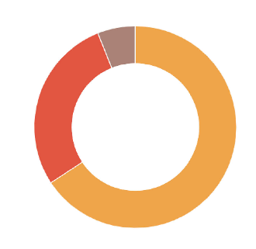
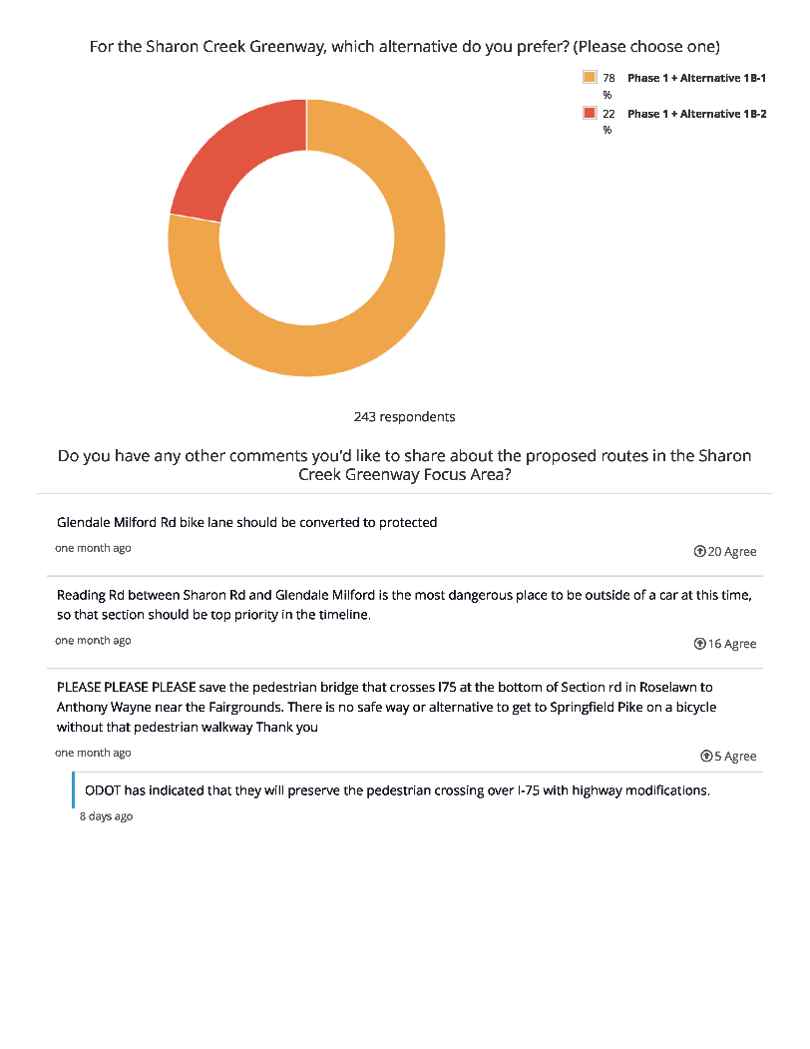

Sharon Creek Greenway Focus Area
314 Respondents
For the Sharonville Community Center Connection, which alternative do you prefer?
For the Sharon Creek Greenway, which alternative do you prefer?
Exon Ave
Cornell Rd
Creek Rd
West Side of Mill Creek
251 Respondents
246 Respondents
Website Walk-Thru
23

Slide 24
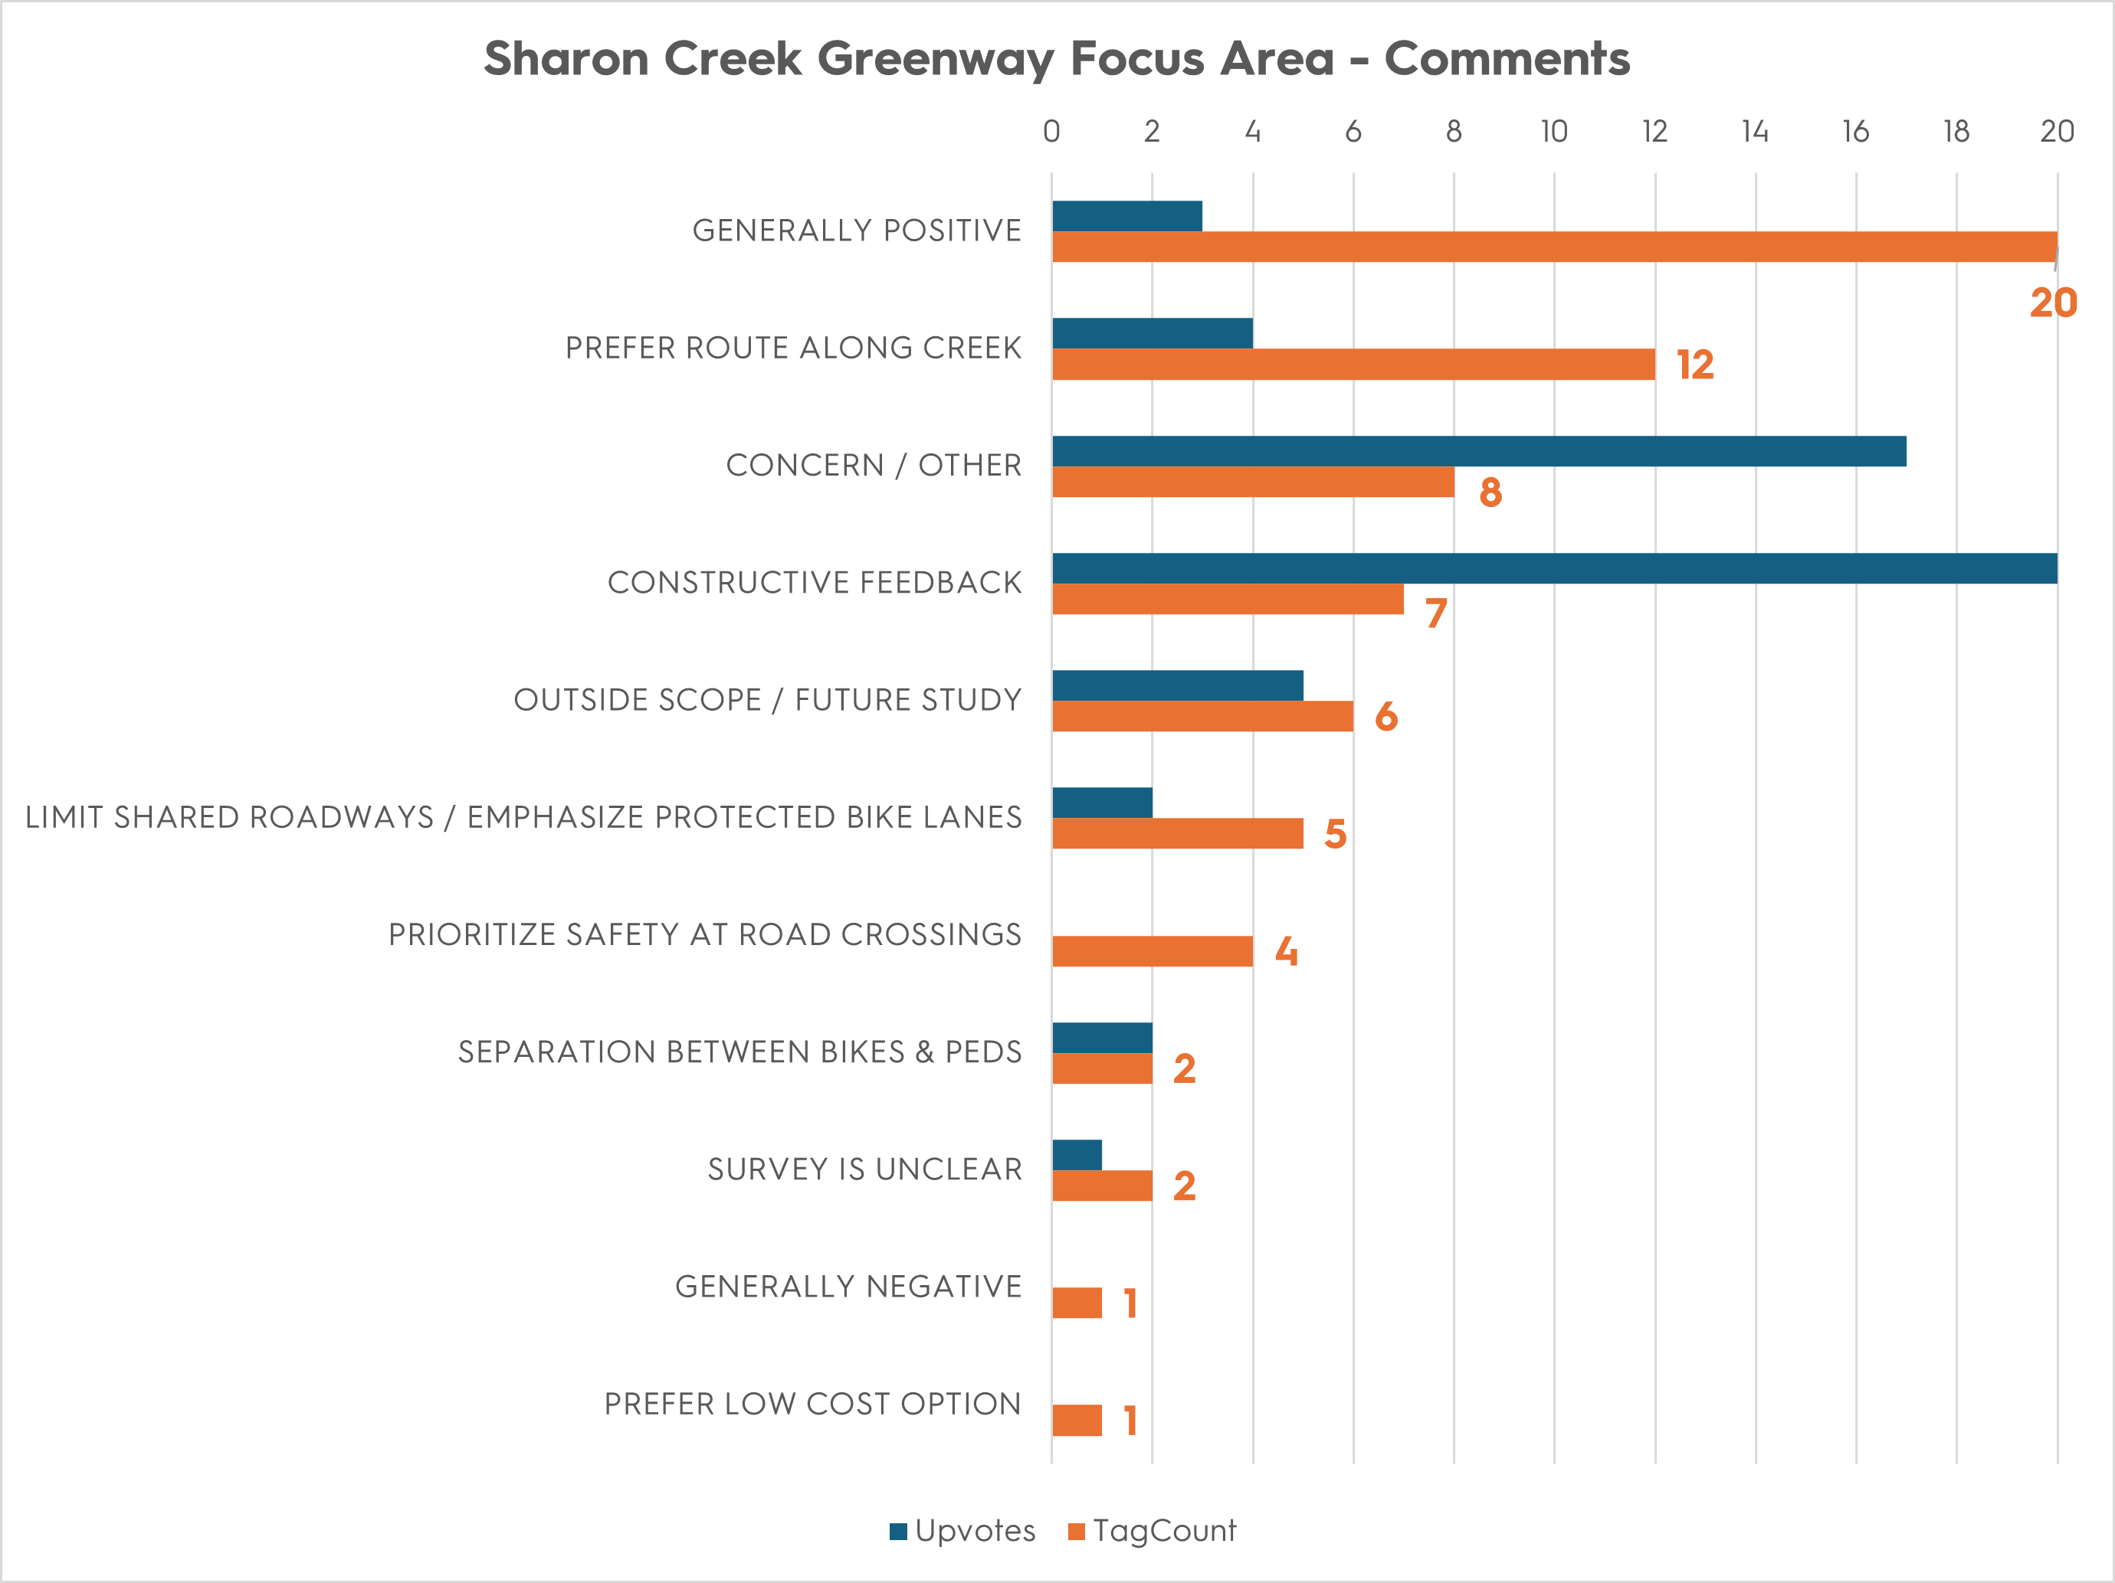
Sharon Creek Greenway Focus Area
77 Total Comments
Website Walk-Thru
24

Slide 25
Sharon Creek Greenway Focus Area
KEY TAKEAWAYS
Keep the trail along the creek
Prioritize safe roadway crossings
Glendale-Milford Rd
Reading Rd / Main St in Sharonville
FUTURE STUDY:
Convert Glendale-Milford bike lane protected bike lane
Alternative 1-C2 (Cornell Rd) creates an opportunity for trail loop around Sharon Woods trail system
Spur trails to Evendale Recreation Center / residential areas
Website Walk-Thru
25
Notes:
Emphasize safe road crossings – Sharonville intersection also came up
Route that goes under Glendale-Milford

Slide 26

Wins for Tri-State Trails
Strengthen future funding prospectives
Strong feasibility study report
Constructive feedback from public
Clear preferred alternatives to pursue funding
Demonstrated significant support for the project due to number of residents participating in VPI and voicing support
Benefits
26
Notes:
Emphasize safe road crossings – Sharonville intersection also came up
Route that goes under Glendale-Milford

Slide 27
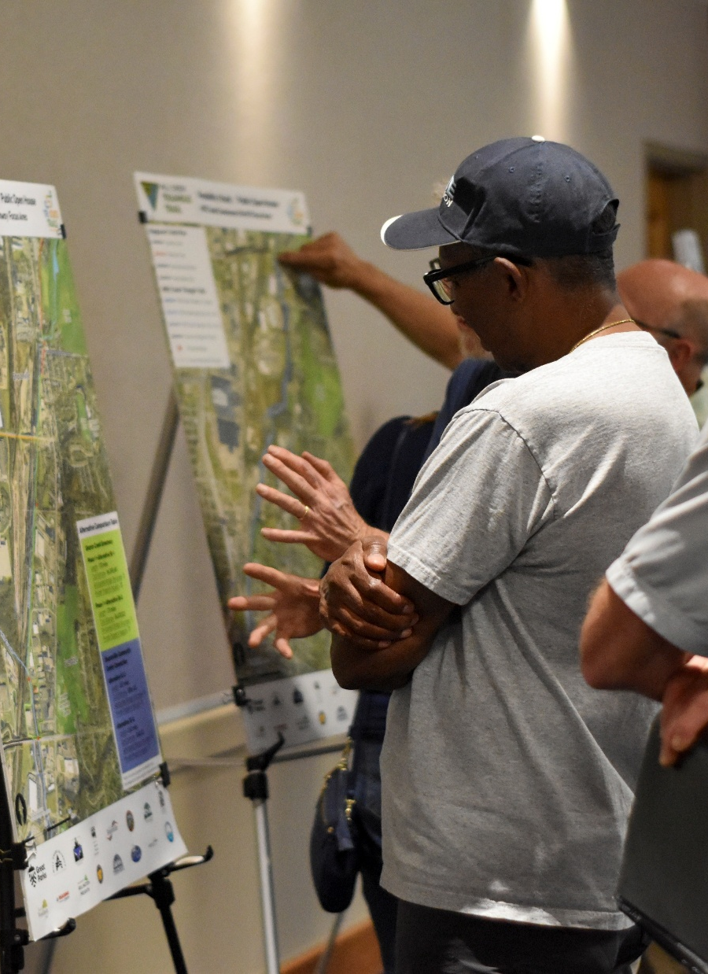
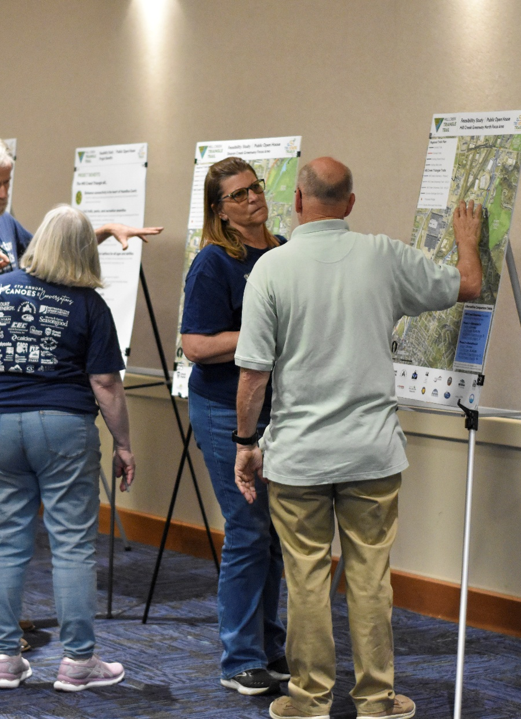
Wins for ODOT
Reduced burden for future phases that are constructed
Strong feasibility study to create better projects to later oversee
I.E. all viable alternatives identified and covered
PI already identified hot button issues
Public input already received
Smooth transition into an LPA project managed by an ODOT PM
Benefits
27
Notes:
Emphasize safe road crossings – Sharonville intersection also came up
Route that goes under Glendale-Milford

Slide 28

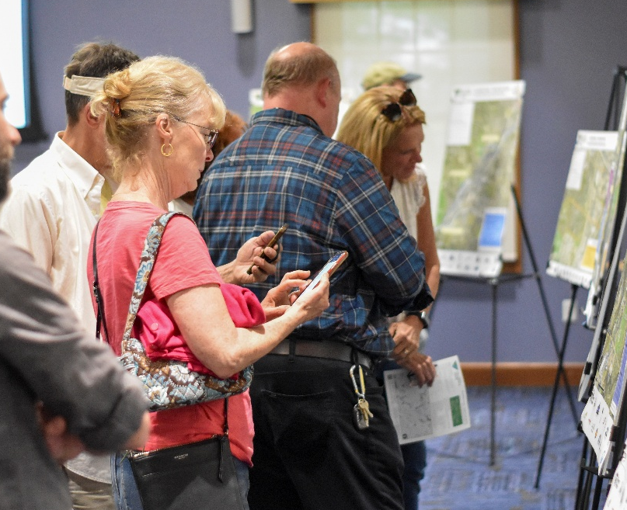
Lessons Learned
Not all VPIs are created equal!
VPI (Open House) are static websites that are open 24/7 for at least 30 days
VPI (Live Q&A) aka Zoom PI meetings, have many of the same drawbacks of in-person meetings. Very limited timeframe to try and participate.
VPI can be low effort and still be highly effective
It’s very rare for the public to complain about not having a “presentation”
Lessons Learned
28
Notes:
Emphasize safe road crossings – Sharonville intersection also came up
Route that goes under Glendale-Milford

Slide 29
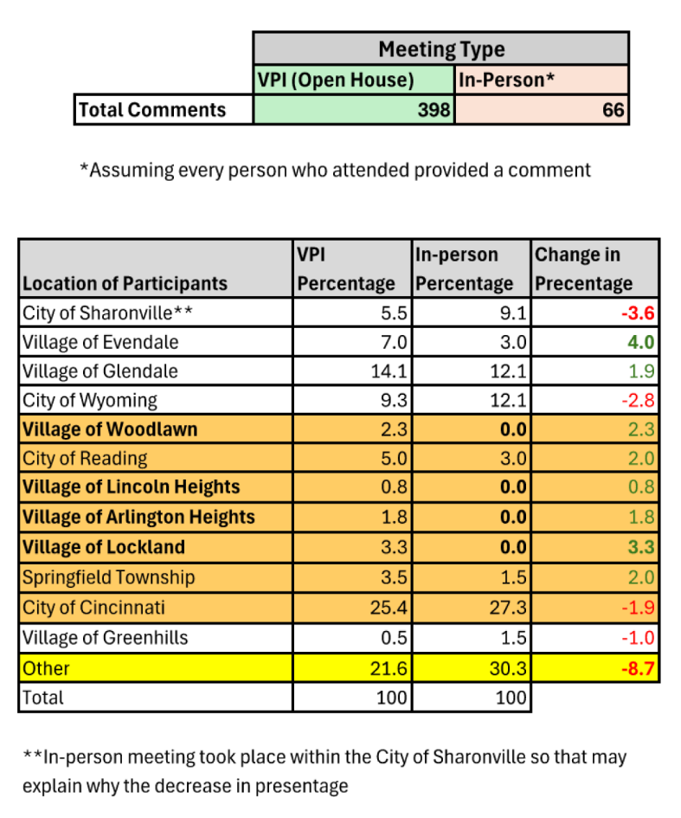
Lessons Learned
VPI (Open House) allows for better representation vs. In-person
In-person meeting had over representation and under representation of communities.
VPI actually reduced representation from people who lived outside of the communities impacted by the project.
VPI allowed for more equal representation weighted by population of communities.
VPI generates more representation of traditionally underserved communities (low income & minorities).
Lessons Learned
29
Notes:
Emphasize safe road crossings – Sharonville intersection also came up
Route that goes under Glendale-Milford

Slide 30
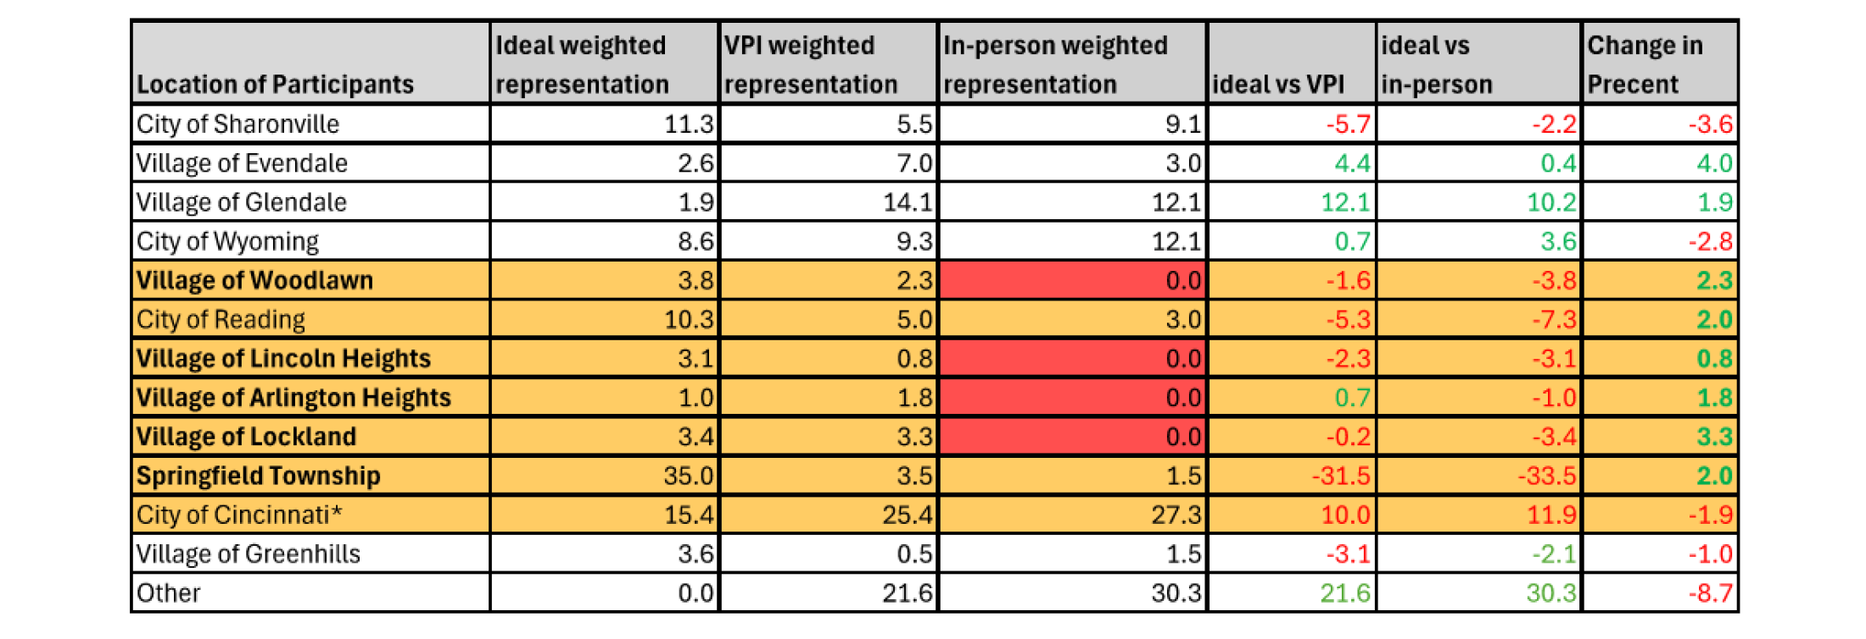

Lessons Learned
VPI (Open House) allows for better representation vs. In-person
VPI allowed for more equal representation weighted by populations of communities
VPI generates more representation of traditionally underserved communities
Lessons Learned
30
Notes:
Emphasize safe road crossings – Sharonville intersection also came up
Route that goes under Glendale-Milford

Slide 31
Lessons Learned
What to do differently “next time”
Projected cost estimates
LTAP training – PDP
Recommendations to other agencies / districts
Early coordination with ODOT if you’re planning to pursue federal grant funds
Lessons Learned
31
Notes:
Emphasize safe road crossings – Sharonville intersection also came up
Route that goes under Glendale-Milford

Slide 32
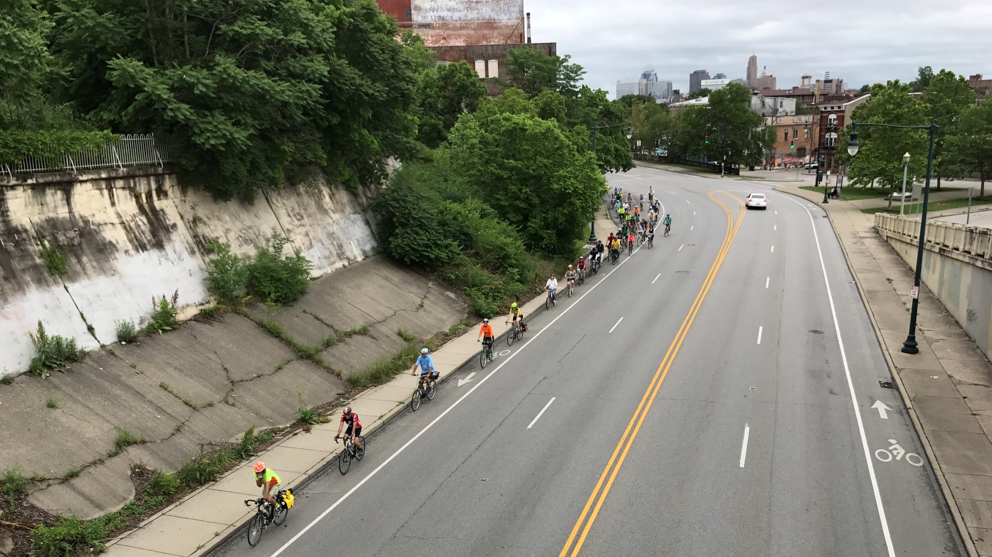
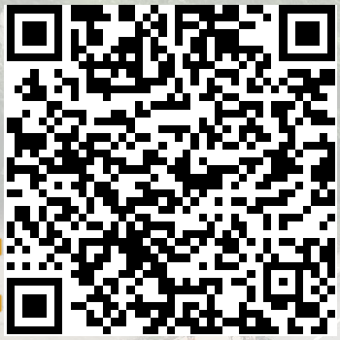
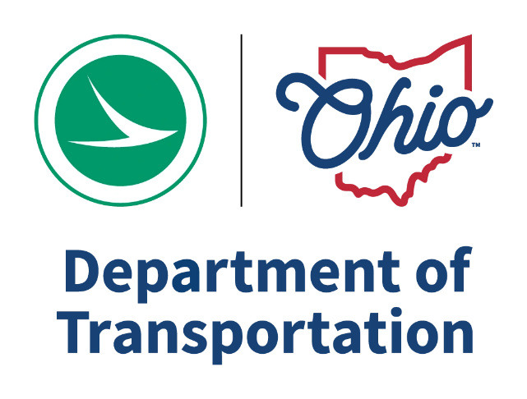
Thank you!
Brad Bowers, AICP
Tri-State Trails
Project Manager brad@tristatetrails.org
Anthony Pankala
ODOT District 8 Environmental Engineer Anthony.Pankala@dot.ohio.gov

