Slide 1
September 2025 Programmatic
D11 Proj.: HOL-39-14.16 PID 122470
D11 Proj.: HOL-39-17.23 PID 123599
Notes:
This presentation will provide an overview of the subject project that will be placed on the upcoming programmatic selection for consultant design services.

Slide 2
HOL-39-(17.16)(17.23) PID 122470 & 123599
Proj. Description: Design the replacement for bridges:
HOL-39-17.16 SFN 3800512
HOL-39-17.23 SFN 3800547
Separate plans will be developed simultaneously and potentially sold as a Part 1/Part 2 contract.
The Department will complete the topographic survey for both projects and provide to the selected consultant at the Scope meeting.
Notes:
The project will replace bridge HOL-39-17.16 PID 12247 & HOL-39-17.23 PID 123599 (SFN 3403246) carrying State Route 39 over Kilbuck Creek and the Holmes County Trail.

Slide 3
Available project information
Some project information is available at the following FTP site:
https://ftp.dot.state.oh.us/pub/Districts/D11/122470_and_123599/
The PIP will be released through SAFE on the programmatic scheduled date
D11 does not release the PIP early
All information on the FTP site is subject to change, please review the information in SAFE to create your LOI
Notes:
Additional project information is available on the District 11 ftp site, at the link shown on your screen. The Project Initiation Package document, along with a more complete and detailed scope of work will be released through The ODOT Scope and Fee System (or SAFE) at the request for LOIs. All information on the FTP site is subject to change. Ensure you review the ftp site and the information in SAFE before completing your LOI for this project.

Slide 4
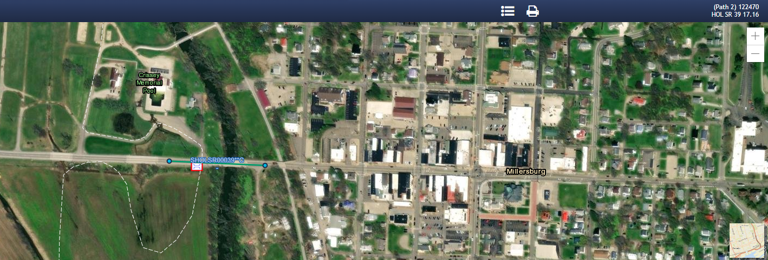
Ellis MAPPING
Notes:
Here is an image showing the anticipated project limits from ODOT’s Ellis application for PID 122470. The project will follow the existing horizontal and vertical alignments as much as practical.

Slide 5
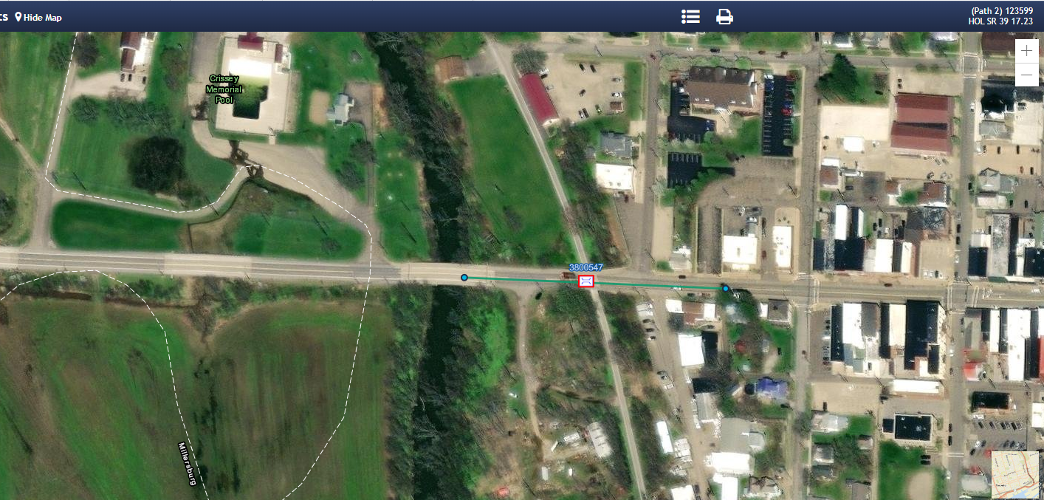
ELLIS MAPPING
Notes:
Here is an image showing the anticipated project limits from ODOT’s Ellis application for PID 123599. The project will follow the existing horizontal and vertical alignments as much as practical.

Slide 6
Project scope
The major items of work include:
HOL-39-1716 (SFN 3800512)
Replace three span steel beam bridge new structure
Soil Borings required
Utility (aerial) relocation anticipated
Maintenance of Traffic via One Lane –Two Way operation via signalized closure of one lane of a two-lane highway
HOL-39-1723 (SFN 3800547)
Replace single span steel beam bridge new structure.
Structure Type Study to investigate buried structures and beam bridges
Soil Borings required
Utility (aerial) relocation anticipated
Detour SR 39 for Maintenance of Traffic
Notes:
The major scope items are listed here. An updated and more complete list will be released in SAFE at the beginning of the LOI process.

Slide 7
Additional scope information and/or items
Driveway for public pool closest to the bridges will need to be closed during construction
Anticipate 4F coordination for both projects
Consultant will perform the floodplain coordination
HOL-39-1723 SFN 3800547 has not been identified as historic and trail traffic will need to be maintained
HOL-39-1716 SFN 3800512 recreational boat traffic will need to be maintained
Notes:
The project will replace bridge HOL-39-17.16 PID 12247 & HOL-39-17.23 PID 123599 (SFN 3403246) carrying State Route 39 over Kilbuck Creek and the Holmes County Trail.

Slide 8
Consultant Prequalifications
Level 1 bridge inspection
Level 2 bridge design
Non-complex roadway design
Various Environmental
Various Geotechnical
Limited R/W
Notes:
The consultant prequalifications required for this project are shown here.

Slide 9
Field Photos – HOL-39-1716
Notes:
The following slides will show you some of the scoping field visit photos, to illustrate how the District arrived at the current scope of work. More photos are available on the ftp site shown earlier.

Slide 10
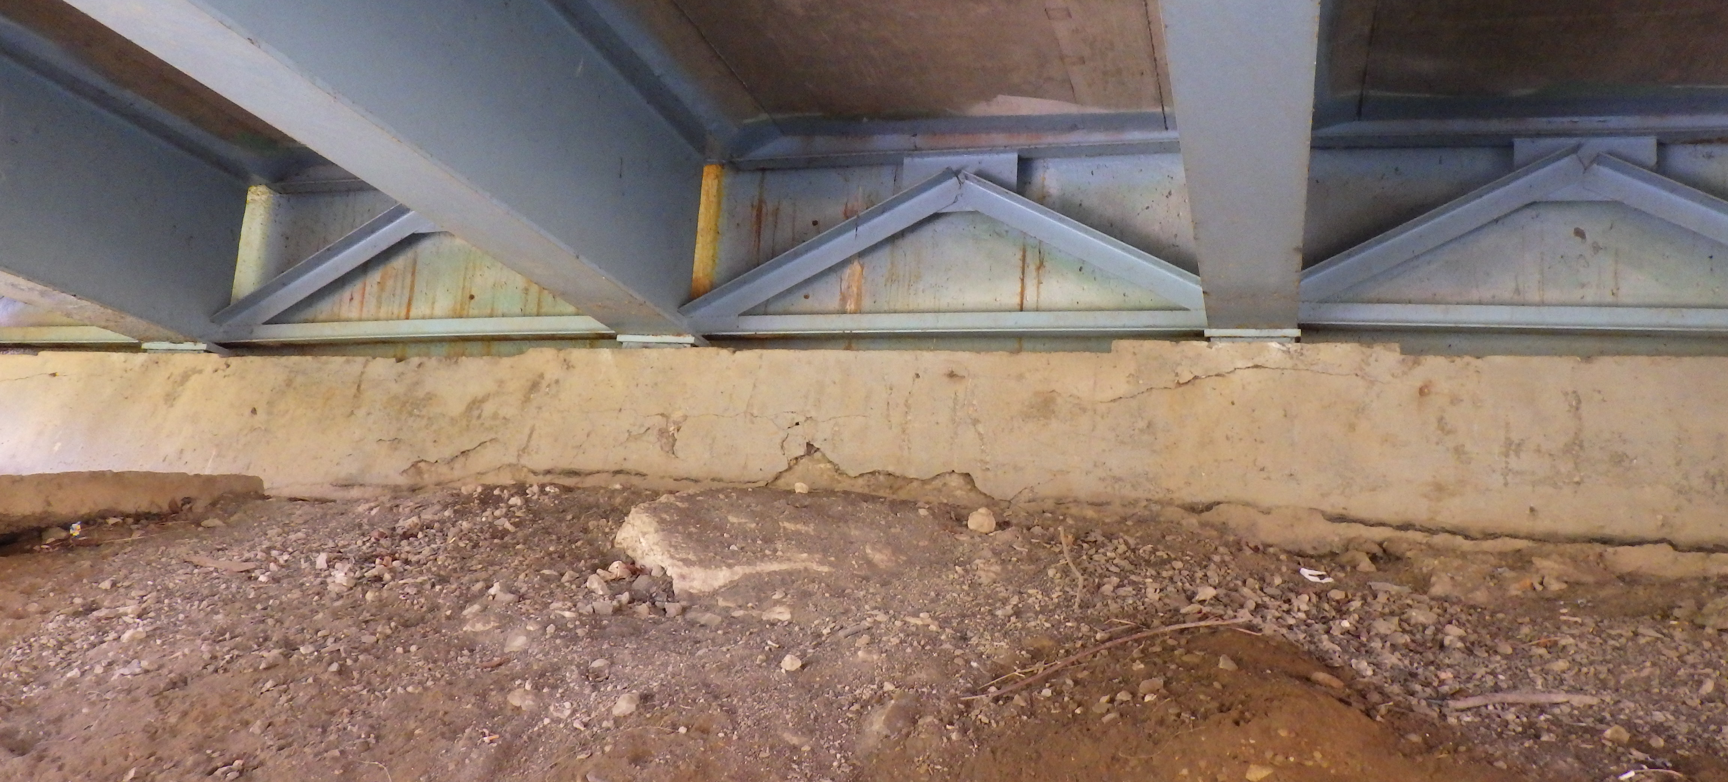
Field Photos – HOL-39-1716

Slide 11
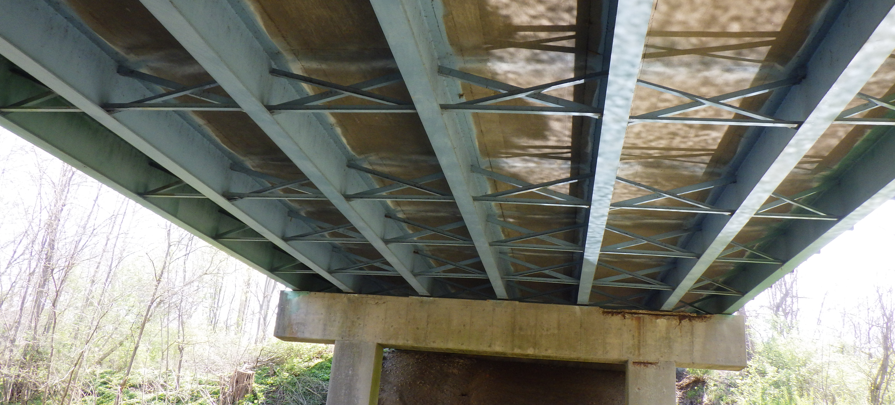
Field Photos – HOL-39-1716

Slide 12
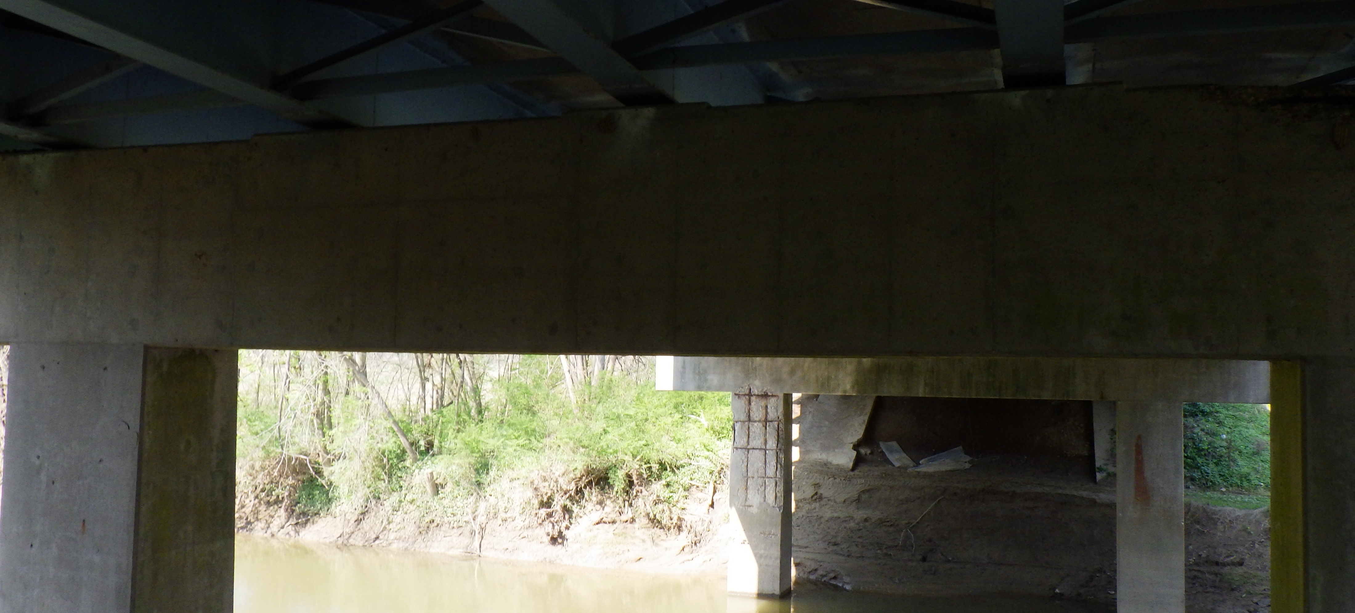
Field Photos – HOL-39-1716

Slide 13
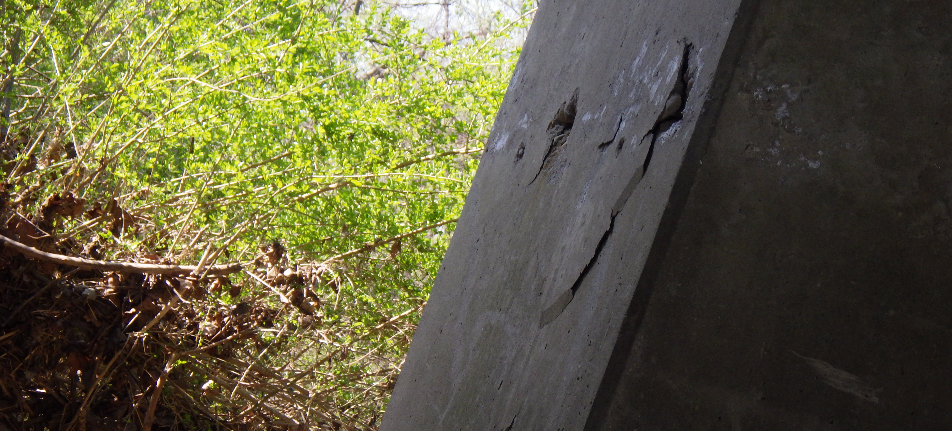
Field Photos – HOL-39-1716

Slide 14
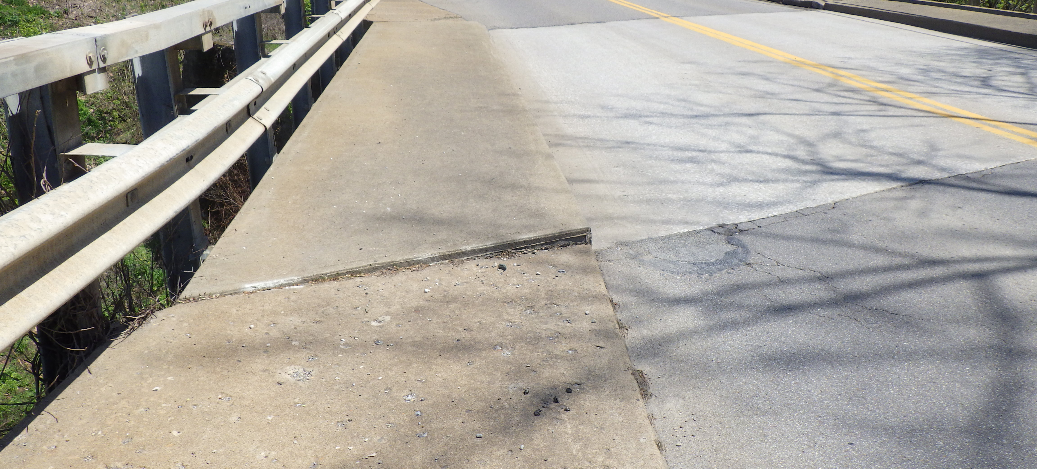
Field Photos – HOL-39-1723

Slide 15
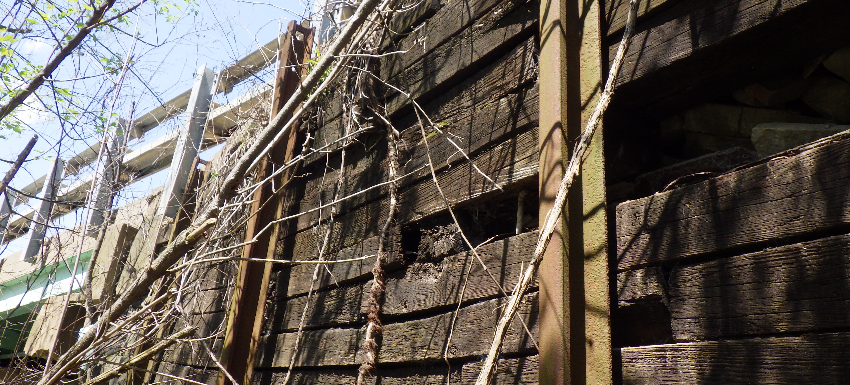
Field Photos – HOL-39-1723

Slide 16
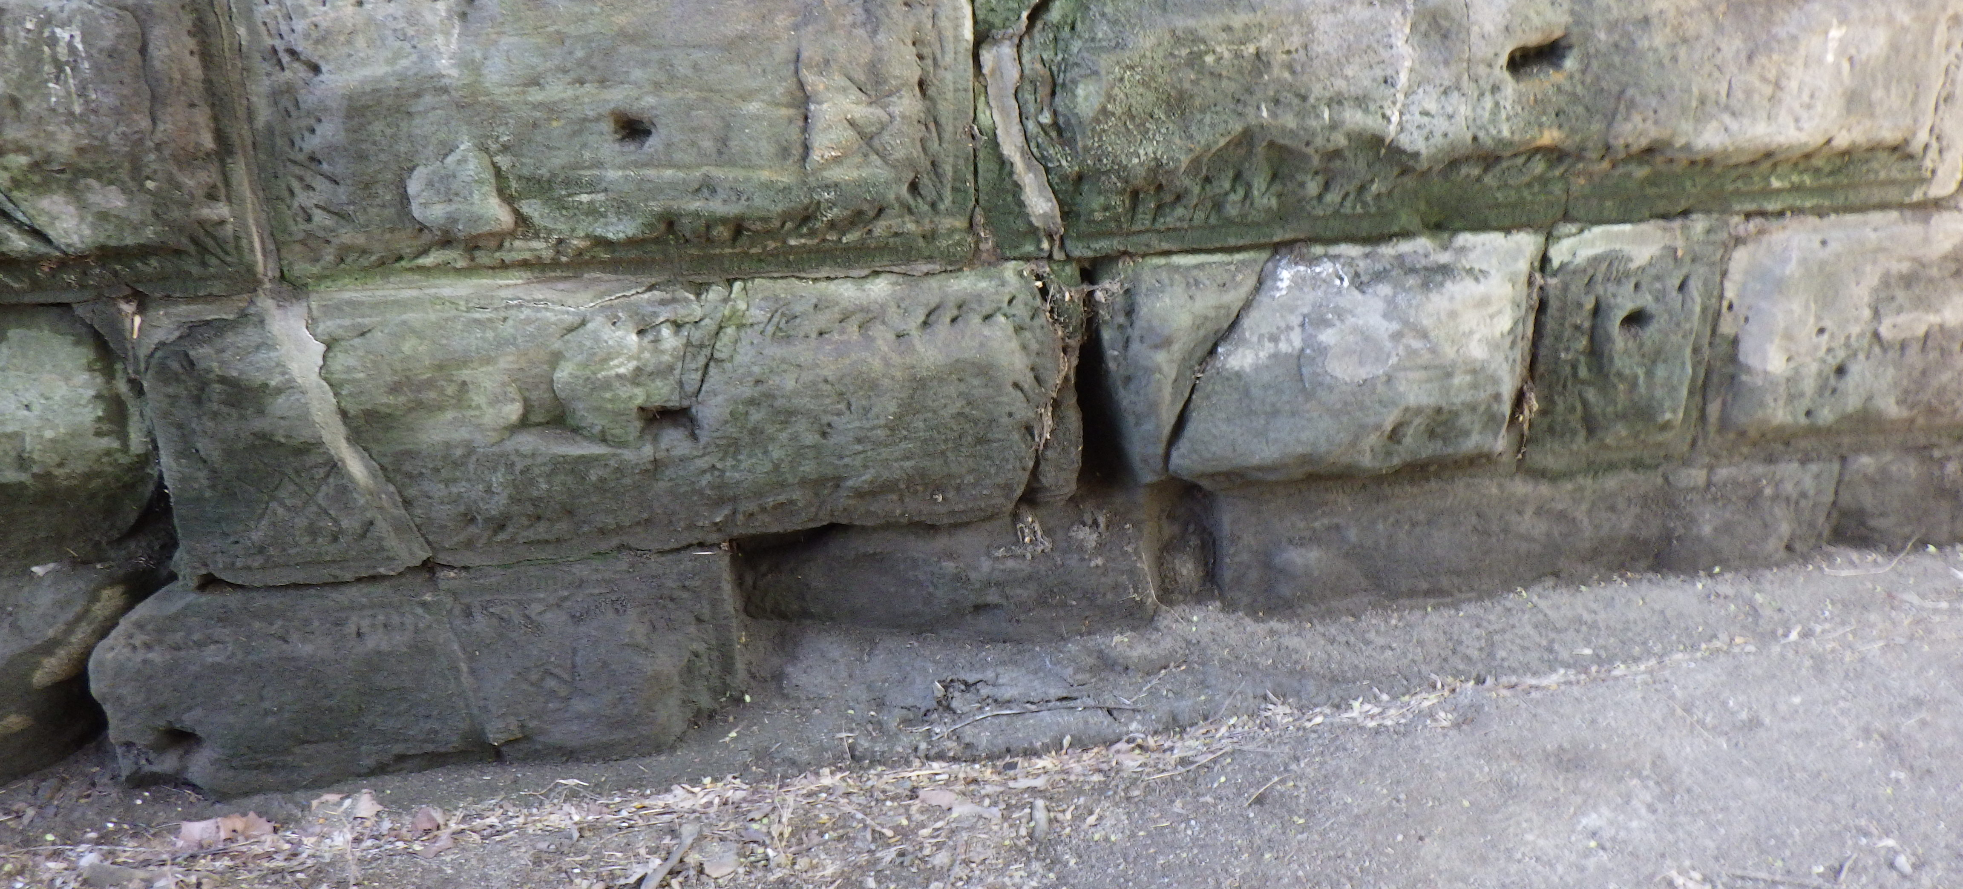
Field Photos – HOL-39-1723

Slide 17
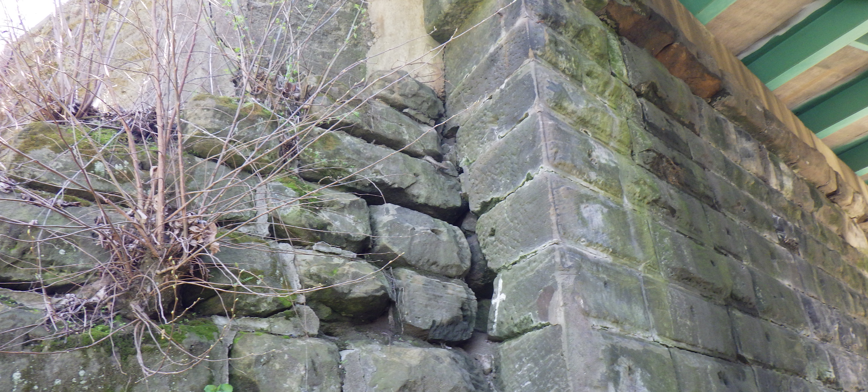
Field Photos – HOL-39-1723

Slide 18
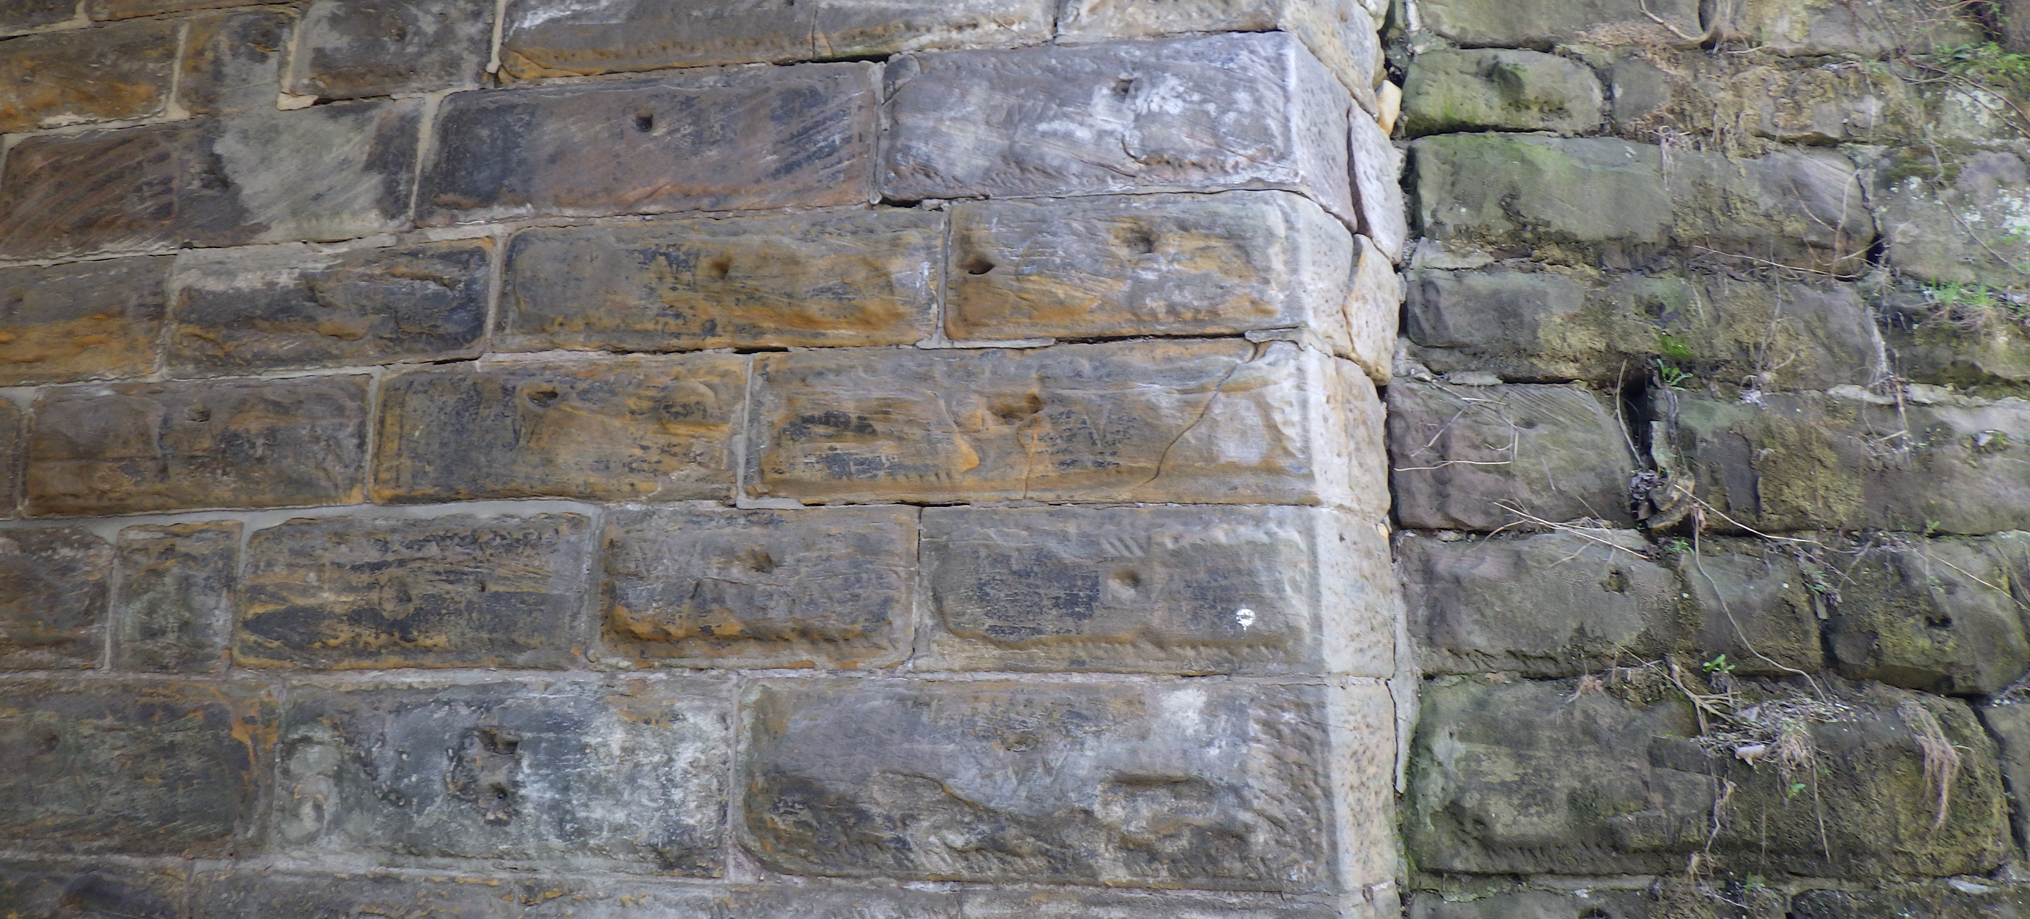
Field Photos – HOL-39-1723

Slide 19
Thank you
Additional photos are available on the FTP Site
Thank you for watching this video presentation for Projs. HOL-39-17.16 PID 122470 and HOL-39-17.23 PID 123599.
District 11 appreciates your interest in partnering with us for a successful project
Notes:
Thank you for watching this video. Visit the ftp site for more photos and information. Please remember that changes to this information and the detailed scope of work are possible. Review the information in SAFE prior to submitting your LOI.

Slide 20
Thank you

