Slide 1

May 2026 Programmatic D11 Proj.: jef-7-4.01 pid 116542
Notes:
This presentation will provide an overview of the subject project that will be placed on the upcoming programmatic selection for consultant design services.

Slide 2
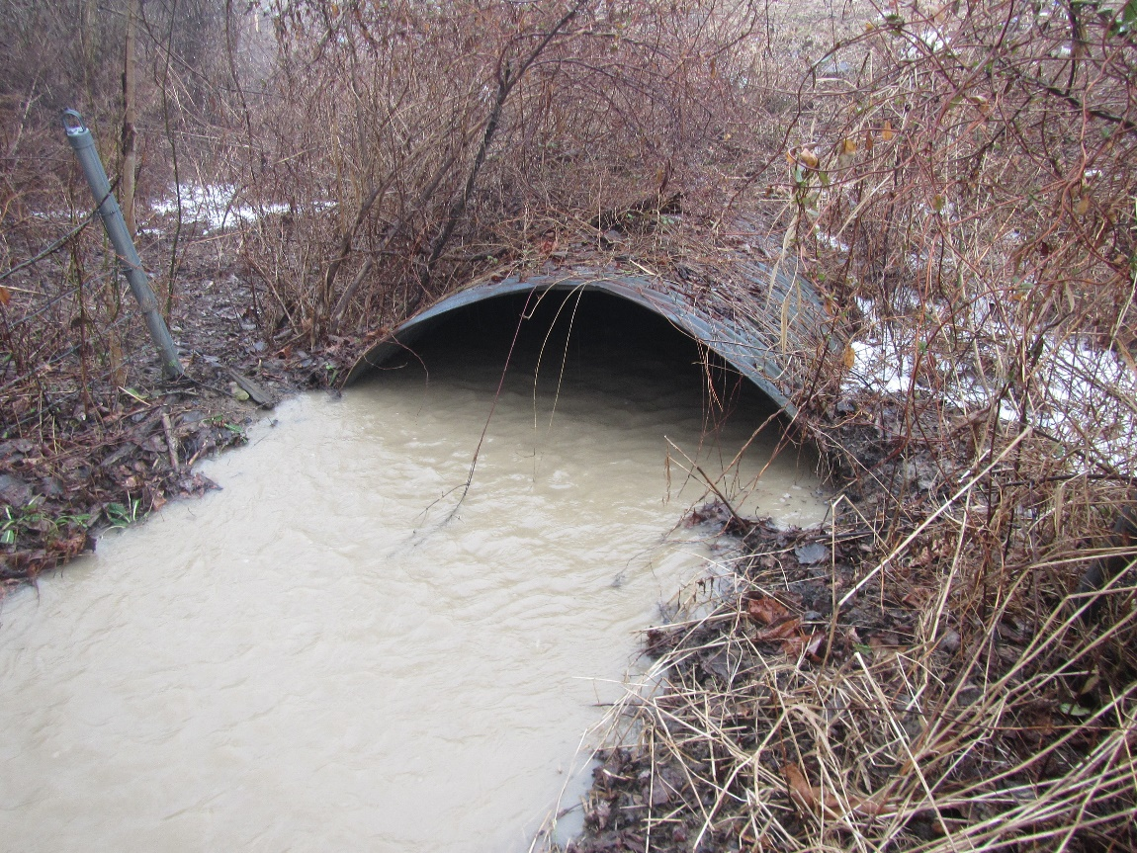
JEF-7-4.01 PID 116542
Proj. Description: Replace existing culvert-type bridge carrying SR 7 over Shannon’s Run with new structure. In stream work required.
Notes:
The project will replace bridge JEF-7-4.01 (SFN 4100143) carrying state route 7 over Shannon’s Run. In stream work is required.

Slide 3
Available project information
Some project information is available at the following FTP site:
https://ftp.dot.state.oh.us/pub/Districts/D11/116542
Internet Explorer recommended for the ftp site
The PIP will be released through SAFE on the programmatic scheduled date
D11 does not release the PIP early
All information on the FTP site is subject to change, please review the information in SAFE to create your LOI
Notes:
Additional project information is available on the District 11 ftp site, at the link shown on your screen. The Project Initiation Package document, along with a more complete and detailed scope of work will be released through The ODOT Scope and Fee System (or SAFE) at the request for LOIs. All information on the FTP site is subject to change. Ensure you review the ftp site and the information in SAFE before completing your LOI for this project.

Slide 4
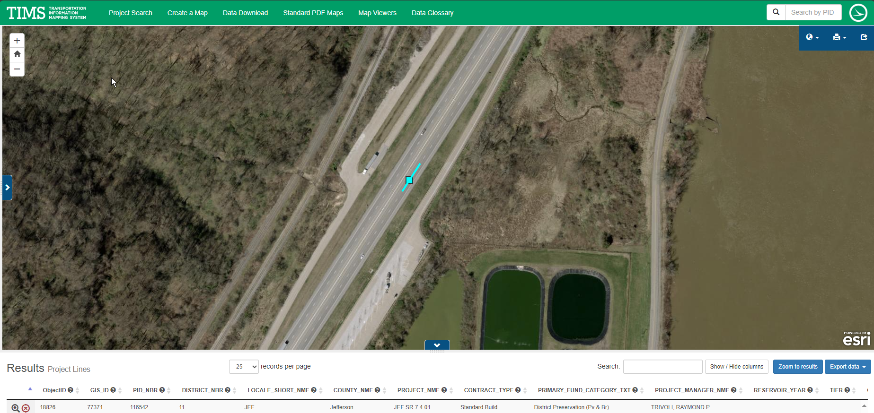
TIMS MAPPING
Notes:
Here is an image showing the anticipated project limits from ODOT’s TIMS application. The project will follow the existing horizontal and vertical alignments as much as practical.

Slide 5
Project scope
The major items of work include
Replace culvert-type bridge with new structure.
Replace culvert type bridge carrying SB On Ramp from the old weigh station, SR 7 mainline and the NB On Ramp from the truck parking area over Shannon’s Run. In stream work is required. Project estimate is based on three single span slab bridges being built in place of the existing culvert. One carrying the SB On Ramp, the second carrying mainline SR 7 and the third carrying NB On Ramp. The preferred alternative will be determined from the preliminary engineering study and must meet hydraulic design criteria and allow for anticipated sediment transport under bridges.
Maintain traffic via phase construction.
MOTAA required because project is a Path 3 project.
Waterway permit required.
Notes:
The major scope items are listed here. An updated and more complete list will be released in SAFE at the beginning of the LOI process.

Slide 6
Anticipated Prequals:
BRG INSP Lv 1
BRG DSGN Lv 2
ROAD
RW PLANS
GEO
ENV
Notes:
The consultant prequalifications required for this project are shown here.

Slide 7
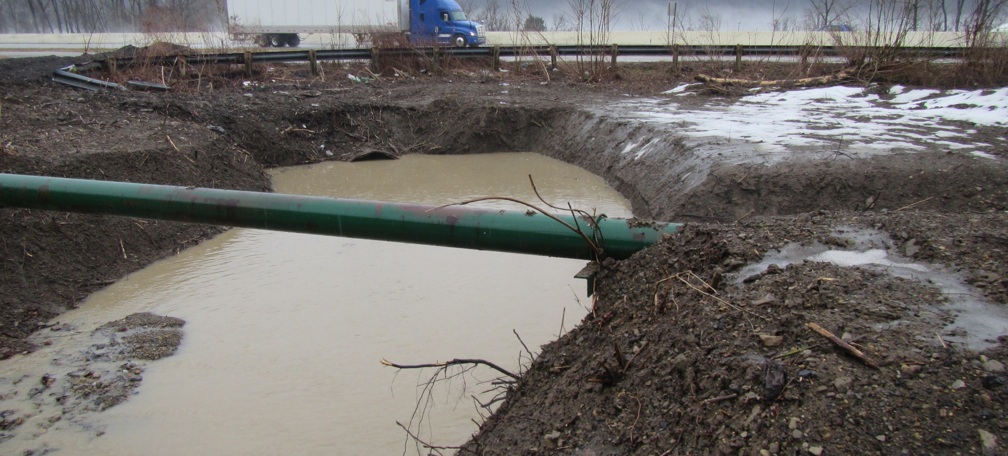
Field Photos

Slide 8
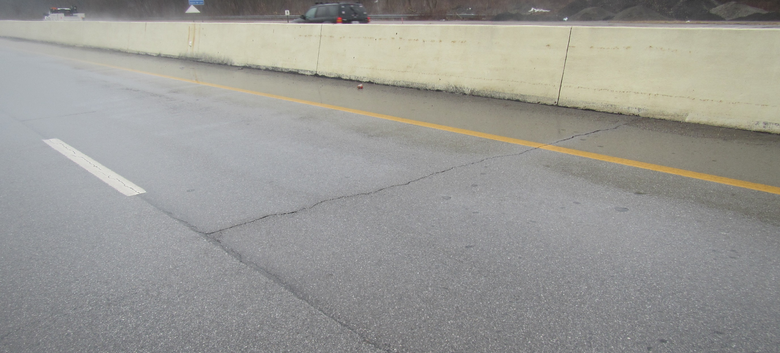
Field Photos

Slide 9
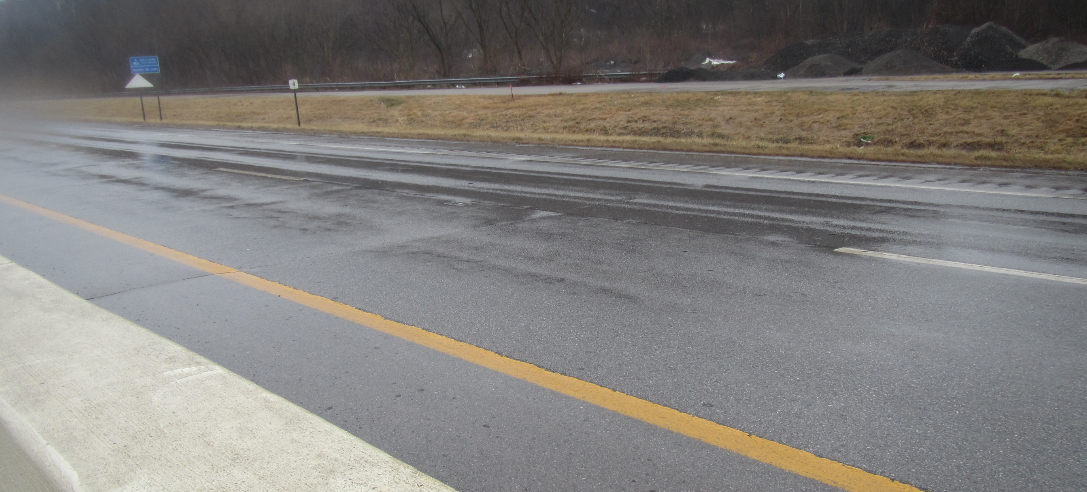
Field Photos

Slide 10

Field Photos

Slide 11
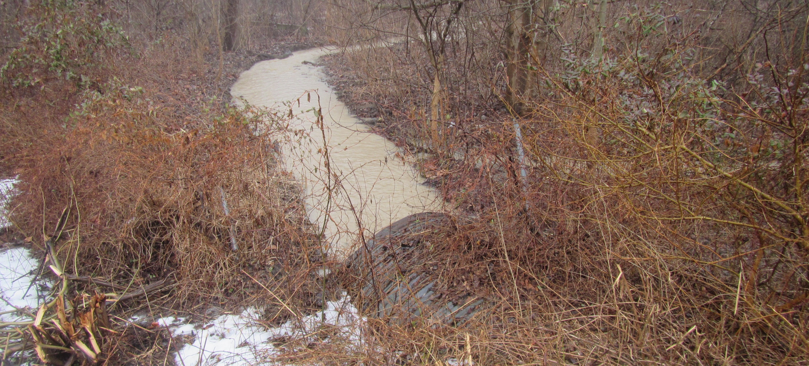
Field Photos
Notes:
The following slides will show you some of the scoping field visit photos, to illustrate how the District arrived at the current scope of work. More photos are available on the ftp site shown earlier.

Slide 12
Thank you
Additional photos are available on the FTP Site
Thank you for watching this video presentation for Proj. JEF-7-4.01 PID 116542.
District 11 appreciates your interest in partnering with us for a successful project
Notes:
Thank you for watching this video. Visit the ftp site for more photos and information. Please remember that changes to this information and the detailed scope of work are possible. Review the information in SAFE prior to submitting your LOI.

