Slide 1
ODOT Safety committee• December 9, 2021
Notes:
Welcome and intro

Slide 2
Cuy-271-8.36
Safety funding application
ODOT District 12
Brian Blayney, ODOT District 12

Slide 3
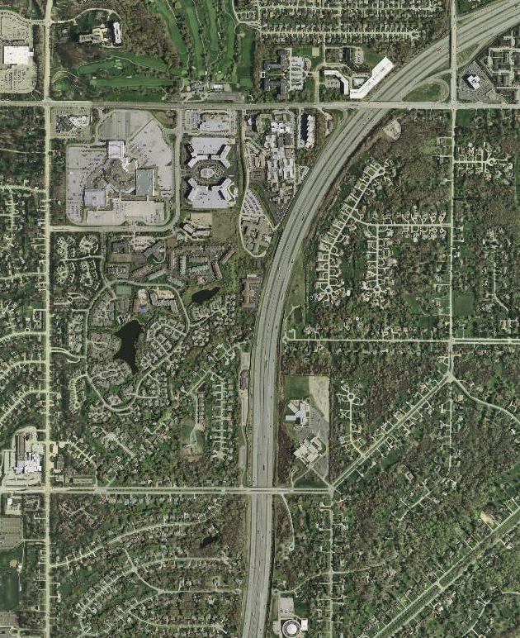
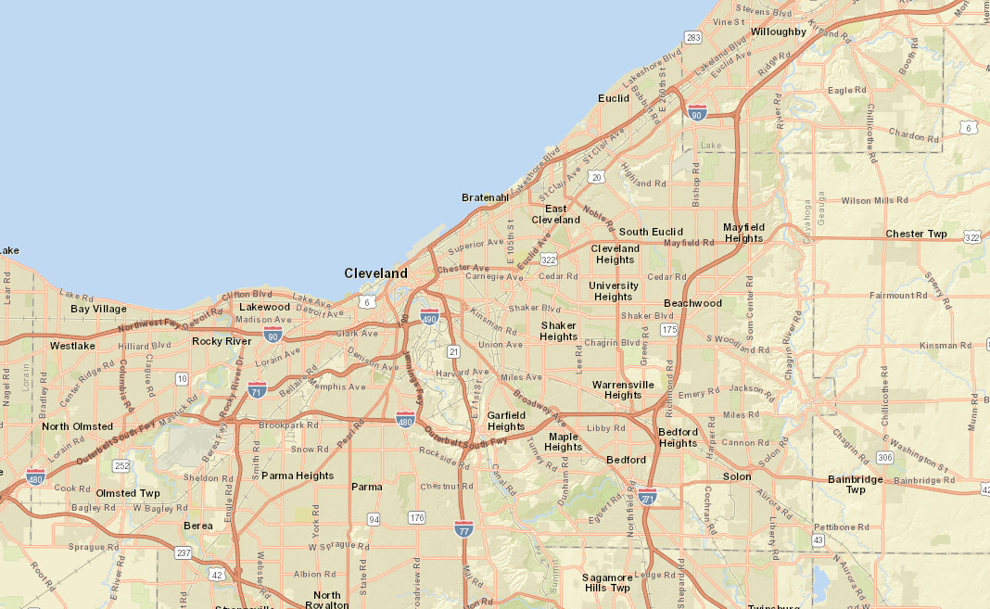
Area map
I-271
Cedar
10.88
Richmond (SR 175)
Brainard
10.05
Fairmount
I-80
9.75
I-71
SR 82
CUY-271-8.36 Funding Presentation

Slide 4
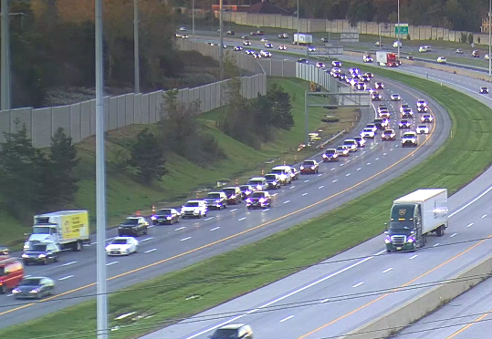
Purpose
Manage queues that extend onto NB I-271 from the Cedar/Brainard exit ramp (Ramp terminal capacity improvement completed on PID 97676 competed in 2018)
Mitigate 161 crashes that occurred within study area on I-271 (2017-2019)
October 19, 2021 7:50 AM

Slide 5
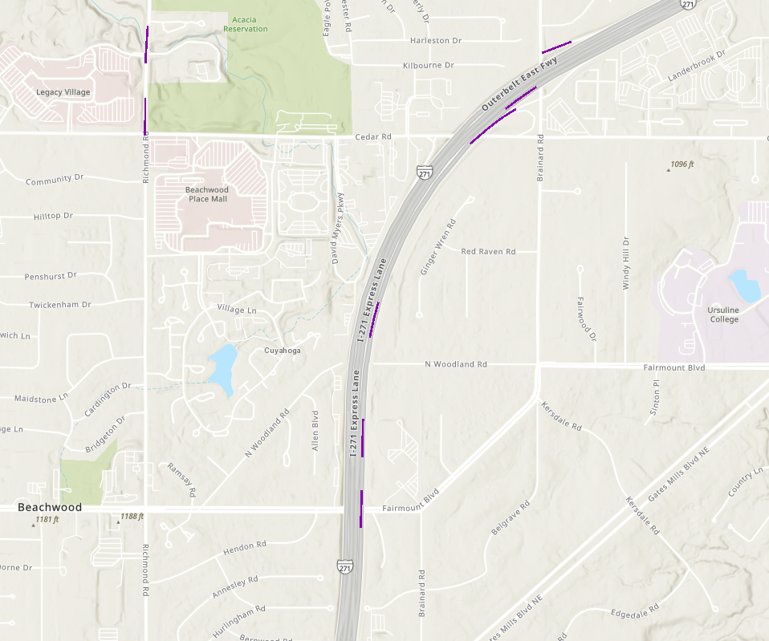
HSIP Urban Freeway rankings
2018 UrbFwy, Rank 12
2020 Urban Freeway Peak Searching Excess Locations (2016-2020), Top 500
Rank | Average Observed Crashes | Predicted Crashes | Expected Crashes | Expected Excess Crashes | NLF ID | Begin Logpoint | End Logpoint
3 | 73.37 | 13.61 | 59.18 | 45.57 | SCUYIR00271**C | 11.072 | 11.172
81 | 34.24 | 13.61 | 29.34 | 15.73 | SCUYIR00271**C | 10.872 | 10.972
187 | 24.15 | 7.97 | 20.65 | 12.68 | SCUYIR00271**C | 9.700 | 9.800
257 | 19.57 | 13.61 | 18.15 | 4.54 | SCUYIR00271**C | 11.272 | 11.372
297 | 17.66 | 13.61 | 16.97 | 3.36 | SCUYIR00271**C | 10.460 | 10.560
433 | 14.45 | 13.61 | 14.31 | 0.70 | SCUYIR00271**C | 10.560 | 10.660
2018 UrbRamp, Rank 98
2018 UrbFwy, Rank 350
I-80
2018 UrbFwy, Rank 458
I-71
2018 UrbFwy, Rank 62
SR 82
CUY-271-8.36 Funding Presentation

Slide 6
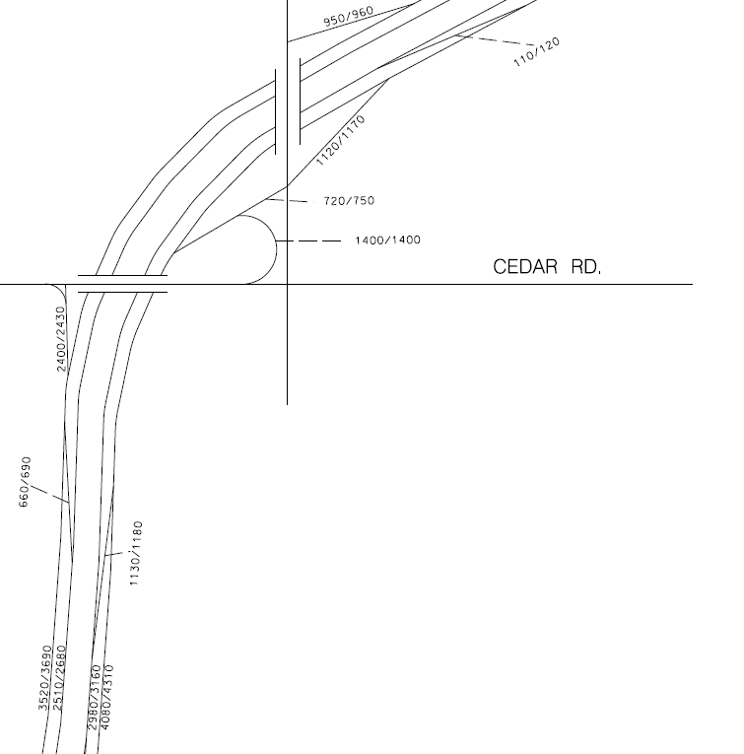
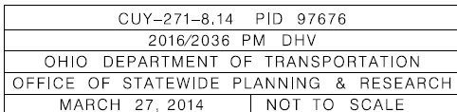
Existing conditions – Ramp volumes
The right lane on NB I-271 is over capacity – 750 veh to Brainard and 1400 veh to WB Cedar (PM peak)
Traffic entering NB I-271 from express lanes must cross 3 lanes to exit
AM and PM exiting DHV’s are nearly identical

Slide 7
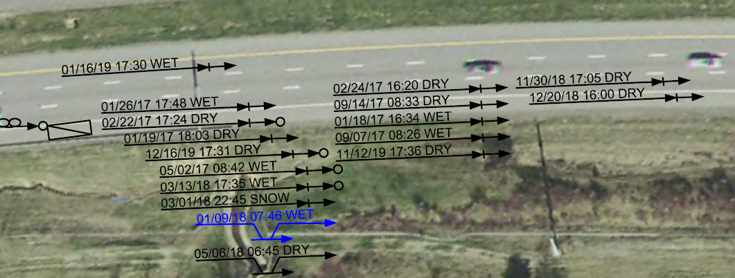
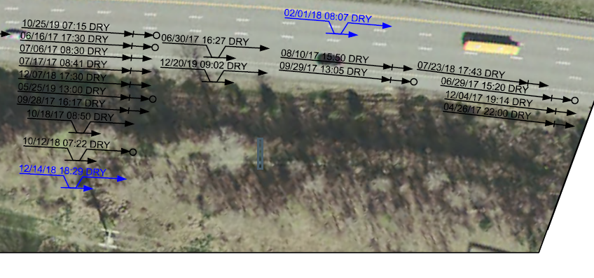
ExISTING CONDITIONS - CRASHES
296 crashes occurred NB I-271 between log points 8.36 to 11.40 including interchange ramps (2017 to 2019)
Rear-end and sideswipe-passing crashes comprise 82 percent of all crashes.
2018 HSIP Urban Freeway segments #12, #62, #350, and #452.

Slide 8
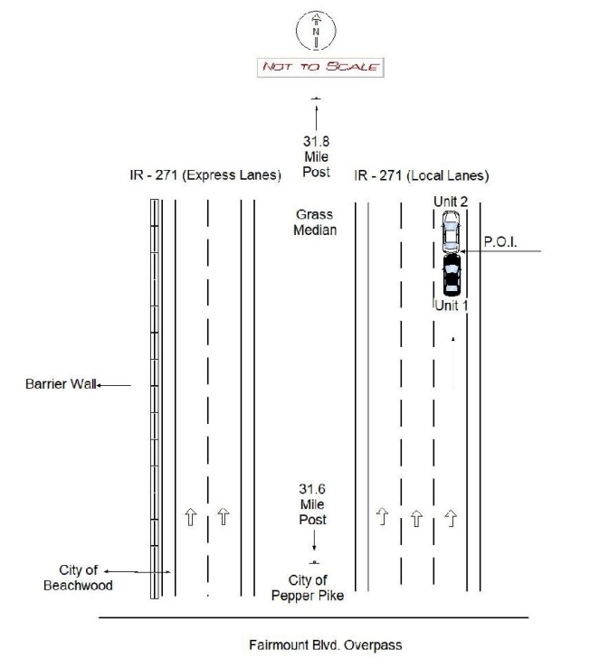
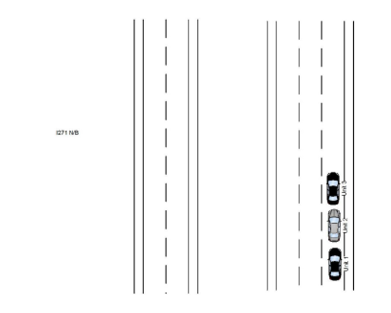
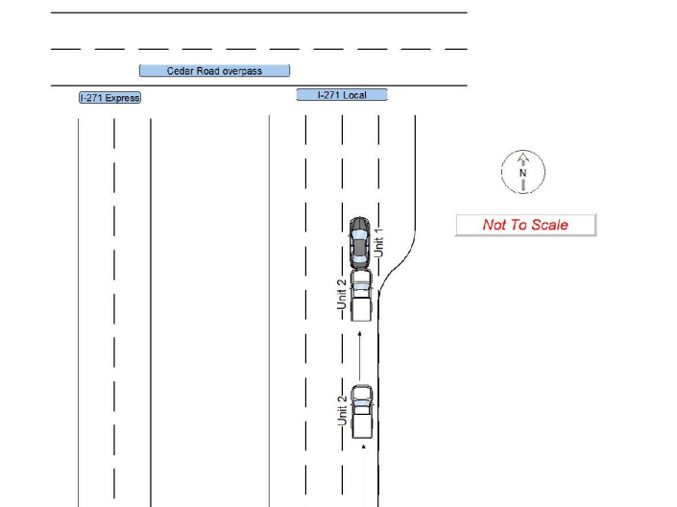
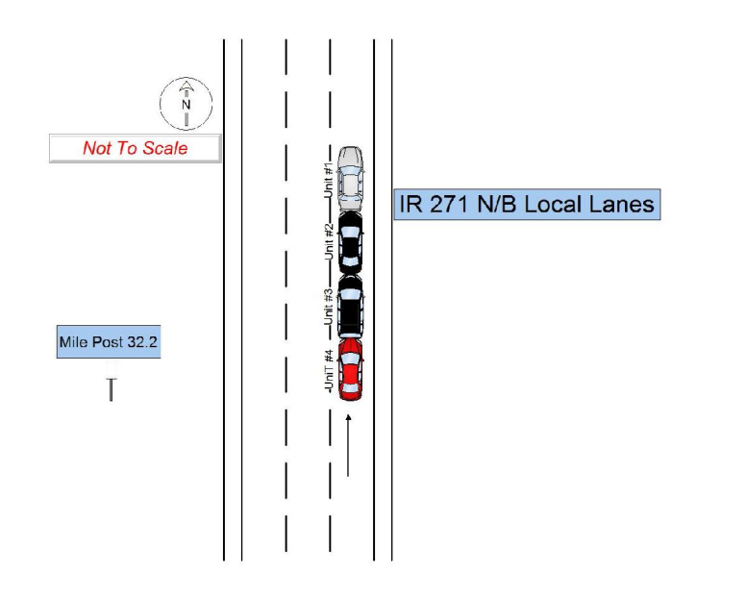
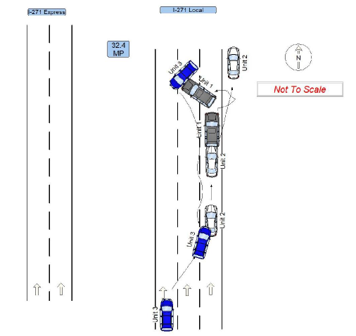
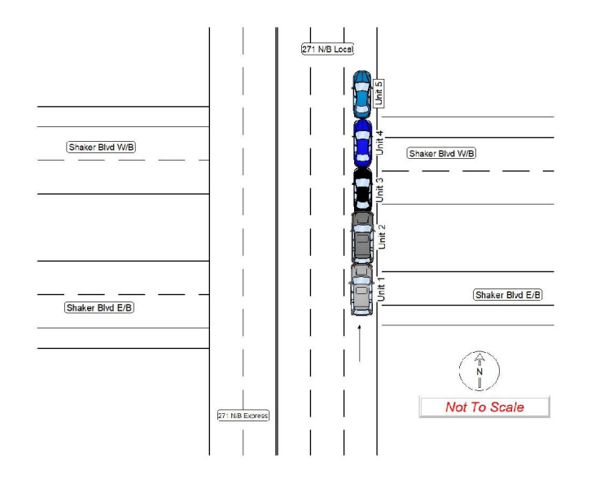
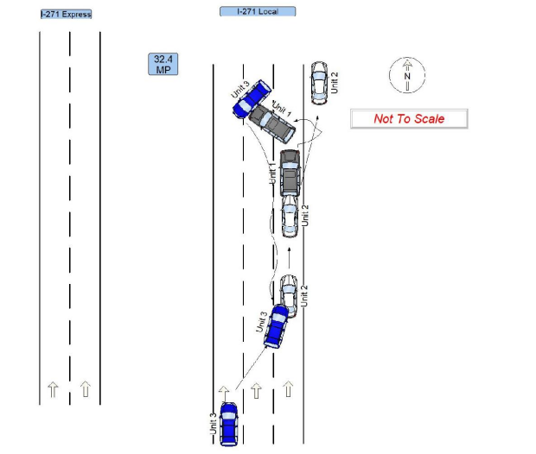
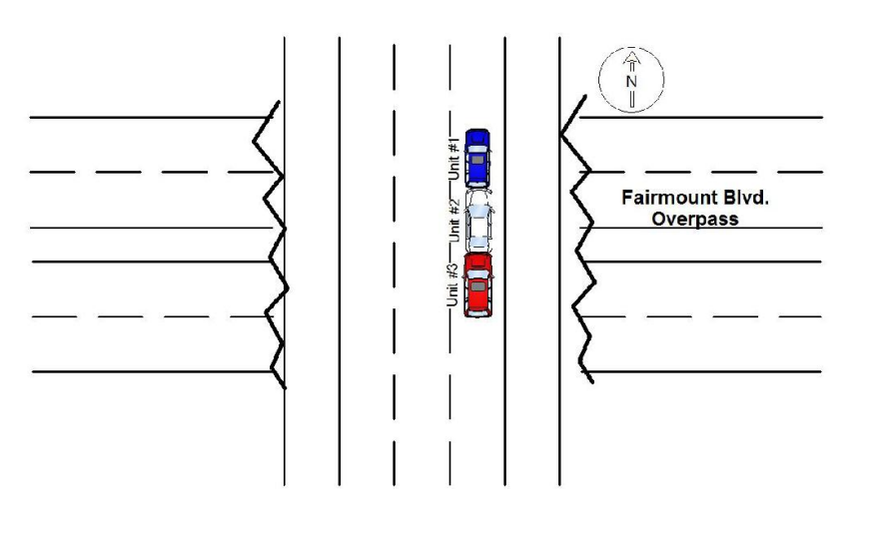
Examples of diagrams from OH1 Narratives…
Notes:
10/8/2019

Slide 9
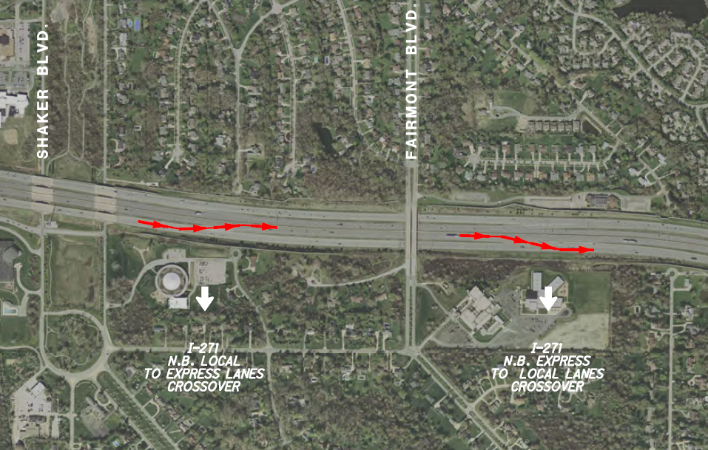
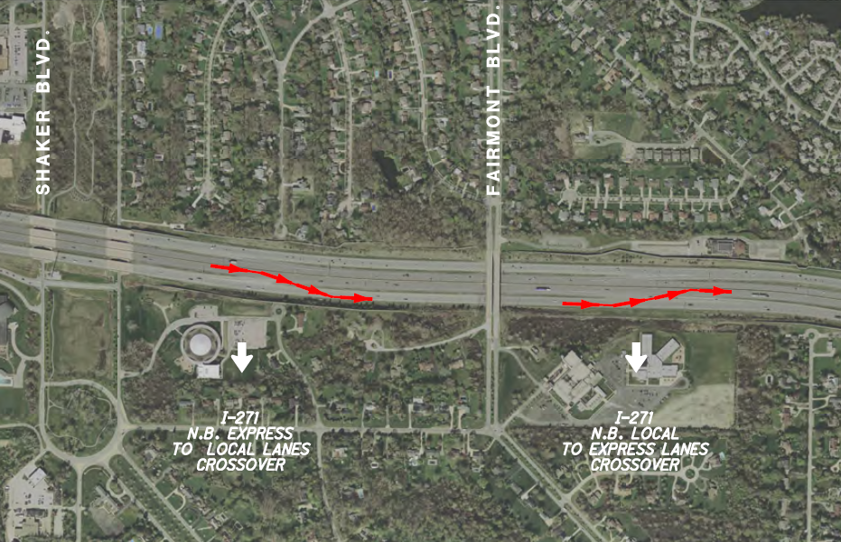
countermeasures
Reverse express lane entrance and exit access with I-271 local lanes between Chagrin and Cedar, adding another 3000’ to provide more room for weaving
Existing Condition
Proposed Condition

Slide 10
Countermeasures
Convert exit diverge from one lane to two lanes to uncork bottleneck to the Cedar loop ramp, providing a second lane to store traffic
Extend deceleration lane for Cedar/Brainard exit ramp 1600’ further south to provide storage for queued traffic when Brainard and Cedar exits are slammed

Slide 11
Design challenges, proposed improvements

Slide 12
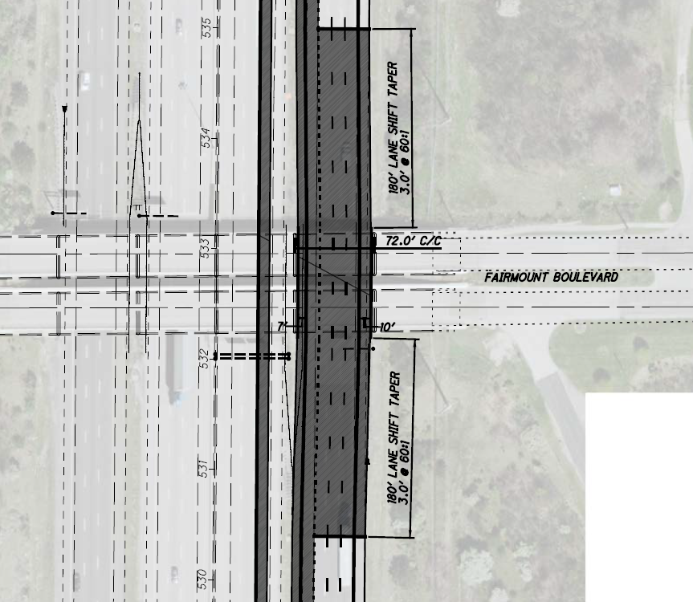
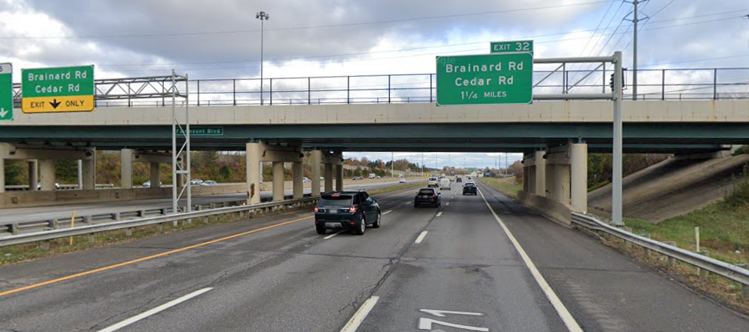
Aux lane addition under fairmount w/ shift
65’ opening under Fairmount
Four 12’ lanes fit, 10’ outer shoulder
A 7’ wide inside shoulder is recommended for a short distance, DE required
65’

Slide 13
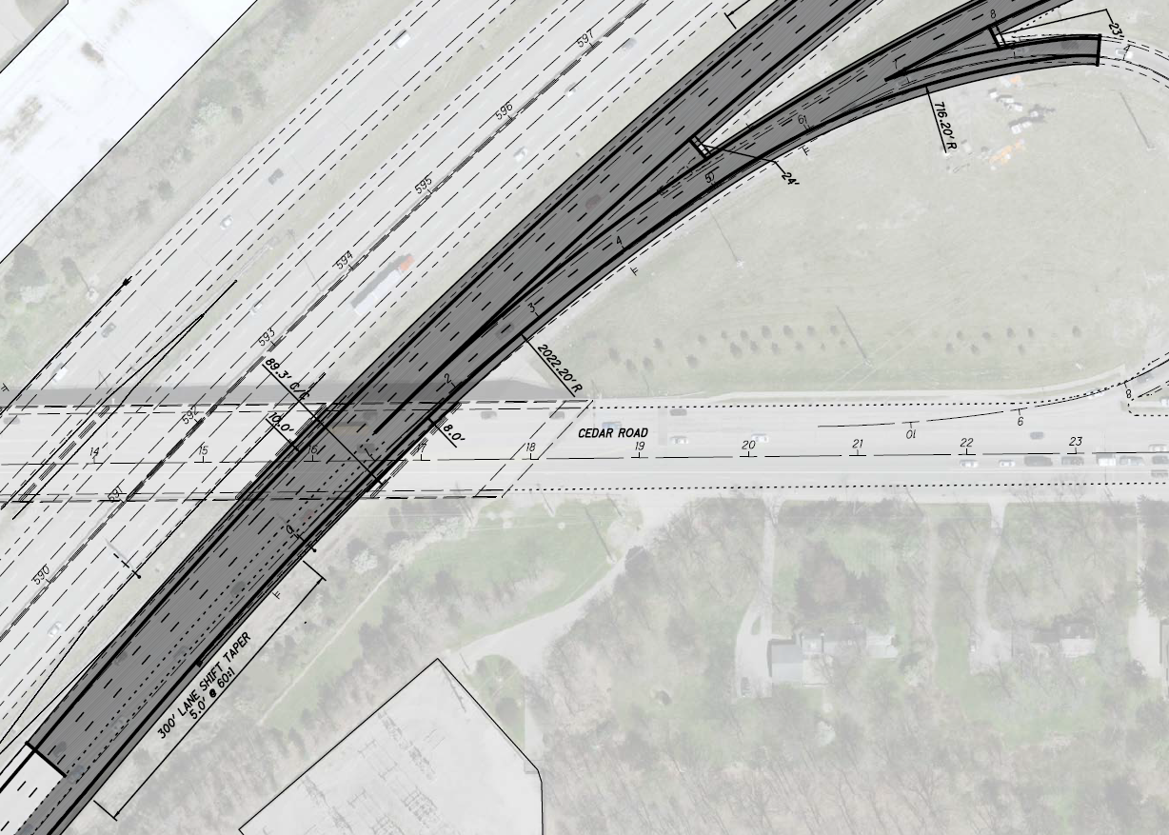
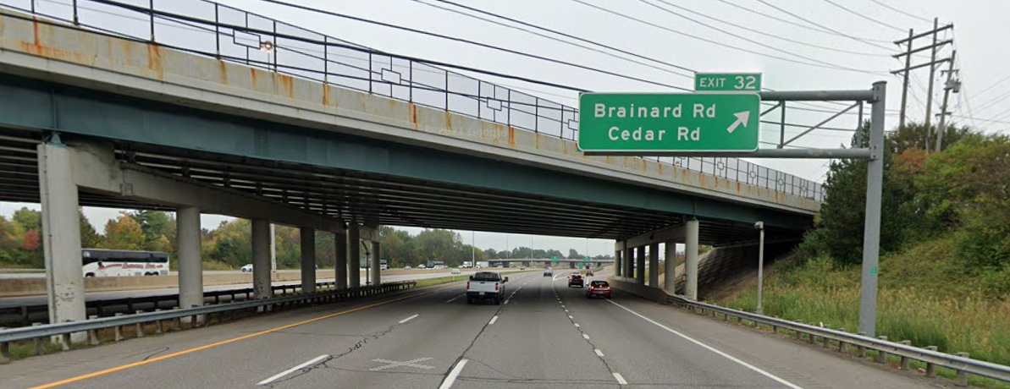
Two-lane diverge under cedar overpass
78’ opening under Cedar
Shift 5’ to median
Five 12’ lanes, 10’ inside shoulder
An 8’ wide outside
No DE required for ramp shoulder
78’

Slide 14
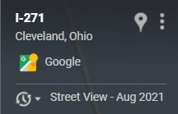
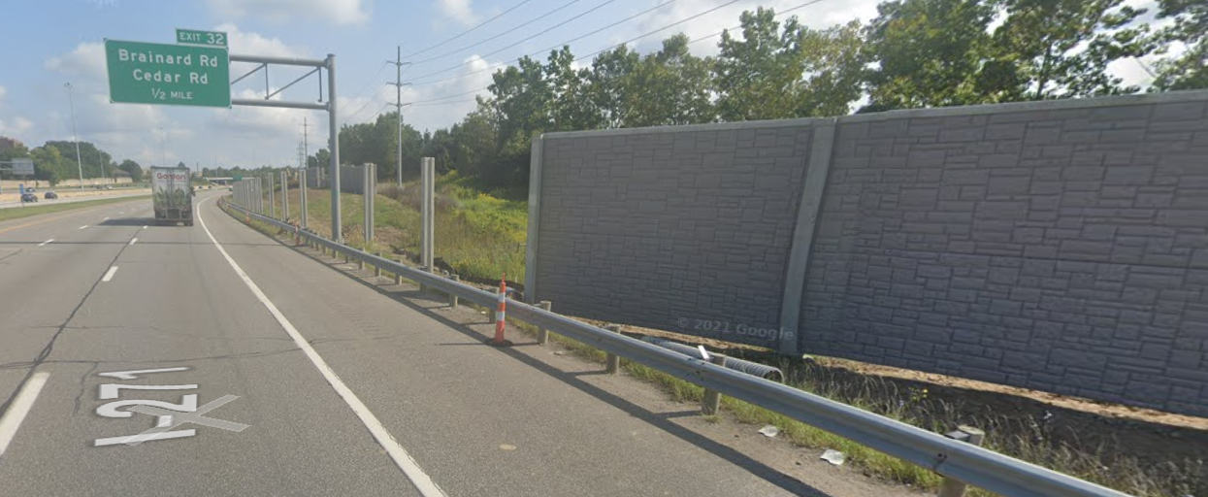
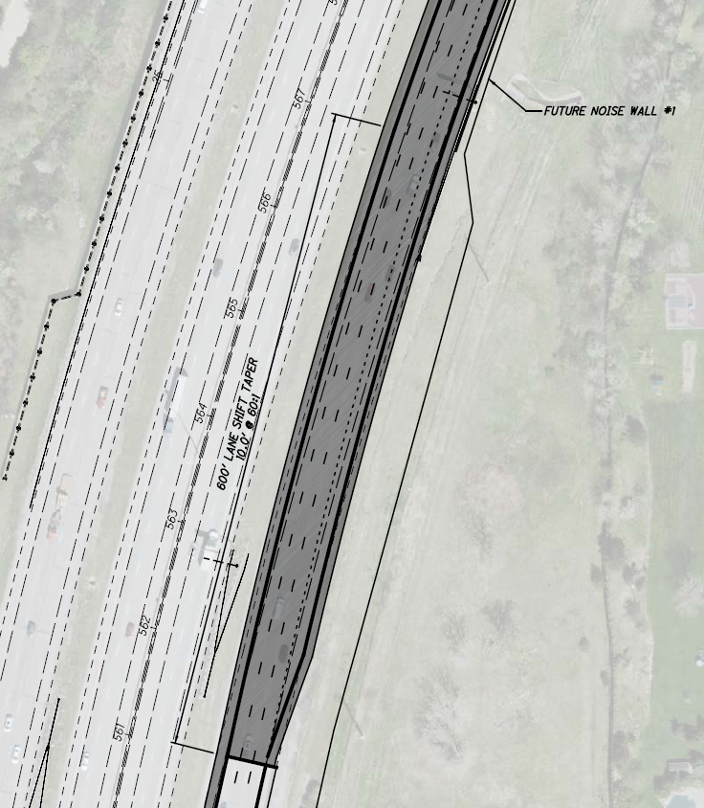
Avoid recently installed noise barrier ☹
Deceleration lane begins at ½ MILE sign
Shift 10’ to median to maintain clearance to guardrail for noise barrier
No DE required for ramp shoulder

Slide 15
Coordination with other projects…
Desired to be combined with upcoming PM overlay on I-271 local lanes (PID 104380, FY2025) to reduce cost of Safety request (for surface course, markings)
Plans will be prepared on Part 1/Part 2 format, just in case they need to be split and sold separately
D12 is requesting design services in January 2022 Programmatic to ensure plans are ready for implementation

Slide 16
Cost summary
$3.890 M Construction Cost
Eng Design ~ $704,000
  D12 will fund PE and DD design phases
  $82,000 already spent on development, refinement
Additional R/W not required

Slide 17
B/C Ratio
Safety Ask Based on Safety Benefits Estimated in ECAT to produce a B/C ratio approximately 1.0
  “Lengthen Ramp” CMF1 = 0.80
  “Extend the Left/Right Turn Lane” (VDOT) CMF2 = 0.85
  “Lengthen Weave Distance” CMF3 = 0.70 (only applied between 10.05 to 10.92)
Notes:
-Lengthen Ramp CMF applied to 37 crashes on the exit ramp, all crashes
-Extend Turn Lane CMF applied to 29 crashes at the Brainard intersection
-Lengthen Weave CMF applied to 95 crashes on I-271 local lanes, only to rear-end’s and sideswipes

Slide 18
Questions
?
Last updated 12/8/2021

Slide 19
